Slide 1
ASICS
PRESENTATION
Strategic Marketing Management (MKM805)
Presented by:
Devansh Solanki- 142127224
Date Presented:
December 8th, 2024

Slide 2
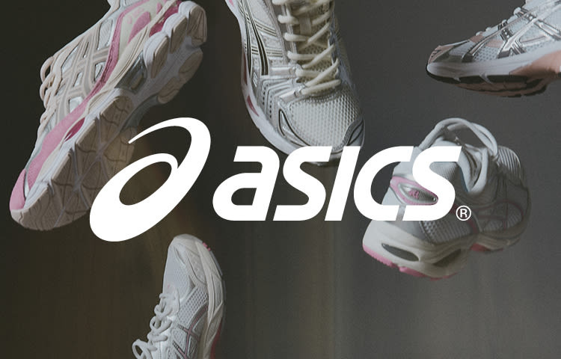
Present Situation & Challenges
1. Company Overview:
ASICS is a Japanese-based company which was established in the year 1949 and is mainly engaged in the production of high-performance running shoes and apparel.
Global market share: ASICS holds the third position in the running footwear market and has a market share of 10% (Statista, 2023).
Revenue: $4.2 billion (2023) of which 35% comes from running shoes.
2. Key Strengths:
Performance Leadership: Inclusive of such innovations as GEL cushioning and FlyteFoam in the market.
Customer Loyalty: According to Statista (2023), 78% of ASICS customers are loyal and make repeat purchases.
3. Challenges:
Lifestyle footwear accounts for only 10% of ASICS’s sales while Nike’s sales come from this segment are 40%.
As for the number of app integrations and the overall digital ecosystem, ASICS lags behind its competitors.
01

Slide 3
Challenges and Objectives
02
ASICS’ Competitive Position
Global Market Trends and Opportunities
1. Key Competitors:
Nike: Nike’s revenue for the year ended 31st March 2023 was $51.2 billion and the Nike Run Club has 19 million active users (Statista, 2023).
Adidas: Generated $24 billion in revenue in 2023 and is known for cultural and fashion collaborations such as Yeezy and Gucci.
Hoka One One: High growth, specialised brand that is especially well received by the ultra runners for cushioning.
2. Insights:
Nike is leading the social media interaction with the help of apps that are gamified and running clubs.
Adidas has adopted stylish and trendy designs coupled with utilitywear to increase its consumer reach.
1. Trends:
Sustainability: Nielsen’s global survey conducted in 2023 reveals that 62% of consumers are interested in buying eco-friendly products.
Tech Integration: The market of fitness applications is expected to achieve the number of users to 1 billion by 2026.
2. Challenges:
According to the Grand View Research (2023), the cost of the raw materials have rose.
The competitive pressure on the prices due to fluctuations in the currencies.
3. Opportunities:
Cross to Sustainable Product Lines in order to target the consumers who are keen on the products that affect the environment.
It is important to leverage on the fitness app market by enhancing Runkeeper’s features

Slide 4
Defining the Problem
03
01
02
03
Core Problem
Supporting Evidence
Statement
ASICS is a performance brand but it does not have the emotional connection and digital ecosystem that is needed for the market which is increasingly being dominated by lifestyle and technological products.
Lifestyle footwear is also part of ASICS‘ offering and is sold by the company even though Nike sells 40% of their products as lifestyle footwear (Nike Annual Report, 2019).
Runkeeper has limited synchronization with ASICS while Nike has engaged millions of users through Nike+ Run Club.
To focus on the lifestyle market and to try to gain more market share from the existing 10% to 15% in the year 2026 to enhance the community and the products’ relationship.

Slide 5
ASICS Positioning: Strengths and Gaps
04
1. Current Position:
Performance Leader: It is noted that they incorporate technologies such as GEL cushioning and FlyteFoam in their products.
Limited Lifestyle Relevance: Has a small market share in the fashion-oriented footwear category.
2. Strengths:
Trusted by serious runners; ASICS GEL-Kayano consistently ranks as a top stability shoe (Runner’s World, 2023).
3. Weaknesses:
Weak emotional connection with lifestyle and recreational users.
Limited leverage of Runkeeper for gamified and community experiences.

Slide 6

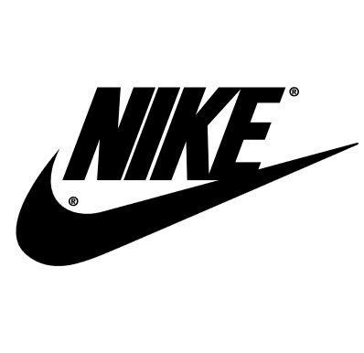



ASICS: Perceived Strengths and Gaps
y axis
Competitor Placement:
Nike: High in both (ZoomX innovation + Nike Run Club’s 19M users).
Adidas: Moderate technology, high community engagement via cultural campaigns.
ASICS: High technology, low engagement (strong technical appeal, weak social/digital presence).
Hoka One One: High technology, moderate engagement (focus on cushioning, less digital presence).
Community Engagemnt
Axes Explanation:
X-Axis: Performance Technology (Low to High):
Measures innovation in features like cushioning and injury prevention.
Y-Axis: Community Engagement (Low to High):
Reflects the brand’s ability to build digital ecosystems (apps, challenges) and engage through events.
x axis
Performance Technology
05

Slide 7
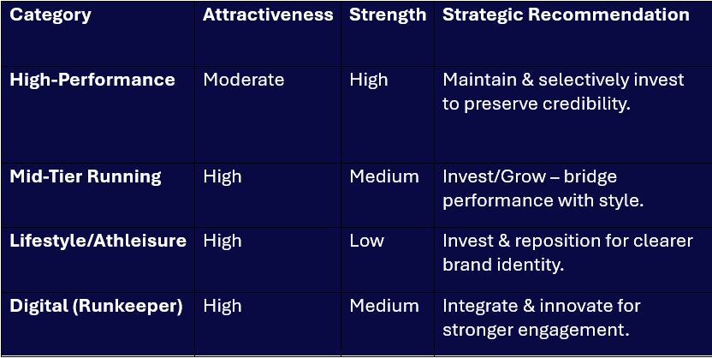
Where to Invest and Maintain
Aligns with AGP 2020 goals to expand the customer base and shift towards DTC engagement.
Balanced investment in high-performance, mid-tier, and digital integration to capture growth opportunities.
06

Slide 8
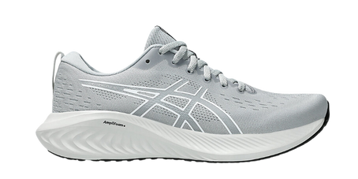
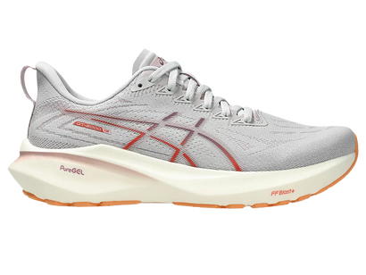
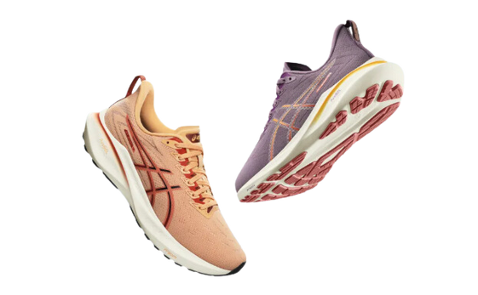
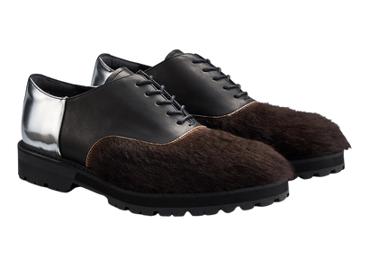
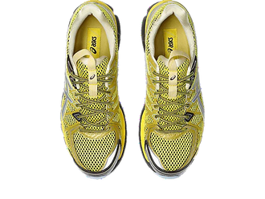

ASICS Portfolio: Performance-Heavy, Limited Lifestyle Presence
Product Categories:
High-Performance Running (Core):
o Strengths: Strong R&D, preferred by serious runners, high brand credibility.
o Weaknesses: Market plateauing, limited growth potential.
Mid-Tier Running:
o Strengths: Rising demand from casual runners.
o Weaknesses: Underdeveloped product line, potential cannibalization risk.
Lifestyle/Athleisure (Onitsuka Tiger, ASICS Tiger):
o Strengths: High market potential, strong brand heritage.
o Weaknesses: Low resonance, unclear positioning, and potential brand confusion.
Digital Services (Runkeeper):
o Strengths: Large user base, potential for community engagement.
o Weaknesses: Moderate integration with product offerings, untapped potential.
Key Insights:
Imbalance towards high-performance products; lifestyle and mid-tier segments need attention.
Runkeeper offers an opportunity for engagement and integration with physical products.
07

Slide 9
Rebalancing the Portfolio
Key Recommendations:
1. High-Performance Line:
o Maintain premium models to preserve credibility among serious runners.
2. Mid-Tier Line:
o Aggressively develop products to attract recreational and casual runners (e.g., ASICS Flow).
o Price Range: $80–$120.
3. Lifestyle Lines:
o Refocus Onitsuka Tiger and ASICS Tiger with distinct identities and clear brand narratives.
4. Digital Integration:
o Leverage Runkeeper for community building and personalized engagement.
08

Slide 10
Creating New Value: Wellness & Community
Mid-Tier Line:
o Introduce ASICS Flow: lightweight, stylish, and moderately cushioned shoes.
o Price Range: $80–$120 to attract casual runners.
Lifestyle Lines:
o Emphasize authenticity, heritage, and sustainability.
o Subtle performance elements to connect with the ASICS brand.
Digital Integration:
o Use Runkeeper for personalized fitness challenges, tips, and wellness programs.
9

Slide 11
Applying Aaker & Joachimsthaler + Quelch & Kenny
Avoid Line Extension Overload:
Ensure clear differentiation and purpose across all lines.
Reinforce ASICS’ Core Equity:
Focus on performance heritage and the “Sound Mind, Sound Body” narrative.
Segment Alignment:
Align product lines with target segments:
Serious Runners: High-tech, performance shoes.
Recreational Runners: Mid-tier, versatile models.
Lifestyle Enthusiasts: Fashion-driven, subtle performance cues.
10

Slide 12
Clarifying Roles Through a Hybrid Approach”
Current Challenges:
Branded House:Risk of diluting ASICS' performance equity.
House of Brands:Too fragmented and resource-intensive.
Recommendation:
Adopt a Hybrid Structure for clarity and synergy.
Turning Insights into Product Solutions”
Recommendation
Performance Line:
Preserve high-end models like GEL-Kayano for serious athletes.
Mid-Tier Line:
Launch ASICS Flow: stylish, versatile shoes for casual runners.
Onitsuka Tiger:
Position as a premium retro-fashion line endorsed by ASICS heritage.
ASICS Tiger (Rebranded as ASICS Lifestyle):
Everyday active footwear blending fitness and comfort.
11

Slide 13
Hybrid Model for Clarity & Consistency
ASICS (Core):
o Focus: High-performance running shoes for serious runners.
ASICS Flow (New Mid-Tier):
o Focus: Casual runners seeking style and comfort.
Onitsuka Tiger by ASICS:
o Focus: Premium, retro-fashion footwear with heritage appeal.
Unified Narrative:
Emphasize mind-body balance and leverage ASICS' credibility across all segments.
12

Slide 14
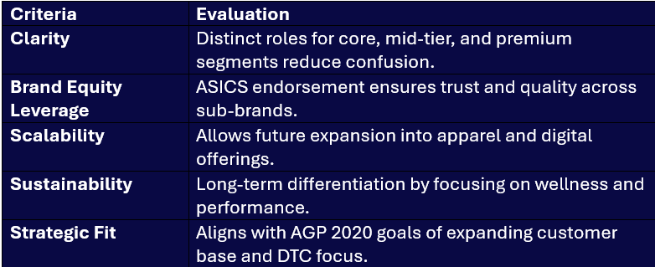
Ensuring Strategic Fit
13

Slide 15
Who Is Our Target Audience?
Serious Runners (Marathoners)
Recreational Runners (5K/10K)
Health-Conscious Runners
Fun Runners
Fitness Enthusiasts
Existing Segments:
Primary Targets
Recreational Runners (5K/10K)
Market Size: 45% of U.S. race finishers.
Growth Potential: Increasing participation in fun runs.
Profitability: High volume potential despite lower prices.
Brand Fit: Supports ASICS’ goal of expanding beyond serious runners.
Strategic Fit: Aligns with AGP 2020's goal to expand the customer base.
Health-Conscious Runners
Market Size: Significant fitness-conscious population.
Growth Potential: Growing focus on wellness and health.
Brand Fit: Aligns with the “Sound Mind, Sound Body” philosophy.
Strategic Fit: Supports direct-to-consumer engagement and brand values.
Secondary Targets
Fitness Enthusiasts
Growth Potential: Rising demand for fitness tech and digital engagement.
Strategic Fit: Leverages ASICS' Runkeeper acquisition and DTC strategy.
Consideration: High competition in tech-focused fitness markets.
Young Female Runners (Millennials and Gen Z)
Growth Potential: Increasing female participation in fun runs.
Brand Fit: Stylish, mid-tier shoes appeal to younger demographics.
Consideration: Smaller market size and lower margins, but aligns with lifestyle goals.
14

Slide 16
Close-Ended Criteria for Target Audience Selection
Criteria | Recreational Runners (5K/10K) | Health-Conscious Runners | Fitness Enthusiasts | Young Female Runners
1. Market Size Is the segment large enough to support growth? | Yes 45% of U.S. race finishers. | Yes Large fitness-conscious population. | Yes Growing demand for fitness products. | No Relatively smaller niche segment.
2. Growth Potential Is the segment expanding or trending upward? | Yes Increasing fun run participation. | Yes Rising focus on wellness and health. | Yes Increasing interest in fitness apps and tech. | Yes Growth in female participation in fun runs.
3. Profitability Does the segment offer high margin or volume potential? | Yes High volume potential despite lower prices. | No Health-focused runners may prioritize value over price. | Yes Opportunities for tech and apparel integration. | No Mid-tier pricing limits margins.
4. Brand Fit Does the segment align with ASICS’ brand values? | Yes Supports expansion beyond serious runners. | Yes Aligns with "Sound Mind, Sound Body" philosophy. | Yes Supports ASICS’ digital fitness vision. | Yes Younger demographics align with mid-tier offerings.
5. Competitive Position Can ASICS differentiate itself effectively? | Yes Strong reputation in running performance. | Yes Quality and performance differentiation possible. | No Highly competitive with tech-focused brands. | No Fashion-driven brands have a stronger foothold.
6. Strategic Fit Does the segment align with AGP 2020 goals? | Yes Expands customer base and DTC focus. | Yes Supports direct-to-consumer strategy. | Yes Leverages digital and community-building goals. | Yes Aligns with lifestyle and DTC expansion.
15

Slide 17
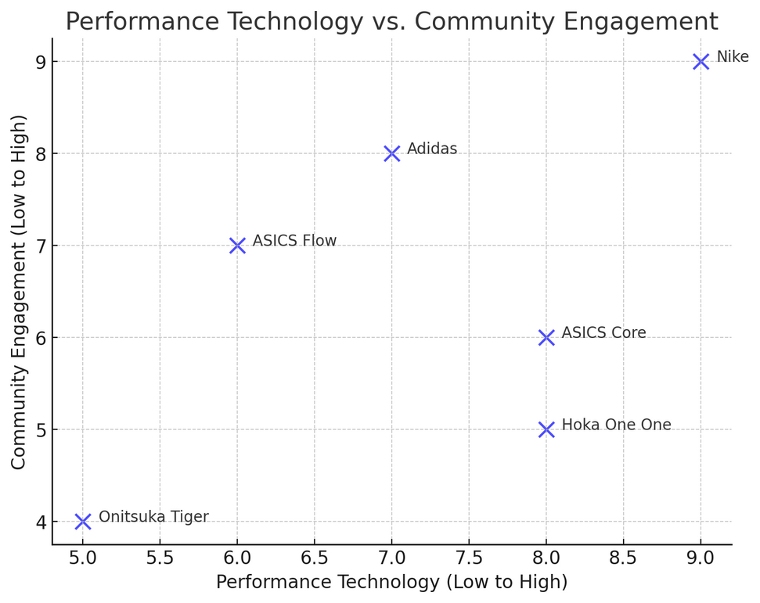
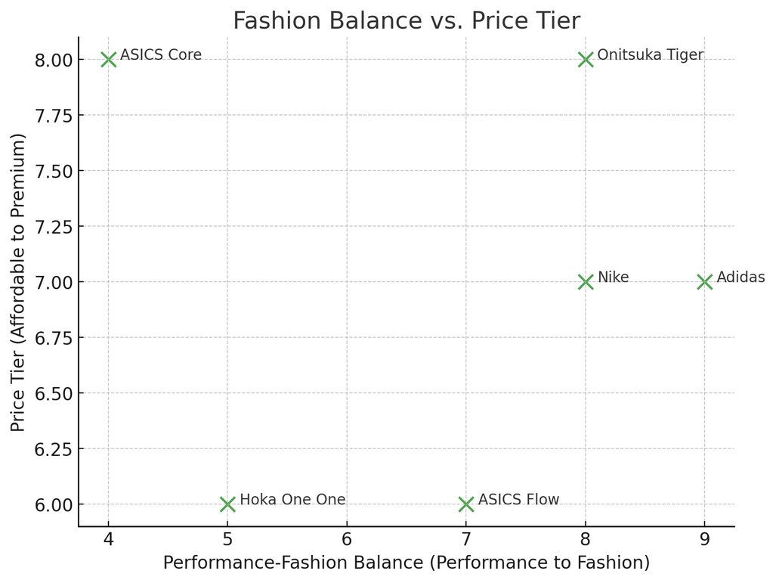
MAPPING THE FUTURE:
WHERE ASICS STANDS AND SOARS
16
Option 1
Option 2
The global fitness app market is projected to grow at a 21.3% CAGR, reaching 1.1 billion users by 2026​​. Nike Run Club’s 19M active users exemplify the success of integrating digital ecosystems with products​.
62% of global consumers prioritize sustainability in fashion, and athleisure demand among urban millennials has surged by 50% since 2020​​.

Slide 18
THE WINNING FORMULA:
STRATEGIC CHOICES BACKED BY DATA
Criteria | Performance Leader | Versatile Blend | Reasoning
Differentiation | High: Reinforces ASICS' technical edge. | Moderate: Risk of blending in. | 50% of marathon finishers use ASICS, a strong differentiator in performance​​.
Profitability | High: Premium pricing ensures strong margins. | Moderate: Mid-tier reduces margins. | Premium performance models maintain a 50% margin, while mid-tier models require higher volumes to compete​​.
Consumer Alignment | Strong: Appeals to serious and fun runners. | Strong: Attracts diverse segments. | Fun runners account for 25% of spending but prefer mid-tier shoes priced below $120​​.
Sustainability Fit | Moderate: Focus on tech, less on eco-trends. | High: Aligns with demand for sustainable products. | 62% of consumers favor eco-friendly products, particularly in athleisure​​.
Scalability | Moderate: Niche focus limits scale. | High: Broader appeal enables growth. | Athleisure’s crossover potential supports scalability in urban markets​​.
Recommendation: Option 1 to strengthen ASICS' unique performance leadership and align with growth opportunities in digital engagement.
17

Slide 19
POSITIONING ASICS:
PERFORMANCE, INNOVATION, AND CONNECTION
Target Audience:
Tech-savvy serious runners and health-conscious recreational athletes.
ASICS provides innovative, high-performance running shoes and digital fitness solutions that enhance performance and foster a sense of belonging.
Unlike other brands that focus solely on style or general fitness, ASICS combines advanced technology (GEL cushioning, FlyteFoam) with community-driven engagement (Runkeeper).
Functional Benefits:
Superior shock absorption (reducing injuries by 25%) with GEL technology.
AI-powered training recommendations via Runkeeper for optimized performance.
Emotional Benefits:
A sense of achievement through improved athletic performance.
Wellness and connection via personalized fitness challenges and a global digital community of 40M+ users.
Reasons to Believe:
50% market share among marathon finishers.
Runkeeper’s rapid growth, with a 15% annual increase in active users.
Proven leadership in innovation with FlyteFoam ranked as a top cushioning technology in 2023.
18

Slide 20
THE ASICS LINEUP:
PCRAFTED FOR EVERY RUNNER, EVERY NEED
19
High-Performance Line:
Example: ASICS MetaRun.
Price Point: Best ($200–$250).
Market Insight: Elite runners account for 17% of the market but represent 25% of spending​.
Rationale:
Flagship model designed for long-distance endurance.
Reinforces ASICS' premium image among serious runners.
Mid-Tier Line:
Example: ASICS Flow.
Price Point: Better ($80–$120).
Market Insight: Casual runners represent the fastest-growing segment, contributing 40% of total running shoe sales globally​​.
Rationale:
Lightweight and fashionable design attracts younger, price-sensitive consumers.
Positioned to counter Nike’s dominance in mid-tier markets.
Lifestyle Line:
Example: Onitsuka Tiger Nippon Made.
Price Point: Best ($150+).
Market Insight: Retro sneakers with sustainability claims enjoy 50% higher growth rates compared to generic fashion sneakers​​.
Rationale:
Combines heritage-driven design with eco-friendly materials.
Targets urban millennials and Gen Z consumers seeking authenticity.

Slide 21
20
ASICS BRANDING ARCHITECHTURE: REBRANDING
ASICS needs to use a hybrid brand approach to balance its core Performance identity with its emerging Lifestyle and Digital brands. This will enable ASICS to:
Maintain the ASICS brand as a leader in performance-driven footwear and apparel.
Position Onitsuka Tiger as a high-end, fashion-forward lifestyle brand.
Develop ASICS Tiger as a more streetwear and youth-oriented brand targeting sneaker aficionados.
Integrate the Runkeeper and MY ASICS apps within the ecosystem to deliver unique identities but align them with broader ASICS objectives.
Criteria | Score | Rationale
Market Differentiation | High | Clear brand roles: ASICS for performance, Onitsuka Tiger for premium lifestyle, and mid-tier ASICS Flow for casual runners.
Operational Efficiency | Medium | Managing multiple brands requires resources but ensures precision in targeting distinct segments.
Consumer Alignment | High | Aligns with diverse needs: serious athletes (ASICS), urban fashion (Onitsuka Tiger), and casual runners (ASICS Flow).
Scalability | Medium | Broader appeal facilitates market expansion, though branding investments are essential for premium segments.

Slide 22
PRODUCT AND POSITIONING STRATEGY
Core Brand (ASICS):
Innovate for high performance to appeal to serious runners, such as MetaRun and GEL-Kayano.
The company maintains its positioning as a performance leader, offering the most advanced technical solution in the industry.
Mid-Tier (ASICS Flow):
Catches the values of price-oriented casual runners.
Extends ASICS's reach into emerging race markets, such as 5K and 10K runs.
Lifestyle Brand (Onitsuka Tiger):
Fashionable urban millennials with environmentally friendly retro designs
Complement "smart lifestyle integration" by focusing on heritage and sustainability.
Digital ecosystem (Runkeeper):
Unified app strategy for integrating ASICS and Runkeeper features to drive community-based growth.
More emotive and functional engagement through personalized coaching and gamification.
Benefits of the Hybrid Model
Clarity and Flexibility: Avoids consumer confusion by maintaining distinct brand identities.
Synergy Across Segments: The same creates cross-brand collaborations, like ASICS performance gear along with Onitsuka Tiger post-race footwear.
Profitability: Premium margins are targeted in lifestyle and high-end performance products, with volume leveraged in the mid-tier.
Brand equity: Strengthens ASICS's perception as a technical leader and lifestyle innovator.
21

Slide 23
Branding Strategy for Runkeeper and MY ASICS
Recommendation: Integrate the Apps
Why?
Combining the apps aligns with ASICS's DTC and digital-first approach to create a unified platform in support of its wider strategy to drive consumer engagement and sales​
One single app would simplify the experience for consumers by combining MY ASICS's functionality for serious runners along with the community-driven features of Runkeeper for the casual runner ​
Consolidation reduces duplication of resources and ensures one cohesive brand presence within the highly competitive fitness app space​
Brand Consistency:
One single app could encompass the ASICS "Sound Mind, Sound Body" philosophy to appeal to both performance- and lifestyle-driven customers​.
Standardized logo, theme, and color scheme throughout the application and other ASICS products further strengthen brand identity.
Driving Sales and Engagement:
The app could also be used as a source of personalized suggestions-for example, recommending ASICS shoes and apparel according to the activity performed by the user-integrated with e-commerce features to enhance DTC sales​
​ Data and insights:
A consolidated platform allows ASICS to leverage a larger, unified data set, gaining deeper insights into user preferences and behaviors to refine its marketing and product strategies​
22

Slide 24
NEXT STEPS
Core App Features
Integrate Runkeeper's social and tracking features with MY ASICS's training programs for advanced runners.
Branding Name and Identity
Rebrand the app under one single name, such as "ASICS Fit", which is tied to the ASICS brand but still neutral enough to appeal to both casual and serious fitness enthusiasts.
Transition
Gradually migrate MY ASICS users to the unified app, ensuring seamless data transfer and clear communication about enhanced features.
Market the app through ASICS's current customer touchpoints.
User Centric Monetization
Following the free services: basic features free of charge and premium ones, such as advanced analytics and customized training plans, will be provided on subscription basis.
23

Slide 25
VRIO
Resource/Capability | Valuable | Rare | Inimitable | Organized | Competitive Advantage
GEL Technology | Yes | Yes | Yes | Yes | Sustained
GEL Technology | Provides superior cushioning and performance | Proprietary technology | Protected by patents | Integrated into product development | Sustained
Onitsuka Tiger Brand | Yes | Yes | Yes | Maybe | Sustained
Onitsuka Tiger Brand | Serves the lucrative luxury lifestyle market with retro designs and high margins​ | Few competitors offer the same blend of retro and high fashion appeal in sportswear​ | The craftsmanship (e.g., Nippon Made line) and established heritage make imitation difficult​ | Strong branding in select regions (Europe, Japan) but less global coordination compared to ASICS​ | Sustained
R&D Capabilities | Yes | No | No | Yes | Temporary
R&D Capabilities | Drives product innovation | Other brands also invest heavily in R&D | Can be replicated with resources | Dedicated research facilities | Temporary
Japanese Craftsmanship | Yes | Yes | Yes | Yes | Sustained
Japanese Craftsmanship | Ensures high quality | Unique heritage | Difficult to replicate | Embedded in company culture | Sustained
Runkeeper Acquisition | Yes | No | No | No | Parity
Runkeeper Acquisition | Provides digital platform and user data | Other brands have similar apps | Can be developed or acquired | Integration still unclear | Parity
24

Slide 26
Force | Level of Impact | Rationale
Threat of New Entrants | Medium | High R&D costs and brand loyalty in performance footwear create barriers; however, lifestyle segments have lower entry barriers​
Industry Rivalry | High | Dominated by Nike and Adidas, which have larger resources, marketing budgets, and DTC infrastructure​
Threat of Substitutes | Medium-High | Rising interest in athleisure and alternative fitness trends (e.g., yoga, gym equipment) threaten sports footwear demand​
Bargaining Power of Buyers | High | Consumers in lifestyle segments are price-sensitive, and casual runners prioritize affordability over brand
Bargaining Power of Suppliers | Medium | Reliance on outsourced production creates some dependency, but ASICS mitigates this with diversified suppliers​
Complements and Ecosystem Effects | Medium | Fitness tracking apps and wearables boost demand for running products, but ASICS lags in leveraging this fully​
6 FORCES ANALYSIS
25

Slide 27
Resource
Page
Statista (2023): Market share, fitness app statistics, consumer insights.
Nike and Adidas Annual Reports (2023): Revenue, product segmentation, community engagement.
Fortune Business Insights (2023): Fitness app market growth.
Grand View Research (2023): Running footwear market analysis.
Nielsen (2023): Sustainability trends.
Runner’s World (2023): ASICS GEL-Kayano rankings.
Ryan, T. J. (2023). EXEC: Asics expands 2026 Plan as company drives past 2023 targets | SGB Media Online. https://sgbonline.com/exec-asics-expands-2026-plan-as-company-drives-past-2023-targets/
岸並. (2024, October 30). New Onitsuka Tiger Store epitomizes Asics’ fashion strategy. The Japan News. https://japannews.yomiuri.co.jp/culture/fashion/20230903-133579/
ASICS Marketing Strategy 2024: A case study – Latterly.org. (n.d.). https://www.latterly.org/asics-marketing-strategy/
26

