Slide 1
Minor Project 2nd Review
VisionEdge
AI-Powered Optical Store Management & Virtual Try-On System
Submitted By: Chaudhari Devanshu Dilipbhai
Enrollment No.: 2504070100284
Course: M. C. A.
Project Guide: Ms. Manali Panchal
01

Slide 2
Minor Project 2nd Review
Expected Deliverables
ER Diagram
UML Diagrams
Database Design
UI Prototype & Screen Flow
Module Planning
System Architecture / Flow
02

Slide 3
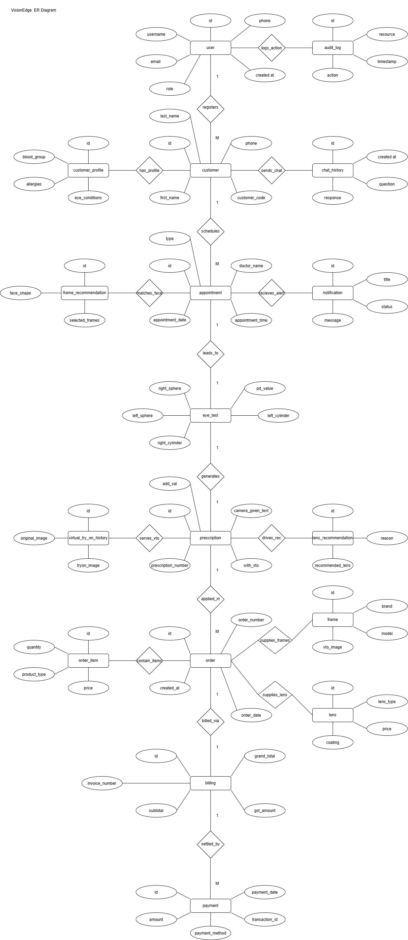
Minor Project 2nd Review
VisionEdge —
ER Diagram
03

Slide 4
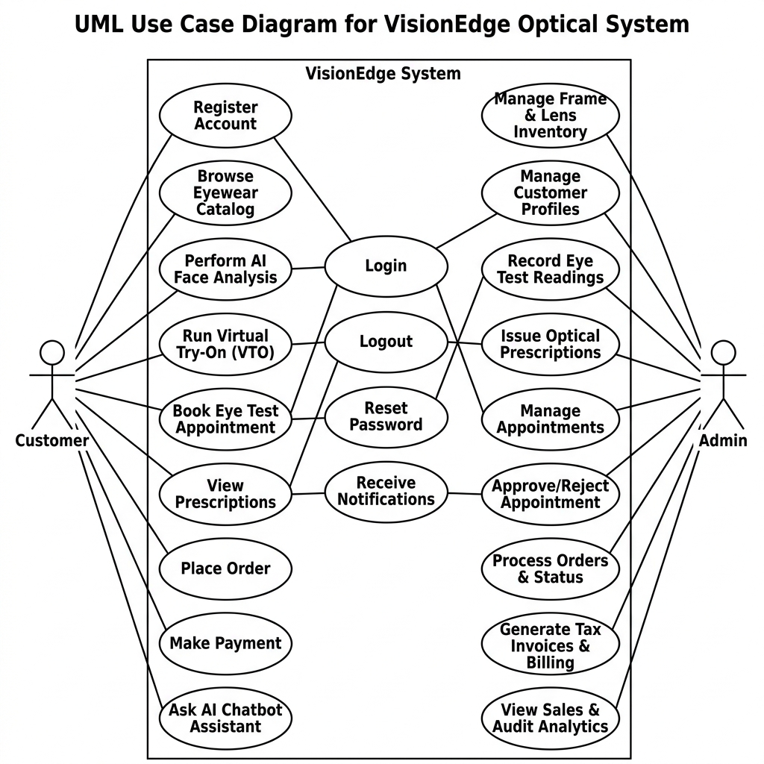
Minor Project 2nd Review
Use Case Diagram
04

Slide 5
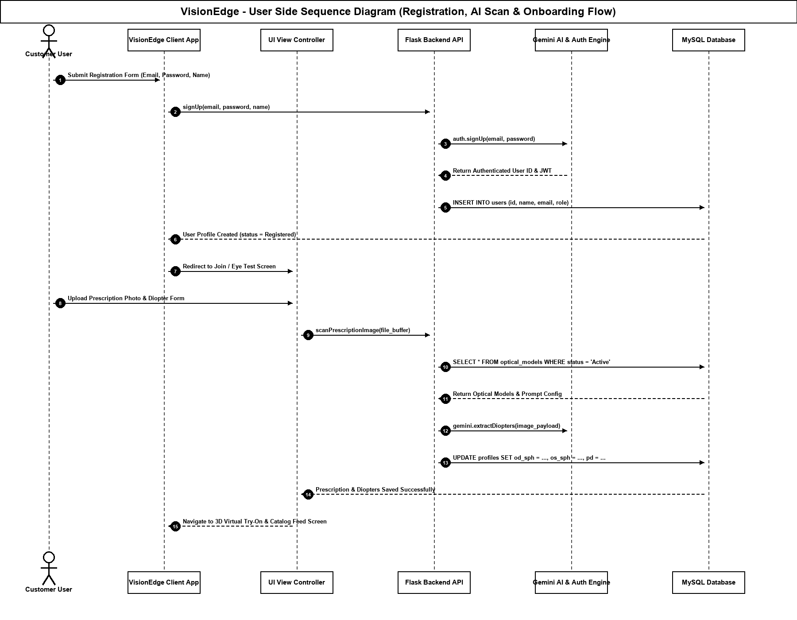
Minor Project 2nd Review
Sequence Diagram
Sequence Diagram: 1)user side
05

Slide 6
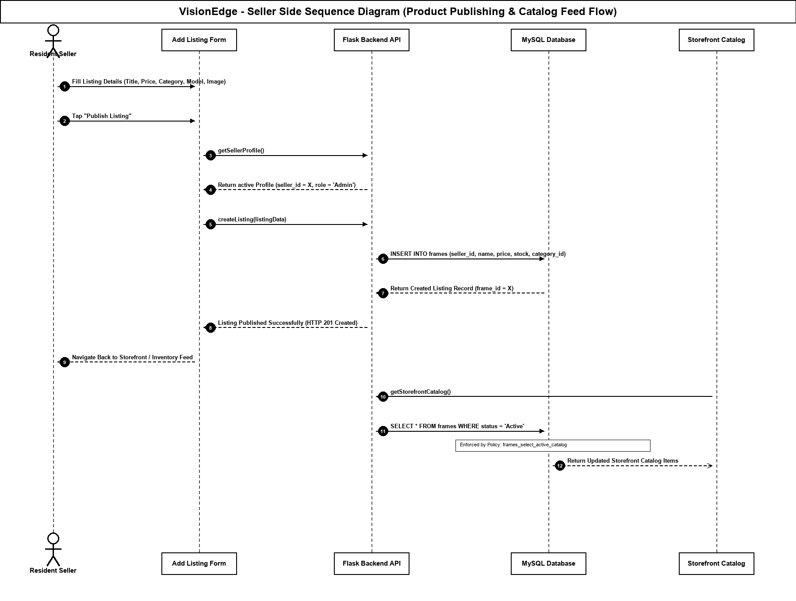
Minor Project 2nd Review
Sequence Diagram
Sequence Diagram: 2)seller side
06

Slide 7
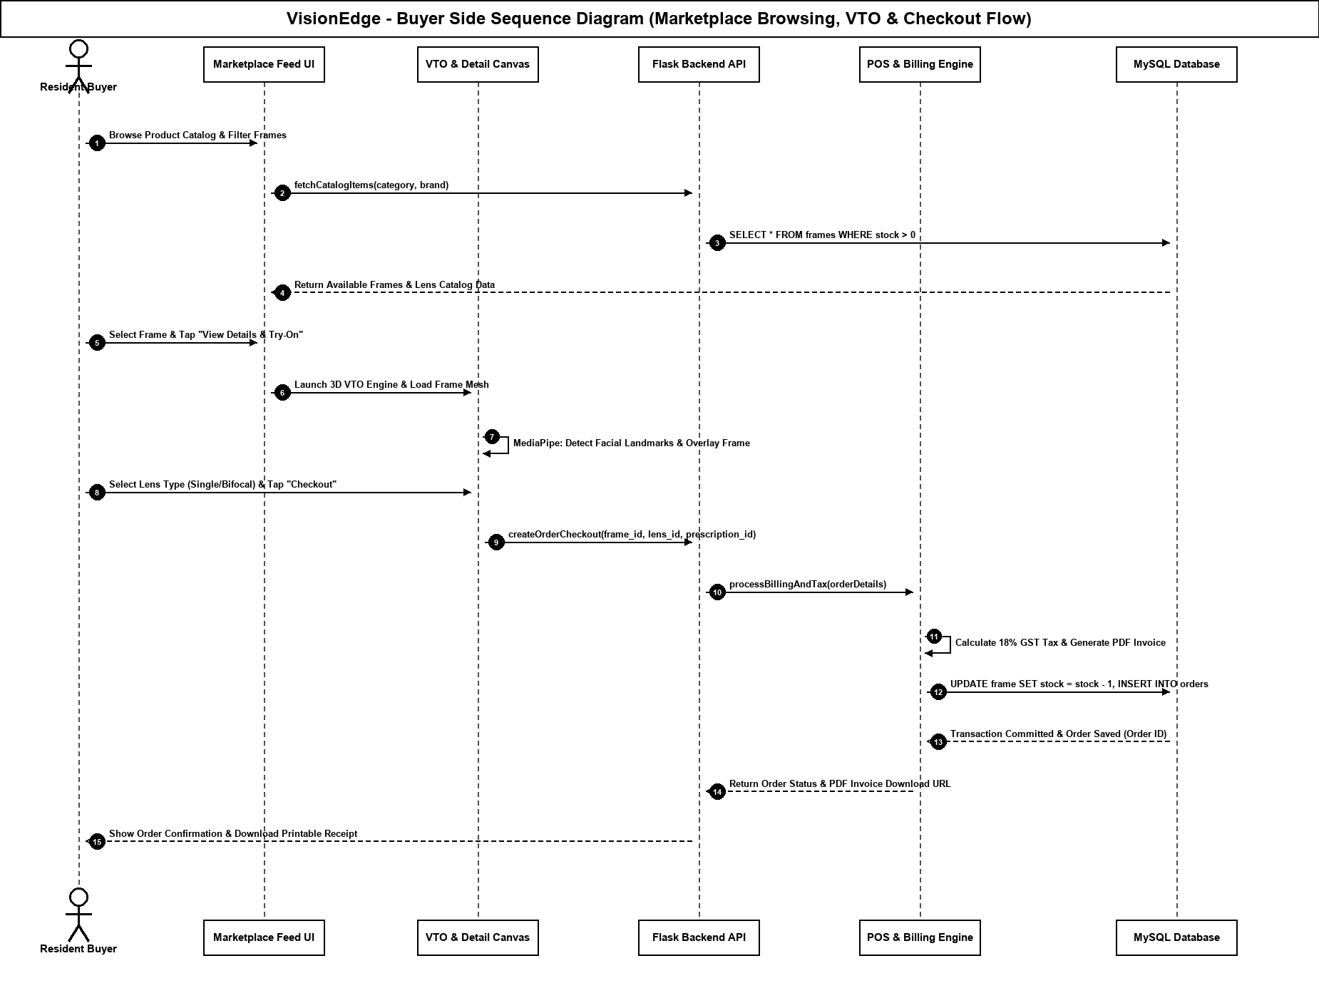
Minor Project 2nd Review
Sequence Diagram
Sequence Diagram: 3)buyer side
07

Slide 8
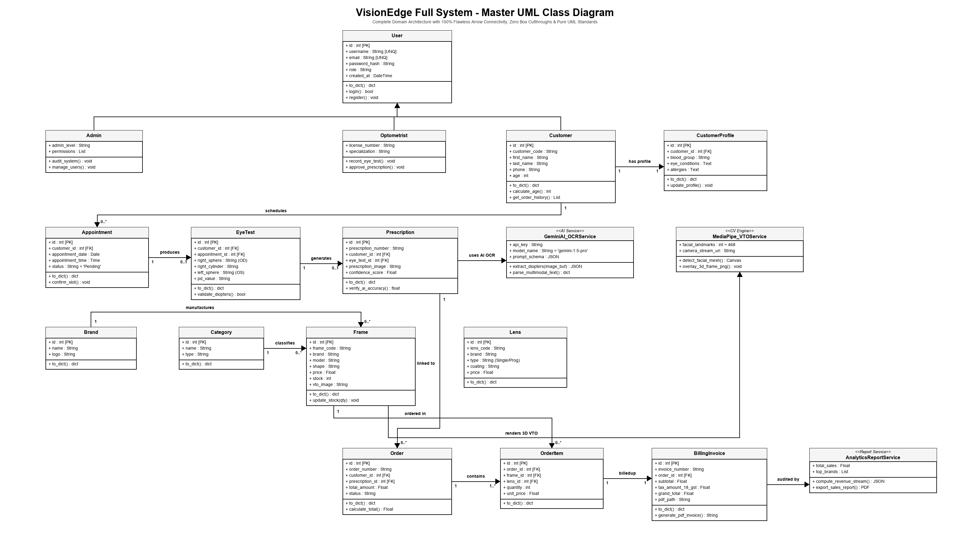
Minor Project 2nd Review
Class Diagram
08

Slide 9
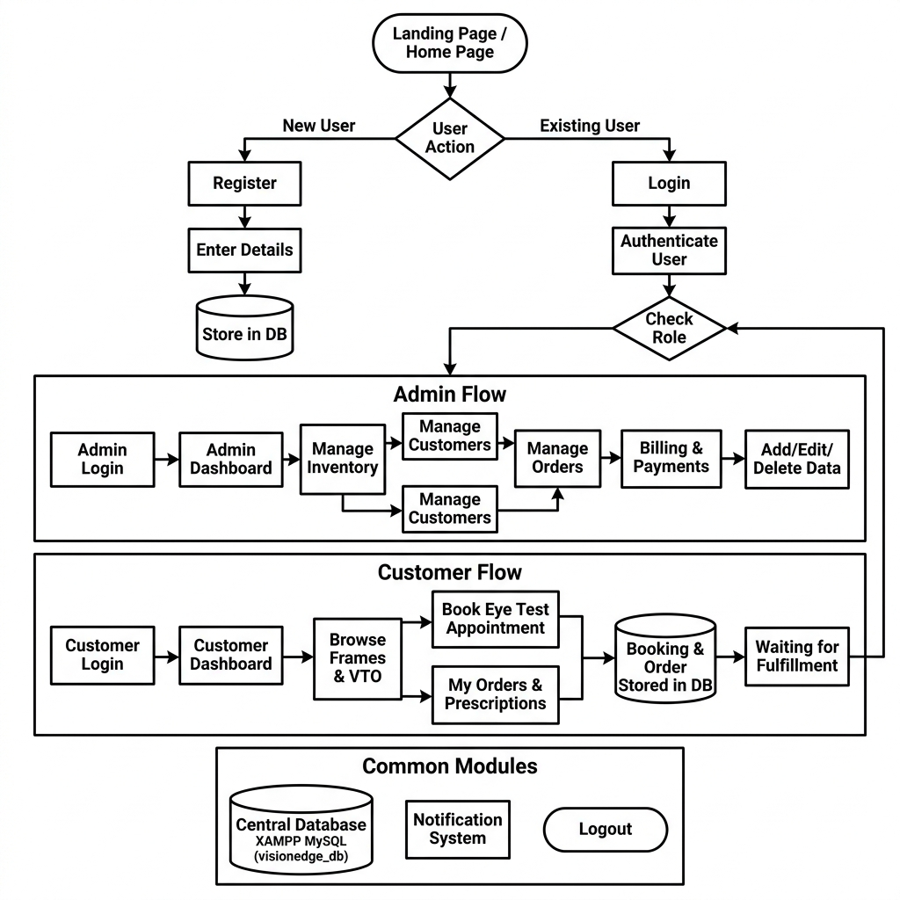
Minor Project 2nd Review
System Flow Diagram
09

Slide 10
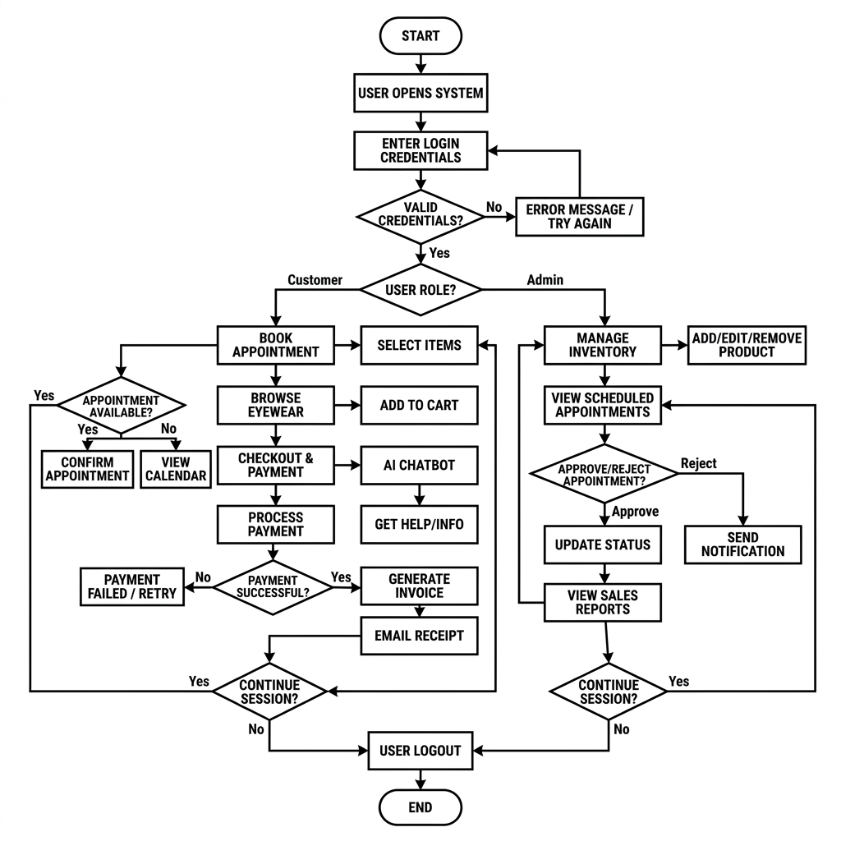
Minor Project 2nd Review
Activity Diagram
10

Slide 11
1
Minor Project 2nd Review
Database Design
1)user
Field Name | Datatype | Constraints | Description
id | Integer | primary_key=True | Unique identifier
username | String | unique=True, nullable=False | Login username
first_name | String | nullable=True | First name
last_name | String | nullable=True | Last name
password_hash | String | nullable=False | Secure password hash
email | String | unique=True, nullable=True | Email address
phone | String | — | Primary contact number
gender | String | — | Gender information
date_of_birth | Date | — | Date of birth
address | Text | — | Address
role | String | default='customer' | Authorization role
created_at | DateTime | default=datetime.utcnow | Record creation timestamp
11

Slide 12
1
Minor Project 2nd Review
Database Design
2)customer
Field Name | Datatype | Constraints | Description
id | Integer | primary_key=True | Unique identifier
customer_code | String | unique=True | Customer reference code
first_name | String | nullable=False | First name
last_name | String | nullable=False | Last name
gender | String | — | Gender information
date_of_birth | Date | — | Date of birth
age | Integer | — | Customer age
phone | String | nullable=False, index=True | Primary contact number
alternate_phone | String | — | Alternate contact number
email | String | index=True | Email address
address | Text | — | Address
city | String | — | City
state | String | — | State
pincode | String | — | Postal code
occupation | String | — | Occupation
photo | String | — | Customer photo path
status | String | default='Active' | Current record status
created_at | DateTime | default=datetime.utcnow | Record creation timestamp
updated_at | DateTime | default=datetime.utcnow, onupdate=datetime.utcnow | Last update timestamp
created_by | Integer | db.ForeignKey('user.id') | User who created the record
12

Slide 13
1
Minor Project 2nd Review
Database Design
3)Customer profile
Field Name | Datatype | Constraints | Description
id | Integer | primary_key=True | Unique identifier
customer_id | Integer | nullable=False, unique=True, db.ForeignKey('customer.id') | Associated customer ID
blood_group | String | — | Blood group
eye_conditions | Text | — | Known eye conditions
allergies | Text | — | Known allergies
notes | Text | — | Additional notes
13

Slide 14
1
Minor Project 2nd Review
Database Design
4)appointment
Field Name | Datatype | Constraints | Description
id | Integer | primary_key=True | Unique identifier
customer_id | Integer | nullable=False, db.ForeignKey('customer.id') | Associated customer ID
appointment_date | Date | nullable=False | Appointment date
appointment_time | Time | nullable=False | Appointment time
appointment_type | String | — | Appointment category
doctor_name | String | — | Doctor / optometrist name
status | String | default='Pending' | Current record status
notes | Text | — | Additional notes
created_at | DateTime | default=datetime.utcnow | Record creation timestamp
14

Slide 15
1
Minor Project 2nd Review
Database Design
5)Eye test
Field Name | Datatype | Constraints | Description
id | Integer | primary_key=True | Unique identifier
customer_id | Integer | nullable=False, db.ForeignKey('customer.id') | Associated customer ID
appointment_id | Integer | nullable=True, db.ForeignKey('appointment.id') | Associated appointment ID
right_sphere | String | — | Right eye (OD) sphere
right_cylinder | String | — | Right eye (OD) cylinder
right_axis | String | — | Right eye (OD) axis
left_sphere | String | — | Left eye (OS) sphere
left_cylinder | String | — | Left eye (OS) cylinder
left_axis | String | — | Left eye (OS) axis
pd_value | String | — | Pupillary distance
remarks | Text | — | Clinical remarks
created_at | DateTime | default=datetime.utcnow | Record creation timestamp
15

Slide 16
1
Minor Project 2nd Review
Database Design
6)prescription
Field Name | Datatype | Constraints | Description
id | Integer | primary_key=True | Unique identifier
prescription_number | String | unique=True | Prescription reference number
customer_id | Integer | nullable=False, db.ForeignKey('customer.id') | Associated customer ID
eye_test_id | Integer | nullable=True, db.ForeignKey('eye_test.id') | Associated eye test ID
add_power | String | — | Near add power
prescription_image | String | — | Uploaded prescription image
ai_extracted_text | Text | — | AI-extracted prescription text
confidence_score | Float | — | AI extraction confidence
doctor_name | String | — | Doctor / optometrist name
created_at | DateTime | default=datetime.utcnow | Record creation timestamp
date | Date | default=datetime.utcnow | Date
expiry_date | Date | — | Prescription expiry date
status | String | default='Completed' | Current record status
16

Slide 17
1
Minor Project 2nd Review
Database Design
7)frame
Field Name | Datatype | Constraints | Description
id | Integer | primary_key=True | Unique identifier
frame_code | String | unique=True | Frame SKU/code
brand | String | — | Brand name
model | String | — | Frame/lens model
name | String | — | Display name
shape | String | — | Frame shape
color | String | — | Frame color
size | String | — | Frame size
material | String | — | Frame material
gender | String | — | Gender information
price | Float | nullable=False | Retail price
selling_price | Float | — | Selling price
stock | Integer | default=0 | Current stock quantity
min_stock | Integer | default=5 | Low-stock threshold
image | String | — | Product image path
vto_image | String | — | Virtual Try-On image path
status | String | default='Available' | Current record status
created_at | DateTime | default=datetime.utcnow | Record creation timestamp
updated_at | DateTime | default=datetime.utcnow, onupdate=datetime.utcnow | Last update timestamp
17

Slide 18
1
Minor Project 2nd Review
Database Design
8)lens
Field Name | Datatype | Constraints | Description
id | Integer | primary_key=True | Unique identifier
lens_code | String | unique=True | Lens SKU/code
name | String | — | Display name
brand | String | — | Brand name
type | String | — | Product / lens type
lens_type | String | — | Lens type compatibility field
coating | String | — | Lens coating
price | Float | nullable=False | Retail price
selling_price | Float | — | Selling price
stock | Integer | default=0 | Current stock quantity
min_stock | Integer | default=10 | Low-stock threshold
image | String | — | Product image path
status | String | default='Available' | Current record status
created_at | DateTime | default=datetime.utcnow | Record creation timestamp
18

Slide 19
1
Minor Project 2nd Review
Database Design
9)supplier
Field Name | Datatype | Constraints | Description
id | Integer | primary_key=True | Unique identifier
name | String | nullable=False | Display name
phone | String | — | Primary contact number
email | String | — | Email address
address | Text | — | Address
created_at | DateTime | default=datetime.utcnow | Record creation timestamp
19

Slide 20
1
Minor Project 2nd Review
Database Design
10)order
Field Name | Datatype | Constraints | Description
id | Integer | primary_key=True | Unique identifier
order_id | String | unique=True | Associated order ID
order_number | String | unique=True | Order reference number
customer_id | Integer | nullable=False, db.ForeignKey('customer.id') | Associated customer ID
prescription_id | Integer | nullable=True, db.ForeignKey('prescription.id') | Associated prescription ID
status | String | default='Pending' | Current record status
total_amount | Float | default=0.0 | Total monetary amount
order_date | DateTime | default=datetime.utcnow | Order date
created_at | DateTime | default=datetime.utcnow | Record creation timestamp
20

Slide 21
1
Minor Project 2nd Review
Database Design
11)Order item
Field Name | Datatype | Constraints | Description
id | Integer | primary_key=True | Unique identifier
order_id | Integer | nullable=False, db.ForeignKey('order.id') | Associated order ID
product_type | String | — | Product type
item_type | String | — | Compatibility item type
product_id | Integer | — | Referenced product ID
item_id | Integer | — | Compatibility item ID
quantity | Integer | default=1 | Quantity
price | Float | — | Retail price
total_price | Float | — | Line total price
21

Slide 22
1
Minor Project 2nd Review
Database Design
12)billing
Field Name | Datatype | Constraints | Description
id | Integer | primary_key=True | Unique identifier
invoice_number | String | unique=True, nullable=False | Invoice number
order_id | Integer | nullable=False, db.ForeignKey('order.id') | Associated order ID
subtotal | Float | default=0.0 | Subtotal before discount/tax
discount | Float | default=0.0 | Discount amount
gst | Float | default=0.0 | GST amount
total_amount | Float | nullable=False | Total monetary amount
payment_status | String | default='Pending' | Payment status
payment_method | String | — | Payment method
invoice_pdf | String | — | Generated invoice PDF path
created_at | DateTime | default=datetime.utcnow | Record creation timestamp
22

Slide 23
1
Minor Project 2nd Review
Database Design
13)payment
Field Name | Datatype | Constraints | Description
id | Integer | primary_key=True | Unique identifier
billing_id | Integer | nullable=False, db.ForeignKey('billing.id') | Associated billing ID
amount | Float | nullable=False | Payment amount
transaction_id | String | — | Transaction reference
payment_method | String | — | Payment method
payment_date | DateTime | default=datetime.utcnow | Payment date
23

Slide 24
1
Minor Project 2nd Review
Database Design
14)Lens recommedation
Field Name | Datatype | Constraints | Description
id | Integer | primary_key=True | Unique identifier
customer_id | Integer | db.ForeignKey('customer.id') | Associated customer ID
prescription_id | Integer | db.ForeignKey('prescription.id') | Associated prescription ID
recommended_lens | Text | — | Recommended Lens
reason | Text | — | Transaction reason
ai_response | Text | — | Ai Response
created_at | DateTime | default=datetime.utcnow | Record creation timestamp
24

Slide 25
1
Minor Project 2nd Review
Database Design
15)Frame recommedation
Field Name | Datatype | Constraints | Description
id | Integer | primary_key=True | Unique identifier
customer_id | Integer | nullable=False, db.ForeignKey('customer.id') | Associated customer ID
face_shape | String | — | Detected face shape
face_image | String | — | Face Image
recommended_frames | Text | — | Recommended Frames
selected_frame | String | — | Selected Frame
ai_reason | Text | — | Ai Reason
created_at | DateTime | default=datetime.utcnow | Record creation timestamp
25

Slide 26
1
Minor Project 2nd Review
Database Design
16)Virtual try on history
Field Name | Datatype | Constraints | Description
id | Integer | primary_key=True | Unique identifier
customer_id | Integer | nullable=False, db.ForeignKey('customer.id') | Associated customer ID
frame_id | Integer | nullable=False, db.ForeignKey('frame.id') | Recommended frame ID
original_image | String | — | Original Image
generated_image | String | — | Generated Image
tryon_image | String | — | Tryon Image
created_at | DateTime | default=datetime.utcnow | Record creation timestamp
26

Slide 27
1
Minor Project 2nd Review
Database Design
17)Chat history
Field Name | Datatype | Constraints | Description
id | Integer | primary_key=True | Unique identifier
user_id | Integer | db.ForeignKey('user.id') | User Id
customer_id | Integer | nullable=True, db.ForeignKey('customer.id') | Associated customer ID
question | Text | nullable=False | Question
answer | Text | nullable=False | Answer
created_at | DateTime | default=datetime.utcnow | Record creation timestamp
27

Slide 28
1
Minor Project 2nd Review
Database Design
18)notification
Field Name | Datatype | Constraints | Description
id | Integer | primary_key=True | Unique identifier
user_id | Integer | nullable=True, db.ForeignKey('user.id') | User Id
customer_id | Integer | nullable=True, db.ForeignKey('customer.id') | Associated customer ID
notification_type | String | nullable=False | Notification Type
title | String | nullable=False | Notification title
message | Text | nullable=False | Chat/notification message
status | String | default='Unread' | Current record status
created_at | DateTime | default=datetime.utcnow | Record creation timestamp
28

Slide 29
1
Minor Project 2nd Review
Database Design
19)Audit log
Field Name | Datatype | Constraints | Description
id | Integer | primary_key=True | Unique identifier
user_id | Integer | db.ForeignKey('user.id') | User Id
action | String | — | Audit action
module | String | — | Module
timestamp | DateTime | default=datetime.utcnow | Timestamp
29

Slide 30
1
Minor Project 2nd Review
Database Design
20)brand
Field Name | Datatype | Constraints | Description
id | Integer | primary_key=True | Unique identifier
name | String | nullable=False | Display name
30

Slide 31
1
Minor Project 2nd Review
Database Design
21)category
Field Name | Datatype | Constraints | Description
id | Integer | primary_key=True | Unique identifier
name | String | nullable=False | Display name
31

Slide 32
1
Minor Project 2nd Review
Database Design
22)Inventory transaction
Field Name | Datatype | Constraints | Description
id | Integer | primary_key=True | Unique identifier
product_type | String | — | Product type
product_id | Integer | — | Referenced product ID
transaction_type | String | — | Inventory transaction type
quantity | Integer | — | Quantity
notes | Text | — | Additional notes
created_at | DateTime | default=datetime.utcnow | Record creation timestamp
32

Slide 33
1
Minor Project 2nd Review
Database Design
23)Order status history
Field Name | Datatype | Constraints | Description
id | Integer | primary_key=True | Unique identifier
order_id | Integer | nullable=False, db.ForeignKey('order.id') | Associated order ID
status | String | — | Current record status
notes | Text | — | Additional notes
created_at | DateTime | default=datetime.utcnow | Record creation timestamp
33

Slide 34
Minor Project 2nd Review
UI Prototypes
Landing Page → Login / Sign Up
Customer Dashboard → Products → Product Details
Cart → Checkout → QR Invoice / Billing
Prescription → Lens Recommendation
Virtual Try-On → Frame Recommendation → History
Profile → Orders → Notifications
34

Slide 35
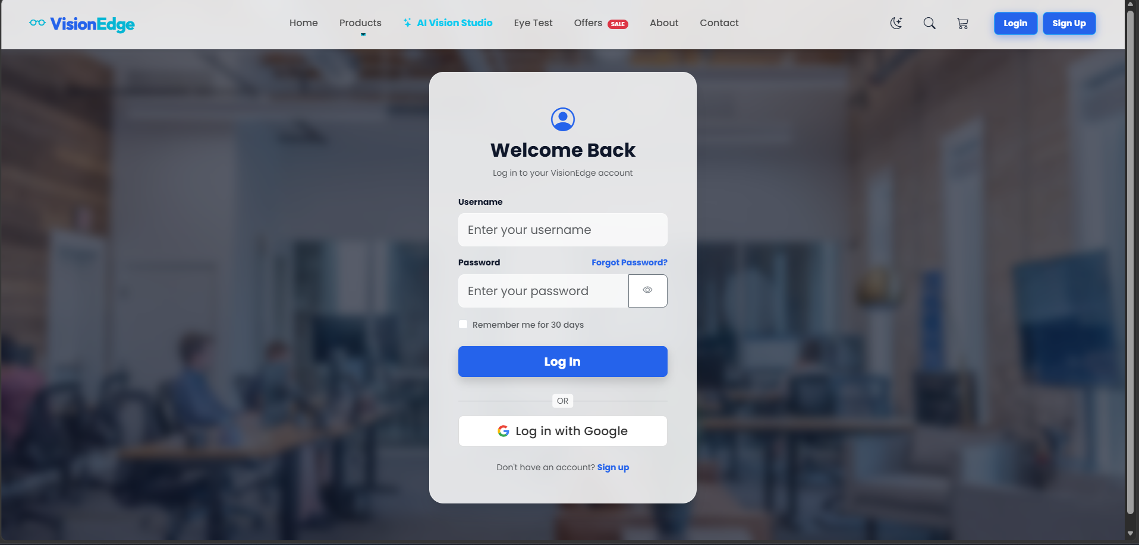
Minor Project 2nd Review
UI Prototype
1)Landing Page:
Login
35

Slide 36
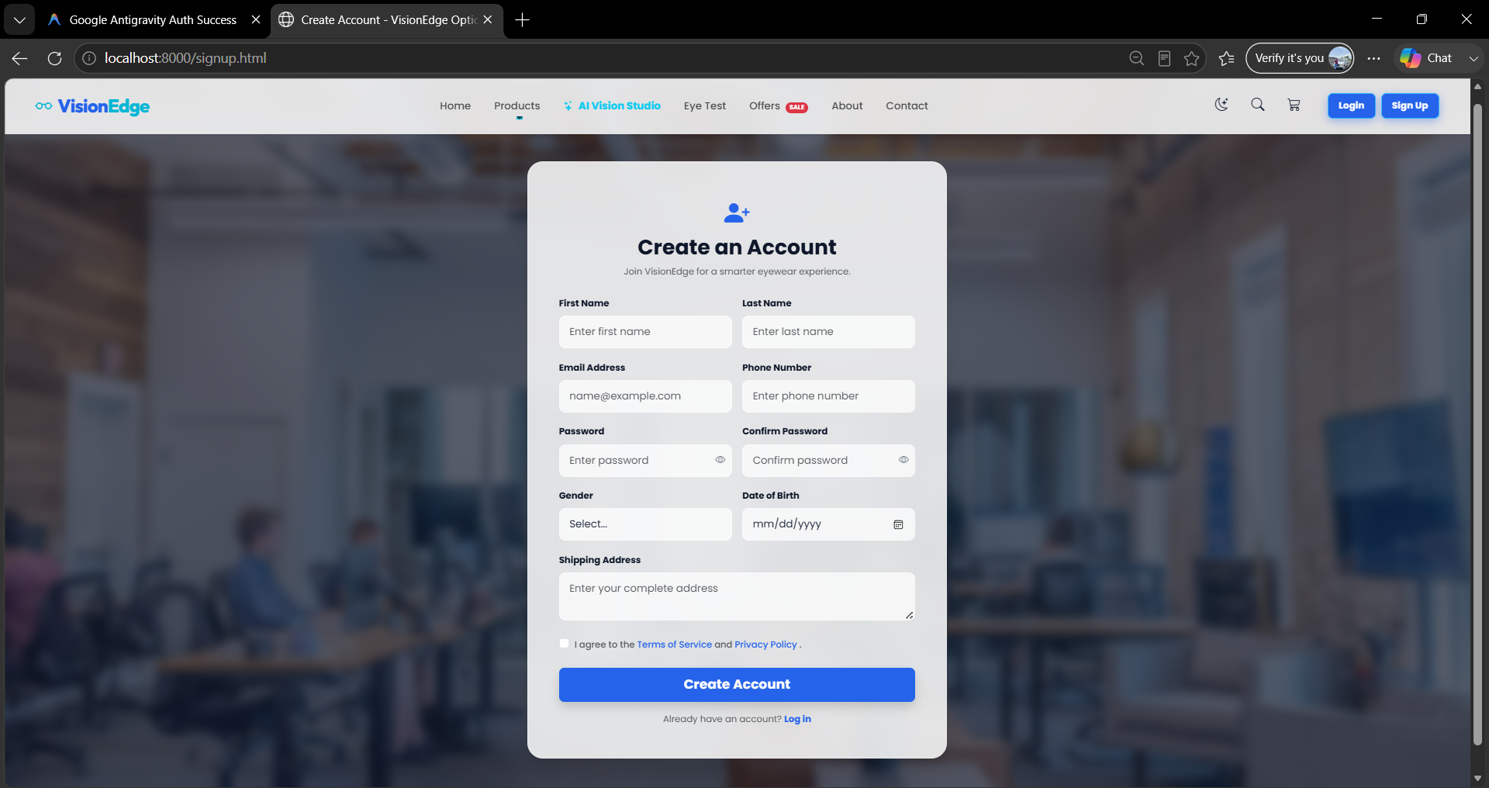
Minor Project 2nd Review
UI Prototype
1)Landing Page:
Sign Up
36

Slide 37
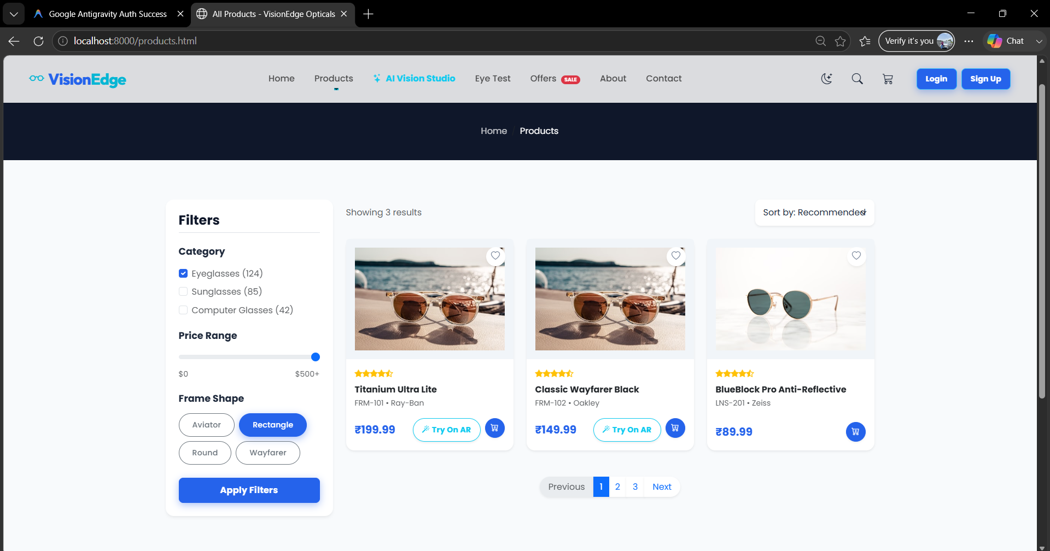
Minor Project 2nd Review
UI Prototype
2)Customer Dashboard: products
37

Slide 38
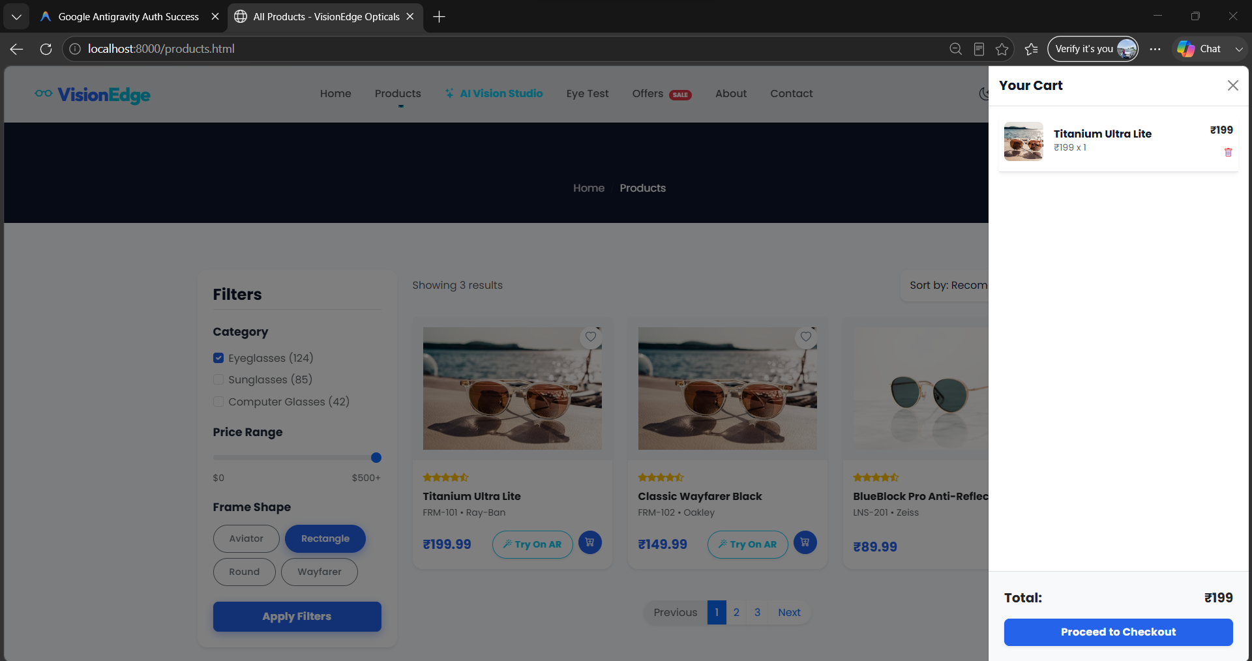
Minor Project 2nd Review
UI Prototype
3)Cart
38

Slide 39
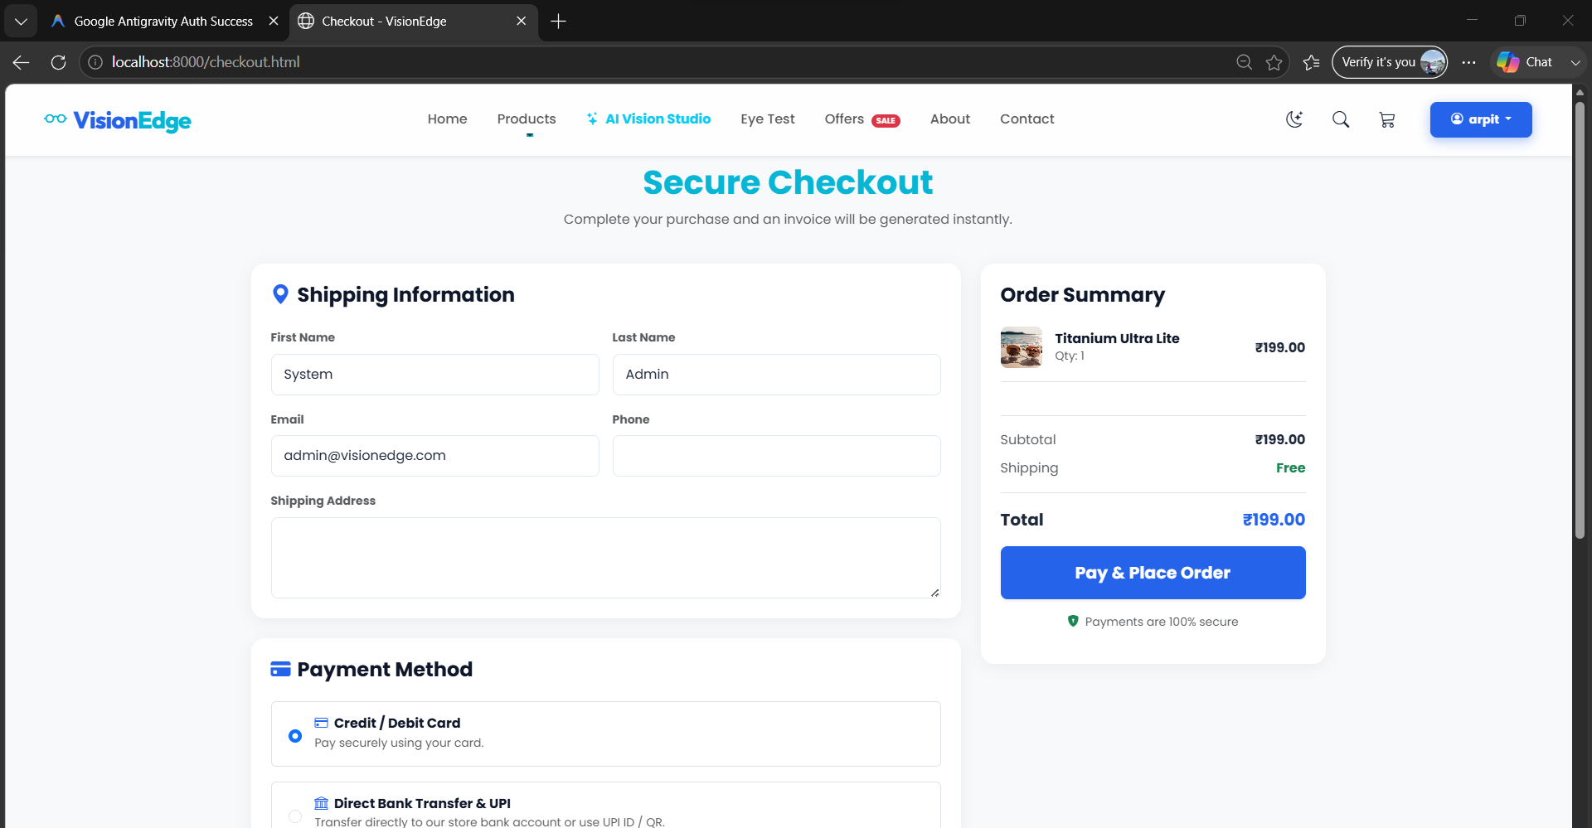
Minor Project 2nd Review
UI Prototype
3)Cart: checkout
39

Slide 40
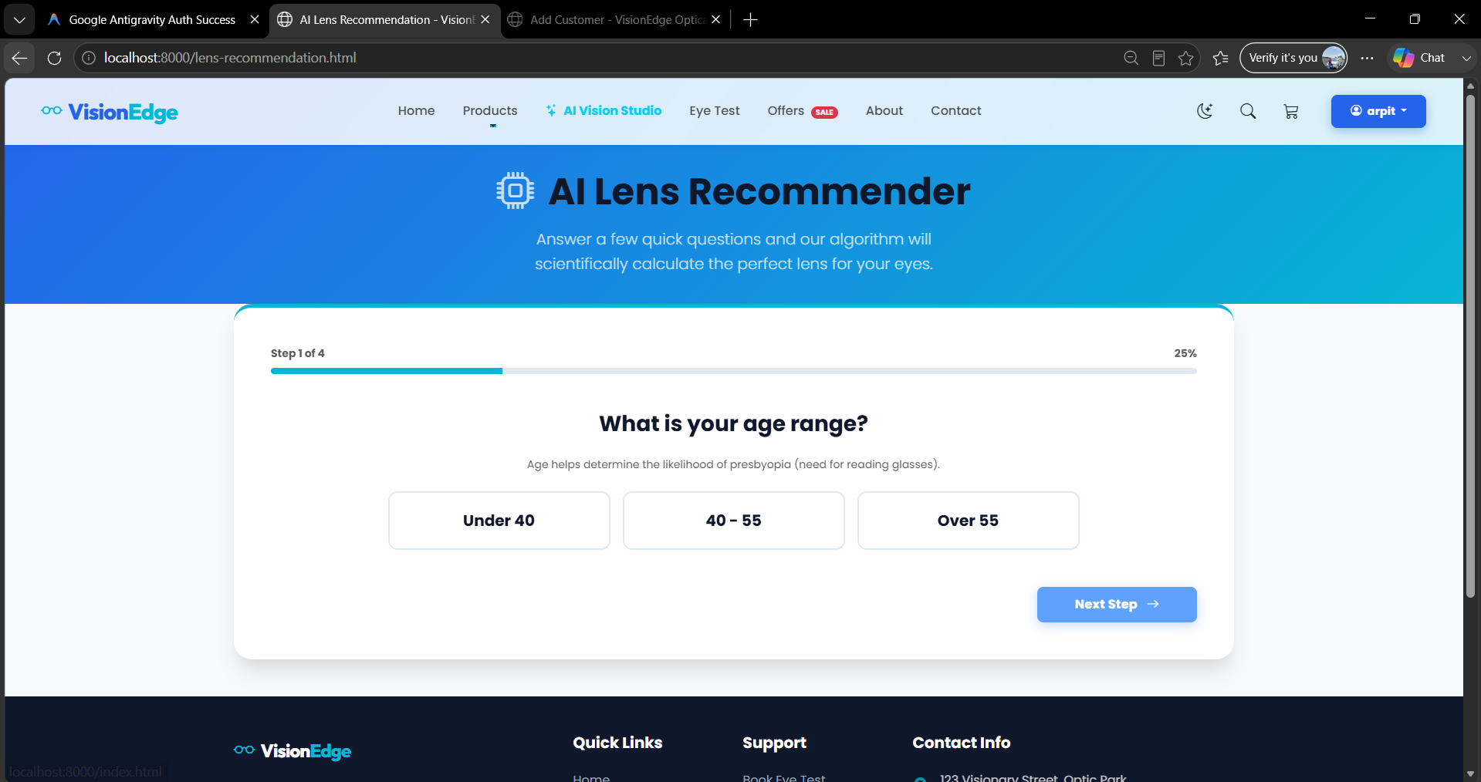
Minor Project 2nd Review
UI Prototype
4)prescriptions
40

Slide 41
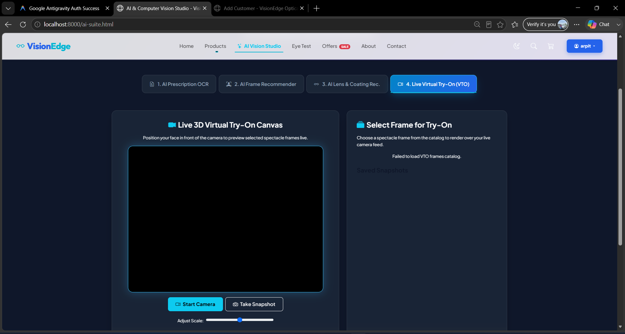
Minor Project 2nd Review
UI Prototype
5)Virtul try on
41

Slide 42
Minor Project 2nd Review
Module Planning & Architecture Breakdown
1. Identity & Authentication (RBAC)
2. Customer CRM & Clinical Eye Test
3. AI Vision & Virtual Try-On
4. Order & Inventory Management
5. Billing & GST Invoicing
6. Analytics & Financial Reporting
42

Slide 43
Minor Project 2nd Review
System Modules & Responsibilities Matrix
Module Name | Core Responsibilities | Key Code Components
1. Identity & Authentication (RBAC) | Handles user registration, password security, JWT session validation, and role-based access for Customer, Optometrist, and Admin/Seller. | auth_routes.py auth_utils.py User model (models.py) login.html, signup.html
2. Customer CRM & Clinical Eye Test | Manages customer profiles, eye-test/prescription data, patient history, appointments, and optometrist approval. | customer_routes.py appointment_routes.py CustomerProfile, EyeTest, Appointment models profile.html, eye-test.html
3. AI Vision & Virtual Try-On | Provides AI prescription OCR, face-shape analysis, facial landmark detection, and virtual frame try-on using camera/image processing. | ai_routes.py virtual_tryon_routes.py GeminiAI OCR & MediaPipe VTO services face_analysis.py ai-suite.html
4. Order & Inventory Management | Manages frames, lenses, and coatings, synchronizes online and retail inventory, and tracks orders from pending to delivery. | inventory_routes.py order_routes.py Frame, Lens, Order, OrderItem models products.html, checkout.html
5. Billing & GST Invoicing | Calculates GST, records payments, integrates payment gateways, and generates PDF tax invoices with QR codes. | billing_routes.py pdf_generator.py BillingInvoice model (models.py) payment-history.html
6. Analytics & Financial Reporting | Provides sales and revenue analysis, profit insights, top-brand/product statistics, inventory audits, and optometrist performance tracking. | reports_routes.py AnalyticsReportService dashboard.html
43

Slide 44
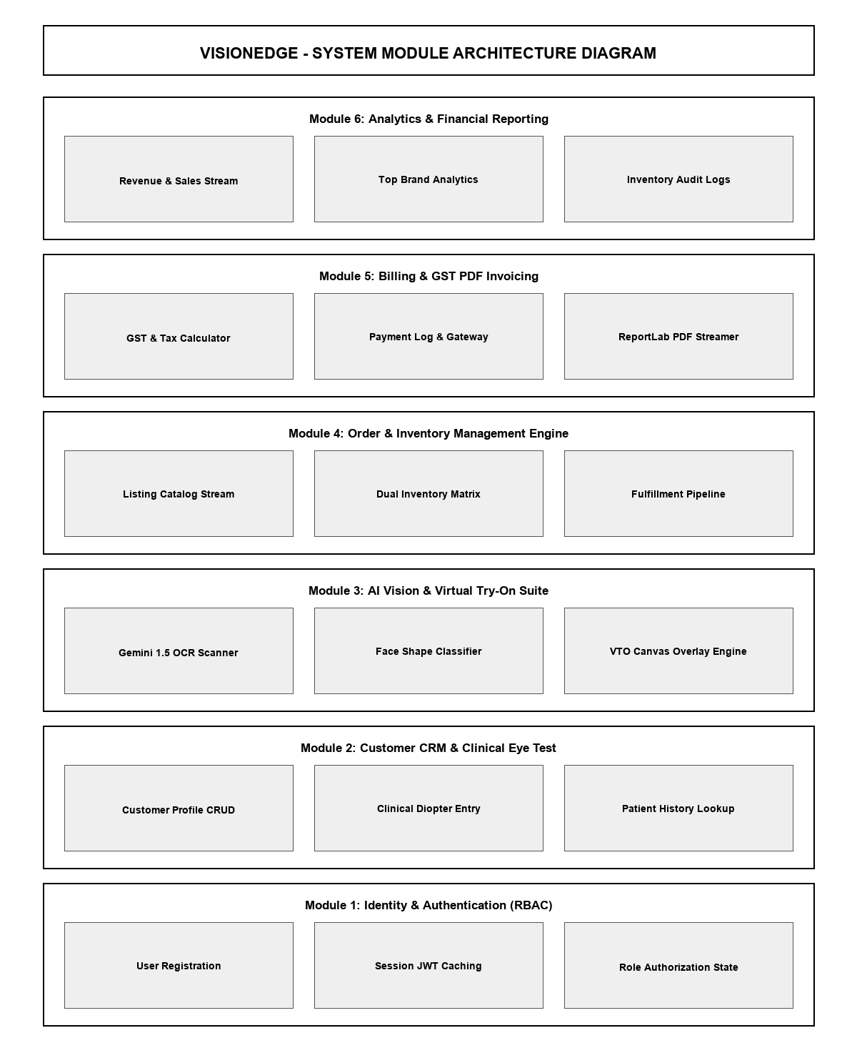
Minor Project 2nd Review
System Modules & Responsibilities Matrix
44

Slide 45
Thank You !
VisionEdge — AI-Powered Optical Store Management & Virtual Try-On System
45

