Slide 1

DR. AKHILESH DAS GUPTA INSTITUTE OF TECHNOLOGY & MANAGEMENT DEPARTMENT OF ELECTRICAL AND ELECTRONICS ENGINEERING
Real Time Facial recognition implementation
on Attendance System
Group No. 9
Under the guidance of
Dr. Pratul Arvind
Presented by
Devanshu Rawat [001]
Date: 1/12/2023
Notes:
Adjust it as per your requirements

Slide 2

Table of contents
Objective
Introduction
Proposed model
Simulation Results
Application
Video of working model
Conclusion
Details of publications
References

Slide 3
Objective
To create a model to detect the face of students and recognize them with their names.

Slide 4

Introduction
Face Recognition is a biometric method of identifying an individual by comparing live capture or digital image data with the stored record for that person.
Face Recognition Attendance System is marking of attendance based on this technology.

Slide 5
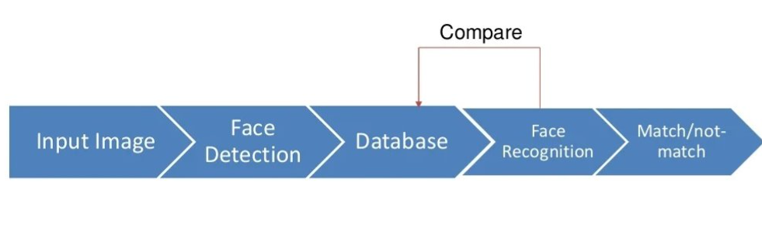
Methodology
This system important part is face detection and face recognition.
For face detection using Haar cascade classifier face detection algorithm.
For face recognition using local binary pattern histogram algorithm.

Slide 6
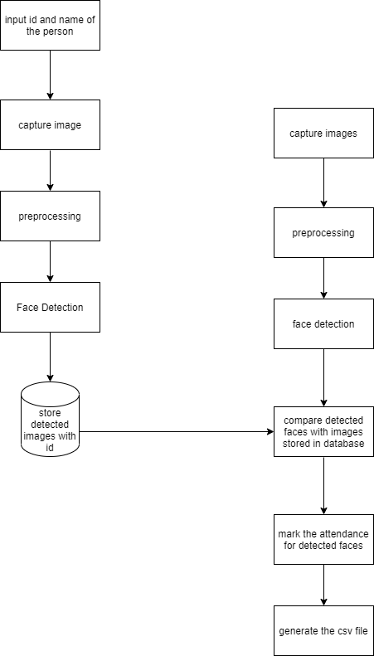
Structure Chart Structure Chart represent hierarchical structure of modules. It breaks down the entire system into lowest functional modules, describe functions and sub-functions of each module of a system to a greater detail.

Slide 7
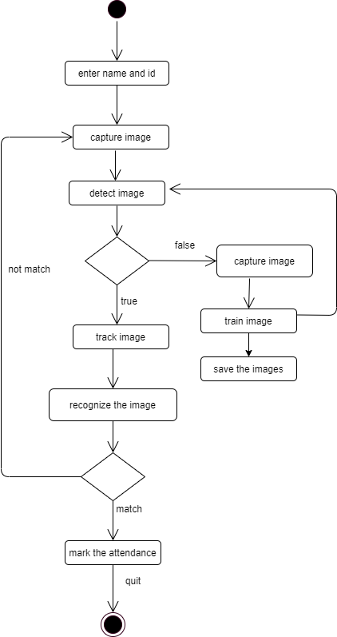
Activity Diagram It depicts the behavior or purposed logic of this system. This depicts process from input of credentials to capturing of images to detect for known record to mark attendance for the same, if not in present record train to save the image.

Slide 8
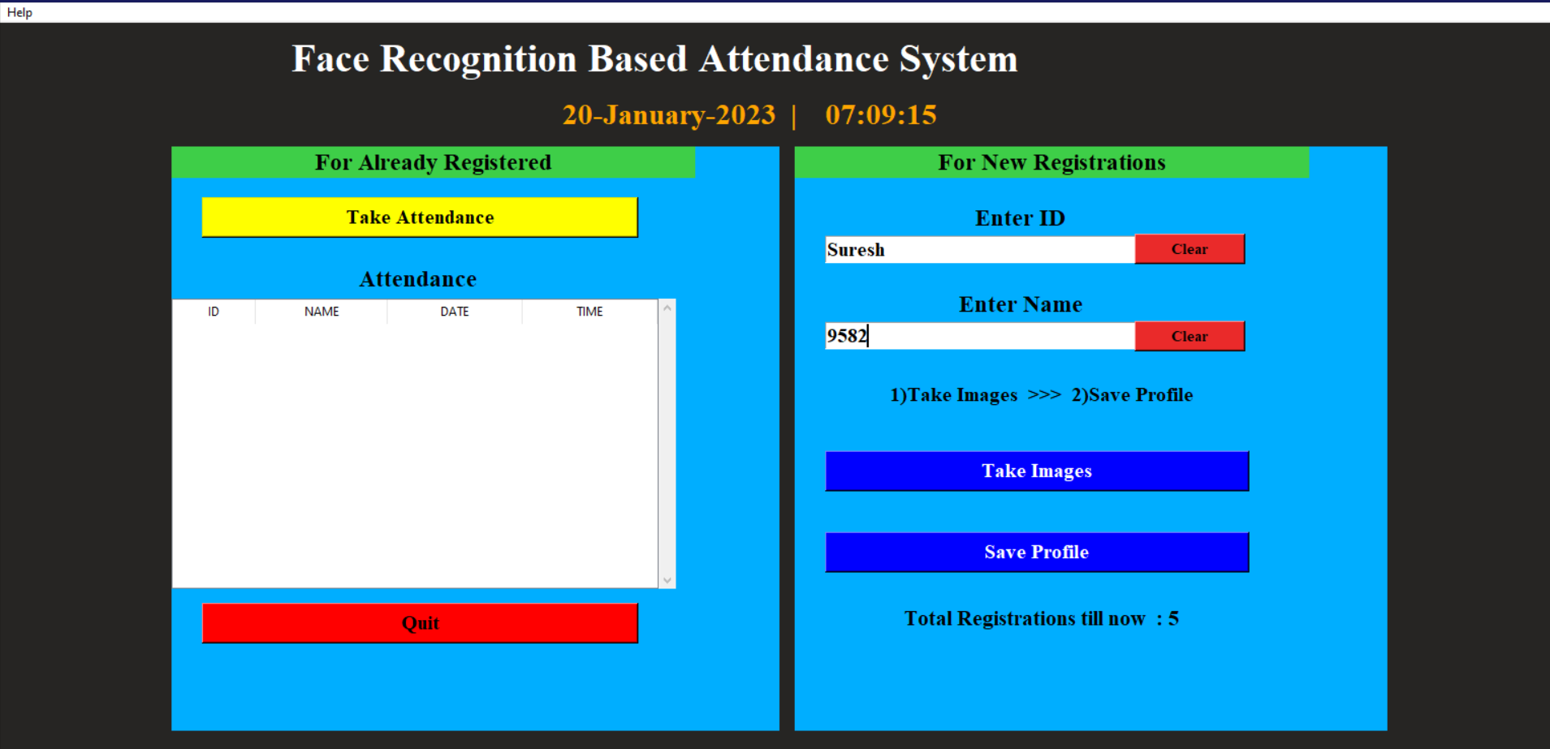
Simulated Results: Portal

Slide 9
Application
Provides an automated attendance system that is practical. reliable and Eliminate disturbance and time loss of traditional attendance systems.
Present a system that can accurately evaluate student's performance depending on their recorded attendance rate.

Slide 10
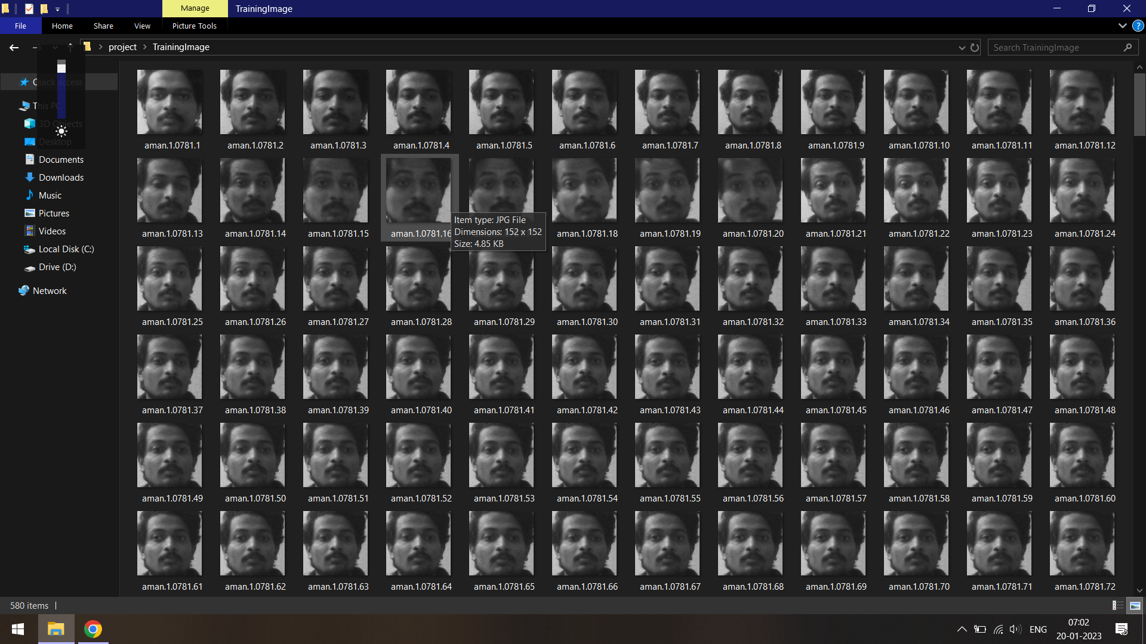
Images stored in Particular Folder

Slide 11
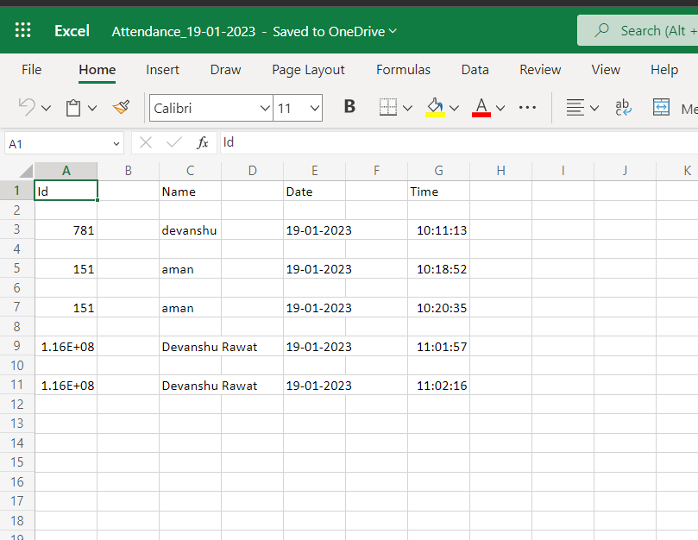
Attendance Database
Attendance is being marked at a excel sheet in that respective folder.

Slide 12
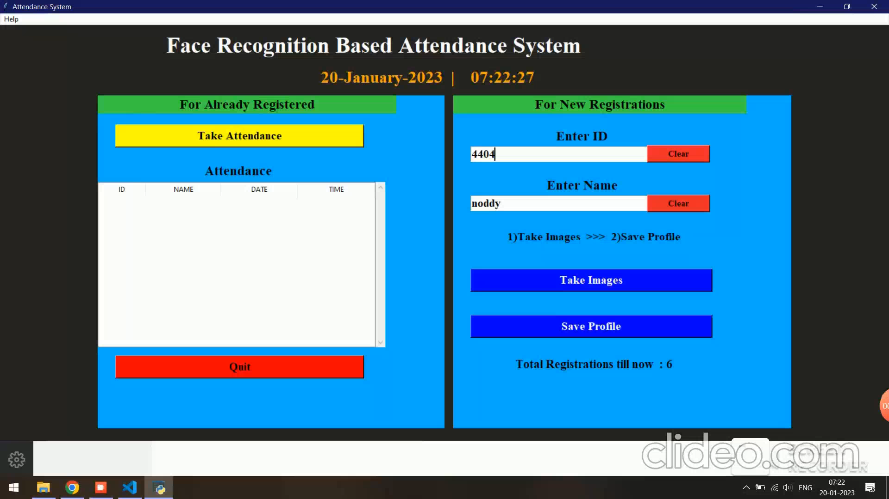
Video

Slide 13
Conclusion
The implementation of an automated attendance system has effectively addressed the issues of inaccuracies in traditional attendance methods. By utilizing facial recognition technology, we are able to prevent instances of fraud and improve efficiency. Overall, this cutting-edge technology holds immense potential for future advancements in attendance tracking.

Slide 14
References
Faruqe, M.O. and Hasan, M. A. M.(2009). “ Face recognition using PCA and SVM. ” Proceedings of the 3rd International Conference on Anti Counterfeiting, Security and Identification in Communication, Aug. 20- 22, Hong Kong, pp: 97-101.
Viola, Paul, and Michael J. Jones, “ Robust real-time face detection ”, International journal of computer vision 57.2 (2017):137-154.
T. Lim, S. Sim, and M. Mansor,” RFID based attendance system ”, in Industrial Electronics and Applications, 2009. ISIEA 2009. IEEE Symposium on, vol. 2. IEEE, 2019, pp. 778782.

Slide 15
THANK YOU

