Slide 1

DR. AKHILESH DAS GUPTA INSTITUTE OF TECHNOLOGY & MANAGEMENT DEPARTMENT OF ELECTRICAL AND ELECTRONICS ENGINEERING
Solar Powered Autonomous Multipurpose Agricultural Robot
Group No. I
Under the guidance of
Mr. Kumail Hassan Naqvi
Presented by
Devanshu Rawat [001]
Date: 9/06/2023
Notes:
Adjust it as per your requirements

Slide 2

Table of contents
Objective
Introduction
Methodology
Model
Stimulated Results
Video
Applications
Conclusion
References

Slide 3
Objective
To design and develop a solar-powered autonomous multipurpose agricultural robot that can be controlled through Bluetooth enabled Android-app.

Slide 4

Introduction
This project introduces a solar-powered agricultural robot that can perform various tasks, controlled through Bluetooth. It aims to enhance farming practices by automating operations, promoting sustainability through solar energy, and enabling remote monitoring for increased efficiency and productivity.

Slide 5
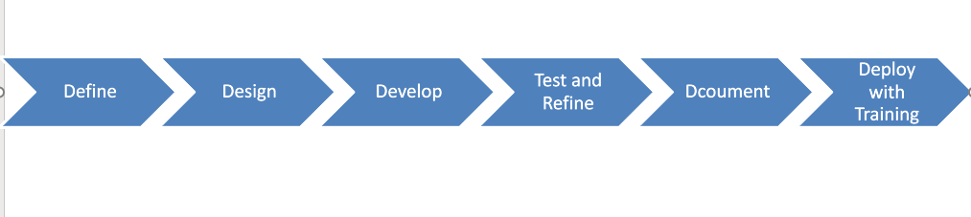
Methodology
Define requirements and agricultural tasks.
Design mechanical components and integrate electronic elements.
Develop firmware for microcontroller..
Test and refine the system, ensuring safety features.
Document the design, code, and manuals.
Deploy the robot with training and support for end-users.

Slide 6
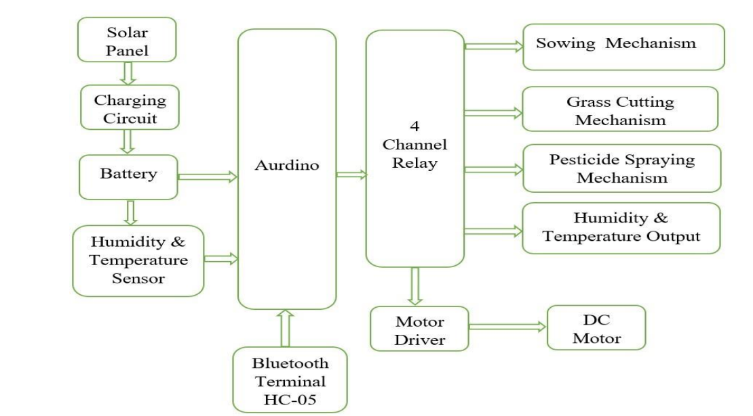
Model

Slide 7
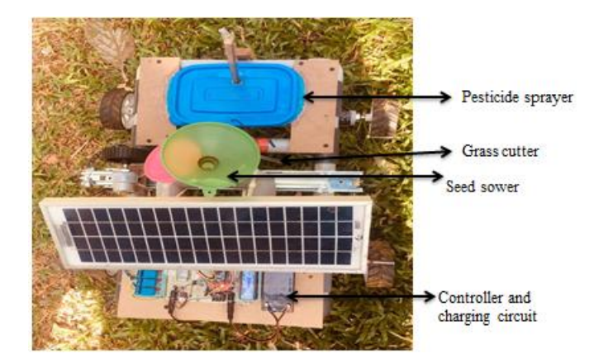
Result
The ultimate goal of the project is to provide farmers with a versatile and efficient tool that enhances productivity, optimizes resource utilization, and promotes sustainable farming practices.

Slide 8
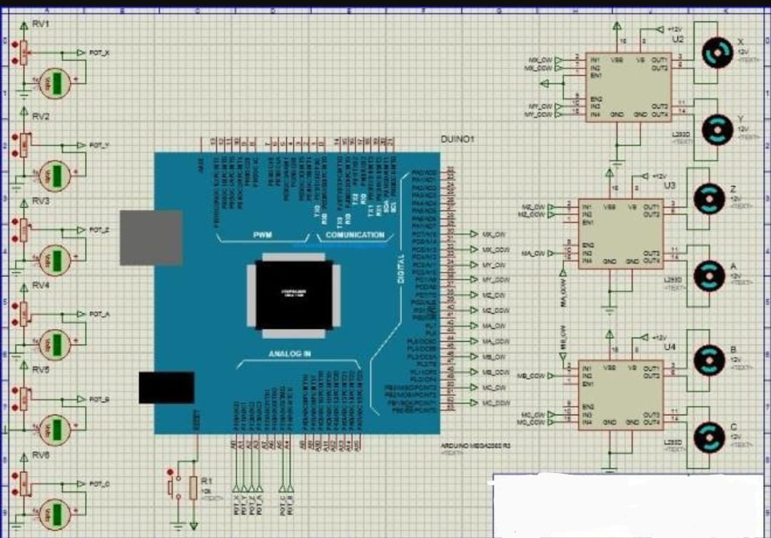
SIMULATION

Slide 9
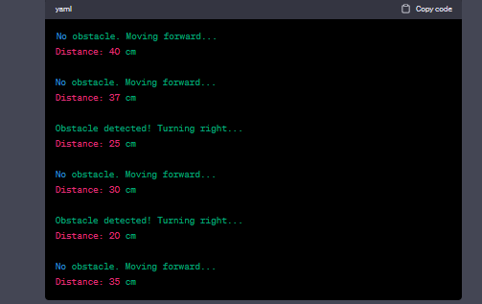
Result
SIMULATION Output

Slide 10
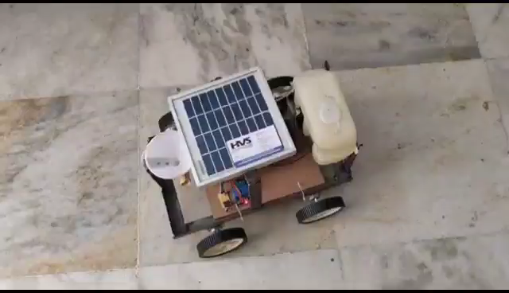
Video

Slide 11
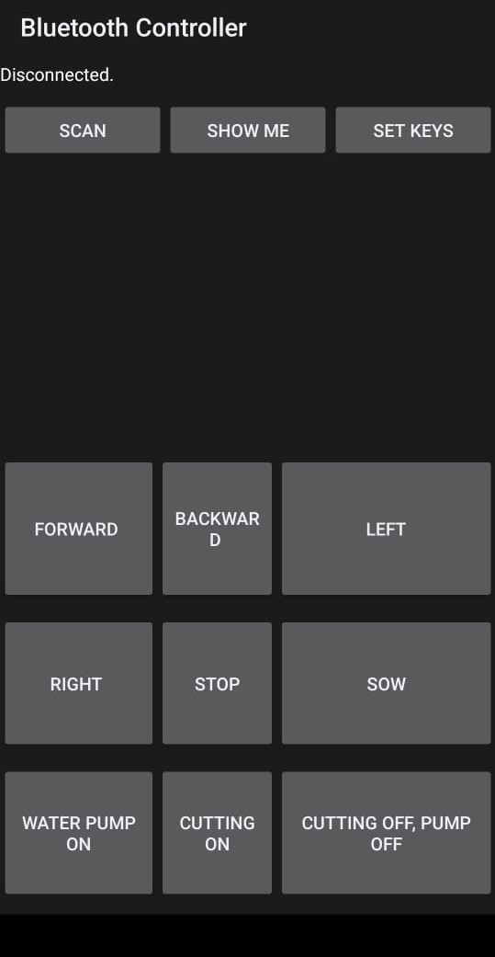
Bluetooth Application Interface

Slide 12
Application
Crop Monitoring and Management
Data-Driven Decision Making
Remote Monitoring and Control
Irrigation and Water Management
Soil Analysis and Mapping
Planting and Seeding
Weed and Pest Control
Precision Farming

Slide 13
Conclusion
The solar-powered autonomous agricultural robot controlled via Bluetooth/Android app presents a transformative solution for farming, combining automation, sustainability, and remote monitoring.
With its versatile applications and potential to enhance productivity, this technology has the capability to revolutionize modern agriculture practices.

Slide 14
References
Shiva kumara M C, Sunil Y S, Yamuna A S, Shruthi M, "Smart Phone Operated Multipurpose Agricultural Robot”, International Journal of Engineering Research & Technology (IJERT), 2018.
Bagyaveereswaran V, Ankita Ghorui, R. Anita, "Automation of Agricultural Tasks with Robotics- Agrobot ", IEEE International Conference on Technological Innovations in Power and Advanced Computing Technologies (IPACT),Vellore, India, 2019
Akshay Y. Kachor, Ketaki Ghodinde, "Design of Microcontroller Based Agribot for Fertigation and Plantation", IEEE Proceedings of the International Conference on Intelligent Computing and Control Systems (ICICCS 2019), 2019.

Slide 15
THANK YOU

