Slide 1
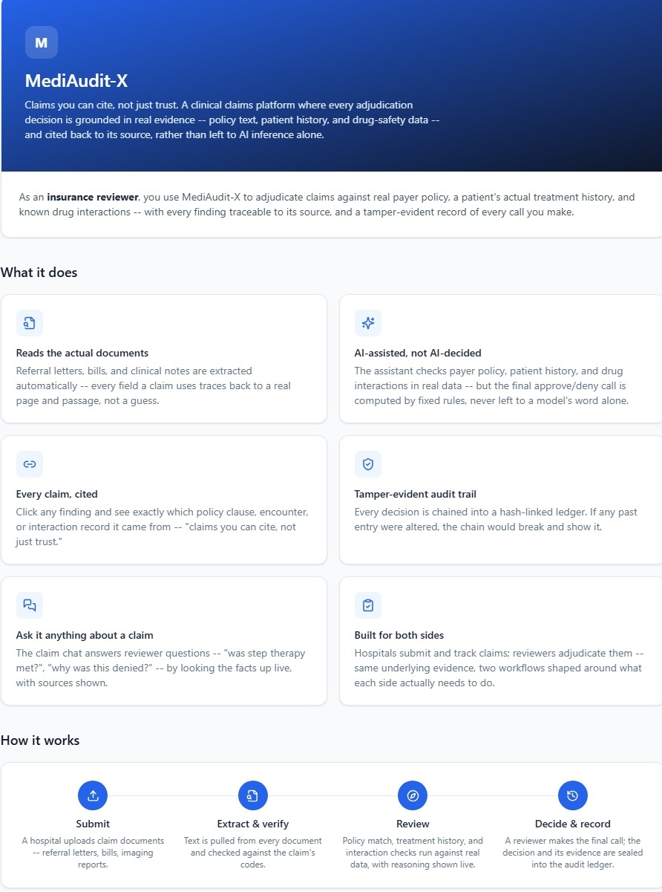
FORGE THE FUTURE HACKATHON 2026 · ELASTIC × AWS × SARVAM
MediAudit-X
Claims you can cite, not just trust.
A zero-hallucination clinical claims auditor — grounded in real Elasticsearch search results, cited back to source, every time.

Slide 2



THE PROBLEM
MediAudit-X
Prior authorization is a black box — and it's breaking under its own weight
37
16.4 hrs
26%
prior-authorization requests handled per practice, per week
of physician & staff time spent on PA requirements every week
of physicians wait 3+ business days for a payer's decision
Reviewers manually dig through charts, policy PDFs, and drug-interaction databases for every claim — and when a claim is denied or sent back for more information, there's often no verifiable trail explaining why. Patients and hospitals wait. Audits can't be trusted.
Source: American Medical Association, 2024 Prior Authorization Physician Survey

Slide 3





THE SOLUTION
MediAudit-X
An agent that adjudicates like a senior reviewer — and shows its work
MediAudit-X turns a claim into a cited decision. It searches real policy text, a patient's real treatment history, and real drug-interaction data — the LLM reasons over those results, and a deterministic rule confirms the final Approve, Deny, or Request Info outcome.
1. Search
2. Reason with citations
3. Reason, then confirm
Hybrid BM25 + vector search (RRF) over policies, and ES|QL over patient history
Claude streams its reasoning over SSE, citing real source IDs at every step
The LLM reasons through the evidence toward an outcome; a deterministic rule confirms it
A ranker picks the best code from real search results and the LLM's own browsing, and defers to the coder's entry on review. Server-side validation drops anything it can't verify against the underlying text — that's what "zero-hallucination" means here.

Slide 4
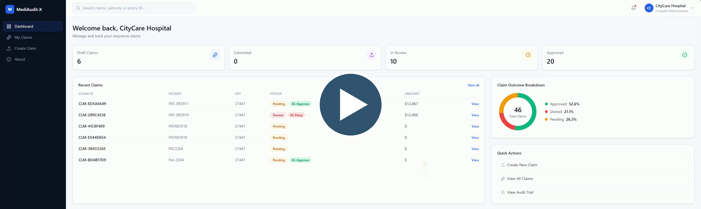
HOW IT WORKS
MediAudit-X
From upload to a cited decision
1. Upload
2. OCR
3. Draft & review
4. Evidence check
5. Adjudicate
6. Decide + audit
Hospital submits documents
pdfplumber → Tesseract, offset-cited chunks
Coder accepts / edits codes with citations
Do the documents support the final codes?
Policy + history + drug interaction agent
Letter, FHIR response, hash-chained ledger entry
Every step above writes an entry to a SHA-256 hash-chained audit ledger — not only the final decision.

Slide 5
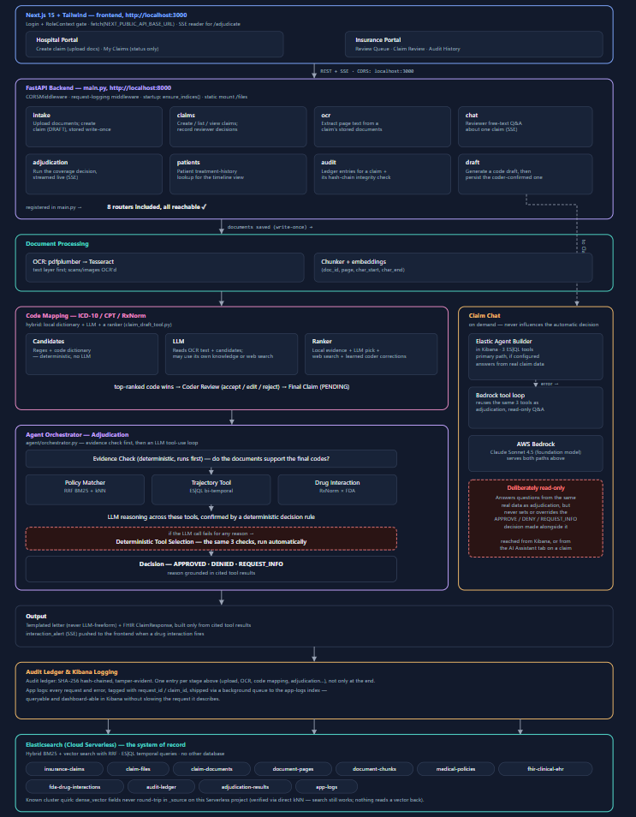
MediAudit-X
ARCHITECTURE

Slide 6
TECH STACK
MediAudit-X
Built on Elastic, AWS, and Claude
FRONTEND
BACKEND
AI / LLM
Next.js 15 (App Router) + React 18
Tailwind CSS
TypeScript
FastAPI + Uvicorn (Python)
Pydantic settings & validation
AWS Bedrock — Claude Sonnet 4.5 (foundation model)
Elastic Agent Builder (Kibana)
SEARCH & DATA
DOCUMENTS & OCR
TRUST & OPS
Elasticsearch Cloud Serverless
Hybrid BM25 + kNN with RRF
ES|QL bi-temporal queries
pdfplumber — embedded PDF text
Tesseract (pytesseract) — scans
SHA-256 hash-chained audit ledger
Docker Compose — backend + frontend
pytest against a live ES cluster

Slide 7




AI AGENTS & INFRASTRUCTURE
MediAudit-X
Two purpose-built agents, one shared foundation
Adjudication Agent
Claim Chat Agent
Runs the end-to-end coverage decision: checks payer policy, verifies the patient's treatment history, and screens for drug interactions — then a deterministic rule turns those findings into Approve, Deny, or Request Info, streamed live to the reviewer.
Lets a reviewer ask free-text questions about a claim — "was step therapy met?", "why was this denied?" — answered from the same real clinical and policy data, not a canned response.
AWS Bedrock
Elastic Agent Builder, in Kibana
Hosts the Claude Sonnet 4.5 foundation model that powers both agents
Orchestrates the Claim Chat agent natively inside Kibana, giving reviewers a Kibana-native conversational layer over the same clinical and policy data
Kibana logging captures every search, citation, and decision behind an agent's answer — including the tamper-evident audit ledger — so the full trail is inspectable directly in Kibana, alongside its own conversational orchestration for the Claim Chat agent.

Slide 8



MediAudit-X
WHY THIS IS DIFFERENT
The ranker chooses.
The LLM never invents.
A ranker picks the code, not the model
LLM-assisted, rule-confirmed
Every stage is hash-chained
Candidates come from a retriever engine and the LLM's own search; a ranker picks the best match — and picks the coder's entered code whenever a claim goes through review
The LLM reasons through the evidence toward the outcome; a deterministic rule confirms it before it's final
SHA-256 audit ledger — tampering is mathematically detectable

Slide 9
TEST RESULTS
MediAudit-X
Evaluation Benchmark
Tested against a live Elasticsearch cluster · 26 retrieval + 12 end-to-end test cases
TOOL-LEVEL RESULTS
Tool | Test Cases | Precision | Recall | F1 | Avg Latency
Policy Matcher (RRF Hybrid) | 9 | 1.000 | 1.000 | 1.000 | 403ms
Drug Interaction Detection | 14 | 1.000 | 1.000 | 1.000 | 707ms
Severity Classification | 14 | — | — | 1.000 | —
Brand Name Resolution | 2/2 | — | — | ✓ | —
12/12
end-to-end decisions correct — precision, recall and F1 all 1.000
END-TO-END DECISION ACCURACY
Verdict | TP | FP | FN | Precision | Recall | F1
APPROVED | 5 | 0 | 0 | 1.000 | 1.000 | 1.000
DENIED | 7 | 0 | 0 | 1.000 | 1.000 | 1.000
Overall | 12/12 | — | — | 1.000 | 1.000 | 1.000
872ms
average end-to-end latency per claim

Slide 10
MediAudit-X
POTENTIAL IMPACT — ESTIMATED, NOT YET BENCHMARKED
~27 min
70–85%
average staff time spent per prior-authorization request today
reduction we're targeting once review means verifying AI-cited evidence, not re-deriving it
Derived from AMA's 2024 Prior Authorization Physician Survey — 16.4 staff hours/week ÷ 37 requests/week per practice. Our own benchmark harness is intentionally still a work in progress; we're reporting the mechanism's target, not a measured result.

Slide 11
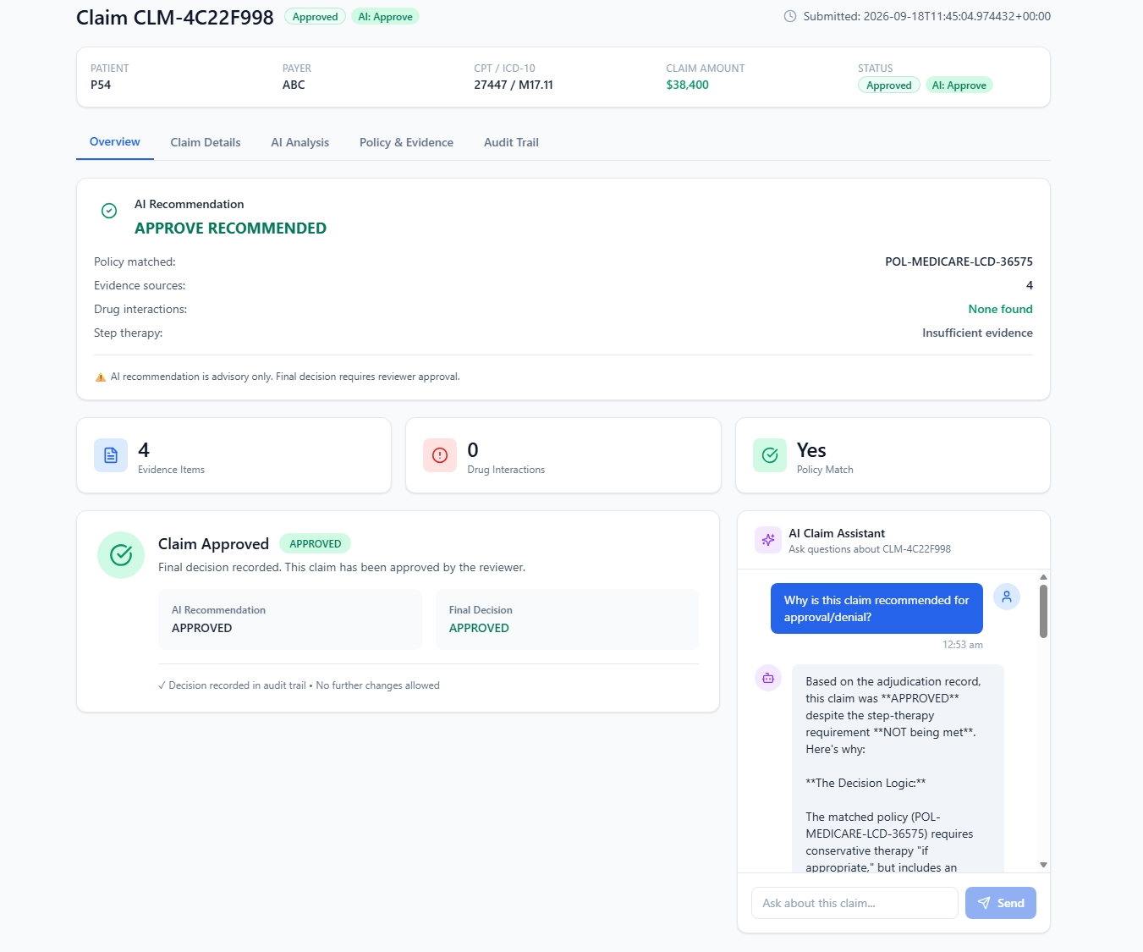
MEDIAUDIT-X
Claims you can cite, not just trust.
Forge the Future Hackathon 2026 · Elastic × AWS × Sarvam
Thank you — happy to walk through a live adjudication, citations and all.

