Slide 1
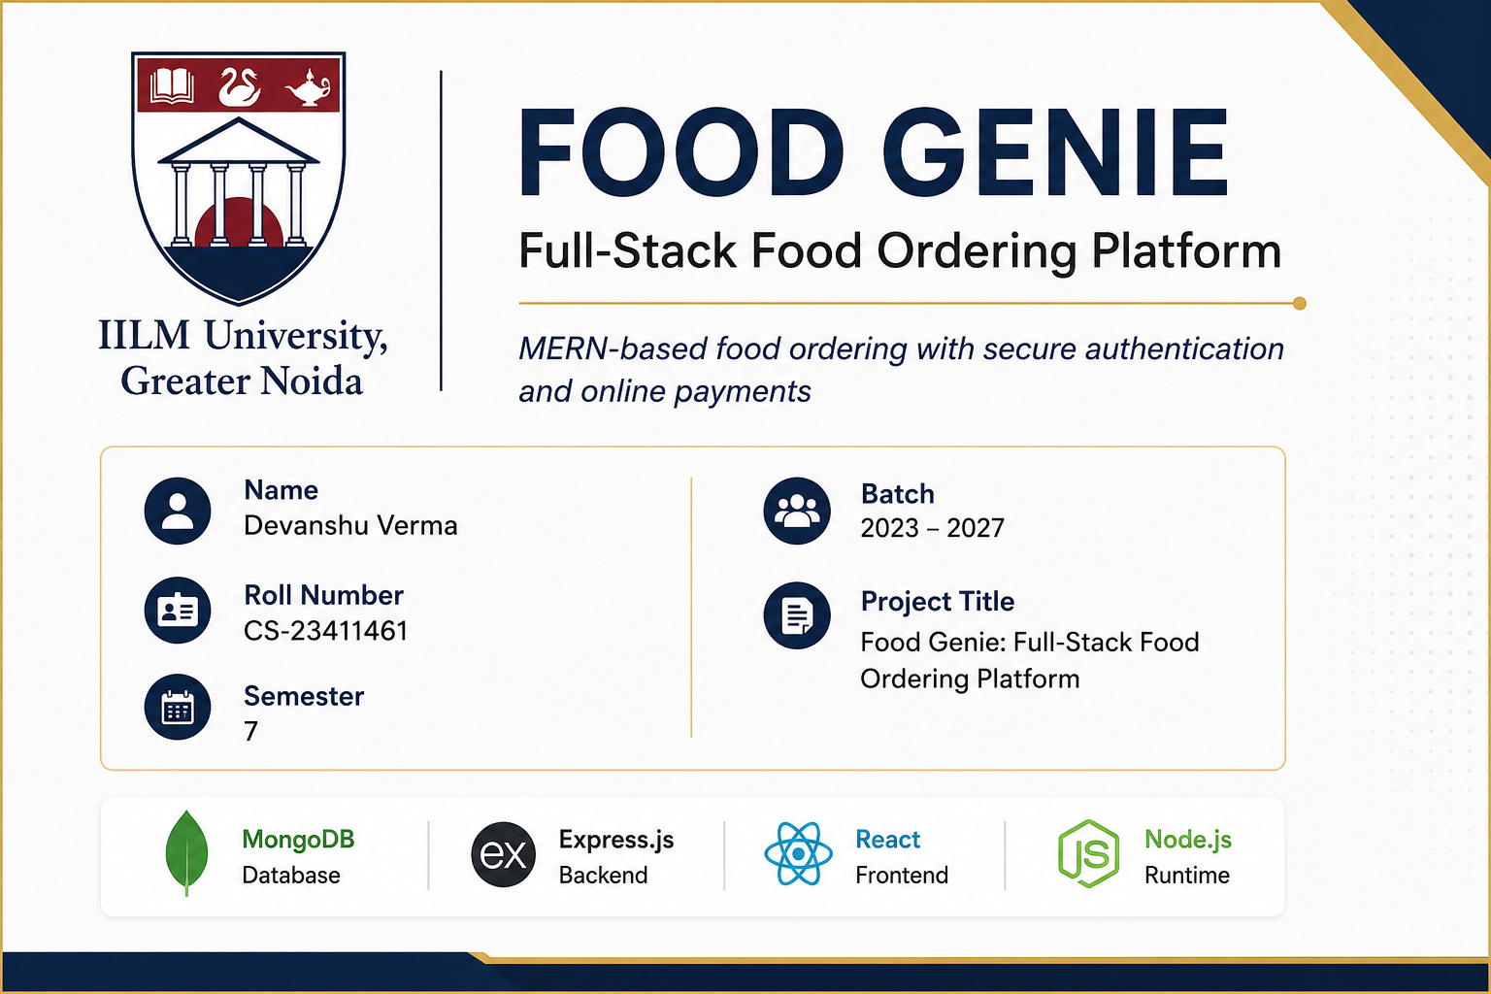

Slide 2
Problem Statement & Objectives
Why Food Genie was built
Problem
Objectives
Traditional food-ordering project implementations often separate browsing, cart, authentication and payment into disconnected modules. A complete application needs a consistent data flow, secure APIs and reliable third-party integrations.
• Build a complete MERN-based ordering workflow • Provide secure user authentication and protected APIs • Manage restaurants, menus, food items, carts and orders • Integrate online payment through Stripe • Support cloud image storage and transactional email • Keep the backend modular for future recommendation/AI extensions
02

Slide 3
System Architecture
Client → API → business logic → database, with external service integrations
React UI
Express.js
Components + React Router
Routes + middleware
Axios / REST API
MongoDB
HTTP + credentials
Mongoose models
Redux Toolkit
Controllers
Application state
Business logic
External Services
Stripe • Cloudinary • Nodemailer
03

Slide 4
Technology Stack
Technologies visible in the project repository
Frontend
Backend
Database
React 18 • Vite React Router • Redux Toolkit Axios • Bootstrap / styled-components
Node.js • Express REST APIs • Middleware Mongoose • Error handling
MongoDB Mongoose schemas/models Users • Restaurants • Menus • Carts • Orders
Integrations
Security
Stripe payments Cloudinary media storage Nodemailer email
JWT authentication bcrypt password hashing Protected routes Environment-based secrets
04

Slide 5
Frontend Architecture
Component-driven UI with centralized application state
Pages / Components
React Router
Redux Toolkit
Axios
Home • Restaurant • Menu Food Item • Cart • Auth
Client-side navigation
State + async actions
API communication
User-facing capabilities
REST API
Restaurant discovery • Menu browsing • Cart management • Authentication • Order placement • Order history • Checkout
Backend
05

Slide 6
Backend Architecture
Modular Express backend organized around routes, controllers, models and middleware
Routes
Controllers
Middleware
Map HTTP endpoints to controllers
Authentication, restaurants, menus, food items, cart, orders and payments
Authentication, authorization and centralized error handling
Models
Utils / Config
Mongoose schemas for core application entities
Database connection, email and cloud-service helpers
Design pattern: HTTP request → route → middleware → controller → model/service → response
06

Slide 7
Database Design
MongoDB collections modeled with Mongoose
User
Restaurant
Menu
FoodItem
Profile + credentials
Restaurant information
Restaurant menu
Item details + price
Key benefit Flexible document model with Mongoose validation and population for related data.
Cart
Order
User's selected items
Checkout + order data
07

Slide 8
Authentication & Application Security
Implemented security mechanisms — without overstating compliance
Register / Login
bcrypt
JWT
Protected API
User credentials
Password hashing
Token generation
Middleware verification
Additional controls
User Context
Payment boundary
Environment variables for secrets • CORS configuration • Centralized error handling
req.user
Stripe handles payment collection; the application receives the resulting payment/session information.
08

Slide 9
Core Ordering Workflow
End-to-end user journey implemented by the application
1. Browse
2. Select
3. Cart
4. Checkout
5. Pay
6. Order
Restaurants & menus
Food items
Review quantity & total
Create Stripe session
Stripe-hosted payment
Persist order + clear cart
This flow connects React state, REST APIs, MongoDB persistence and Stripe checkout into one transaction-oriented user experience.
09

Slide 10
Stripe Payment Integration
Real payment workflow rather than a simulated checkout
Cart
Backend
Stripe
Success / Cancel
Items + totals
Create checkout session
Hosted payment
Redirect result
Order Controller
MongoDB
Validate session + create order
Persist order
Implementation focus: server-side payment session creation and order persistence after successful checkout.
10

Slide 11
External Service Integrations
Third-party services used to extend the MERN application
Stripe
Cloudinary
Nodemailer
• Checkout session creation • Payment flow • Payment/session information used by order processing
• User/avatar image uploads • Stores media outside the application server • Returns hosted image information
• Email utility • Password-reset communication • Transactional messaging capability
Integration pattern: application backend acts as the controlled boundary between the frontend and external services.
11

Slide 12
Engineering Quality & Current Limitations
A realistic 4th-year project assessment
Implemented engineering practices
Before production deployment
✓ Modular backend structure ✓ Protected API routes ✓ JWT authentication ✓ Password hashing ✓ Centralized error handling ✓ Environment-based configuration ✓ External payment/cloud integrations ✓ Separate frontend and backend
• Add automated unit/integration tests • Add API monitoring and structured logging • Add rate limiting and stronger validation • Configure production CORS and deployment secrets • Benchmark API response times before publishing metrics • Add CI/CD and deployment health checks
12

Slide 13
AI / ML Extension — Future Scope
AI claims are intentionally separated from the current implemented MERN core
Order History
Feature Engineering
Recommendation Model
Personalized Menu
User-item interactions
Cuisine, frequency, price, recency
Content / collaborative filtering
Ranked suggestions
Next AI feature
Analytics
Conversational UX
Personalized food recommendations
Demand forecasting and restaurant insights
AI assistant for menu discovery and ordering
This slide is future scope unless the corresponding model/API is implemented in the codebase.
13

Slide 14
Conclusion
What Food Genie demonstrates
Full-Stack Development
Real-World Integrations
Extensible Foundation
A complete React + Node/Express + MongoDB application with modular architecture and state management.
JWT authentication, Stripe checkout, Cloudinary media handling and email functionality.
The current architecture can be extended with testing, deployment automation, analytics and AI-based recommendations.
Food Genie — a practical MERN application built around a complete ordering workflow.
14

Slide 15
THANK YOU
Questions & Discussion
Food Genie • MERN Full-Stack Food Ordering Platform
Devanshu Verma | CS-23411461

