Slide 1

IILM University, Greater Noida
Name- Devanshu Verma
Roll Number- CS-23411461
Sem- 7
Batch- 2023-2027
Title- Food Genie: AI-Powered Food Ordering Platform
Built for scale. Powered by intelligence. Delivered by MERN.

Slide 2

Built on MERN Stack
MongoDB
Flexible NoSQL data layer
Express.js
Lightweight backend routing
React
Dynamic UI components
Node.js
High-performance runtime

Slide 3
Intelligent Order Processing
1
Learns user preferences
2
Predicts next orders
3
Optimizes delivery routes in real-time

Slide 4
Seamless User Experience
Intuitive Navigation
Frictionless flows from browse to checkout
Live Order Tracking
Real-time delivery status with live map updates
Responsive UI
React-driven components that adapt to any device

Slide 5

Scalable Backend Infrastructure
Incoming Requests
Non-blocking I/O
Node.js handles thousands of concurrent connections
Client traffic and API calls
Three-layer Backend Architecture
Load Balancing
Traffic distributed across multiple server instances
Horizontal Scaling Nodes
Node.js + Express Load Balancer
Horizontal Scaling
Multiple server instances
Non-blocking routing and distribution
Add capacity on demand without downtime

Slide 6
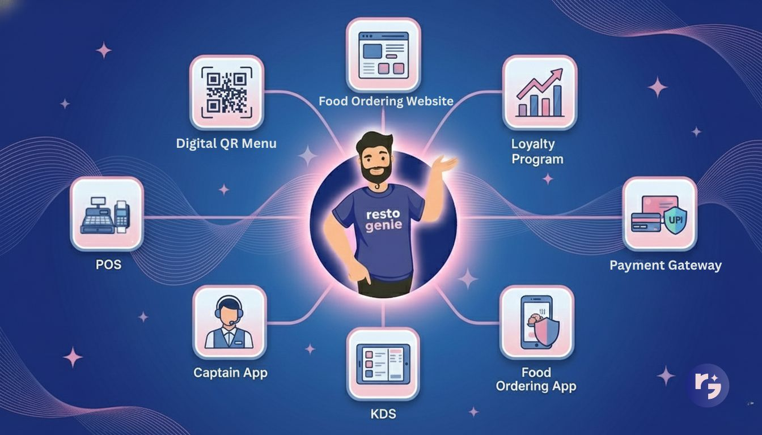
MongoDB: Flexible Data Layer
User Profiles
Restaurant Data
Order Records
AI Training Sets

Slide 7
Real-Time Performance
<1s
Redis
100%
Response Time
Caching Layer
Indexed Queries
Even at peak load
Hot data served instantly
Optimized MongoDB patterns

Slide 8
Enterprise-Grade Security
End-to-End Encryption
All data in transit and at rest
JWT Authentication
Stateless, secure session management
RBAC
Granular role-based access control
PCI-DSS Compliant
Certified payment data handling

Slide 9




AI-Driven Personalization
Analyze Patterns
ML models study ordering behavior
Recommend Dishes
Hyper-relevant suggestions per user
Predict Demand
Optimize inventory and prep times
Retain Customers
Personalization that builds loyalty

Slide 10


Reliability & Uptime
99.9%
100%
Availability
Automated Monitoring
Database replication + failover
Real-time error detection
Automated Monitoring
Database Replication
Failover Mechanisms
Proactive alerts before failures occur
Multi-node replica sets in MongoDB
Automatic recovery with zero manual intervention

Slide 11
Business Impact
⬇ Operational Costs
⬆ Customer LTV
Automation reduces manual overhead across fulfillment
Personalization drives repeat orders and retention
🏆 Competitive Edge
AI innovation sets Food Genie apart in the market

