Slide 1



SMART INDIA HACKATHON 2026
VISHWAS
Forecast Confidence Intelligence — knowing when not to trust the forecast
Problem Statement ID – SIH26079
Problem Statement Title – [ paste exact title from SIH portal ]
Theme – Disaster Management
PS Category – Software
Team ID – [ paste Team ID from SIH portal ]
Team Name – Hellfire Labs
Team Hellfire Labs · Ministry of Earth Sciences · SIH 2026
Notes:
VISHWAS = "confidence" in Hindi. One line: every forecast India issues arrives with no honesty label. We predict when the forecast will be wrong. Confirm PS title and Team ID against the SIH portal before submitting.

Slide 2
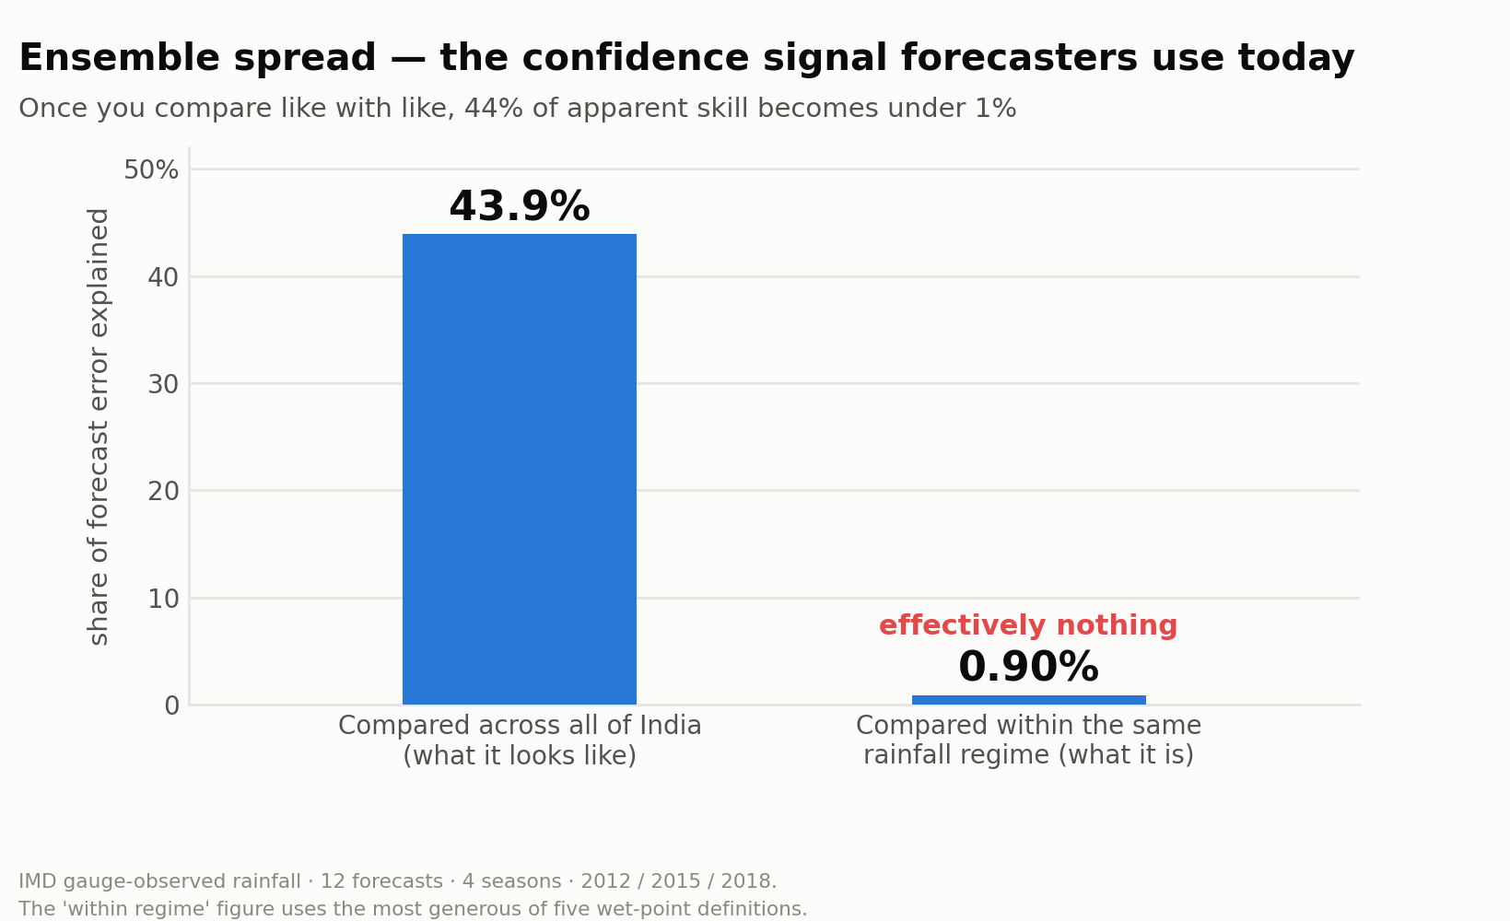
VISHWAS · FORECAST FAILURE DETECTION
PROPOSED SOLUTION
A reliability layer on top of the forecast — not another forecast. VISHWAS scores each operational rainfall forecast, by location and lead time from Day 1 to Day 10, as RELIABLE, UNCERTAIN or HIGH-RISK.
HOW IT ADDRESSES THE PROBLEM
A forecast tells a District Collector what may happen. It never says how much to trust it. VISHWAS supplies that missing layer, so the decision-maker can verify, adapt and act instead of guessing.
INNOVATION AND UNIQUENESS
Forecasters judge confidence today using ensemble spread. We measured it against IMD’s own gauge observations across four seasons and three years: spread appears to explain 43.9% of forecast error across India — but under 1% once you compare forecasts in the same rainfall regime.
Most teams pitch a hypothesis. We pitch a measurement.
The gap between those two bars is the opening VISHWAS exists to fill: the confidence signal forecasters rely on today is mostly a wet/dry map of India, not a statement about this forecast.
Notes:
Quote the variance framing (43.9% vs under 1%), never the bare correlation. The under-1% range is 0.17-0.90% across five definitions of a wet gridpoint, so it does not rest on one arbitrary cut.

Slide 3
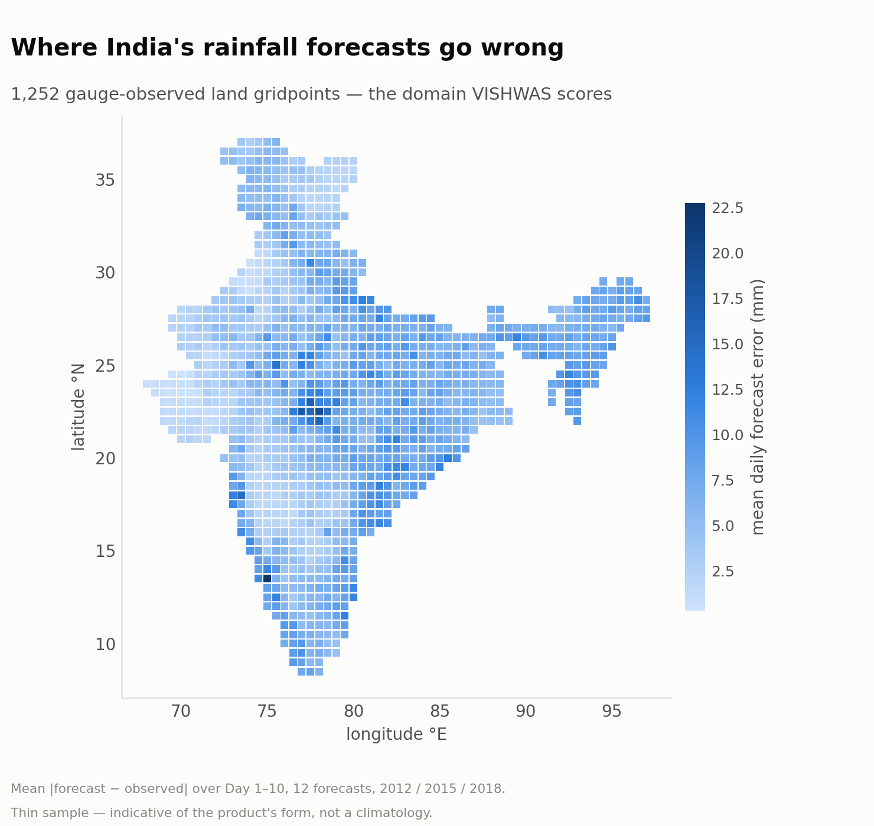
TECHNICAL APPROACH
DATA — ALL PUBLIC, NO CREDENTIALS, NO COST
GEFSv12 reforecast ensemble (NOAA, 2000–2019) supplies every predictor. IMD 0.25° gauge-gridded daily rainfall (1901–2024) is the truth — MoES’s own product, a gauge observation rather than a reanalysis, so no model physics is shared with the forecast we are judging.
FEATURES AND MODEL
Ensemble spread, lead time, season, region, 500 hPa geopotential gradient, true 500–850 hPa wind shear, 500 hPa flow deformation, precipitable-water anomaly and CAPE feed a HistGradientBoostingClassifier.
A bust is |forecast − observed| above the 95th percentile, computed per region and per lead time, so a Day 10 error is never compared with a Day 1 error.
EXPLAINABLE BY DESIGN
SHAP attributions say why a forecast was flagged. Probabilities are calibrated and checked on a reliability diagram and Brier decomposition — a confidence number nobody can trust is worse than none.
HOW WE SCORE IT
ROC-AUC, PR-AUC and precision within the top-10% flagged, against ensemble spread on identical truth. Train and test split by time, never randomly — weather is autocorrelated.
The deliverable takes this shape: a confidence value on every gauge-observed gridpoint, for each lead time.
Notes:
The pipeline streams each forecast date and discards the raw GRIB, so peak disk stays near 310 MB. Never call the 500 hPa deformation feature "wind shear" - shear_500_850 is the column that means shear.

Slide 4
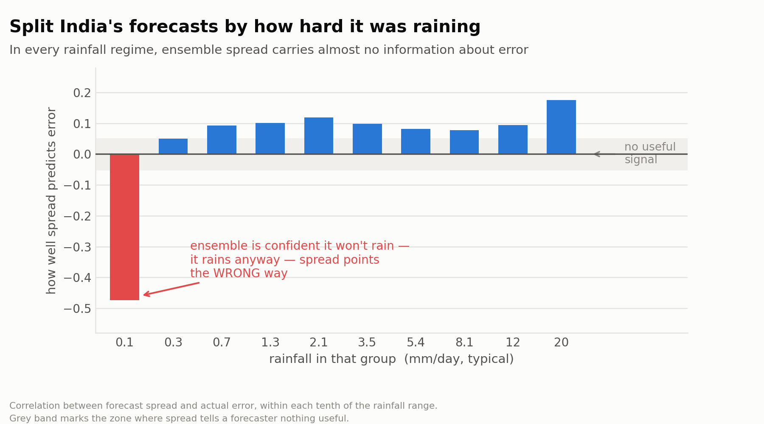
FEASIBILITY AND VIABILITY
The forecast already exists. The data already exists. The gap is turning it into a reliability signal.
THE DATA AND THE FORECAST ALREADY EXIST
GEFS reforecasts and IMD gridded rainfall are public and free. We are not building a weather network — we are building intelligence on top of one. Training runs on CPU; the pipeline streams each date and discards raw files, so no large archive is ever held.
ALREADY BUILT AND VERIFIED
The truth source passes all four verification checks, the feature pipeline runs end to end, and the baseline is measured across four seasons and three years. Nothing in this deck depends on work still to come.
A second finding, not a wart: when the ensemble is confidently dry and it rains anyway, spread points the wrong way — a specific, operationally usable failure mode.
LAND-ONLY DOMAIN
The IMD gauge grid covers 1,252 of 5,041 gridpoints (24.8%). That is the gauge domain — and we state it ourselves rather than let a judge find it.
A 5-MEMBER SPREAD IS NOISY
Measured, not assumed: moving from 5 to 11 members shifts the baseline by +0.001. It does not threaten the conclusion.
BUSTS ARE RARE (~5% BASE RATE)
We report PR-AUC and never plain accuracy. If our model cannot beat ensemble spread, we will say so.
Notes:
Risks are stated up front on purpose. The land-only 24.8% figure is the one a meteorologist judge would otherwise find - saying it first is worth more than hiding it.

Slide 5
IMPACT AND BENEFITS
When a forecast drives a decision, reliability has real-world value.
PRIMARY — DISTRICT COLLECTOR / DDMA
Decides evacuation, shelter preparation, rescue-team deployment, road restrictions and public warnings. VISHWAS answers the question the forecast leaves open: how much should I trust this one?
STATE AUTHORITIES AND FARMERS
SDMAs prioritise limited emergency resources. Farmers decide whether to harvest, spray or protect a crop — the same forecast, a different cost of being wrong.
IMD ITSELF
An added uncertainty layer over an existing forecast, flagging the locations and conditions where it is most likely to fail. It complements the forecast; it does not replace it.
₹6,972 cr
average annual flood damage
CWC, 1953–2021
1,666
lives lost to floods each year
CWC, 1953–2021
4.1 M ha
cropped area affected each year
CWC, 1953–2021
0.34–0.37
IMD false-alarm ratio, heavy rainfall
IMD Monsoon Report 2024 · Day 1–5
WHAT CHANGES
Today a decision-maker sees a forecast and must judge its reliability with almost nothing to go on. With VISHWAS they see the forecast and an estimate of how likely it is to be badly wrong — before committing people, money and public credibility.
“Don’t just know the forecast.
Know whether to trust it.”
Notes:
Every figure here is traceable to CWC or the IMD Monsoon Report 2024. Do NOT describe these as losses caused by forecast failure - they establish the scale of the decision, not an attributable cost.

Slide 6
RESEARCH AND REFERENCES
OUR OWN MEASUREMENT
12 GEFSv12 reforecasts spanning four seasons and three years (2012 / 2015 / 2018), scored against IMD gauge-gridded rainfall over 1,252 land gridpoints.
Ensemble spread appears to explain 43.9% of the variance in forecast error. Controlling for rainfall magnitude it explains 0.17–0.90% — the range spans five different definitions of a “wet” gridpoint, so the finding does not rest on one arbitrary cut.
95% interval from a cluster bootstrap over forecast dates, because the independent unit is the forecast, not the gridpoint.
GOVERNMENT SOURCES
Central Water Commission. Flood Management in India: A Statistical Report, 2023. — cwc.gov.in
India Meteorological Department. Monsoon Report 2024 — heavy-rainfall verification, False Alarm Ratio, POD and Threat Score. — mausam.imd.gov.in
India Meteorological Department. Annual Report 2024 — district-level forecast coverage. — metnet.imd.gov.in
Ministry of Earth Sciences. Assessment of the economic benefits of weather and climate services. — moes.gov.in
Ministry of Home Affairs / PIB. 2024 flood-response funding released to 14 states. — pib.gov.in
Ministry of Agriculture & Farmers Welfare / PIB. Cropped area affected by hydro-meteorological disasters, 2024–25. — pib.gov.in
Government of Maharashtra. Statistical press note, June–September 2024 heavy-rainfall and flood compensation. — des2.mahaonline.gov.in
DATA SOURCES
NOAA GEFSv12 Reforecast — s3://noaa-gefs-retrospective/
IMD 0.25° Gridded Daily Rainfall, 1901–2024 — imdpune.gov.in/cmpg/Griddata/Rainfall_25_Bin.html
Hamill et al., The GEFS version 12 reforecast dataset, Bull. Amer. Meteor. Soc. — ensemble spread–skill relationships.
Notes:
Research compiled by Dhruv. Every government figure retains its source, period and exact definition. Disaster-loss figures are never relabelled as forecast-failure losses.

