Slide 1



SMART INDIA HACKATHON 2026
VISHWAS
Forecast Confidence Intelligence — knowing when not to trust the forecast
Problem Statement ID – SIH26079
Problem Statement Title – AI-Based Forecast Bust Detection for Medium-Range Weather Forecasts
Theme – Smart Automation
PS Category – Software
Team ID – [ paste Team ID from SIH portal ]
Team Name – Hellfire Labs
Team Hellfire Labs · Ministry of Earth Sciences / NCMRWF · SIH 2026
Notes:
Theme is SMART AUTOMATION - SIH re-listed SIH26079 from Disaster Management. PS title from README.md. Team ID still to be pasted from the portal.

Slide 2
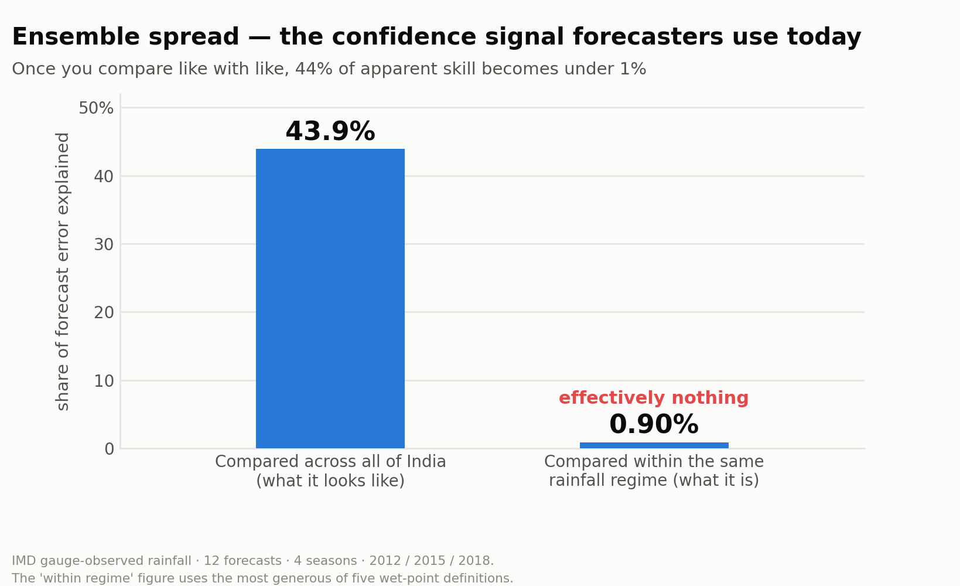
VISHWAS · FORECAST BUST DETECTION
PROPOSED SOLUTION
A reliability layer on top of the forecast — not another forecast. VISHWAS scores each operational rainfall forecast, by location and lead time from Day 1 to Day 10, as RELIABLE, UNCERTAIN or HIGH-RISK. It flags busts; it does not adjust the forecast.
HOW IT ADDRESSES THE PROBLEM
A duty forecaster assesses confidence today by eyeballing ensemble spread — a manual judgement, made under time pressure, on every forecast that goes out. And the forecast underneath decays fast: GEFS detects 23% of heavy-rain events at Day 1 and 0.2% by Day 10. VISHWAS automates the judgement and gives it an evidence base.
INNOVATION AND UNIQUENESS
We measured that manual method against India’s own gauge observations, across all four seasons and three years: spread appears to explain 43.9% of the variance in forecast error across India — but under 1% once you compare forecasts in the same rainfall regime.
We are not automating a task that already works. We are automating a judgement that currently has no evidence behind it.
AND WE BUILT THE REPLACEMENT
On that same fair comparison ensemble spread scores 0.565. VISHWAS scores 0.728 — a margin of +0.13 to +0.16, with a 95% interval entirely above zero, on a test year the model had never seen.
Notes:
Quote the variance framing (43.9% vs under 1%), never a bare correlation. Under-1% spans 0.17-0.90% across five wet-point definitions. Detection, NOT correction - never say "AI-adjusted forecast".

Slide 3
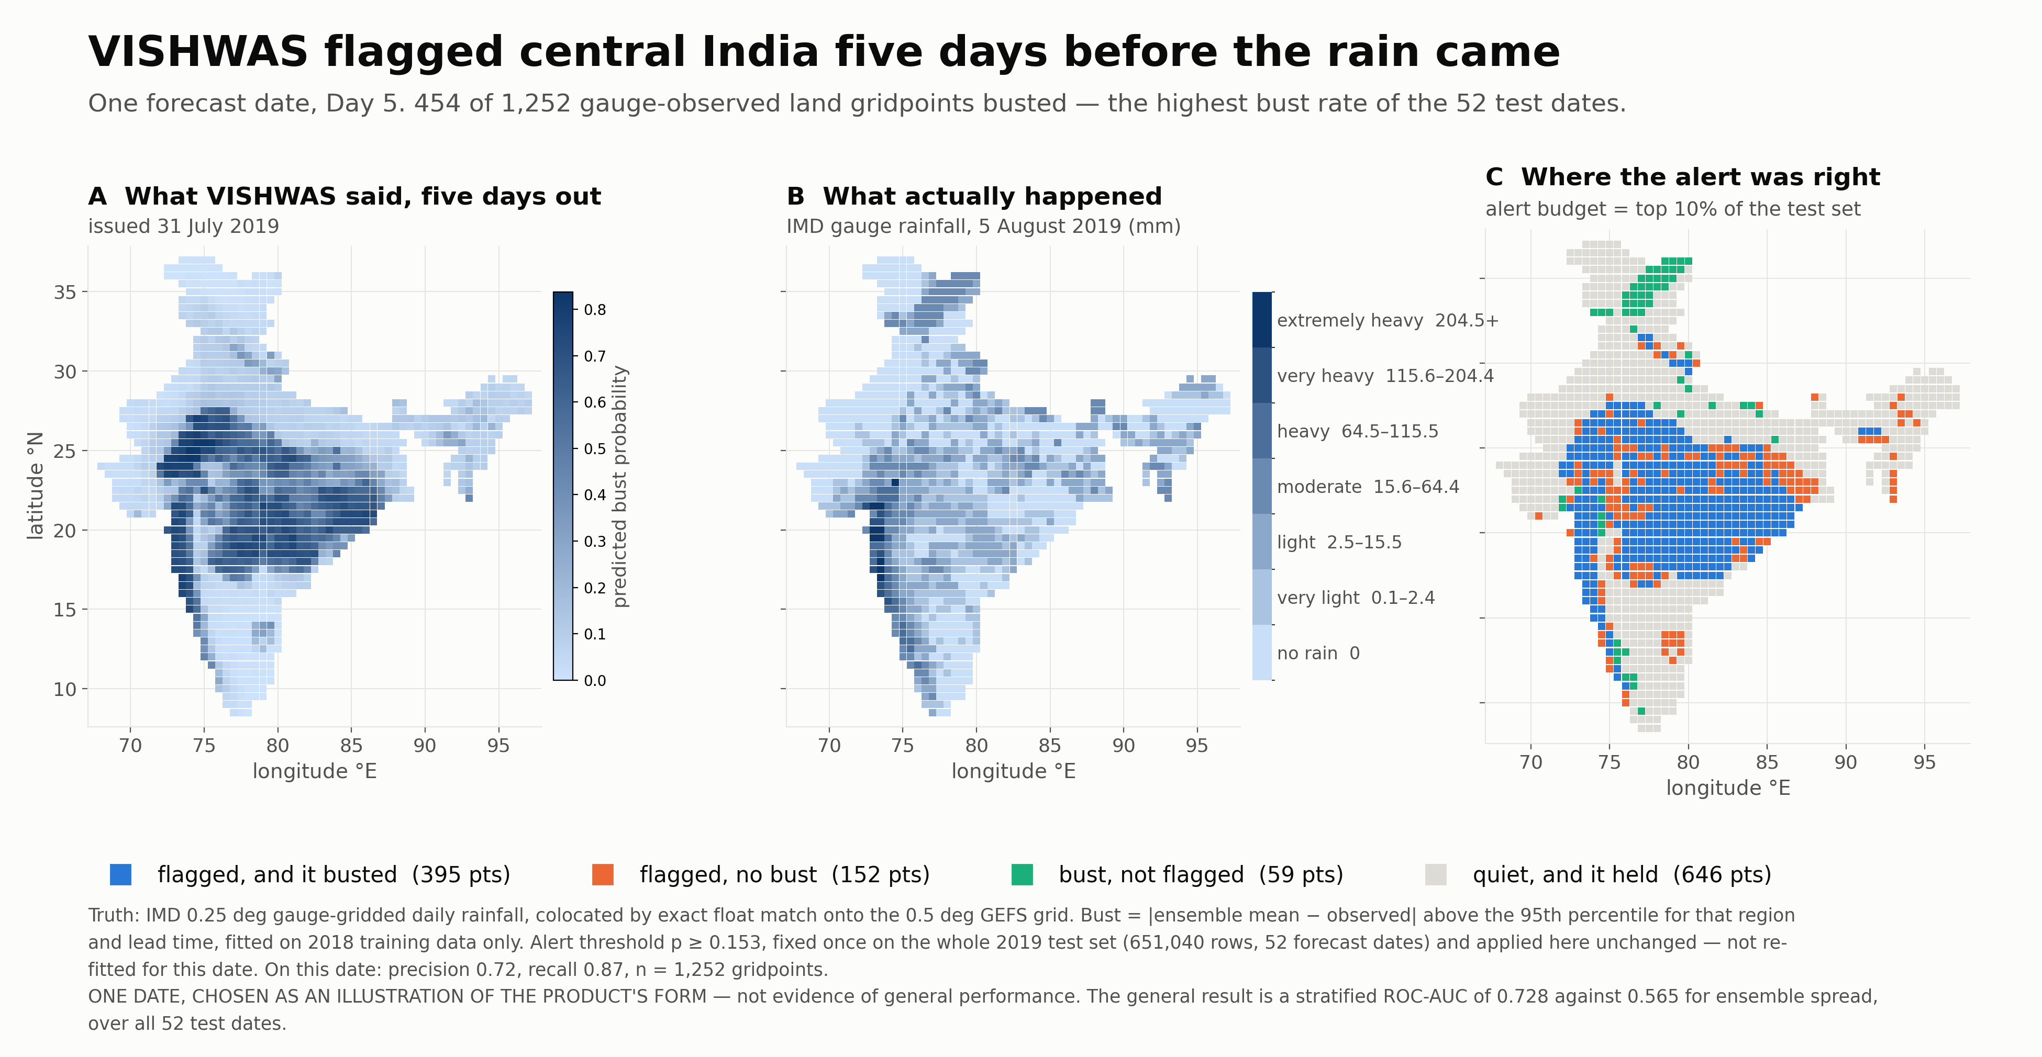
TECHNICAL APPROACH
1 FETCH
01_fetch.py
GEFS v12 reforecast, public S3
2 FEATURES
02_features.py
11 members → mean + spread
3 TRUTH
imd_truth.py
IMD gauge rainfall, exact colocation
4 LABEL
06_label.py
bust = error above 95th pct, train only
5 MODEL
07_model.py
HistGradientBoosting, then calibration
6 EVALUATE
08_met_metrics.py
vs spread, stratified, + SHAP
→
→
→
→
→
LANGUAGE & CORE
Python 3 · NumPy · pandas · Parquet
DATA ACCESS
NOAA public S3 · xarray + cfgrib · imdlib
MODEL
scikit-learn HistGradientBoosting
EXPLAIN & VERIFY
SHAP · permutation · cluster bootstrap
OUTPUT
matplotlib · confidence map per lead day
ALL OPEN SOURCE · NO GPU · NO PAID API · NO CREDENTIALS
DATA — ALL PUBLIC, NO COST
GEFSv12 reforecast ensemble supplies every predictor. IMD 0.25° gauge-gridded rainfall is the truth — the Ministry’s own product, a gauge observation rather than a reanalysis, so no model physics is shared with the forecast being judged.
FEATURES, LABEL AND MODEL
23 features, all from GEFS, none from the truth. A bust is |forecast − observed| above the 95th percentile, per region and per lead time.
Remove the rainfall forecast entirely and performance does not fall — it rises, 0.728 to 0.731. “You are just predicting heavy rain” is dead on evidence.
Notes:
Confidence map: issued 31 July 2019, Day 5, valid 5 August. ONE date, illustrating the product's form - NOT evidence of general performance. If a judge says 'your model just predicts where it rains': busts happen where it rains - a 41% bust rate in the wettest of the EIGHT rainfall bins against 0.15% in the driest bin (canonical, ablations/a_full.log; the evaluation stratifies into eight bins, NOT deciles - do not say tenth) - so the test is whether we beat 'it is raining' alone - within each rainfall band we score 0.728 against 0.565, and removing the rainfall forecast RAISED performance to 0.731. SHAP and permutation pick the same top three (precip spread, forecast rainfall, precipitable water) in different order. Probabilities are calibrated; resolution is 1.4x the incumbent's.

Slide 4
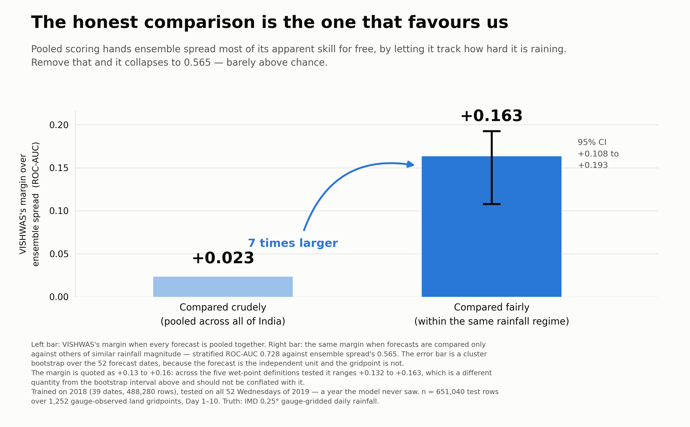
FEASIBILITY AND VIABILITY
The forecast already exists. The data already exists. We closed the gap — and measured it.
FEASIBILITY — THE REPLACEMENT WORKS
Trained on 2018 and tested on all 52 Wednesdays of 2019, a year the model never saw. On the fair, within-regime comparison ensemble spread scores 0.565 and VISHWAS scores 0.728 — a margin of +0.13 to +0.16, with a 95% interval entirely above zero, an edge in all eight rainfall bins, and ahead under every wet-point definition tested.
In operational terms: given the same number of alerts a forecaster would tolerate, VISHWAS catches 64% of busts against the current method’s 55%.
Three defects in our own work were found and fixed on the way here — two data leaks, and a tie in the baseline that had silently voided our first matched-budget comparison.
VIABILITY — COULD THIS RUN AT NCMRWF TOMORROW?
Features come from ensemble fields any operational centre already produces, and the model trains and runs on CPU with no GPU. 50.3 GB fetched and 1.3 million gridpoint-days labelled and modelled on a laptop. It is a layer over an existing run, not a new one.
On a third of the test set ensemble spread returns exactly 0.00 mm — 189,758 forecasts it cannot tell apart at all. VISHWAS ranks inside that tie.
POTENTIAL CHALLENGES AND RISKS — AND THE STRATEGY FOR EACH
WHY GEFS, NOT NEPS
NEPS reforecast archives are not public. GEFS is the only medium-range ensemble with a public ~20-year reforecast, which is what makes a four-season measurement possible. It is ensemble-agnostic and moves to NEPS the day access exists.
LAND-ONLY DOMAIN
The IMD gauge grid covers 1,252 of 5,041 gridpoints (24.8%). That is the gauge domain — and we state it ourselves rather than let a judge find it.
ONE TEST YEAR IS THIN
The interval resamples 52 dates inside a single year, so it is blind to year-to-year variation. Treat it as a floor, not a ceiling. Extending to five years needs no new code.
FALSE ALARMS COST MORE
Busts are ~6% of cases, so we report PR-AUC, never plain accuracy. The cry-wolf effect is documented (LeClerc & Joslyn, 2015) — and an NDRF constable told us he had mobilised for rain that never came. So we tune toward precision, not maximum detection.
Notes:
Ablations all passed: without month 0.722, without the rainfall forecast 0.731, spread-only 0.562. NEVER quote a margin range containing +0.035 - it came from a filter conditioning on the outcome; the range is +0.132 to +0.163. THE POOLED PAIR 0.909 vs 0.885 IS DELIBERATELY NOT IN THIS DECK - the regenerated fig4 removed it, and it appears nowhere on any slide. Hold it for Q&A only: if asked what it scores without the stratification, the answer is 0.909 against 0.885, and the point is that the gap is only +0.023 because pooling lets ensemble spread track rainfall magnitude for free. Never offer it unprompted, and never as a performance claim.

Slide 5
IMPACT AND BENEFITS
Automating a judgement that currently has no evidence behind it.
WHO THE SYSTEM SERVES
Primary — the duty forecaster at an operational centre such as NCMRWF or IMD, where confidence is assessed by hand on every cycle. Downstream — district authorities, agricultural advisories, power scheduling and aviation, all acting on the same forecast.
THE PROBLEM OWNER’S OWN NUMBERS
85% → 58% IMD’s own heavy-rainfall warning accuracy, Day 1 to Day 5 (MoES, Lok Sabha Q. 2953, 17 Dec 2025). Its verification also reports a substantial false-alarm rate at these lead times.
Skill falls with lead time — which is exactly the window VISHWAS scores.
PRIMARY FIELD RESEARCH — WE ASKED THREE PEOPLE WHO ACT ON THE FORECAST
FARMER — ASSAM
Shifted a sowing date for rain that did not arrive, losing seed, labour and time. Said he would act on a reliability signal once it had been validated.
KRISHI VIBHAG — UNNAO, UP
Routine planning leans on statistical norms. Called advance knowledge of forecast reliability “very, very beneficial” for making arrangements ahead of time.
NDRF CONSTABLE — GUWAHATI
Has mobilised for forecast heavy rain that never came. Agreed that detecting forecast failure earlier would improve preparedness and resource use.
BENEFITS OF THE SOLUTION
OPERATIONAL
Confidence stops being judged by eye. It becomes computed, consistent, reviewable — and measurable against observations.
ECONOMIC
Fewer people and vehicles committed to forecasts that were never reliable. Fewer mobilisations for rain that does not arrive.
SOCIAL
District authorities, farmers and rescue services act on the same forecast with an honest reliability label attached.
“Don’t just know the forecast.
Know whether to trust it.”
Notes:
Three exploratory qualitative conversations run by Mahika in Aug 2026 - never convert them to percentages. The 85-58% figures are MoES's own, from Lok Sabha Q.2953 of 17 Dec 2025: 85, 73, 67, 63, 58 percent for Day 1 to Day 5 - PDF at moes.gov.in/sites/default/files/2953English.pdf. The 0.34-0.37 false-alarm ratio was REMOVED on 30 Aug - it could not be traced to a table in the IMD Monsoon Report 2024, and every other figure on this deck is traced. The card now says only that IMD reports a substantial false-alarm rate, which the report does support. IF ASKED how substantial: we could not put our hands on the table, so we did not put a number on it. A team that removes an untraceable figure the day before presenting is a team whose other figures you believe.

Slide 6
RESEARCH AND REFERENCES
OUR OWN MEASUREMENT
12 GEFSv12 reforecasts spanning four seasons and three years (2012 / 2015 / 2018), 77,425 wet samples over 1,252 gauge-observed land gridpoints, Day 1–10, scored against IMD gauge-gridded rainfall.
Ensemble spread appears to explain 43.9% of the variance in forecast error. Controlling for rainfall magnitude it explains 0.17–0.90% — the range spans five different definitions of a “wet” gridpoint, so the finding does not rest on one arbitrary cut.
The learned layer, trained on 2018 and tested on 2019, scores 0.728 on that same fair comparison against ensemble spread’s 0.565, measured on the 651,040-row 2019 test set drawn from a 1,302,080-row labelled table.
Uncertainty is assessed with a cluster bootstrap over forecast dates, because the independent unit is the forecast, not the gridpoint. The range above spans analyst choices, not sampling error.
BACKGROUND AND VERIFICATION PRACTICE
India Meteorological Department. Monsoon Report 2024 — heavy-rainfall verification: false-alarm ratio, probability of detection and threat score. — mausam.imd.gov.in
India Meteorological Department. Annual Report 2024 — district-level forecast coverage. — metnet.imd.gov.in
Ministry of Earth Sciences. Assessment of the economic benefits of weather and climate services. — moes.gov.in
Central Water Commission. Flood Management in India: A Statistical Report, 2023 — background on the decisions that ride on a medium-range forecast. — cwc.gov.in
Ashrit et al. (2020), NCMRWF. Prediction of the August 2018 heavy rainfall events over Kerala with high-resolution NWP models. Meteorological Applications 27(2).
Kumar et al. (2008). Analysis of the 26 July 2005 heavy rain event over Mumbai. Q. J. R. Meteorol. Soc. 134 — source of the Santacruz / Colaba contrast.
Ministry of Earth Sciences. Lok Sabha Q. 2953, 17 Dec 2025 — heavy-rainfall warning accuracy of 85, 73, 67, 63 and 58% at Day 1–5, and ~40% improvement on 2014. — moes.gov.in
LeClerc & Joslyn (2015). The Cry Wolf Effect and Weather-Related Decision Making. Risk Analysis 35(3) — why an over-warning assistant loses its users.
Kusunose & Mahmood (2016). Imperfect forecasts and decision making in agriculture. Agricultural Systems 146.
WMO / Jolliffe & Stephenson, Forecast Verification — standard definitions for POD, FAR, CSI, ETS and FSS.
DATA SOURCES
NOAA GEFSv12 Reforecast — s3://noaa-gefs-retrospective/
IMD 0.25° Gridded Daily Rainfall, 1901–2024 — imdpune.gov.in/cmpg/Griddata/Rainfall_25_Bin.html
Guan et al. (2022). GEFSv12 reforecast dataset. Mon. Wea. Rev. 150(3), 647–665.
WHO DID THIS WORK — AN INTERDISCIPLINARY TEAM
B.Tech — Devansh (model and evaluation) · Ankit (data pipeline)
BCA — Arnav (forecast-failure case studies) · Paras (metrics and evaluation integrity)
BBA / BA — Mahika (stakeholder interviews and pitch) · Dhruv (users, impact and sourcing)
Notes:
Every figure on the deck traces to CLAUDE.md, README.md or a named government source. Metrics framing from Paras. Impact research from Dhruv.

