Slide 1

EXTERNAL Project PRESENTATION

Slide 2
Implementation of RCA in both Mentor Graphics and QCA & it’s comparative analysis
Presented By:
Devara Harsha (20P31A04J4)
Padarthi Harshitha (20P31A04J5)
Marisetti Sharan Teja (20P31A04L5)
Vasamsetti Dhanupya (20P31A04O1)
Under the Guidance of :
Mr. Anjaiah Talamala, M.Tech,(Ph.D)
Associate Professor
ECE Department

Slide 3

Aditya College of Engineering and Technology
ABSTRACT
QCA technology is a new platform, which is a transistor less and wire-less technology, hence it is one of the best alternatives to CMOS technology for developing low power and high- speed digital circuits at nano-scale level.
A proposed full adder is designed in QCA and with the help of 4 full adders a 4-Bit Ripple Carry Adder is designed in QCA and compared the results with the existing RCA in QCA.
Also, implemented the 4-Bit Ripple Carry Adder in Mentor Graphics and also done the comparison between the two designs.
IV ECE D, BATCH NO. 4

Slide 4
Aditya College of Engineering and Technology
CONTENTS
INTRODUCTION TO MENTOR GRAPHICS
IMPLEMENTATION OF FULL ADDER AND FOUR BIT RCA USING MENTOR GRAPHICS
SIMULATION RESULTS OF RCA
INTRODUCTION TO QCA
EXSITING MODEL OF FULL ADDER AND FOUR BIT RCA
PROPOSED MODEL OF FULL ADDER AND FOUR BIT RCA
SIMULATION RESULTS OF FOUR BIT RCA
COMPARISON BETWEEN EXISTING AND PROPOSED DESIGN OF 4-BIT RCA IN QCA
COMPARATIVE ANALYSIS
BAR GRAPHS OF PARAMETERS IN EXISTING AND PROPOSED DESIGN
ADVANTAGES
CONCLUSION
IV ECE D, BATCH NO. 4

Slide 5
Aditya College of Engineering and Technology
Introduction To Mentor Graphics
Mentor Graphics was an electronic design automation (EDA) which is used to design complex VLSI architectures
This includes schematic entry tools for traditional designs and HDL (Hardware Description Language) entry tools for digital designs using languages like Verilog, VHDL, and System Verilog.
IV ECE D, BATCH NO. 4

Slide 6
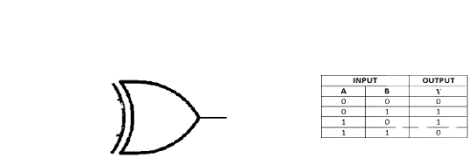
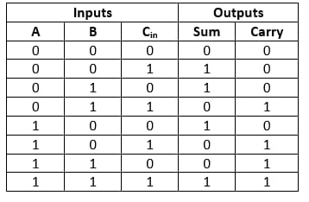
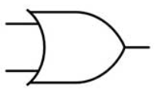
Aditya College of Engineering and Technology
Implementation of Full Adder Using Mentor Graphics
XOR 1
XOR 2
A
SUM
B
C
AND 2
OR 1
AND 1
CARRY
Fig: Full Adder Circuit
Fig: Truth Table of Full Adder
IV ECE D, BATCH NO. 4

Slide 7
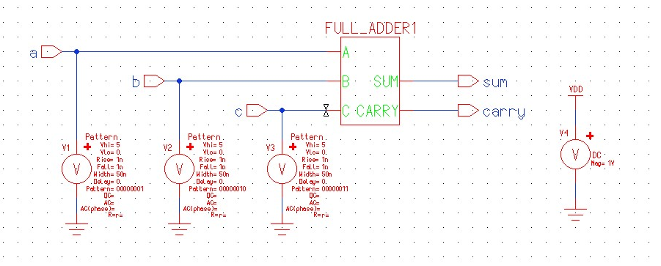
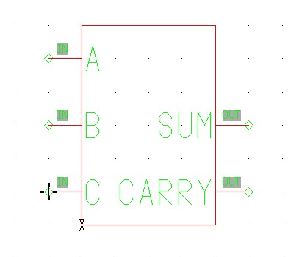
Aditya College of Engineering and Technology
Fig: Full Adder Symbol
Fig: Full Adder Test Bench
IV ECE D, BATCH NO. 4

Slide 8
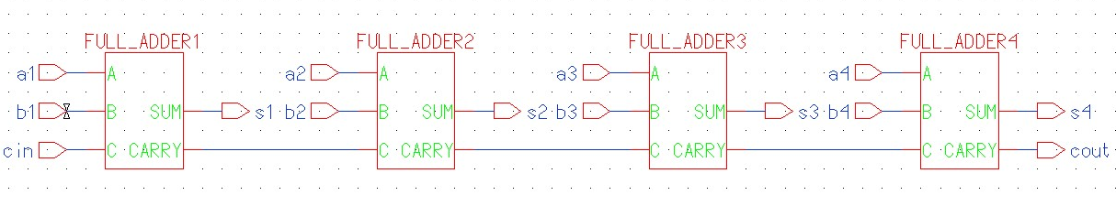
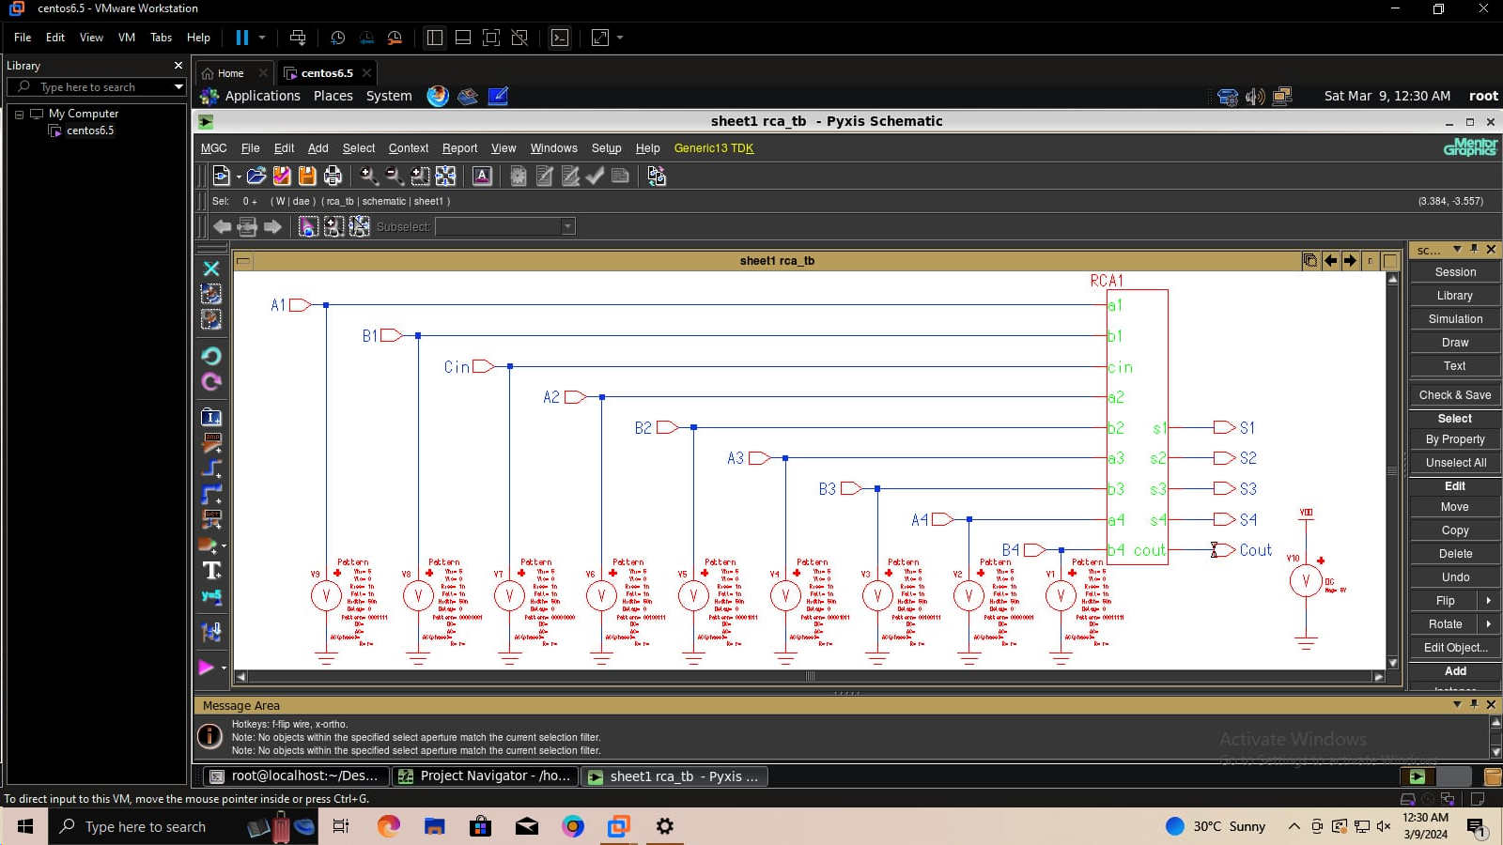
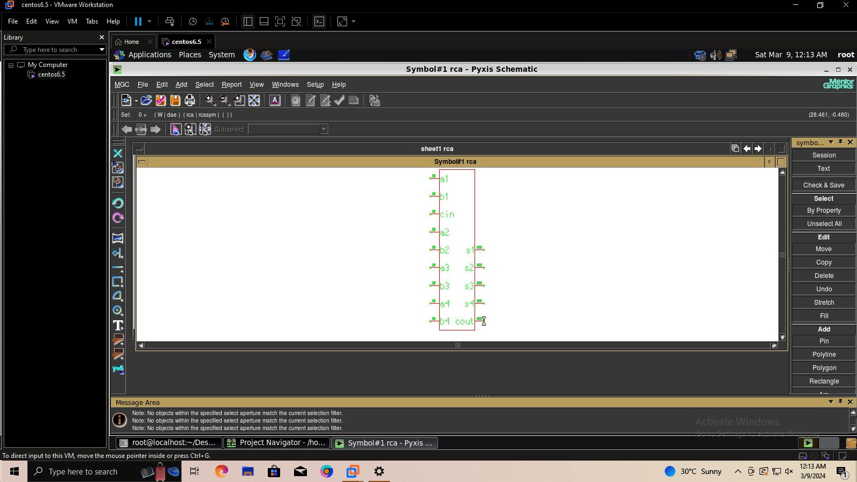
Aditya College of Engineering and Technology
Implementation of RCA Using Mentor Graphics
Fig: RCA Circuit
Fig: RCA Test Bench
Fig: RCA Symbol
IV ECE D, BATCH NO. 4

Slide 9
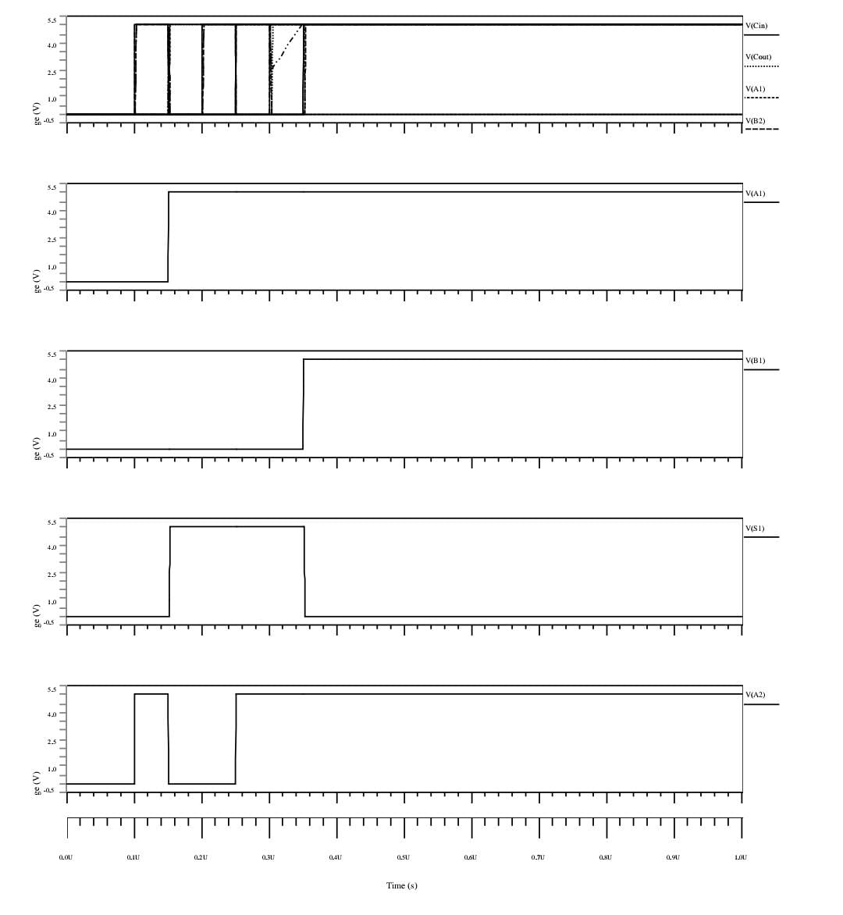
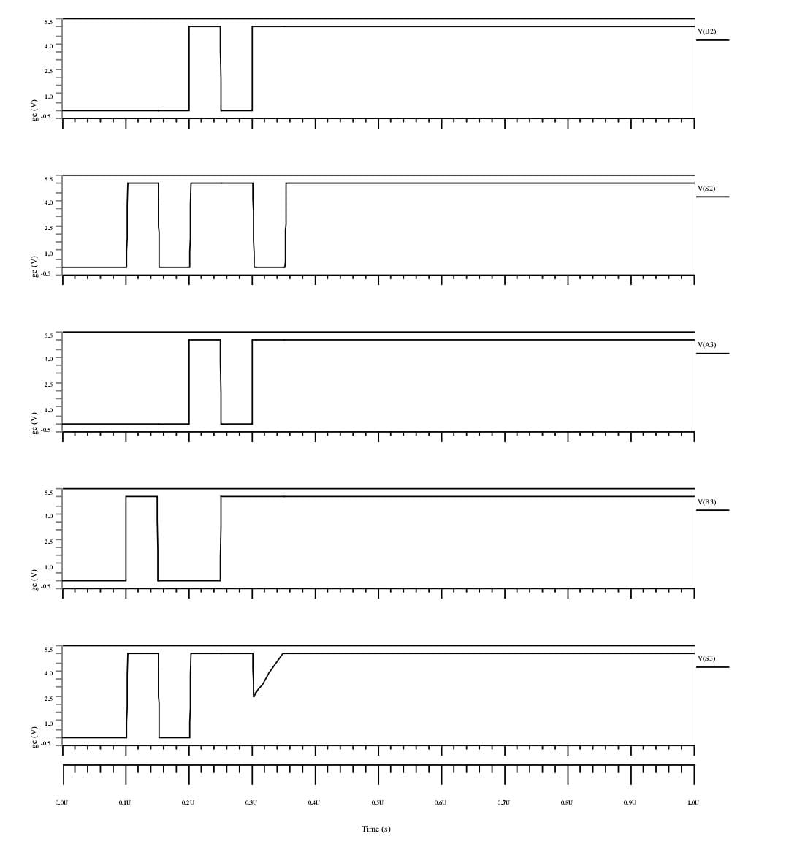
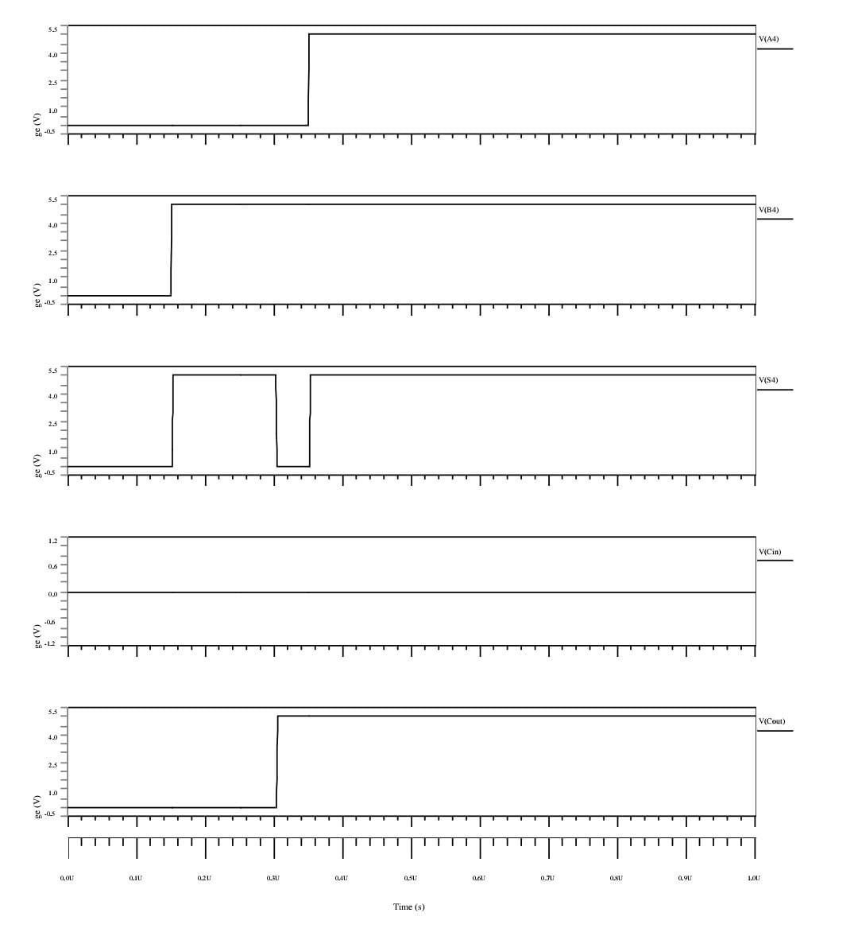
Aditya College of Engineering and Technology
SIMULATION RESULTS OF RCA
IV ECE D, BATCH NO. 4

Slide 10
Aditya College of Engineering and Technology
Introduction To QCA
QCA technology implements complex VLSI architectures with very less power consumption and achieves high speed at nano-scale level compared to CMOS technology.
QCA works mainly on majority gate
A majority gate consists of 5 cells
A cell consist of 4 Quantum dots
Quantum Dot
Electron
If electron is in Clock-wise then it is Logic 1
If electron is in Anti clock-wise then it is Logic 0
Tunnel Junction
Polarization = 1
(Binary 1)
Polarization = -1
(Binary 0)
Fig: Polarization in QCA
IV ECE D, BATCH NO. 4

Slide 11

Aditya College of Engineering and Technology
Majority Gate :-
A majority gate consists of 5 cells
Where Orange color represents Fixed polarization
Blue color represents Input
Yellow color represents Output
Electron
Input A
Output State Y
A
M
M(A,B,C)
B
C
Input B
Fig: Majority Voter Gate
IV ECE D, BATCH NO. 4

Slide 12
Aditya College of Engineering and Technology
EXISTING MODEL OF FULL ADDER
Cin
B
Sum
Fig: Truth Table of Full Adder
A
In existing model the Full Adder consists of 47 cell counts.
Cout
Fig: Circuit of Existing Full Adder
IV ECE D, BATCH NO. 4

Slide 13
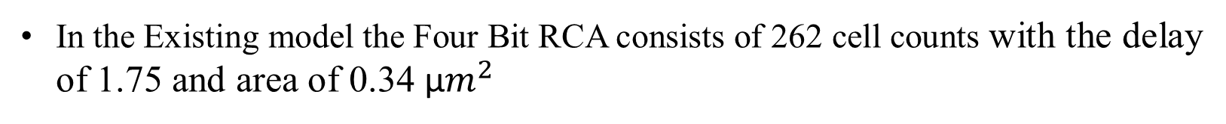
Aditya College of Engineering and Technology
EXISTING MODEL OF FOUR BIT RCA
Y3
X3
Y2
X2
Y1
X1
Y0
X0
Cin
Cout
S3
S2
S1
S0
Fig: Circuit of Existing 4-Bit Ripple Carry Adder
In the Existing model the Four Bit RCA consists of 262 cell counts with the delay of 1.75 and area of 0.34 µ$m^{2}$
IV ECE D, BATCH NO. 4

Slide 14
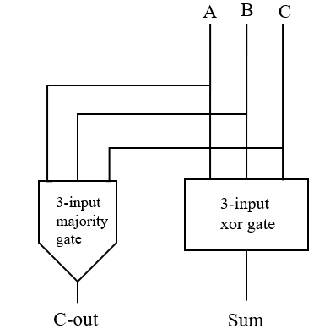
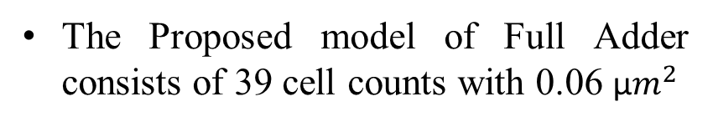
Aditya College of Engineering and Technology
PROPOSED MODEL OF FULL ADDER
A
B
Cout
C
Fig: Block diagram of Proposed Full Adder
Sum
The Proposed model of Full Adder consists of 39 cell counts with 0.06 µ$m^{2}$
Fig: Proposed Full Adder Circuit in QCA
IV ECE D, BATCH NO. 4

Slide 15
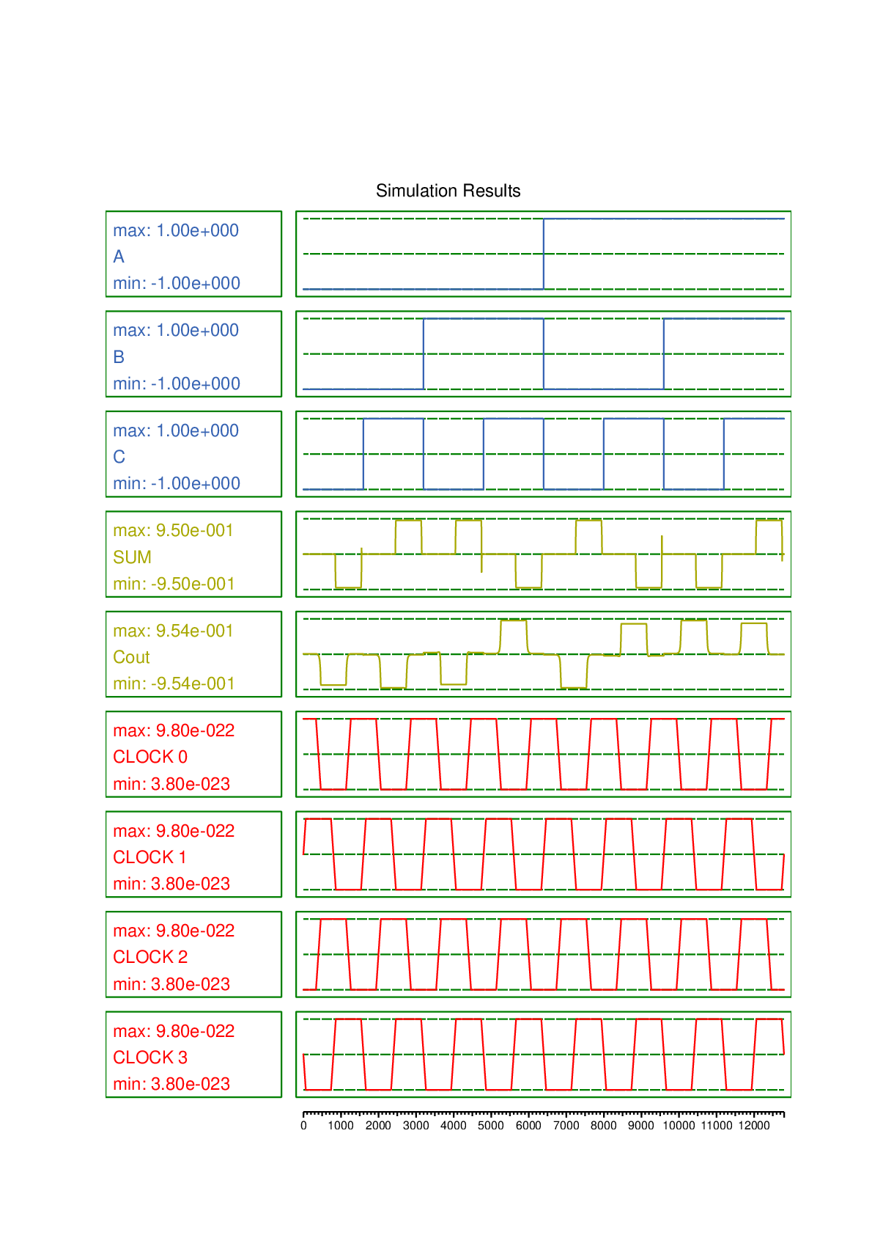
Aditya College of Engineering and Technology
SIMULATION RESULTS OF PROPOSED FULL ADDER
Fig: Full Adder Results
IV ECE D, BATCH NO. 4

Slide 16
Aditya College of Engineering and Technology
PROPOSED MODEL OF FOUR BIT RCA BLOCK DIAGRAM
A3
B3
A2
B2
A1
B1
A0
B0
Cin
3-input majority gate
3-input majority gate
3-input majority gate
3-input majority gate
COUT
3-input xor gate
3-input xor gate
3-input xor gate
3-input xor gate
S3
S2
S1
S0
Fig: Block Diagram of Proposed 4-Bit RCA in QCA
IV ECE D, BATCH NO. 4

Slide 17
Aditya College of Engineering and Technology
TRUTH TABLE FOR FOUR BIT RCA
 | A |  |  |  | B |  |  |  | Sum |  |  |  | Carry
Cin | A3 | A2 | A1 | A0 | B3 | B2 | B1 | B0 | S3 | S2 | S1 | S0 | Cout
0 | 0 | 0 | 0 | 0 | 0 | 0 | 0 | 0 | 0 | 0 | 0 | 0 | 0
0 | 0 | 0 | 0 | 1 | 0 | 0 | 0 | 1 | 0 | 0 | 1 | 0 | 0
0 | 0 | 0 | 1 | 0 | 0 | 0 | 1 | 0 | 0 | 1 | 0 | 0 | 0
0 | 0 | 0 | 1 | 1 | 0 | 0 | 1 | 1 | 0 | 1 | 1 | 0 | 0
0 | 0 | 1 | 0 | 0 | 0 | 1 | 0 | 0 | 1 | 0 | 0 | 0 | 0
0 | 0 | 1 | 0 | 1 | 0 | 1 | 0 | 1 | 1 | 0 | 1 | 0 | 0
0 | 0 | 1 | 1 | 0 | 0 | 1 | 1 | 0 | 1 | 1 | 0 | 0 | 0
0 | 0 | 1 | 1 | 1 | 0 | 1 | 1 | 1 | 1 | 1 | 1 | 0 | 0
0 | 1 | 0 | 0 | 0 | 1 | 0 | 0 | 0 | 0 | 0 | 0 | 0 | 1
0 | 1 | 0 | 0 | 1 | 1 | 0 | 0 | 1 | 0 | 0 | 1 | 0 | 1
0 | 1 | 0 | 1 | 0 | 1 | 0 | 1 | 0 | 0 | 1 | 0 | 0 | 1
0 | 1 | 0 | 1 | 1 | 1 | 0 | 1 | 1 | 0 | 1 | 1 | 0 | 1
0 | 1 | 1 | 0 | 0 | 1 | 1 | 0 | 0 | 1 | 0 | 0 | 0 | 1
0 | 1 | 1 | 0 | 1 | 1 | 1 | 0 | 1 | 1 | 0 | 1 | 0 | 1
0 | 1 | 1 | 1 | 0 | 1 | 1 | 1 | 0 | 1 | 1 | 0 | 0 | 1
0 | 1 | 1 | 1 | 1 | 1 | 1 | 1 | 1 | 1 | 1 | 1 | 0 | 1
1 | 1 | 1 | 1 | 1 | 1 | 1 | 1 | 1 | 1 | 1 | 1 | 1 | 1
Fig: Truth Table of 4-bit RCA
IV ECE D, BATCH NO. 4

Slide 18
Aditya College of Engineering and Technology
PROPOSED MODEL OF FOUR BIT RCA
A3
B3
A2
B2
A1
B1
A0
B0
Cout
Cin
S3
S2
S1
S0
Fig: Proposed 4-Bit RCA Circuit in QCA
The Proposed model of Four Bit RCA using Four Full Adders consists of 208 cell counts, 1.25 delay and 0.30 µ$m^{2}$
IV ECE D, BATCH NO. 4

Slide 19
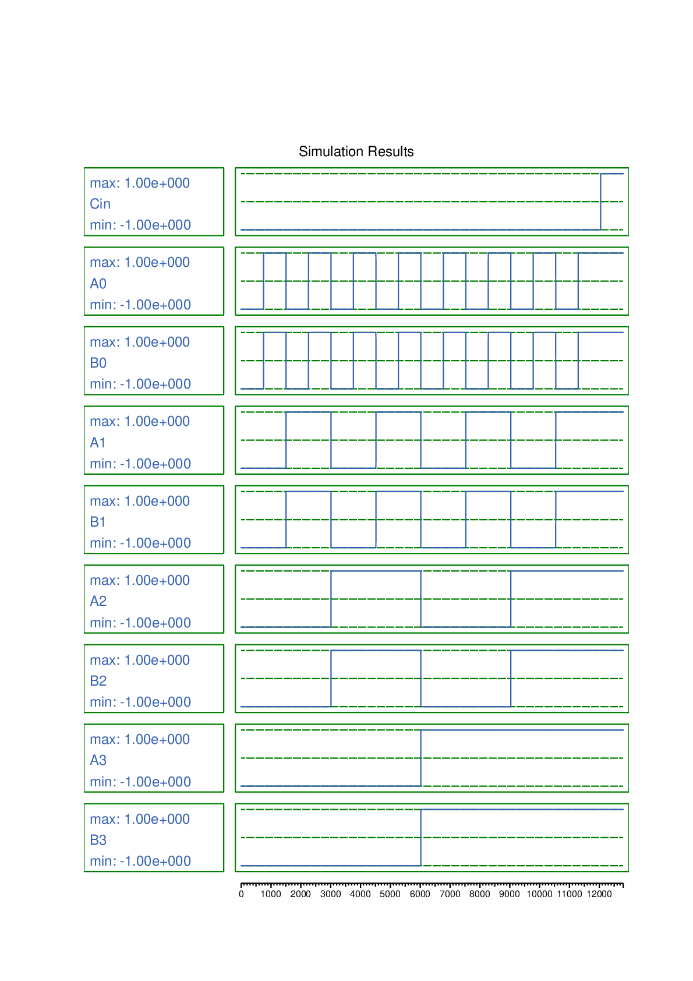
Aditya College of Engineering and Technology
SIMULATION RESULTS OF PROPOSED FOUR BIT RCA
Fig: Output Generation of 4-bit RCA in QCA
IV ECE D, BATCH NO. 4

Slide 20
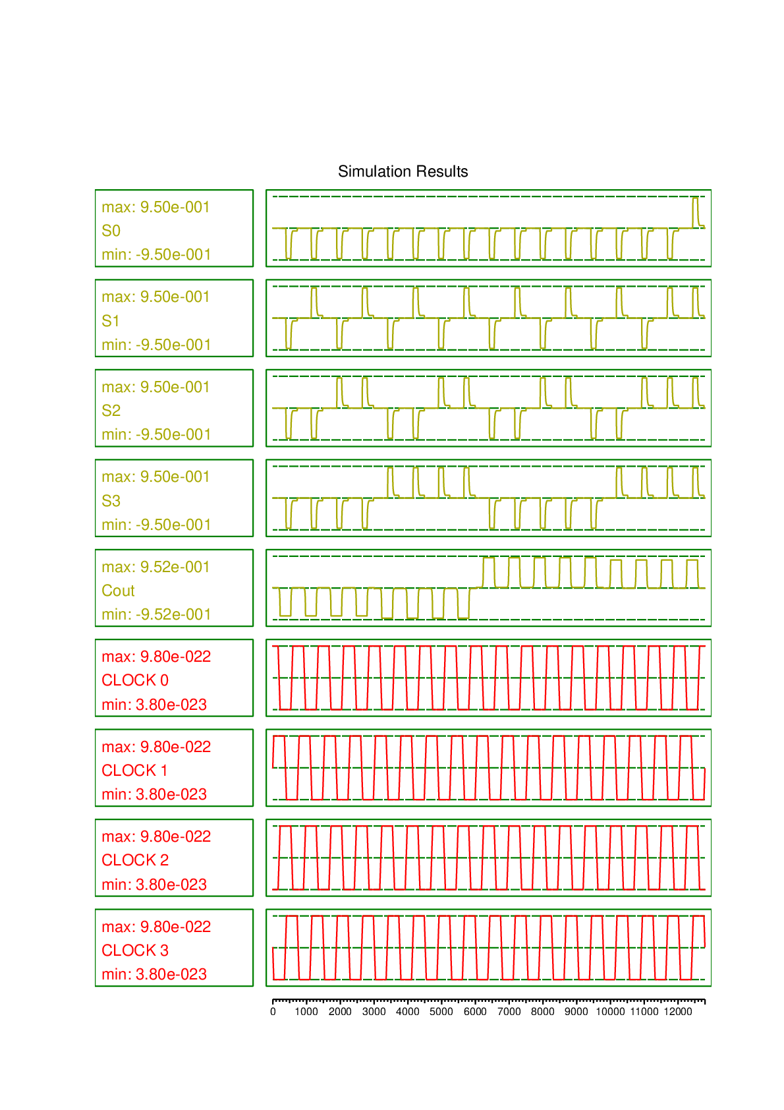
Aditya College of Engineering and Technology
Fig: Output Generation of 4-bit RCA in QCA
IV ECE D, BATCH NO. 4

Slide 21
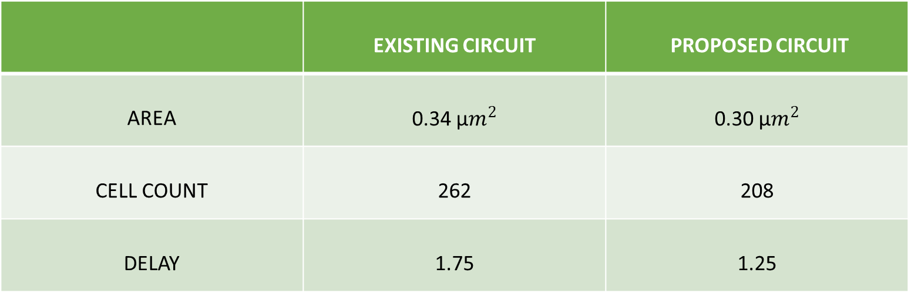
Aditya College of Engineering and Technology
COMPARISON BETWEEN EXISTING AND PROPOSED DESIGN OF 4-BIT RCA IN QCA
 | EXISTING CIRCUIT | PROPOSED CIRCUIT
AREA | 0.34 µ$m^{2}$ | 0.30 µ$m^{2}$
CELL COUNT | 262 | 208
DELAY | 1.75 | 1.25
IV ECE D, BATCH NO. 4

Slide 22
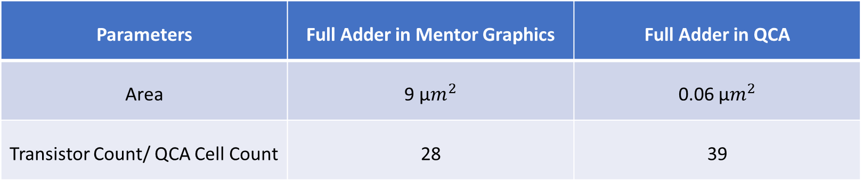
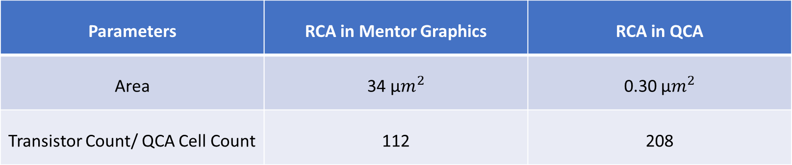
Aditya College of Engineering and Technology
COMPARATIVE ANALYSIS
Parameters | Full Adder in Mentor Graphics | Full Adder in QCA
Area | 9 µ$m^{2}$ | 0.06 µ$m^{2}$
Transistor Count/ QCA Cell Count | 28 | 39
Parameters | RCA in Mentor Graphics | RCA in QCA
Area | 34 µ$m^{2}$ | 0.30 µ$m^{2}$
Transistor Count/ QCA Cell Count | 112 | 208
IV ECE D, BATCH NO. 4

Slide 23
Aditya College of Engineering and Technology
BAR GRAPHS OF PARAMETERS IN EXISTING AND PROPOSED DESIGN
Fig : Cell count comparison between existing and proposed design
Fig : Area comparison between existing and proposed design
IV ECE D, BATCH NO. 4

Slide 24
Aditya College of Engineering and Technology
Fig: Delay comparison between existing and proposed methods
IV ECE D, BATCH NO. 4

Slide 25
Aditya College of Engineering and Technology
ADVANTAGES
Due to small size of quantum dots which are used in QCA, it has very compact arrangements which reduces the overall size and delay of the circuits.
Also QCA circuits have low power consumption with less delay due to having less cell count.
IV ECE D, BATCH NO. 4

Slide 26
Aditya College of Engineering and Technology
CONCLUSION
QCA full adder circuit is proposed which is designed with minimum number of QCA cells. The proposed full adder requires only 39 QCA cells, an area of 0.06 μm2 to implement its function.
The simulation results shows that the proposed 4-bit Ripple Carry Adder (RCA) requires only 208 QCA cells, an area of 0.3 μm2 and delay of about 1.25 clock cycles to implement its function with enhanced performance in terms of latency, area and QCA Cost.
IV ECE D, BATCH NO. 4

Slide 27
Aditya College of Engineering and Technology
FUTURE SCOPE
In future, high-speed adders which play an important role in multiplier designs could be designed and its computational performance could be improved further.
The 4-bit ripple carry adder using QCA are used in Arithmetic Logic Units (ALUs) in processors, Digital Signal Processing (DSP) like DFT and FFT.
IV ECE D, BATCH NO. 4

Slide 28
Aditya College of Engineering and Technology
REFERENCES
[1] Y. Adelnia., A. Rezai, A novel adder circuit design in quantum-dot cellular automata technology, Int. J. Theory Phys. (2018), doi: 10.1007/s10773- 018- 3922- 0 .
[2] H. Cho., E.E. Swartzlander, Adder designs and analyses for quantum-dot cellu- lar automata, IEEE Trans. Nanotechnol. 6 (3) (May 2007), doi: 10.1109/TNANO. 2007.894839 .
[3] T.N. Sasamal , A.K. Singh , U. Ghanekar , Efficient design of coplanar ripple carry adder in QCA, IET Circuits Devices Syst. 12 (5) (2018) 594–605 ©The Institution of Engineering and Technology 2018 .
[4] Y.Z. Barughi, S.R. Heikalabad, A three-layer full adder/subtractor structure in quantum-dot cellular automata, Int. J. Theory Phys. (2017), doi: 10.1007/ s10773- 017- 3453- 0 .
IV ECE D, BATCH NO. 4

Slide 29


