Slide 1

EXTERNAL Project PRESENTATION

Slide 2
Implementation of 4-Bit RCA in both Mentor Graphics and QCA & it’s comparative analysis
Presented By:
Devara Harsha (20P31A04J4)
Padarthi Harshitha (20P31A04J5)
Marisetti Sharan Teja (20P31A04L5)
Vasamsetti Dhanupya (20P31A04O1)
Under the Guidance of :
Mr. Anjaiah Talamala, M.Tech,(Ph.D)
Associate Professor
ECE Department

Slide 3

Aditya College of Engineering and Technology
ABSTRACT
First, a full adder is designed in both QCA as well as Mentor Graphics which has improved performance in propagation delay and cell count.
Then with the help of 4 full adders a 4-Bit Ripple Carry Adder is designed in QCA and compared the results with the existing RCA in QCA.
From the comparison, it is found that the proposed ripple carry adder has better performance than the existing ripple carry adder.
Also, implemented the 4-Bit Ripple Carry Adder in Mentor Graphics and did the comparison between the two tools to prove that QCA is the best tool/platform to design complex VLSI architectures.
IV ECE D, BATCH NO. 4

Slide 4
Aditya College of Engineering and Technology
CONTENTS
INTRODUCTION TO MENTOR GRAPHICS
IMPLEMENTATION OF FULL ADDER USING MENTOR GRAPHICS
IMPLEMENTATION OF RCA USING MENTOR GRAPHICS
RCA RESULTS
INTRODUCTION TO QCA
EXSITING MODEL
PROPOSED MODEL
COMPARISON BETWEEN EXISTING AND PROPOSED DESIGN OF 4-BIT RCA IN QCA
COMPARATIVE ANALYSIS
ADVANTAGES
CONCLUSION
IV ECE D, BATCH NO. 4

Slide 5
Aditya College of Engineering and Technology
Introduction To Mentor Graphics
Mentor Graphics was a US-based electronic design automation (EDA) which is used to design complex VLSI architectures
This includes schematic entry tools for traditional designs and HDL (Hardware Description Language) entry tools for digital designs using languages like Verilog, VHDL, and System Verilog.
Mentor Graphics offers synthesis tools that convert RTL (Register Transfer Level) descriptions of digital circuits into gate-level representations. This step optimizes the design for area, power, and timing constraints while preserving its functionality.
IV ECE D, BATCH NO. 4

Slide 6
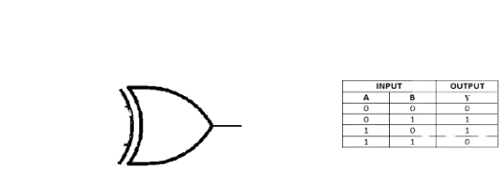
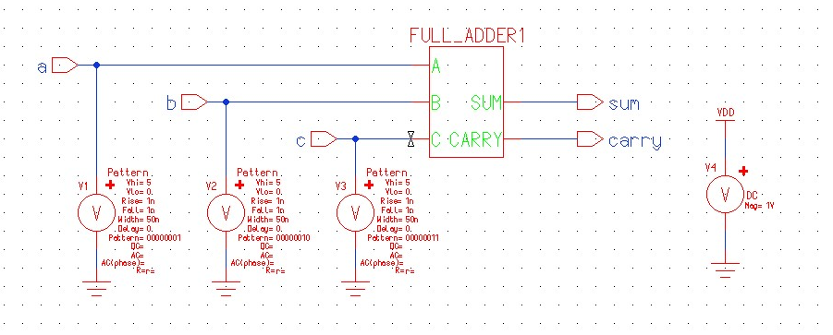
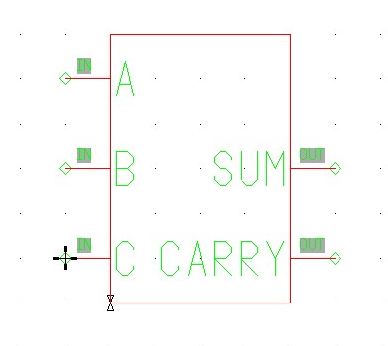
Aditya College of Engineering and Technology
Implementation of Full Adder Using Mentor Graphics
XOR 1
XOR 2
A
B
SUM
C
AND 2
OR 1
AND 1
CARRY
Fig: Full Adder Circuit
Fig: Full Adder Symbol
Fig: Full Adder Test Bench
IV ECE D, BATCH NO. 4

Slide 7
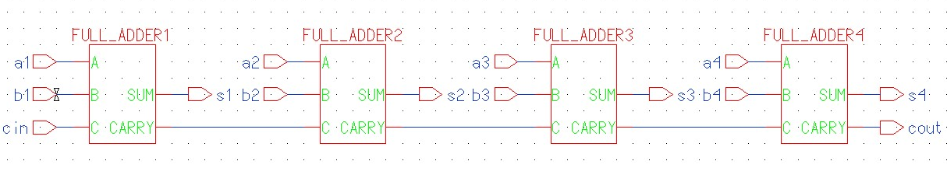
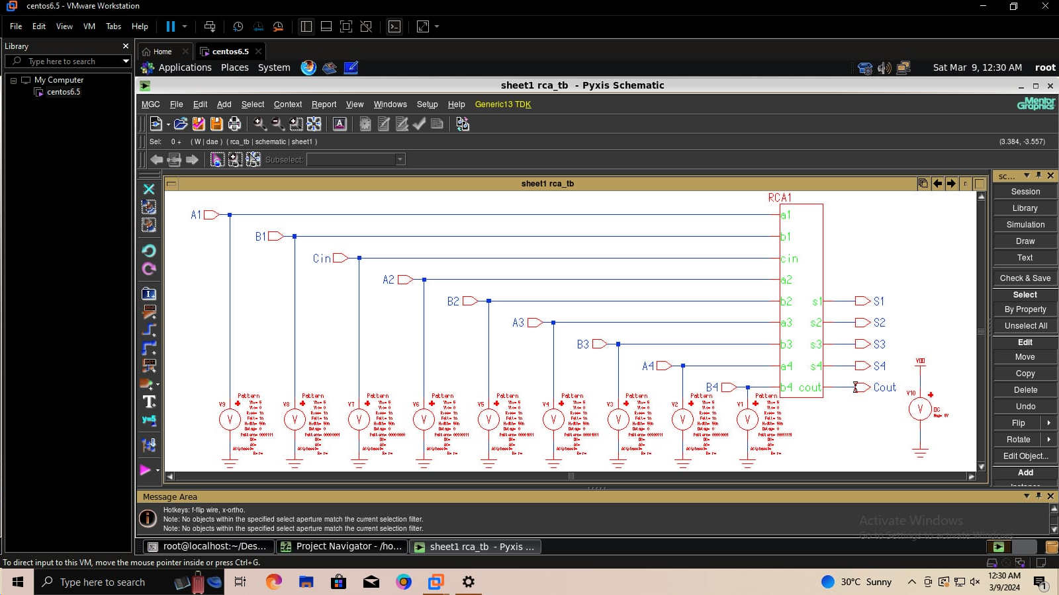
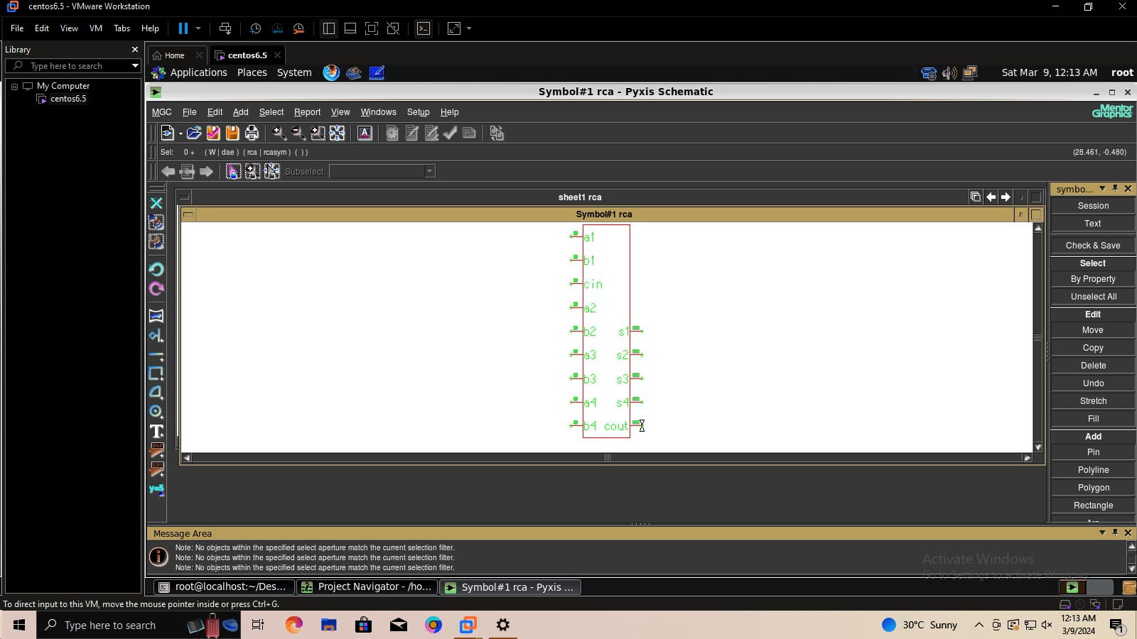
Aditya College of Engineering and Technology
Implementation of RCA Using Mentor Graphics
Fig: RCA Symbol
Fig: RCA Test Bench
Fig: RCA Circuit
IV ECE D, BATCH NO. 4

Slide 8
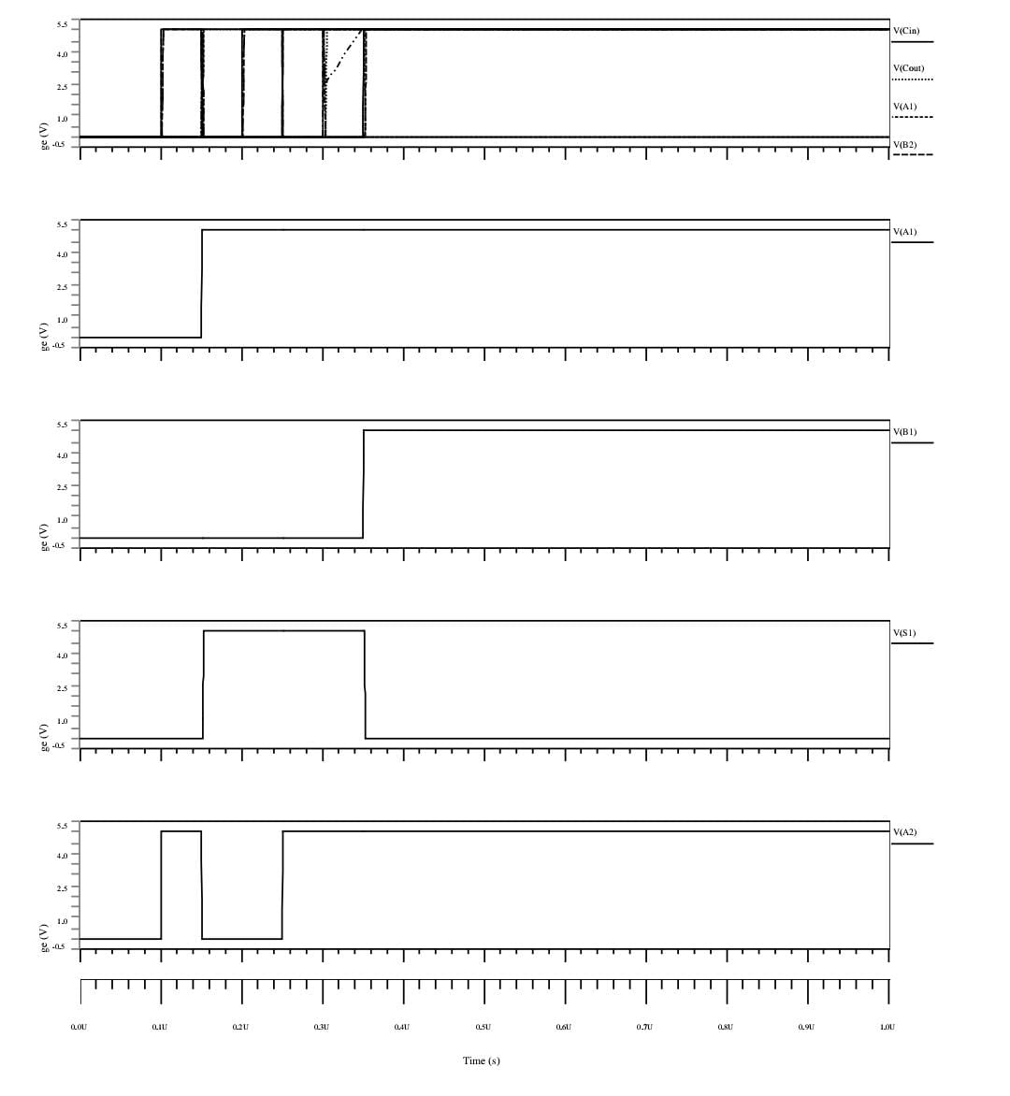
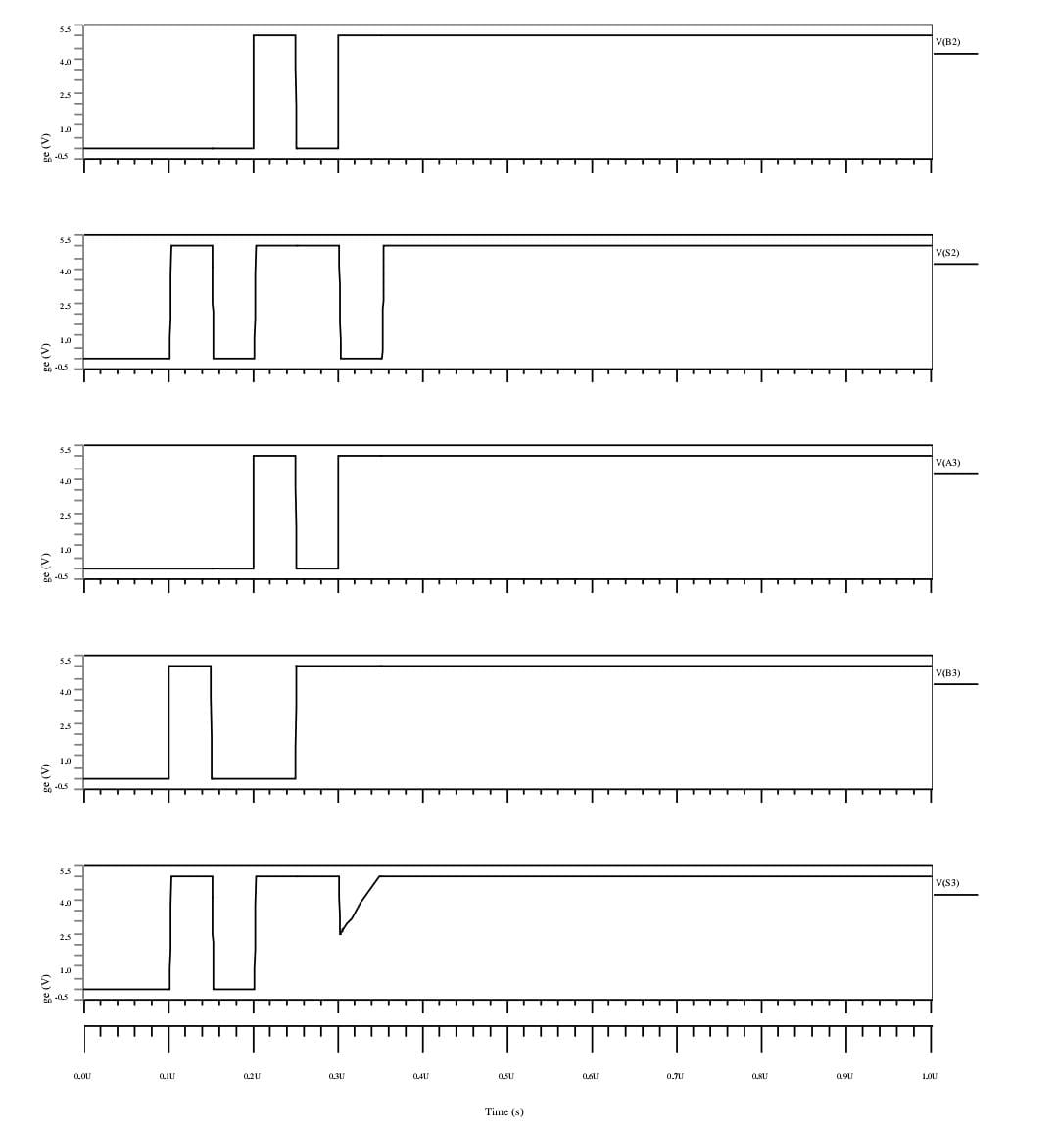
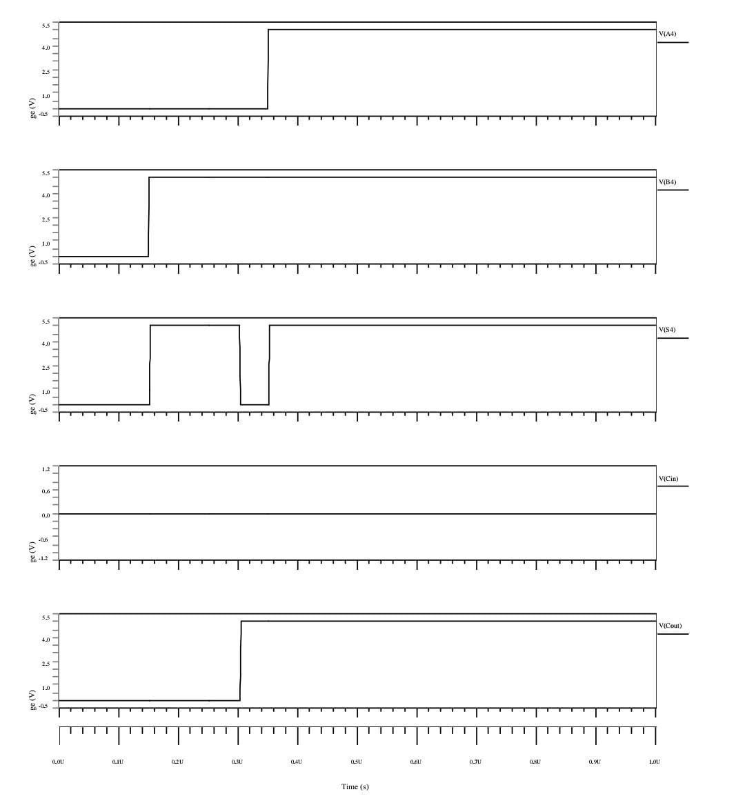
Aditya College of Engineering and Technology
RCA RESULTS
IV ECE D, BATCH NO. 4

Slide 9
Aditya College of Engineering and Technology
Introduction To QCA
QCA technology is a new platform which implements complex VLSI architectures with very less power consumption and achieves high speed at nano-scale level compared to CMOS technology. Also, in CMOS technology, the voltage and current represents the binary values and the circuit switching frequency couldn't be increased beyond certain values.
QCA works mainly on majority gate
A majority gate consists of 5 cells
A cell consist of 4 Quantum dots
Quantum Dot
Electron
If electron is in Clock-wise then it is Logic 1
If electron is in Anti clock-wise then it is Logic 0
Tunnel Junction
Polarization = 1
(Binary 1)
Polarization = -1
(Binary 0)
IV ECE D, BATCH NO. 4

Slide 10

Aditya College of Engineering and Technology
Majority Gate :-
A majority gate consists of 5 cells
Where Orange color represents Fixed polarization
Blue color represents Input
Yellow color represents Output
Electron
A
M
M(A,B,C)
B
Input A
Output State Y
C
Input B
IV ECE D, BATCH NO. 4

Slide 11
Aditya College of Engineering and Technology
EXISTING MODEL
Cin
A
B
C
B
Maj 3
Cout
Maj 5
Sum
Sum
A
Fig: Block diagram of Existing Full Adder
Cout
Fig: Circuit of Existing Full Adder
IV ECE D, BATCH NO. 4

Slide 12
Aditya College of Engineering and Technology
Y3
X3
Y2
X2
Y1
X1
Y0
X0
Cin
Cout
S3
S2
S1
S0
Fig: Circuit of Existing 4-Bit Ripple Carry Adder
IV ECE D, BATCH NO. 4

Slide 13
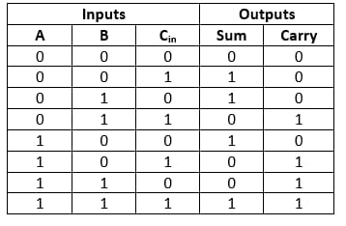
Aditya College of Engineering and Technology
PROPOSED MODEL
A
B
C
A
B
3-input majority gate
3-input xor gate
Cout
C
C-out
Sum
Fig: Block diagram of Proposed Full Adder
SUM
Fig: Truth Table of Full Adder
Fig: Proposed Full Adder Circuit in QCA
IV ECE D, BATCH NO. 4

Slide 14
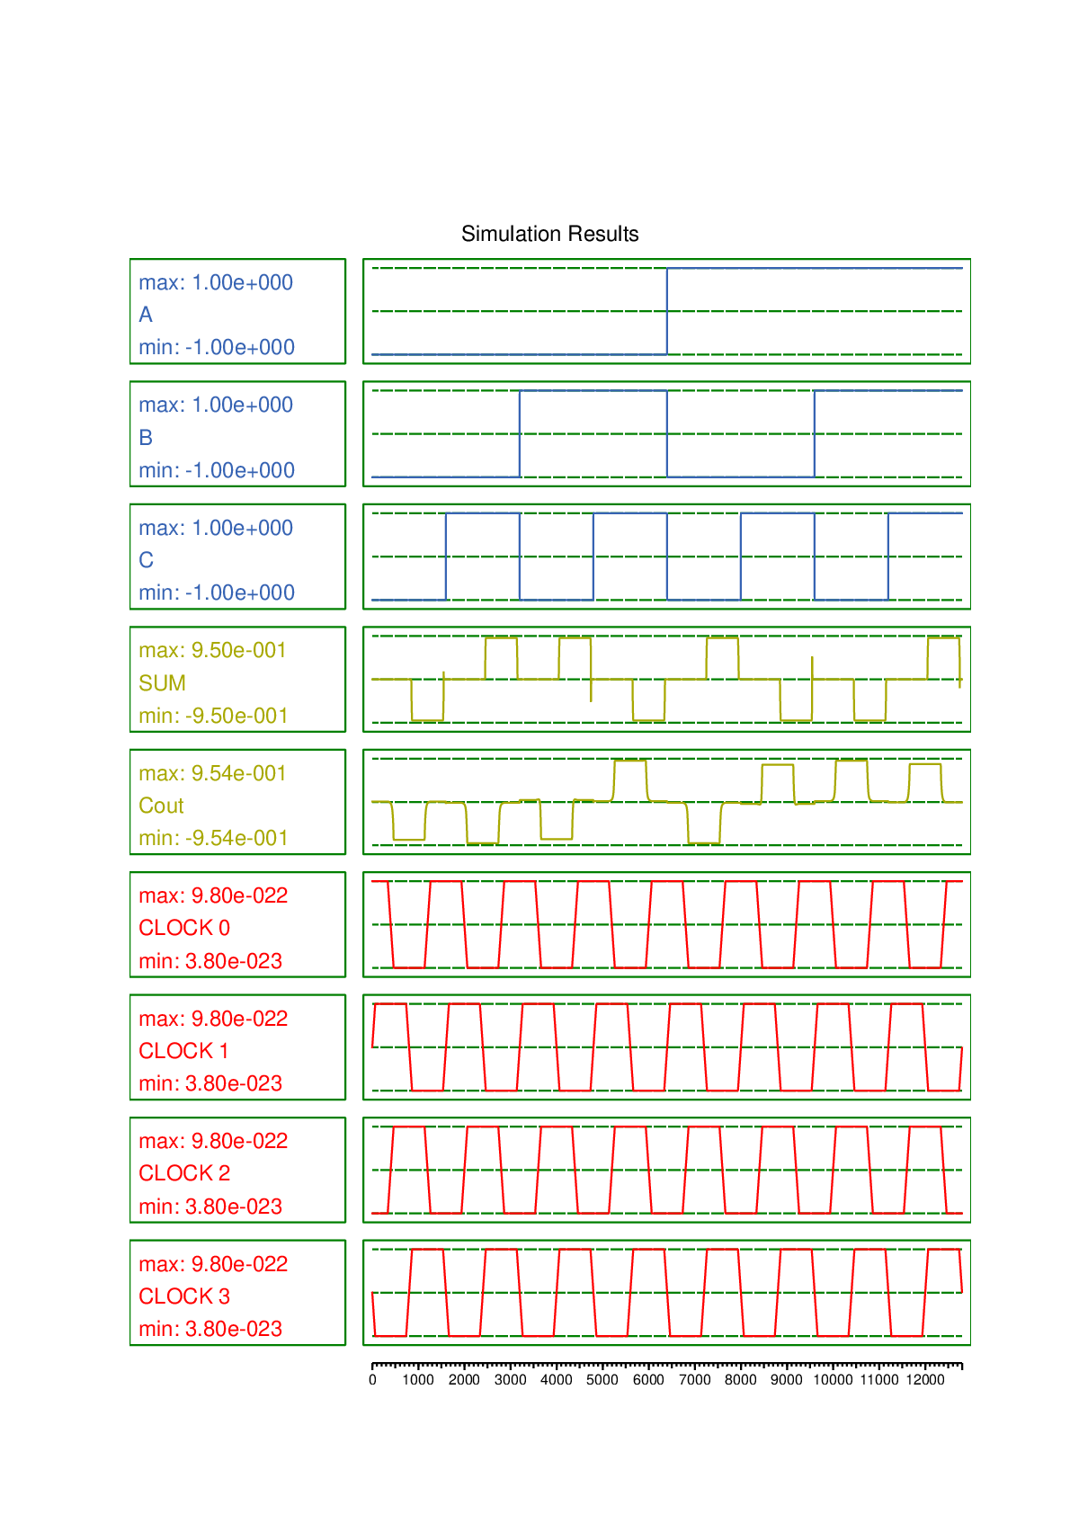
Aditya College of Engineering and Technology
Fig: Full Adder Waveforms
IV ECE D, BATCH NO. 4

Slide 15
Aditya College of Engineering and Technology
A3
B3
A2
B2
A1
B1
A0
B0
Cin
3-input majority gate
3-input majority gate
3-input majority gate
3-input majority gate
COUT
3-input xor gate
3-input xor gate
3-input xor gate
3-input xor gate
S3
S2
S1
S0
Fig: Block Diagram of Proposed 4-Bit RCA in QCA
IV ECE D, BATCH NO. 4

Slide 16
Aditya College of Engineering and Technology
 | A |  |  |  | B |  |  |  | Sum |  |  |  | Carry
Cin | A3 | A2 | A1 | A0 | B3 | B2 | B1 | B0 | S3 | S2 | S1 | S0 | Cout
0 | 0 | 0 | 0 | 0 | 0 | 0 | 0 | 0 | 0 | 0 | 0 | 0 | 0
0 | 0 | 0 | 0 | 1 | 0 | 0 | 0 | 1 | 0 | 0 | 1 | 0 | 0
 | 0 | 0 | 1 | 0 | 0 | 0 | 1 | 0 | 0 | 1 | 0 | 0 | 0
0 | 0 | 0 | 1 | 1 | 0 | 0 | 1 | 1 | 0 | 1 | 1 | 0 | 0
0 | 0 | 1 | 0 | 0 | 0 | 1 | 0 | 0 | 1 | 0 | 0 | 0 | 0
0 | 0 | 1 | 0 | 1 | 0 | 1 | 0 | 1 | 1 | 0 | 1 | 0 | 0
0 | 0 | 1 | 1 | 0 | 0 | 1 | 1 | 0 | 1 | 1 | 0 | 0 | 0
0 | 0 | 1 | 1 | 1 | 0 | 1 | 1 | 1 | 1 | 1 | 1 | 0 | 0
0 | 1 | 0 | 0 | 0 | 1 | 0 | 0 | 0 | 0 | 0 | 0 | 0 | 1
0 | 1 | 0 | 0 | 1 | 1 | 0 | 0 | 1 | 0 | 0 | 1 | 0 | 1
0 | 1 | 0 | 1 | 0 | 1 | 0 | 1 | 0 | 0 | 1 | 0 | 0 | 1
0 | 1 | 0 | 1 | 1 | 1 | 0 | 1 | 1 | 0 | 1 | 1 | 0 | 1
0 | 1 | 1 | 0 | 0 | 1 | 1 | 0 | 0 | 1 | 0 | 0 | 0 | 1
0 | 1 | 1 | 0 | 1 | 1 | 1 | 0 | 1 | 1 | 0 | 1 | 0 | 1
0 | 1 | 1 | 1 | 0 | 1 | 1 | 1 | 0 | 1 | 1 | 0 | 0 | 1
0 | 1 | 1 | 1 | 1 | 1 | 1 | 1 | 1 | 1 | 1 | 1 | 0 | 1
1 | 1 | 1 | 1 | 1 | 1 | 1 | 1 | 1 | 1 | 1 | 1 | 1 | 1
Fig: Truth Table of 4-bit RCA
IV ECE D, BATCH NO. 4

Slide 17
Aditya College of Engineering and Technology
A3
B3
A2
B2
A1
B1
A0
B0
Cout
Cin
S3
S2
S1
S0
Fig: Proposed 4-Bit RCA Circuit in QCA
IV ECE D, BATCH NO. 4

Slide 18
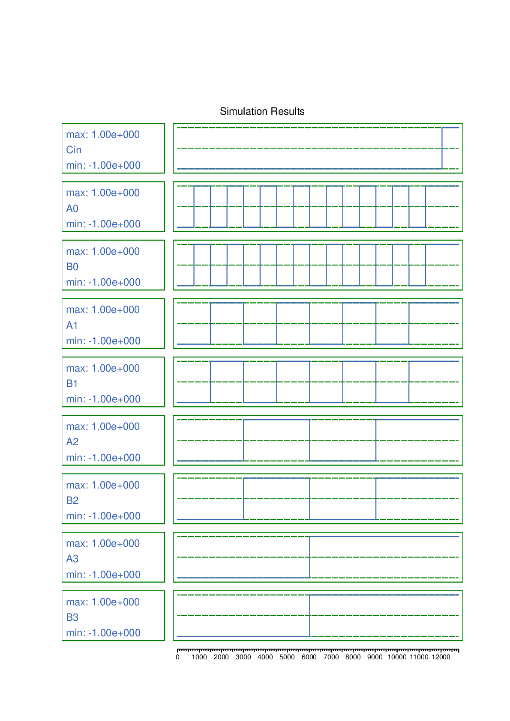
Aditya College of Engineering and Technology
Fig: Output Generation of 4-bit RCA in QCA
IV ECE D, BATCH NO. 4

Slide 19
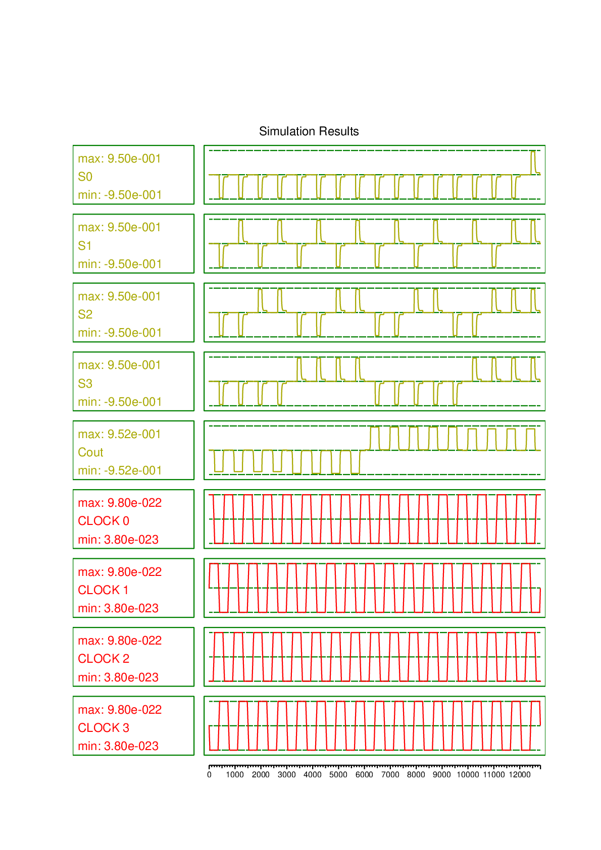
Aditya College of Engineering and Technology
IV ECE D, BATCH NO. 4

Slide 20
Aditya College of Engineering and Technology
COMPARISON BETWEEN EXISTING AND PROPOSED DESIGN OF 4-BIT RCA IN QCA
 | EXISTING CIRCUIT | PROPOSED CIRCUIT
AREA | 0.34 | 0.30
CELL COUNT | 262 | 208
DELAY | 1.75 | 1.25
IV ECE D, BATCH NO. 4

Slide 21
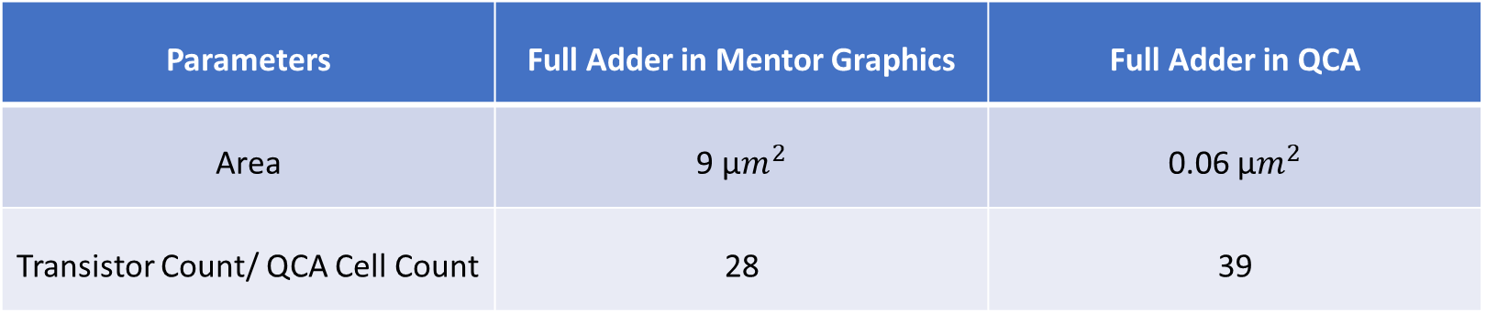
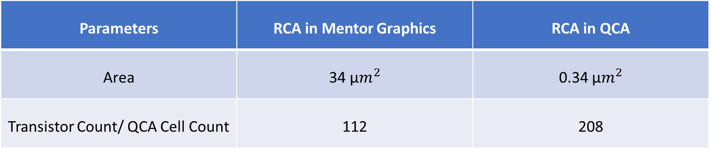
Aditya College of Engineering and Technology
Comparative Analysis
Parameters | Full Adder in Mentor Graphics | Full Adder in QCA
Area | 9 µ$m^{2}$ | 0.06 µ$m^{2}$
Transistor Count/ QCA Cell Count | 28 | 39
Parameters | RCA in Mentor Graphics | RCA in QCA
Area | 34 µ$m^{2}$ | 0.34 µ$m^{2}$
Transistor Count/ QCA Cell Count | 112 | 208
IV ECE D, BATCH NO. 4

Slide 22
Aditya College of Engineering and Technology
Advantages
The possibility of continuity with CMOS still exists but it is the cost to benefit ratio that motivates the researchers to shift their attention towards the development of alternatives to CMOS technology. The QCA technology discussed in this paper is one such alternative.
The main advantages of QCA over the other possible alternatives are the high density circuits that it allows. Due to small size of quantum dots or metal islands which are used as potential wells, very compact arrangements are possible which further reduce the overall size and delay of the circuits.
Another very important advantage of the QCA circuits is the low power consumption.
The unique feature of QCA clocking provides the provision of signal gain and pipelining for the realization of efficient logic structures.
IV ECE D, BATCH NO. 4

Slide 23
Aditya College of Engineering and Technology
Conclusion
The proposed adders have less delay, cell count, latency and lesser area when compared to the existing adders.
QCA full adder circuit is proposed which is designed with minimum number of QCA cells. The proposed full adder requires only 39 QCA cells, an area of 0.06 μm2 to implement its function. Then an efficient 4-bit Ripple Carry Adder (RCA) is designed based on the proposed full adder that performs higher end addition in an effective way.
The simulation results shows that the proposed 4-bit Ripple Carry Adder (RCA) requires only 208 QCA cells, an area of 0.3 μm2 and delay of about 1.25 clock cycles to implement its function with enhanced performance in terms of latency, area and QCA Cost. In future, high-speed adders which play an important role in multiplier designs could be designed and its computational performance could be improved further.
IV ECE D, BATCH NO. 4

Slide 24
Aditya College of Engineering and Technology
References
[1] Y. Adelnia., A. Rezai, A novel adder circuit design in quantum-dot cellular automata technology, Int. J. Theory Phys. (2018), doi: 10.1007/s10773- 018- 3922- 0 .
[2] H. Cho., E.E. Swartzlander, Adder designs and analyses for quantum-dot cellu- lar automata, IEEE Trans. Nanotechnol. 6 (3) (May 2007), doi: 10.1109/TNANO. 2007.894839 .
[3] T.N. Sasamal , A.K. Singh , U. Ghanekar , Efficient design of coplanar ripple carry adder in QCA, IET Circuits Devices Syst. 12 (5) (2018) 594–605 ©The Institution of Engineering and Technology 2018 .
[4] Y.Z. Barughi, S.R. Heikalabad, A three-layer full adder/subtractor structure in quantum-dot cellular automata, Int. J. Theory Phys. (2017), doi: 10.1007/ s10773- 017- 3453- 0 .
[5] R. Singhal, M. Perkowski.,: Comparative analysis of full adder custom design circuit using two regular structures in quantum-dot cellular automata (QCA). 2019 IEEE 49th International Symposium on Multiple-Valued Logic (ISMVL). DOI 10.1109/ISMVL.2019.0 0 041
[6] D. Abedi, G. Jaberipur, M. Sangsefidi, Coplanar full adder in quantum-dot cellular automata via clock-zone based crossover, IEEE Trans. Nanotechnol. (2015), doi: 10.1109/TNANO.2015.2409117 .
IV ECE D, BATCH NO. 4

Slide 25


