Slide 1
5G TECHNOLOGY
SPARK
VEDA 2K22
THE NEXT GENERATION OF TECHNOLOGY
BY
D.HARSHA
K.SANTOSH REDDY

Slide 2
ABSTRACT
5G technology has a theoretical peak speed of 20 Gbps, while the peak speed of 4G is only 1 Gbps. .While earlier generations of cellular technology (such as 4G LTE) focused on ensuring connectivity, 5G takes connectivity to the next level by delivering connected experiences from the cloud to clients.5G network share virtualized and software-driven, and they exploit cloud technologies. .5G technology should improve connectivity in underserved rural areas and in cities where demand can outstrip today's capacity with 4G technology. New 5G networks will also have a dense, distributed-access architecture and move data processing closer to the edge and the users to enable faster data processing. . G technology will not only usher in a new era of improved network performance and speed but also new connected experiences for users.

Slide 3
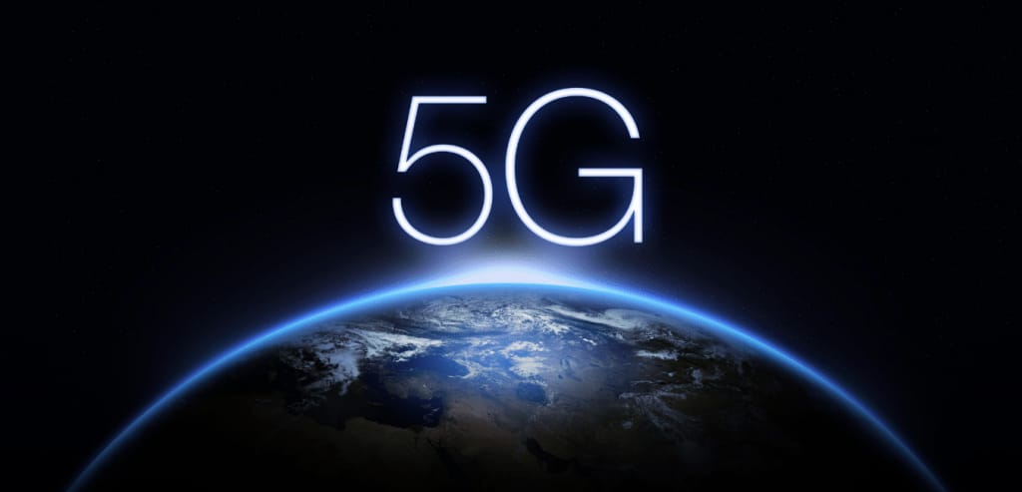
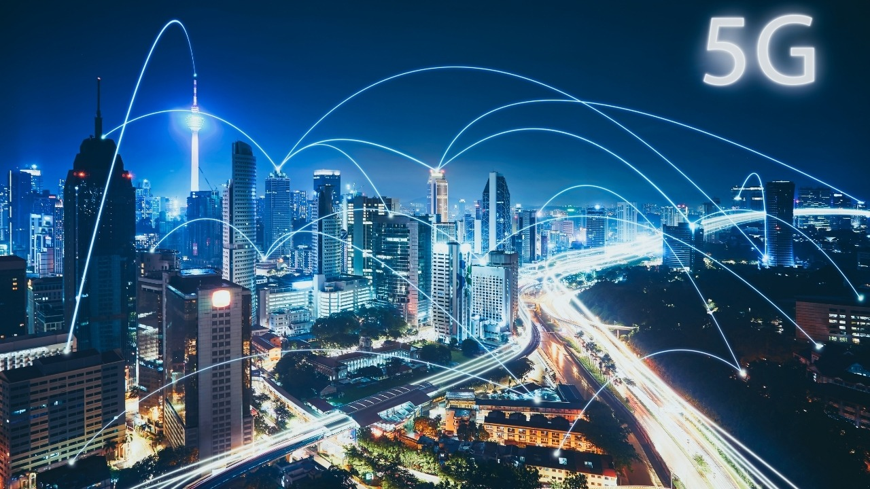
EVOLUTION

Slide 4
INTRODUCTION
➔5G technology is the abbreviation of the fifth generation
Mobile technology.
➔It is a complete wireless communication with almost no
limitations.
➔It is highly supportable to WWWW(Wireless World Wide
Web).

Slide 5
Technology
➔5G is an advanced form of 4G to get more advanced
features.
➔In coming years, the 5G technology will be in use
because of its advancement, affordable cost and posses
a bright future that will keep its safe for years.

Slide 6
APPLICATIONS
➔Education system
➔Weather forecasting
➔Medical field
➔Detecting natural disasters..........

Slide 7
ADVANTAGES
➔5G speeds will range from around 50 Mbps to 1,000 Mbps(1Gbps)depending on the RF channel and BS load.
➔ In 5G, the ideal "air latency" is of the order of 8–12 milli seconds i.e., excluding delays due to HARQ retransmissions, handover.
➔5G uses adaptive modulation and coding scheme (MCS) to keep the biter rotate(BLER) extremely low The range of 5G network is very high when compared to other generations.

Slide 8
DISADVANTAGES
➔We need skilled engineers to install and maintain a5Gnetwork.
➔ Technology is still under process and research on its viability is going on.
➔High Radiation It causes many effects on our Eco-System

Slide 9
THANK YOU

