Slide 1
Nextgen Input devices
Welcome to FUTURE possibilities

Slide 2
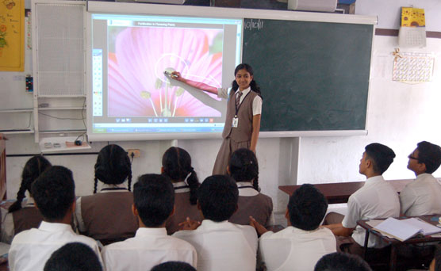
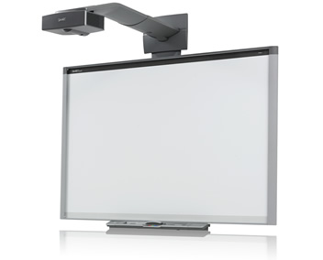
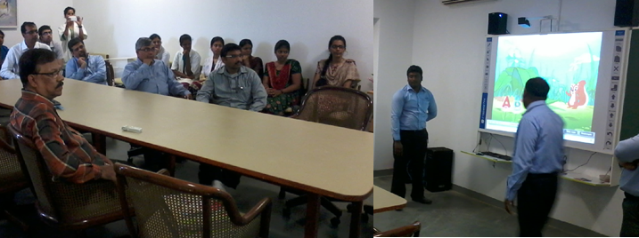
Smart Boards
Short range
Fixed sensor
Pen used for pixel identification
Mainly used for white boards
NKK during a demo on Smart board given to CANCER institute
MS community in Chennai helped in evaluating these devices, when donating one in CANCER institute through Mindtree ISR

Slide 3
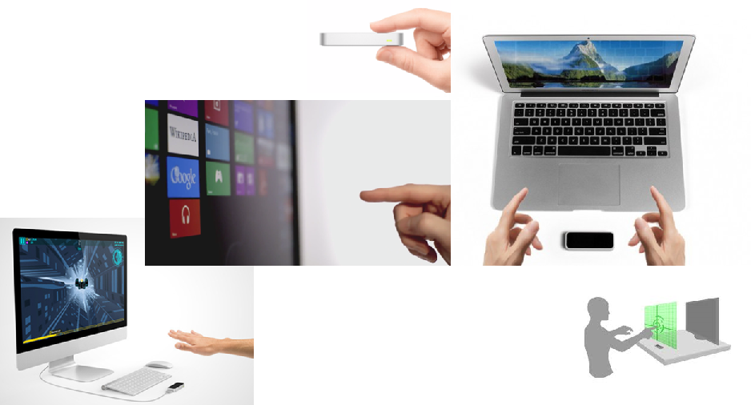
Leap Motion
Short range sensor
Can be connected with PCs
Only hand gestures detection
Can be used to make a non-touch screen into touch screen
APIs available for app development

Slide 4
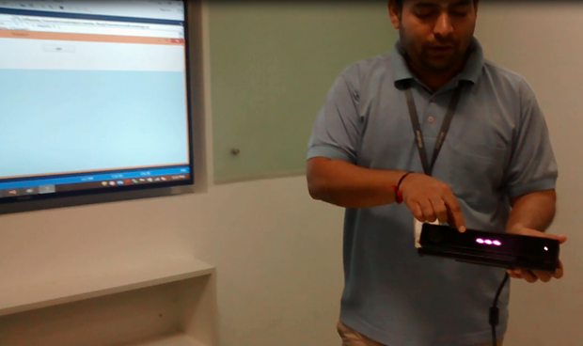
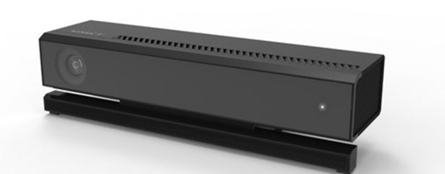
Kinect for windows v2
We developed few PoCs on Kinect v2
XBOX players will be familiar with this ☺
Latest version is called Kinect for windows v2
Can connect to Windows 8.1 OS PC/Tablet
Through USB 3.0
Simple API provided for programming
Huge possibilities to innovate new business solutions

Slide 5
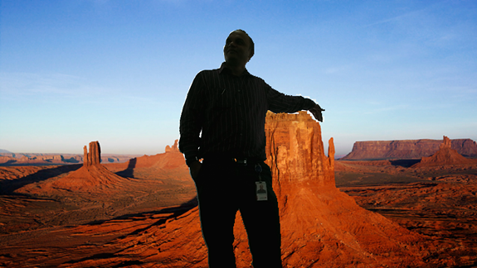
Kinect for windows v2 – Virtual Reality
Sample that demonstrates that we can extract the person image in runtime using Kinect

Slide 6
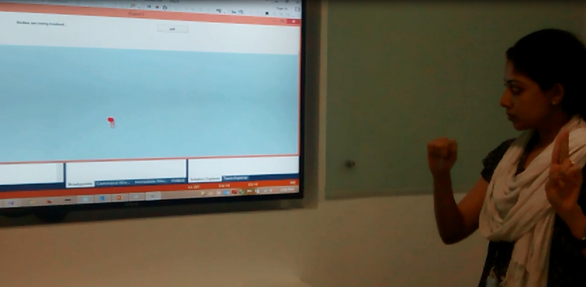
Kinect for windows v2 – Hand gestures
An App being demonstrated by Megha (MS community member)
This app can be controlled by Kinect using hand gestures (maximize, minimize and normal)
She also showed how to draw using hand gestures
This app is developed by us

Slide 7
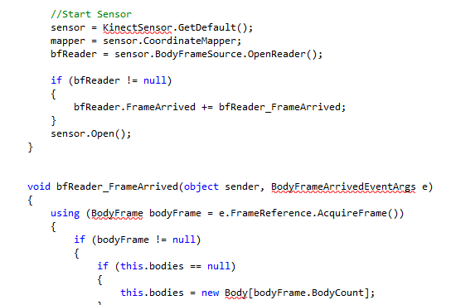
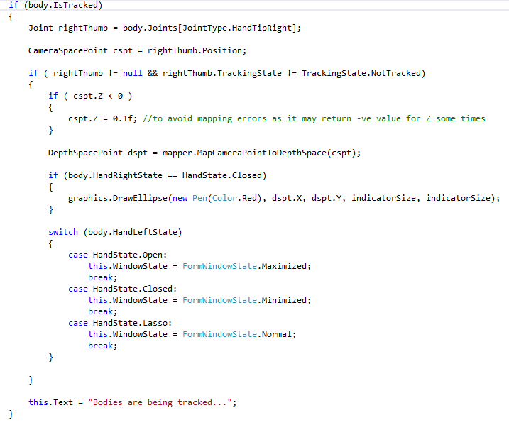
Kinect for windows v2 – very easy SDK to use
It takes less than 25 LOC of Kinect SDK to start sensor and capture the inputs from it.
Now it is easy for any .Net developer to start using Natural user inputs

Slide 8
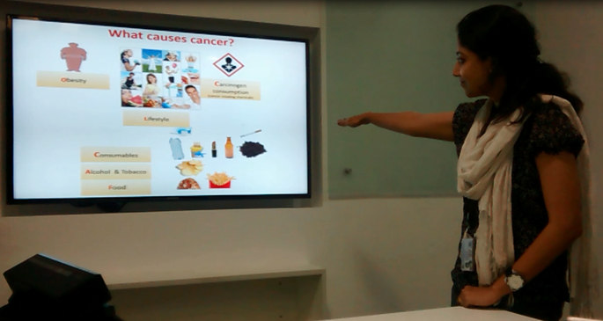
Kinect for windows v2 – bare hands for PPT
This is an app we developed to control the power point presentation using hand swipe gestures.
SWIPE is not a basic input in Kinect, but we can calculate using the hand TIP positions.

Slide 9
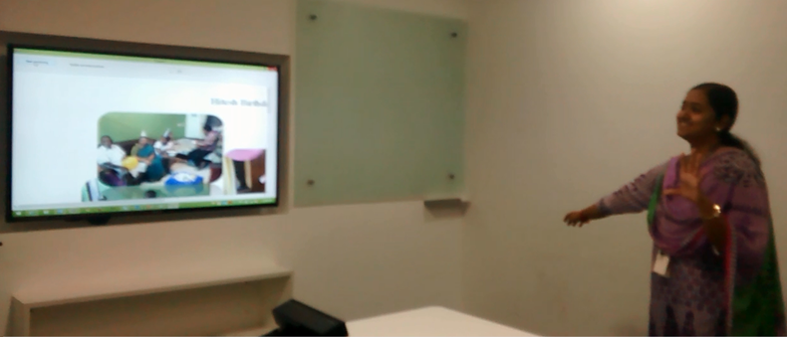
Kinect for windows v2 – pinch and zoom
Anjali is demonstrating how we created a PoC to do a picture zoom in and zoom out using Kinect API
This app also uses swipe to traverse the pictures

Slide 10
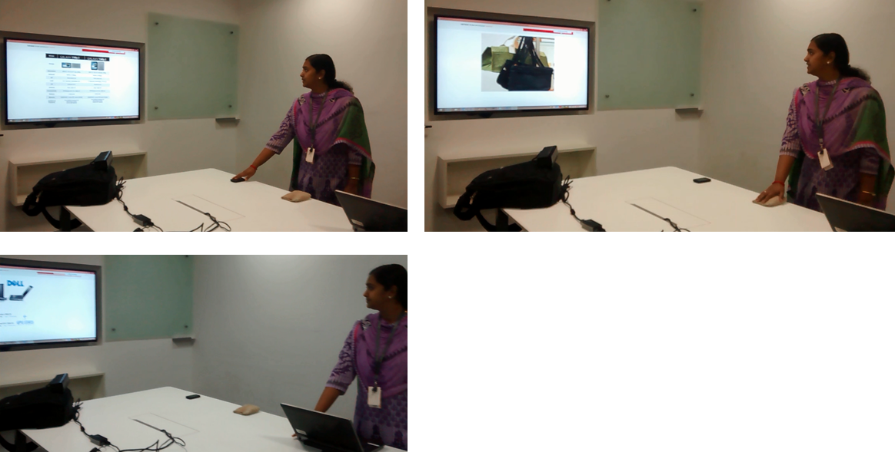
Kinect for windows v2 – convert any surface into a touch surface
This is an interesting app we developed to showcase that we can convert any surface into a touch surface using KINECT.
This app detects which object the user is touching and displays relevant content “CONTEXT AWARE” inputs
This has a great potential in RETAIL space (BDMs.. Beaware of this feature to excite our customers)

Slide 11
What are you waiting for??
If you are BDM.. Start exciting our customers by proposing Natural interfaces for appropriate business applications
If you are an Architect.. Start thinking of business solutions that can add value using Natural user interface and gesture based apps
If you are an engineer.. Start downloading Kinect SDK and play around to learn more to use Natural User interfaces
If you are an UX person.. Learn to redesign for NUI..
If you want a Kinect device to play around
……………come and meet us @ Microsoft community Chennai.. We will be happy to work with you..
For more details on KINECT for windows v2… contact us @ MS community Chennai.

Slide 12
Thanks..
By Microsoft Community, Chennai…

