Slide 1


Team Details
  Team name: Prod Pilots
  Team leader name: Lohith DS
  Problem Statement: BFSI: Intelligent Risk, Fraud and Financial Experiences. Rakshak, a scam-moment guardian that stops authorised-push-payment scams at the moment of payment.

Slide 2
Brief about the idea
Rakshak: stop the scam at the moment of payment, not after it
81.8%
Scam victims now send the money themselves, on a call, under pressure. Bank fraud engines see a genuine customer on a genuine device, and an SMS alert arrives after the money has left.
Rakshak is a guardian built into a bank or UPI app. With the customer's opt-in it listens to a call from an unknown number and scores the caller's coercion live with Gemini. When the customer taps Pay, it fuses that call risk with the payee's mule-account risk from the bank's ledger, and in under 100 ms pauses the payment, explains why in the customer's language, alerts a trusted contact and files an auditable case. An ADK agent confirms with evidence; the customer always keeps an override.
of Singapore's 2025 scam cases were transfers the victim made (Singapore Police)
₹22,495 cr
lost to cyber fraud in India in 2025, about 24% recovered (MHA via Moneylife)
Built and deployed
Customer app (installable PWA), caller phone, family phone and fraud desk on Cloud Run
Gemini 3.5 and 3.8 models, Google ADK 2.11 agents, Firestore case store
Live two-way calls between two phones, six languages, 50-call evaluation
₹1.56 lakh
average loss per digital-arrest victim in 2024 (Lok Sabha data)

Slide 3
Opportunities
How is it different from existing ideas?
How does it solve the problem?
USP of the solution
Pixel scam detection: on the handset, warns only, knows nothing about the payee
Call-state signals (FICO Scam Signal, BioCatch): know a call is on, not what is said
Bank fraud engines: blind to the call; the coerced victim passes every check
SMS alerts and 1930: after the money left; about 24% is recovered
Rakshak fuses call semantics with payee mule risk at the moment of authorisation, on the bank side
Listens (opt-in) from the first ring; scores 8 coercion signals live in 6 languages
Whispers privately to the customer when the risk passes 85%
At Pay: graded decision in under 100 ms: proceed, warn, 30-minute hold, or hold plus alert
Speaks the reason, notifies a trusted contact, drafts the fraud-desk case and 1930 referral
Payments within 60 minutes of a high-risk call are still checked
Intervention, not an alert: the money does not leave until the customer has had time to think
Explainable: every hold names its evidence; an ADK agent can only make it stricter
Human in the loop: the customer can override by typing the amount
Vernacular voice for the people scammers target most
Privacy tiers: works with no audio, on-device text, or cloud analysis

Slide 4
List of features offered by the solution
1
Live coercion scoring
2
Private whisper
3
Payment-moment hold
Gemini scores 8 signals (authority, threat, secrecy, urgency, remote app, safe account, investment pressure, OTP) after every sentence
At 85% risk Rakshak warns the customer in their ear; the caller hears nothing
Deterministic fusion of call risk, payee risk and profile decides in under 100 ms
4
Voice barge-in
5
Payee mule risk with lineage
6
ADK investigator
The reason is spoken in the customer's language; Hindi, Hinglish, English, Kannada, Tamil, Singapore English
Fan-in, cash-out, dormancy, account age, telecom risk and 1930 complaints, computed from a live ledger stream
Two Gemini agents check the payee and official advisories (RBI, CBI, MAS, SEBI) and confirm or upgrade
7
Trusted-contact alert
8
Talk to Rakshak
9
Fraud desk
The family phone chimes with the case; also Pub/Sub and SMS hooks
Gemini Live voice conversation after the hold, with tools to keep the hold or call family
Case timeline, agent trace, drafted 1930 referral, and the SMS-versus-Rakshak contrast
Also: post-call carry-over (60 minutes), practice drill for elderly users, PIN-hidden balance, live two-way call between phones, installable app.

Slide 5
Process flow diagram or Use-case diagram
During the call
1
Caller rings
2
Live transcription
3
Coercion rubric
4
Private whisper
unknown number; Guardian mode on (opt-in)
Gemini 3.5 Transcribe Live, one stream per speaker
Gemini 3.5 Flash, JSON, 8 signals, every sentence
at 85% risk, Gemini 3.8 Flash TTS
At the moment of payment
5
Customer taps Pay
6
Fusion policy
7
Graded action
8
ADK agents confirm
during the call or within 60 min after
0.65 call + 0.35 payee + profile, under 100 ms
proceed, warn, 30-min hold, hold + alert
payee ledger + official advisories; never relax
After the decision
9
Voice + family alert
10
Customer choice
11
Fraud desk
12
Bank acts
reason spoken; trusted contact notified
cancel, Talk to Rakshak (Gemini Live), or typed override
case in Firestore, agent trace, drafted 1930 referral
freeze review of the mule account; customer follow-up

Slide 6
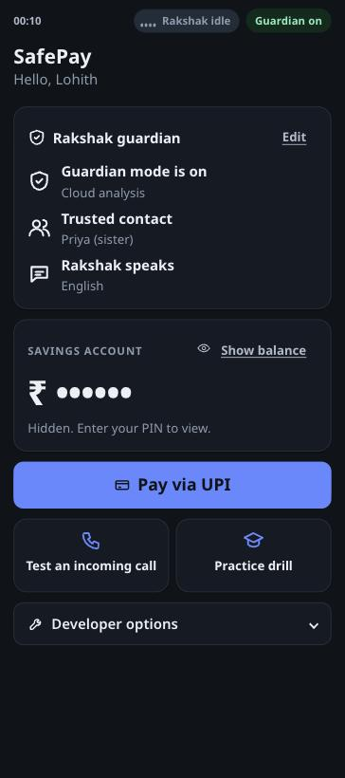
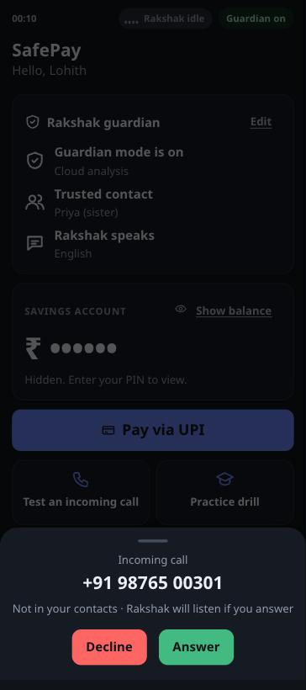
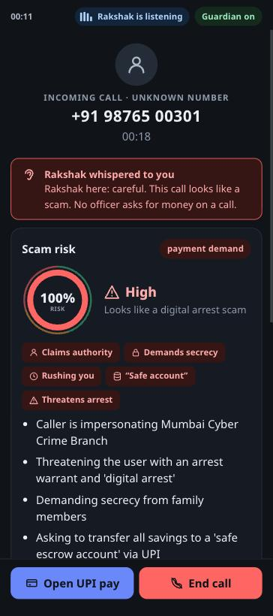
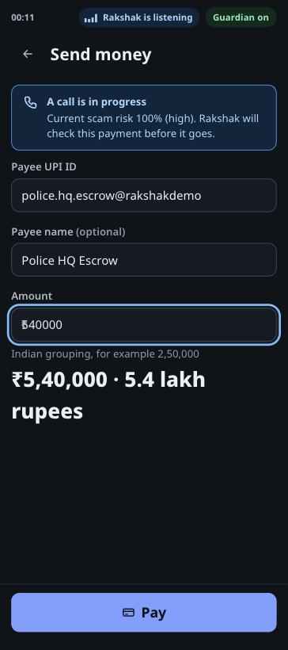
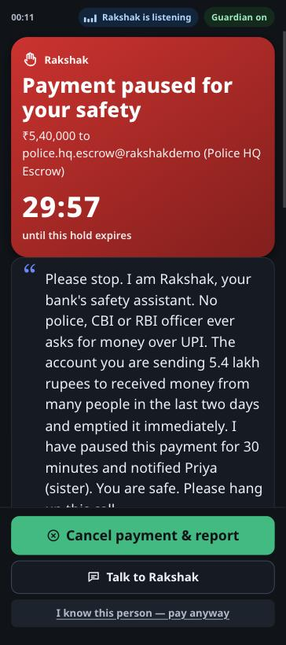
Wireframes/Mock diagrams of the proposed solution (optional)
Home: Guardian on, balance hidden by PIN
Unknown number rings
Live risk 100%, whisper, reasons
Pay screen knows a call is on
Payment paused, reason spoken

Slide 7
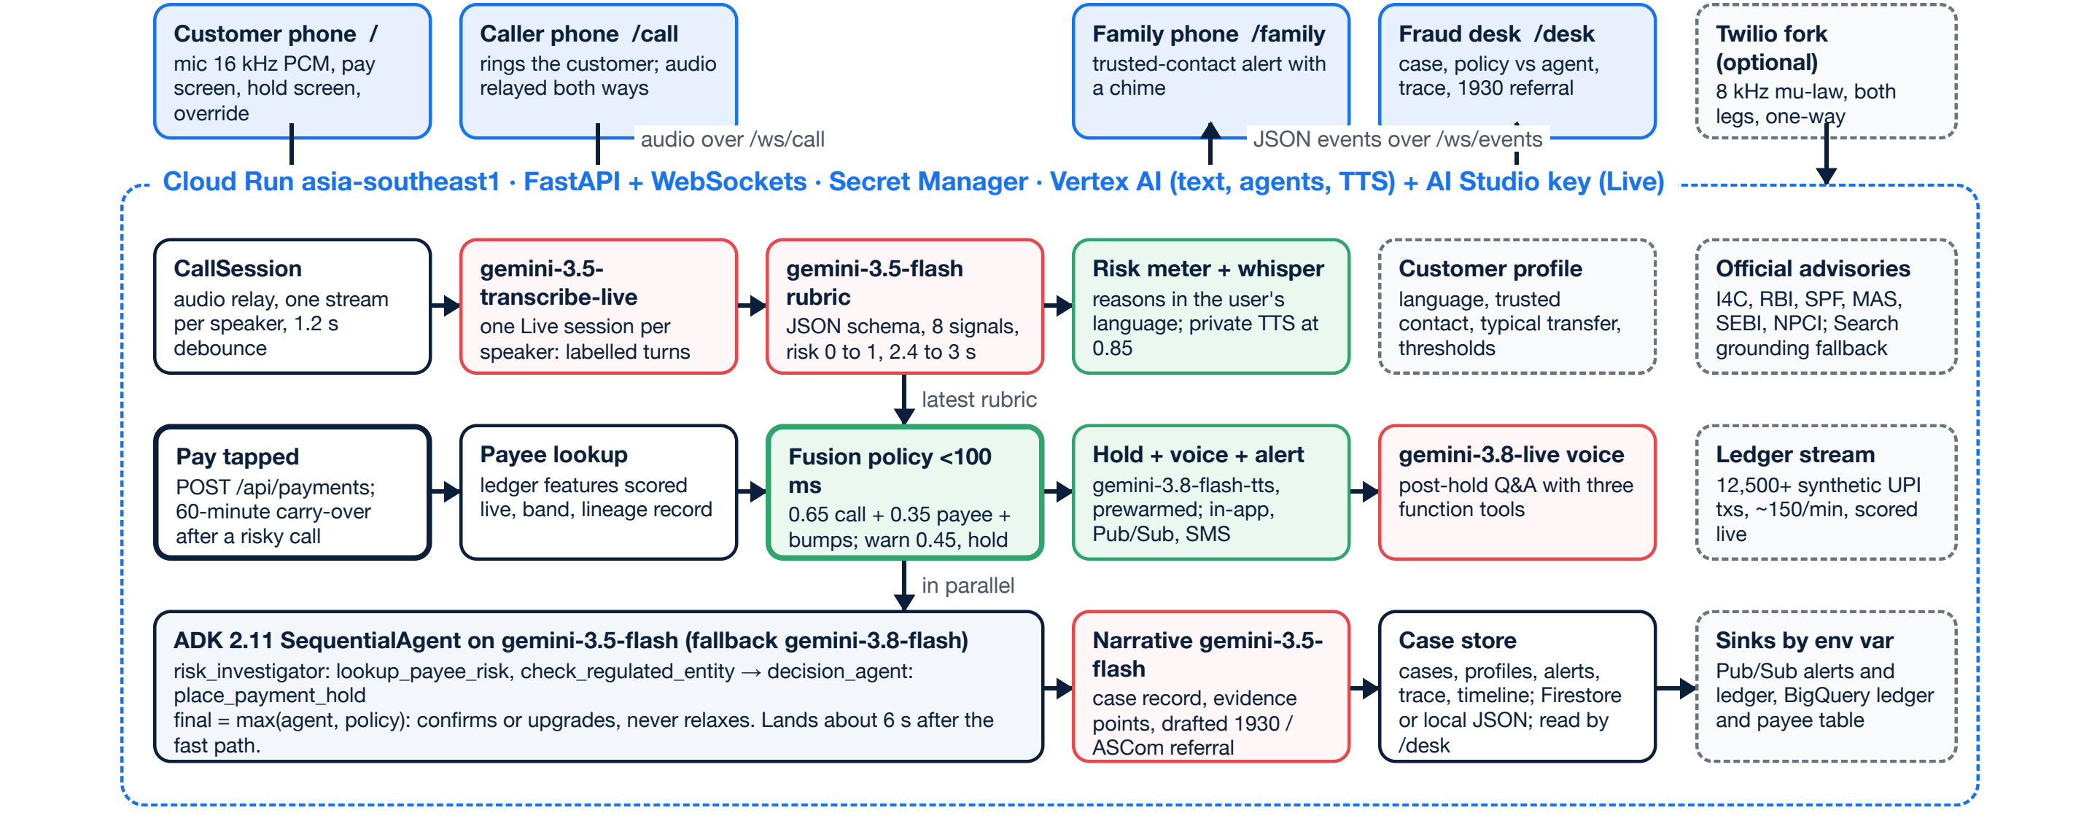
Architecture diagram of the proposed solution
Google Cloud: Cloud Run (FastAPI, WebSockets, one always-on instance) · Gemini on Vertex AI and the Gemini API · ADK 2.11 · Firestore case store (Firebase) · Pub/Sub alerts · BigQuery ledger SQL · Secret Manager. Firebase Hosting serves the same app at https://fde-cloud-run-lab-123456.web.app.

Slide 8
Technologies to be used in the solution
Gemini models
Agents
Serving
3.5 Flash: coercion rubric (JSON), ADK agents, case narrative
3.5 Transcribe Live: one live stream per speaker
3.8 Flash TTS: whisper and spoken hold
3.8 Live: voice conversation with tools
3.8 Flash: agent fallback
Google ADK 2.11 SequentialAgent
risk_investigator: payee ledger + official advisories, Search grounding fallback
decision_agent: place_payment_hold tool
Policy floor: agents can only make it stricter
Cloud Run, asia-southeast1, WebSockets, session affinity
FastAPI, Python 3.12, uv
Installable PWA: customer app, caller phone, family phone, fraud desk
Firebase Hosting front door
Data
Security and privacy
Quality
Firestore (Firebase): cases, profiles, alerts
Ledger stream with mule features (same formula as the BigQuery SQL)
Pub/Sub for trusted-contact alerts; BigQuery sink optional
Secret Manager for the API key; IAM service account
Opt-in Guardian mode, visible indicator
No raw audio stored; PIN-hidden balance
Typed-amount override, holds expire
50-call labelled evaluation in 6 languages
16 automated tests incl. a 3-day ledger drift test
Live two-device audio smoke test on the public URL

Slide 9
Estimated implementation cost (optional)
Item (per guarded 3-minute call) | Assumption | Estimate (USD)
Live transcription, both speakers | Gemini 3.5 Transcribe Live, 360 s of audio at 25 tokens/s | 0.03
Coercion rubric | about 15 scorings, Gemini 3.5 Flash | 0.07
ADK agents and case narrative | about 5 Gemini 3.5 Flash calls | 0.03
Whisper and spoken hold | Gemini 3.8 Flash TTS, about 33 s of audio | 0.01
Total per guarded call with a hold | list prices, Gemini API, Oct 2026 | about 0.14 (₹12)
₹12
per guarded call that ends in a hold
versus ₹1.56 lakh lost by the average digital-arrest victim
Cost is paid only when Guardian mode is on and an unknown number calls.
Infrastructure (prototype) | Estimate
Cloud Run, 1 always-on instance (1 vCPU, 1 GiB) | about USD 50 to 70 a month
Firestore, Pub/Sub, BigQuery, Secret Manager | within free tiers at prototype scale
At bank scale
Sessions move to Firestore or Memorystore and Cloud Run scales out; agents can move to Agent Runtime.
Estimates use list prices; Vertex AI contract prices differ.

Slide 10
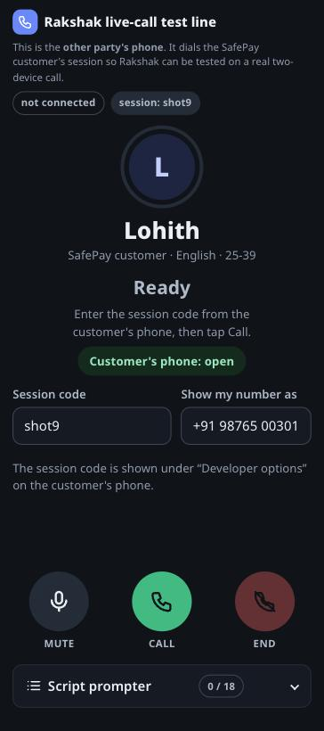
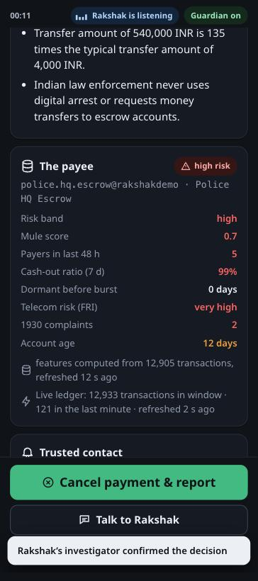
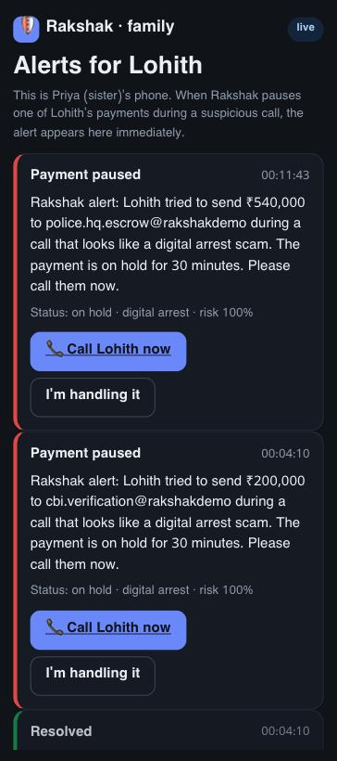
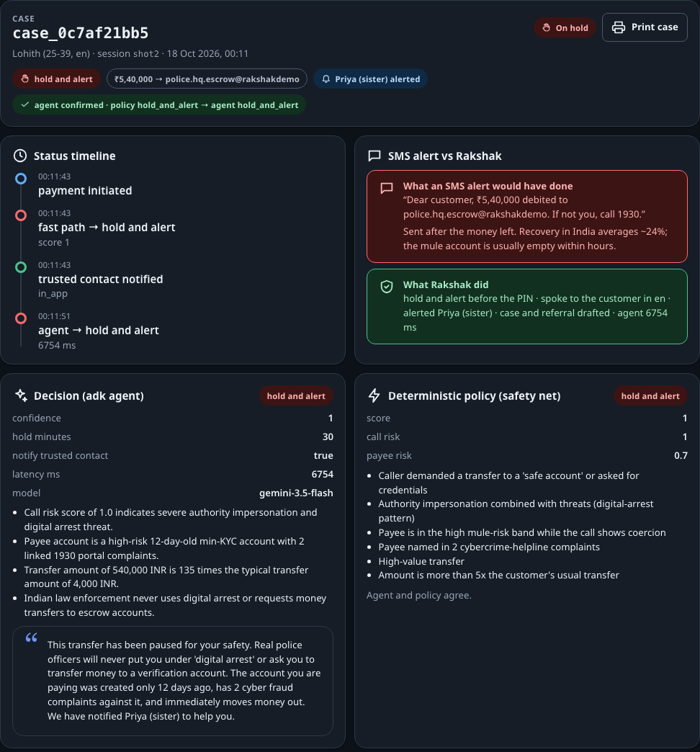
Snapshots of the prototype
Caller phone: live two-way call
Payee evidence with ledger lineage
Family phone: alert arrives
Fraud desk: case, timeline, agent versus policy, SMS contrast

Slide 11
Prototype Performance report/Benchmarking
1.00
1.00
Latency and reliability | Measured
Coercion score after a sentence | 3.1 s mean, 2.0 s median
Hold on screen after Pay | 0.02 to 1.4 s
Spoken reason (prewarmed) | about 0.1 s after the hold
ADK agent confirmation | 5.4 to 7.2 s
Live two-device audio test | 3 of 3 sentences transcribed; whisper fired
Automated tests | 16 passing, incl. 3-day ledger drift
Ledger stream | about 12,800 transactions in window, about 120 a minute
Precision
no benign call held
Recall
every scam call held
39 / 39
93.2%
Payment decisions
correct action on every payment
Signal accuracy
8 signals x 50 calls
50 labelled calls | Predicted scam | Predicted benign
Actual scam (25) | 25 | 0
Actual benign (25) | 0 | 25
25 scam and 25 benign calls in Hindi, Hinglish, English, Singapore English, Kannada and Tamil, including 10 legitimate-but-urgent calls and 10 scams written to dodge keywords. Self-authored set, not held-out.

Slide 12
Additional Details/Future Development (if any)
Next with a bank or PSP partner
Real ledger features in BigQuery on a schedule; DoT FRI, NPCI DPIP and I4C registry feeds
On-device Tier 1 with an OS or OEM partner (Pixel scam detection to a GPay hold)
Telco audio fork for cellular calls, as banks already do with call-state signals
Native Android app: call-state signal, foreground service, FCM push to family
Human-labelled call corpus and red-team evaluation; native-speaker QA for Indic voices
Model-risk evidence pack for RBI FREE-AI and MAS AI risk guidelines
Honest limits of this prototype
Synthetic ledger and scripted calls; no bank partner yet
Third-party apps cannot tap cellular calls on Android or iOS, so live audio uses in-app calls or a telco bridge
The Twilio phone bridge is one-way: the spoken hold stays on the app
Kannada and Tamil voices not yet tested with native speakers
One Cloud Run instance holds live call sessions; scale-out needs shared session state

Slide 13
Provide links to your:
GitHub Public Repository: https://github.com/devaramanelohith/rakshak-agent
Demo Video Link (3 Minutes): [paste the public YouTube link here]
Final Product Link: https://rakshak-223197895518.asia-southeast1.run.app
Try it in 60 seconds (one device)
Open the product link, tap Test an incoming call
Choose Cyber Crime Branch (English), tap Auto-play script
When asked to pay, tap Open UPI pay, then Pay
Watch the hold, hear Rakshak, open /desk for the case
Balance PIN for the demo: 1234
Live two-way call (two phones)
Customer phone: /?session=demo1&user=demo-user
Caller phone: /call?session=demo1, tap Call
Family phone: /family?user=demo-user
Fraud desk: /desk
Hindi customer: &user=demo-user-hi

Slide 14
Privacy by design, and how it works on a real cellular call
Tier | What Rakshak uses | What leaves the phone
0: no audio | Call from an unknown number + pay screen + payee risk | Only the payment request
1: on-device text | Rolling 60 s transcript kept on the phone | Scores and last 60 s, only if a payment is attempted
2: cloud (this prototype) | Live transcription through a lawful channel | Audio stream, never stored
Real cellular calls
No third-party app can read cellular call audio on Android 10+ or iOS. Rakshak therefore runs on the bank side and receives audio only through lawful channels:
the bank's own in-app or verified calls (shown in the demo)
a telco audio fork with consent (FICO Scam Signal precedent)
an OS vendor feed: Google can connect Pixel scam detection to a GPay hold
Without audio, Tier 0 still holds risky payments to mule accounts during unknown calls.
Rules at every tier
Guardian mode is opt-in with a visible listening indicator
The caller never hears Rakshak; holds expire; the customer can override
Raw audio is never written to disk; cases are kept for the bank's audit trail

Slide 15


