Slide 1

2023 3rd International Conference on Smart Data Intelligence (ICSMDI) March 30-31, 2023 Trichy, India Session 2, Parallel Session 4 Paper ID -ICSMDI431 Machine Vision Based Object Detection Using Deep Learning Techniques
Presented By
Garapati Deva Ram Ganesh
B.Tech Student, Dept.of CSE
KL UNIVERSITY, Green Fields A.P, India
Co-authors:
P Vidyullatha,
Maddipati Ravi Krishna
S Thanooj Prapulla,
A Pavan Saran
PupPala Ramya

Slide 2
OUTLINE:-
(ICSMDI)
1)NEED OF THIS TOPIC
2)INDEX
3)ABSTRACT
4)INTRODUCTION
5)METHODOLOGY
6)LITERATURE WORK
7)RESULTS & DISCUSSION
8)COMPARATIVE ANALYSIS
9)CONCLUSION
10)REFERENCES

Slide 3
NEED OF THIS TOPIC:-
(ICSMDI)
Improved hyperspectral image capture sensor:- There is a need for an improved sensor that can capture hyperspectral images with both improved spectral and spatial resolution.
Classification of hyperspectral images:- There is a need for methods to classify the pixels in hyperspectral images based on their spectral and spatial properties.
Challenges in classification:- There are challenges such as limited sample count and the curse of dimensionality that need to be addressed in developing effective classification methods.
Spatial-spectral classification:- Spatial-spectral classification techniques can provide significant efficiency advantages in addressing the geographical heterogeneity of spectral signatures.
Importance of feature selection:- It is crucial to understand which traits are most important for the classification algorithms in order to effectively classify the wide variety of represented materials.
Deep learning techniques:- Deep learning techniques have shown promising results for categorizing and recognizing objects in various fields, and can be applied to the classification of hyperspectral images.
Convolutional Neural Network:- In this study, a neural network convolutional is used to classify the hyperspectral picture based on spectral and spatial properties (CNN). There are only a few areas in the hyperspectral picture.

Slide 4
INDEX:-
(ICSMDI)
It is a continuous block of text describing the use of hyperspectral imaging for identifying and classifying objects on the earth's surface, the challenges associated with hyperspectral data classification, and the development of various classification methods including conventional pattern recognition approaches, statistical learning methods, and deep learning techniques. The introduction also introduces the proposed approach of using a Multi-Layer Perceptron and a modified convolutional neural network for spectral-spatial classification.

Slide 5
ABSTRACT:-
(ICSMDI)
The identification of items on the surface of the earth is widely known to be possible using hyperspectral images.
To do classification and identify the various items on the image, the majority of classifiers just take into account spectral information.
In this study, a neural network convolutional is used to classify the hyperspectral picture based on spectral and spatial properties (CNN).
There are only a few areas in the hyperspectral picture. The multilayer perceptron aids in the categorization of visual characteristics into many classes while CNN builds the upper categorical level of strategic spectral and spatial aspects in each of the patch.
The patch size of 13× 13 is found to be sufficient to attain the best accuracy. Compared to other classifiers, CNN requires greater computing time for training and testing.
In comparison to other classifiers, simulation findings indicate that CNN stores the hyperspectral picture with the best classification accuracy.

Slide 6
INTRODUCTION:-
(ICSMDI)
1)Hyperspectral imaging is a technology that uses spectral and spatial information to identify objects on Earth's surface.
2)The classification of picture pixels based on their spectral properties is used for ground cover classifications and has applications in astronomy, surveillance, biomedical imaging, agriculture, and environmental science.
3)The limited sample count that has been labeled and the large spatialized diversity of spectral fingerprints are challenges in identifying hyperspectral images.
4)Current research aims to use traditional pattern recognition methods, such as k-nearest neighbors, logistic regression, and neural networks, to classify hyperspectral data
5)Support vector machines (SVM) are a popular classification method for hyperspectral data, but they are resistant to the Hughes effect and sensitive to the curse of dimensionality.
6)Spatial-spectral classification techniques provide significant efficiency advantages in addressing the geographical heterogeneity of spectral signatures.Edge-preserving filters like the bidirectional filter and sparse representation filter are used to provide spatial characteristics to the SVM classifier.

Slide 7
(ICSMDI)
7)Deep learning techniques have demonstrated promising results in classifying and recognizing genuine objects, such as vehicles, using high-level features.
8)Autoencoders and logistic regression classifiers are used to combine spectral and spatially dominant data for classification.
9)Multi-Layer Perceptrons and modified Convolutional Neural Networks are recommended for building spectral-spatial features and making instantaneous predictions of different classes in the picture.
10)Deep learning techniques have demonstrated promising results for categorizing and recognizing genuine objects, such as vehicles or buildings.
11)Auto encoders can be used to develop a deep architecture that collects highest level spatialized information from the picture in a hierarchical manner to classify each pixel.Spectral properties can be combined with spatially dominant data and provided as input to a logistic regression classifier.
12)Multi-Layer Perceptron and a modified convolutional neural network can be used to build spectral-spatial features and make instantaneous predictions of different classes in the picture.

Slide 8
METHODOLOGY:-
(ICSMDI)
CNN is a popular deep learning approach for image categorization and identification tasks.
CNN extracts features from input images to categorize them into multiple groups or categories.
The resolution of the input image affects how CNN perceives it as an array or matrix.
Convolution layer is used to extract features from input images.
A kernel or filter is multiplied with an image matrix to produce the convolved feature or feature map.
Non-linear functions like ReLU are used to introduce nonlinearity to the convolution network.
Pooling layers decrease the complexity of large images by reducing their spatial dimension.
The output of the pooling layer is used to build a fully connected layer.

Slide 9
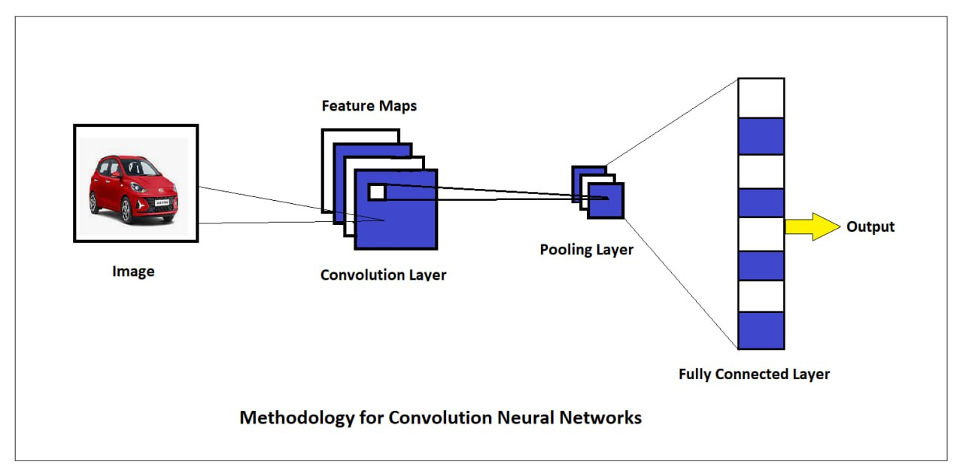
9.Hyperspectral images have multiple channels that enhance the computing capacity and memory resources of CNN-based systems.
10.Dimensionality reduction strategies like PCA can be used to reduce the spectral dimensions of hyperspectral images.
11. ReLU, or Rectified Linear Unit, operates on nonlinear data.
12.Spatial pooling reduces the image's spatial dimension by keeping most of the image's information.
13.The implementation process for CNN-based hyperspectral image categorization involves dimensionality reduction and patch splitting.
(ICSMDI)

Slide 10
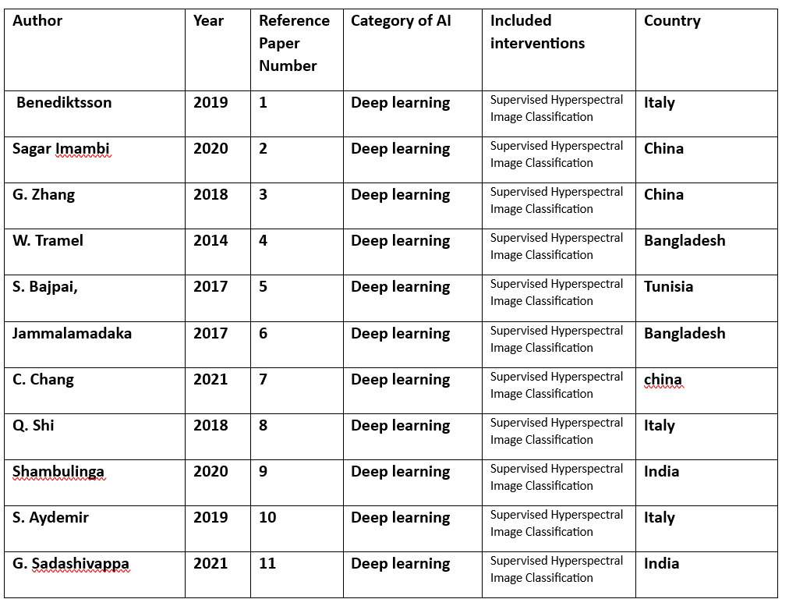
LITERATURE WORK:-
(ICSMDI)

Slide 11
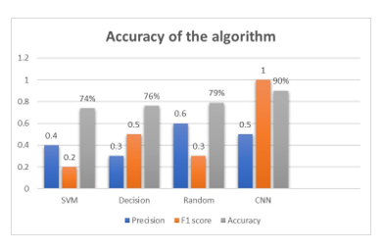
RESULTS & DISCUSSION:-
(ICSMDI)
Results

Slide 12
(ICSMDI)
DISCUSSION
We will discuss the various challenges and limitations of using Object Detection Using Deep Learning Techniques:-
The use of hyperspectral imaging and machine learning algorithms, specifically the CNN method, for classification of the Indian Pines dataset. The study explores the effect of different patch sizes and dimensionality reduction techniques on classification accuracy and computational time.
A comparison is made between the CNN method and the support vector machine (SVM) algorithm, with and without the use of spatial features such as guided image filters and bilateral filters. While the CNN method achieves higher classification accuracy, it also requires more processing time compared to the SVM algorithm.

Slide 13
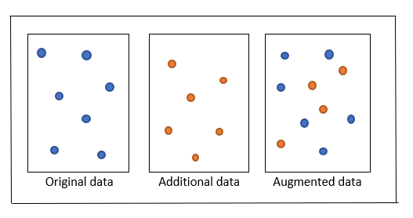
COMPARATIVE ANALYSIS:-
(ICSMDI)
Data Augmentation

Slide 14
Conclusion & Future work
(ICSMDI)
Our research's primary goal is to describe the various picture recognition approaches, with a particular technique of using hyper-spatialized images and a convolutional neural network for image classification
The inclusion of spatial components categorization has significantly improved the accuracy of image classification
The patch size used for categorization has a direct impact on the accuracy of the convolutional neural network, and a patch size of 13x13 is found to be the most effective
Compared to other classifiers, the convolutional neural network requires more computing time for training and testing.
The future scope is to develop CNN using to classify the images also.

Slide 15
REFERENCES:-
(ICSMDI)
REFERENCES:-
Deep Learning for Hyperspectral Image Classification: An Overview, S. Li, W. Song, L. Fang, Y. Chen, P. Ghamisi, and J. A. Benediktsson, IEEE Transactions on Geoscience and Remote Sensing, vol. 57(9), pp.. 66906709, 2019.
Sagar Imambi, S., Mandhala, V.N., Naaz, M.A.” The Amalgamation of Machine Learning and LSTM Techniques for Pharmacovigilance”, Lecture Notes in Networks and Systems, 2020, 105, pp. 123–132.
B. Tu, J. Wang, X. Kang, G. Zhang, X. Ou and L. Guo, "KNN-Based Representation of Superpixels for Hyperspectral Image Classification," in IEEE Journal of Selected Topics in Applied Earth Observations and Remote Sensing, vol. 11, no. 11, pp. 4032-4047, Nov. 2018.
IEEE China Summit & International Conference on Signal and Information Processing, Xi'an, 2014, pp. W. Li, S. Prasad, E. W. Tramel, J. E. Fowler, and Q. Du, "Decision fusion for hyperspectral image classification based on minimumdistance classifiers in thewavelet domain,". 162165.
S. Bajpai, H. V. Singh and N. R. Kidwai, "Feature extraction and classification of hyperspectral images using singular spectrum analysis and multinomial logistic regression classifiers," 2017 International Conference on Multimedia, Signal Processing and Communication Technologies (IMPACT), Aligarh, 2017, pp. 97-100. Using principal component analysis and deep learning, Q. Sun, X. Liu, and M. Fu classified a hyperspectral picture, International Conference on Electronics Information and Emergency Communication, 2017, pp. 356-359.
Jammalamadaka, K., Parveen, N. “Testing coverage criteria for optimized deep belief network with search and rescue”, Journal of Big Data, 2021, 8(1), 59.

Slide 16
(ICSMDI)
S. Zhong, C. Chang and Y. Zhang, "Iterative Support Vector Machine for Hyperspectral Image Classification," International Conference on Image Processing, 2018, pp. 3309-3312.
Few-Shot Hyperspectral Image Classification With Unknown Classes Using Multitask Deep Learning, IEEE on Geoscience and Remote Sensing, 2020; S.Liu, Q. Shi, and L. Zhang.
Shambulinga M and Sadashivappa G., "Hyperspectral Image Classification Support Vector Machine with Guided Image Filter" International Journal of Advanced Computer Science and Applications, vol. 10(10), 2019.
Semisupervised Hyperspectral Image Classification Using Deep Features, M. S. Aydemir and G. Bilgin, IEEE Journal of Selected Topics in Applied Earth Observations and Remote Sensing, vol. 12(9), pp. 3615–3622.
"Supervised Hyperspectral Image Classification Using SVM and Linear Discriminant Analysis" by M. Shambulinga and G. Sadashivappa was published in the International Journal of Advanced Computer Science and Applications on October 10, 2020.
I.Bidari, S.Chickerur, H.Ranmale, S.Talawar, H.Ramadurg and R.Talikoti, "Hyperspectral Imagery Classification Using Deep Learning," Conference on Smart Trends in Systems, Security and Sustainability, 2020, pp. 672-676

Slide 17

(ICSMDI)

