Slide 1
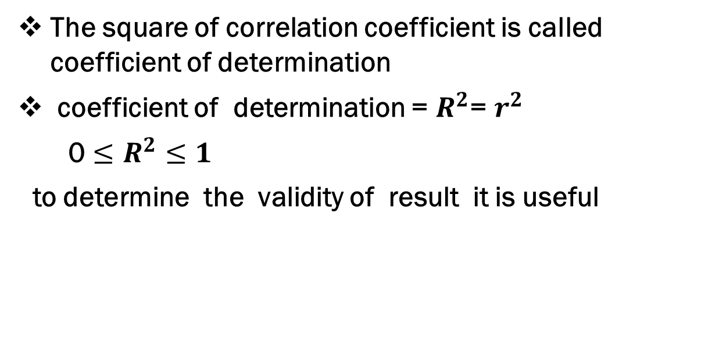
Coefficient of determination
The square of correlation coefficient is called coefficient of determination
coefficient of determination = $R^{2}$= $r^{2}$
0 $≤R^{2}≤1$
to determine the validity of result it is useful

Slide 2
REGRESSION

Slide 3
REGRASSION
FUNCTIONAL RELATIONSHIP BETWEEN DEPENDENT AND INDEPENDENT VARIABLES IS CALLED REGRESSION EQUATION
Concept of regression was given by sir Francis Galton
If a functional relationship between a dependent and independent variables is linear then it is known as simple regression
If a functional relationship between a dependent and two or more independent variables is linear then it is known as multiple regression
In a regression equation a dependent random variable is known as explained or response and independent random variable is called explanatory variable or regressor

Slide 4
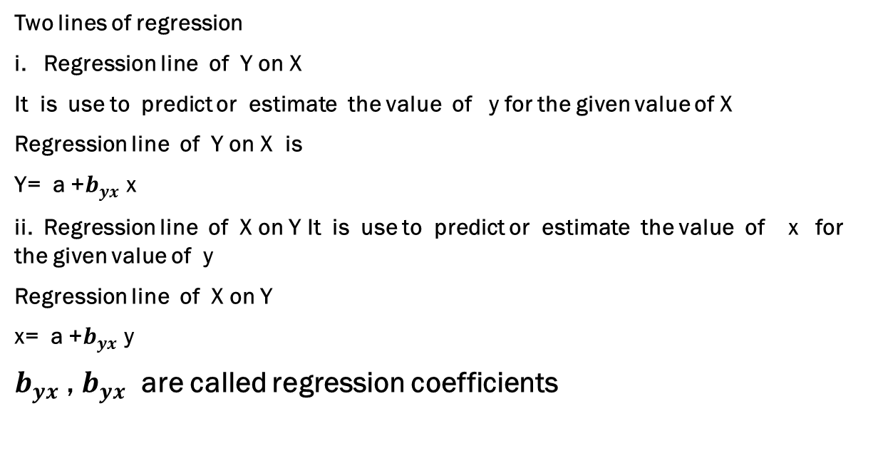
Lines of regression
Two lines of regression
i. Regression line of Y on X
It is use to predict or estimate the value of y for the given value of X
Regression line of Y on X is
Y= a +$b_{yx}$ x
ii. Regression line of X on Y It is use to predict or estimate the value of x for the given value of y
Regression line of X on Y
x= a +$b_{yx}$ y
$b_{yx}$,$b_{yx}$ are called regression coefficients

Slide 5
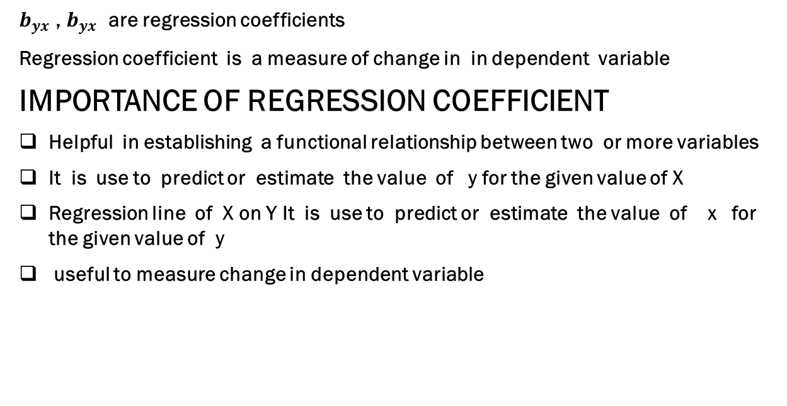
Regression co efficient
$b_{yx}$,$b_{yx}$are regression coefficients
Regression coefficient is a measure of change in in dependent variable
IMPORTANCE OF REGRESSION COEFFICIENT
Helpful in establishing a functional relationship between two or more variables
It is use to predict or estimate the value of y for the given value of X
Regression line of X on Y It is use to predict or estimate the value of x for the given value of y
useful to measure change in dependent variable

Slide 6
Difference between correlation and regression
The degree and direction of relationship between variables can be known
If value of one variable is known the value of other variable can not be estimated
Correlation coefficient lies between -1 and 1
Correlation coefficient is free from change of origin and scale
With the help of Correlation coefficient regression coefficient can be obtained
Independent and dependent variables have no practical significance in correlation analysis
The nature of relationship can be known
If value of one variable is known the value of other variable can be estimated
Only one regression coefficient can be greater then one
regression coefficient is free from change of origin but not free from change of scale
With the help of regression coefficient Correlation coefficient can be obtained
Independent and dependent variables have practical significance in regression analysis

Slide 7
Regression equations
Equation of regression line can be obtained by two methods
scatter diagram method
method of least square

Slide 8
scatter diagram method
In this method independent variables values are shown along the x-axis and dependent variable Y’s values shown along the y-axis
Now pair (x , y) wise points are plotted on the graph paper then a freehand curve is drawn from which most of points are at minimum distance . Obtained diagram is called scatter diagram
Equation of line obtained by taking co-ordinates of any two points on a given curve
Such a line is called a line of best fit and it is known as regression line

Slide 9
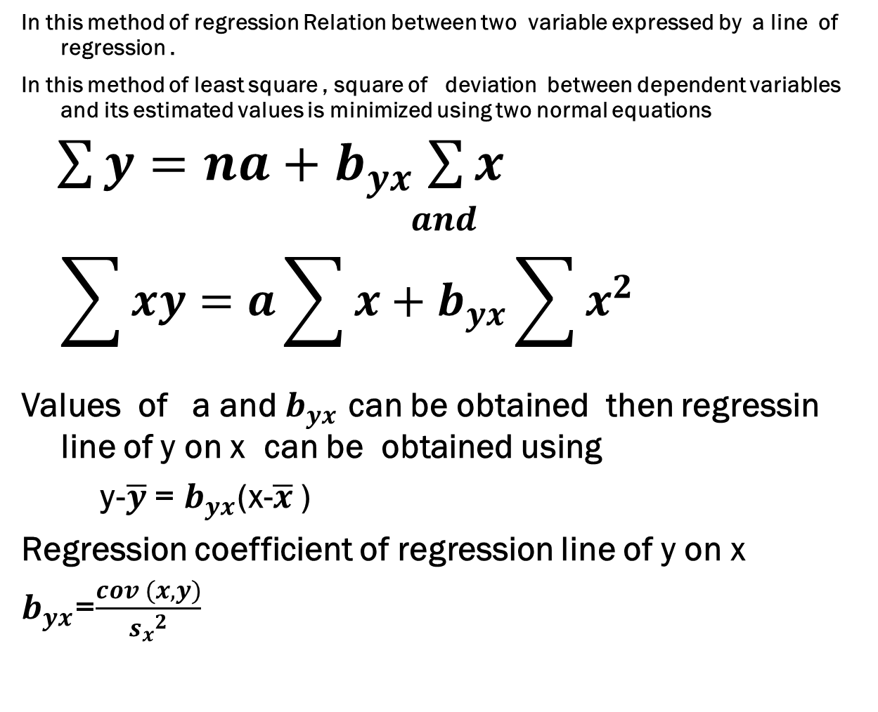
method of least square
In this method of regression Relation between two variable expressed by a line of regression .
In this method of least square , square of deviation between dependent variables and its estimated values is minimized using two normal equations
$\sum{y=na+}$$b_{yx}$$\sum{x }$
$$and$$
$$\sum{xy=a\sum{x+b_{yx}\sum{x^{2}} }}$$
Values of a and $b_{yx}$ can be obtained then regressin line of y on x can be obtained using
y-$\overline{y}$ = $b_{yx}$(x-$\overline{x}$ )
Regression coefficient of regression line of y on x
$b_{yx}$=$\frac{cov (x,y)}{{s_{x}}^{2}}$

Slide 10
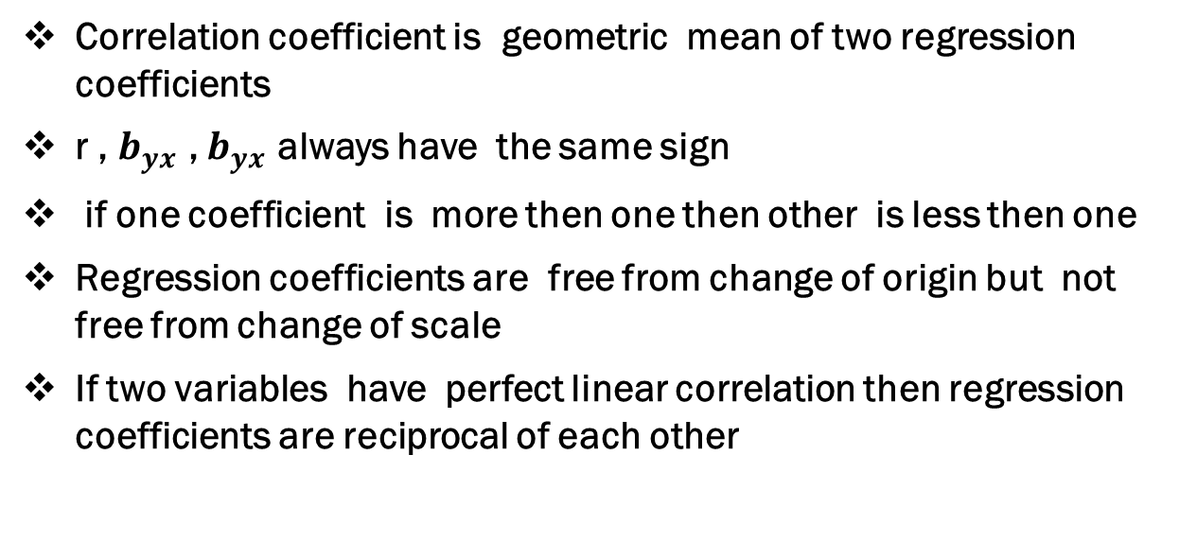
Properties of regression coefficient
Correlation coefficient is geometric mean of two regression coefficients
r , $b_{yx}$,$b_{yx}$ always have the same sign
if one coefficient is more then one then other is less then one
Regression coefficients are free from change of origin but not free from change of scale
If two variables have perfect linear correlation then regression coefficients are reciprocal of each other

