Slide 1
Chapter 3: Memory Management
Memory Management – 15% (Ch.2 & Ch.3)
Paged Memory Allocation
Demand Paging
Page Replacement Policies
Segmented Memory Allocation
Segmented/Demand Paged Memory Allocation
Virtual Memory

Slide 2
Memory Management
Previous memory allocation schemes required the entire program to be loaded in main memory.
Major problems encountered were:
- Fragmentation.
- Overhead due to relocation.
New improved memory allocation schemes help in:
- Eliminating need to store programs contiguously.
- Eliminating need for entire program to reside in memory during execution.

Slide 3
Paged Memory Allocation
PAGES
Based on dividing each incoming job into pages of equal size.
SECTORS
The section of a disk are called sectors.
PAGE FRAME
The memory block size or sections on main memory are known as page frames.
The scheme works efficiently when the pages, sectors and page frames are all of the same size.
- Page size must be Same as memory block size
sectors
The section of a disk are called sectors.
The memory block size or sections on main memory are known as page frames.
The scheme works efficiently when the pages, sectors and page frames are all of the same size.

Slide 4
TASK OF MEMORY MANAGER
Before executing a program, memory manager:
- Determines number of pages in program.
- Locates enough empty page frames in main memory.
- Loads all of the program’s pages into them. (not necessarily contiguous)

Slide 5
Paged Memory Allocation
Memory Manger requires three tables:
Job Table (JT)
- Consists of 2 entries for each active job.
- Maintains size of job & memory location of its page map table.
- Job table is Dynamic – grows/shrinks as jobs loaded/completed.

Slide 6
Paged Memory Allocation
Example of Job Table:

Slide 7
Paged Memory Allocation
Page Map Table (PMT)
- Consists of one entry per page.
- Maintains Page number & corresponding page frame memory address. Page numbers are sequential (Page 0, Page 1 …)

Slide 8
Paged Memory Allocation
The PMT represents location of the line with respect to the job’s pages.
Hence each job page must be correlated to the corresponding page frame and is done through Page Map Table (PMT).
Job Page Number | Page Frame Number
0 | 8
1 | 10
2 | 5
3 | 11
Example of PMT for JOB 1

Slide 9
Paged Memory Allocation
Memory Map Table (MMT)
- Consists of 1 entry for each page frame.
- Maintains location of each page frame and free/busy status for each one.

Slide 10
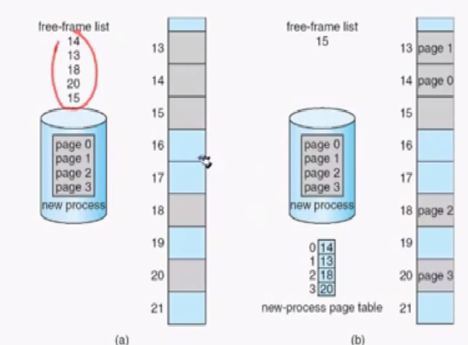

Slide 11
Paged Memory Allocation
Consider the example of JOB 1 with 350 lines.
At compilation time every job is divided into pages:
- Page 0 contains the first hundred lines.
- Page 1 contains the second hundred lines.
- Page 2 contains the third hundred lines.
- Page 3 contains the last fifty lines.
Program has 350 lines.
- Referred to by system as line 0 through line 349.

Slide 12
Paged Memory Allocation
Example where JOB 1 of 350 lines (or bytes) is divided into pages of 100 lines each.
Requires the entire job to be loaded in main memory.
Still a problem of internal fragmentation in the last page.

Slide 13
Paged Memory Allocation
Displacement or offset
- Indicates how far a line is from the beginning of its page.
- A factor used to locate the line within its page frame.
- It is a relative factor.
For example,
lines 0, 100, 200, and 300 has displacement of zero.
To access line 214
go to Page 2 and then go to line 14 (fifteenth line).
The OS uses an algorithm (simple arithmetic calculation) to calculate the page and displacement.

Slide 14
Paged Memory Allocation
Dividing the line number by the page size, keeping the remainder as an integer gives the address of given program line.
The resulting Quotient gives the page number and the remainder is the displacement within that page.
Page number
Page size line number to be located
xxx
xxx
xxx
Displacement

Slide 15
To find the exact location of a line in main memory
Find the displacement and page number using the algorithm.
Refer to job’s PMT and identify the corresponding page frame number.

Slide 16
To find the exact location of a line in main memory
Get the address of the beginning of page frame using:
ADDR_PAGE_FRAME = PAGE_FRAME_NO * PAGE_SIZE
Add the displacement to the starting address of page frame to compute the precise location in memory using:
ADDR_IN_MEM = ADDR_PAGE_FRAME + DISPL

Slide 17
Paged Memory Allocation
Advantages
Allows jobs to be allocated in non-contiguous memory locations.
- Memory used more efficiently; more jobs can fit.
Disadvantages
Size of page is crucial (not too small, not too large).
Increased overhead occurs.
Reduces, but does not eliminate, internal fragmentation.

Slide 18
Demand Paging
Demand paging made virtual memory widely available.
- Can give appearance of an almost infinite or nonfinite amount of physical memory.
The use of a high-speed direct access storage device that can work directly with CPU.

Slide 19
Demand Paging
Pages must be passed quickly from secondary storage to MM and back again .
How and when the pages are passed (or “swapped”) depends on predefined policies.

Slide 20
Tables in Demand Paging
Job Table.
Page Map Table (with 3 new fields).
- STATUS: If requested page is already in memory.
- MODIFIED: Determines if page contents have bee modified.
- REFRENCED: Determines if the page has been referenced recently.
Memory Map Table.

Slide 21
Demand Paging (DP)
Page Map Table

Slide 22
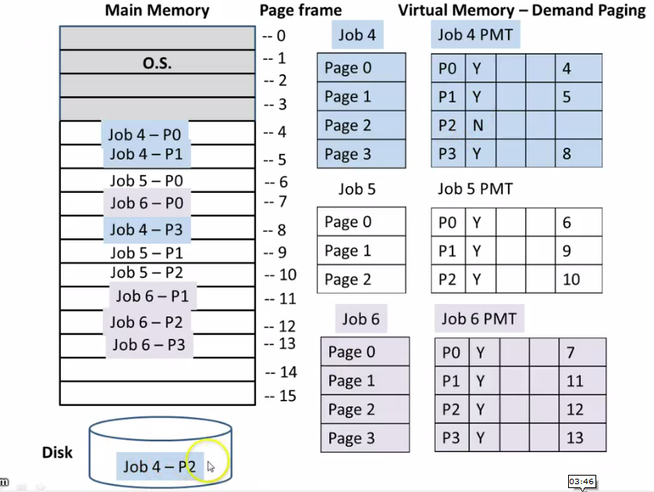

Slide 23
Demand Paging (DP)
Such a swap requires close interaction between:
Hardware Components
Software Algorithms
Policy Schemes
Hardware components:
- Generate address of the required page
- Find the page number.
- Determine whether the page is in memory.

Slide 24
Hardware Instruction Processing Algorithm
Start processing instruction
Generate data address
Compute page number
If page is in memory
Then
get data and finish instruction
advance to next instruction
return to step 1
Else
generate page interrupt
call page fault handler End if

Slide 25
Page Fault Handler
When Page is not found in main memory Page Fault Handler (section of OS that resolves these problems) comes into picture.
Determines if free page frames are there in main memory.
Decides to swap some pages out of main memory if enough free page frames are not available in main memory.

Slide 26
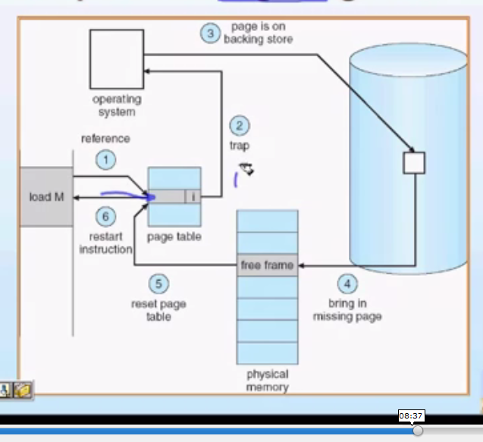

Slide 27
Page Fault Handler Algorithm
If there is no free page frame
Then
Select page to be swapped out using page removal algorithm
Update job’s PMT
If content of page had been changed then
Write page to disk
End if
End if

Slide 28
Page Fault Handler Algorithm
2. Use page number from step 3 (0f algorithm 1)to get disk address where the requested page is stored.
3. Read page into memory.
4. Update job’s PMT
5. Update MMT
6. Restart interrupted instruction

Slide 29
Disadvantage
Thrashing – an excessive amount of page swapping back and forth between main memory and secondary storage.
A page is removed from memory but is called back shortly thereafter.
Can occur across jobs, when a large number of jobs are vying for a relatively few number of free pages.
Can happen within a job (e.g., in loops that cross page boundaries).
Page fault – a failure to find a page in memory.

Slide 30
Page Replacement Policies and Concepts
Policy that selects page to be removed is crucial to system efficiency.
- Selection of algorithm is critical.
First-in first-out (FIFO) policy* – best page to remove is one that has been in memory the longest.
Least-recently-used (LRU) policy* – chooses pages least recently accessed to be swapped out.
Most recently used (MRU) policy.
Least frequently used (LFU) policy.

Slide 31
Page Replacement Policies and Concepts
FIFO Policy - Consider four pages A, B, C and D for a Job.
The job to be processed needs its pages in the following sequence:
A, B, A, C, A, B, D, B, A, C, D

Slide 32
Page Replacement Policies and Concepts
When program is ready to be processed all 4 pages are on secondary storage.
Throughout program, 11 page requests are issued.
When program calls a page that isn’t already in memory, a page interrupt is issued (shown by *).
Results in 9 page interrupts.
Hence the failure rate of the system is 9 / 11 i.e. almost 82%.
Success rate of the system is 2 / 11 i.e. almost 18%

Slide 33
Page Replacement Policies and Concepts
High failure rate shown in previous example caused by:
- Limited amount of memory available.
- Order in which pages are requested by program (can’t change).
There is no guarantee that more memory will always result in better performance.

Slide 34
Page Replacement Policies and Concepts
LRU Policy - Consider four pages A, B, C and D for a Job.
The job to be processed needs its pages in the following sequence:
A, B, A, C, A, B, D, B, A, C, D

Slide 35
Page Replacement Policies and Concepts
8 page interrupts result.
Hence the failure rate of the system is 8 / 11 i.e. almost 64%.
Success rate of the system is 3 / 11 i.e. almost 27%.
The efficiency of LRU is only slightly better than with FIFO.

Slide 36
Page Replacement Policies and Concepts
Four possible combinations of modified and referenced bits:
Modified
Referenced
Meaning
Case 1
0
0
Not modified AND not referenced
Case 2
0
1
Not modified BUT was referenced
Case 3
1
0
Was modified BUT not referenced (impossible?)
Case 4
1
1
Was modified AND referenced

Slide 37
Page Replacement Policies and Concepts
Advantages and Disadvantages of Demand Paging
First scheme in which a job was no longer constrained by the size of physical memory (virtual memory).
Uses memory more efficiently than previous schemes because sections of a job is not at all loaded into memory unless specifically requested.
Increased overhead caused by tables and page interrupts.

Slide 38
Segmented Memory Allocation
A segment is a logical unit such as: main program, subroutine, procedure, function etc.
Each job is divided into several segments of different sizes, mainly carried out with an objective of reducing page faults.
Moreover Main memory is not divided into page frames because size of each segment is different.
Memory is allocated dynamically like dynamic partitions.

Slide 39
Segmented Memory Allocation
Segment Map Table
Each segment is numbered and a Segment Map Table (SMT) is generated for each job.
Segment Map Table Contains:
- Segment numbers
- Length of segment
- Access rights
- Status
- Location of segment in memory.

Slide 40
Segmented Memory Allocation
0
.
.
.
3000
4000
7000
0
.
.
.
.
.
349
0
.
.
.
199
0
.
.
99
Segment No. | Size | Status | Access | Memory Address
0 | 350 | Y | E | 4000
1 | 200 | Y | E | 7000
2 | 100 | N | E
Main Program
Operating
System
Empty
Segment Map Table
Main
Program
Subroutine A
Other
Program
Subroutine A
Subroutine B
Other
Program
Segment Map Table tracks each segment for Job 1

Slide 41
Segmented Memory Allocation
Tables :
- Job Table (JT) lists every job in process (one for whole system).
- Segment Map Table lists details about each segment (one for each job).
- Memory Map Table monitors allocation of main memory (one for whole system).

Slide 42
Segmented Memory Allocation
DISADVANTGE
Return of external fragmentation as memory is allocated dynamically.
Recompaction of available memory is necessary from time to time.
Difference between Paging and Segmentation:
- Pages are of fixed size.
- Segments consists of variable sizes.

Slide 43
Segmented / Demand Paged Memory Allocation
Combination of segmentation and demand paging.
- Logical benefits of segmentation.
- Physical benefits of paging.
Subdivides each segment into pages of equal size, smaller than most segments, and more easily manipulated than whole segments.
Eliminates many problems of segmentation because it uses fixed length pages.

Slide 44
Segmented / Demand Paged Memory Allocation
Tables:
Job Table lists every job in process (one for whole system).
Segment Map Table lists details about each segment (one for each job).
- E.g., protection data, access data.
Page Map Table lists details about every page (one for each segment).
- E.g., status, modified, and referenced bits .
Memory Map Table monitors allocation of page frames in main memory (one for whole system).

Slide 45
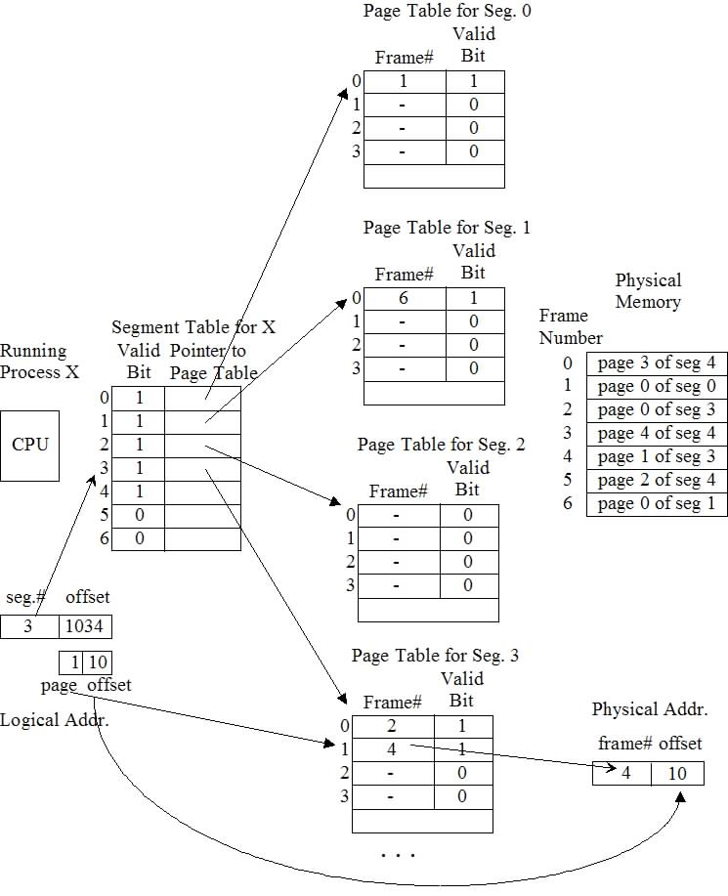

Slide 46
Segmented / Demand Paged Memory Allocation
DISADVANTAGE
- Overhead required for the extra tables.
- Time required to reference segment table and page table.

Slide 47
Virtual Memory - VM
The capability of moving pages between primary memory and secondary memory gave way to new concept known as Virtual Memory.
In other words Virtual Memory is, using a disk as an extension of RAM so that the effective size of usable memory grows correspondingly.

Slide 48
Virtual Memory
Virtual memory is a feature of an operating system that enables a process to use a memory (RAM) address space that is independent of other processes running in the same system, and use a space that is larger than the actual amount of RAM present, temporarily relegating some contents from RAM to a disk, with little or no overhead.
VM is implemented through demand paging and segmentation schemes.

Slide 50
ADVANTAGES
Works well in a multiprogramming environment because most programs spend a lot of time waiting.
Job’s size is no longer restricted to the size of main memory .
Memory is used more efficiently.
Eliminates external fragmentation when used with paging and eliminates internal fragmentation when used with segmentation.

Slide 51
DISADVANTAGES
Increased processor hardware costs.
Increased overhead for handling paging interrupts.
Increased software complexity to prevent thrashing.

