Slide 1
Introduction to System Analysis & Design

Slide 2
What is this IT?
IT : Hardware + Software + Services
(Used to Manage, Access, Communicate & Share Information)
Successful Firms treat Information as vital asset that must be used effectively, updated constantly and safeguarded carefully.

Slide 3
Role of S A D
It is step by step process for developing high end Information Systems.
Information Systems = IT + People + Data
(To Support Business requirements)
IT Dept. team has System Analyst who plan, develop & Maintain system.

Slide 4
Options for development
In-house applications
Software Packages.
Internet-based application services.
Outsourcing
Custom Solutions from IT Consultants
Enterprise wide software strategies.
Important thing is to be clear with objective

Slide 5
Information System
Every system requires input data.
In an information system, data consists of basic facts that are system’s raw material.
Information is data that has been transformed into output that is valuable to user.
Ex: Order Processing System (customer number, product code, quantity is given & order is created by system)
Large biz with millions of transactions will have company wide Information system & powerful server.

Slide 6

Information System Components
Information System
People
Processes
Data
Software
Hardware
Notes:
s/w – sytem, app. App- horizontal, vertical & legacay
Data – table

Slide 7
Organizational Structure
Top Managers
Middle Managers & Knowledge Workers
Supervisors &
Team Leaders
Operational Employees
Organizational Levels

Slide 8
The System Analyst Position
System Analyst investigates, analyzes, designs, develops, installs, evaluates & maintains a company’s Information system.
To do all this tasks they continuously interact with users & managers.
On large project SA works as a part of IT team while on smaller one he/she works alone.
Smaller companies uses consultants to perform analysis work on an as-needed basis

Slide 9
Responsibilities:
Overlaps biz & technical issues. They help in translating biz requirements into IT projects.
They help to document biz profiles, review biz processes, select h/w & s/w packages, design Information systems, train users & plan e-commerce websites.
They plans projects, develop schedules& estimates costs & analysis benefits.
To keep everyone informed, analysts conducts meetings, presentations, write memos, reports & documentation.

Slide 10
Required Skills:
Solid Technical knowledge
Strong oral & written communication skills
Good analytical ability
Good understanding of biz operations & processes.
Good interpersonal skills to interact with people at all levels.
Leads IT team so must have leadership qualities.

Slide 11
Background:
Companies typically require that analysts have a collage degree in information systems, computer science, business, or closely related field, and some IT experience.
For higher level positions in bigger companies, they require master of science degree & additional experience.

Slide 12
Categories of Business Systems
Today new set of systems are taken into use in business, they are:
OAS
TPS
MIS
DSS

Slide 13
Office Automation Systems (OAS)
Office automation refers to the varied computer machinery and software used to digitally create, collect, store, manipulate, and relay office information needed for accomplishing basic tasks.
Raw data storage, electronic transfer, and the management of electronic business information comprise the basic activities of an office automation system.
Office automation helps in optimizing or automating existing office procedures.

Slide 14
OAS
The backbone of office automation is a LAN, which allows users to transfer data, mail and even voice across the network.
All office functions, including dictation, typing, filing, copying, fax, records management, telephone and telephone switchboard operations, fall into this category.
Many of the manual tasks that used to be done by hand can now be done through hand held devices & Sensor devices.
Office payrolls have been automated which means no one has to manually cut checks, and those checks that are cut can be printed through computer programs. Direct deposit can be automatically set up and this further reduces the manual process and most employees who participate in direct deposit often find their paychecks come earlier than if they'd have to wait for their checks to be written and then cleared by the bank.
Other ways automation has reduced employee manpower on tasks is automated voice direction. Through the use of prompts, automated phone menus and directed calls, the need for employees to be dedicated to answer the phones has been reduced, and in some cases, eliminated.

Slide 15
OAS
Advantages are:
Office automation can get many tasks accomplished faster.
It eliminates the need for a large staff.
Less storage is required to store data.
Multiple people can update data simultaneously in the event of changes in schedule

Slide 16
Transaction Processing system (TPS)
A transaction process system (TPS) is an information processing system for business transactions involving the collection, modification and retrieval of all transaction data.
Characteristics of a TPS include performance, reliability and consistency.
TPS is also known as transaction processing or real-time processing.

Slide 17
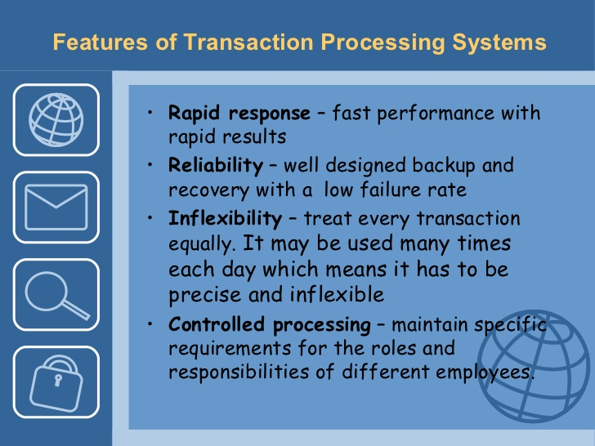
TPS
Characteristics:

Slide 18
TPS
Customer Order Processing
Verify Customer Data
Check Credit Status
Post to accounts receivable
Check In-stock status
Adjust Inventory Data
Update Sales Activity File
TP System process data generated by day-to-day business operations.
It is mission critical system.
Ex: Customer Order Processing

Slide 19
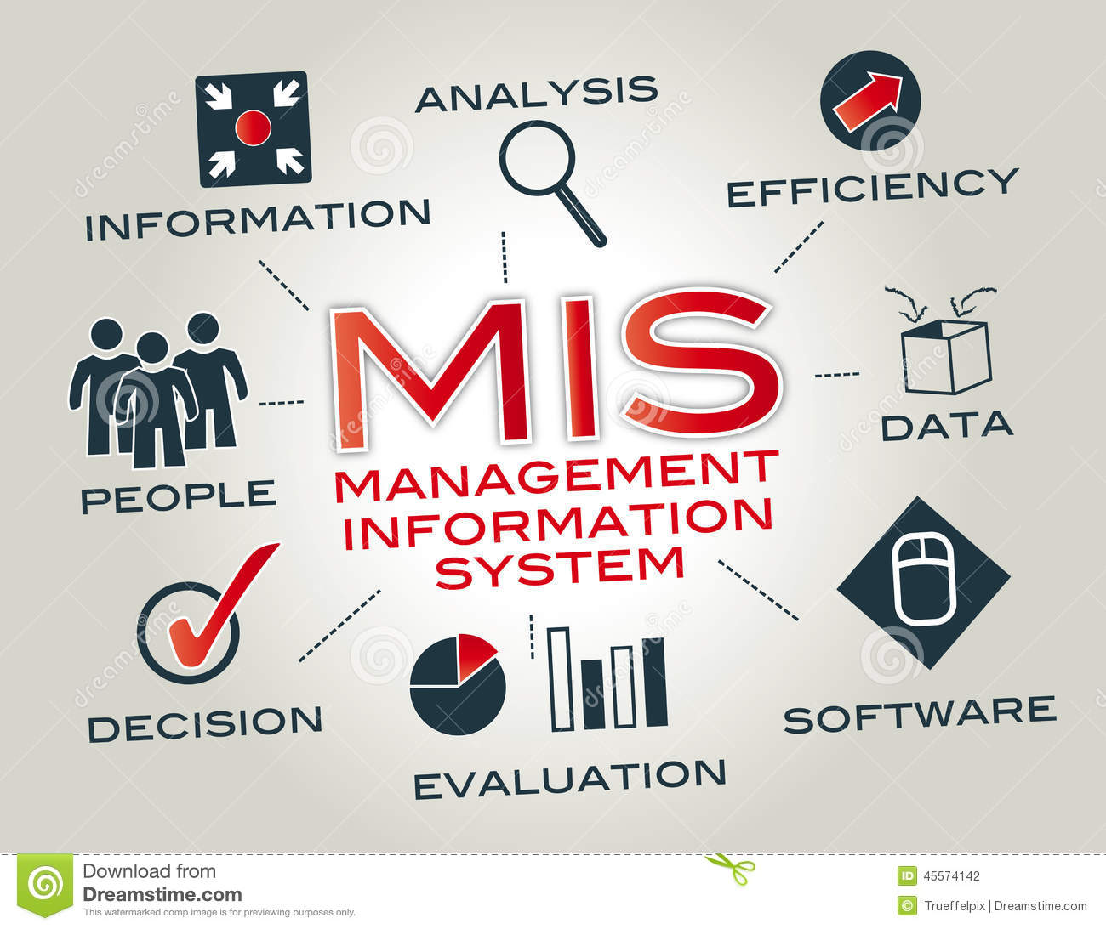
Management Information System (MIS)
A management information system (MIS) is a computerized database of financial information organized and programmed in such a way that it produces regular reports on operations for every level of management in a company. It is usually also possible to obtain special reports from the system easily.
The main purpose of the MIS is to give managers feedback about their own performance; top management can monitor the company as a whole.
Information displayed by the MIS typically shows "actual" data over against "planned" results and results from a year before; thus it measures progress against goals.

Slide 20
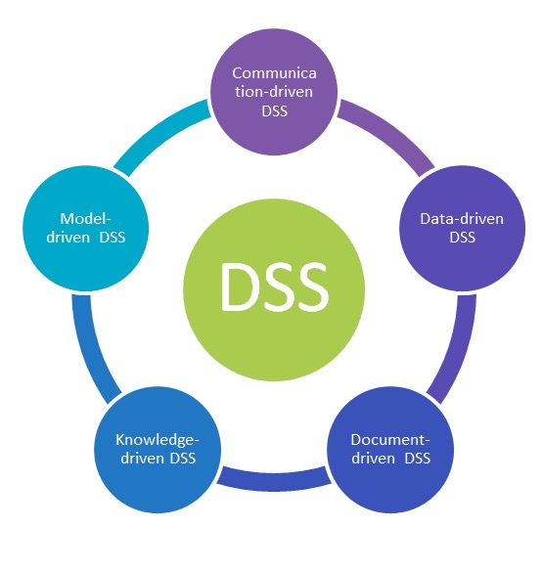
Decision support system
A decision support system (DSS) is a computer-based information system that supports business or organizational decision-making activities.
DSSs serve the management, operations, and planning levels of an organization (usually mid and higher management) and help people make decisions about problems that may be rapidly changing and not easily specified in advance.
Decision support systems can be either fully computerized, human-powered or a combination of both.
While academics have perceived DSS as a tool to support decision making process, DSS users see DSS as a tool to facilitate organizational processes.

Slide 21
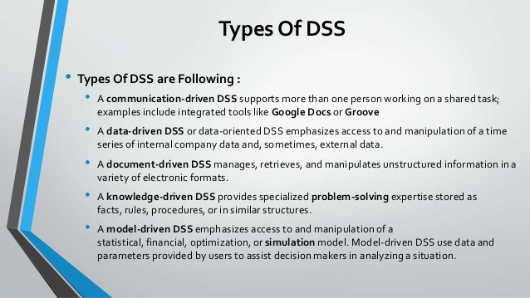

Slide 22
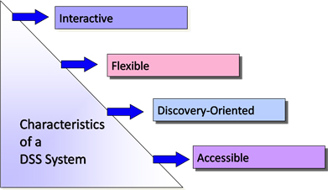
Characteristics
DSS tends to be aimed at the less well structured, underspecified problem that managers typically face;
DSS attempts to combine the use of models or analytic techniques with traditional data access and retrieval functions;
DSS specifically focuses on features which make them easy to use by non-computer-proficient people in an interactive mode; and
DSS emphasizes flexibility and adaptability to accommodate changes in the environment and the decision making approach of the user.
Maximum Possible Interaction with Managers.
Rigidity should be avoided because of changing scenarios & circumstances.
Should lead to results by new discoveries on changing events.
Must be easily accessible by all.

Slide 23
Outcomes
Typical information that a decision support application might gather and present includes:
inventories of information assets (including legacy and relational data sources, cubes, data warehouses, and data marts),
comparative sales figures between one period and the next,
projected revenue figures based on product sales assumptions.

Slide 24
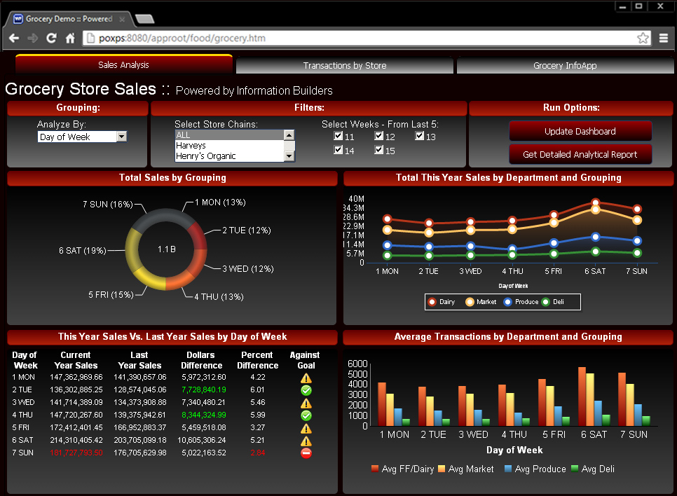
Demo window

Slide 25
Enterprise Computing System
This refers to company wide information system that supports both its Operations & data management requirements.
for ex: US Pizza, Jet Airways
Main objective of ECS is to integrate company’s primary functions (Productions, sales, accounts, services) to improve efficiency, reduce costs & have help in decision making.
Companies use ERP (Enterprise Resource Planning) applications to provide cost effective support for users & Managers both.
SAP - a German multinational software firm is leading developer of Enterprise software

Slide 26
System Development Strategies
Along with understanding biz operations, system analysts must know how to use different techniques to plan, design & implement information systems.
Analysts work with these tools & techniques along with input from users, managers & IT staff to develop an efficient design.

Slide 27
System Development Techniques & Tools
System analysts must also know how to use different techniques like Classical, Structured & Prototyping kind of development strategies to plan, design, and implement information systems.

Slide 28
Structured Analysis
It is traditional system development technique i.e. time-tested & easy to understand.
It uses series of stages called System Development Life Cycle (SDLC).
As it is based on detailed plan, just like a blue print of a building it is also called predictive approach.
It uses set of process models to describe system graphically & as it focuses on processes that transforms data into useful information, It is also called process-centered technique.

Slide 29
Structured Analysis
Students
Student
Data
Register
Students
Registration
Data
OUTPUT
INPUT
Attendance
Registers
Course
Data
Courses
Process Model for School Registration System

Slide 30
Predictive Method (structured)
As it is predictive method, structured analysis divides development process into series of stages called SDLC which is also called waterfall model.
One more method is followed in structured approach which is called SPIRAL Model.

Slide 31
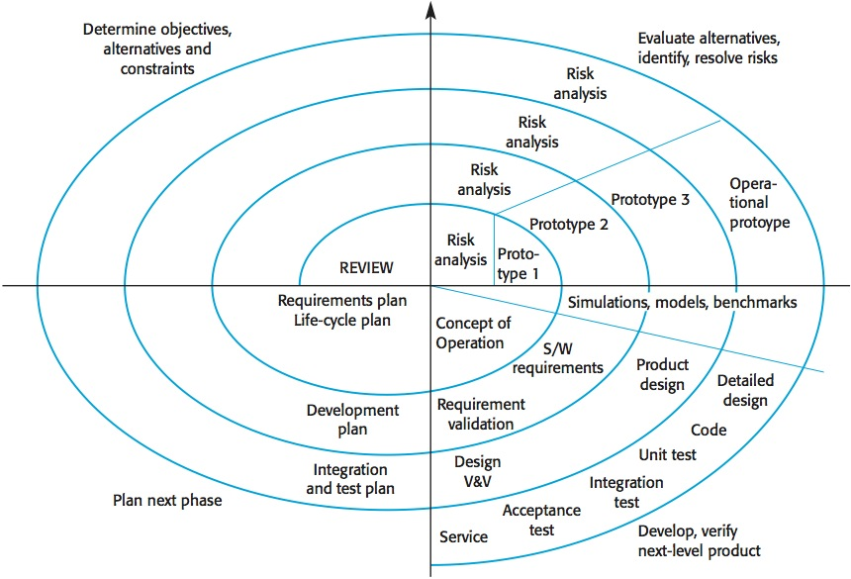
Spiral Model

Slide 32
Stages & Tasks in Spiral Model
STAGE | TASKS
Planning | Define Objectives, constraints & deliverables
Risk Analysis | Identify risks & develop acceptable solutions
Engineering | Develop a prototype that includes all deliverables
Evaluation | Perform assessment & testing to develop objectives for next iteration

Slide 33
Quadrant 1
Objectives: functionality, performance, hardware/software interface, critical success factors, etc.
Alternatives: build, reuse, Purchase, sub-contract, etc.
Constraints: Cost, Schedule, Interface, etc.

Slide 34
Quadrant 2
Study alternatives: relative to objectives and constraints
Identify risks: lack of experience, new technology, tight schedules, poor process, etc.
Resolve risks: evaluate if money could be lost by continuing system development & develop reasonable solution for it.

Slide 35
Quadrant 3
Typical activities to develop & verify next level product:
Create a design
Review design
Develop code
Inspect code
Test product

Slide 36
Quadrant 4
Typical activities to plan next phases:
Develop project development plan
Develop Requirements Plan
Develop an integration & test plan
Develop an installation plan

Slide 37
Systems Development Methods
Structured Analysis
Deliverable or end product
Disadvantage in the built-in structure of the SDLC, because the waterfall model does not emphasize interactivity among the phases
This criticism can be valid if the SDLC phases are followed too rigidly otherwise two consecutive phases can interact with each other.

Slide 38
Prototyping
It tests system concepts & provides an opportunity to examine I/O & user interfaces before final decisions are made.
A Prototype is like a early working model of an info. System.
It can serve as a initial model which can be used as a benchmark for further development or evaluation of finished system.
It can be very valuable if it is based on careful fact finding & modeling technique.
Disadvantage: important decisions might be made too early, before biz or IT issues are understood easily.

Slide 39
Reasons for Systems Initiation
Marketing trends, customer choices & other valuable info is required.
Email, SMS & automatic calling facility on package arrival
Systems Request
Improved Services
Better Performance
More Information
Support for New Products & Services
Stronger Controls
Reduced Cost
Levels of user access, password, encryption or coding of date
On multiple request system might respond slowly
Current system is expensive to operate, maintain due to design, technical problems or changing demands
Providing customers with their information on online portal

Slide 40
Systems Review Committee
Committee consists of Top Managers, IT director & managers of several other departments. IT director is included for technical assistance.
Large companies use a system review committee instead of relying on an individual as it provides a variety of experience and knowledge.
Also team can establish priorities more effectively as biasness wont have more impact in decisions.
But with committee approach, Delay in decisions may occur.
Smaller firms rely on single person.
Goal is to evaluate system requests and to set priorities.
Suppose certain times if there are multiple requests coming together from different departments, which one is more critical should be decided on the basis of their Feasibility Study.

Slide 41
Review Committee Method Evaluating Feasibility
First step in evaluation is to identify and remove systems requests that are not feasible.
Ex: h/w or s/w required for system is already once rejected by company.
Certain times necessity of feasible request is also considered.
Ex: change in design or types of report. User must be trained to do it themselves as per their need, rather than designing & developing new report.
Conditions may change as project progresses like costs may increase or management may loose confidence in project so feasibility analysis must be performed throughout system development.

Slide 42
Review Committee Method Setting Priorities
After rejecting systems that are not feasible now committee must establish priorities for the remaining items.
Highest priority goes to projects that provide the greatest benefit, at the lowest cost, in the shortest period of time.
Factors that affect priority:
Will Proposed system reduce costs? Where? How? How much?
Will system increase revenue for the company? Where? When? How?
Will system serve customers better? How?
Will system serve organization better? In what ways?
Can project be implemented in reasonable time? How long result will last?
Are necessary resources available?

Slide 43
Review Committee Method Discretionary & Non Discretionary Projects
When Management has a choice in Implementing project than it is called Discretionary project. Ex: Change in User Reports.
When No choice exists and change is inevitable in projects than it is called Non Discretionary project. Ex: Adding report specified by govt. law

Slide 44
Preliminary Investigation Overview

Slide 45
Preliminary Investigation Overview
Define the Project Scope and Constraints
Project scope : Defining the specific boundaries, or extent, of the project. Some analyst find it helpful to define scope by creating list with sections called Must Do, Should Do, Could Do & Won’t Do.
Project creep: Projects with general scope definitions are at risk of expanding gradually, without specific authorization, in a process called project creep.
Constraint: It is a requirement or condition that system must satisfy or an outcome that system must achieve. It can involve h/w, s/w, time, policy, law or cost.
Present v/s Future
Internal v/s External
Mandatory v/s Desirable
Regardless of the type, all constraints should be identified as early as possible to avoid future problems and surprises

Slide 46
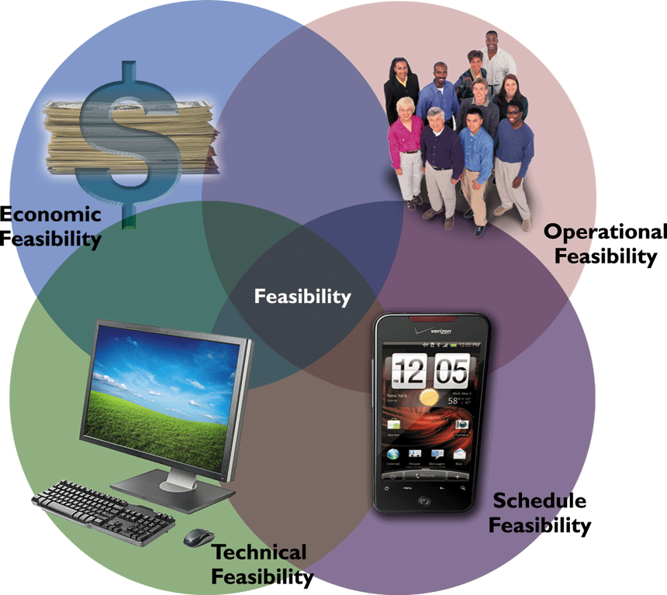
Feasibility Study
A system request must pass several tests, called a feasibility study, to see whether it is worthwhile to proceed further.
Four major feasibilities which is been looked Upon are:
1. Operational
2. Technical
3. Economic
4. Schedule

Slide 47
Operational & Technical Feasibility
Operational Feasibility: This means that proposed system will be used effectively after it has been developed. If users will have difficulty in operations than it can’t produce expected benefits. It depends on questions like:
Will new system result in workforce reduction? If so, what will happen to affected employees?
Will new system place any new demands on users or require any operating changes?
Technical Feasibility: It refers to technical resources needed to develop, purchase, install, or operate new system. Following points are considered in this:
Does company have necessary h/w, s/w & n/w resources? If not, can those be acquired without difficulty?
Does company have needed technical expertise?
Does proposed system have sufficient capacity for future needs?

Slide 48
Economic Feasibility
This simply means that the projected benefits of the proposed system outweigh the estimated costs usually considered the total cost of ownership (TCO).
TCO includes all kind of costs like people, h/w, s/w, training, license, facility & setup, cost of delaying development.
Along with TCO, Tangible & Intangible benefits are also assessed.
Tangible benefits are those which can be measured in money.
Overtime, Decreasing need of clerical staff, elimination of production delay due to proper inventory system
Intangible benefits are those which can not be measured in money
Employees’ job satisfaction, increase in productivity, customer satisfaction, Enhancement of company’s Image, etc..

Slide 49
Schedule Feasibility
This means Project can be implemented in an acceptable time frame.
While doing this SA must also check interaction between time and costs. For ex: Increasing speed of project development might also increase project cost.
Other points that should be discussed are:
Has management established a firm TT for project?
Will project be managed properly in scheduled time frame?
Is this right time to develop or implement new system?

Slide 50
Preliminary Investigation Overview
Present Results and Recommendations to Management
The final task in the preliminary investigation is to prepare a report to management
The format of the preliminary investigation report varies from one company to another

Slide 51

Preliminary Investigation Overview
Present Results and Recommendations to Management
Introduction
Systems request summary
Findings (Scope, Constraints & Feasibility)
Recommendations
Project Roles
Time & cost estimates
Expected benefits
Appendix

Slide 52
Institutional vs End-User Applications
Institutional Applications:
It is meant for whole institute i.e. for whole organization
It is developed generally by IT department.
This will have impact on outcomes or performance of whole organization.
More amount of data is processed.
End-user Applications:
It is meant for single user
It is generally developed by single user.
This will have impact on performance of single end user.
Limited amount of data is processed
Horizontal and Vertical Applications

