Slide 1
Introduction
Mathematical models for different types of problems is called mathematical equation
Types of equation
Algebraic equation
Polynomial equations
Transcendental equations
Any equation does not graph as a straight line then the equation in a plane is called non linear
We are familiar with solution of linear equations its very easy too in this chapter we will learn how to solve non linear equations

Slide 2
Solution of non linear equations
Non linear equations are of two types
Polynomials
Transcendental
Methods of finding solution of non linear equations
i)Direct method
ii)Iterative methods

Slide 3
Direct method
Direct method gives the solution of non linear equation in finite number of steps
These methods are capable of giving all the roots at the same time
For example roots of the quadratic equation

Slide 4
Iterative methods
Iterative methods are also known as trial and error methods
It is based on successive approximations
in this method start with one or more initial approximations to the root and obtain a sequence of approximations by repeating a fixed sequence of steps till the solution with reasonable accuracy is obtained
These methods are very cumbersome and time consuming

Slide 5
Iterative Methods of finding solution of non linear equations
Bisection method
Iteration method
False position method (Regula falsi method)
Newton-Raphson method
Secant method

Slide 6
Methods of locating roots
Before discussing about these methods lets see some results without proof useful in solution of these equations
Theorem 1: if f(x) is continuous for a≤x≤b and if f(a) and f(b) are of opposite signs then there exist a number c for which f(c) =0 for a<c<b then c is called a root of equation
Theorem 2: (Rolle’s theorem)
1)if f(x) is continuous in a≤x≤b
2) the derivative f’(x) of f(x) exists in a<x<b
3) f(a)=f(b) = 0
There exist at least one value of x , c such that f’(c)=0 for a<c<b

Slide 7
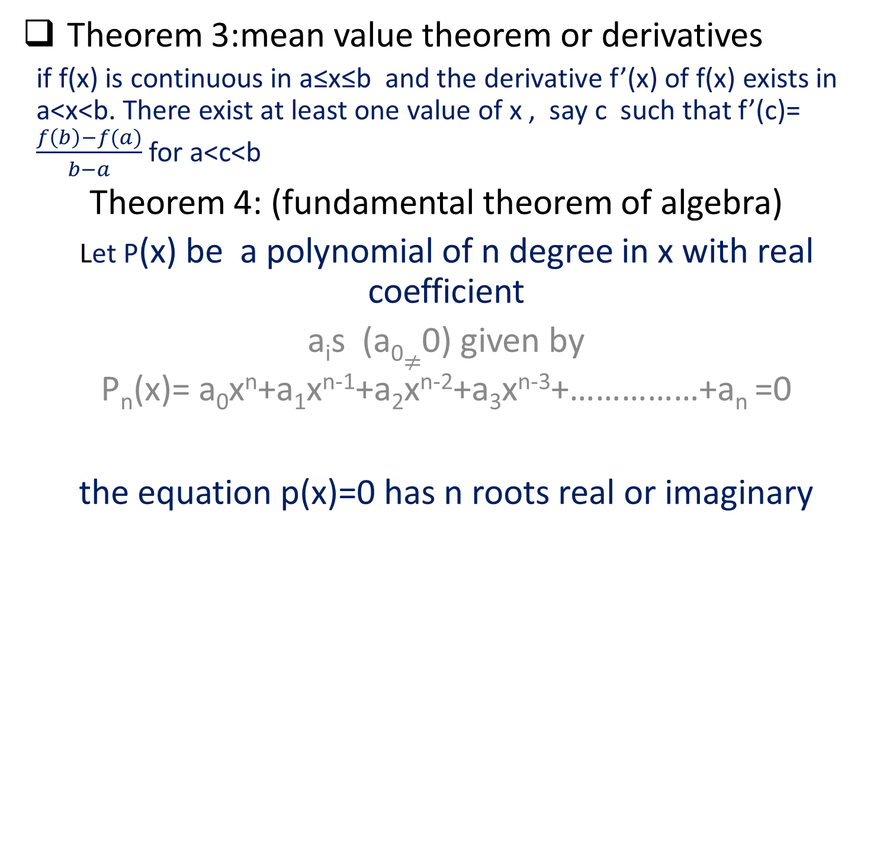
Theorem 3:mean value theorem or derivatives
if f(x) is continuous in a≤x≤b and the derivative f’(x) of f(x) exists in a<x<b. There exist at least one value of x , say c such that f’(c)= $\frac{f\left(b\right)−f(a)}{b−a}$ for a<c<b
Theorem 4: (fundamental theorem of algebra)
Let P(x) be a polynomial of n degree in x with real coefficient
a_{i}s(a₀$≠$0) given by
P_{n}(x)= a₀x^{n}+a₁x^{n-1}+a₂x^{n-2}+a₃x^{n-3}+……………+a_{n} =0
the equation p(x)=0 has n roots real or imaginary

Slide 8
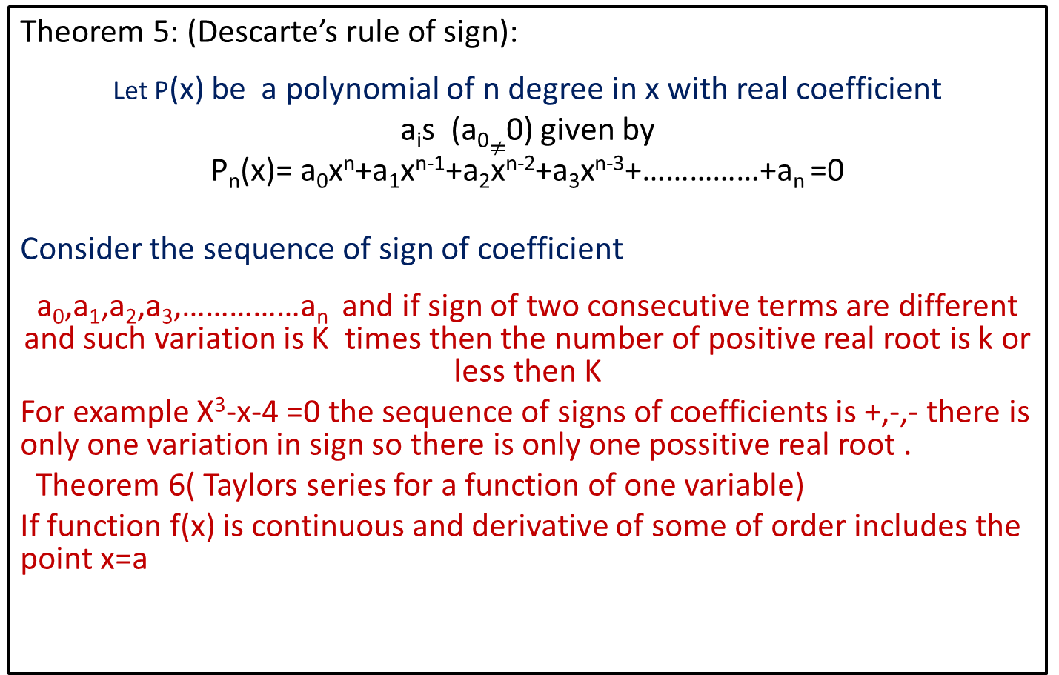
Theorem 5: (Descarte’s rule of sign):
Let P(x) be a polynomial of n degree in x with real coefficient
a_{i}s (a₀$≠$0) given by
P_{n}(x)= a₀x^{n}+a₁x^{n-1}+a₂x^{n-2}+a₃x^{n-3}+……………+a_{n} =0
Consider the sequence of sign of coefficient
a₀,a₁,a₂,a₃,……………a_{n}and if sign of two consecutive terms are different and such variation is K times then the number of positive real root is k or less then K
For example X³-x-4 =0 the sequence of signs of coefficients is +,-,- there is only one variation in sign so there is only one possitive real root .
Theorem 6( Taylors series for a function of one variable)
If function f(x) is continuous and derivative of some of order includes the point x=a

Slide 9
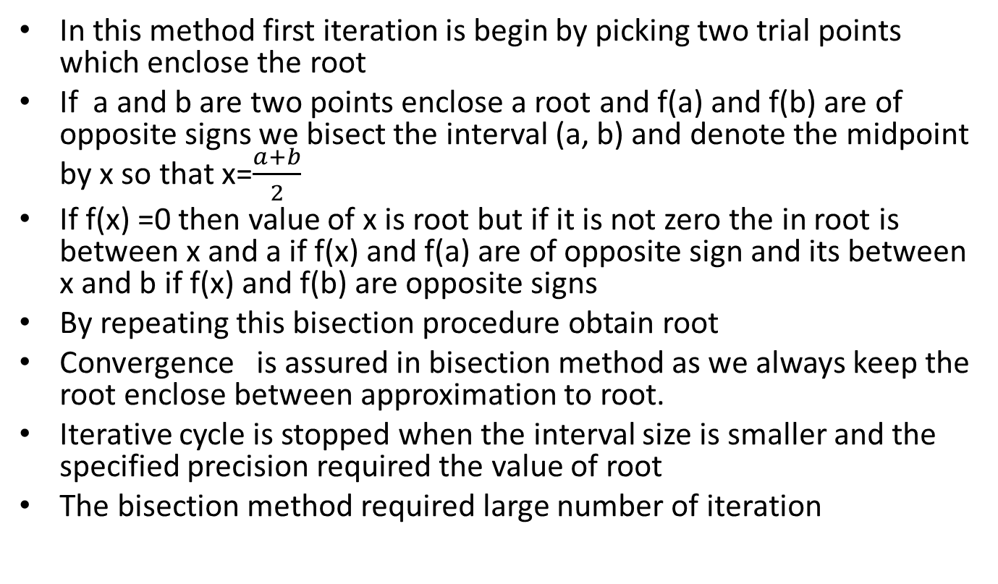
The method of bisection
In this method first iteration is begin by picking two trial points which enclose the root
If a and b are two points enclose a root and f(a) and f(b) are of opposite signs we bisect the interval (a, b) and denote the midpoint by x so that x=$\frac{a+b}{2}$
If f(x) =0 then value of x is root but if it is not zero the in root is between x and a if f(x) and f(a) are of opposite sign and its between x and b if f(x) and f(b) are opposite signs
By repeating this bisection procedure obtain root
Convergence is assured in bisection method as we always keep the root enclose between approximation to root.
Iterative cycle is stopped when the interval size is smaller and the specified precision required the value of root
The bisection method required large number of iteration

Slide 10
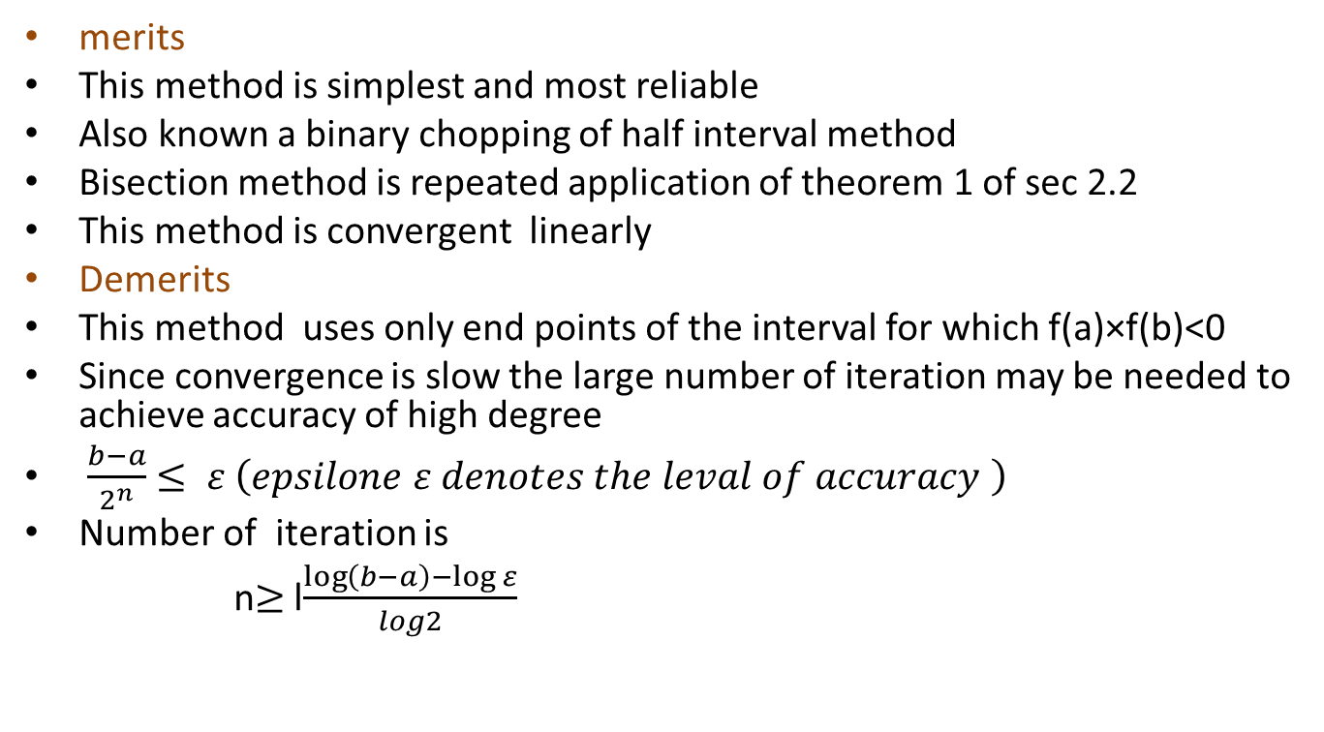
Merit and demerits of bisection method
merits
This method is simplest and most reliable
Also known a binary chopping of half interval method
Bisection method is repeated application of theorem 1 of sec 2.2
This method is convergent linearly
Demerits
This method uses only end points of the interval for which f(a)×f(b)<0
Since convergence is slow the large number of iteration may be needed to achieve accuracy of high degree
$\frac{b−a}{2^{n}}$$≤ ε \left(epsilone ε denotes the leval of accuracy \right)$
Number of iteration is
n$≥$ l$\frac{\log\left(b−a\right)−\log{ε}}{log2}$

