Slide 1
Principles of object oriented programming

Slide 2
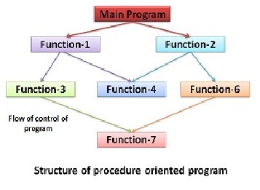
Procedure – oriented programming
Structure of procedure oriented programing.

Slide 3
Procedure – oriented programming
Divided into functions
Defined purpose and interface to other function
Grouping a no. of functions together in a larger entity called A Module.

Slide 4
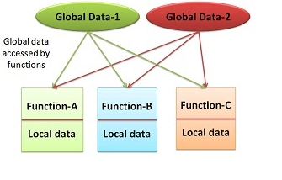
Procedure – oriented programming
In multi function program important data items are placed as global so they may be accessed by all functions.
Each function may have its own local data.
Procedure paradigm

Slide 5
Procedure – oriented programming
Characteristics:
Emphasis on doing things(Algorithms).
Larger programs divided into small programs known as functions.
Most of the function share global data.
Data move openly around the system from function to function.
Functions transforms data from one form to another.
Employs top-down approach in program design.

Slide 6
Procedure – oriented programming
Drawbacks:
Global data may be accessed by all the function.
There is no protection, so data can be accessed by one function from other.
Very difficult to identify what data is used by which function.
Modification is critical and time consuming.
Does not model real world problem very well.

Slide 7
Procedure – oriented programming
Top down approach decomposition is the process of breaking the overall procedure into Modules then subdivide each module until the lowest level of detail has been reached.

Slide 8
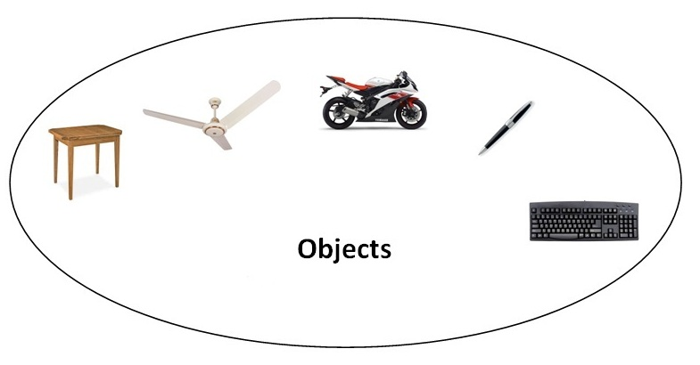
Object– oriented programming
Introduced to overcome flaws of procedure approach to programming.

Slide 9
Object– oriented programming
Problem is divided into the no of entities called objects and then builds data and function around these objects.
Ties data more closely to the function.
Data of an object can be accessed only by the function associated with that object.
Communication of objects can be doing through function.

Slide 10
Object– oriented programming
Characteristics:
Emphasis on data rather than procedure.
Programs are divided into entities known as objects.
Data structures are designed such that they characterize the objects.
Functions that operate on the data of an object are tied together in the data structure.

Slide 11
Data is hidden and cannot be accessed by external functions.
Objects may communicate with each other through functions.
New data and functions can be easily added whenever necessary.
Follows bottom-up approach in program design.

Slide 12
Object– oriented programming
Object-oriented programming (OOP) is a programming paradigm based on "objects", it may contain data, often known as attributes; and code, often known as methods.
C++, Java, Visual Basic are the examples of OOP languages.

Slide 13

Basic concepts of OOPs
Objects
Classes
Encapsulation
Data Abstraction
Inheritance
Polymorphism
Dynamic Binding
Message Passing

Slide 14
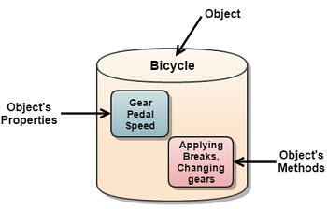
Objects are the basic runtime entities of an object oriented system.
They may represent a place, a person, or any item that the program must handle.
In object oriented languages, a single unit combines data and function that known as object

Slide 15
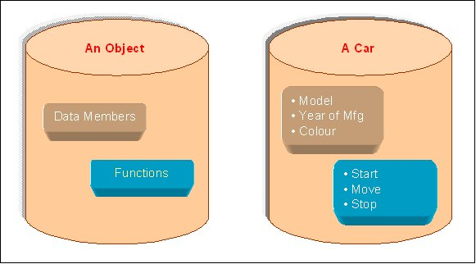
Objects
When a program is executed, the objects interact by sending messages to one another.
Each object contains data and code to manipulate the data.

Slide 16
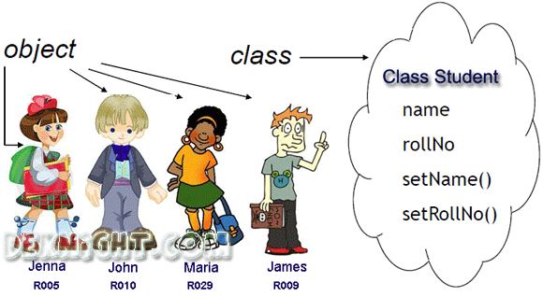

Slide 17
Classes
Classes are user-defined data types and it behaves like built-in types of programming language.
Object contains data and code which can be made user defined data type using class.
Objects are variables of class.

Slide 18
Once a class has been defined we can create any no of objects for that class.
A class is collections of objects of similar type.
Syntax:
fruit mango, orange;

Slide 19
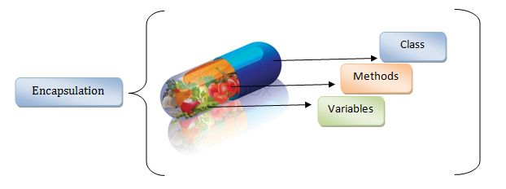
Encapsulation

Slide 20
Encapsulation
It is very first principle of object oriented programming.
Encapsulation is a process of binding data members and member function in a single unit.
Class is the best example of encapsulation.

Slide 21
Encapsulation means hiding the important features of a class which is not been needed to be exposed outside the class.
Hidden part of a class acts like Encapsulation and exposing part of a class acts like Abstraction.

Slide 22
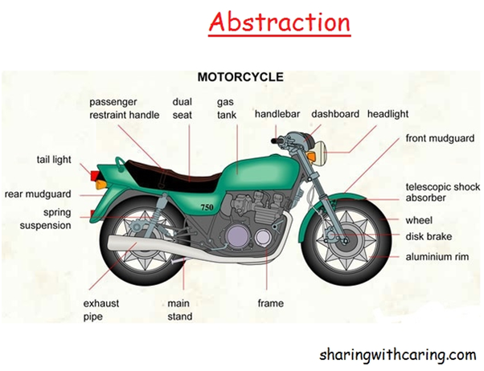
Abstraction
Abstraction refers to representation of necessary features of a class without including more details or explanations.

Slide 23
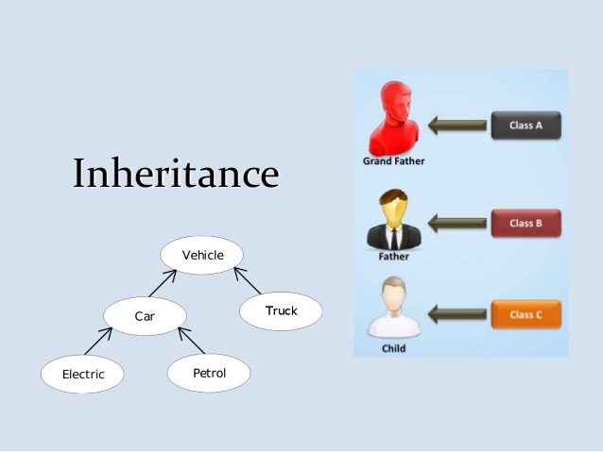

Slide 24
Inheritance
The mechanism of deriving a new class from an old class is called Inheritance or Derivation.
The old class is known as base class while new class is known as derived class or sub class.
The Inheritance is the most powerful feature of OOP.

Slide 25
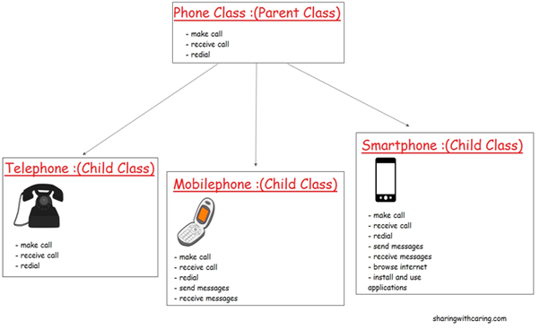

Slide 26
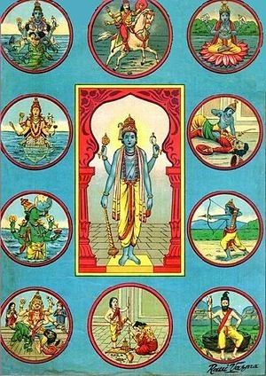
Polymorphism

Slide 27
Polymorphism
Polymorphism is a Greek word it means that ability to take more than one form.
For Example, + is used to make sum of two numbers as well as it is used to combine two strings.

Slide 28
Operator +
20+10=30
“sy”+”bca”=“sybca”

Slide 29
This is known as operator overloading because same operator may behave differently on different Instances.
Same way functions can be overloaded that is known as function overloading.

Slide 30
Single function may draw different objects.
Shape
Print()
Triangle
Print()
Circle
Print()
Rectangle
Print()

Slide 31
Dynamic Binding
Binding means link between procedure call and code to be execute.
Dynamic binding is the process of linking procedure call to the actual code of the function at runtime.

Slide 32
In dynamic binding, the actual code to be executed is not known to the compiler until run-time.
It is also known as late binding.

Slide 33
Message Passing
Objects can communicate with each others by passing messages same as people passing message with each other.
Objects can send or receive messages or information.

Slide 34
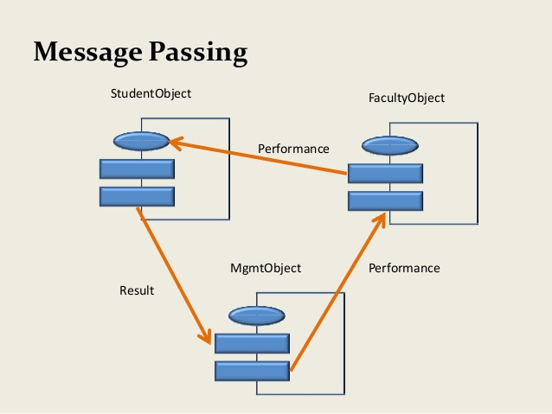

Slide 35
Message passing involves the following basic steps :
Creating classes.
Creating objects from class definition.
Establishing communication between objects.

Slide 36
Benefits of OOP
Object oriented system can be easily upgrade from small system to large system.
It is easy to partition work for same project.
Message passing technique make communication easier.
Software complexity can be easily managed.
Maintenance cost is less.
Simple to implement.

Slide 37
Application of OOP
Real time systems
Simulation and modeling
Object oriented database
Hypertext, hypermedia and ExpertText
AI and expert systems
Neural Network and parallel programming
Decision support system
CIM / CAM / CAD systems

Slide 38
C++
C++ is an Object Oriented Programming Language.
C++ was developed by Bjarne Stroustrup at AT&T Bell Laboratories, USA.
C++ is an extension of C.
Class was major addition to the original C language so Stroustrup called the new language ‘C with classes’.

Slide 39
main() in C++
In C++ main() returns an integer value to the operating system.
Therefore, every C++ main() should end with return 0; statement otherwise a warning or error might occur.
Since main() returns an integer value, return type of main() is explicitly specified as int.
In C++ default return type for all functions is int.

Slide 40
C++ output operator
cout<<“C++ is better than C”;
cout: it is predefined object that represent the standard output stream in C++.
Here standard output stream represent the screen.
Also possible to redirect output to other output devices.
<< this operator is also known as insertion or put to operator.

Slide 41
It inserts the content of the variable on its right to the object on its left.
We can also use printf() for displaying output.
<< it is bitwise left-shift operator and it can still be used for this purpose.

Slide 42
C++ Input Operator
cin>>num;
It is input statement and causes the program to wait for the user to type a no.
The operator >> is known as extraction or get from operator.
It extract the value from keyboard and assigns it to the variable on its right.

Slide 43
C++ iostream file
#include <iostream.h>
It contains declarations for the identifier cout, cin , <<,>>.
The header file iostream should be included at the beginning of all the programs that use input/output statements.

Slide 44
Structure of C++ program
Include Files
Class Declaration
Class Function Definition
Main Function Program

