Slide 1


Guide Name: Miss. Shivangi Kiritbhai Bakori
Book-E-Sale
Student Name: Trivedi Devarshi P.
En. No.: 190470107070
Branch: Computer Engineering
Semester: 7th

Slide 2
COMPANY PROFILE
TatvaSoft is a Consummate Custom Software Development company delivering splendid business IT Solutions and related services to customers across the globe. Their development services are led by our dedicated and passionate team to provide best industry practices combined with technology expertise and business domain knowledge to drive digital transformation. Their proficiency in understanding business challenges and professional competence allows them to create a better experience for our customers. They have emerged and marked their presence in different continents by providing Bespoke software development services to all major Industry Domains.
TatvaSoft have successfully served for more than 1800 success stories ranging from Enterprise level to Start-ups, who have grown alongside the success of the company.
At present we are a Robust Team having diverse skills with more than 21+ years of Technology experience engaging with customers at Deeper level to provide cutting edge solutions and innovations.

Slide 3

COMPANY PROFILE
Company Website :- https://www.tatvasoft.com

Slide 4
ABSTRACT
Book-E-Cell is an E-commerce website for book purchasing and selling. It contains basic functionalities such as Login, Registration, Book Search, Book listing, Add to Cart, and Logout. It has buyer, seller and admin module. User can become seller or buyer. Website help people to find the book they need. People can sell their non-used books online. It follows C2C Business model.

Slide 5
TECHNOLOGY
This Project is a Small E-Book selling website using ReactJS, TypeScript, ASP.net, and PostgreSQL. It is a website to buy and sell books. It has various functionalities like login, registration, Addition of book to cart, etc…
Frontend:-
TypeScript: - TypeScript is a free, open-source programming language developed and maintained by Microsoft. It is a strict superset of JavaScript.
React with TypeScript: -React is the most popular JavaScript front-end framework in use today. React is a JavaScript library for creating user interfaces.

Slide 6
TECHNOLOGY
Backend: -
ASP.net: - ASP.net is a framework of C#. Some widely used C# frameworks for backend development are ASP.NET Core and .NET MVC.
PostgreSQL: - PostgreSQL, also known as Postgres, is a free and open-source relational database management system emphasizing extensibility and technical standards compliance. PostgreSQL is a powerful, open-source object-relational database system that uses and extends the SQL language combined with many features that safely store and scale the most complicated data workloads.
3. POSTMAN: - Postman is an Application Programming Interface (API) testing tool.

Slide 7
PROJECT SUMMARY
Book-E-Sale system is a simple project similar to a shopping cart or eCommerce website but is only for book shopping and selling books. Through a web browser the customers need to login or register later can search for a book by its title or author, later can add it to the shopping cart, and finally purchase the books. And the sellers can add books for selling.
It has modules for Admin, Buyer and Seller.

Slide 8
PROJECT SUMMARY
Features of the website:
Register Page
Login Page
CRUD Operations for Books
Filtering Books
Various Roles for User
Main Role – Admin
Buyer Role
Seller Role

Slide 9
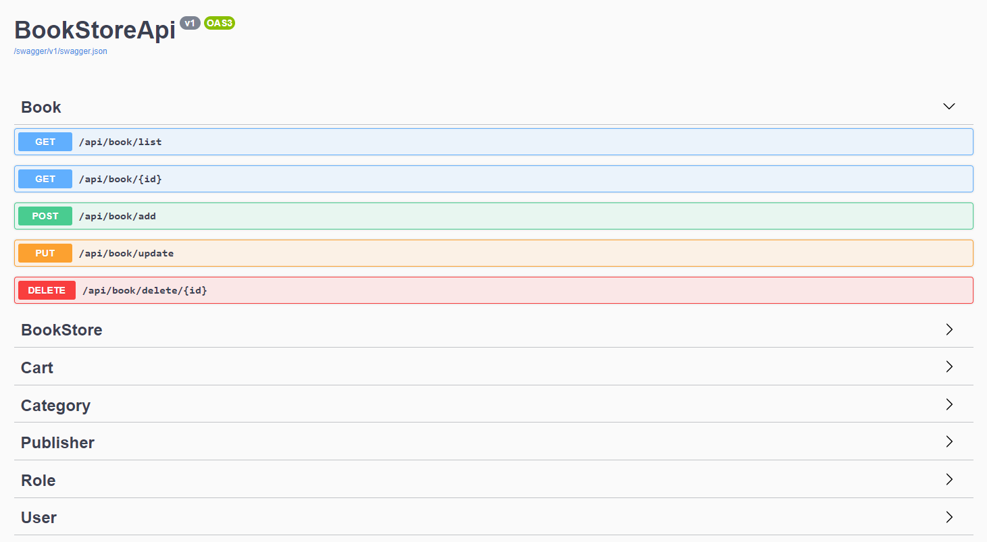
IMPLEMENTATION SCREENSHOT
Backend Web API

Slide 10
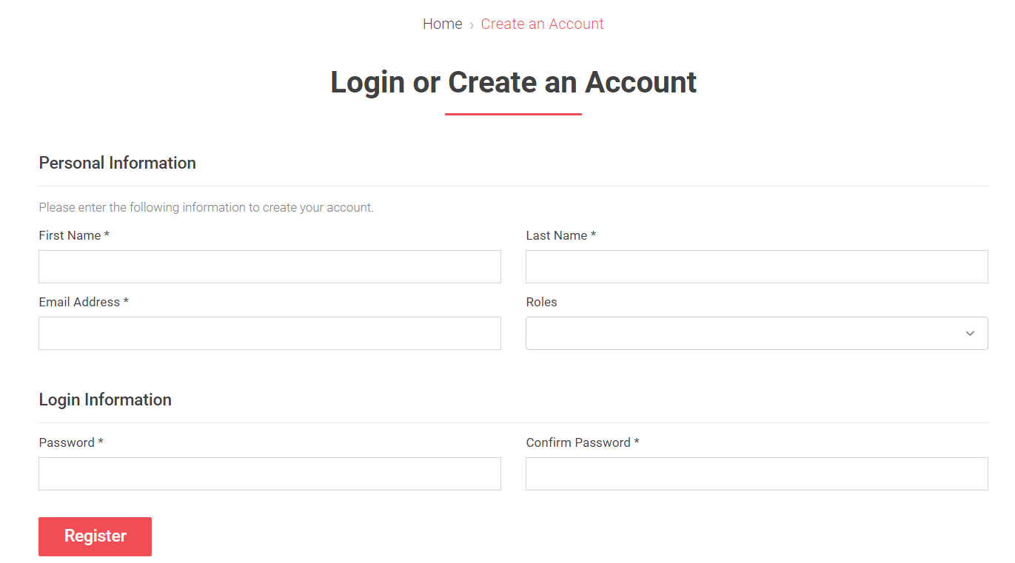
IMPLEMENTATION SCREENSHOT
Registration Module of Frontend

Slide 11
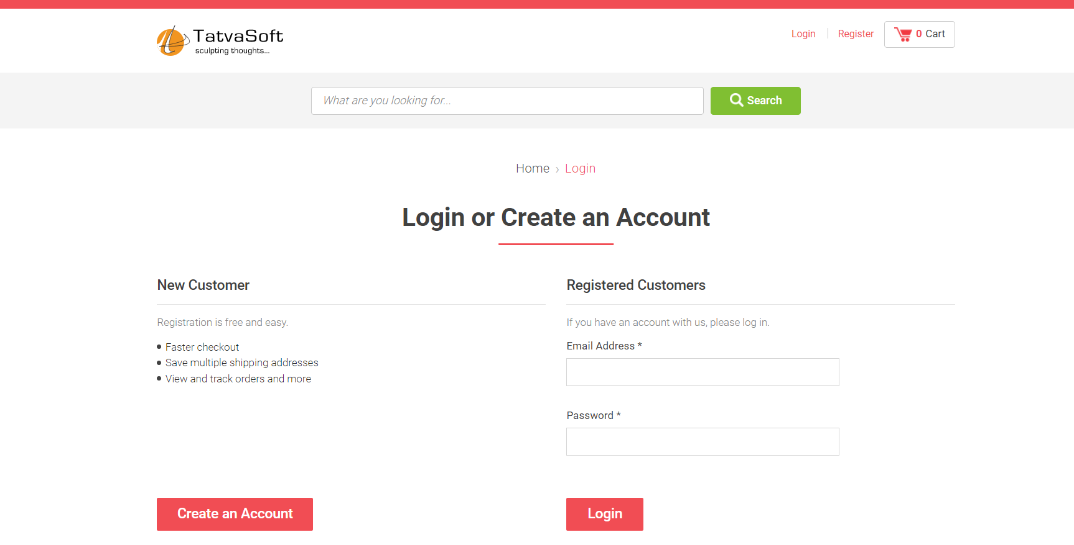
IMPLEMENTATION SCREENSHOT
Login Module of Frontend

Slide 12
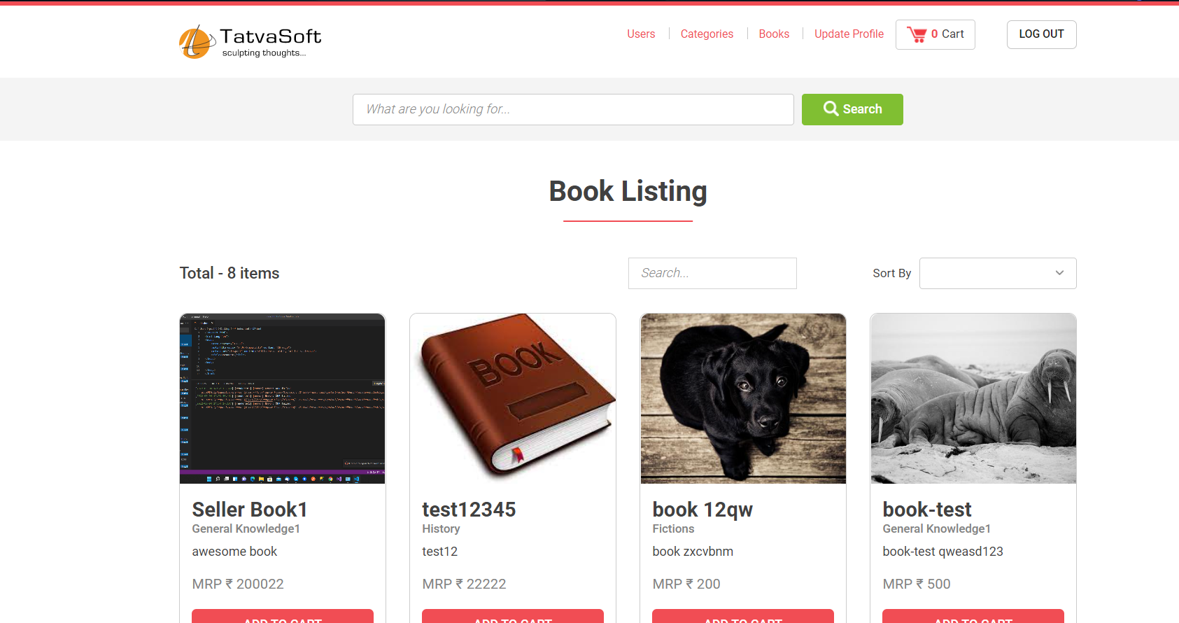
IMPLEMENTATION SCREENSHOT
Book-E-Sale Website

Slide 13
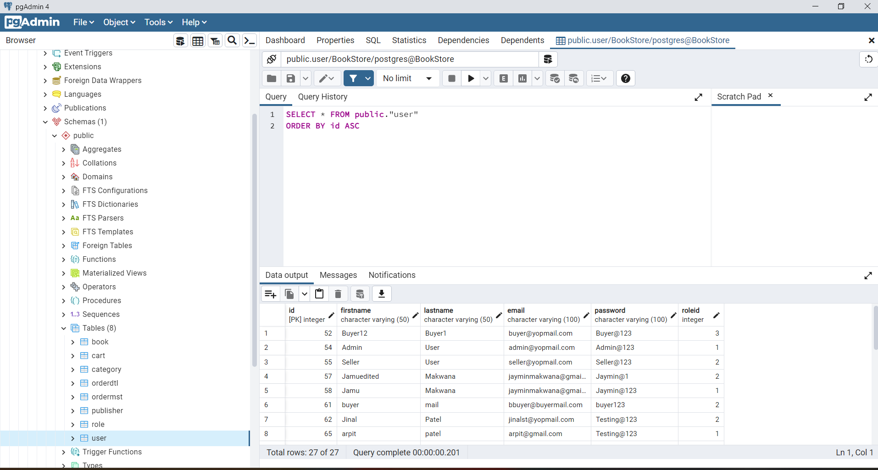
IMPLEMENTATION SCREENSHOT
Book-E-Sale Database

Slide 14
CONCLUSION
The E-Book store project is designed using .NET, react with typescript, and PostgreSQL database. E-Book Store System is a simple project similar to a shopping cart or an eCommerce website but is only for book shopping. Through a web browser customers need to log in or register and after registering customers can search for a book by its title or author, add it to the shopping cart, and finally purchase the book. Here I provide functions based on the type of user. There are three types of user’s buyer, seller, and admin. Each has its own functionalities like the user can purchase a book, a seller can add, delete, and update the book based on the requirement, and the admin has all rights to handle the application.

Slide 15
References
1. https://reactjs.org/docs/getting-started.html
2. https://www.typescriptlang.org/docs/
3. https://www.typescriptlang.org/docs/handbook/react.html
4. https://docs.microsoft.com/en-us/aspnet/core/web-api/?view=aspnetcore-5.0
5. https://www.postgresql.org/docs/
Project GitHub Link:-
https://github.com/devarshitrivedi01/Book-E-Sale

Slide 16
Thank You

