Slide 1


SECURING CLOUD INFRASTRUCTURE: A ZERO TRUST AND ENCRYPTED TRAFFIC SOLUTION
PRESENTED BY: SECURESPHERE TECHNOLOGIES

Slide 2

SecureSphere Technologies
A cybersecurity solutions provider specializing in scalable, secure cloud infrastructure for high-risk industries like finance and e-commerce.
Our Mission:
What We Deliver:
To deliver robust, cutting-edge cloud security solutions that ensure data protection, compliance, and business continuity for our clients.
Encrypted traffic, Zero Trust architecture, and secure web applications.

Slide 3



Our
Professional Team
Devarshi Mahadevwala
Gautam Kumar
We are SecureSphere Technologies, a dedicated team of cybersecurity professionals specializing in delivering advanced cloud security solutions. With expertise in Zero Trust architecture, encryption, and access control, we ensure robust and scalable infrastructures tailored to meet our clients' unique needs. Our commitment to innovation and excellence drives us to secure the future of businesses across industries.
Saima Anam Syed

Slide 4

Executive Summary
Client Problem
Our Solution
Impact for Clients
High risk of cyberattacks and compliance challenges in industries like finance and e-commerce.
A comprehensive Zero Trust-based cloud infrastructure secured with DNSSEC, SSL/TLS, and Cloudflare services.
Protection against data breaches, regulatory compliance, and enhanced customer trust

Slide 5
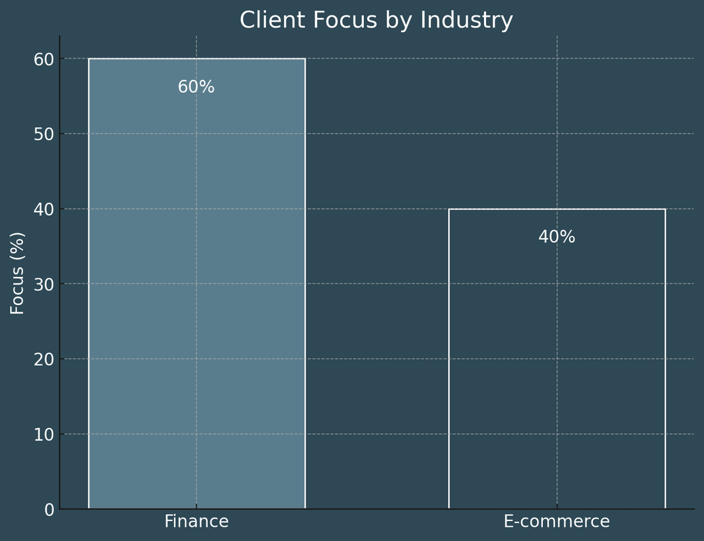
Project Scope
Business Context:
Financial and e-commerce clients require secure, compliant cloud systems to handle sensitive customer and transaction data.
Our Value Proposition:
Seamless, scalable solutions tailored to client needs. Industry-standard compliance with GDPR and PCI DSS.

Slide 6

Project Objectives
Implement a Zero Trust Architecture to secure access to cloud resources.
Enable end-to-end encryption using SSL/TLS and DNSSEC to protect data integrity.
Configure Cloudflare Tunnel for secure traffic routing and origin server protection.
Integrate Single Sign-On (SSO) to streamline and secure user authentication.

Slide 7



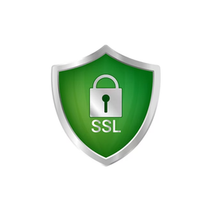
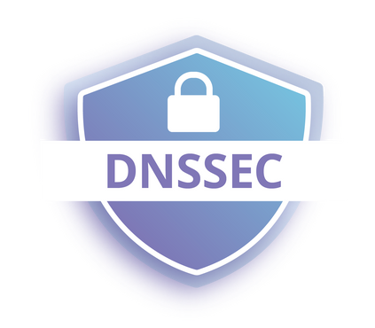

KEY TECHNOLOGIES AND TOOLS
AWS EC2 and S3
Cloudflare Zero Trust
Cloudflare Tunnel
SSL/TLS Encryption
Git HUB as idp
DNSSEC
For scalable and secure cloud infrastructure hosting
Ensures robust access control and protects resources with continuous verification.
Secures traffic by masking the origin server’s IP address and preventing direct attacks.
Provides end-to-end encrypted communication between clients, Cloudflare, and the origin server.
Protects against DNS spoofing by cryptographically signing DNS records.
Implements Single Sign-On (SSO) for seamless and secure authentication

Slide 8

AWS Instance Setup
Overview:
Deployed and configured an AWS EC2 instance to serve as the origin server.
Ensures scalability, high availability, and secure hosting.
Steps Performed:
Instance Configuration:
Selected an appropriate AMI and configured security groups to restrict traffic to HTTPS and Cloudflare Tunnel ports.
Webpage Hosting:
Deployed a simple HTML webpage displaying the message
"Hello! Welcome to the Secure Sphere Solutions Website. This is a secured page owned by Saima, Gautam, and Devarshi."

Slide 9
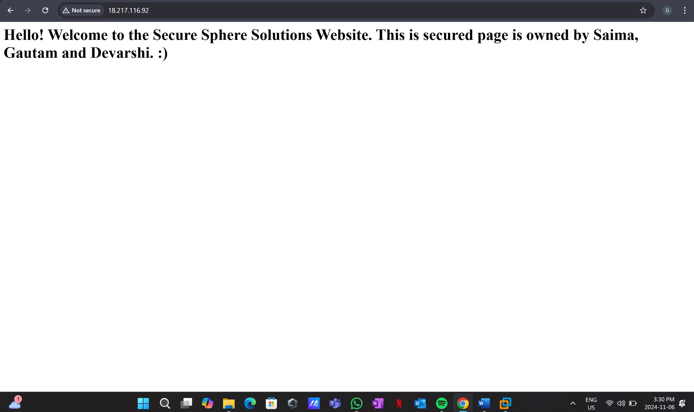

Slide 10

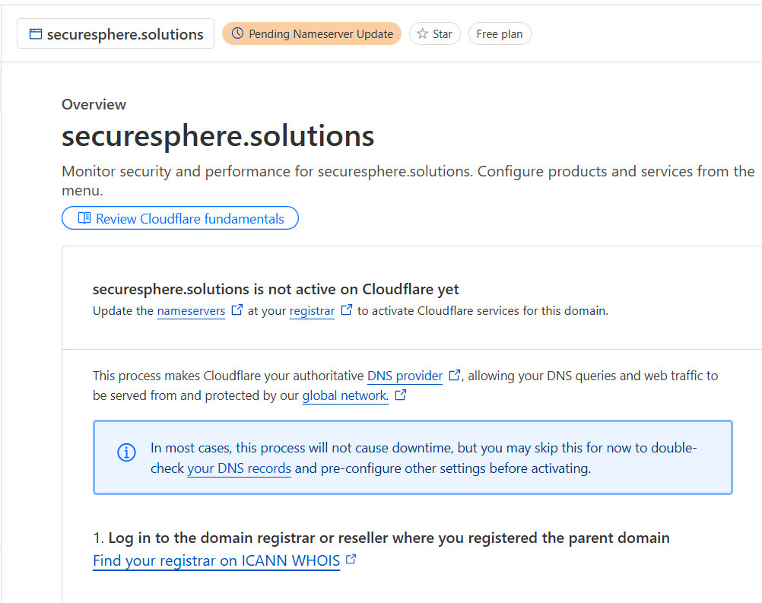


CLOUDFLARE INTEGRATION
Overview:
Integrated Cloudflare’s security and proxying services to enhance the security, performance, and reliability of the origin server.
Steps Performed:
Domain Purchase:
Acquired a domain name from GoDaddy to provide a professional and unique identity for the project.
Configured the domain to work seamlessly with Cloudflare.

Slide 11
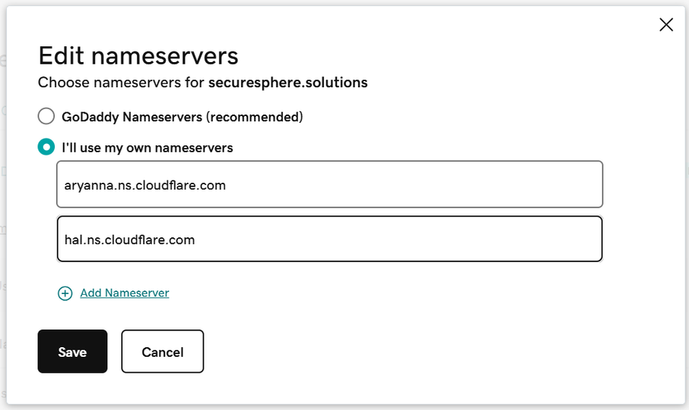
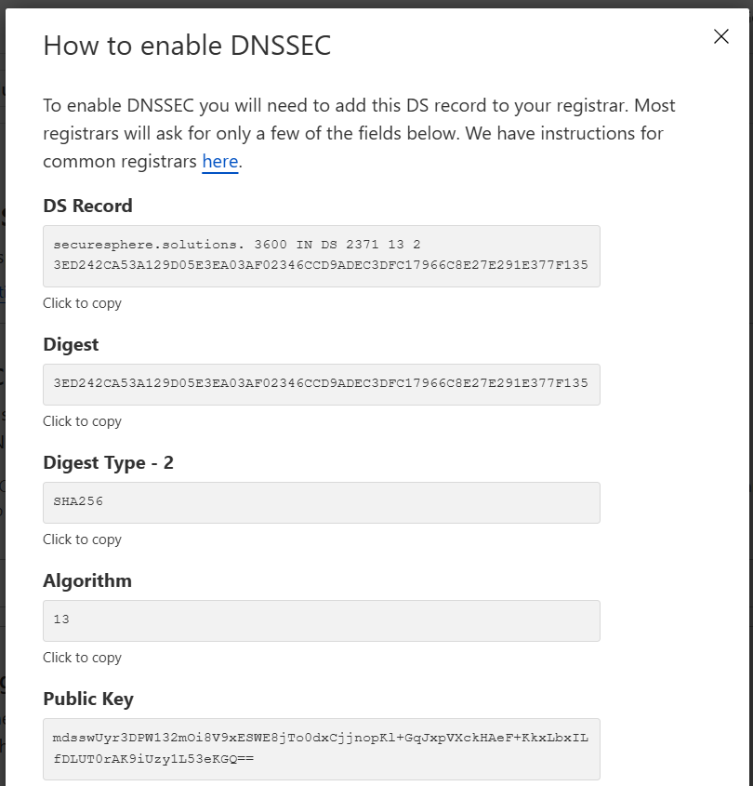
Nameserver Update
Replaced GoDaddy’s default nameservers with Cloudflare’s nameservers for advanced DNS management and enhanced security.
DNSSEC Activation
Enabled DNSSEC to protect against DNS spoofing and ensure the authenticity of DNS queries.

Slide 12
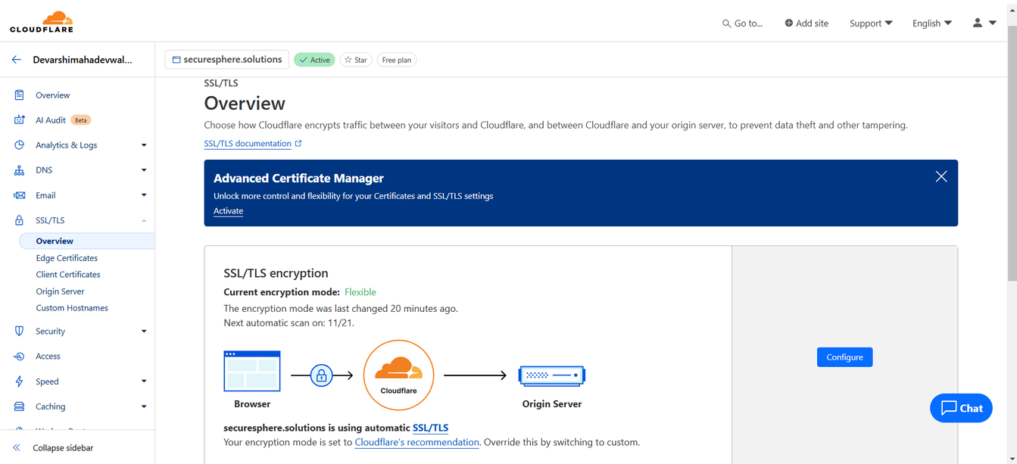
A and CNAME Records Configuration
Configured A records to point to the server’s public IP and CNAME records for mapping subdomains securely through Cloudflare’s proxy.
SSL/TLS Encryption
Configured Full (Strict) SSL/TLS mode for complete end-to-end encryption between the client, Cloudflare, and the origin server.

Slide 13
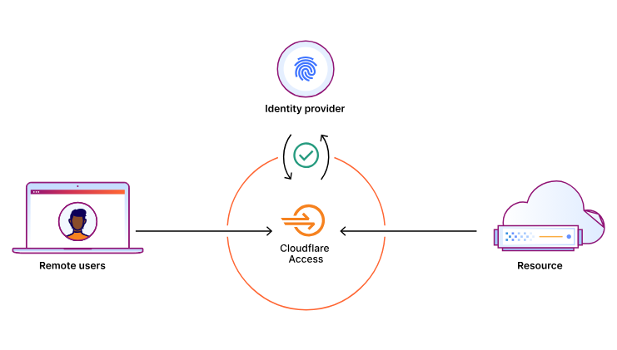
Cloudflare Zero Trust & SSO
Our Expertise:
Cloudflare Tunnel Configuration:
Set up Cloudflare Tunnel to securely route traffic between Cloudflare and the origin server, masking the server’s public IP and protecting it from direct attacks.
2.Single Sign-On (SSO) Integration:
Implemented SSO with GitHub as the Identity Provider (IdP) to enable secure and seamless authentication.
Configured role-based access control to restrict access based on user roles and email domains.

Slide 14


ADVANCED SECURITY
SSL/TLS Encryption
DNSSEC
Outcome
Verified secure access to application routes with tamper-proof DNS and encrypted communication.
Fully compliant with GDPR and PCI DSS standards, ensuring user trust and data protection.
Enabled cryptographic signing of DNS records to protect against DNS spoofing and tampering.
Ensures that users are always directed to the legitimate origin server.
Configured Full (Strict) SSL/TLS mode to secure all communication between the client, Cloudflare, and the origin server.
Provides end-to-end encryption, safeguarding data in transit from interception.

Slide 15

Challenges Encountered
Cloudflare Tunnel Configuration: Issues with hostname mapping and traffic routing due to misconfigured ports.
SSO Integration: Redirect URI errors while integrating GitHub as the Identity Provider.
End-to-End Encryption: SSL/TLS validation errors during Full (Strict) encryption setup.

Slide 16
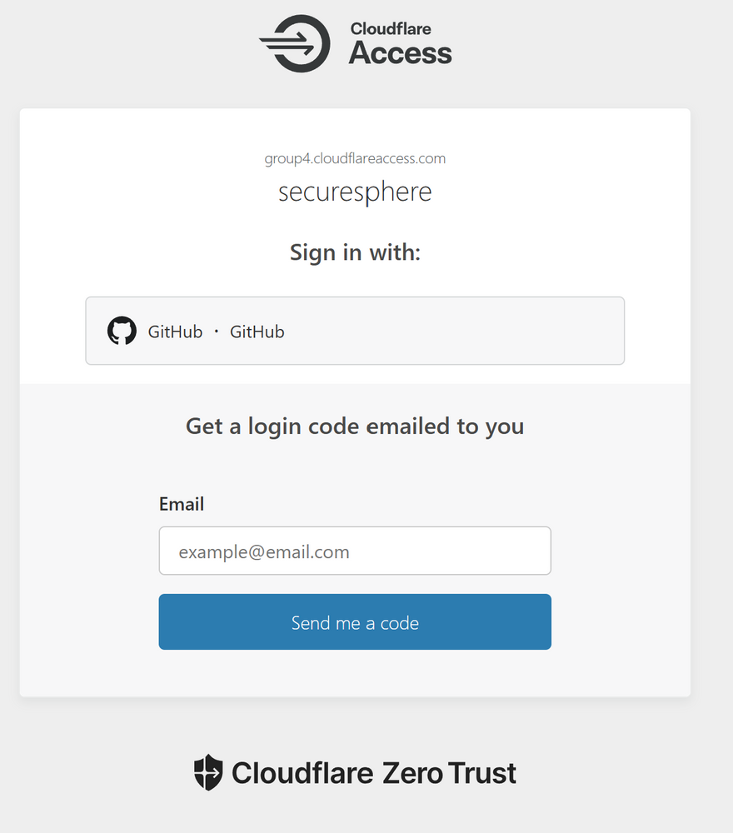
What We Deliver
Secure Cloud Infrastructure:
A robust, scalable origin server protected by Cloudflare and advanced encryption technologies.
Enhanced Access Control:
Zero Trust architecture integrated with GitHub SSO for seamless and secure user authentication.
End-to-End Encryption:
Full (Strict) SSL/TLS and DNSSEC ensuring secure communication and tamper-proof DNS records.

Slide 17


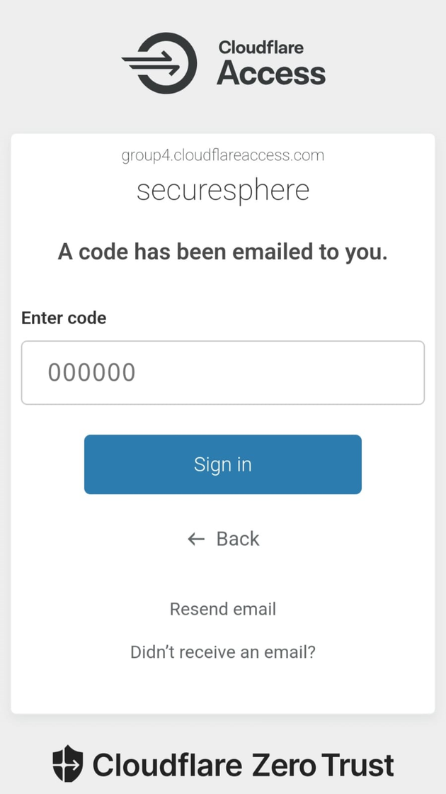
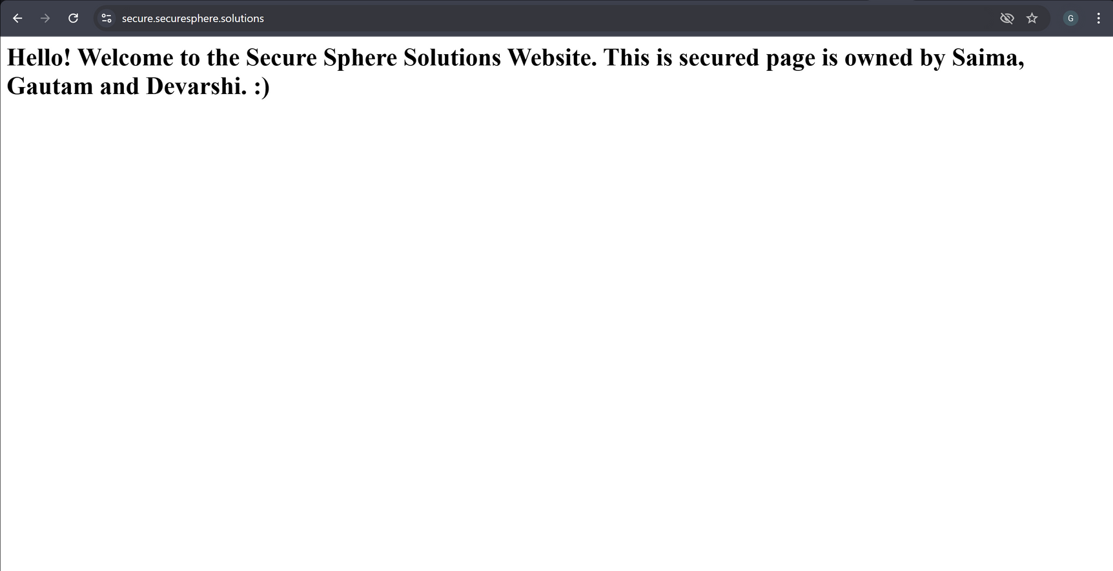
Access Our Website
http://secure.securesphere.solutions

Slide 18


Securesphere Technologies
THANK YOU!

