Slide 1
Pension Management System
SUBMITTED BY: BATCH-4 Group-6
DEVARSHI PATIDAR
NAGARURU HARISH BABU
GANGAPPA IRAPPA HUBBALLI
JAKIR PINJARI
RAJ KUMAR VANKADOTHU

Slide 2
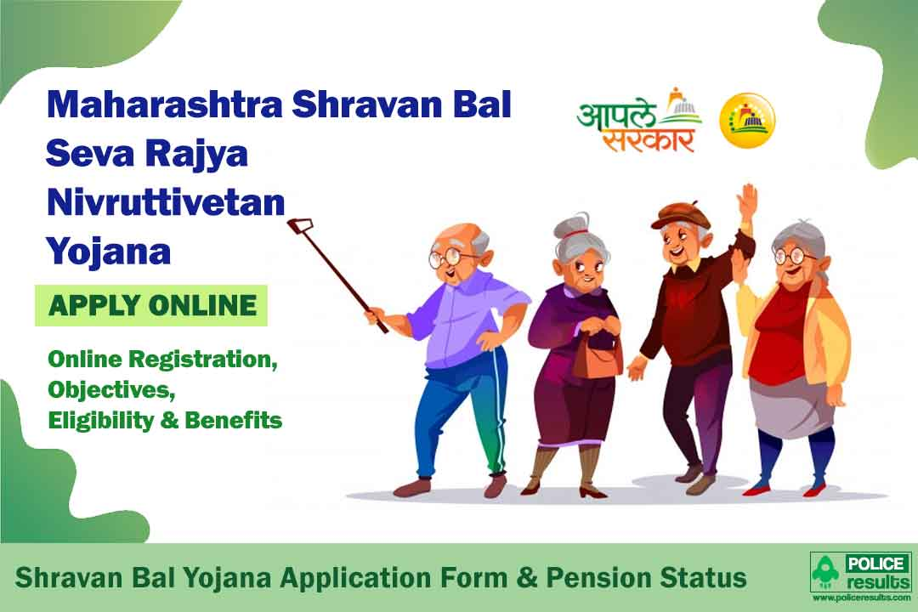
AGENDA OF PROJECT
Provision to define the rules and regulation for each scheme as per government laws.
Provision to manage the monthly payments.
Provision to manage the fund amount by each scheme, Fund , Assess Class and Employer each month.

Slide 3
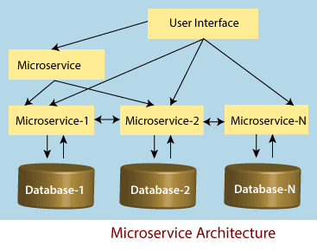
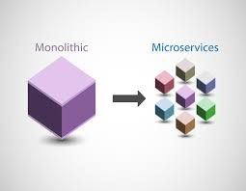
APPLICATION OF JAVA MICROSERVICES
Microservices are individual components that work together to deliver an overall solution.
It is better suited for the smaller and well portioned, web-based system.
The application is safe when it comes to both data reliability.
The concept of microservices makes it easy for upgradation.
Easier to scale each individual microservices.
Clear ownership and accountability.
Easier to maintain and evolve system.
Short time to add new features.

Slide 4
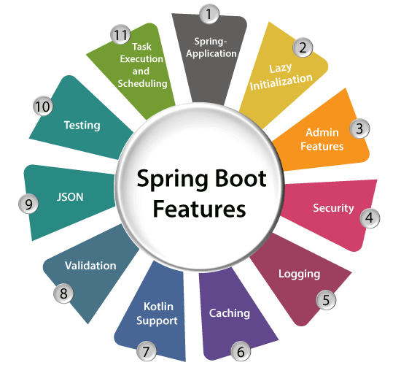
SCOPE
Spring:- Java Spring Boot (Spring Boot) is a tool that makes developing
web application and microservices with Spring Framework faster
and easier through three core capabilities:
1)Autoconfiguration
2)An opinionated approach to configuration
3)The ability to create standalone applications
Maven:- Maven is a popular open-source build tool developed by the Apache Group to build, publish, and deploy several projects at once for better project management. The tool provides allows developers to build and document the lifecycle framework. MAVEN FOCUSES : Documentation, Dependencies, Reports, SCMs, Distribution, Releases, Mailing list

Slide 5
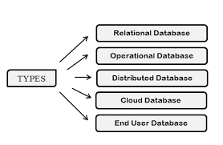
SCOPE
Postman:- Postman is one of the most popular software testing tools which is used for API testing. With the help of this tool, developers can easily create, test, share, and document APIs.
Database:- You can organize data into tables, rows, columns, and index it
to make it easier to find relevant information. Database handlers
create a database in such a way that only one set of software
program provides access of data to all the users. The main purpose
of the database is to operate a large amount of information by storing, retrieving, and managing data.

Slide 6
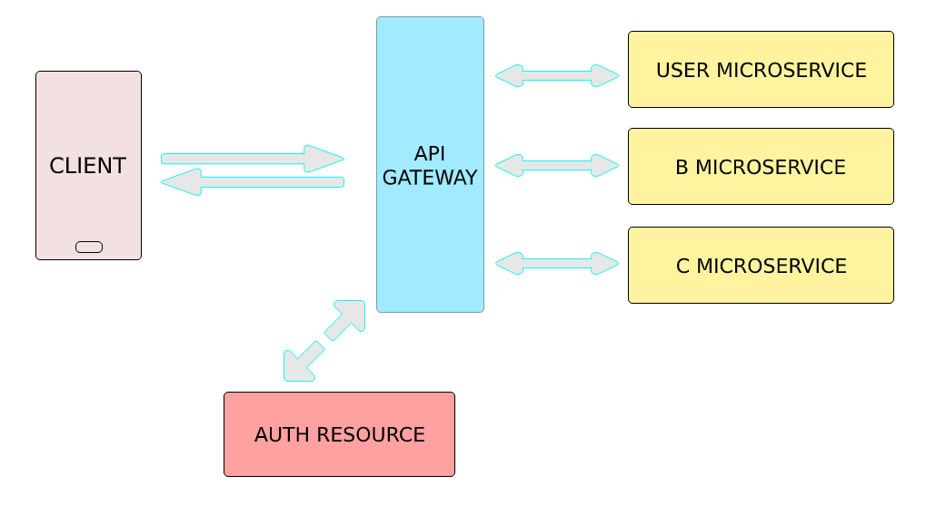
MICROSERVICES
Authorization Service
Eureka Server
3) Pension Disbursement Service
4) Pension Detail Service
5) Pension Process Service

Slide 7
AUTHORIZATION AND AUTHENTICATION
This service is responsible to provide login access to the application and provide security to it with the help of stateless authentication using JWT Tokens.
Generate the token and Validate the token:- http://localhost:8400/auth/api/v1/authenticate
Authorization:- http://localhost:8400/auth/api/v1/authorize
Now check response section whether the token is valid or not. The boolean output 'true' indicates that the token is valid and 'false' indicates that the token is invalid.

Slide 8
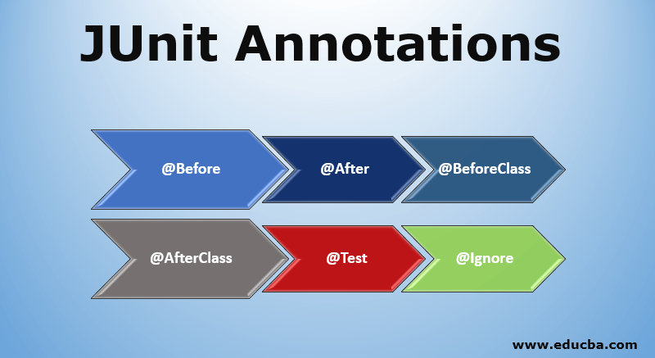
TEST CASES
Gets the pension amount along with pensioner Aadhaar details.
This internally gets the bank detail from the Pensioner detail Microservice.
Checks if the bank service charge is credited along with the pension amount or not. If the data is correct, then success code is returned, else appropriate error code is returned
This should be invoked from the Process Pension microservice

Slide 9
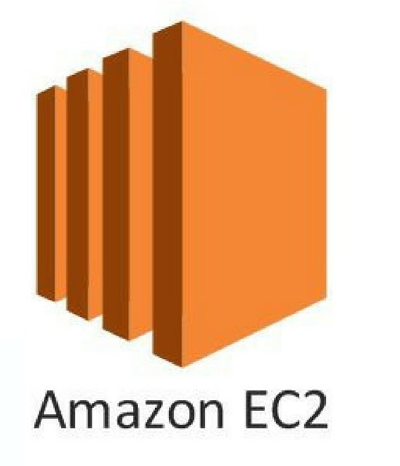

DEPLOYMENT THROUGH AWS
AWS(amazon web services) provides services to build, deploy, host web applications.
Creating EC2 instance and generate key value pair and generate “pem” file using putty
Creating S3 bucket and upload project jar file. And connection bucket to EC2 instance
Run the Object URL through putty terminal to successfully deploy application on AWS cloud.
URL:- ec2-3-80-152-111.compute-1.amazonaws.com:8080/auth/api/v1/authenticate

Slide 10
THANK YOU

