Slide 1
Students’ Characteristics in Learning Environment
Group 5

Slide 2
Report by Group 5, November 2019
Overview of Report
Original Data Sets; 7 CSVs
1
2
3
Business Analysis
Data
Modeling
Business Case
- Significant number of failing students
Examination and Selection
Feature Importance
Cleansing and Joining
Overview of Models
4
Implications
Increased passing rates
Increased college’s ranking
Increased applications
Realistic Observations
27K Rows
RF1
RF2
GBM
DT
NB
SVM
Extreme Observations
500K Rows
Model Comparison
Realistic vs Extreme Observations

Slide 3
1. Help improve colleges’ ranking by taking actions on possible failing students.
Business Objective
1
Problem:
Significant number of failing students in the education system
Nearly one-third of undergraduates leave after their first year, and many require six years to complete their studies
Solution:
Predicting passing/failing students and take actions
Outcome:
Increased passing rates and college overall ranking
Deloitte Insights 2017

Slide 4
Data > Examination and Selection
2
2.1. Examining data sets and deciding which data sets to join for final analysis.
41
Total variables
Student – activities
studentRegistration
studentVle
studentRegistration
Module Presentation
assessment
courses
vle
Demographics
studentInfo
22
Unique variables
id_student
id_assessment
score
sum_click
code_module
code_presentation
id_site
gender
imd_band
age_band
studied_credits
2-3
Unrelated sheets
vle
courses
student-Registration
4-5
Sheets joint
vle
student-Assessment
studentVle
studentInfo
assessment
withdrawn

Slide 5
Data > Examination and Selection > Cleansing and Joining > Limited Observations
3
2.2. Focus on cleansing and normalizing variables; id_student as reference variable.
Assessment
SUM_CLICK (studentVle)
Cleaned outliers with standard deviation
Final range 0 to 30
id_student, code_module, code_presentation to get average sum_click
More usable in actual business prediction, based on cleansed individual variables.
27K
observations
15
variables
25%
Failed
studentAssessment
SCORE (studentAssessment)
Segmented by id_student, code_module, code_presentation, and assessment_type
Calculated the average score of students relative weights
studentInfo
studentVle

Slide 6
Data > Examination and Selection > Cleansing and Joining > Extreme Observations
4
2.3. Focus on having as many independent observations as possible; id_student as reference variable.
Assessment
Minimum Cleansing
Quick NA removal with na.omit()
All scores are treated as individual cases with no reference to id_student
Theoretically better performance, but prone to overfitting.
studentAssessment
500K
observations
22
variables
20%
Failed
studentInfo
Overfitting Prevention
Split data into halves; 250K each
The first half is split into 50:50 train & test
Tested model against the second half
studentVle
vle

Slide 7
Modeling > Feature Importance
5
3.1. Important parameters used for modeling.
SCORE
Higher the score, better pass rate
%
WEIGHTS
Higher the weight, more important the score
IMD_BAND
Wealthier = better education
SUM_CLICKS
More engagement should mean better scores
CODE_MODULE
Some modules might be harder than others

Slide 8
Modeling > Feature Importance > Overview of Models
6
3.2. Running 5 classification models with parameters & observations, RF shows the best results.
Model | Observations | Accuracy | Specificity | Sensitivity
RF1 (U.Sample) | 500,000 | 94% | 96% | 93%
Model | Observations | Accuracy | Specificity | Sensitivity
RF2 | 27,000 | 85% | 63% | 92%
GBM | 27,000 | 83% | 65% | 89%
DT | 27,000 | 76% | 66% | 79%
NB | 27,000 | 71% | 64% | 74%
SVM | 27,000 | 77% | 64% | 81%

Slide 9
Modeling > Overview of 6 Models > Model with Limited Observations and Cleansed Variables
7
3.3. Predictions with RF1 vs. RF2 model; High performance vs. realistic application.
RF1
 | Reference
Prediction | Fail | Pass
Fail | 41,290 | 11,171
Pass | 1,649 | 158,539
RF2
 | Reference
Prediction | Fail | Pass
Fail | 1,275 | 500
Pass | 761 | 5,633

Slide 10
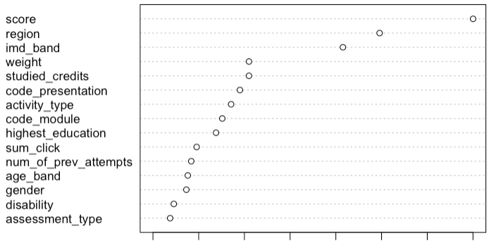
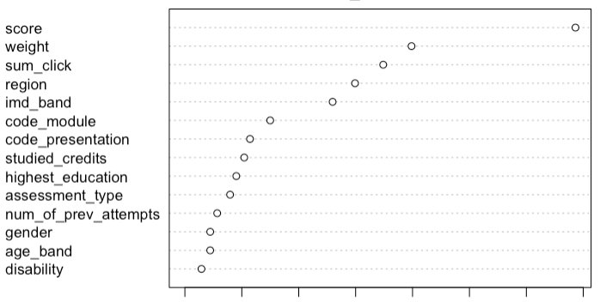
Modeling > Overview of 6 Models > Model with Limited Observations and Cleansed Variables
8
3.4. Ranking importance of variables between two models.
RF1
RF2
SCORE | WEIGHT | IMD_BAND | REGION | CODE_PRESENTATION

Slide 11
Business Objective > Implications
9
4. By predicting and taking action on potential failing students, pass rates and applications would increase.
prediction
action
result
Pay attention to:
score
region
imd_band
studied_credits
code_presentation
Characteristics of potential failing student:
Low score
From wales, NW Region, London Region
Poorer family
Internal:
Establish more helping sessions for students
More focus on students displaying predicted traits
External:
Stricter admission process for students from poorer regions
More marketing capital for better regions
Financial help for students from poorer families
Passing Rate
Number of
Applications
College’s Ranking
Revenue from
Tuition

Slide 12
Thank You Q&A

Slide 13
APPENDIX

Slide 14
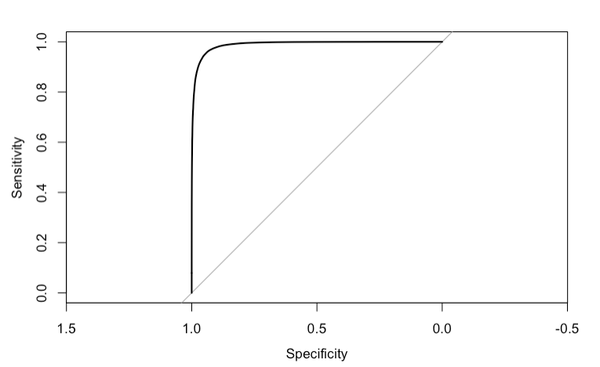
RF1

Slide 15
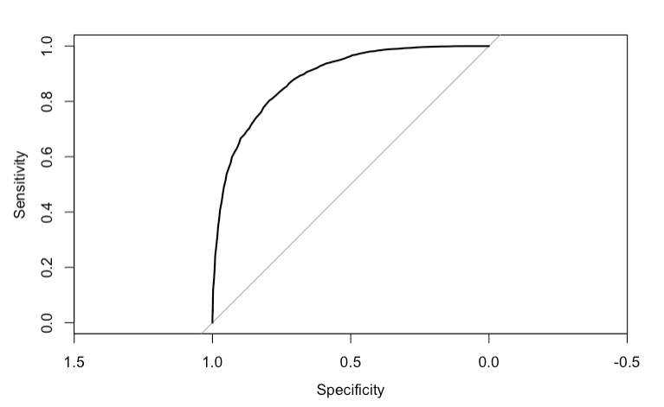
RF2

