Slide 1
Introduction
Tomato (Solanum lycopersicum) is one of the world's most important vegetable crops, with global production exceeding 190 million tonnes annually.
Tomato plants are affected by more than 200 diseases, caused mainly by fungi, bacteria, viruses, and other pathogens.
Tomato diseases can cause 20–80% yield losses in affected regions, depending on the disease and environmental conditions.
In India, Tomato Leaf Curl Virus is a major production constraint; severe outbreaks can result in 40–100% yield loss.
Traditional disease identification depends on expert visual inspection, which can be time-consuming, subjective, and difficult for early-stage symptoms.
AI and Machine Learning, particularly Deep Learning/CNN models, can automatically analyse leaf images and identify diseases rapidly and accurately.
Therefore, AI-based tomato disease detection can support early diagnosis, reduce crop losses, improve disease management, and assist farmers in making timely decisions.

Slide 2
Literature Survey
Author | Review of paper | Method | Dataset | Research observation
Patrick Wspanialy and Medhat Moussa (2020)[1] | The paper proposes a computer-vision-based system for automatic detection of tomato diseases and estimation of disease severity. The main objective is to reduce dependence on manual disease scouting and expert assessment in greenhouse tomato production. The study also investigates whether a generic disease model can recognize previously unseen tomato diseases. | ResNet is uses for classification and disease detection. Modified U-net architecture uses for severity of disease. | PlantVillage tomato dataset, containing 9 tomato disease classes. | The authors identified dataset bias, particularly due to backgrounds, lighting, and image-capture conditions in PlantVillage. This indicates a need for more diverse real greenhouse/field datasets for robust deployment.
Thuseethan et al. (2024) | Proposed a lightweight framework for tomato leaf disease recognition, especially for small and imbalanced datasets | Siamese Network + Lightweight CNN + Contrastive Loss | PlantVillage tomato subset: 14,531 images, 10 classes; Taiwan dataset: 622 images, 6 classes. | Achieved 96.97% accuracy on PlantVillage and 95.48% on the Taiwan dataset. The lightweight model is suitable for resource-limited devices, but real-field conditions and larger diverse datasets need further study.

Slide 3
Literature Survey
Author | Review of paper | Method | Dataset | Research observation
Mangsura Kabir Oni & Tabia Tanzin Prama (2025) | Proposed an automated system for real-time tomato leaf disease detection using deep learning. | Custom CNN, compared with YOLOv5, MobileNetV2, and ResNet18. | Tomato leaf images collected from Brahmanbaria, Bangladesh, with preprocessing and augmentation. | The Custom CNN achieved 95.2% accuracy, outperforming YOLOv5 (77%), MobileNetV2 (89.38%), and ResNet18 (71.88%). The model shows good potential for real-time detection,.
Huy-Tan Thai & Kim-Hung Le (2025) | Proposed a lightweight system for real-time leaf disease detection suitable for smartphones and other resource-limited devices. | MobileH-Transformer, combining CNN + Transformer architectures | PlantVillage subset: 10,008 images, 11 disease classes; also a corn disease dataset | Achieved 96.80% F1-score on the PlantVillage subset and up to 30.5 FPS on mobile devices
Asha Gowda Karegowda, Raksha Jain & G. Devika (2021) | Proposed a deep-learning-based tomato leaf disease detection system with a farmer-friendly mobile application. | YOLO and Faster R-CNN for detection, followed by SVM and Random Forest for classification. | Tomato leaf disease images covering different disease conditions. | YOLO and Random Forest achieved about 90–95% accuracy.This study is shows good detection performance, but further improvement is needed for real-field images with varying lighting, backgrounds, and disease severity.

Slide 4
Literature Survey
Author | Review of paper | Method | Dataset | Research observation
Hosen & Islam (2025) | Proposed a deep-learning approach for automatic tomato leaf disease detection to support sustainable crop management. | VGG19 and Inception V3 CNN models; preprocessing included resizing and normalization, with dropout and modified classification layers. | Tomato Villages Dataset – 4,525 images | The models achieved promising disease-classification performance, with 93.93% accuracy using dropout. The study demonstrates the potential of deep learning for early tomato disease detection and precision agriculture.
Anu, Solanki & Dhankar (2023) | Proposed a multi-class deep learning system for automatic detection and classification of tomato leaf diseases. | mage preprocessing and segmentation using thresholding, Gaussian blur, and Canny edge detection, followed by a CNN for feature extraction and classification. The study compared ReLU and Leaky-ReLU activation functions. | Approximately 10,000 tomato leaf images from the PlantVillage dataset; 10 disease categories were considered. | The Leaky-ReLU architecture performed better than ReLU. Training accuracy was 95.08% with Leaky-ReLU, compared with 92.76% with ReLU.
Trivedi et al. (2021) | The study proposed an automated deep-learning approach for the early detection and classification of tomato leaf diseases, with the aim of helping farmers identify diseases at an early stage. | Convolutional Neural Network (CNN) with image preprocessing, segmentation, and hyperparameter optimization. CNN was used to extract features such as color, texture, and edges. | 3,000 tomato leaf images, representing 9 diseases and 1 healthy class. | The proposed CNN achieved 98.49% prediction accuracy.

Slide 5
Literature Survey
Author | Review of paper | Method | Dataset | Research Observation
Nyasulu et al. (2023) | The study investigated machine-learning techniques for classifying tomato fungal leaf diseases using texture information extracted from leaf images. | GLCM (Gray Level Co-occurrence Matrix) was used to extract texture features. Four classifiers were compared: Artificial Neural Network (ANN), K-Nearest Neighbors (KNN), Random Forest (RF), and Support Vector Machine (SVM). | Tomato leaf images representing four fungal diseases: Alternaria, Curvularia, Helminthosporium, and Lasiodiplodia. | ANN performed best, achieving 94% overall accuracy, with average precision The models showed some confusion between Helminthosporium and Curvularia, indicating that these diseases have similar visual/texture characteristics.
Chen et al. (2022) | The study developed an automated tomato leaf disease detection system using a modified AlexNet-based CNN, with the objective of identifying tomato diseases through leaf images and deploying the model in an Android application. | Modified AlexNet CNN, Adam optimizer, data preprocessing and image classification. The model used 64 × 64 RGB images and was integrated into an Android-based disease-recognition application. | 22,930 images: 18,345 training images and 4,585 testing images. The dataset contained 10 classes. | The model achieved approximately 98% average accuracy, with precision of 0.98, recall of 0.99, and F1-score of 0.98. The study demonstrated that modified AlexNet can provide accurate tomato disease classification and can be implemented on a mobile platform.

Slide 6
Literature Survey
Author | Review of paper | Method | Dataset | Research Observation
Harakannanavar et al. (2022) | The study developed a computer-vision and machine-learning-based system for plant leaf disease detection. It focuses on identifying disease symptoms from leaf images at an early stage. | The study used image preprocessing, K-means clustering, contour tracing, DWT, PCA, and GLCM for feature extraction. SVM, K-NN, and CNN were used for classification. | Plant leaf disease image dataset, including tomato leaf images. Images were resized to 256 × 256 pixels and enhanced before processing. | CNN achieved the best performance (99.6% accuracy) compared with K-NN and SVM. The study demonstrates that deep learning can provide highly accurate disease classification.
Maeda-Gutiérrez et al. (2020) | The study compared different pre-trained CNN architectures to determine which model is most effective for tomato plant disease classification | Transfer learning/fine-tuning using AlexNet, GoogleNet, Inception V3, ResNet-18, and ResNet-50. The models were evaluated using accuracy, precision, sensitivity, specificity, F-score, AUC, and ROC analysis. | PlantVillage dataset containing 18,160 tomato leaf images, representing 9 disease classes and 1 healthy class. | GoogleNet achieved the best overall performance, with 99.39% accuracy, 99.72% AUC, and 99.12% sensitivity. Inception V3 produced the lowest accuracy among the compared models at 98.65%.

Slide 7
Literature Survey
Author | Review of paper | Method | Dataset | Research Observation
Hussein, A. H. A., Adnan, M. M., Hemalatha, K. L., Malathy, V., & Rajesh, N. (2023) | The study proposed a deep-learning approach for tomato leaf disease detection, focusing on improving the model's ability to identify important disease features. | Convolutional Neural Network (CNN) with Coordinate Attention Mechanism was used to improve feature extraction and disease classification. | Tomato leaf disease images, including healthy and diseased leaves. | The attention mechanism helps the CNN focus on important disease regions and subtle symptoms. The approach shows potential for accurate tomato disease recognition.
Abbas, A., Jain, S., Gour, M., & Vankudothu, S. (2021) | The study proposed a deep-learning approach for tomato plant disease detection and addressed the problem of limited training images by generating synthetic leaf images. | Conditional GAN (C-GAN) was used to generate synthetic images, and DenseNet121 with transfer learning was used for disease classification. | PlantVillage tomato leaf dataset, classified into 5, 7, and 10 disease classes. | The model achieved 99.51% accuracy for 5 classes, 98.65% for 7 classes, and 97.11% for 10 classes. C-GAN-based augmentation improved model generalization.
Ahmed, S., Hasan, M. B., Ahmed, T., Sony, M. R. K., & Kabir, M. H. (2022) | The study proposed a lightweight and fast deep-learning model for tomato leaf disease classification, especially for use on low-end devices. | MobileNetV2 with transfer learning, CLAHE-based image enhancement, and runtime data augmentation. | PlantVillage tomato dataset: 18,160 images covering 10 classes (9 diseases + healthy). | The model achieved 99.30% accuracy with only 9.60 MB model size and 4.87 million FLOPs, making it suitable for resource-limited devices..

Slide 8
Literature Survey
Author | Review of paper | Method | Dataset | Research Observation
Ala’a R. Al-Shamasneh & Rabha W. Ibrahim (2024) | The study proposed a new image-processing approach for tomato leaf disease detection using texture information from leaf images. | Conformable Polynomials (CP) for texture feature extraction, followed by dimension reduction and SVM classification. | PlantVillage tomato leaf dataset, with about 18,200 images from different classes. | The proposed method achieved 98.80% accuracy using SVM. It effectively captured texture differences between healthy and infected leaves..
Li, D., Yin, Z., Wu, Z., & Liu, Q. (2021) | The study proposed a deep-learning model for tomato disease classification with imbalanced samples, where some disease classes contain fewer images than others | TD-MobileNetV2, a modified lightweight MobileNetV2 designed to improve classification performance on imbalanced tomato disease datasets. | Tomato disease dataset: 1,890 images covering 3 disease classes. | The model achieved approximately 97.33% accuracy while maintaining a lightweight architecture. The study demonstrates that MobileNetV2 can effectively handle imbalanced tomato disease samples.
Shoaib, M., Hussain, T., Shah, B., Ullah, I., Shah, S. M., Ali, F., & Park, S. H. (2022) | The study developed a deep-learning-based system for tomato disease detection by first separating the leaf region from the background and then classifying healthy and diseased leaves. | Modified U-Net was used for leaf segmentation, while InceptionNet was used for disease classification. | PlantVillage tomato dataset, containing 18,161 tomato leaf images with segmented and non-segmented images. | Modified U-Net achieved 98.66% segmentation accuracy, while InceptionNet achieved 99.95% accuracy for binary classification and 99.12% for six-class classification.

Slide 9
Literature Survey
Author | Review of paper | Method | Dataset | Research Observation
Gangwar, A., Dhaka, V. S., Rani, G., Khandelwal, S., Zumpano, E., & Vocaturo, E. (2024) | The study developed a time- and space-efficient deep-learning model for detecting tomato leaf diseases under plain and complex/varied backgrounds. | Proposed Swift-Lite-CvT, a customized Convolution Vision Transformer (CvT) combining ideas from VGG16, ViT, and CvT. | Tomato leaf image dataset with experiments on 10, 11, and 13 disease classes, including images with varied backgrounds. | The proposed model achieved 93.51% accuracy for 13 classes, with only 5.8 MB storage and 44 minutes training time. It is suitable for mobile, IoT and drone-based applications.
Karim, M. J., Goni, M. O. F., Nahiduzzaman, M., Ahsan, M., Haider, J., & Kowalski, M. (2024) | The study developed a real-time grape leaf disease classification system designed for low-resource edge devices. | Modified MobileNetV3Large with transfer learning and Grad-CAM for visual explanation. | Grapevine Disease Dataset: 9,027 images, 4 classes—black rot, ESCA, healthy, and leaf blight. | The lightweight edge-AI approach can be adapted to tomato disease detection.

Slide 10
Literature Survey
Author | Review of paper | Method | Dataset | Research Observation
Masud, K. I., Rahman, M. M., Jannat, M. R., Hasan, M. M., Islam, M. S., & Rahman, M. O. (2024) | The study proposed a CNN-based transfer-learning model for detecting and classifying tomato leaf diseases. The aim was to improve automatic disease identification and support early disease management. | Convolutional Neural Network (CNN) with Transfer Learning was used for feature extraction and classification of tomato leaf diseases. | Tomato leaf disease image dataset containing healthy and diseased tomato leaves. | The study demonstrated that transfer learning can effectively classify tomato leaf diseases while reducing training requirements.
Hatice Catal Reis (2024) | The study proposed an advanced framework for automatic tomato leaf disease detection, focusing on healthy leaves, early blight, and late blight. | A fusion of deep learning and meta-learning, combining CNN, Transformer, and MLP models with a Voting Classifier (VtC). Models included DenseNet201, CoAtNet, FasterNet, FastViT and WaveMLP. CLAHE was also used for image enhancement. | Tomato leaf image dataset containing three classes: healthy, early blight, and late blight. The test set contained 900 images. | The proposed hybrid framework misclassified only 4 of 900 images when CLAHE-enhanced images were used, giving approximately 99.56% accuracy.
Junare, C. B., Ghanokar, V. S., Khandare, R. M., Koche, S. P., & Pagrut, S. B. (2024) | The study proposed an automated plant leaf disease detection system to identify and localize diseased regions in leaf images. | Mask R-CNN was used for object detection and instance segmentation, allowing the diseased regions to be identified at pixel level. | A self-created dataset of healthy and diseased plant leaf images was collected from different angles and scenes and resized to 1024 × 1024 pixels. | The study showed that Mask R-CNN can accurately identify and locate diseased regions on plant leaves. However, the work is not specifically focused on tomato,

Slide 11
Research Gap
The detection of tomato plant diseases is influenced by both biotic and abiotic factor.[1][11][12].
Limited Handling of Imbalanced Datasets and also Accuracy drop in noisy, real-field images[2][21][24][26]
Research is often disease-specific, focusing on a single disease at a time, and lacks real-time applicability[1][6][20].
Models trained on tomato often fail to generalize to other crops or even unseen tomato disease variations due to overfitting. [5][8][19][20][2][4]
Some Research are focused on distinguish between healthy image and Unhealthy image. [5][18][29][16]
Models show low accuracy on real-field images because of changing light, background clutter, and leaf overlap. [23] [26][27][3]
Most studies cannot correctly locate the exact disease spots (no bounding boxes or segmentation). [2][16][22][31]
No proper methods to measure how severe the disease is on the leaf.[29][30]
Systems cannot detect more than one disease on the same leaf at the same time. [23][26][27][31]
There is a lack of real-world tomato datasets collected from farms. [1][3][6][25][26]
No study focuses on tracking disease changes over time (no temporal analysis).[1][20][28]
Models do not generalize well to different tomato varieties, lighting conditions, and environments. [1], [17], [19], [25], [26][27]

Slide 12
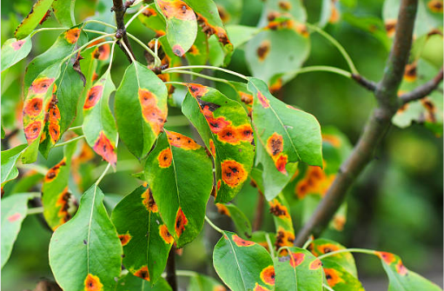
Problem Statement
Tomato crops are vulnerable to multiple diseases that reduce yield and quality. Manual inspection is slow and error-prone. The research problem is to develop a lightweight unified deep learning framework that can identify tomato diseases through TomaNet-C and detect and localize multiple disease regions through TomaNet-D, using a shared TomaBlock-based trunk while maintaining accuracy, efficiency, and reliable evaluation The goal is a robust, explainable pipeline suitable for field deployment or assisting farm experts.

Slide 13
Objectives
Gather datasets from various authorized websites.
Analyse and implement preprocessing techniques on an image dataset like tomato leaf.
Explore and utilize feature extraction techniques to identify features like color, texture, shape, and size of the affected areas.
Study and identify DL model selection for classification.
Explore the measurement parameters to check the overall performance of proposed recognition system.
Evaluate the performance of a model with existing model.

Slide 14
Comparative Analysis: Existing Research Gaps and TomaNet
Existing Research | TomaNet
Many studies focus only on classification. | TomaNet-C and TomaNet-D use the same TomaBlock-based layer, enabling one shared feature extractor for both classification and detection tasks
Most research focuses on leaf classification rather than disease localization. Existing CNN models identify disease labels but do not indicate where the disease appears on the plant. | TomaNet-D performs object detection, identifying disease type and drawing bounding boxes around multiple infected regions.
Heavy deep learning models are difficult to deploy on smartphones and edge devices. Many CNN and Transformer models require high computational resources. | TomaNet uses Partial Convolution (PConv) and re-parameterisation to reduce parameters and computational cost, making it lightweight.
Existing lightweight models often lose spatial information when detecting small lesions. Small disease spots are difficult to detect accurately. | TomaNet integrates Coordinate Attention, preserving positional information to improve learning of small localized disease symptoms.
Existing studies rely heavily on PlantVillage laboratory images. Models trained on plain-background images often perform poorly in real agricultural fields. | TomaNet uses both laboratory and field datasets (Rajashthan) to improve real-field applicability.
Dataset leakage leads to overestimated accuracy. Duplicate or augmented images appear in both train and test sets in some datasets. | TomaNet creates a corrected leakage-free train/test split for Tomato-Village, providing more reliable evaluation.

Slide 15
Propsed Methodology

Slide 16
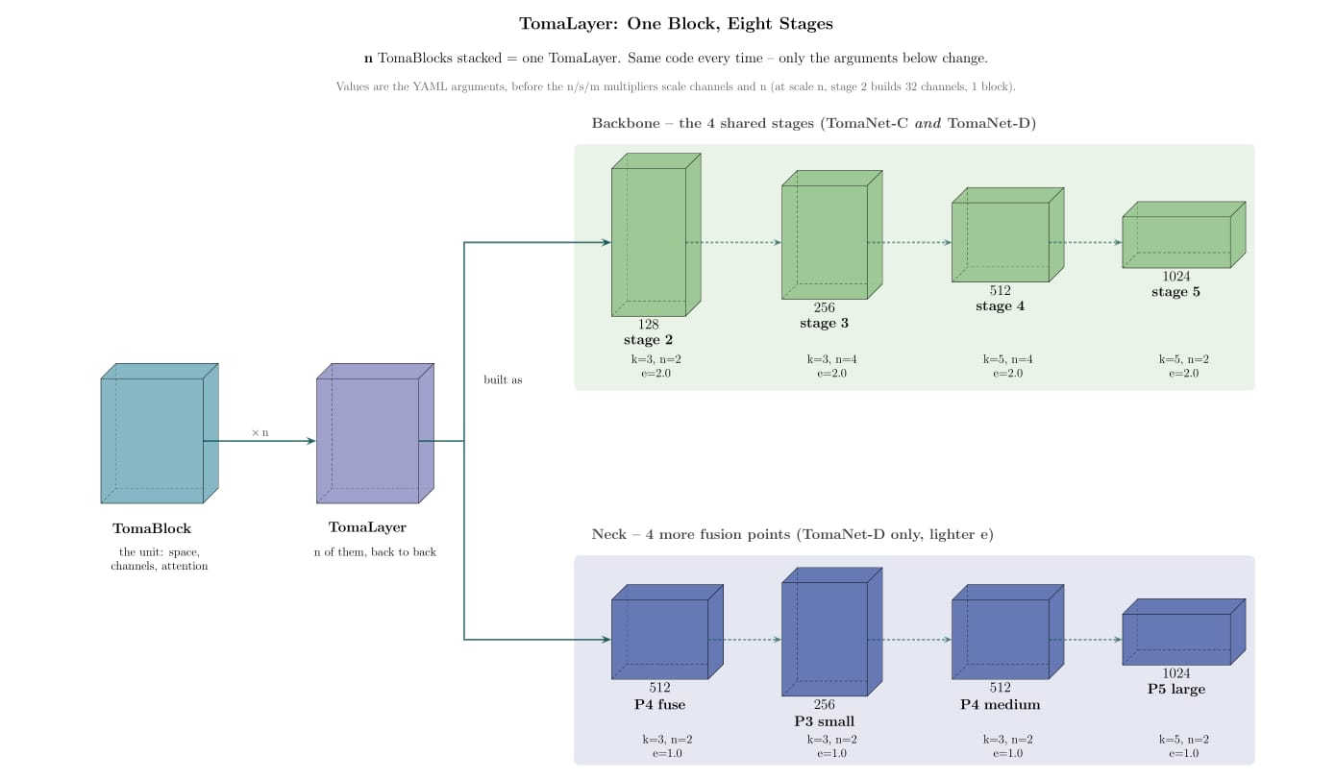

Slide 17
Plantvillage dataset and size(Tomanet-c)
PlantVillage– 18,000
• Taiwan tomato dataset– 622 real field photos
• PlantDoc– 700

Slide 18
Training testing validation

Slide 19
Plantvilage dataset(Tomanet-d)
Tomato-Village (detection variant)– field photos from Rajasthan, India. This is currently our only working detection dataset. After preparing it, we have 14,259 usable images with 6 disease classes that actually have boxes drawn on them.

Slide 20
Training,Testing and Validation

Slide 21
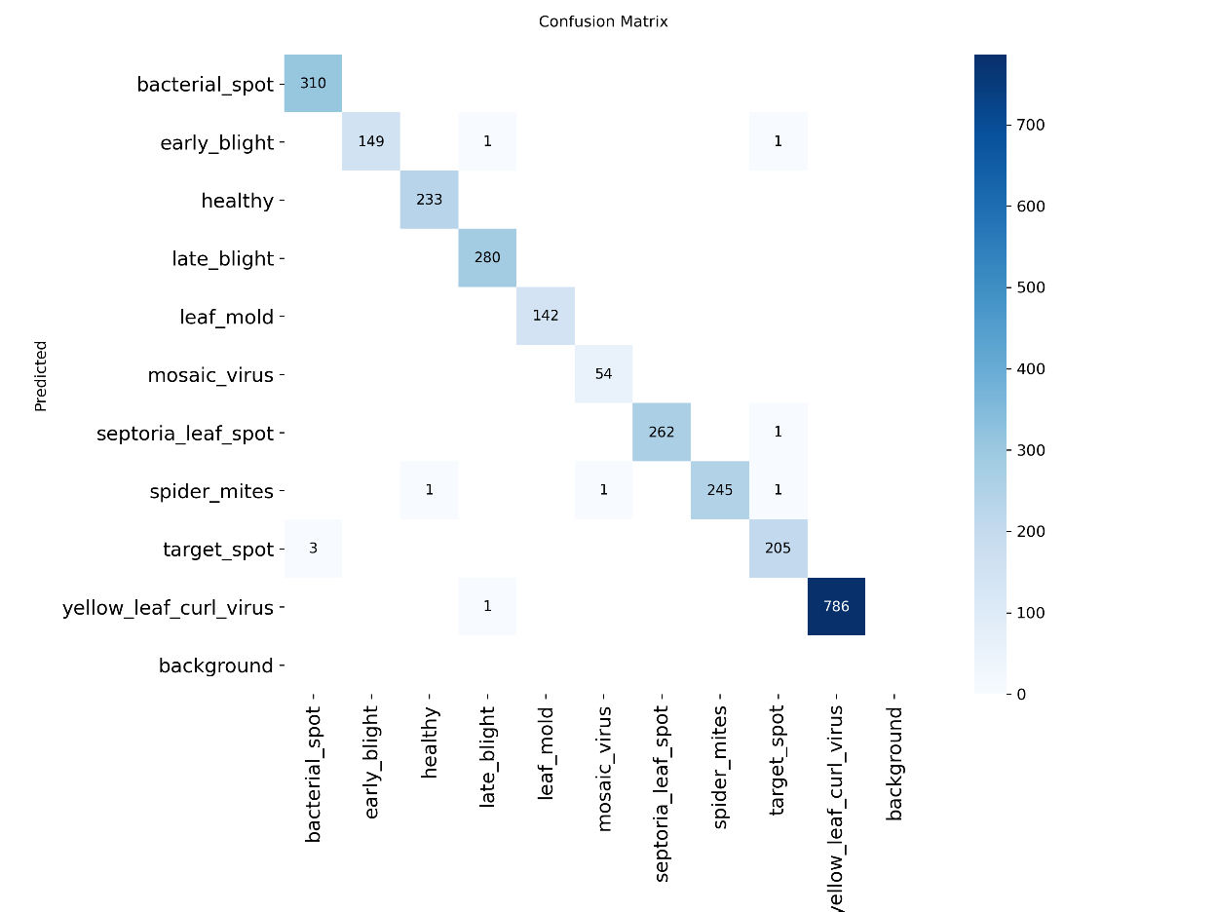
Result(Tomanetn)&Dataset Split
Training-70%
Testing-20%
Validation-10%
Epoch-100

Slide 22
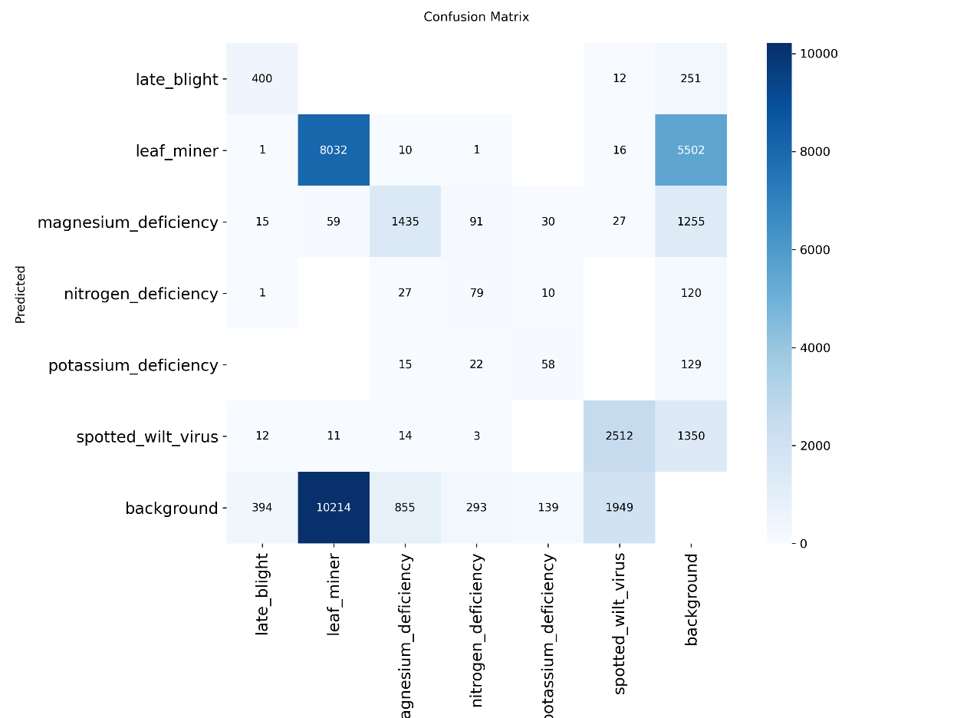
Continue(Tomanetm)&Dataset split
Training-70%
Testing-20%
Validation-10%
Epoch-100

Slide 23
Result
Metric | Score
F1 Score | 99.45%
Recall | 99.4%
Precision | 99.5%
Accuracy | 99.6%

Slide 24
Conclusion
The proposed TomaNet framework aims to provide an efficient and unified solution for tomato disease analysis by addressing the limitations of existing classification and detection approaches. The framework consists of TomaNet-C for disease classification and TomaNet-D for disease detection and localization, both built using the same TomaBlock-based shared trunk.
The integration of Partial Convolution (PConv), Coordinate Attention, and re-parameterisation is intended to achieve a balance between feature-learning capability and computational efficiency. TomaNet-C focuses on identifying the disease category from tomato leaf images, while TomaNet-D extends the same feature-extraction framework to identify and localize multiple diseased regions in real-field images.
The project also emphasizes data quality and reliable evaluation through dataset verification and a corrected leakage-free data split. The availability of different model sizes provides flexibility for deployment from resource-constrained mobile/edge devices to more powerful computing systems.
Overall, the proposed work demonstrates the potential of a single lightweight architecture for two complementary tomato disease tasks—“What disease?” and “Where is the disease?”

Slide 25
Further Enhancement
Further experiments with larger training runs, comparisons with existing models.

Slide 26
References
Wspanialy, P.; Moussa, M. A detection and severity estimation system for generic diseases of tomato greenhouse plants. Comput. Electron. Agric. 2020, 178, 105701.
Thuseethan, S., Vigneshwaran, P., Charles, J., & Wimalasooriya, C. (2024). Siamese network-based lightweight framework for tomato leaf disease recognition. Computers, 13(12), 323.
Oni, M. K., & Prama, T. T. (2025). Optimized Custom CNN for Real-Time Tomato Leaf Disease Detection. arXiv preprint arXiv:2502.18521.
Thai, H. T., & Le, K. H. (2025). MobileH-Transformer: Enabling real-time leaf disease detection using hybrid deep learning approach for smart agriculture. Crop Protection, 189, 107002.
Karegowda, A. G., Jain, R., & Devika, G. (2021, September). State-of-Art Deep Learning Based Tomato Leaf Disease Detection. In 3rd International Conference on Integrated Intelligent Computing Communication & Security (ICIIC 2021) (pp. 303-311). Atlantis Press.
Hosen, M. D., & Islam, M. H. (2025). Aggrotech: Leveraging Deep Learning for Sustainable Tomato Disease Management. arXiv preprint arXiv:2501.12052.
Anu, A., Solanki, K., & Dhankar, A. (2024). A novel multi-class deep learning approach for tomato leaf disease detection system. International Journal of Intelligent Systems and Applications in Engineering, 12(6s), 187-196.
Trivedi, N. K., Gautam, V., Anand, A., Aljahdali, H. M., Villar, S. G., Anand, D., ... & Kadry, S. (2021). Early detection and classification of tomato leaf disease using high-performance deep neural network. Sensors, 21(23), 7987.

Slide 27
References
Chen, H. C., Widodo, A. M., Wisnujati, A., Rahaman, M., Lin, J. C. W., Chen, L., & Weng, C. E. (2022). AlexNet convolutional neural network for disease detection and classification of tomato leaf. Electronics, 11(6), 951.
Nyasulu, C., Diattara, A., Traore, A., Ba, C., Diedhiou, P. M., Sy, Y., ... & Peluffo-Ordóñez, D. H. (2023). A comparative study of Machine Learning-based classification of Tomato fungal diseases: Application of GLCM texture features. Heliyon, 9(11).
Harakannanavar, S. S., Rudagi, J. M., Puranikmath, V. I., Siddiqua, A., & Pramodhini, R. (2022). Plant leaf disease detection using computer vision and machine learning algorithms. Global Transitions Proceedings, 3(1), 305-310.
Maeda-Gutiérrez, V., Galvan-Tejada, C. E., Zanella-Calzada, L. A., Celaya-Padilla, J. M., Galván-Tejada, J. I., Gamboa-Rosales, H., ... & Olvera-Olvera, C. A. (2020). Comparison of convolutional neural network architectures for classification of tomato plant diseases. Applied Sciences, 10(4), 1245.

Slide 28
References
Hussein, A. H. A., Adnan, M. M., Hemalatha, K. L., Malathy, V., & Rajesh, N. (2023, November). Coordinate Attention Mechanism with Convolutional Neural Network for Tomato Leaf Diseases. In 2023 International Conference on Integrated Intelligence and Communication Systems (ICIICS) (pp. 1-5). IEEE.
Abbas, A., Jain, S., Gour, M., & Vankudothu, S. (2021). Tomato plant disease detection using transfer learning with C-GAN synthetic images. Computers and electronics in agriculture, 187, 106279.
Ahmad, M., Abdullah, M., Moon, H., & Han, D. (2021). Plant disease detection in imbalanced datasets using efficient convolutional neural networks with stepwise transfer learning. IEEE Access, 9, 140565-140580.
Ala'a, R., & Ibrahim, R. W. (2024). Classification of tomato leaf images for detection of plant disease using conformable polynomials image features. MethodsX, 13, 102844.
Wang, X., Liu, J., & Liu, G. (2021). Diseases detection of occlusion and overlapping tomato leaves based on deep learning. Frontiers in plant science, 12, 792244.

Slide 29
References
Li, D., Yin, Z., Wu, Z., & Liu, Q. (2021, July). Classification for tomato disease with imbalanced samples based on td-mobilenetv2. In 2021 5th international conference on imaging, signal processing and communications (ICISPC) (pp. 35-39). IEEE.
Shoaib, M., Hussain, T., Shah, B., Ullah, I., Shah, S. M., Ali, F., & Park, S. H. (2022). Deep learning-based segmentation and classification of leaf images for detection of tomato plant disease. Frontiers in plant science, 13, 1031748.
Gangwar, A., Dhaka, V. S., Rani, G., Khandelwal, S., Zumpano, E., & Vocaturo, E. (2024). Time and Space Efficient Multi-Model Convolution Vision Transformer for Tomato Disease Detection from Leaf Images with Varied Backgrounds. Computers, Materials & Continua, 79(1).
O. F., Nahiduzzaman, M., Ahsan, M., Haider, J., & Kowalski, M. (2024). Enhancing agriculture through real-time grape leaf disease classification via an edge device with a lightweight CNN architecture and Grad-CAM. Scientific Reports, 14(1), 16022.
Masud, K. I., Rahman, M. M., Jannat, M. R., Hasan, M. M., Islam, M. S., & Rahman, M. O. (2024, December). A CNN-based Model to Detect and Classify the Tomato Leaf Disease using Transfer Learning. In 2024 27th International Conference on Computer and Information Technology (ICCIT) (pp. 2823-2828). IEEE.
Catal Reis, H. (2024). Advanced tomato disease detection using the fusion of multiple deep-learning and meta-learning techniques. Journal of Crop Health, 76(6), 1553-1567..
Junare, C. B., Ghanokar, V. S., Khandare, R. M., Koche, S. P., & Pagrut, S. B. (2024). Plant disease detection using mask RCNN. SSGM Journal of Science and Engineering, 2(1), 21-26.

Slide 30
Thank You

