Slide 1
MAJOR PROJECT REVIEW
TomaNet
One lightweight shared trunk for both tomato disease
classification and in-field disease localisation
TomaNet-C classification · 99.63% test accuracy on PlantVillage
TomaNet-D detection · mAP@0.5 0.392 on Tomato-Village (in testing)
Built on TomaBlock · Partial Convolution + Coordinate Attention + re-parameterisation
Notes:
TomaNet: one TomaBlock-based trunk, two heads. TomaNet-C is complete and highly accurate; TomaNet-D is trained and running but still in the tuning phase.

Slide 2
1 · WHY TOMATO DISEASE DETECTION
Introduction
190 Mt
200+
20–80%
40–100%
global tomato production each year
diseases affect the tomato plant
yield loss in an affected region
loss in severe Leaf Curl Virus outbreaks in India
The problem today
What deep learning changes
Diagnosis still depends on expert visual inspection — slow, subjective and scarce in the field.
Early-stage symptoms are small, faint and easy to miss with the naked eye.
A single leaf often carries more than one problem at once, so a single label is not enough.
By the time a disease is obvious, a large share of the yield is already lost.
A CNN reads a leaf photo and returns a disease name in milliseconds.
A detector goes further: it draws a box around every diseased region on a whole plant.
A lightweight model runs on an ordinary phone — no data-centre GPU, no connectivity.
Result: early diagnosis, lower crop loss, and timely decisions in the farmer's own hand.
1 · Introduction
2

Slide 3
2 · PRIOR WORK (1 OF 5)
Literature Survey
Author (Year) | Method | Dataset | Key result / observation
Wspanialy & Moussa (2020) | ResNet classifier + modified U-Net for severity | PlantVillage, 9 tomato classes | Adds disease-severity estimation. Flags PlantVillage background and lighting bias — real greenhouse/field data needed.
Thuseethan et al. (2024) | Siamese network + lightweight CNN, contrastive loss | PlantVillage 14,531 (10 cls); Taiwan 622 (6 cls) | 96.97% and 95.48% accuracy. Edge-friendly, but real-field conditions untested.
Oni & Prama (2025) | Custom CNN vs YOLOv5, MobileNetV2, ResNet18 | Field images, Brahmanbaria, Bangladesh | Custom CNN 95.2% beats YOLOv5 77%, MobileNetV2 89.4%, ResNet18 71.9%.
Thai & Le (2025) | MobileH-Transformer (CNN + Transformer hybrid) | PlantVillage 10,008 (11 cls) + corn set | 96.80% F1 and 30.5 FPS on a phone — real-time mobile inference is feasible.
Karegowda, Jain & Devika (2021) | YOLO / Faster R-CNN detection → SVM / Random Forest | Tomato leaf disease images | 90–95% accuracy with a farmer-facing mobile app; weak under varied light and severity.
2 · Literature Survey
3

Slide 4
2 · PRIOR WORK (2 OF 5)
Literature Survey
Author (Year) | Method | Dataset | Key result / observation
Hosen & Islam (2025) | VGG19 and InceptionV3 with dropout | Tomato-Villages, 4,525 images | 93.93% accuracy with dropout — confirms field data is materially harder than lab data.
Anu, Solanki & Dhankar (2023) | Threshold + Gaussian blur + Canny → CNN (ReLU vs Leaky-ReLU) | PlantVillage ~10,000 images, 10 classes | Leaky-ReLU 95.08% vs ReLU 92.76% — activation choice measurably matters.
Trivedi et al. (2021) | CNN with preprocessing, segmentation, hyper-parameter tuning | 3,000 images, 9 diseases + healthy | 98.49% accuracy on colour, texture and edge features.
Nyasulu et al. (2023) | GLCM texture features + ANN / KNN / RF / SVM | 4 fungal diseases (Alternaria, Curvularia, ...) | ANN best at 94%. Confuses Helminthosporium with Curvularia — visually similar classes.
Chen et al. (2022) | Modified AlexNet CNN, Adam, 64×64 RGB, Android app | 22,930 images, 10 classes | ~98% accuracy (P 0.98 / R 0.99 / F1 0.98) running inside a mobile application.
2 · Literature Survey
4

Slide 5
2 · PRIOR WORK (3 OF 5)
Literature Survey
Author (Year) | Method | Dataset | Key result / observation
Harakannanavar et al. (2022) | K-means + contour + DWT / PCA / GLCM → SVM, KNN, CNN | Plant leaf set incl. tomato, 256×256 | CNN 99.6% clearly ahead of KNN and SVM on the same features.
Maeda-Gutiérrez et al. (2020) | Transfer learning: AlexNet, GoogleNet, InceptionV3, ResNet-18/50 | PlantVillage 18,160 images, 10 classes | GoogleNet best: 99.39% accuracy, 99.72% AUC. InceptionV3 lowest at 98.65%.
Hussein et al. (2023) | CNN + Coordinate Attention mechanism | Tomato leaf disease images | Attention steers the CNN onto lesion regions and subtle symptoms — direct precedent for our block.
Abbas et al. (2021) | Conditional GAN synthetic images + DenseNet121 transfer learning | PlantVillage, 5 / 7 / 10 class setups | 99.51% / 98.65% / 97.11%. Synthetic augmentation improves generalisation.
Ahmed et al. (2022) | MobileNetV2 + CLAHE enhancement + runtime augmentation | PlantVillage 18,160 images, 10 classes | 99.30% at only 9.60 MB and 4.87 MFLOPs — the lightweight-CNN benchmark to beat.
2 · Literature Survey
5

Slide 6
2 · PRIOR WORK (4 OF 5)
Literature Survey
Author (Year) | Method | Dataset | Key result / observation
Al-Shamasneh & Ibrahim (2024) | Conformable-polynomial texture features + SVM | PlantVillage ~18,200 images | 98.80% from texture features alone, with no deep network at all.
Li et al. (2021) | TD-MobileNetV2 tuned for imbalanced samples | 1,890 images, 3 disease classes | ~97.33% while staying lightweight — imbalance can be handled architecturally.
Shoaib et al. (2022) | Modified U-Net segmentation → InceptionNet classification | PlantVillage 18,161, segmented + raw | 98.66% segmentation; 99.95% binary and 99.12% six-class classification.
Gangwar et al. (2024) | Swift-Lite-CvT (VGG16 + ViT + CvT hybrid) | 10 / 11 / 13 class sets, varied backgrounds | 93.51% on 13 classes at 5.8 MB and 44 min training — aimed at IoT and drones.
Karim et al. (2024) | MobileNetV3-Large + Grad-CAM on an edge device | Grapevine, 9,027 images, 4 classes | Edge-AI plus visual explanation; the recipe transfers directly to tomato.
2 · Literature Survey
6

Slide 7
2 · PRIOR WORK (5 OF 5)
Literature Survey
Author (Year) | Method | Dataset | Key result / observation
Masud et al. (2024) | CNN with transfer learning | Tomato leaf disease images | Transfer learning classifies reliably while cutting training requirements.
Çatal Reis (2024) | DenseNet201 + CoAtNet + FasterNet + FastViT + WaveMLP, voting + CLAHE | 3 classes, 900 test images | Only 4 of 900 misclassified (~99.56%) — but on just three easy classes.
Junare et al. (2024) | Mask R-CNN instance segmentation | Self-collected images, 1024×1024 | Pixel-level localisation of diseased regions, though not tomato-specific.
Wang, Liu & Liu (2021) | Deep detection under occlusion and overlap | Tomato leaves with occluded / overlapping views | Handles leaf overlap — the exact failure mode of real field photography.
2 · Literature Survey
7

Slide 8
3 · WHAT 24 PAPERS STILL LEAVE OPEN
Research Gap
1
Classification without localisation
2
Collapse on real field photos
3
Lab datasets and hidden leakage
Most models name the disease but never say where it is — no boxes, no segmentation, no severity number. [2][16][22][31]
Accuracy falls sharply under changing light, cluttered backgrounds and overlapping leaves. [3][23][26][27]
PlantVillage plain backgrounds dominate; duplicate and augmented images leak across splits, inflating reported scores. [1][3][6][25][26]
4
Poor generalisation
5
One disease at a time
6
Narrow, single-task scope
Models overfit one dataset and fail on other varieties, other crops and unseen disease variants. [2][4][5][8][19][20]
Systems cannot report two or more co-occurring problems on the same leaf, which is the normal field case. [23][26][27][31]
Work is disease-specific and single-task; no temporal tracking, no shared model across classification and detection. [1][20][28][29][30]
3 · Research Gap
8

Slide 9
4 · THE QUESTION THIS PROJECT ANSWERS
Problem Statement
Tomato crops lose 20–80% of yield to disease, yet the tools that could catch it early either name the disease without locating it, or are too heavy to run where the crop actually grows.
Design constraints
Phone / edge compute budget
Real field imagery, not only lab photos
Multiple lesions per image
Evaluation that cannot be inflated by leakage
Develop a lightweight unified deep-learning framework in which
TomaNet-C
TomaNet-D
identifies the disease from a single tomato leaf image
detects and localises multiple diseased regions on a whole plant
— both built on the same TomaBlock-based trunk, so accuracy, efficiency and reliable evaluation are achieved once and reused twice.
4 · Problem Statement
9

Slide 10
5 · WHAT WE SET OUT TO BUILD AND PROVE
Objectives
1
Design TomaBlock
2
Build two models on one trunk
One reusable block combining Partial Convolution, Coordinate Attention and RepVGG-style re-parameterisation.
Assemble TomaNet-C and TomaNet-D on a byte-identical shared trunk, at three scales (n / s / m).
3
Curate and repair the data
4
Train and verify TomaNet-C
Prepare PlantVillage (18,160 leaves, 10 classes) and Tomato-Village (14,259 field images, 6 box classes); remove the authors' train/test leakage.
Report accuracy, macro-F1, Cohen's κ, MCC and a per-class breakdown — not accuracy alone.
5
Transfer the trunk across tasks
6
Evaluate detection honestly
Warm-start TomaNet-D from the trained classification trunk and measure whether cross-task transfer actually helps.
Precision, recall, mAP@0.5 and mAP@0.5:0.95 per class, on the leakage-free split only.
7
Tune TomaNet-D to close the gap
8
Keep it deployable
Sweep batch size, epochs, LR schedule and augmentation; pre-process Tomato-Village if tuning alone is not enough.
Fold the re-parameterised branches before export so the shipped model pays no extra inference cost.
5 · Objectives
10

Slide 11
5 · HOW EACH OBJECTIVE ANSWERS A GAP
Existing Research Gaps vs. TomaNet
Gap in existing research | How TomaNet answers it
Most studies address classification only. | TomaNet-C and TomaNet-D share one TomaBlock-based trunk — a single feature extractor serves both tasks, and an automated test asserts the two trunks are identical.
Models give a disease label but not its location. | TomaNet-D performs object detection: disease type plus a bounding box around every infected region, several per image.
Heavy CNN and Transformer models will not run on a phone. | Partial Convolution cuts memory movement and re-parameterisation folds three training-time branches into one at deployment — 1.32 M params at the smallest classification scale.
Lightweight models lose the spatial detail that small lesions need. | Coordinate Attention keeps positional information instead of collapsing it, which is what small localised symptoms depend on.
Reliance on plain-background PlantVillage images. | Trained and evaluated on both lab data (PlantVillage) and real field data from Rajasthan (Tomato-Village).
Dataset leakage inflates reported accuracy. | A corrected, leakage-free split for Tomato-Village keeps every augmented copy of a photo on one side of the split.
5 · Objectives
11

Slide 12
6
Proposed Methodology
TomaBlock → shared trunk → two task heads
6 · Proposed Methodology
12

Slide 13
6 · VISUAL DIAGRAM
Proposed Methodology — System Architecture
Placeholder — insert the TomaNet system architecture diagram here
6 · Proposed Methodology
13
Notes:
Reserved slide: paste the hand-drawn / draw.io system architecture diagram full-bleed here.

Slide 14
6 · END-TO-END PIPELINE
How the System Processes an Image
1
Collect
PlantVillage leaf photos and Tomato-Village field photos from Rajasthan.
2
Clean & de-duplicate
Hash every image, group augmented copies of the same original, then split so no copy crosses train/test.
3
Pre-process
Resize to 224 px (classification) or 800 px (detection); leaf-safe augmentation — flips, mild colour jitter, no distortion that destroys a lesion.
4
Shared trunk
The image passes through stacked TomaLayers built from TomaBlock — identical layers for both tasks.
5
Task head
Classification: global average pool → FC → softmax. Detection: FPN-style neck → three detect heads at P3 / P4 / P5.
6
Evaluate
Accuracy, macro-F1, κ, MCC for TomaNet-C; precision, recall, mAP@0.5 and mAP@0.5:0.95 for TomaNet-D.
6 · Proposed Methodology
14

Slide 15
6 · THE IDEA IN ONE SLIDE
What is TomaNet, and Why is it Different?
TomaNet is one small convolutional design built from a single reusable brick, TomaBlock. The same brick stacks into the same trunk for both tasks — literally the same list of layers, asserted by an automated test — so a trunk trained to classify can jump-start a trunk that detects.
1
2
3
4
Partial Convolution
Coordinate Attention
Re-parameterisation
One trunk, two jobs
Convolve only a quarter of the channels. The real bottleneck on a phone is memory movement, not arithmetic — so this keeps the model fast and light.
Lesions are small and appear in specific places. Channel-only attention throws that away; Coordinate Attention keeps track of where on the leaf something is wrong.
Three parallel branches during training help it learn; they fold mathematically into one branch before deployment, so inference pays nothing. Verified numerically exact in our tests.
The uncommon part. Most tomato work builds a separate model per task; here classification and detection share the trunk byte-for-byte and transfer between each other.
FasterNet, CVPR 2023
Hou et al., CVPR 2021
RepVGG, CVPR 2021
Our contribution
Measured parameter counts TomaNet-C 1.32 M (n) · 4.47 M (s) · 14.44 M (m) TomaNet-D 2.92 M (n) · 10.64 M (s) · 30.79 M (m)
6 · Proposed Methodology
15

Slide 16
6 · THE SHARED BRICK
TomaBlock Inside TomaNet-C and TomaNet-D
Inside one TomaBlock
RepPConv 3×3
1×1 expand
DWConv k×k
CoordAtt
1×1 project
1/4 channels
×2 width
spatial mixing
keeps where
back to c₂
+ residual when c₁ = c₂
Shared trunk
TomaNet-C
global avg pool → FC → softmax
Conv 3×3/2 ×2
TomaLayer ×2 (128)
TomaLayer ×4 (256)
TomaLayer ×4 (512)
TomaLayer ×2 (1024)
One disease name per leaf image, with a confidence score. 224×224 input.
e.g. bacterial_spot 0.99
TomaNet-D
FPN neck → detect heads at P3 / P4 / P5
Many boxes per plant image, each with a class and score. 800×800 input.
Identical layer list for both
tasks — asserted by a unit test
e.g. leaf_miner 0.73 × 5 boxes
Because the trunk is the same object, the PlantVillage-trained classifier was used directly to warm-start TomaNet-D.
6 · Proposed Methodology
16

Slide 17
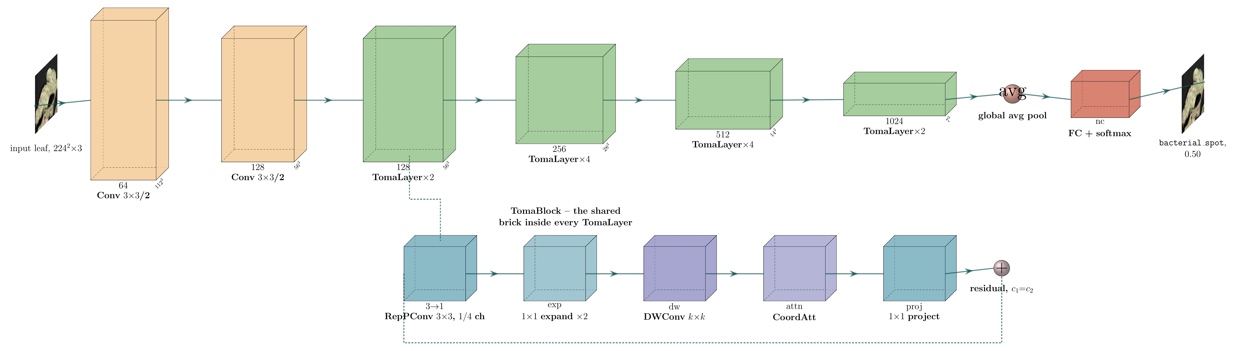
6 · CLASSIFICATION BACKBONE
TomaNet-C — Layer-by-Layer
TomaNet-C: two stem convolutions, four TomaLayer stages, global average pool, FC + softmax. The lower strip expands one TomaBlock.
Stem
Four stages
Head
Two stride-2 3×3 convolutions take 224² down to 56² before any TomaBlock runs — cheap early downsampling.
128 → 256 → 512 → 1024 channels. TomaNet-D taps the 256 and 512 stages as P3 and P4 for its neck.
Global average pool removes the spatial dimensions, then a single FC layer maps 1024 features to the class scores.
6 · Proposed Methodology
17

Slide 18
7 · WHAT WE TRAIN AND TEST ON
Datasets
PlantVillage
Tomato-Village
TomaNet-C · classification
TomaNet-D · detection
Images
18,160 tomato leaves
Images
14,259 usable field photos
Classes
10 (9 diseases + healthy)
Classes
6 with real box annotations
Capture
single leaf, plain lab background
Capture
open fields, Rajasthan, India
Input size
224 × 224
Input size
800 × 800
Test split
2,692 images
Test split
3,536 images
Near-saturated in the literature (99.4–99.96%), so we use it to prove the architecture trains correctly — not as a headline claim.
Real field imagery: clutter, occlusion, harsh sun, several lesions per frame. The authors' own split leaks — we rebuilt it.
70 / 10 / 20 train / val / test
70 / 10 / 20 train / val / test
7 · Dataset
18

Slide 19
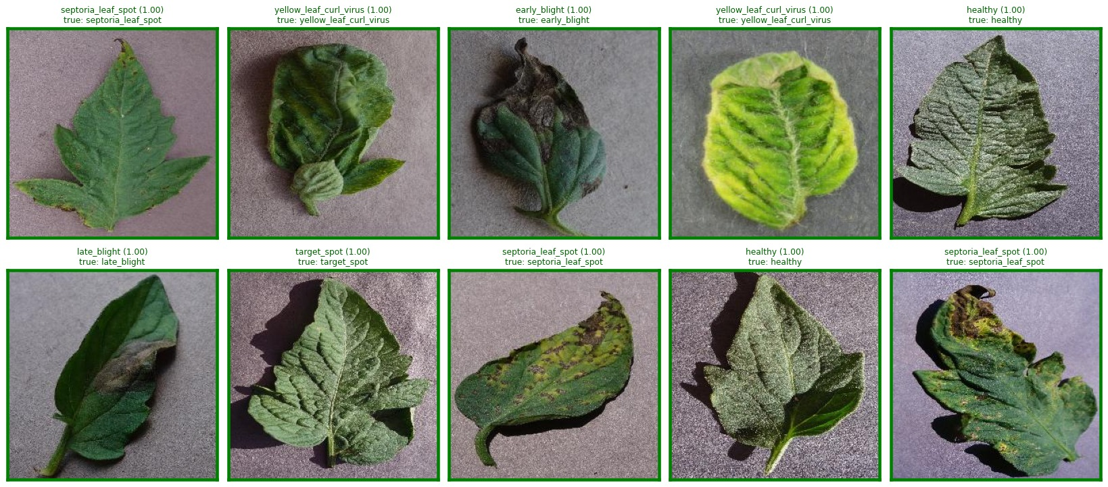
7 · WHAT TOMANET-C SEES
Dataset — PlantVillage Classes
10 classes
bacterial spot
n=315
early blight
n=151
healthy
n=236
late blight
n=283
leaf mold
n=143
mosaic virus
n=56
septoria leaf spot
n=264
spider mites
n=247
target spot
n=210
yellow leaf curl virus
n=787
Held-out PlantVillage test images with the class name printed above each leaf. Single leaf, plain lab background, 224 × 224 input.
7 · Dataset
19
Notes:
The grid is drawn from the model's own test-split output because the raw PlantVillage images are not in the repo. Swap it for a curated one-image-per-class grid when those files are available — same position and size.

Slide 20
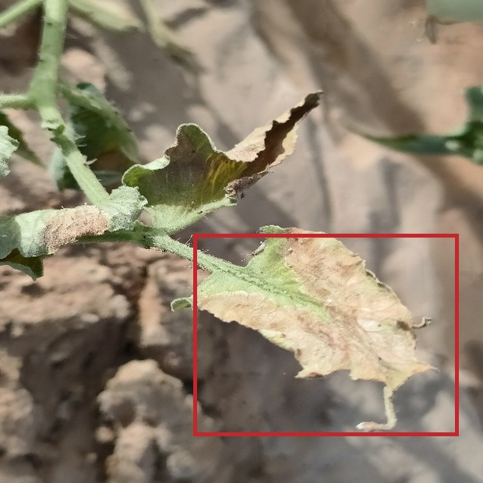
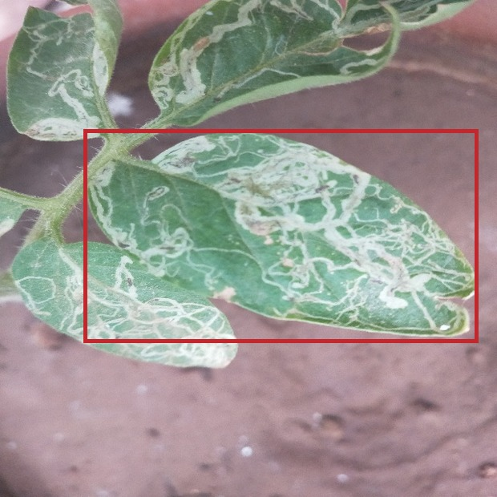
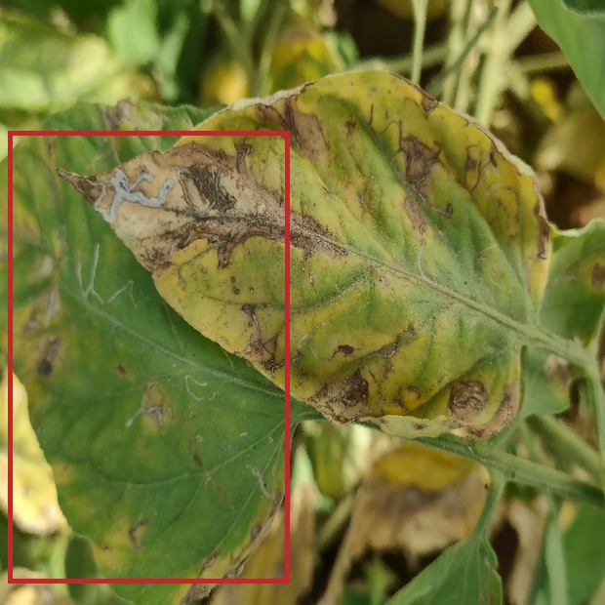
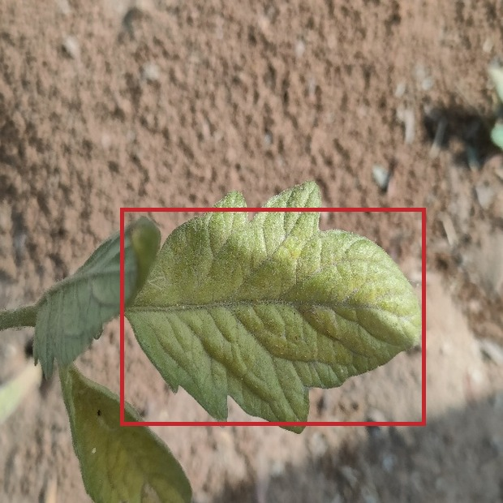
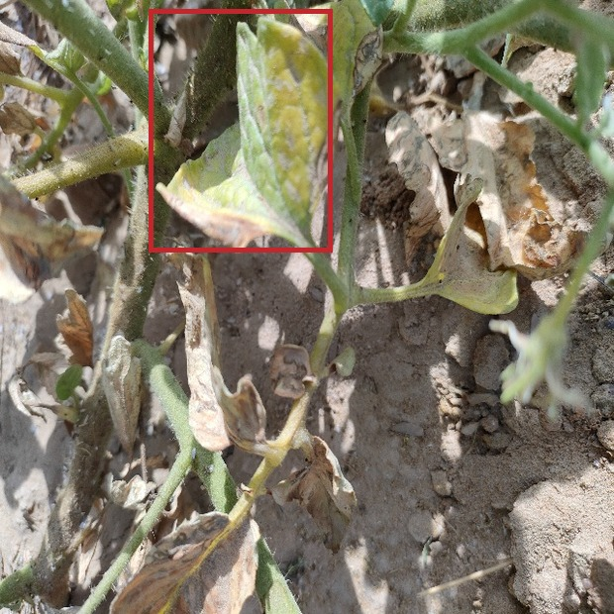
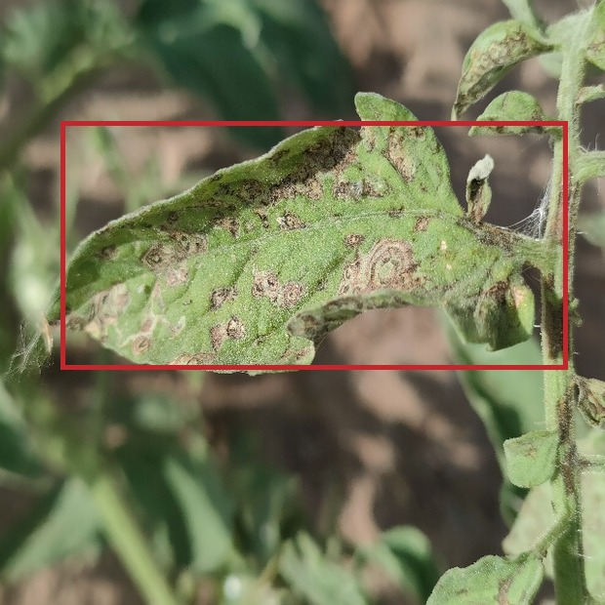
7 · WHAT TOMANET-D SEES
Dataset — Tomato-Village Classes
Why this data
is hard
late blight
leaf miner
magnesium deficiency
823
boxes
18,316
boxes
2,356
boxes
Open-field clutter and soil in frame
Harsh, uneven sunlight
Overlapping and occluded leaves
Several lesions per image
Severe imbalance: 18,316 leaf-miner boxes vs 237 potassium
nitrogen deficiency
potassium deficiency
spotted wilt virus
489
boxes
237
boxes
4,516
boxes
Held-out Tomato-Village frames, cropped around one ground-truth box per class (red outline).
7 · Dataset
20

Slide 21
7 · EXACTLY WHAT WAS RUN
Experimental Setup
Setting | TomaNet-C (PlantVillage) | TomaNet-D (Tomato-Village)
Model scale | TomaNet-C-n — 1.32 M parameters | TomaNet-D-m — 30.79 M parameters
Task | 10-class leaf classification | 6-class object detection
Input resolution | 224 × 224 | 800 × 800
Batch size | 128 | 32
Initial learning rate | 0.001 | 0.01
Epochs (budget / actual) | 100 / stopped at 83, patience 15 | 100 / stopped at 85, patience 60
Initialisation | from scratch | warm-started from the trained TomaNet-C trunk
Augmentation | leaf-safe preset (flips, mild colour jitter) | leaf-safe preset
Hardware / seed | single GPU, 8 workers, seed 0 | single GPU, 8 workers, seed 0
Split | 70 / 10 / 20 — 2,692 test images | 70 / 10 / 20, leakage-corrected — 3,536 test images
7 · Dataset
21

Slide 22
8 · CLASSIFICATION: THE TOMABLOCK EXPERIMENT SUCCEEDED
Results — TomaNet-C
99.63%
99.61%
99.60%
99.63%
0.9956
0.9956
Test accuracy
Macro F1
Macro precision
Macro recall
Cohen's κ
MCC
What this shows
TomaNet-C is highly accurate: 10 wrong predictions out of 2,692 test images (0.4%).
Every one of the 10 classes lands above 0.988 F1 — no weak class, no class collapsed.
κ and MCC both 0.9956, so the score is not an artefact of class imbalance.
This is the result that validates TomaBlock: PConv + Coordinate Attention + re-parameterisation train stably and lose nothing at 1.32 M parameters.
We report it as a correctness proof, not a record claim — PlantVillage is already saturated at 99.4–99.96% in the literature.
8 · Results
22

Slide 23
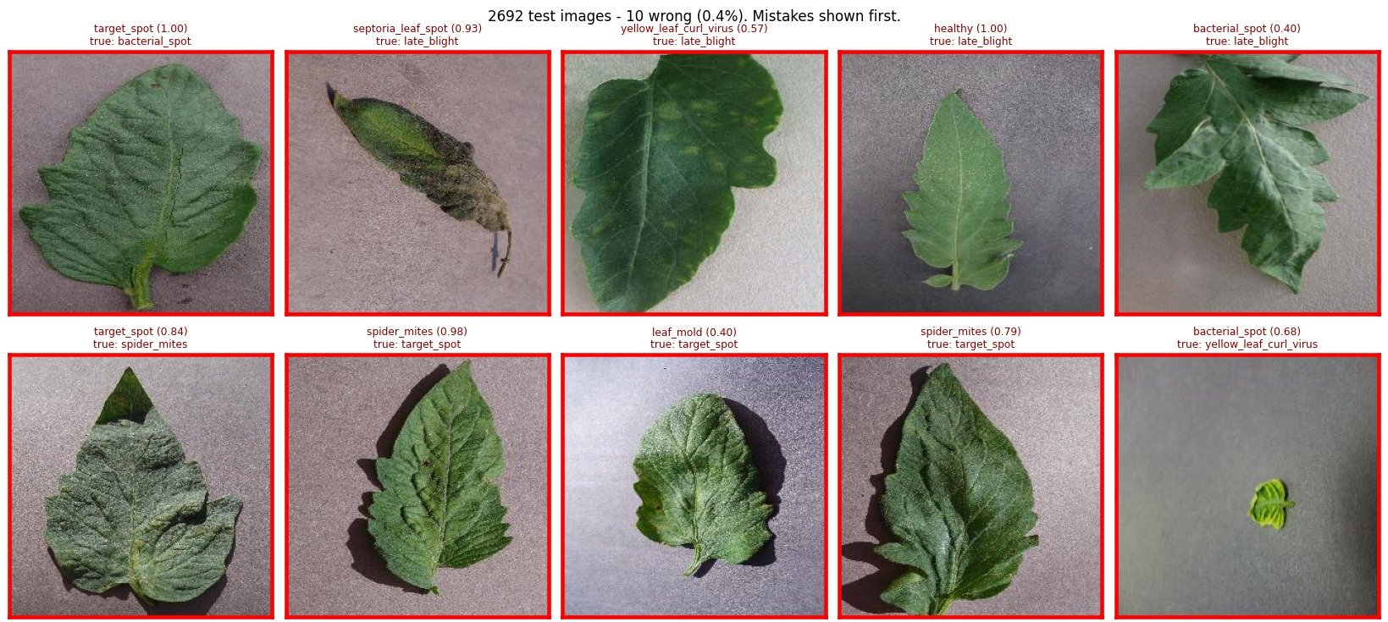
8 · RESULTS: EVERY ONE OF THE 10 MISTAKES
TomaNet-C Predictions
2,692
10
test images
wrong · 0.4%
Where it still fails
target_spot ↔ spider_mites: 3 of the 10 errors — both present as fine stippling.
late_blight → septoria / yellow curl: visually overlapping lesion patterns.
One healthy leaf read as late_blight, and one tiny curled leaf as bacterial_spot.
Every mistake is between diseases a human agronomist also confuses — none are absurd, which rules out a label-mapping bug.
All 10 errors from the 2,692-image test split, shown in full. Red frame = wrong; predicted class and confidence above, ground truth below.
8 · Results
23

Slide 24
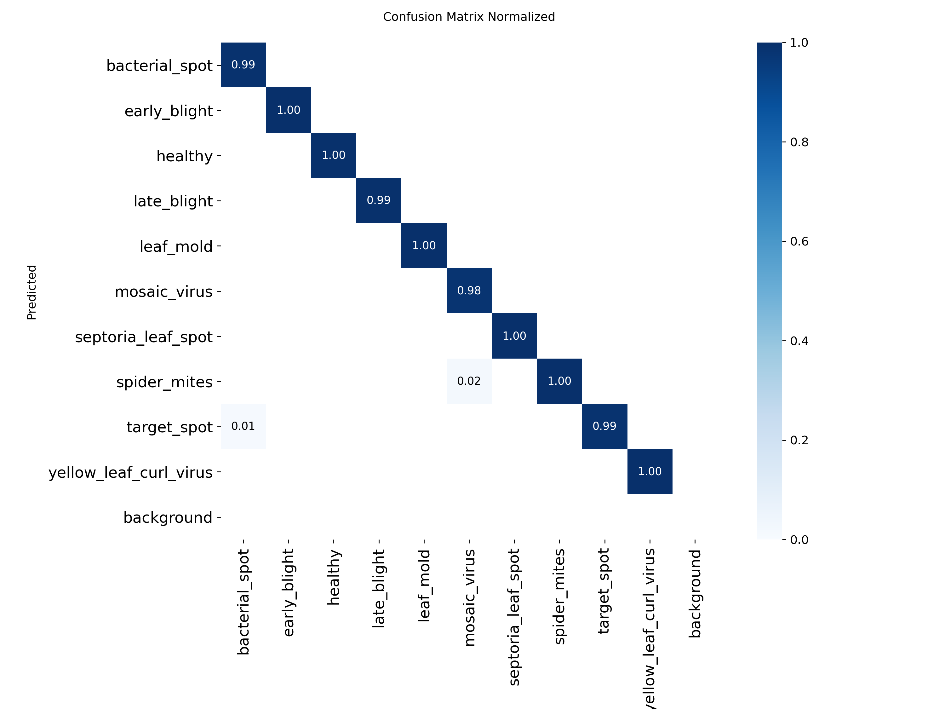
8 · RESULTS: TRAINING BEHAVIOUR
TomaNet-C Convergence and Confusion
Normalised confusion matrix — test split
Accuracy passes 90% by epoch 5 and 99% by epoch 33; validation loss keeps falling with training loss, so there is no overfitting. Early stopping fired at epoch 83.
8 · Results
24

Slide 25
8 · DETECTION: UNDER EXPERIMENT AND TESTING
Results — TomaNet-D
Status: TomaNet-D trains end to end and produces correct box predictions, but its accuracy is still being improved. The numbers below are a working checkpoint, not a final result.
0.392
0.178
0.459
0.400
3,536
85
mAP@0.5
mAP@0.5:0.95
Precision
Recall
test images
epochs so far
Reading the result
The well-represented classes already work: magnesium 0.550, spotted wilt 0.542, late blight 0.437, leaf miner 0.433.
The two rare classes drag the mean down: nitrogen 0.157 (489 boxes) and potassium 0.234 (237 boxes) against 18,316 leaf-miner boxes.
Published best on this dataset is mAP@0.5 0.936 (large model) and 0.864 (phone-sized) — that is the target we are tuning towards.
The pipeline, the shared trunk and the warm-start all work; what remains is optimisation, not architecture.
8 · Results
25

Slide 26
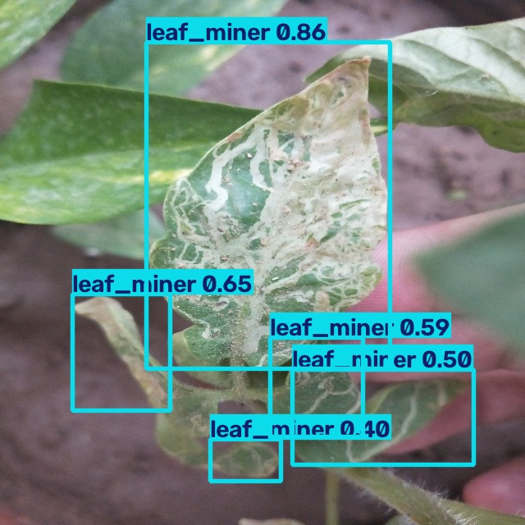
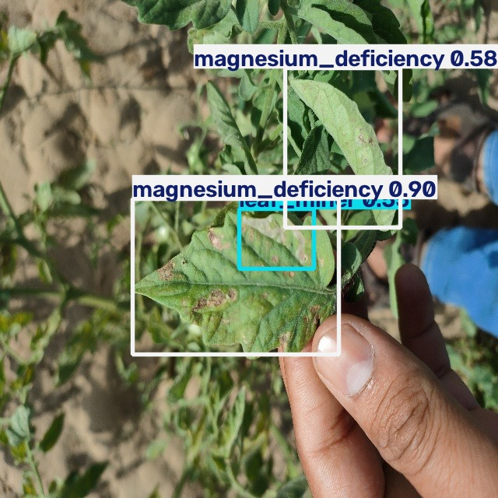
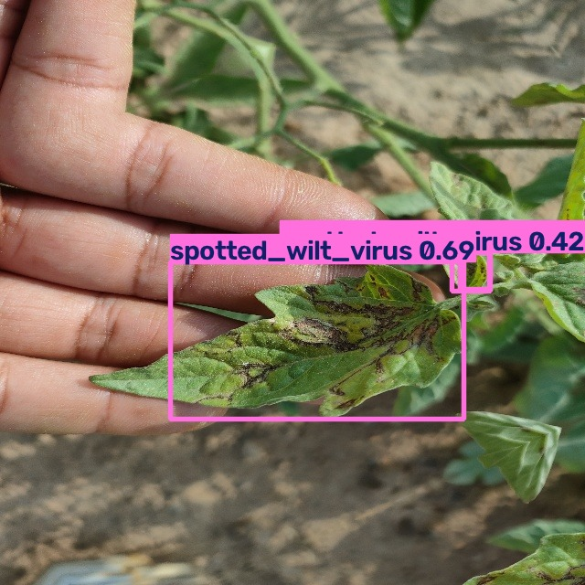
8 · RESULTS: BOXES ON REAL FIELD PHOTOS
TomaNet-D Detections
leaf miner · 5 boxes
magnesium deficiency + leaf miner
spotted wilt virus · 3 boxes
Fine mine trails on a single leaf, held in-hand against a cluttered field background.
Two different problems on the same plant, reported together — the multi-disease case the literature misses.
Whole-plant view: several infected leaves boxed separately in one pass.
TomaNet-D-m on held-out test images at confidence threshold 0.35. Colour encodes class; the number is the score.
8 · Results
26

Slide 27
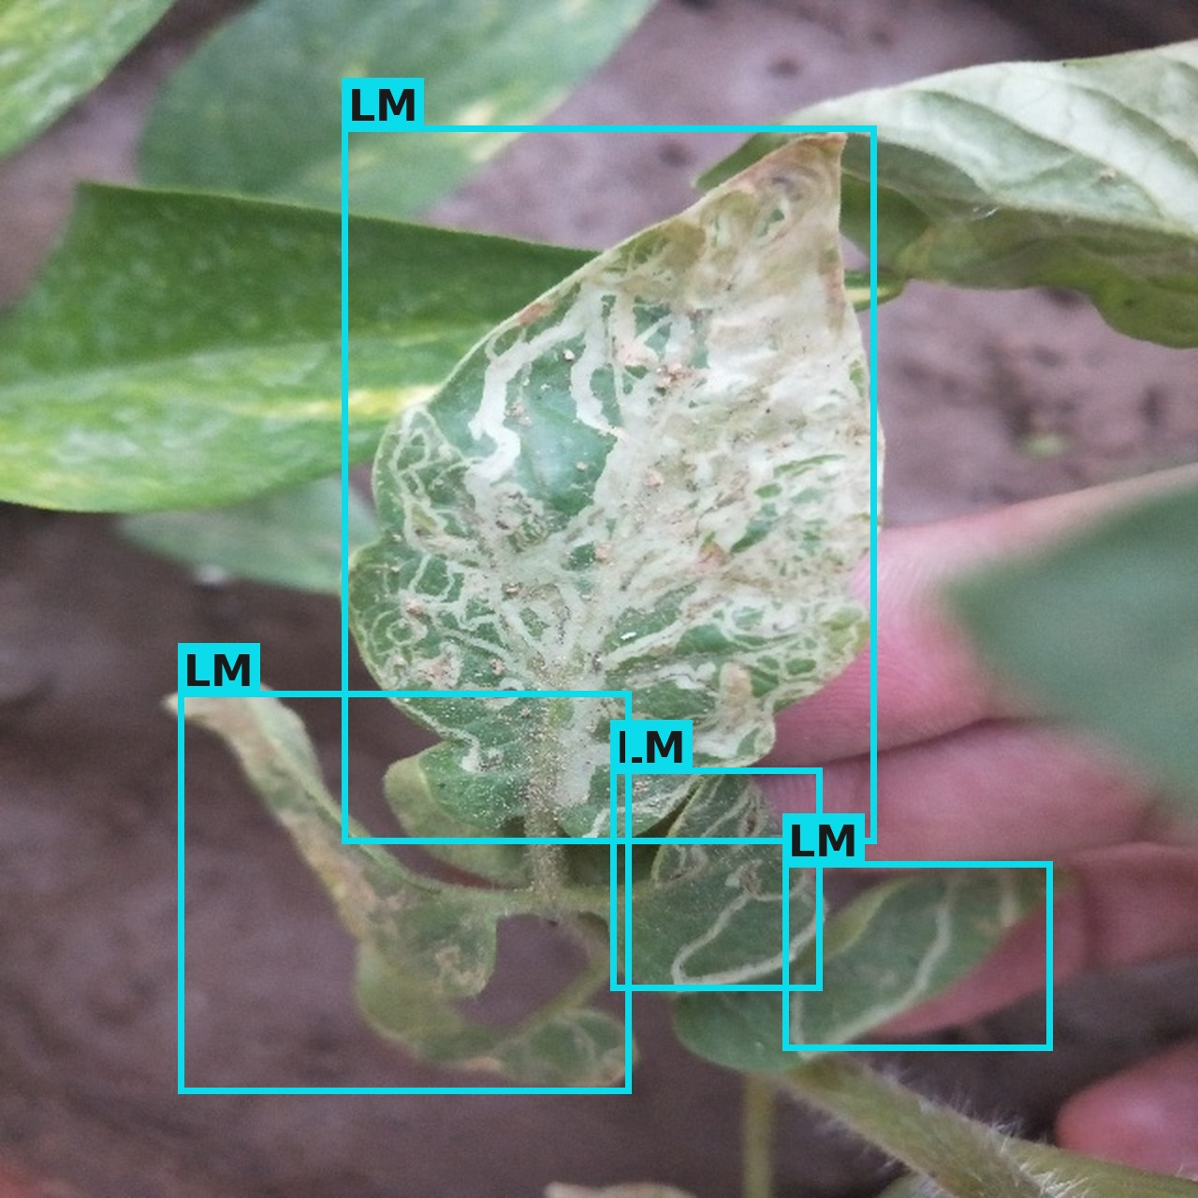
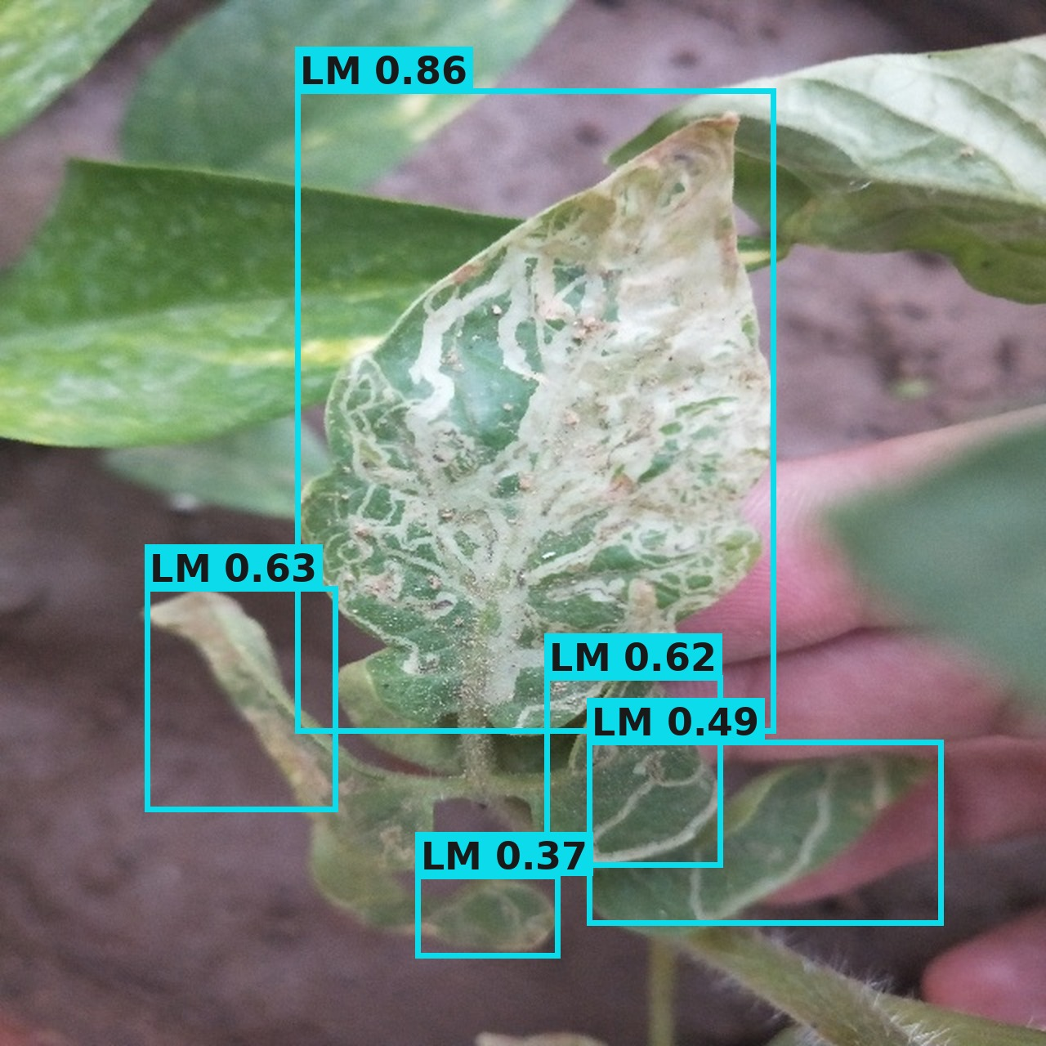
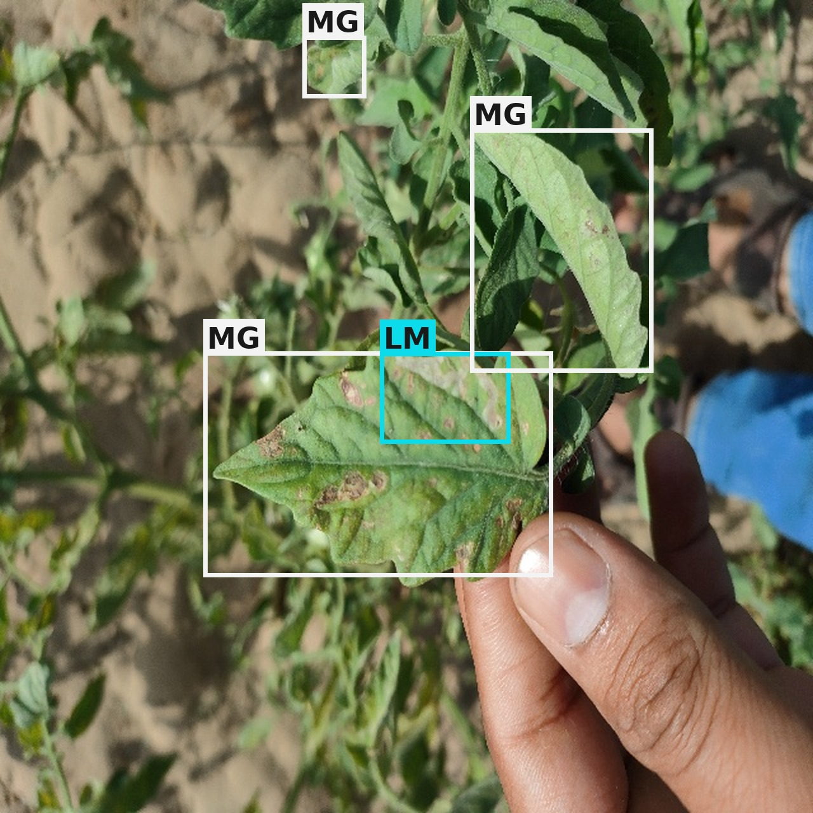
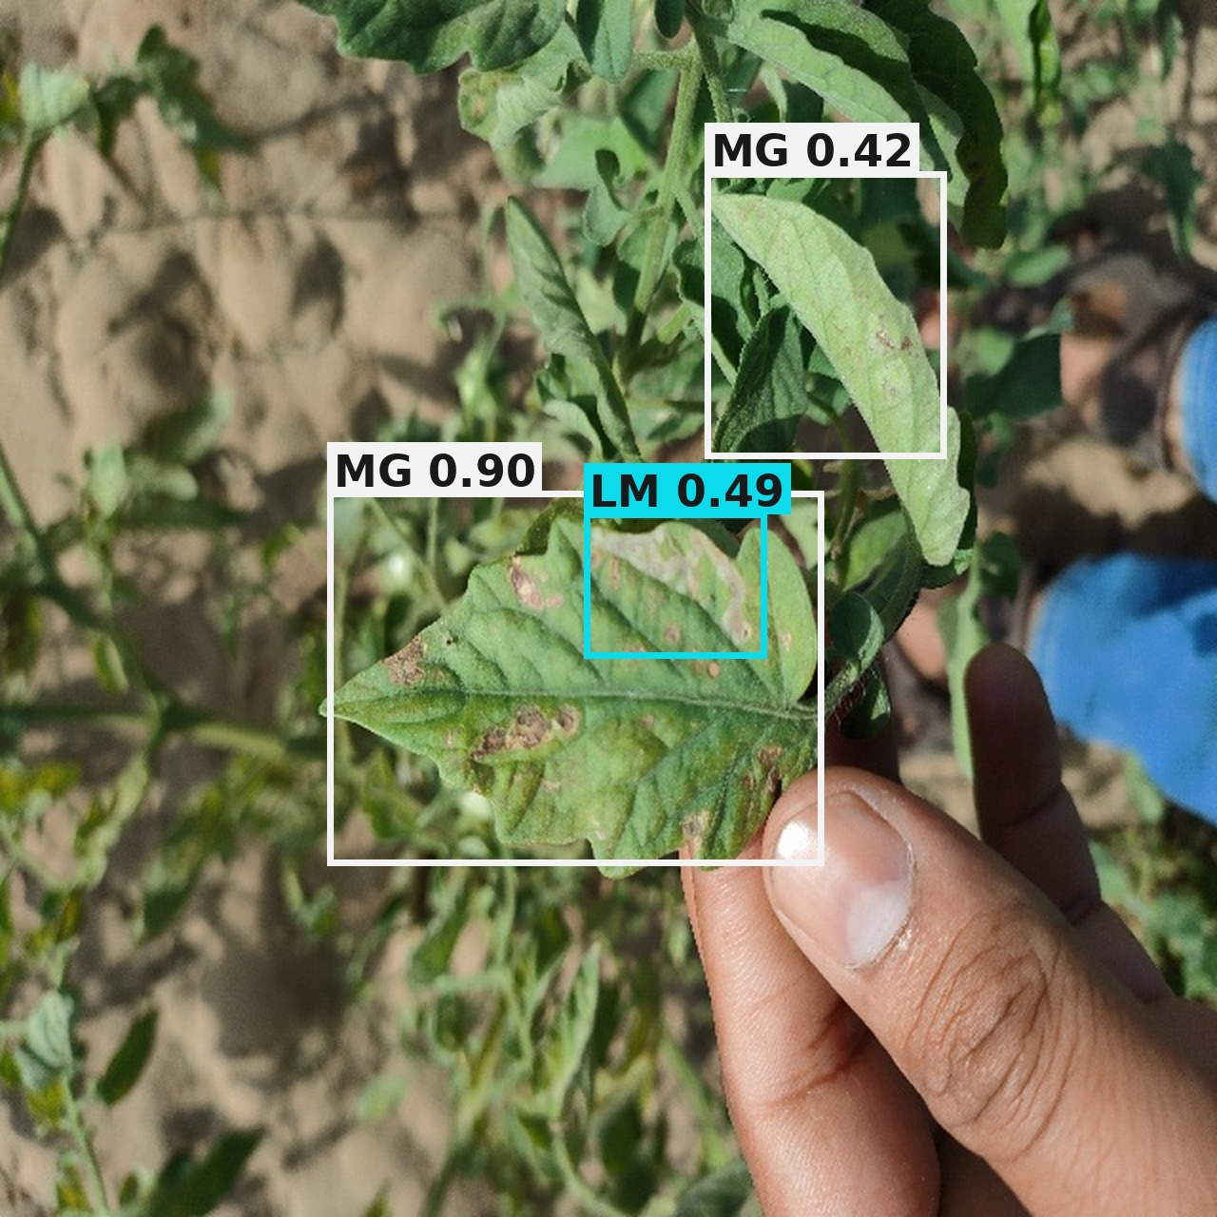
8 · RESULTS: THE SAME IMAGE, SIDE BY SIDE
Ground Truth vs. TomaNet-D Prediction
Example 1 · Jaipur_Pots (394)
Example 2 · IMG20220324091033
Ground truth — 4 annotated boxes
TomaNet-D — 5 predicted boxes
Ground truth — 4 annotated boxes
TomaNet-D — 3 predicted boxes
Class correct on every box (all leaf miner) and all four annotated mines are found. The model adds a fifth box at 0.37 on a leaf the annotator left unmarked — counted as a false positive even though the symptom is visible there.
Both classes present are recovered: magnesium deficiency at 0.90 on the main leaf and leaf miner at 0.49 inside it. One small magnesium box in the upper canopy is missed — the kind of small, low-contrast instance the tuning plan targets.
Box labels
LB
late blight
LM
leaf miner
MG
magnesium deficiency
NT
nitrogen deficiency
PT
potassium deficiency
SW
spotted wilt virus
8 · Results
27
Notes:
Ground-truth boxes are drawn straight from the Tomato-Village label files; predictions are TomaNet-D-m at confidence 0.35. Box colours are per class and match the previous slide.

Slide 28
8 · RESULTS: THE TUNING PLAN, IN ORDER
Improving TomaNet-D
TomaNet-D is in the experiment and testing phase. Accuracy is expected to rise as we work down this list — architecture changes are the last resort, not the first.
1
Hyper-parameter tuning
Sweep the initial learning rate and schedule, warm-up length, optimiser momentum and weight decay. The current run used lr₀ = 0.01 with no sweep behind it.
2
Batch size
Retry at 16 and 64 against the current 32. At 800 × 800 the batch size drives both the BatchNorm statistics and the effective learning rate.
3
Epoch budget
Training stopped at epoch 85 of 100 with patience 60, and mAP was still climbing — extend the budget and re-check the early-stopping point.
4
Class imbalance
Oversample nitrogen and potassium deficiency, or reweight the loss. 237 potassium boxes against 18,316 leaf-miner boxes is the single clearest cause of the low mean.
5
Pre-process Tomato-Village
If tuning alone is not enough: tighten annotation quality, filter unusable frames, normalise illumination, and revisit the augmentation preset for field imagery.
8 · Results
28

Slide 29
9 · WHAT THIS PROJECT HAS ESTABLISHED
Conclusion
Proven
In progress
Contribution
TomaBlock works. PConv + Coordinate Attention + re-parameterisation train stably and lose nothing: 99.63% accuracy, 99.61% macro-F1, κ = MCC = 0.9956 at 1.32 M parameters.
One trunk really is shared. The classification and detection trunks are the same layer list, asserted by an automated test, and the trained classifier successfully warm-started the detector.
Evaluation is trustworthy. The Tomato-Village author split leaks augmented duplicates across train and test; our corrected split keeps every copy of a photo on one side.
TomaNet-D detects correctly on real field photos but at mAP@0.5 0.392 against a published best of 0.936 — an optimisation gap, with the pipeline itself verified working.
Severe class imbalance (18,316 leaf-miner boxes vs 237 potassium) is the clearest single cause, and is being addressed by tuning and resampling before any change to the architecture.
A single lightweight design answers both questions farmers actually ask — “what disease is this?” and “where is it?” — instead of needing two separate models.
Three model scales (n / s / m) let the same design run on a phone or on a server without redesign, because the deployed block folds to a single path.
9 · Conclusion
29

Slide 30
9 · NEXT STEPS
Further Enhancement
1
Finish the TomaNet-D sweep
2
Fair benchmark comparison
Complete the tuning plan and report mAP@0.5 against the published Tomato-Village baselines at matched model size.
Same dataset, same split, same seed against YOLOv8–YOLOv12 — the only comparison the literature accepts.
3
Repeat every run
4
Cross-domain generalisation
Multiple seeds per configuration, because +1 to +4 mAP on a single seed is within normal run-to-run noise.
Train on PlantVillage, test on real field photos, and report the drop explicitly instead of only the lab number.
5
Explainability as a number
6
On-device deployment
Score how well a Grad-CAM heat-map overlaps the annotated lesion, rather than showing a picture and asserting it looks right.
Fold the re-parameterised branches, export, and measure real latency and memory on a phone.
9 · Conclusion
30

Slide 31
10 · (1 OF 4)
References
1.
Wspanialy, P., & Moussa, M. (2020). A detection and severity estimation system for generic diseases of tomato greenhouse plants. Computers and Electronics in Agriculture, 178, 105701.
2.
Thuseethan, S., Vigneshwaran, P., Charles, J., & Wimalasooriya, C. (2024). Siamese network-based lightweight framework for tomato leaf disease recognition. Computers, 13(12), 323.
3.
Oni, M. K., & Prama, T. T. (2025). Optimized custom CNN for real-time tomato leaf disease detection. arXiv:2502.18521.
4.
Thai, H. T., & Le, K. H. (2025). MobileH-Transformer: Enabling real-time leaf disease detection using a hybrid deep learning approach for smart agriculture. Crop Protection, 189, 107002.
5.
Karegowda, A. G., Jain, R., & Devika, G. (2021). State-of-the-art deep learning based tomato leaf disease detection. ICIIC 2021, 303–311. Atlantis Press.
6.
Hosen, M. D., & Islam, M. H. (2025). Aggrotech: Leveraging deep learning for sustainable tomato disease management. arXiv:2501.12052.
7.
Anu, A., Solanki, K., & Dhankar, A. (2024). A novel multi-class deep learning approach for tomato leaf disease detection system. IJISAE, 12(6s), 187–196.
8.
Trivedi, N. K., Gautam, V., Anand, A., Aljahdali, H. M., Villar, S. G., Anand, D., … & Kadry, S. (2021). Early detection and classification of tomato leaf disease using high-performance deep neural network. Sensors, 21(23), 7987.
9.
Chen, H. C., Widodo, A. M., Wisnujati, A., Rahaman, M., Lin, J. C. W., Chen, L., & Weng, C. E. (2022). AlexNet convolutional neural network for disease detection and classification of tomato leaf. Electronics, 11(6), 951.
10 · References
31

Slide 32
10 · (2 OF 4)
References
10.
Nyasulu, C., Diattara, A., Traore, A., Ba, C., Diedhiou, P. M., Sy, Y., … & Peluffo-Ordóñez, D. H. (2023). A comparative study of machine learning-based classification of tomato fungal diseases: Application of GLCM texture features. Heliyon, 9(11).
11.
Harakannanavar, S. S., Rudagi, J. M., Puranikmath, V. I., Siddiqua, A., & Pramodhini, R. (2022). Plant leaf disease detection using computer vision and machine learning algorithms. Global Transitions Proceedings, 3(1), 305–310.
12.
Maeda-Gutiérrez, V., Galvan-Tejada, C. E., Zanella-Calzada, L. A., Celaya-Padilla, J. M., Galván-Tejada, J. I., Gamboa-Rosales, H., … & Olvera-Olvera, C. A. (2020). Comparison of convolutional neural network architectures for classification of tomato plant diseases. Applied Sciences, 10(4), 1245.
13.
Hussein, A. H. A., Adnan, M. M., Hemalatha, K. L., Malathy, V., & Rajesh, N. (2023). Coordinate attention mechanism with convolutional neural network for tomato leaf diseases. ICIICS 2023, 1–5. IEEE.
14.
Abbas, A., Jain, S., Gour, M., & Vankudothu, S. (2021). Tomato plant disease detection using transfer learning with C-GAN synthetic images. Computers and Electronics in Agriculture, 187, 106279.
15.
Ahmad, M., Abdullah, M., Moon, H., & Han, D. (2021). Plant disease detection in imbalanced datasets using efficient convolutional neural networks with stepwise transfer learning. IEEE Access, 9, 140565–140580.
16.
Al-Shamasneh, A. R., & Ibrahim, R. W. (2024). Classification of tomato leaf images for detection of plant disease using conformable polynomials image features. MethodsX, 13, 102844.
17.
Wang, X., Liu, J., & Liu, G. (2021). Diseases detection of occlusion and overlapping tomato leaves based on deep learning. Frontiers in Plant Science, 12, 792244.
18.
Li, D., Yin, Z., Wu, Z., & Liu, Q. (2021). Classification for tomato disease with imbalanced samples based on TD-MobileNetV2. ICISPC 2021, 35–39. IEEE.
10 · References
32

Slide 33
10 · (3 OF 4)
References
19.
Shoaib, M., Hussain, T., Shah, B., Ullah, I., Shah, S. M., Ali, F., & Park, S. H. (2022). Deep learning-based segmentation and classification of leaf images for detection of tomato plant disease. Frontiers in Plant Science, 13, 1031748.
20.
Gangwar, A., Dhaka, V. S., Rani, G., Khandelwal, S., Zumpano, E., & Vocaturo, E. (2024). Time and space efficient multi-model convolution vision transformer for tomato disease detection from leaf images with varied backgrounds. Computers, Materials & Continua, 79(1).
21.
Karim, M. J., Goni, M. O. F., Nahiduzzaman, M., Ahsan, M., Haider, J., & Kowalski, M. (2024). Enhancing agriculture through real-time grape leaf disease classification via an edge device with a lightweight CNN architecture and Grad-CAM. Scientific Reports, 14(1), 16022.
22.
Masud, K. I., Rahman, M. M., Jannat, M. R., Hasan, M. M., Islam, M. S., & Rahman, M. O. (2024). A CNN-based model to detect and classify the tomato leaf disease using transfer learning. ICCIT 2024, 2823–2828. IEEE.
23.
Çatal Reis, H. (2024). Advanced tomato disease detection using the fusion of multiple deep-learning and meta-learning techniques. Journal of Crop Health, 76(6), 1553–1567.
24.
Junare, C. B., Ghanokar, V. S., Khandare, R. M., Koche, S. P., & Pagrut, S. B. (2024). Automated plant leaf disease detection and localization using Mask R-CNN.
25.
Chen, J., Kao, S., He, H., Zhuo, W., Wen, S., Lee, C. H., & Chan, S. H. G. (2023). Run, don't walk: Chasing higher FLOPS for faster neural networks (FasterNet). CVPR 2023. arXiv:2303.03667.
26.
Hou, Q., Zhou, D., & Feng, J. (2021). Coordinate attention for efficient mobile network design. CVPR 2021. arXiv:2103.02907.
27.
Ding, X., Zhang, X., Ma, N., Han, J., Ding, G., & Sun, J. (2021). RepVGG: Making VGG-style ConvNets great again. CVPR 2021. arXiv:2101.03697.
10 · References
33

Slide 34
10 · (4 OF 4)
References
28.
Mohanty, S. P., Hughes, D. P., & Salathé, M. (2016). Using deep learning for image-based plant disease detection. Frontiers in Plant Science, 7, 1419.
29.
Noyan, M. A. (2022). Uncovering bias in the PlantVillage dataset. arXiv:2206.04374.
30.
Jelali, M. (2024). Deep learning for tomato disease detection using real-field datasets: A review. Frontiers in Plant Science.
31.
Ramos, L., & Sappa, A. D. (2025). Benchmarking YOLOv8–YOLOv12 for tomato disease detection. Scientific Reports. doi:10.1038/s41598-025-11064-0.
32.
Fu, Y., Wang, X., Wang, L., & Sun, Y. (2025). PMJDM: Joint species classification and disease detection. Frontiers in Plant Science.
10 · References
34

Slide 35
Thank you
Questions and suggestions on the TomaNet-D tuning plan are especially welcome.

