Slide 1
TomaNet
A Lightweight Unified Framework for Tomato Disease Classification and Detection
TomaNet-C · classification TomaNet-D · detection
Major Project Review

Slide 2
Introduction
Tomato (Solanum lycopersicum) is one of the world's most important vegetable crops, with global production exceeding 190 million tonnes annually.
Tomato plants are affected by more than 200 diseases, caused mainly by fungi, bacteria, viruses and other pathogens.
Tomato diseases can cause 20–80% yield losses in affected regions, depending on the disease and environmental conditions.
In India, Tomato Leaf Curl Virus is a major production constraint; severe outbreaks can result in 40–100% yield loss.
Traditional disease identification depends on expert visual inspection, which is time-consuming, subjective and difficult for early-stage symptoms.
AI and Machine Learning, particularly Deep Learning / CNN models, can automatically analyse leaf images and identify diseases rapidly and accurately.
A detection model goes further than classification: it draws a bounding box around every diseased region on a whole plant, so several problems can be reported at once.
A lightweight model can run on an ordinary phone rather than a data-centre GPU, which is what makes field use practical.
Therefore, AI-based tomato disease detection can support early diagnosis, reduce crop losses, improve disease management and assist farmers in making timely decisions.

Slide 3
Literature Survey (1 of 9)
Author | Review of paper | Method | Dataset | Research observation
Patrick Wspanialy and Medhat Moussa (2020)[1] | The paper proposes a computer-vision-based system for automatic detection of tomato diseases and estimation of disease severity. The main objective is to reduce dependence on manual disease scouting and expert assessment in greenhouse tomato production. The study also investigates whether a generic disease model can recognize previously unseen tomato diseases. | ResNet is uses for classification and disease detection. Modified U-net architecture uses for severity of disease. | PlantVillage tomato dataset, containing 9 tomato disease classes. | The authors identified dataset bias, particularly due to backgrounds, lighting, and image-capture conditions in PlantVillage. This indicates a need for more diverse real greenhouse/field datasets for robust deployment.
Thuseethan et al. (2024) | Proposed a lightweight framework for tomato leaf disease recognition, especially for small and imbalanced datasets | Siamese Network + Lightweight CNN + Contrastive Loss | PlantVillage tomato subset: 14,531 images, 10 classes; Taiwan dataset: 622 images, 6 classes. | Achieved 96.97% accuracy on PlantVillage and 95.48% on the Taiwan dataset. The lightweight model is suitable for resource-limited devices, but real-field conditions and larger diverse datasets need further study.

Slide 4
Literature Survey (2 of 9)
Author | Review of paper | Method | Dataset | Research observation
Mangsura Kabir Oni & Tabia Tanzin Prama (2025) | Proposed an automated system for real-time tomato leaf disease detection using deep learning. | Custom CNN, compared with YOLOv5, MobileNetV2, and ResNet18. | Tomato leaf images collected from Brahmanbaria, Bangladesh, with preprocessing and augmentation. | The Custom CNN achieved 95.2% accuracy, outperforming YOLOv5 (77%), MobileNetV2 (89.38%), and ResNet18 (71.88%). The model shows good potential for real-time detection,.
Huy-Tan Thai & Kim-Hung Le (2025) | Proposed a lightweight system for real-time leaf disease detection suitable for smartphones and other resource-limited devices. | MobileH-Transformer, combining CNN + Transformer architectures | PlantVillage subset: 10,008 images, 11 disease classes; also a corn disease dataset | Achieved 96.80% F1-score on the PlantVillage subset and up to 30.5 FPS on mobile devices
Asha Gowda Karegowda, Raksha Jain & G. Devika (2021) | Proposed a deep-learning-based tomato leaf disease detection system with a farmer-friendly mobile application. | YOLO and Faster R-CNN for detection, followed by SVM and Random Forest for classification. | Tomato leaf disease images covering different disease conditions. | YOLO and Random Forest achieved about 90–95% accuracy.This study is shows good detection performance, but further improvement is needed for real-field images with varying lighting, backgrounds, and disease severity.

Slide 5
Literature Survey (3 of 9)
Author | Review of paper | Method | Dataset | Research observation
Hosen & Islam (2025) | Proposed a deep-learning approach for automatic tomato leaf disease detection to support sustainable crop management. | VGG19 and Inception V3 CNN models; preprocessing included resizing and normalization, with dropout and modified classification layers. | Tomato Villages Dataset – 4,525 images | The models achieved promising disease-classification performance, with 93.93% accuracy using dropout. The study demonstrates the potential of deep learning for early tomato disease detection and precision agriculture.
Anu, Solanki & Dhankar (2023) | Proposed a multi-class deep learning system for automatic detection and classification of tomato leaf diseases. | mage preprocessing and segmentation using thresholding, Gaussian blur, and Canny edge detection, followed by a CNN for feature extraction and classification. The study compared ReLU and Leaky-ReLU activation functions. | Approximately 10,000 tomato leaf images from the PlantVillage dataset; 10 disease categories were considered. | The Leaky-ReLU architecture performed better than ReLU. Training accuracy was 95.08% with Leaky-ReLU, compared with 92.76% with ReLU.
Trivedi et al. (2021) | The study proposed an automated deep-learning approach for the early detection and classification of tomato leaf diseases, with the aim of helping farmers identify diseases at an early stage. | Convolutional Neural Network (CNN) with image preprocessing, segmentation, and hyperparameter optimization. CNN was used to extract features such as color, texture, and edges. | 3,000 tomato leaf images, representing 9 diseases and 1 healthy class. | The proposed CNN achieved 98.49% prediction accuracy.

Slide 6
Literature Survey (4 of 9)
Author | Review of paper | Method | Dataset | Research observation
Nyasulu et al. (2023) | The study investigated machine-learning techniques for classifying tomato fungal leaf diseases using texture information extracted from leaf images. | GLCM (Gray Level Co-occurrence Matrix) was used to extract texture features. Four classifiers were compared: Artificial Neural Network (ANN), K-Nearest Neighbors (KNN), Random Forest (RF), and Support Vector Machine (SVM). | Tomato leaf images representing four fungal diseases: Alternaria, Curvularia, Helminthosporium, and Lasiodiplodia. | ANN performed best, achieving 94% overall accuracy, with average precision The models showed some confusion between Helminthosporium and Curvularia, indicating that these diseases have similar visual/texture characteristics.
Chen et al. (2022) | The study developed an automated tomato leaf disease detection system using a modified AlexNet-based CNN, with the objective of identifying tomato diseases through leaf images and deploying the model in an Android application. | Modified AlexNet CNN, Adam optimizer, data preprocessing and image classification. The model used 64 × 64 RGB images and was integrated into an Android-based disease-recognition application. | 22,930 images: 18,345 training images and 4,585 testing images. The dataset contained 10 classes. | The model achieved approximately 98% average accuracy, with precision of 0.98, recall of 0.99, and F1-score of 0.98. The study demonstrated that modified AlexNet can provide accurate tomato disease classification and can be implemented on a mobile platform.

Slide 7
Literature Survey (5 of 9)
Author | Review of paper | Method | Dataset | Research observation
Harakannanavar et al. (2022) | The study developed a computer-vision and machine-learning-based system for plant leaf disease detection. It focuses on identifying disease symptoms from leaf images at an early stage. | The study used image preprocessing, K-means clustering, contour tracing, DWT, PCA, and GLCM for feature extraction. SVM, K-NN, and CNN were used for classification. | Plant leaf disease image dataset, including tomato leaf images. Images were resized to 256 × 256 pixels and enhanced before processing. | CNN achieved the best performance (99.6% accuracy) compared with K-NN and SVM. The study demonstrates that deep learning can provide highly accurate disease classification.
Maeda-Gutiérrez et al. (2020) | The study compared different pre-trained CNN architectures to determine which model is most effective for tomato plant disease classification | Transfer learning/fine-tuning using AlexNet, GoogleNet, Inception V3, ResNet-18, and ResNet-50. The models were evaluated using accuracy, precision, sensitivity, specificity, F-score, AUC, and ROC analysis. | PlantVillage dataset containing 18,160 tomato leaf images, representing 9 disease classes and 1 healthy class. | GoogleNet achieved the best overall performance, with 99.39% accuracy, 99.72% AUC, and 99.12% sensitivity. Inception V3 produced the lowest accuracy among the compared models at 98.65%.

Slide 8
Literature Survey (6 of 9)
Author | Review of paper | Method | Dataset | Research observation
Hussein, A. H. A., Adnan, M. M., Hemalatha, K. L., Malathy, V., & Rajesh, N. (2023) | The study proposed a deep-learning approach for tomato leaf disease detection, focusing on improving the model's ability to identify important disease features. | Convolutional Neural Network (CNN) with Coordinate Attention Mechanism was used to improve feature extraction and disease classification. | Tomato leaf disease images, including healthy and diseased leaves. | The attention mechanism helps the CNN focus on important disease regions and subtle symptoms. The approach shows potential for accurate tomato disease recognition.
Abbas, A., Jain, S., Gour, M., & Vankudothu, S. (2021) | The study proposed a deep-learning approach for tomato plant disease detection and addressed the problem of limited training images by generating synthetic leaf images. | Conditional GAN (C-GAN) was used to generate synthetic images, and DenseNet121 with transfer learning was used for disease classification. | PlantVillage tomato leaf dataset, classified into 5, 7, and 10 disease classes. | The model achieved 99.51% accuracy for 5 classes, 98.65% for 7 classes, and 97.11% for 10 classes. C-GAN-based augmentation improved model generalization.
Ahmed, S., Hasan, M. B., Ahmed, T., Sony, M. R. K., & Kabir, M. H. (2022) | The study proposed a lightweight and fast deep-learning model for tomato leaf disease classification, especially for use on low-end devices. | MobileNetV2 with transfer learning, CLAHE-based image enhancement, and runtime data augmentation. | PlantVillage tomato dataset: 18,160 images covering 10 classes (9 diseases + healthy). | The model achieved 99.30% accuracy with only 9.60 MB model size and 4.87 million FLOPs, making it suitable for resource-limited devices..

Slide 9
Literature Survey (7 of 9)
Author | Review of paper | Method | Dataset | Research observation
Ala’a R. Al-Shamasneh & Rabha W. Ibrahim (2024) | The study proposed a new image-processing approach for tomato leaf disease detection using texture information from leaf images. | Conformable Polynomials (CP) for texture feature extraction, followed by dimension reduction and SVM classification. | PlantVillage tomato leaf dataset, with about 18,200 images from different classes. | The proposed method achieved 98.80% accuracy using SVM. It effectively captured texture differences between healthy and infected leaves..
Li, D., Yin, Z., Wu, Z., & Liu, Q. (2021) | The study proposed a deep-learning model for tomato disease classification with imbalanced samples, where some disease classes contain fewer images than others | TD-MobileNetV2, a modified lightweight MobileNetV2 designed to improve classification performance on imbalanced tomato disease datasets. | Tomato disease dataset: 1,890 images covering 3 disease classes. | The model achieved approximately 97.33% accuracy while maintaining a lightweight architecture. The study demonstrates that MobileNetV2 can effectively handle imbalanced tomato disease samples.
Shoaib, M., Hussain, T., Shah, B., Ullah, I., Shah, S. M., Ali, F., & Park, S. H. (2022) | The study developed a deep-learning-based system for tomato disease detection by first separating the leaf region from the background and then classifying healthy and diseased leaves. | Modified U-Net was used for leaf segmentation, while InceptionNet was used for disease classification. | PlantVillage tomato dataset, containing 18,161 tomato leaf images with segmented and non-segmented images. | Modified U-Net achieved 98.66% segmentation accuracy, while InceptionNet achieved 99.95% accuracy for binary classification and 99.12% for six-class classification.

Slide 10
Literature Survey (8 of 9)
Author | Review of paper | Method | Dataset | Research observation
Gangwar, A., Dhaka, V. S., Rani, G., Khandelwal, S., Zumpano, E., & Vocaturo, E. (2024) | The study developed a time- and space-efficient deep-learning model for detecting tomato leaf diseases under plain and complex/varied backgrounds. | Proposed Swift-Lite-CvT, a customized Convolution Vision Transformer (CvT) combining ideas from VGG16, ViT, and CvT. | Tomato leaf image dataset with experiments on 10, 11, and 13 disease classes, including images with varied backgrounds. | The proposed model achieved 93.51% accuracy for 13 classes, with only 5.8 MB storage and 44 minutes training time. It is suitable for mobile, IoT and drone-based applications.
Karim, M. J., Goni, M. O. F., Nahiduzzaman, M., Ahsan, M., Haider, J., & Kowalski, M. (2024) | The study developed a real-time grape leaf disease classification system designed for low-resource edge devices. | Modified MobileNetV3Large with transfer learning and Grad-CAM for visual explanation. | Grapevine Disease Dataset: 9,027 images, 4 classes—black rot, ESCA, healthy, and leaf blight. | The lightweight edge-AI approach can be adapted to tomato disease detection.

Slide 11
Literature Survey (9 of 9)
Author | Review of paper | Method | Dataset | Research observation
Masud, K. I., Rahman, M. M., Jannat, M. R., Hasan, M. M., Islam, M. S., & Rahman, M. O. (2024) | The study proposed a CNN-based transfer-learning model for detecting and classifying tomato leaf diseases. The aim was to improve automatic disease identification and support early disease management. | Convolutional Neural Network (CNN) with Transfer Learning was used for feature extraction and classification of tomato leaf diseases. | Tomato leaf disease image dataset containing healthy and diseased tomato leaves. | The study demonstrated that transfer learning can effectively classify tomato leaf diseases while reducing training requirements.
Hatice Catal Reis (2024) | The study proposed an advanced framework for automatic tomato leaf disease detection, focusing on healthy leaves, early blight, and late blight. | A fusion of deep learning and meta-learning, combining CNN, Transformer, and MLP models with a Voting Classifier (VtC). Models included DenseNet201, CoAtNet, FasterNet, FastViT and WaveMLP. CLAHE was also used for image enhancement. | Tomato leaf image dataset containing three classes: healthy, early blight, and late blight. The test set contained 900 images. | The proposed hybrid framework misclassified only 4 of 900 images when CLAHE-enhanced images were used, giving approximately 99.56% accuracy.
Junare, C. B., Ghanokar, V. S., Khandare, R. M., Koche, S. P., & Pagrut, S. B. (2024) | The study proposed an automated plant leaf disease detection system to identify and localize diseased regions in leaf images. | Mask R-CNN was used for object detection and instance segmentation, allowing the diseased regions to be identified at pixel level. | A self-created dataset of healthy and diseased plant leaf images was collected from different angles and scenes and resized to 1024 × 1024 pixels. | The study showed that Mask R-CNN can accurately identify and locate diseased regions on plant leaves. However, the work is not specifically focused on tomato,

Slide 12
Research Gap
The detection of tomato plant diseases is influenced by both biotic and abiotic factors. [1][11][12]
Limited handling of imbalanced datasets, and accuracy drops in noisy, real-field images. [2][21][24][26]
Research is often disease-specific, focusing on a single disease at a time, and lacks real-time applicability. [1][6][20]
Models trained on tomato often fail to generalize to other crops, or even to unseen tomato disease variations, due to overfitting. [2][4][5][8][19][20]
Some research is limited to distinguishing only between healthy and unhealthy images. [5][16][18][29]
Models show low accuracy on real-field images because of changing light, background clutter and leaf overlap. [3][23][26][27]
Most studies cannot correctly locate the exact disease spots — no bounding boxes or segmentation. [2][16][22][31]
No proper methods to measure how severe the disease is on the leaf. [29][30]
Systems cannot detect more than one disease on the same leaf at the same time. [23][26][27][31]
There is a lack of real-world tomato datasets collected from farms. [1][3][6][25][26]
No study focuses on tracking disease changes over time — no temporal analysis. [1][20][28]
Models do not generalize well to different tomato varieties, lighting conditions and environments. [1][17][19][25][26][27]
No lightweight model under about 5 million parameters has been shown to work for both whole-leaf classification and box-level detection on tomato. Multi-task examples exist but are heavy — one recent model uses about 49 million parameters. [32]

Slide 13
Problem Statement
Tomato crops are vulnerable to multiple diseases that reduce yield and quality, and manual inspection is slow and error-prone. Existing work either names the disease without locating it, or is too computationally heavy to run where the crop actually grows.
The research problem is to develop a lightweight unified deep learning framework that can:
identify tomato diseases from a single leaf image through TomaNet-C, and
detect and localize multiple disease regions on a whole plant through TomaNet-D,
using a shared TomaBlock-based trunk, while maintaining accuracy, computational efficiency and reliable evaluation.
The design must work within a phone or edge compute budget, on real field imagery rather than only laboratory photographs, must handle several lesions in the same image, and must be evaluated on a split that cannot be inflated by data leakage. The goal is a robust, explainable pipeline suitable for field deployment or for assisting farm experts.

Slide 14
Objectives
Design TomaBlock — one reusable building block combining Partial Convolution, Coordinate Attention and RepVGG-style re-parameterisation.
Build TomaNet-C (classification) and TomaNet-D (detection) on a byte-identical shared trunk, at three scales (n / s / m), so the same design runs on a phone or on a server.
Gather and prepare datasets from authorized sources: PlantVillage (18,160 leaves, 10 classes) and Tomato-Village (14,259 field images, 6 box classes).
Apply preprocessing and leaf-safe augmentation, and remove the train/test leakage present in the Tomato-Village authors' own split.
Use TomaBlock to extract features of colour, texture, shape and the size of the affected areas, while preserving where on the leaf those features occur.
Train and verify TomaNet-C using accuracy, macro-F1, Cohen's κ, MCC and a per-class breakdown — not accuracy alone.
Warm-start TomaNet-D from the trained classification trunk and measure whether cross-task transfer actually helps detection.
Evaluate detection with precision, recall, mAP@0.5 and mAP@0.5:0.95, per class, on the leakage-free split only.
Tune TomaNet-D — batch size, epochs, learning-rate schedule, augmentation and class-imbalance handling — to close the gap to published Tomato-Village baselines.
Evaluate the performance of the proposed models against existing published models at matched model size.
Keep the deployed model light by folding the re-parameterised branches before export, so inference pays no extra cost.

Slide 15
Existing Research Gaps vs. TomaNet
Gap in existing research | How TomaNet answers it
Most studies address classification only. | TomaNet-C and TomaNet-D share one TomaBlock-based trunk — a single feature extractor serves both tasks, and an automated test asserts the two trunks are identical.
Models give a disease label but not its location. | TomaNet-D performs object detection: disease type plus a bounding box around every infected region, several per image.
Heavy CNN and Transformer models will not run on a phone. | Partial Convolution cuts memory movement and re-parameterisation folds three training-time branches into one at deployment — 1.32 M parameters at the smallest classification scale.
Lightweight models lose the spatial detail that small lesions need. | Coordinate Attention keeps positional information instead of collapsing it, which is what small localised symptoms depend on.
Reliance on plain-background PlantVillage images. | Trained and evaluated on both laboratory data (PlantVillage) and real field data from Rajasthan (Tomato-Village).
Dataset leakage inflates reported accuracy. | A corrected, leakage-free split for Tomato-Village keeps every augmented copy of a photo on one side of the split.

Slide 16
Proposed Methodology — System Architecture
Notes:
Reserved slide: paste the TomaNet system architecture diagram here.

Slide 17
Proposed Methodology — How an Image is Processed
1. Collect — PlantVillage leaf photographs and Tomato-Village field photographs from Rajasthan, India.
2. Clean and de-duplicate — hash every image, group augmented copies of the same original, then split so that no copy of a photo crosses the train/test boundary.
3. Pre-process — resize to 224 × 224 for classification or 800 × 800 for detection; apply leaf-safe augmentation (flips and mild colour jitter, no distortion that would destroy a lesion).
4. Shared trunk — the image passes through stacked TomaLayers built from TomaBlock. The layer list is identical for both tasks.
5. Task head — classification: global average pool, then a fully connected layer and softmax. Detection: an FPN-style neck feeding three detect heads at P3, P4 and P5.
6. Evaluate — accuracy, macro-F1, Cohen's κ and MCC for TomaNet-C; precision, recall, mAP@0.5 and mAP@0.5:0.95 for TomaNet-D.

Slide 18
What is TomaNet, and Why is it Different?
TomaNet is one small convolutional design built from a single reusable building block, TomaBlock. The same block stacks into the same trunk for both tasks — literally the same list of layers, asserted by an automated test — so a trunk trained to classify can jump-start a trunk that detects.
Partial Convolution (PConv) — only a quarter of the channels are convolved at a time. The real bottleneck on a small device is memory movement rather than arithmetic, so this keeps the model fast and light. (FasterNet, CVPR 2023)
Coordinate Attention — disease spots are small and appear in specific places. Channel-only attention discards that positional information; Coordinate Attention keeps track of where on the leaf something is wrong. (Hou et al., CVPR 2021)
Re-parameterisation — the block has three parallel branches during training, which helps it learn. Before deployment those branches fold mathematically into a single path, so inference pays no extra cost. Our tests confirm the folded and unfolded versions agree to about five decimal places. (RepVGG, CVPR 2021)
One trunk, two jobs — the uncommon part. Most published tomato work builds a separate model per task; here classification and detection share the trunk byte-for-byte and can transfer knowledge between each other.
Measured parameter counts — TomaNet-C: 1.32 M (n), 4.47 M (s), 14.44 M (m). TomaNet-D: 2.92 M (n), 10.64 M (s), 30.79 M (m).

Slide 19
TomaBlock Inside TomaNet-C and TomaNet-D
Inside one TomaBlock, in order:
RepPConv 3 × 3 on 1/4 of the channels → 1 × 1 expand (× 2 width) → DWConv k × k → CoordAtt → 1 × 1 project, plus a residual connection when the input and output channel counts match.
The shared trunk — identical for both models:
Conv 3 × 3 / stride 2, twice (224² down to 56² before any TomaBlock runs)
TomaLayer × 2 at 128 channels → TomaLayer × 4 at 256 → TomaLayer × 4 at 512 → TomaLayer × 2 at 1024
The two task heads:
TomaNet-C — global average pool, then a fully connected layer and softmax. Input 224 × 224. Output: one disease name per leaf image with a confidence score, for example bacterial_spot 0.99.
TomaNet-D — an FPN neck taking the 256-channel and 512-channel stages as P3 and P4, then detect heads at P3, P4 and P5. Input 800 × 800. Output: many boxes per plant image, each with a class and a score, for example leaf_miner 0.73 across five boxes.
Because the trunk is the same object, the PlantVillage-trained classifier was used directly to warm-start TomaNet-D.

Slide 20
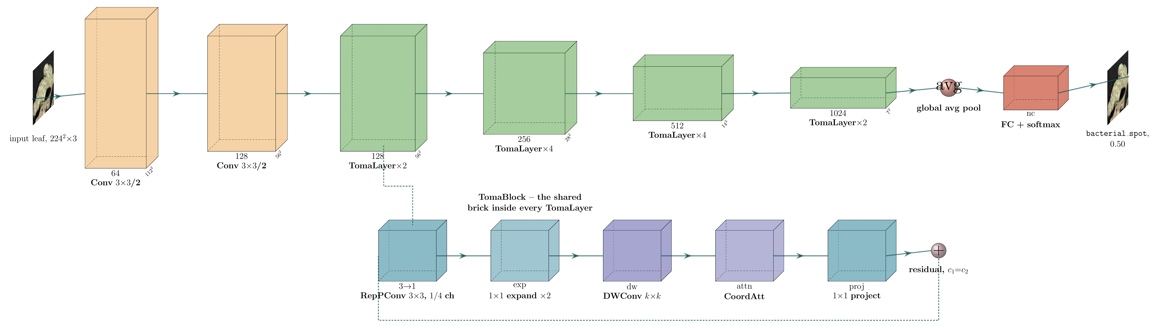
TomaNet-C — Layer by Layer
Two stem convolutions, four TomaLayer stages, global average pool, then a fully connected layer and softmax. The lower strip expands one TomaBlock.
Stem — two stride-2 3 × 3 convolutions take 224² down to 56² before any TomaBlock runs, which is cheap early downsampling.
Four stages — 128 → 256 → 512 → 1024 channels. TomaNet-D taps the 256 and 512 stages as P3 and P4 for its neck.
Head — global average pool removes the spatial dimensions, then a single fully connected layer maps 1024 features to the class scores.

Slide 21
Datasets
 | PlantVillage (TomaNet-C, classification) | Tomato-Village (TomaNet-D, detection)
Images | 18,160 tomato leaf photographs | 14,259 usable field photographs
Classes | 10 (9 diseases + healthy) | 6 classes with real box annotations
Capture conditions | single leaf, plain laboratory background | open fields, Rajasthan, India
Input resolution | 224 × 224 | 800 × 800
Split | 70 / 10 / 20 train / val / test | 70 / 10 / 20, leakage-corrected
Test set | 2,692 images | 3,536 images
Why this dataset | Near-saturated in the literature at 99.4–99.96%, so it is used to prove the architecture trains correctly, not as a headline claim. | Real field imagery with clutter, occlusion, harsh sunlight and several lesions per frame. The authors' own split leaks augmented duplicates, so it was rebuilt.

Slide 22
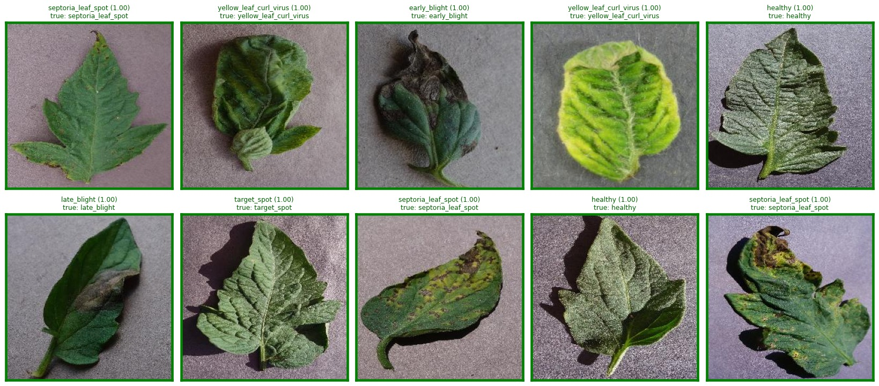
Dataset — PlantVillage Classes
10 classes and test-set counts
bacterial spot (n = 315)
early blight (n = 151)
healthy (n = 236)
late blight (n = 283)
leaf mold (n = 143)
mosaic virus (n = 56)
septoria leaf spot (n = 264)
spider mites (n = 247)
target spot (n = 210)
yellow leaf curl virus (n = 787)
Held-out PlantVillage test images with the class name printed above each leaf. Single leaf, plain laboratory background, 224 × 224 input.
Notes:
Drawn from the model's own test-split output because the raw PlantVillage images are not in the repo. Swap for a curated one-image-per-class grid when those files are available.

Slide 23
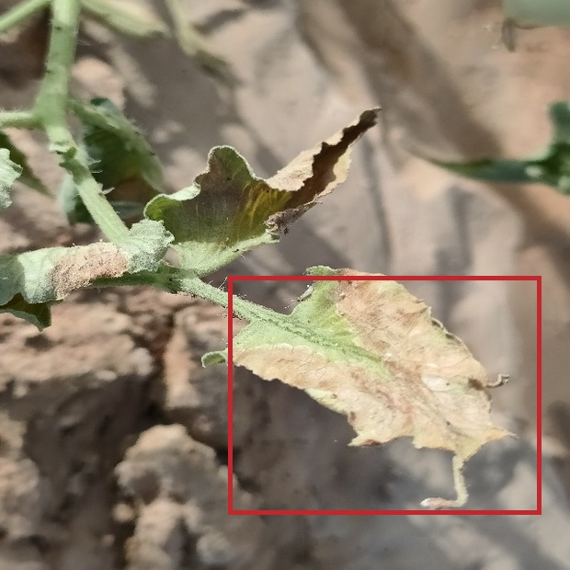
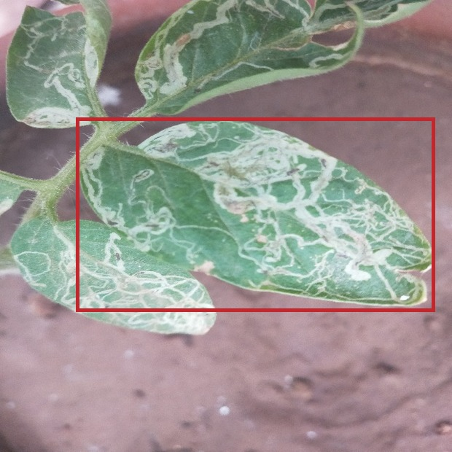
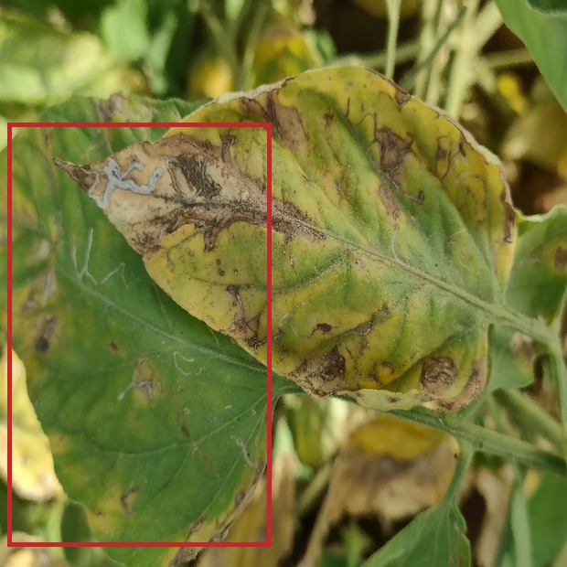
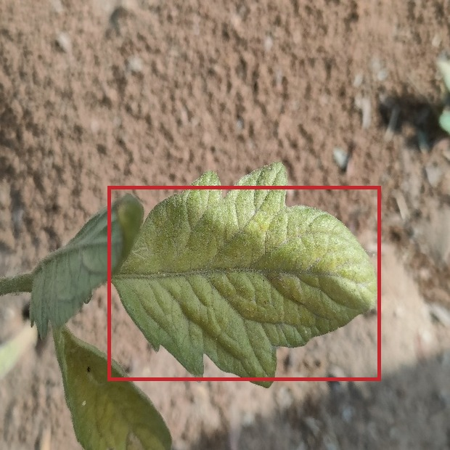
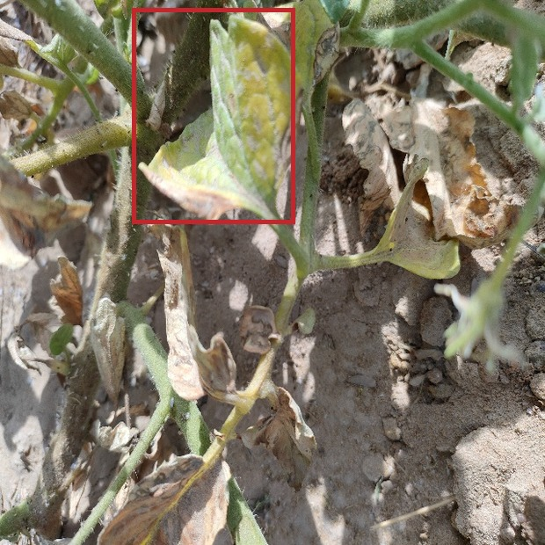
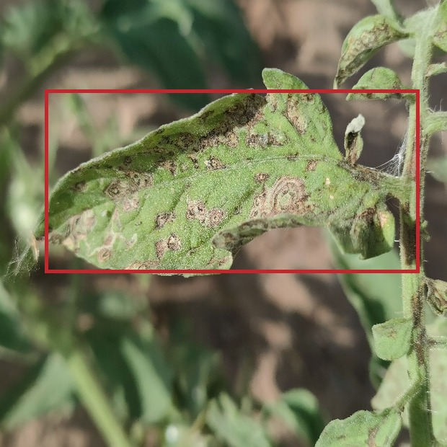
Dataset — Tomato-Village Classes
Why this data is hard
late blight
823 boxes
leaf miner
18,316 boxes
magnesium deficiency
2,356 boxes
Open-field clutter and soil in frame
Harsh, uneven sunlight
Overlapping and occluded leaves
Several lesions per image
Severe class imbalance: 18,316 leaf-miner boxes against 237 potassium
nitrogen deficiency
489 boxes
potassium deficiency
237 boxes
spotted wilt virus
4,516 boxes
Held-out Tomato-Village frames, cropped around one ground-truth box per class (red outline).

Slide 24
Experimental Setup
Setting | TomaNet-C (PlantVillage) | TomaNet-D (Tomato-Village)
Model scale | TomaNet-C-n — 1.32 M parameters | TomaNet-D-m — 30.79 M parameters
Task | 10-class leaf classification | 6-class object detection
Input resolution | 224 × 224 | 800 × 800
Batch size | 128 | 32
Initial learning rate | 0.001 | 0.01
Epochs (budget / actual) | 100 / stopped at 83, patience 15 | 100 / stopped at 85, patience 60
Initialisation | from scratch | warm-started from the trained TomaNet-C trunk
Augmentation | leaf-safe preset (flips, mild colour jitter) | leaf-safe preset
Hardware and seed | single GPU, 8 workers, seed 0 | single GPU, 8 workers, seed 0
Test set | 2,692 images | 3,536 images (leakage-corrected split)

Slide 25
Results — TomaNet-C (Classification)
TomaNet-C is highly accurate, and the TomaBlock experiment succeeded.
Metric | Score
Test accuracy | 99.63%
Macro F1 score | 99.61%
Macro precision | 99.60%
Macro recall | 99.63%
Cohen's κ | 0.9956
Matthews correlation coefficient | 0.9956
Test images / wrong predictions | 2,692 / 10 (0.4%)
Class | F1 | Support
bacterial spot | 0.995 | 315
early blight | 1.000 | 151
healthy | 0.998 | 236
late blight | 0.993 | 283
leaf mold | 0.997 | 143
mosaic virus | 1.000 | 56
septoria leaf spot | 0.998 | 264
spider mites | 0.994 | 247
target spot | 0.988 | 210
yellow leaf curl virus | 0.999 | 787
Every one of the 10 classes lands above 0.988 F1 — no weak class and no collapsed class.
κ and MCC are both 0.9956, so the score is not an artefact of class imbalance.
This is the result that validates TomaBlock: Partial Convolution, Coordinate Attention and re-parameterisation train stably and lose nothing at 1.32 M parameters.
It is reported as a proof of correctness, not a record claim — PlantVillage is already saturated at 99.4–99.96% in the literature.

Slide 26
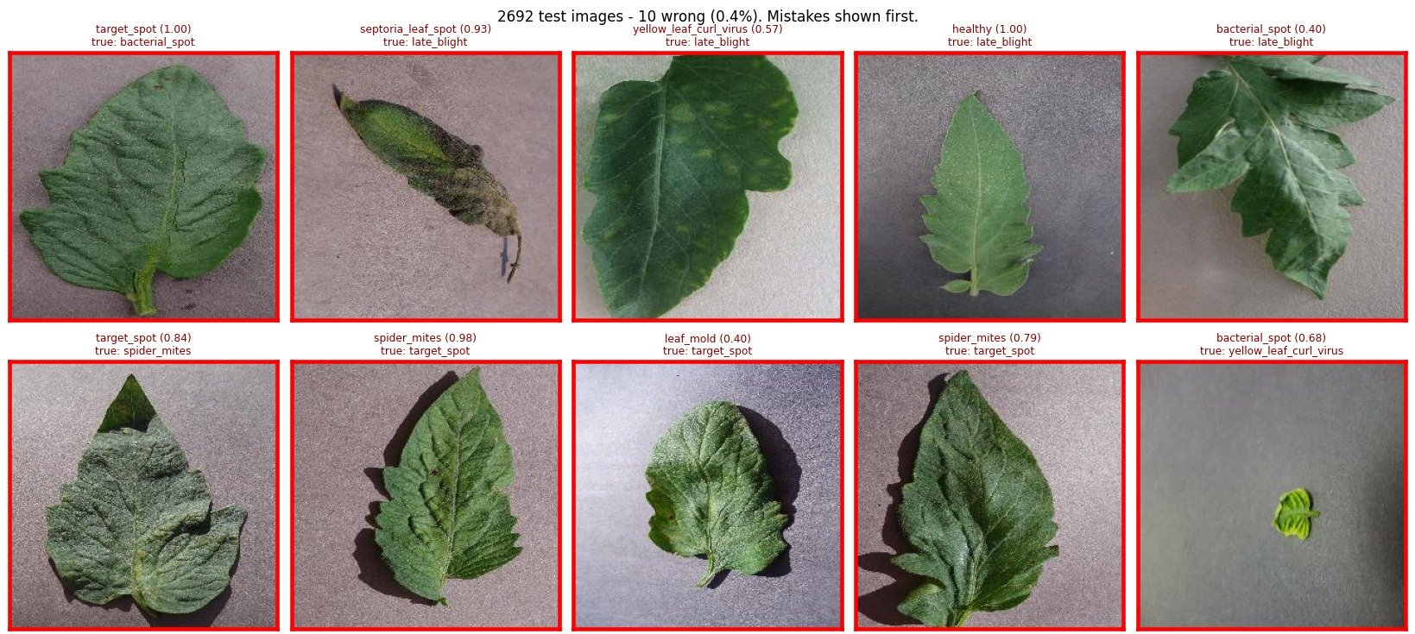
TomaNet-C Predictions — All 10 Mistakes
Where it still fails
target_spot confused with spider_mites — 3 of the 10 errors. Both present as fine stippling.
late_blight read as septoria leaf spot or yellow leaf curl virus — visually overlapping lesion patterns.
One healthy leaf read as late_blight, and one very small curled leaf as bacterial_spot.
Every mistake is between diseases that a human agronomist also confuses. None are absurd, which rules out a label-mapping bug.
Every error from the 2,692-image test split. Red frame = wrong; predicted class and confidence above, ground truth below.

Slide 27
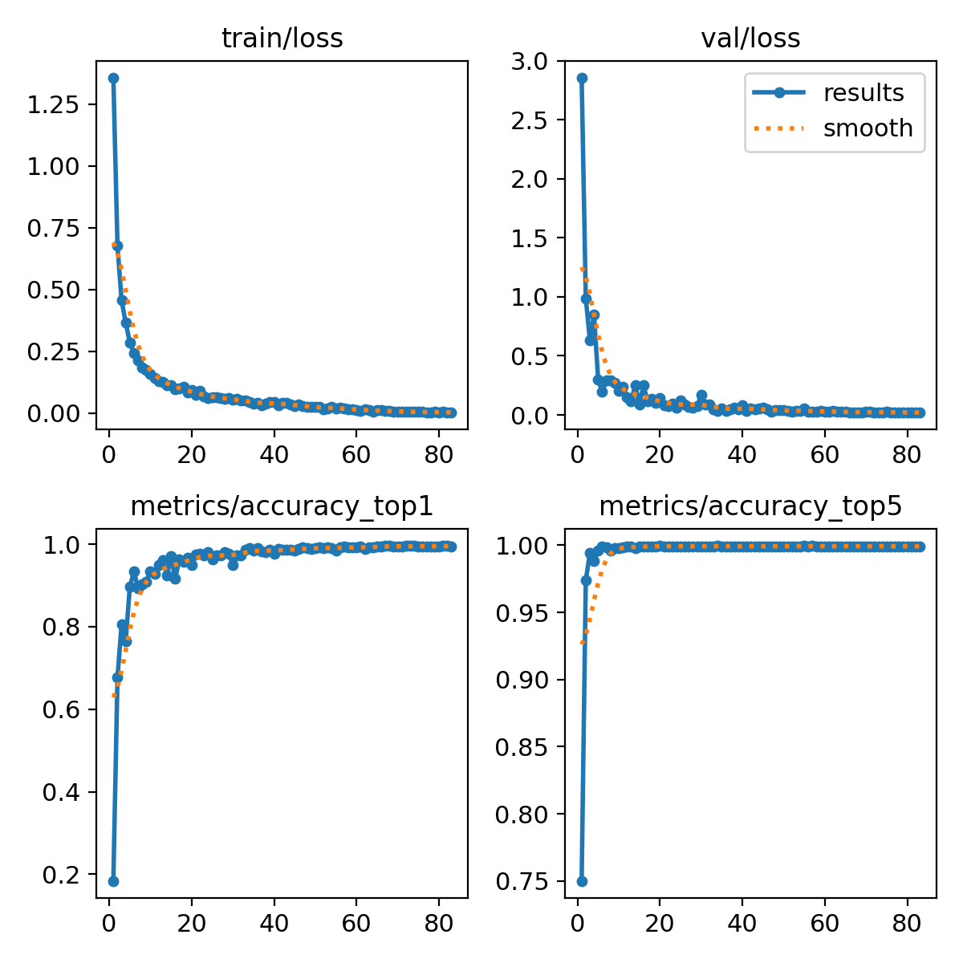
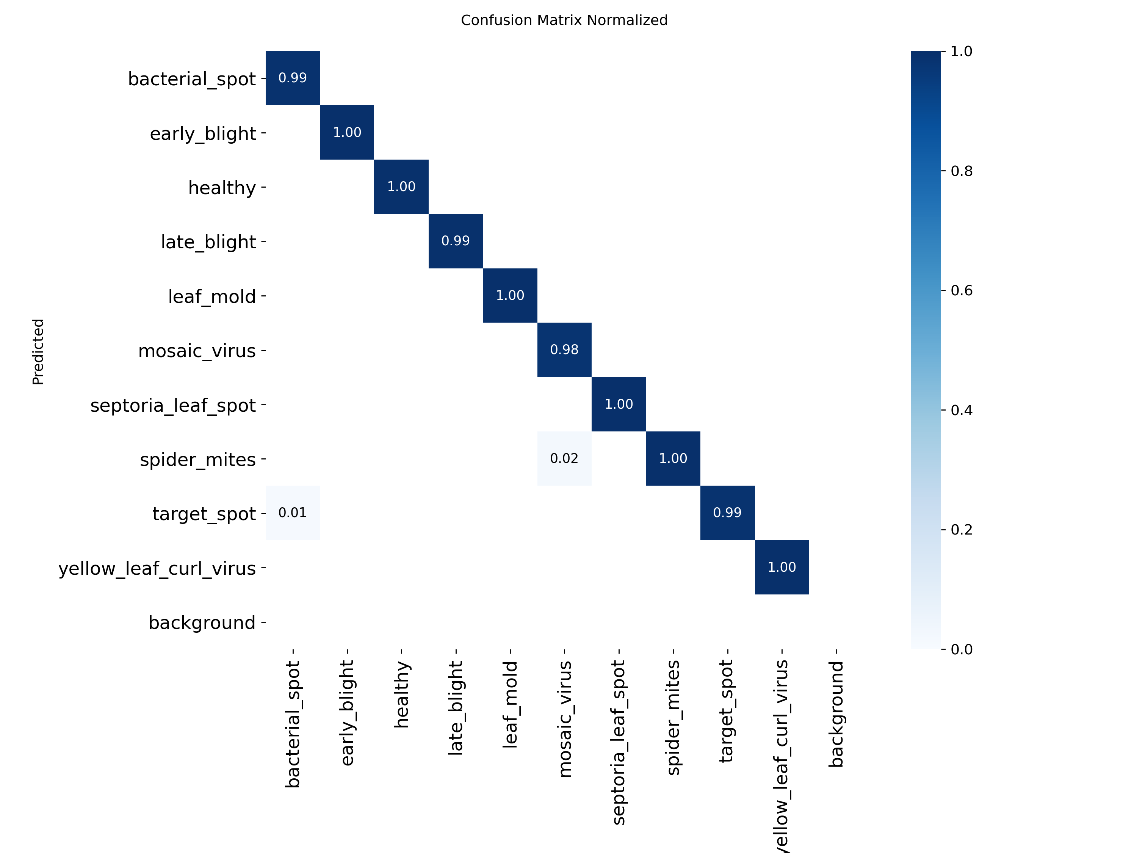
TomaNet-C — Training Behaviour and Confusion Matrix
Training and validation loss, top-1 and top-5 accuracy per epoch.
Normalised confusion matrix on the test split.
Validation accuracy passes 90% by epoch 5 and 99% by epoch 33. Validation loss keeps falling alongside training loss, so there is no overfitting, and early stopping fired at epoch 83 of a 100-epoch budget.

Slide 28
Results — TomaNet-D (Detection)
Status: TomaNet-D trains end to end and produces correct box predictions, but its accuracy is still being improved. The numbers below are a working checkpoint, not a final result.
Metric | Score
mAP@0.5 | 0.392
mAP@0.5:0.95 | 0.178
Precision | 0.459
Recall | 0.400
Test images | 3,536
Epochs completed | 85 of 100
Class | mAP@0.5 | Box instances
late blight | 0.437 | 823
leaf miner | 0.433 | 18,316
magnesium deficiency | 0.550 | 2,356
nitrogen deficiency | 0.157 | 489
potassium deficiency | 0.234 | 237
spotted wilt virus | 0.542 | 4,516
The well-represented classes already work: magnesium deficiency 0.550, spotted wilt virus 0.542, late blight 0.437 and leaf miner 0.433.
The two rare classes drag the mean down: nitrogen deficiency 0.157 on 489 boxes and potassium deficiency 0.234 on 237 boxes, against 18,316 leaf-miner boxes.
The best published result on this dataset is mAP@0.5 = 0.936 with a large model and 0.864 with the smallest, phone-sized model. That is the target we are tuning towards.
The pipeline, the shared trunk and the warm-start all work. What remains is an optimisation problem, not an architectural one.

Slide 29
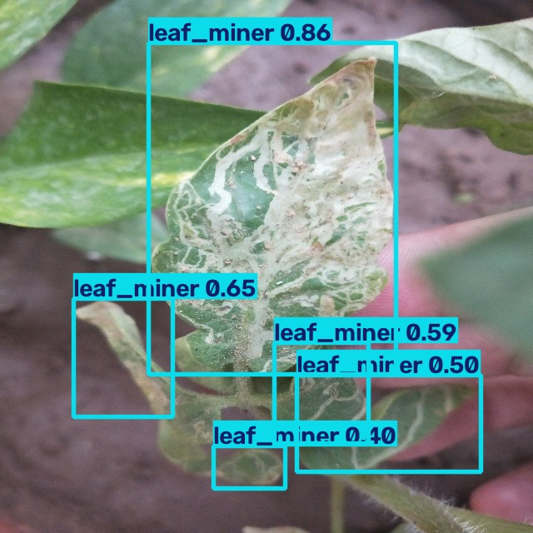
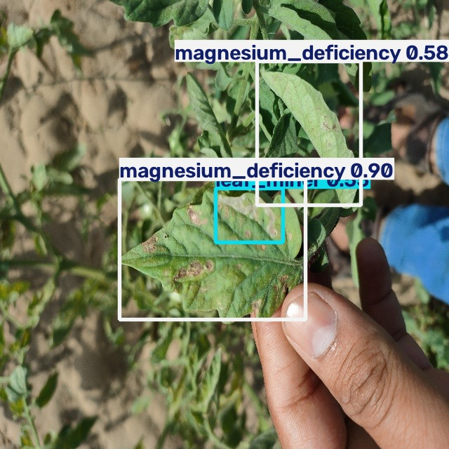
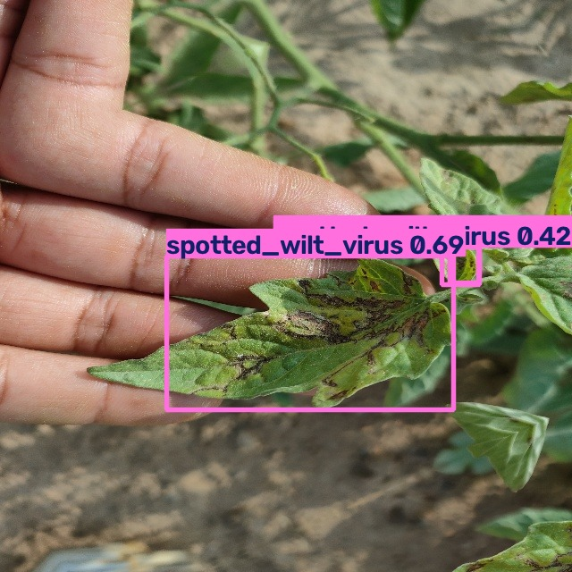
TomaNet-D Detections on Real Field Photographs
leaf miner — 5 boxes
magnesium deficiency + leaf miner
spotted wilt virus — 3 boxes
Fine mine trails on a single leaf, held in hand against a cluttered field background.
Two different problems on the same plant, reported together — the multi-disease case the literature misses.
Whole-plant view: several infected leaves boxed separately in a single pass.
TomaNet-D-m on held-out test images at a confidence threshold of 0.35. Colour encodes the class; the number is the confidence score.

Slide 30
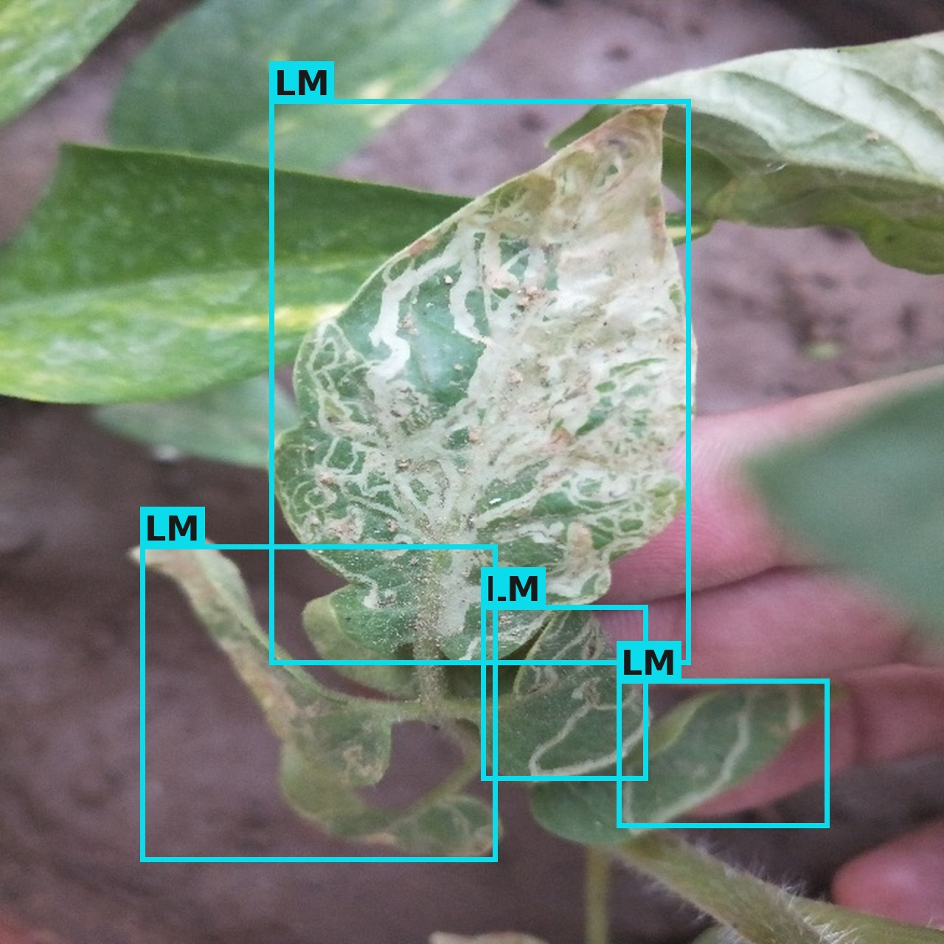
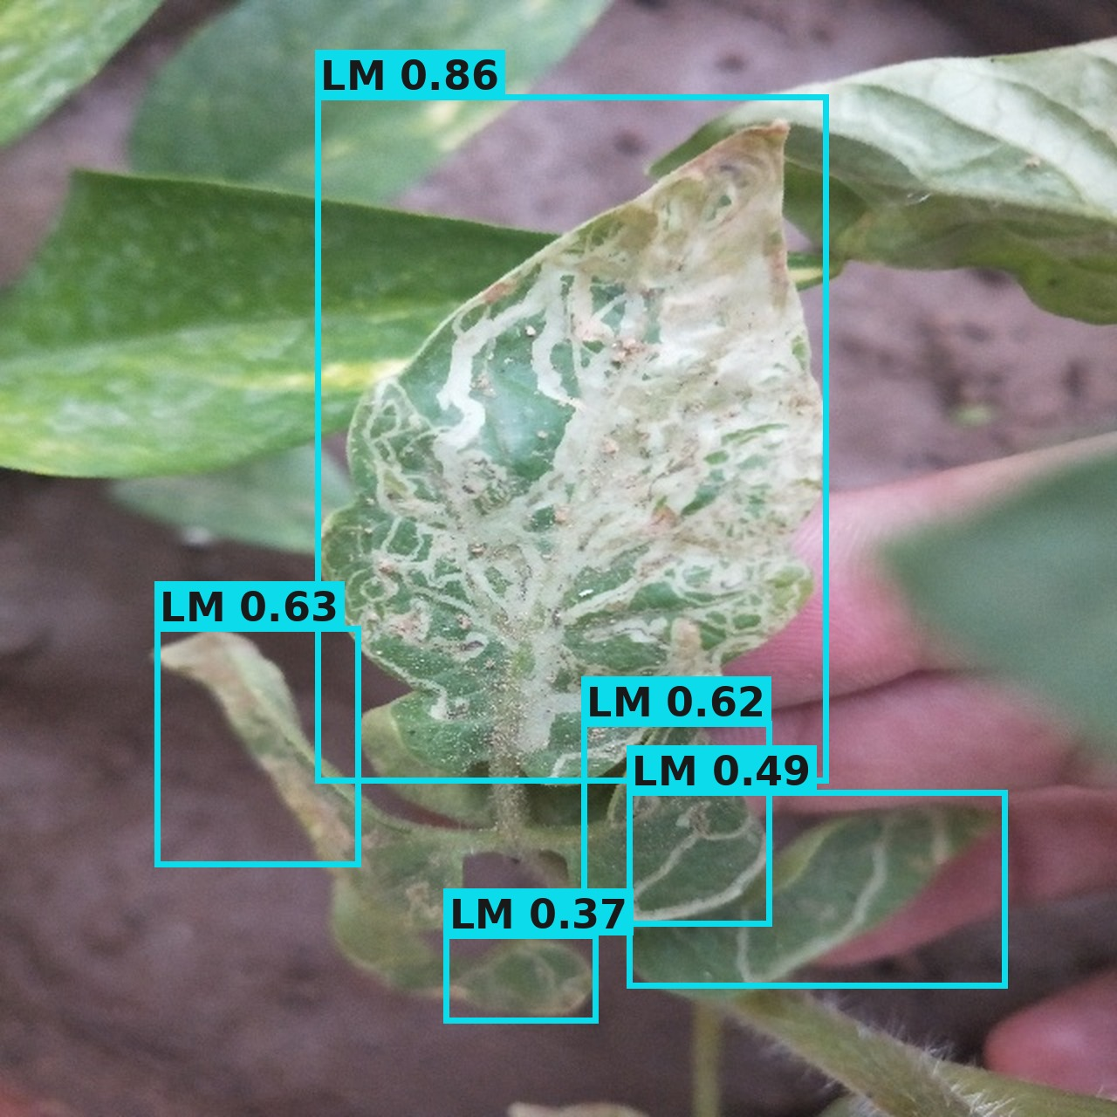
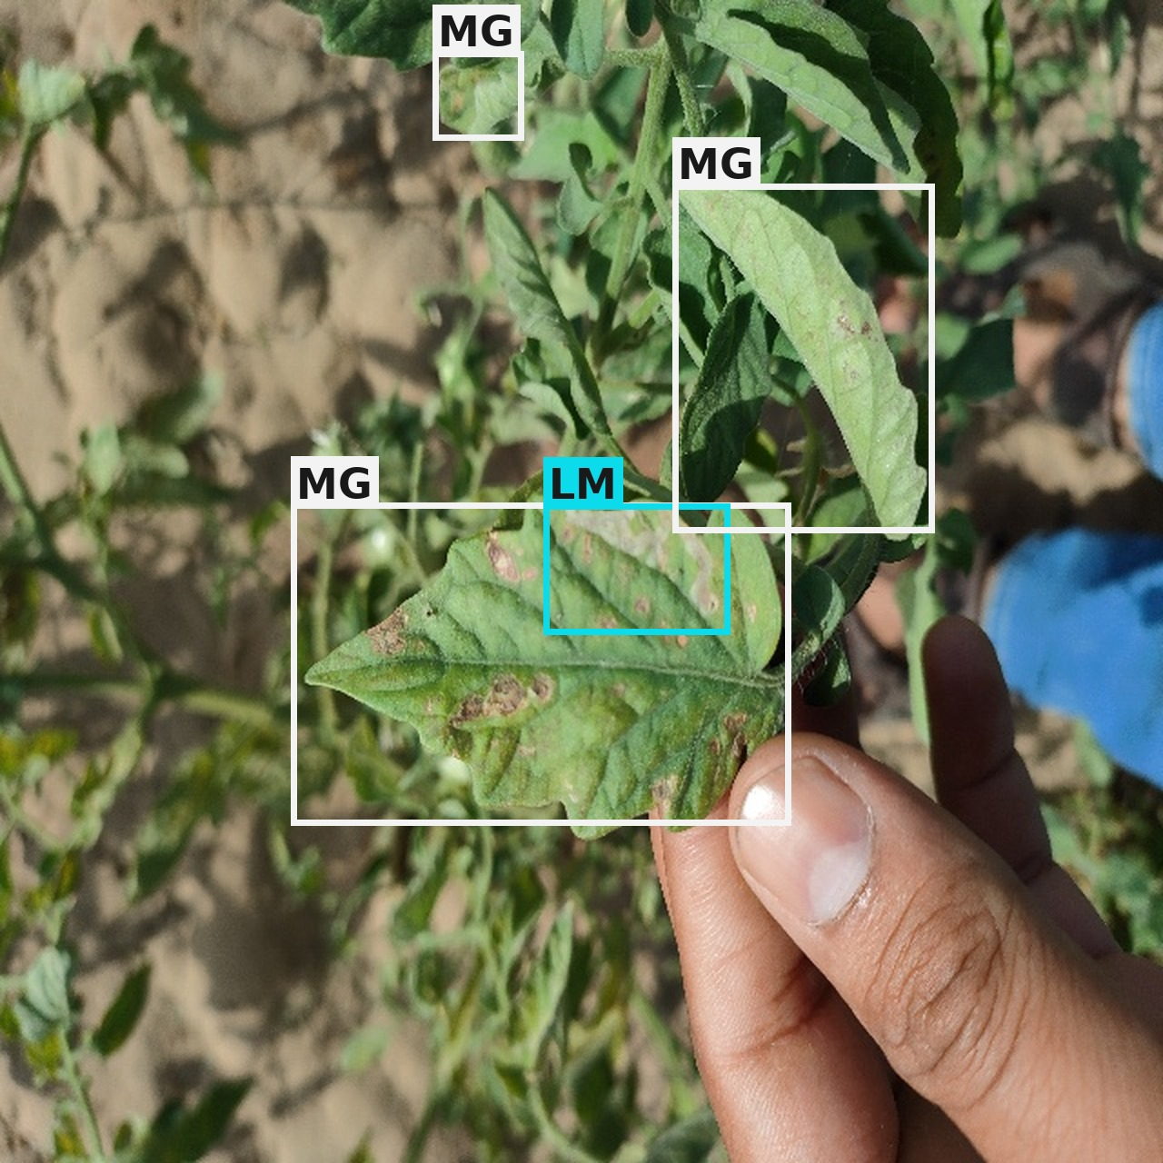
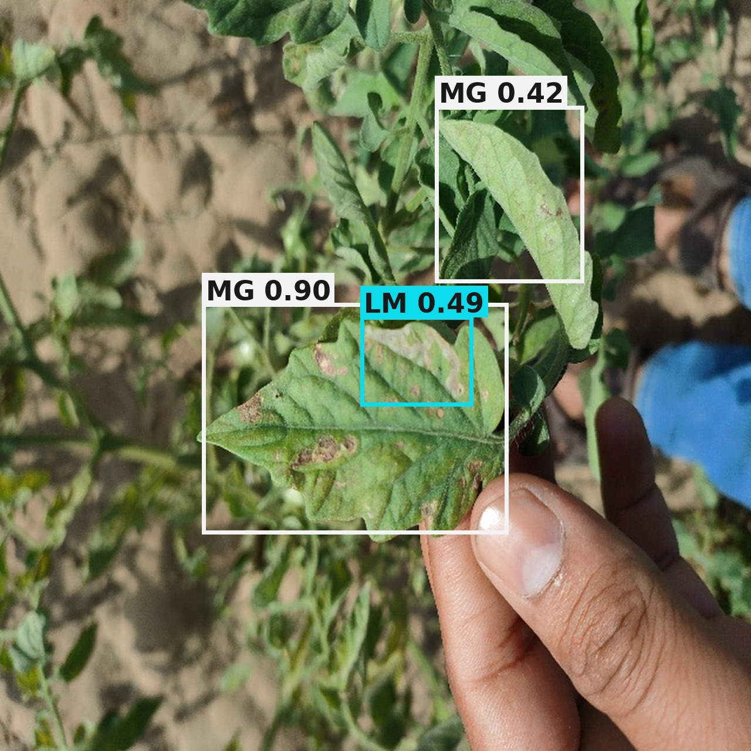
Ground Truth vs. TomaNet-D Prediction
Example 1 — Jaipur_Pots (394)
Example 2 — IMG20220324091033
Ground truth: 4 annotated boxes
TomaNet-D: 5 predicted boxes
Ground truth: 4 annotated boxes
TomaNet-D: 3 predicted boxes
Class correct on every box (all leaf miner) and all four annotated mines are found. The model adds a fifth box at 0.37 on a leaf the annotator left unmarked, which counts as a false positive even though the symptom is visible there.
Both classes present are recovered: magnesium deficiency at 0.90 on the main leaf and leaf miner at 0.49 inside it. One small magnesium box in the upper canopy is missed — the kind of small, low-contrast instance the tuning plan targets.
Box labels: LB late blight · LM leaf miner · MG magnesium deficiency · NT nitrogen deficiency · PT potassium deficiency · SW spotted wilt virus
Ground-truth boxes are drawn from the Tomato-Village label files; predictions are TomaNet-D-m at a confidence threshold of 0.35.

Slide 31
Improving TomaNet-D
TomaNet-D is in the experiment and testing phase. Accuracy is expected to rise as we work down this list; architecture changes are the last resort, not the first.
1. Hyper-parameter tuning — sweep the initial learning rate and schedule, the warm-up length, optimiser momentum and weight decay. The current run used lr₀ = 0.01 with no sweep behind it.
2. Batch size — retry at 16 and at 64 against the current 32. At 800 × 800 the batch size drives both the BatchNorm statistics and the effective learning rate.
3. Epoch budget — training stopped at epoch 85 of 100 with patience 60, and mAP was still climbing. Extend the budget and re-check the early-stopping point.
4. Class imbalance — oversample nitrogen and potassium deficiency, or reweight the loss. 237 potassium boxes against 18,316 leaf-miner boxes is the single clearest cause of the low mean.
5. Pre-process the Tomato-Village dataset — if tuning alone is not enough: tighten annotation quality, filter unusable frames, normalise illumination and revisit the augmentation preset for field imagery.

Slide 32
Conclusion
The proposed TomaNet framework provides a unified solution for tomato disease analysis, addressing the limitations of existing classification-only and detection-only approaches. It consists of TomaNet-C for disease classification and TomaNet-D for disease detection and localization, both built on the same TomaBlock-based shared trunk.
TomaBlock works. The integration of Partial Convolution, Coordinate Attention and re-parameterisation trains stably and loses nothing: 99.63% accuracy, 99.61% macro-F1 and κ = MCC = 0.9956, at 1.32 M parameters.
One trunk really is shared. The classification and detection trunks are the same layer list, asserted by an automated test, and the trained classifier successfully warm-started the detector.
Evaluation is trustworthy. The Tomato-Village authors' split leaks augmented duplicates across train and test; the corrected split keeps every copy of a photograph on one side.
TomaNet-D detects correctly on real field photographs but reaches mAP@0.5 = 0.392 against a published best of 0.936. This is an optimisation gap with the pipeline itself verified working, and severe class imbalance is the clearest single cause.
A single lightweight design answers both questions farmers actually ask — what disease is this, and where is it — instead of requiring two separate models. Three model scales let the same design run on a phone or on a server without redesign, because the deployed block folds to a single path.

Slide 33
Further Enhancement
Finish the TomaNet-D tuning sweep and report mAP@0.5 against the published Tomato-Village baselines at matched model size.
Run a fair benchmark comparison — same dataset, same split, same seed — against YOLOv8 to YOLOv12, which is the only comparison the literature accepts.
Repeat every run with multiple seeds per configuration, because a gain of +1 to +4 mAP on a single seed is within normal run-to-run noise.
Measure cross-domain generalisation: train on PlantVillage, test on real field photographs, and report the drop explicitly instead of only the laboratory number.
Turn explainability into a number — score how well a Grad-CAM heat-map overlaps the annotated lesion, rather than showing a picture and asserting that it looks right.
Deploy on device: fold the re-parameterised branches, export, and measure real latency and memory on a phone.
Extend to larger training runs and to the remaining datasets for which a working adapter has not yet been written.

Slide 34
References (1 of 4)
1. Wspanialy, P., & Moussa, M. (2020). A detection and severity estimation system for generic diseases of tomato greenhouse plants. Computers and Electronics in Agriculture, 178, 105701.
2. Thuseethan, S., Vigneshwaran, P., Charles, J., & Wimalasooriya, C. (2024). Siamese network-based lightweight framework for tomato leaf disease recognition. Computers, 13(12), 323.
3. Oni, M. K., & Prama, T. T. (2025). Optimized custom CNN for real-time tomato leaf disease detection. arXiv:2502.18521.
4. Thai, H. T., & Le, K. H. (2025). MobileH-Transformer: Enabling real-time leaf disease detection using a hybrid deep learning approach for smart agriculture. Crop Protection, 189, 107002.
5. Karegowda, A. G., Jain, R., & Devika, G. (2021). State-of-the-art deep learning based tomato leaf disease detection. ICIIC 2021, 303–311. Atlantis Press.
6. Hosen, M. D., & Islam, M. H. (2025). Aggrotech: Leveraging deep learning for sustainable tomato disease management. arXiv:2501.12052.
7. Anu, A., Solanki, K., & Dhankar, A. (2024). A novel multi-class deep learning approach for tomato leaf disease detection system. IJISAE, 12(6s), 187–196.
8. Trivedi, N. K., Gautam, V., Anand, A., Aljahdali, H. M., Villar, S. G., Anand, D., … & Kadry, S. (2021). Early detection and classification of tomato leaf disease using high-performance deep neural network. Sensors, 21(23), 7987.
9. Chen, H. C., Widodo, A. M., Wisnujati, A., Rahaman, M., Lin, J. C. W., Chen, L., & Weng, C. E. (2022). AlexNet convolutional neural network for disease detection and classification of tomato leaf. Electronics, 11(6), 951.

Slide 35
References (2 of 4)
10. Nyasulu, C., Diattara, A., Traore, A., Ba, C., Diedhiou, P. M., Sy, Y., … & Peluffo-Ordóñez, D. H. (2023). A comparative study of machine learning-based classification of tomato fungal diseases: Application of GLCM texture features. Heliyon, 9(11).
11. Harakannanavar, S. S., Rudagi, J. M., Puranikmath, V. I., Siddiqua, A., & Pramodhini, R. (2022). Plant leaf disease detection using computer vision and machine learning algorithms. Global Transitions Proceedings, 3(1), 305–310.
12. Maeda-Gutiérrez, V., Galvan-Tejada, C. E., Zanella-Calzada, L. A., Celaya-Padilla, J. M., Galván-Tejada, J. I., Gamboa-Rosales, H., … & Olvera-Olvera, C. A. (2020). Comparison of convolutional neural network architectures for classification of tomato plant diseases. Applied Sciences, 10(4), 1245.
13. Hussein, A. H. A., Adnan, M. M., Hemalatha, K. L., Malathy, V., & Rajesh, N. (2023). Coordinate attention mechanism with convolutional neural network for tomato leaf diseases. ICIICS 2023, 1–5. IEEE.
14. Abbas, A., Jain, S., Gour, M., & Vankudothu, S. (2021). Tomato plant disease detection using transfer learning with C-GAN synthetic images. Computers and Electronics in Agriculture, 187, 106279.
15. Ahmad, M., Abdullah, M., Moon, H., & Han, D. (2021). Plant disease detection in imbalanced datasets using efficient convolutional neural networks with stepwise transfer learning. IEEE Access, 9, 140565–140580.
16. Al-Shamasneh, A. R., & Ibrahim, R. W. (2024). Classification of tomato leaf images for detection of plant disease using conformable polynomials image features. MethodsX, 13, 102844.
17. Wang, X., Liu, J., & Liu, G. (2021). Diseases detection of occlusion and overlapping tomato leaves based on deep learning. Frontiers in Plant Science, 12, 792244.
18. Li, D., Yin, Z., Wu, Z., & Liu, Q. (2021). Classification for tomato disease with imbalanced samples based on TD-MobileNetV2. ICISPC 2021, 35–39. IEEE.

Slide 36
References (3 of 4)
19. Shoaib, M., Hussain, T., Shah, B., Ullah, I., Shah, S. M., Ali, F., & Park, S. H. (2022). Deep learning-based segmentation and classification of leaf images for detection of tomato plant disease. Frontiers in Plant Science, 13, 1031748.
20. Gangwar, A., Dhaka, V. S., Rani, G., Khandelwal, S., Zumpano, E., & Vocaturo, E. (2024). Time and space efficient multi-model convolution vision transformer for tomato disease detection from leaf images with varied backgrounds. Computers, Materials & Continua, 79(1).
21. Karim, M. J., Goni, M. O. F., Nahiduzzaman, M., Ahsan, M., Haider, J., & Kowalski, M. (2024). Enhancing agriculture through real-time grape leaf disease classification via an edge device with a lightweight CNN architecture and Grad-CAM. Scientific Reports, 14(1), 16022.
22. Masud, K. I., Rahman, M. M., Jannat, M. R., Hasan, M. M., Islam, M. S., & Rahman, M. O. (2024). A CNN-based model to detect and classify the tomato leaf disease using transfer learning. ICCIT 2024, 2823–2828. IEEE.
23. Çatal Reis, H. (2024). Advanced tomato disease detection using the fusion of multiple deep-learning and meta-learning techniques. Journal of Crop Health, 76(6), 1553–1567.
24. Junare, C. B., Ghanokar, V. S., Khandare, R. M., Koche, S. P., & Pagrut, S. B. (2024). Automated plant leaf disease detection and localization using Mask R-CNN.
25. Chen, J., Kao, S., He, H., Zhuo, W., Wen, S., Lee, C. H., & Chan, S. H. G. (2023). Run, don't walk: Chasing higher FLOPS for faster neural networks (FasterNet). CVPR 2023. arXiv:2303.03667.
26. Hou, Q., Zhou, D., & Feng, J. (2021). Coordinate attention for efficient mobile network design. CVPR 2021. arXiv:2103.02907.
27. Ding, X., Zhang, X., Ma, N., Han, J., Ding, G., & Sun, J. (2021). RepVGG: Making VGG-style ConvNets great again. CVPR 2021. arXiv:2101.03697.

Slide 37
References (4 of 4)
28. Mohanty, S. P., Hughes, D. P., & Salathé, M. (2016). Using deep learning for image-based plant disease detection. Frontiers in Plant Science, 7, 1419.
29. Noyan, M. A. (2022). Uncovering bias in the PlantVillage dataset. arXiv:2206.04374.
30. Jelali, M. (2024). Deep learning for tomato disease detection using real-field datasets: A review. Frontiers in Plant Science.
31. Ramos, L., & Sappa, A. D. (2025). Benchmarking YOLOv8–YOLOv12 for tomato disease detection. Scientific Reports. doi:10.1038/s41598-025-11064-0.
32. Fu, Y., Wang, X., Wang, L., & Sun, Y. (2025). PMJDM: Joint species classification and disease detection. Frontiers in Plant Science.

