Slide 1
FaZe Media: Insights & Analytics Intern Case Study
Toolset Recommendation · Creator Scouting · Campaign Recap
Prepared by: Devarsh Vora

Slide 2
Table of contents
01.
02.
Toolstack Overview
Creator Scouting
03.
04.
Campaign Performance
Insights & Strategy

Slide 3
01.
Toolstack overview

Slide 4
TOOLSTACK overview
Recommended Tool Ecosystem
• Discovery: TikTok Creative Center, YouGov • Analytics: Blinkfire, StreamHatchet, Tubular • CRM/Management: Aspire, CreatorIQ, HubSpot • Workflow: Airtable, Notion, Monday.com • Reporting: Looker Studio, Google Sheets
Discovery
Analytics
CRM
Workflow
Reporting

Slide 5
TOOLSTACK architecture & rationale
End-to-End Framework
• Creator Discovery Layer • Talent & Contract Management • Cross-Platform Analytics • Content Workflow & Project Tracking • Automated Reporting & Media Value
Why This Stack Works for FaZe
• Scales across 200M+ fan ecosystem • Enables fast performance insights • Improves brand deal reporting • Reduces manual data cleanup • Aligns FaZe with UTA/Night Media standards

Slide 6
02.
Creator scouting

Slide 7
Scouting evaluation Criteria
Multi-platform reach & engagement
30-day growth rate
Audience demographics (age, gender, geo)
Brand safety score (0–100)
Monetization potential
FaZe brand alignment

Slide 8
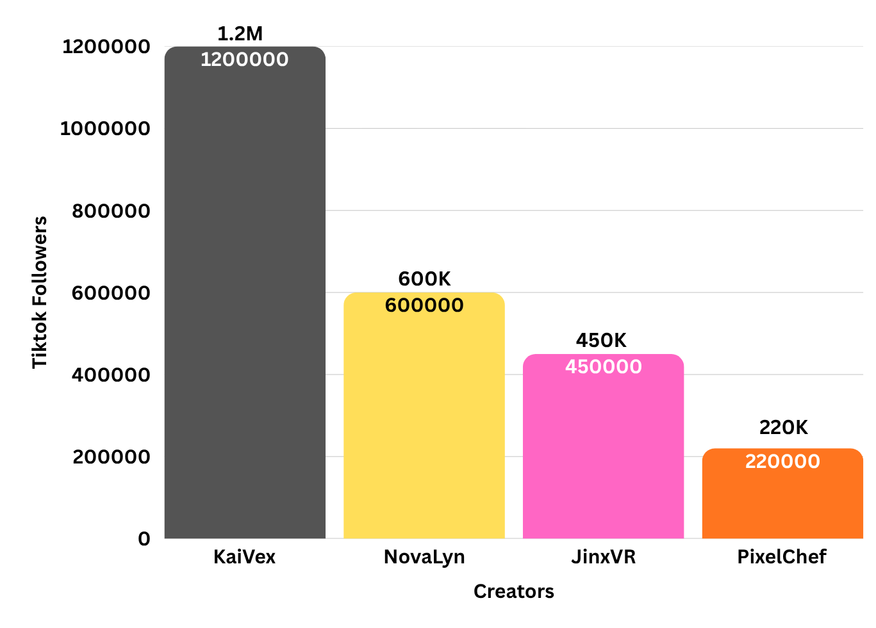
CREATOR comparison (Dataset Overview)
Creator Performance Snapshot
KaiVex — Strong gaming + Twitch presence
NovaLyn — Fastest MoM growth
JinxVR — High short-form ER
PixelChef — Niche gaming × food vertical

Slide 9
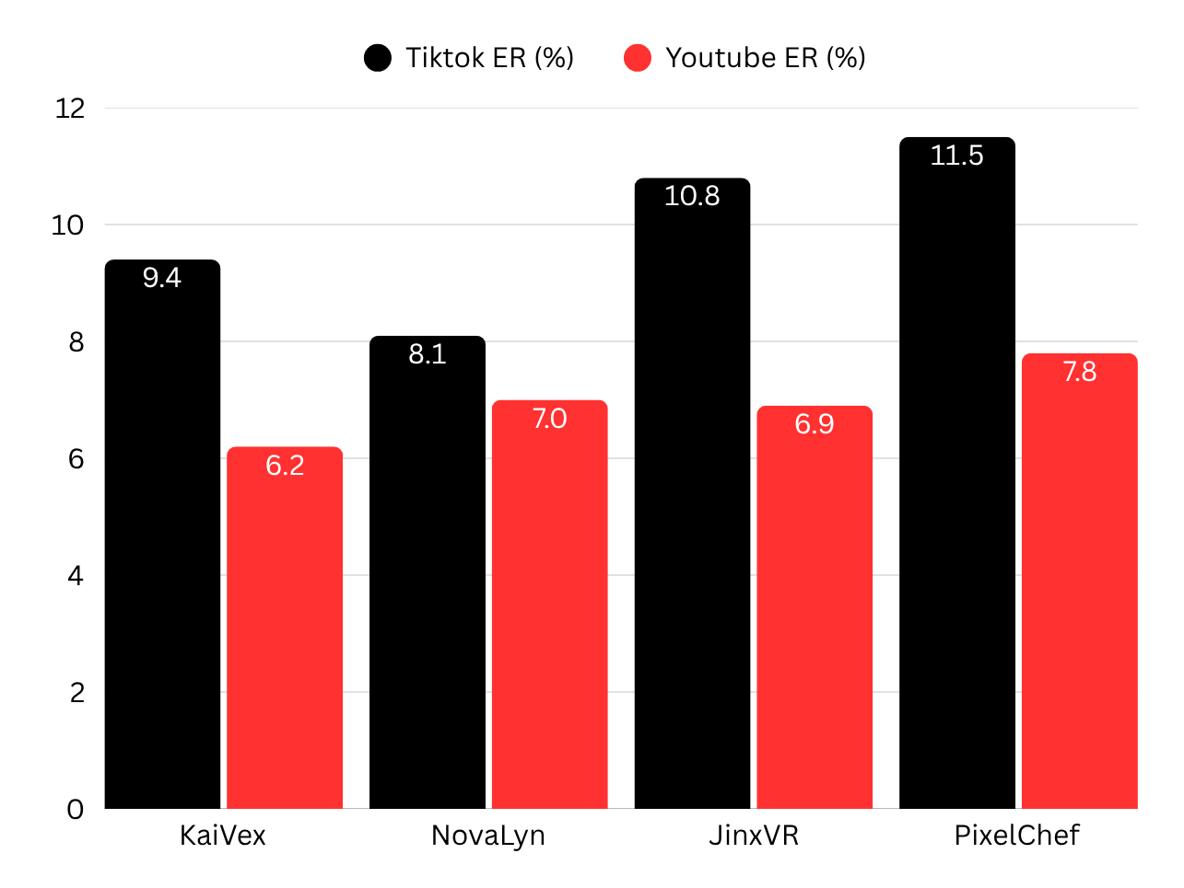
ENGAGEMENT Rate ANALYSIS
Engagement Comparison (TikTok & YouTube)
• PixelChef: 11.5% TikTok ER • JinxVR: 10.8% TikTok ER • KaiVex: 9.4% TikTok ER • NovaLyn: 8.1% TikTok ER
Key Insight: High short-form ER = strong potential for viral reach.

Slide 10
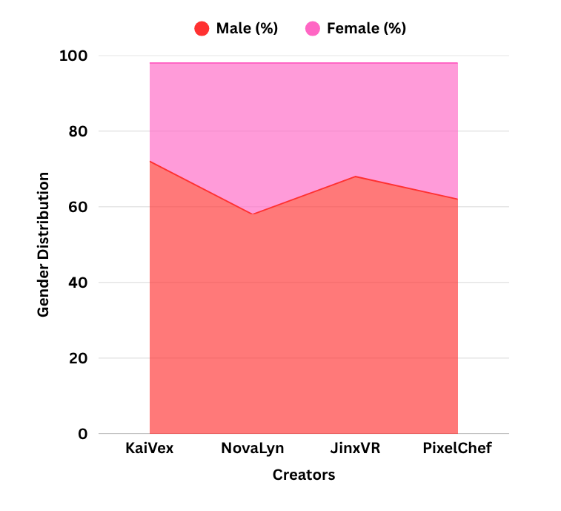
audience demographics
Creator Audience Breakdown
• NovaLyn: 40% female audience • KaiVex: 47% aged 18–24 • JinxVR: High 13–17 segment • PixelChef: Strong US + UK base

Slide 11
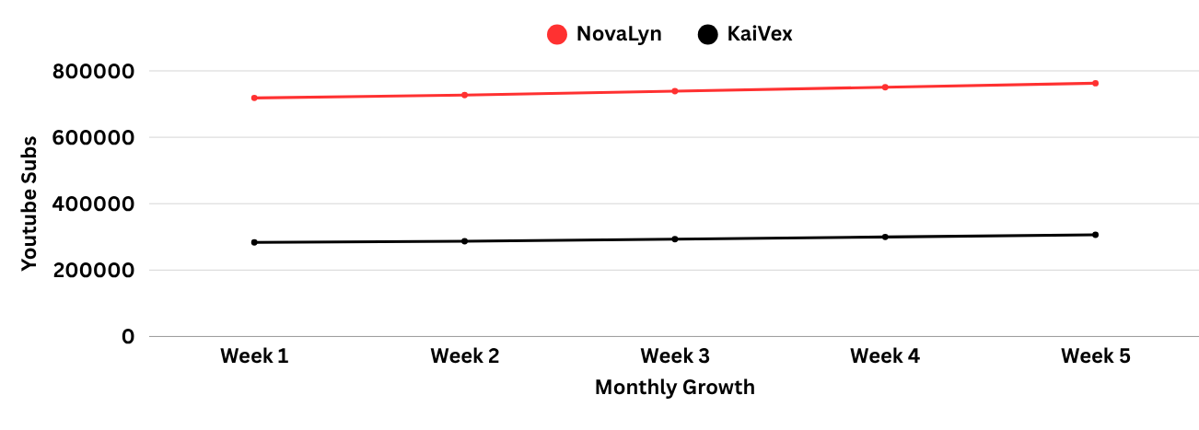
growth trends
30-Day Growth Analysis
• NovaLyn: +18.4% YouTube growth • JinxVR: +15.2% TikTok growth • PixelChef: +16.5% YouTube growth • KaiVex: Stable multi-platform growth
Key Insight:
NovaLyn shows strongest upward momentum of all candidates.

Slide 12
FINAL RECOMMENDATIONS
FaZe Core Roster
FaZe Umbrella Agency
KaiVex
NovaLyn
JinxVR
PixelChef
Reasoning: • Strongest reach (Core Roster) • High growth & ER (Umbrella) • Balanced audience segments • Brand-safe profiles (90+ scores)

Slide 13

03.
Campaign Performance

Slide 14





CAMPAIGN overview
Cash App × FaZe Activation
• Creators: KaiVex + NovaLyn • Platforms: TikTok, YouTube Shorts, Twitch • Duration: 3 weeks • Goal: Drive Cash App sign-ups in Gen Z

Slide 15
KEY campaign METRICS
Performance Highlights :
• 18.4M impressions • 11.2M views • 1.36M engagements • 148k clicks • 38,200 sign-ups • Avg ER: 12.1%
Key Insight: TikTok delivered majority of reach + conversions.

Slide 16
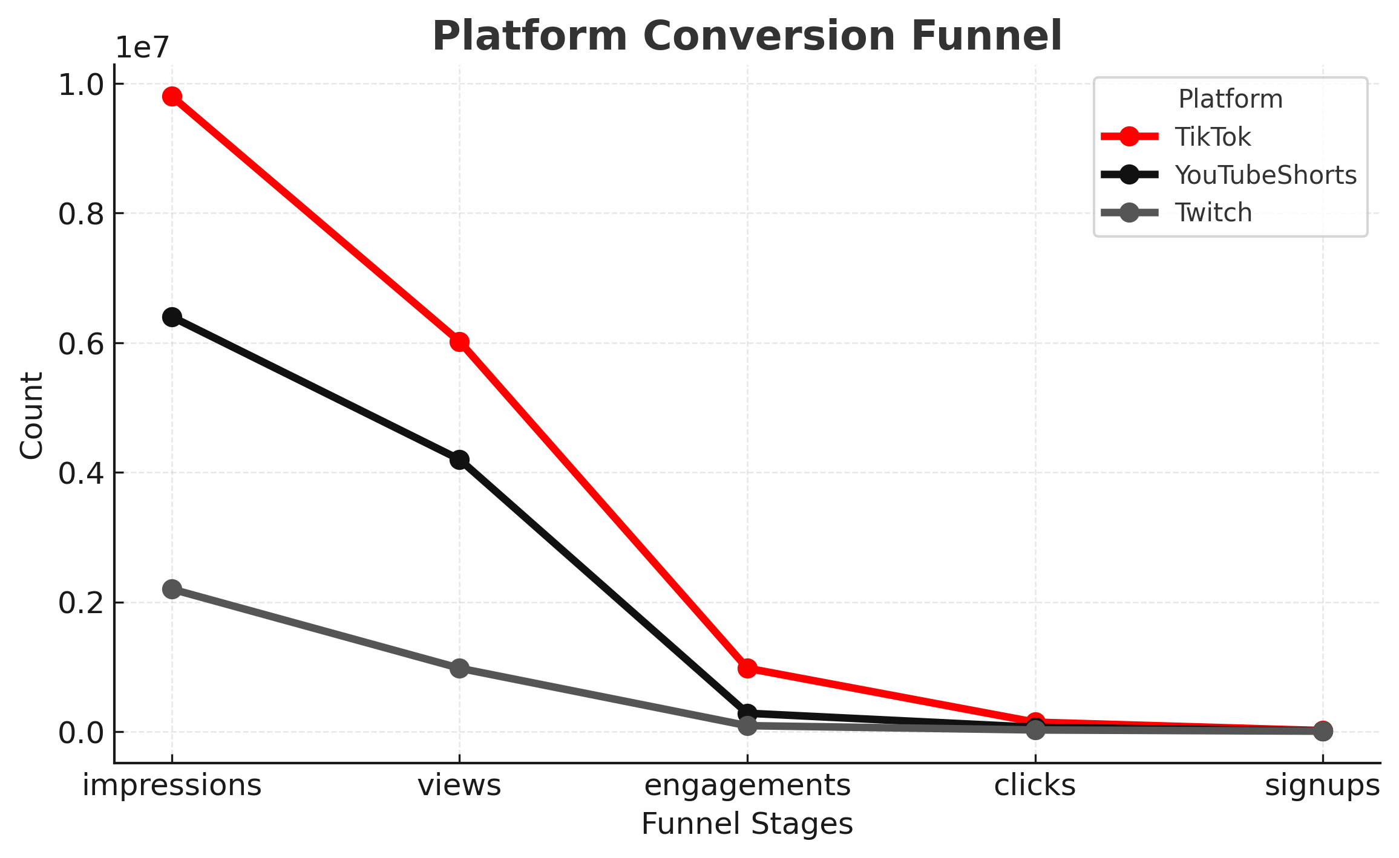
PLATFORM analysis
Major Breakdown
• TikTok: 22.8k sign-ups • YouTube Shorts: 11k • Twitch: 9k
Insight: TikTok outperformed at
every stage.

Slide 17
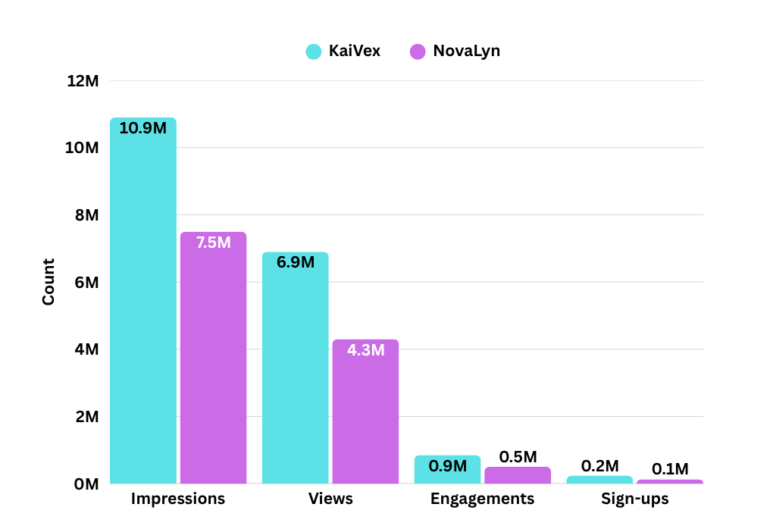
creator performance
KaiVex • 10.9M impressions • 6.9M views • 851k engagements • 24.5k sign-ups
NovaLyn • 7.5M impressions • 4.3M views • 509k engagements • 13.7k sign-ups
Insight: KaiVex generated ~64% of total sign-ups.

Slide 18
04.
Insights & Strategy

Slide 19
Media value insights
Blinkfire Media Value Analysis
• Total Media Value Generated: $437k across both creators • KaiVex: ~$184k driven by high exposure frequency and Twitch stream logo placements • NovaLyn: ~$253k due to strong TikTok visibility, clean frame composition, and consistent brand callouts • Avg Logo Visibility Score: 0.83, indicating the Cash App logo was clearly visible in 83% of viewable frames • Viewable Exposures: Strong ratio of exposures-to-views across both creators (well above industry benchmarks) • Share of Voice (SOV): 0.69–0.76, meaning Cash App maintained brand dominance over all other on-screen elements • Key Takeaway: Both creators produced strong media value, with NovaLyn slightly outperforming due to clean visual framing and tighter short-form editing

Slide 20
KEY insights
Short-form = conversion engine
NovaLyn expanded female demo
Twitch amplified purchase intent
TikTok delivered best CPA
Optimal 2-creator mix (gaming + lifestyle)

Slide 21
STRATEGIC recommendations
Prioritize hybrid gaming–lifestyle creators
Increase short-form volume by +30%
Extend Cash App partnership into monthly challenges
Use Blinkfire value in all BD pitches

Slide 22

THANKS!
Questions welcome — happy to walk through datasets, approach, and methodology.

