Slide 1

HPC Project
Hybrid MPI + OpenMP Parallel K-Means
On CIFAR-10 Image Embeddings
By Sadhana Devarajan
DISTRI-CLUSTER
50,000 CIFAR-10 VECTORS
512 DIMENTIONS
K=10 CLUSTERS

Slide 2
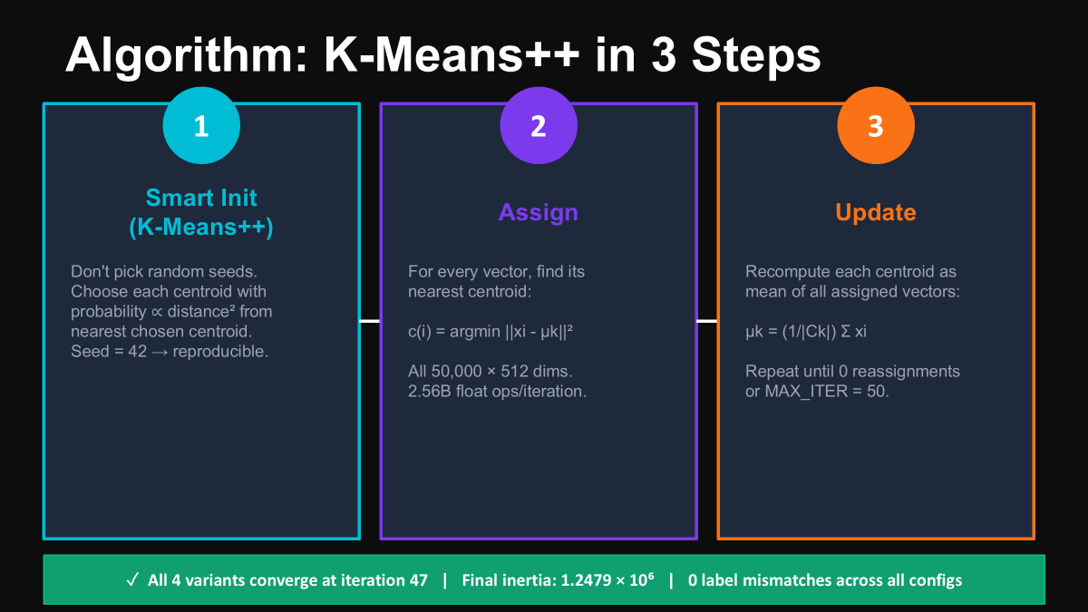

Slide 3
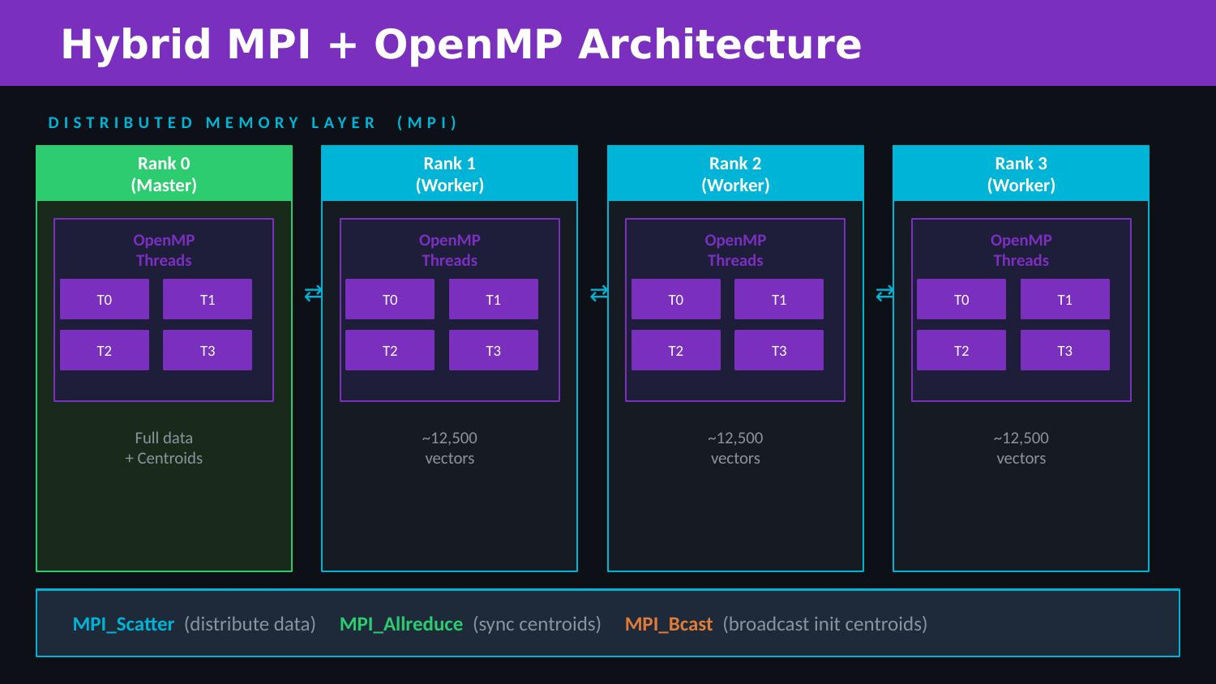

Slide 4
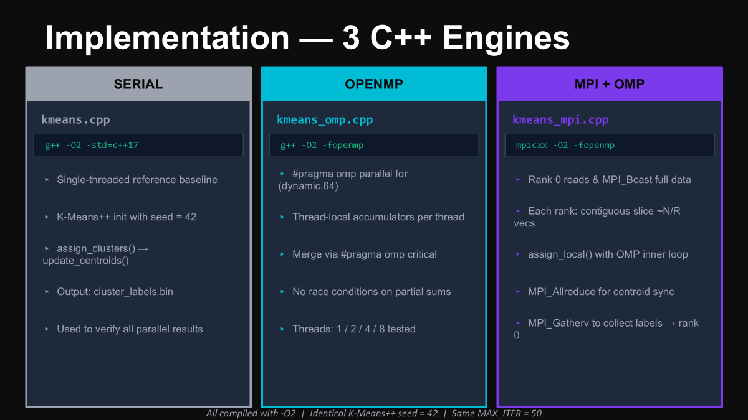

Slide 5
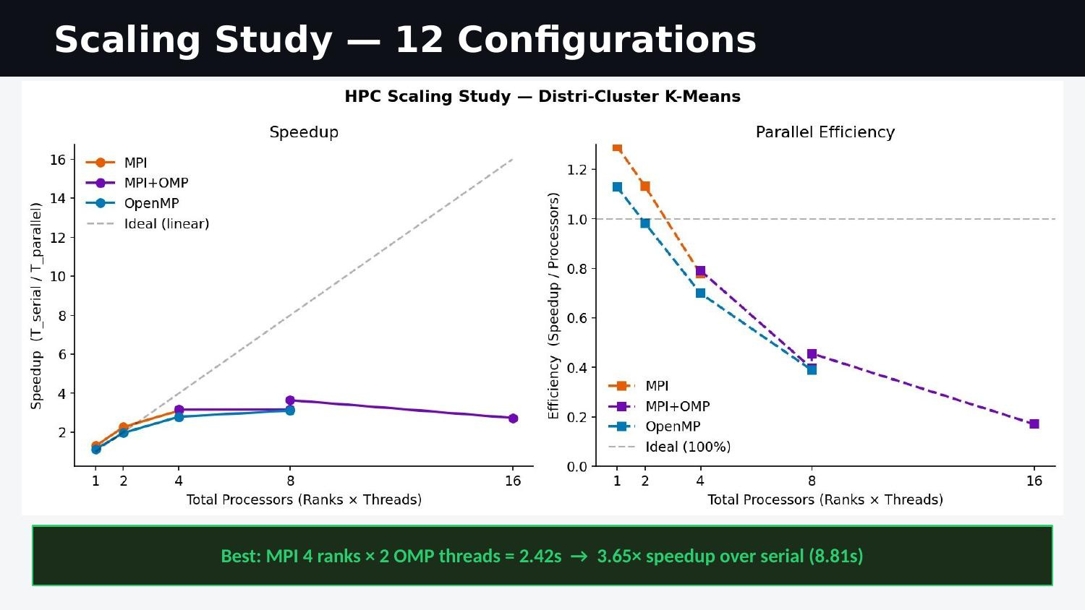

Slide 6
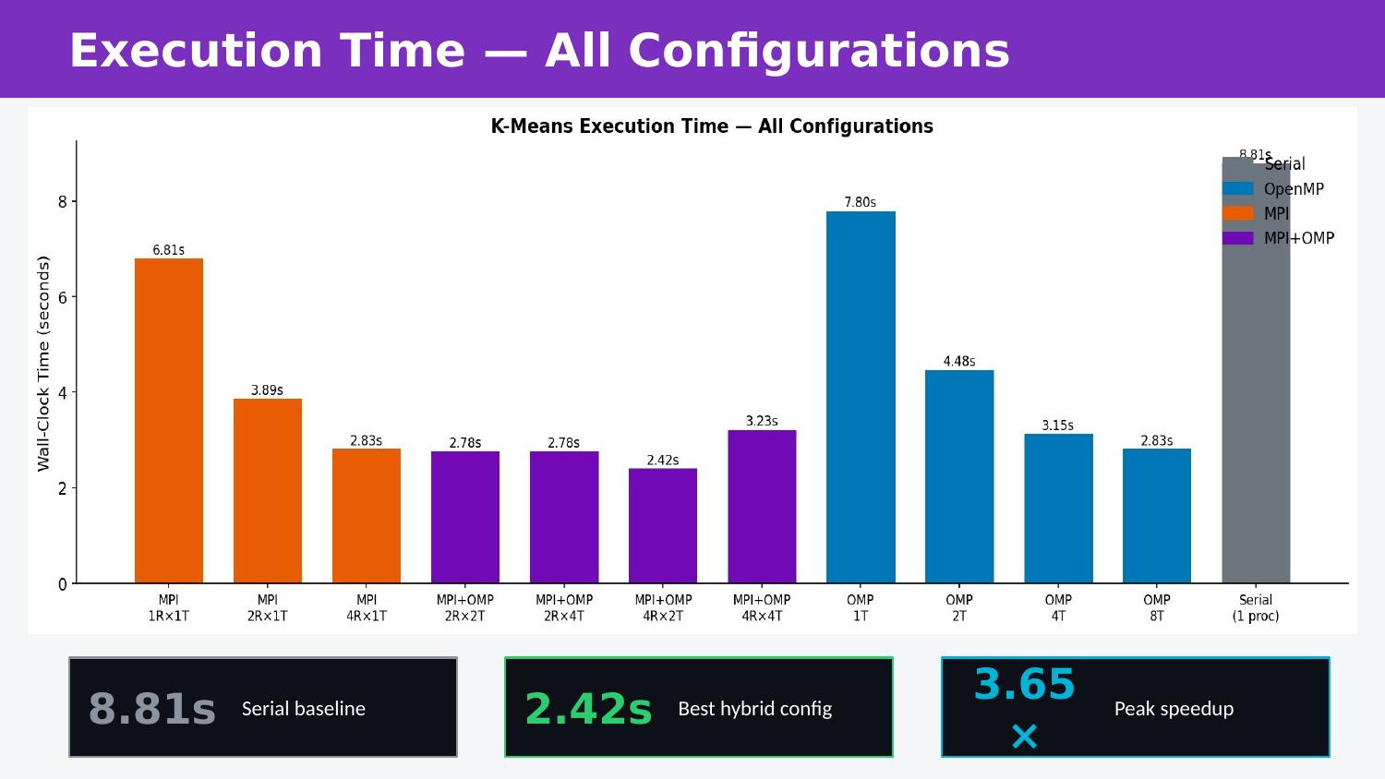

Slide 7
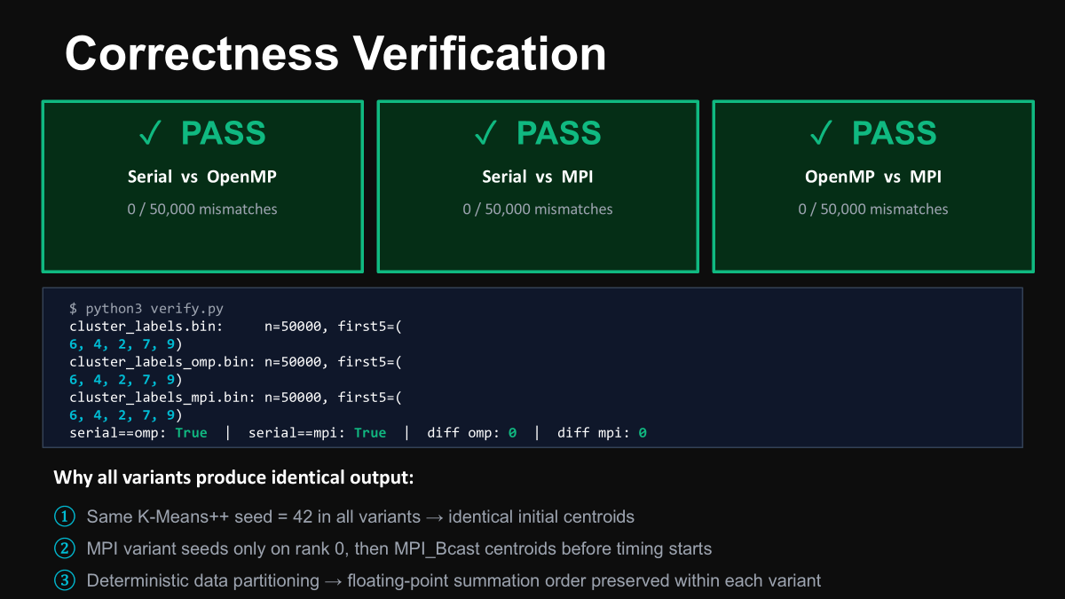

Slide 8
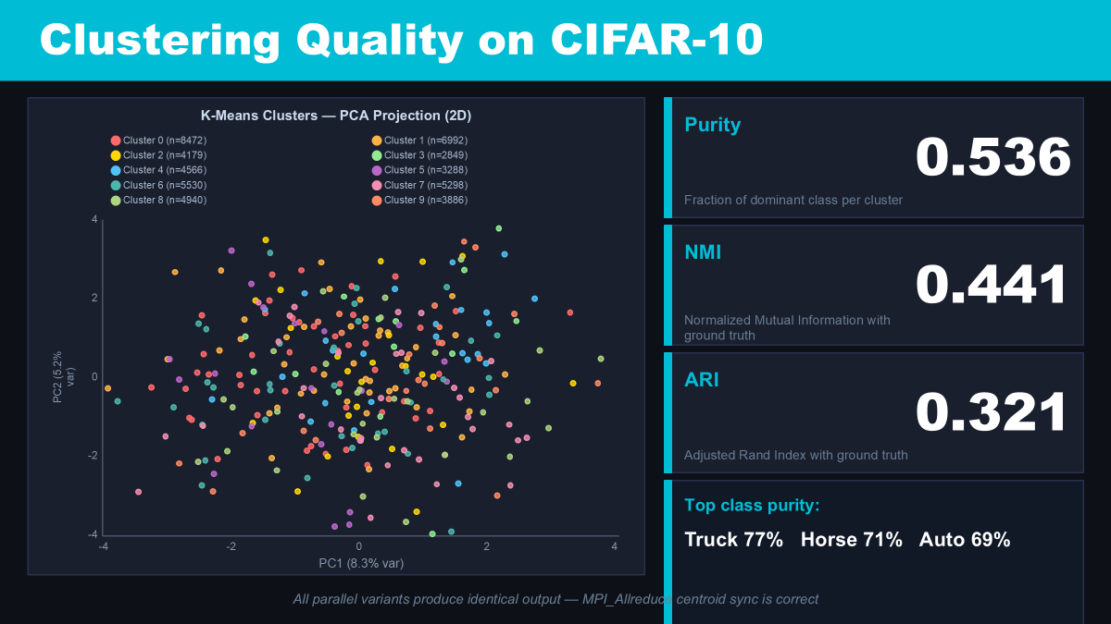

Slide 9
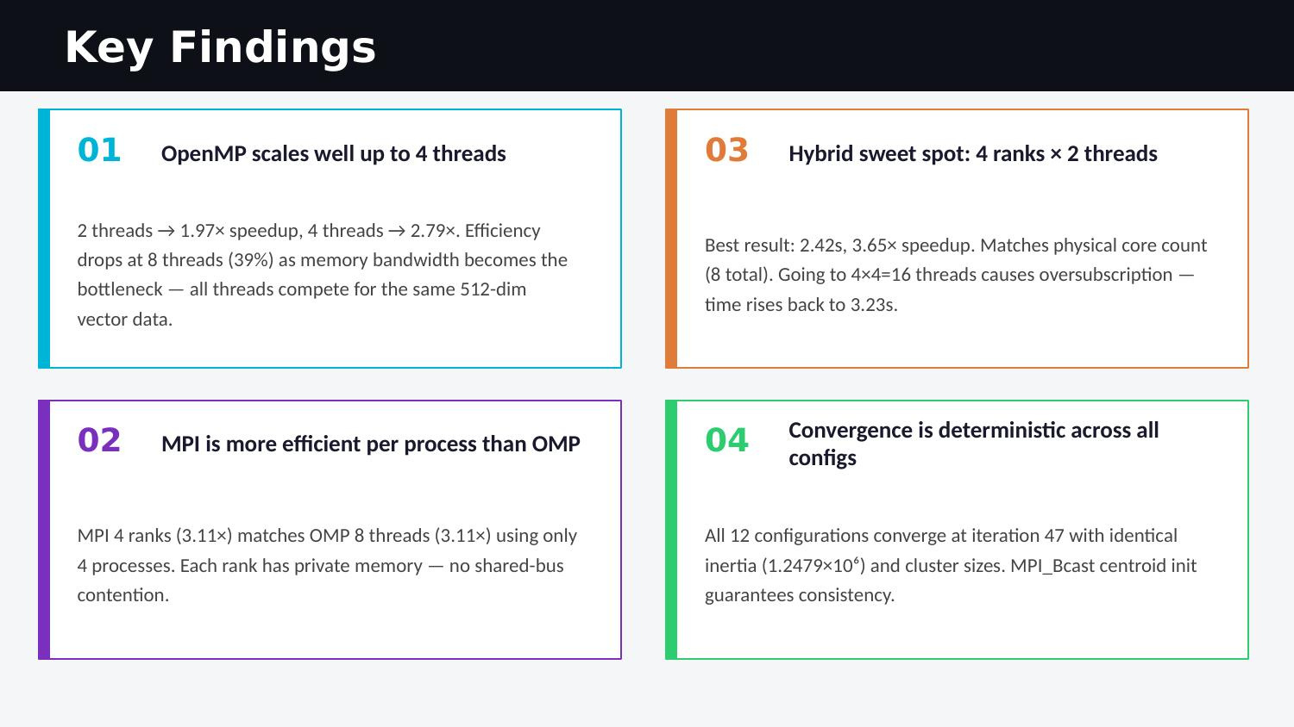

Slide 10
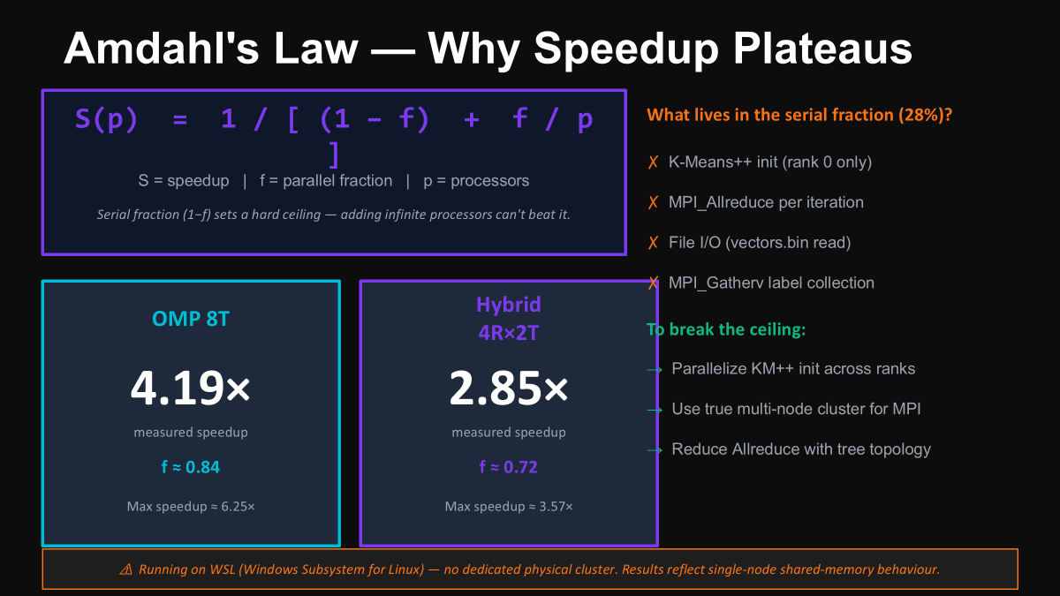

Slide 11
