Slide 1
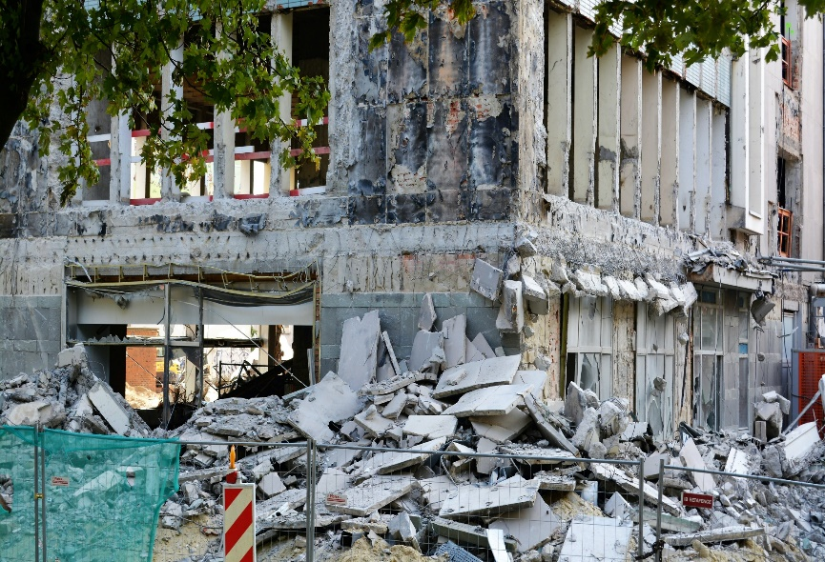
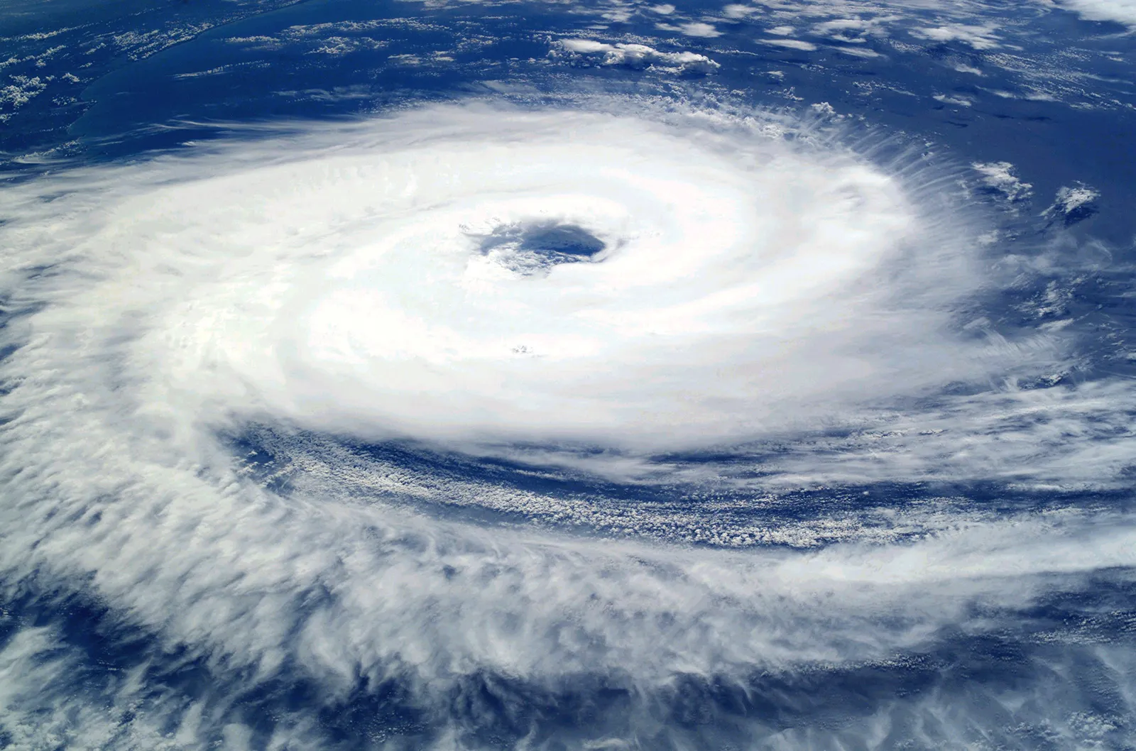
HOW CAN AI HELP IN SOLVING NATURAL CALAMITIES MORE EASILY?
01
LET’S HAVE A LOOK AT THEM AND TRY TO FIND THE SOLUTION!!!
EARTHQUAKE
CYCLONES

Slide 2
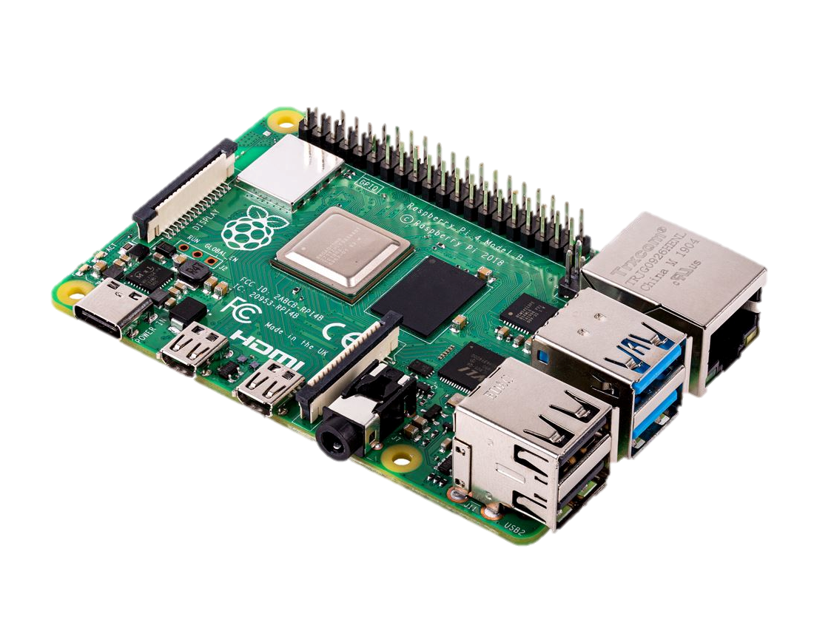
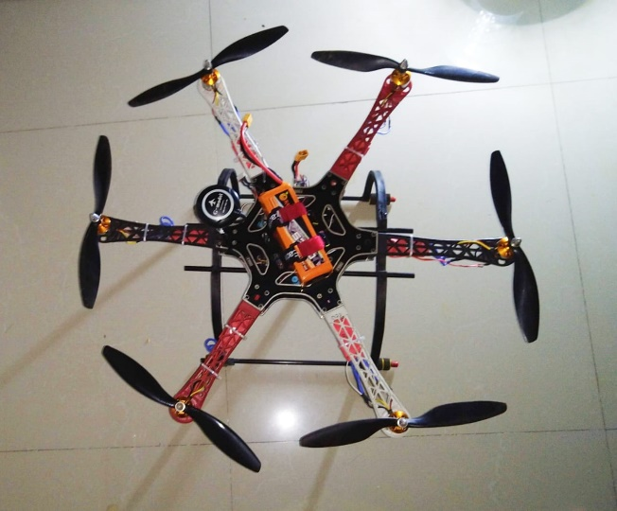
02
So Let’s us see How will the solution work…
The communication between the ground station and with the UAV will be established using radio communication at 4g(5.8)Ghz(Non-Standalone).
The single board computer present in the vehicle will be programmed with certain types of algorithm based on A.I and M.L.
Then the Drone along with its thermal and infrared camera and algorithms programmed in the single board computer will find out any human being present in the situation.
And after executing all the task it will simply follow its last command which is RTL(return to launch).
P.S-THIS WAS CREATED BY ME!

Slide 3
SAME APPLIES IN THE CASE OF CYCLONES BUT WITH DIFFERENT APPROACH!!!
03
During cyclones transportation of things to the right person gets difficult so in order to make it easier what we will be doing is we will be establishing a real-time connection between the UIDAI servers and the UAV so that we can identify everyone before the delivery..
During cyclones in some cases it may happen that thermal sensors cannot give accurate result so in such case we will be using sonar or ultrasound techniques to get more accurate results in terms of searching human beings.
We will also be using a GPS to avoid any loss of communication with the vehicle.
Radio communication with uav
Processing takes place in the SBC &FC
Acc. To needs sensors works
Task execution completed
RTL.

Slide 4

JOB SEEKER PROJECT FOR UNEMPLOYED PERSON BASED ON MACHINE LEARNING
LET’S GO!!!

Slide 5
ABOUT PROJECT
OBJECTIVE
JOB SEEKER FOR UNEMPLOYED PERSONS, as the name suggests is the tool for graduates to suggest the top 10 jobs from the dataset based on the skills of the person.
There are two versions of this tool:
In this program, we have extracted the skills from the resume and according to needs user can decide whether to give input or submit his/her pdf is manually providing the skills as the input. Both have there own WEB-UI based on their input type.
The dataset is downloaded from the web which is generated using web scrapping the Glassdoor website.
And for matching the job description and the skills, We have used multiple algorithm for finding the best jobs for any person. At last deployed both the version using Flask and rendering is done using simple HTML templates.
Version 1: (Input is the resume)
Version 2: (Skills is entered manually)

Slide 6
Dataset:-
The dataset is downloaded from the web which is generated using web scrapping the Glassdoor website.
ABOUT DATASET
Variables of Dataset
URL
POSITION
COMPANY
LOCATION
JOB DESCRIPTION

Slide 7



MARKET SEGMENTATION
TECH TOOLKITS USED
Python
SK-Learn
Python is the programming language which is used to code the project. Various algorithms used are coded in Python
.
Scikit-learn is a free software machine learning library for the Python programming language. It features various classification, regression and clustering algorithms
Visual Studio Code
Visual Studio Code is the effective IDE used for coding in Python. It is very easy to use and widely used over the industry.

Slide 8
Research and understanding
1
The first thing you have to do before you solve a problem is to define exactly what it is. You need to be able to translate data questions into something actionable.
PROJECT PROCESS
2
Web Scraping
Web scraping is the process of using bots to extract content and data from a website. Unlike screen scraping, which only copies pixels displayed onscreen, web scraping extracts underlying HTML code and, with it, data stored in a database. The scraper can then replicate entire website content elsewhere.
3
Data pre-processing
Data preprocessing can refer to manipulation or dropping of data before it is used in order to ensure or enhance performance, and is an important step in the data mining process.
4
Flask
Flask is a web framework. This means flask provides you with tools, functions and technologies that allow you to build a web application.

Slide 9

Hope to see you soon!!!
CREDITS :-
SWARNIM BURNWAL
DEVASHEESH MISHRA
RITVIK SRIVASTAVA
ANSH KAUSHIK
SHREYA GARG

