Slide 1
AUTOJOPPS · AUTOMATED JOB OPPORTUNITIES
Job applications on autopilot, with you in the loop
An AI agent that finds matching roles, tailors and submits applications within your limits, asks you only when a human is truly needed, keeps proof, and learns from you. Built India-first.
Working prototype v1 live · github.com/devashishb-rms/Auto-Jopps
Devashish Bhattacharjee, Founder · Prepared for Fundizr · 29 October 2026
Confidential · © 2026 Devashish Bhattacharjee. All rights reserved. Not to be used or shared without written permission.

Slide 2
The problem: applying for jobs is repetitive, opaque and exhausting
Hours of retyping
Today's bots fail silently
Nothing built for India
The same profile and screening answers go into every portal and ATS form. A serious search means 100-400 applications; each takes 10-25 minutes by hand.
Auto-apply tools stop at OTPs, CAPTCHAs and odd questions, break when a portal changes, and do not show what was sent. Senior candidates will not put their name on that.
USD pricing, no WhatsApp alerts, no Naukri-style profile, no view of what the recruiter did, no DPDP posture.
115M resumes on Naukri, about 21,000 added every day (Info Edge, Q4 FY26). 200M LinkedIn members in India (Sept 2026).
The volume of applying is enormous; the tooling for the person applying has not kept up.
AutoJopps · Investor deck v2 · 29 Oct 2026
Confidential · © 2026 Devashish Bhattacharjee. All rights reserved. Not to be used or shared without written permission.
2
Notes:
Naukri figures from Info Edge Q4 FY26 concall (28 May 2026).

Slide 3
The solution: an agent that applies for you, pauses for you, and shows you everything
1
2
3
4
5
Set up once
Applies within your caps
Asks only when needed
Proof and tracking
Learns from you
Resume in, profile auto-filled, targets, 2-3 dream JDs, alerts, plan. About 5 minutes.
Finds and scores roles, tailors a note, fills forms, submits. 5 / 10 / 20 a day by plan.
OTP, human check, sign-in or an unusual question: a WhatsApp / email alert and a live view of the bot's own browser.
Reference id and screenshot for every submission; viewed, in process, shortlisted.
Answers remembered, portal skills versioned, self-heals when a page changes.
Human-in-the-loop is designed in, not bolted on: every pause resumes at the same step, and the final submit can wait for the user's approval.
AutoJopps · Investor deck v2 · 29 Oct 2026
Confidential · © 2026 Devashish Bhattacharjee. All rights reserved. Not to be used or shared without written permission.
3

Slide 4
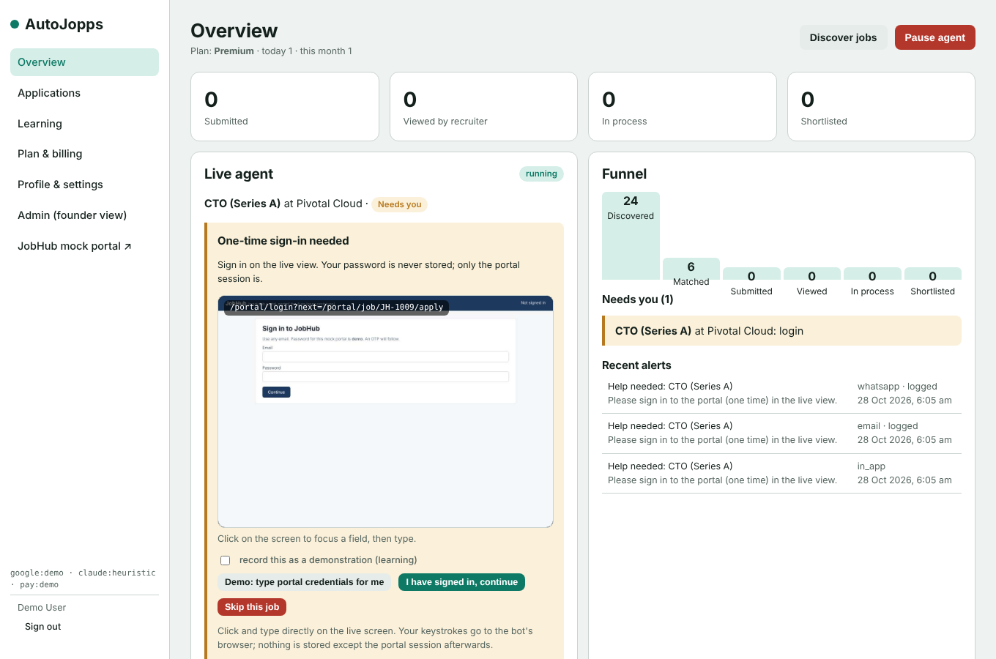
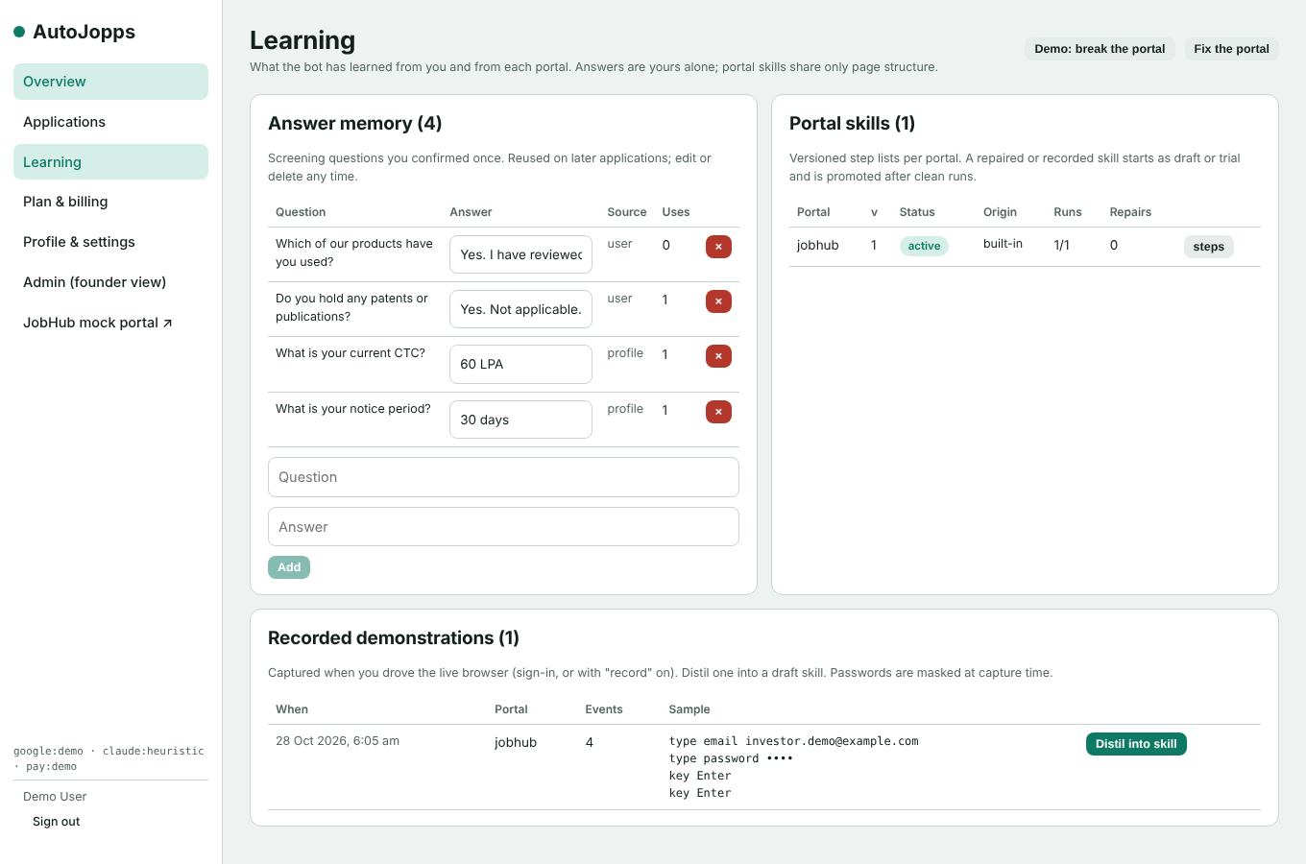
The product today: a working prototype, tested end to end
Live view: the user signs in to the portal once in the bot's browser
Learning: answer memory, portal skills, recorded demonstrations
Implemented and exercised by automated tests: Google sign-in, resume parsing, 8-step onboarding, 3 plans with Razorpay checkout and caps, orchestrator, Playwright runner, 5 human-help states with live view, email / WhatsApp / in-app alerts, tracker with proof, answer memory, skill versions, self-heal, DPDP delete-my-data, admin cost meter. React + FastAPI + Playwright, ~2,400 lines, on GitHub.
AutoJopps · Investor deck v2 · 29 Oct 2026
Confidential · © 2026 Devashish Bhattacharjee. All rights reserved. Not to be used or shared without written permission.
4
Notes:
Screens from the automated UI test on 28 Oct 2026. The runner applies on JobHub, a realistic mock portal shipped with the app; real portals are added as adapters.

Slide 5
How it works, and why it gets better with every application
Discover
›
Score
›
Tailor
›
Fill
›
Human?
›
Submit
›
Track
The learning loop (our moat)
Why it is hard to copy
1. Observe: the user applies once in the live browser; the trace is recorded with consent.
2. Distil: the trace becomes a versioned portal skill with several ways to find each field.
3. Remember: screening answers are confirmed once and reused.
4. Replay: the runner applies the skill to new jobs.
5. Self-heal: when a page changes, the step is repaired and a trial version is filed; promoted after clean runs.
6. Canary: skills are replayed daily on test accounts.
Verified in the prototype: 8 locators repaired automatically after the portal renamed its fields.
• A skill library that compounds with every user and every portal change.
• Human-in-the-loop as a first-class state, with a live view of the bot's own browser, not a screenshot after the fact.
• India-first plumbing: rupee plans, WhatsApp alerts, Naukri-style profile, DPDP consent and erasure built in.
• Cost discipline: cost per application is metered from day one, with a path from LLM-driven to scripted steps.
• Founder has built inside Naukri.com and LinkedIn, and shipped 8-10 B2B SaaS products.
AutoJopps · Investor deck v2 · 29 Oct 2026
Confidential · © 2026 Devashish Bhattacharjee. All rights reserved. Not to be used or shared without written permission.
5

Slide 6
Market: a large, under-served candidate-side market in India
TAM ₹6,000 cr
TAM: ₹6,000 cr / yr (~$630M)
India's active online job seekers, est. 20M a year (Naukri holds 115M resumes and adds 21k a day; EPFO added 14M formal subscribers in FY25) × ₹3,000 a year (3 months of Premium).
SAM ₹1,500 cr
SAM: ₹1,500 cr / yr (~$160M)
Experienced knowledge workers (3+ years) actively searching on Naukri / LinkedIn with intent to pay, est. 5M a year × ₹3,000. Naukri reports paid users at 2.2% of monthly actives, so paying intent exists on the candidate side.
SOM
₹36 cr ARR
SOM (year 3): ₹36 cr ARR (~$3.8M)
40,000 paying users (0.8% of the 5M seekers in SAM) at an average ₹750 a month across the three plans, through Naukri-adjacent channels, placement cells, bootcamps and referrals.
Estimates at ₹95 / USD. Context: global online job advertising is $37.6B in 2026 (SIA), all of it employer-side spend.
AutoJopps · Investor deck v2 · 29 Oct 2026
Confidential · © 2026 Devashish Bhattacharjee. All rights reserved. Not to be used or shared without written permission.
6
Notes:
TAM/SAM/SOM are bottom-up estimates built from public figures: Naukri 115M resumes and 21k/day (Info Edge concall, 28 May 2026); LinkedIn India ~200M members (NapoleonCat, Sept 2026); EPFO 13.98M net new subscribers FY25 (Quess via PTI). Assumptions are stated on the slide. Global online job advertising of $37.6B (SIA, 2026) is employer-side and shown only as context.

Slide 7
Business model: three monthly plans, margin that grows as steps get scripted
Plan | Price / month | Daily cap | Monthly cap | Net revenue | Net per application
Basic | ₹501 | 5 | 100 | ₹416 | ₹4.16
Premium | ₹1,001 | 10 | 200 | ₹831 | ₹4.16
Ultra | ₹2,001 | 20 | 400 | ₹1,662 | ₹4.16
Contribution margin per user (after cloud, model, messaging, support)
What the numbers say
Rung 1: LLM drives the GUI
-80% (loss)
• Every tier nets about ₹4.16 per application, so the all-in cost per application must stay under ₹2.
• Cloud alone breaks even at about 140 users; a ₹5 L / month team at about 1,100-1,400 users.
• Rung 1 (LLM driving a GUI bot) loses money on every tier; that is why scripted adapters and the learning loop come first.
• Also to test: outcome-linked fee on offers; licences for placement cells and coaches.
Rung 2: scripted adapters
+64%
Rung 3: mostly scripted
+80%
AutoJopps · Investor deck v2 · 29 Oct 2026
Confidential · © 2026 Devashish Bhattacharjee. All rights reserved. Not to be used or shared without written permission.
7
Notes:
Net revenue removes 18% GST (included in price) and ~2% gateway fee. Costs per application: rung 2 scripted ₹1.2 model + browser share; rung 3 ₹0.6. Full working in the cost-estimate document.

Slide 8
Competition: opaque auto-apply tools priced in dollars
Tool | Price | Human-in-the-loop | Learns the user | Proof of submit | India fit
LazyApply | $99-249 one-time | No | No | Weak | No
Sonara | ~$49 / month | No | Partial | Weak | No
AIApply | ~$29 / month | No | Partial | Partial | No
Jobright | Free; $30 / month | Partial (assist) | Partial | Partial | No
Simplify | Free; $30 / month | Browser extension | Partial | Partial | No
AutoJopps | ₹501-2,001 / month | Live view + 5 pause states | Answer memory + skills + self-heal | Reference + screenshot | Rupee, WhatsApp, Naukri model, DPDP
Independent reviews report that many tools do not autonomously submit at all, and users cannot see what was sent. LinkedIn's user agreement prohibits bots; AutoJopps keeps LinkedIn automation off by default and applies where terms allow.
AutoJopps · Investor deck v2 · 29 Oct 2026
Confidential · © 2026 Devashish Bhattacharjee. All rights reserved. Not to be used or shared without written permission.
8
Notes:
Prices checked 28 Oct 2026 from public pages; they change often. Jobright raised $3.2M in June 2025 and reports 520k+ users.

Slide 9
Go-to-market: start where trust is highest, then scale through partners
1. Founder-led beta (now)
2. Content and referral (month 2-4)
3. Partner licences (month 4-12)
25 senior tech professionals from the founder's network in Delhi NCR and Bengaluru. Goal: 90%+ verified submit rate, first paid conversions, cost per application measured.
LinkedIn posts with real, anonymised proof of applications; a "watch me apply" live-view demo; referral month free. WhatsApp as the service channel.
Placement cells, bootcamps, career coaches and outplacement firms buy seats for continuous candidate flow, which also answers churn after a successful search.
Pricing experiments in beta: GST-inclusive vs exclusive; a short, higher-priced sprint for active seekers; re-activation offers for the next search. Channel costs: target blended CAC under one month of Premium (₹1,001) by month 6.
AutoJopps · Investor deck v2 · 29 Oct 2026
Confidential · © 2026 Devashish Bhattacharjee. All rights reserved. Not to be used or shared without written permission.
9

Slide 10
Traction and roadmap
Done (Oct 2026)
Next 6 weeks
By week 12
12 months
Working bot on Grok Bot; Prototype v1 of the SaaS: full journey, live view, caps, tracking, learning loop; automated E2E tests; PRD, architecture, cost model
Naukri + one ATS family as real adapters; Postgres, encrypted vault; Razorpay Subscriptions; 25-user private beta; cost per application measured
Public launch; cells and autoscaling; canary bot; WhatsApp templates approved; DPDP notice and runbooks; security review
5+ portals and career sites; teacher agent for new portals; partner licences; 5,000 paying users; cost per application ≤ ₹1.2
KPIs we will report monthly: verified submit rate, human-help events per application, cost per application, activation, paid conversion, reply rate (viewed or in process / submitted), churn.
AutoJopps · Investor deck v2 · 29 Oct 2026
Confidential · © 2026 Devashish Bhattacharjee. All rights reserved. Not to be used or shared without written permission.
10

Slide 11
Team
Devashish Bhattacharjee, Founder and CTO
First hires (with this round)
18+ years building and leading engineering. B.Tech and M.Tech in Computer Science, IIT Delhi; executive programmes at IIM Bangalore and INSEAD.
• Built inside the job market: Naukri.com and LinkedIn.
• Platforms at scale: Microsoft, Flipkart, IBM; AVP Solution Architecture at GeM (national e-procurement), where he architected fraud and collusion detection.
• Has shipped 8-10 B2B SaaS products; deep in browser automation and GenAI tooling.
• Built the working AutoJopps bot and Prototype v1.
• Automation engineer: portal adapters, skills, canaries.
• Full-stack engineer: product, billing, live view.
• Growth lead (part-time at first): beta, content, partners.
Advisors sought: HR-tech operator; data-protection counsel.
AutoJopps · Investor deck v2 · 29 Oct 2026
Confidential · © 2026 Devashish Bhattacharjee. All rights reserved. Not to be used or shared without written permission.
11

Slide 12
The ask (proposal for discussion with Fundizr)
₹1.5-2 cr pre-seed for 12-15 months of runway
Product and engineering
45%
Go-to-market and partners
25%
Cloud, model and messaging
15%
Legal, DPDP, Google verification, security review
10%
Reserve
5%
Milestones this funds: public launch on 2 real portals within 12 weeks; 5+ portals and 5,000 paying users within 12 months (about ₹40 L gross MRR at a 60/30/10 plan mix); cost per application ≤ ₹1.2; monthly KPI reporting to investors.
AutoJopps · Investor deck v2 · 29 Oct 2026
Confidential · © 2026 Devashish Bhattacharjee. All rights reserved. Not to be used or shared without written permission.
12
Notes:
Amount and instrument to be finalised with Fundizr. Build cost from the cost-estimate document: ₹50-60 L for a 5-person team to launch (4.5 months), then about ₹5 L / month running plus cloud and marketing.

Slide 13
Risks, assumptions and dependencies
Risk or assumption | Mitigation
Portal terms and bot blocking (LinkedIn prohibits bots; others may rate-limit) | Apply only where terms allow; LinkedIn off by default; human sign-in with stored session; per-user pacing within caps; adapters per portal
Cost per application above ₹2 if steps stay LLM-driven | Scripted adapters first; learning loop moves steps from model to script; per-tenant cost meter and kill switch
Google Gmail verification (restricted scope, CASA) takes months | Forwarding-alias route works today; verification pursued in parallel
Successful users churn after one search | Short sprint pricing, re-activation offers, partner licences with continuous candidate flow
DPDP obligations and user trust | Consent with timestamp, erasure built in, processor register, breach runbook before launch, counsel engaged
Single founder today | Round funds two engineers and a growth lead; prototype and documents de-risk the build
AutoJopps · Investor deck v2 · 29 Oct 2026
Confidential · © 2026 Devashish Bhattacharjee. All rights reserved. Not to be used or shared without written permission.
13

Slide 14
AutoJopps
Job applications on autopilot, with you in the loop.
Demo on request: the live agent applying on the built-in portal, pausing for OTP and a human check, and healing itself after a page change.
Devashish Bhattacharjee · devashish.bms@gmail.com · New Delhi
github.com/devashishb-rms/Auto-Jopps
Confidential · © 2026 Devashish Bhattacharjee. All rights reserved. Not to be used or shared without written permission.

