Slide 1
Drone Collision Detection system
Devashri Deshmukh

Slide 2
Aim
To monitor the progress of a drone from its source to destination
To detect anomalies in the path of a drone
Issue correction incase of anomalies in the path
Training the path travelled to reach the destination
Use pre-trained path to monitor drone’s progress from source to destination

Slide 3
Approach
Collision Detection System

Slide 4
GRID
The drone’s progress is traced using a grid of nodes
The drone is made to jump to the next node depending on the anomaly present
Each node’s location is maintained by its x and y co-ordinates

Slide 5
Source
0,0
0,1
0,2
0,3
1,1
1,2
Destination

Slide 6
Regular Node
Presence of low intensity anomaly
Visited by Drone
Drone
Presence of high intensity anomaly
.
PathNode
.
…………….
Link

Slide 7
Node
Drone traces its path by hopping to its adjacent node
Each node has following properties,
Node name
X co-ordinate
Y co-ordinate
Anomalies are randomly created on each node every second. There are two types of anomalies.
Color code
Normal Node
Presence of low intensity anomaly
Visited by Drone
Presence of high intensity anomaly
Drone

Slide 8

Nearest neighbor chaining Algorithm
Consider the given example,
The drone is currently located on (1,1)
It can dynamically find out its neighboring nodes. It has 8 adjacent nodes
Out of these nodes, only those which do not have high intensity anomaly are selected
In the given eg, (0,0),(0,2),(2,1) and (2,2) are selected for application of distance formula
Distances calculated are as follows,
D((0,0),(3,3))= 4.2425
D((0,2),(3,3))= 3.1623
D((2,1),(3,3))= 2.236
D((2,2),(3,3))= 1.4142
Hence, Node(2,2) is selected for the next hop
0,0
0,1
0,2
0,3
1,0
1,1
1,2
1,3
2,0
2,1
2,2
2,3
3,0
3,1
3,2
3,3
Destination

Slide 9
Machine Learning
While the drone is traversing through the space its path is recorded and stored in the FLIGHT DATA RECORDER MACHINE
Algorithms used for this are,
Instance based algorithm
ADABOOST
Data structure used for machine learning is a HashMap

Slide 10
Machine Learning | Data set
Key
Value
Node
Linked list of Paths
Source
.
…………….
…………….
.
.
…………….
PathNode

Slide 11
PathNode
A PathNode is a set of nodes that the drone has traversed to reach its destination
PathNode = path taken by drone
Every PathNode has a Travesal Count associated with it.
Confidence Factor = probability of traversal through same path
PathNode is inserted into the linked list placed as value in the corresponding in the corresponding Key (Source) in order of its confidence factory
Source
.
Destination

Slide 12
Training | First Instance
A
PathNode
B
.
A
B
C
D
E
F
C
D
E
F
This is inserted in the Dataset against corresponding source. Its traversal count is set to 1
A
.
A
B
C
D
E
F
Traversal Count = 1

Slide 13
Travelling Via Learned Path
A
Drone reaches node A.
It looks for the trained path in the data set
It finds a path corresponding to source A
Drone starts travelling by this path
Anomaly detected at D
Hence, it finds other node to travel, using Nearest Neighbor Chaining Algorithm
Hence it jumps to node M.
Smaller paths where anomaly is detected are also stored in data set
B
A
.
A
B
C
D
E
F
C
D
E
TC = 1
M
F
New PathNodes Obtained
.
A
B
C
D
M
F
Smaller Path

Slide 14
Training | Next Instance
A
PathNode
B
.
A
B
C
D
M
F
C
M
F
This is inserted in the Dataset against corresponding source. Its traversal count is set to 1. And it is added to the linked list
A
.
.
A
B
C
D
E
F
A
B
C
D
M
F
TC = 1
TC = 1
M
.
M
F

Slide 15
Training | Next Instance
A
ADABOOST ALGORITHM
If the drone traverses a learned path, again its entry is made to the corresponding linked list by increasing its traversal count (TC).
Linked list is shuffled to keep the pathnode with highest confidence factor in front
B
C
M
F
.
A
B
C
D
M
F
TC = 1+1=2
A
.
.
Inserting path
A
B
C
D
E
F
A
B
C
D
M
F
TC = 1
TC = 1
A
.
.
Sorting List
A
B
C
D
M
F
A
B
C
D
E
F
TC = 2
TC = 1

Slide 16
Trained Data Set
Key
Value
A
.
.
A
B
C
D
M
F
A
B
C
D
E
F
TC = 2
TC = 1
.
M
M
F
TC = 2

Slide 17
Test Results
Run No | Computational Time (milliseconds) | Situation
1 | 19014 | Path got trained, Entry of source to HashMap
2 | 19004 | Anomalies detected, new path added to linked list
3 | 19002 | Used learned path
4 | 19010 | Anomalies detected, new path added to linked list
5 | 19008 | Anomalies detected, used learned path to travel further
6 | 19004 | Used learned path
7 | 19003 | Used learned path
8 | 19007 | Anomalies detected, used learned path to travel further
9 | 19008 | Anomalies detected, used learned path to travel further
10 | 20005 | Anomalies detected, new path added to linked list
11 | 18005 | Used learned path

Slide 18
Drawbacks and Future Advancements
Currently developed system can learn data for multiple sources but for a single destination
More training is required
Priority of selection of learned path can be based on fuel along with confidence factor. I.e. if two pathnodes have same confidence factor then the one with lower fuel consumption is selected.

Slide 19
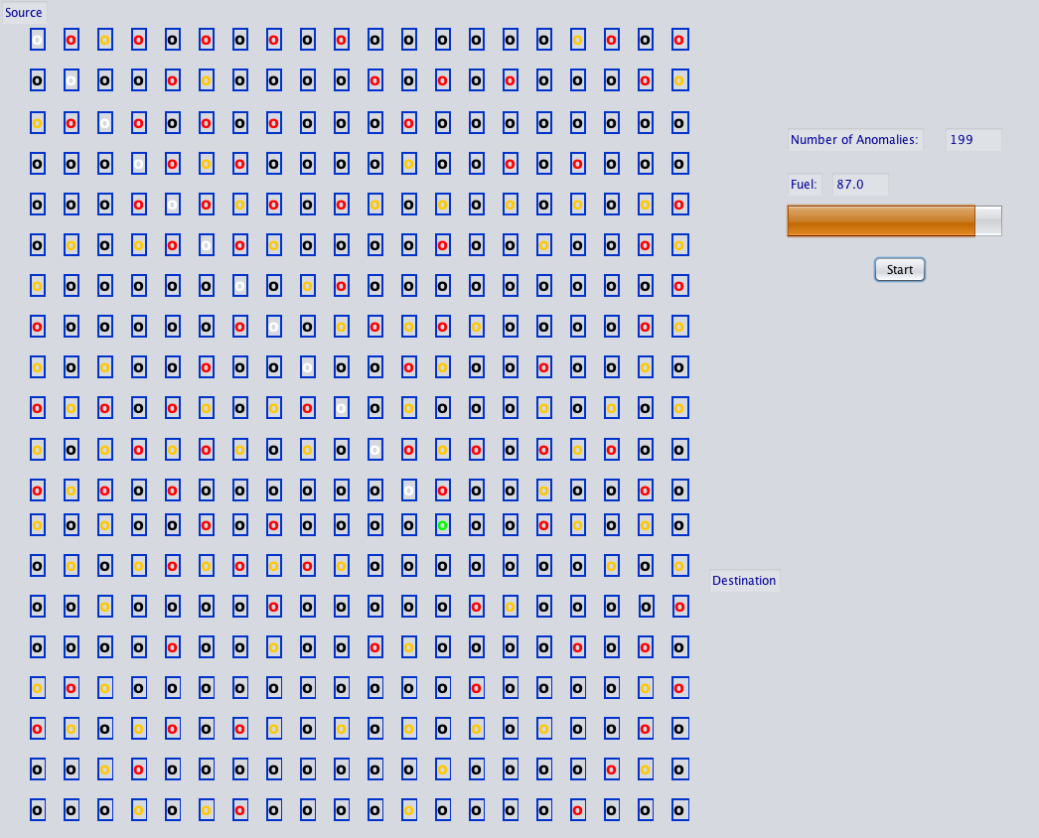
Fuel
Consumed
Location of Drone

Slide 20
Thank You
Collision Detection System

