Slide 1
CS590
Lab 02

Slide 2
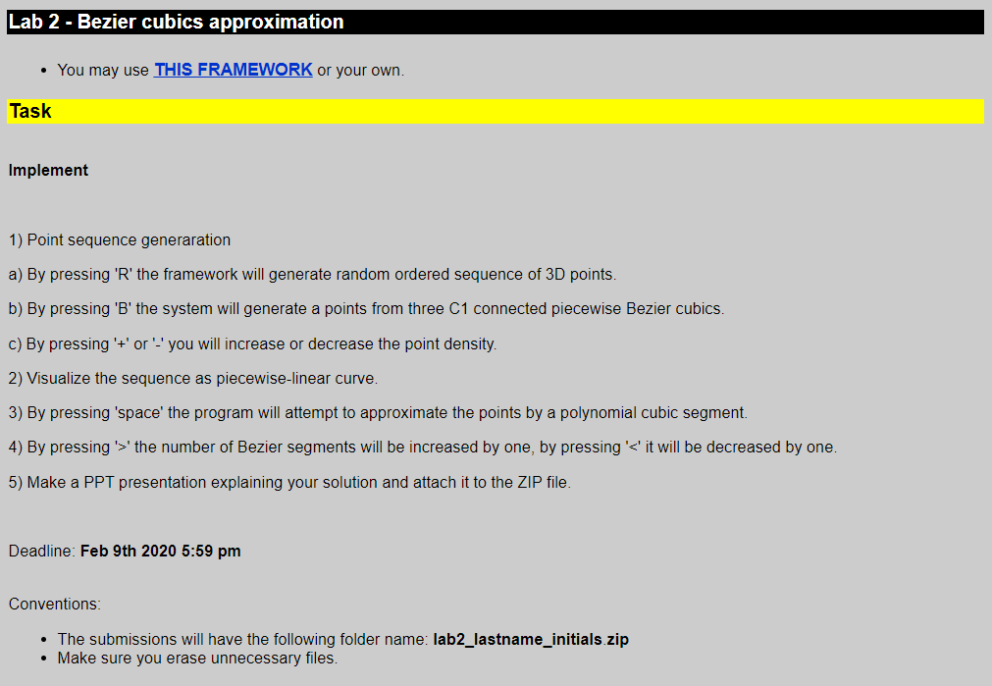
The Problem

Slide 3
Navigate the program
‘r’ – random points
‘p’- Bezier curve control points
‘b’-Bezier curve points(3 C1 connected)
‘c’-Bezier curve segments
‘+’-Bezier curve point density increase
‘-’- Bezier curve point density decrease
‘space’- approximate curve segment
‘q’-approximate curve control points
‘>’-increase no. of segments in approximate curve
‘<‘-decrease no. of segments in approximate curve
‘a’-approximate curve points

Slide 4
1. Point sequence generation
Press ‘r’ → generate random ordered sequence of 3D points
Pseudo code:
Global vector <Vect3d> r // to store random points
Main → InitRandomPoints(10) initialize array for random points
→Randomize→RandomVector→rand()
Kbd→case’r’
Render→RandomPointsFlag

Slide 5
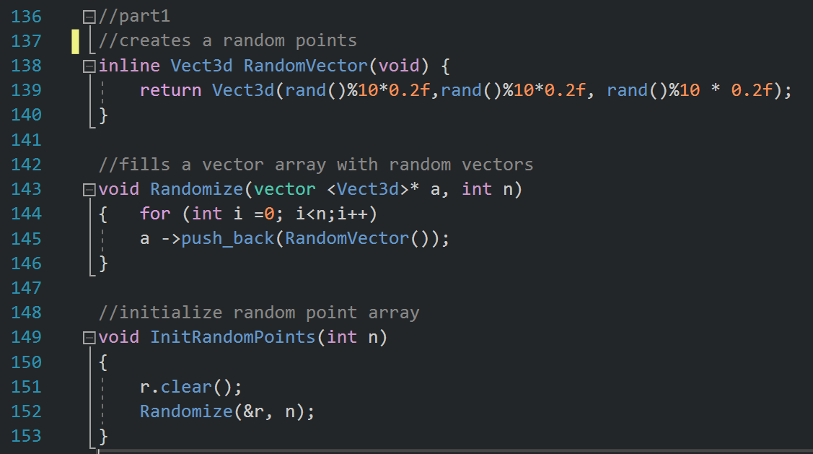
1. Point sequence generation

Slide 6
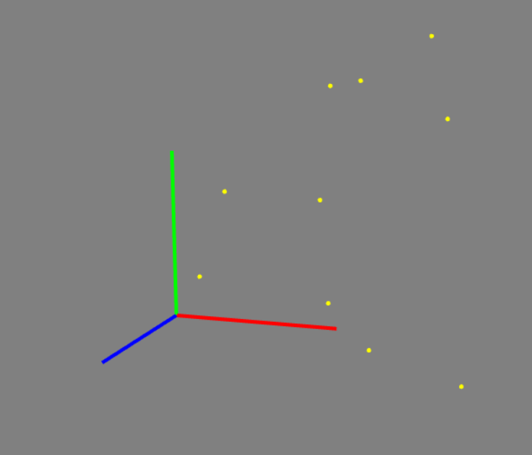
1. Point sequence generation
Press ‘r’ → generate random ordered sequence of 3D points

Slide 7
1. Point sequence generation
Press ‘b’→generate points for 3 peicewise C1 connected Bezier curves
Pseudo code:
Main→InitBezier()
initializes array fpr control points
→CreateBezierPoints()→Bezier() creates control pts for 3 C1 Bezier cubic
→InitBezierCurve()initializes 3 arrays for each segment
→CreateBezierCurve() →C (1st segment)
→D (2nd segment)
→E (3rd segment)
Kbd→case ‘c’ show curve
→case’b’ show Bezier segments
Render→BezierCurveFlag
→BezierPointFlag

Slide 8
1. Point sequence generation
Press ‘b’→generate points for 3 peicewise C1 connected Bezier curves
P2
addC11
P7
P8
P1
P3
addC12
addC11
P6
P9
P0
P4
addC12
P5
Choose randomly

Slide 9
1. Point sequence generation
Press ‘b’→generate points for 3 peicewise C1 connected Bezier curves
P2
addC11
P7
P8
C
=
P1
P3
addC12
=
addC11
P6
P9
P0
P4
addC12
P5
Choose randomly

Slide 10
1. Point sequence generation
Press ‘b’→generate points for 3 peicewise C1 connected Bezier curves
P2
addC11
P7
P8
=
P1
P3
=
addC12
=
addC11
P6
P9
P0
P4
=
D
addC12
P5
Choose randomly

Slide 11
1. Point sequence generation
Press ‘b’→generate points for 3 peicewise C1 connected Bezier curves
P2
addC11
P7
P8
=
E
P1
P3
=
=
addC12
=
addC11
P9
P0
P4
=
addC12
P5
Choose randomly

Slide 12
1. Point sequence generation
Press ‘b’→generate points for 3 peicewise C1 connected Bezier curves
P2
addC11
P7
P8
=
P1
P3
=
addC12
=
addC11
P6
P9
P0
P4
=
addC12
P5
Choose randomly

Slide 13
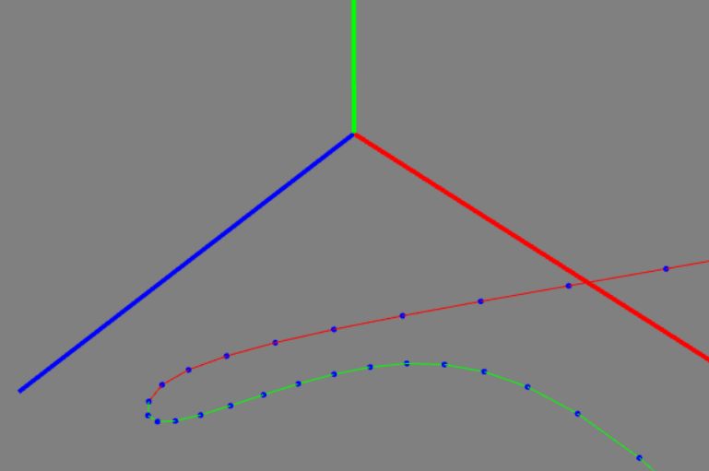
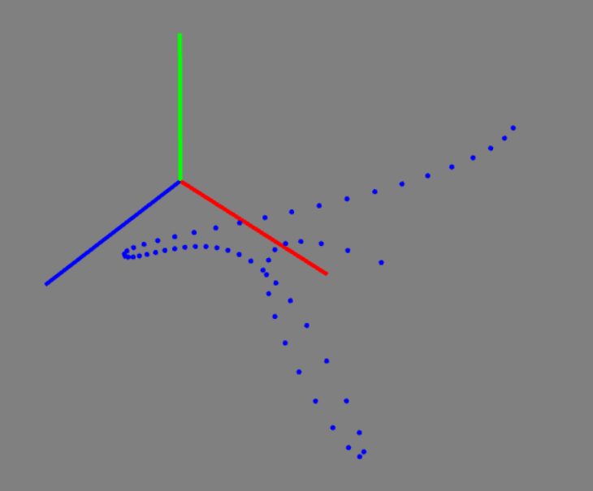
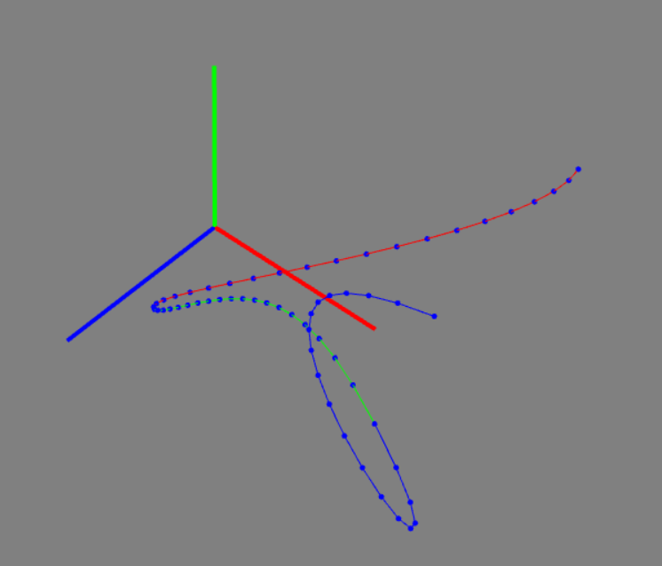
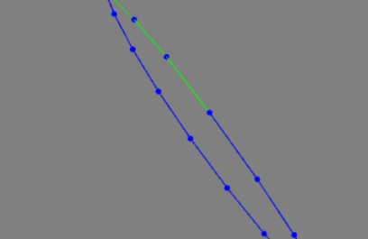
1. Point sequence generation
Press ‘b’→generate points for 3 peicewise C1 connected Bezier curves

Slide 14
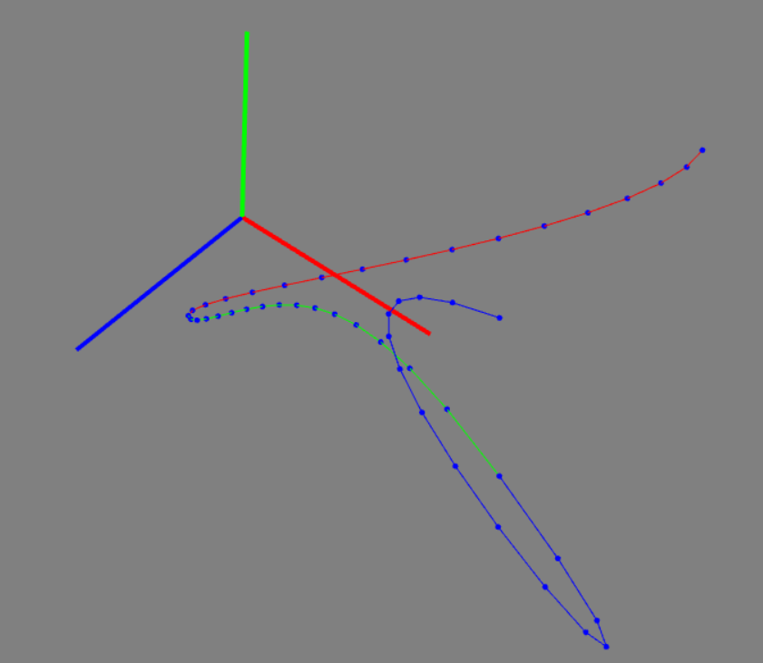
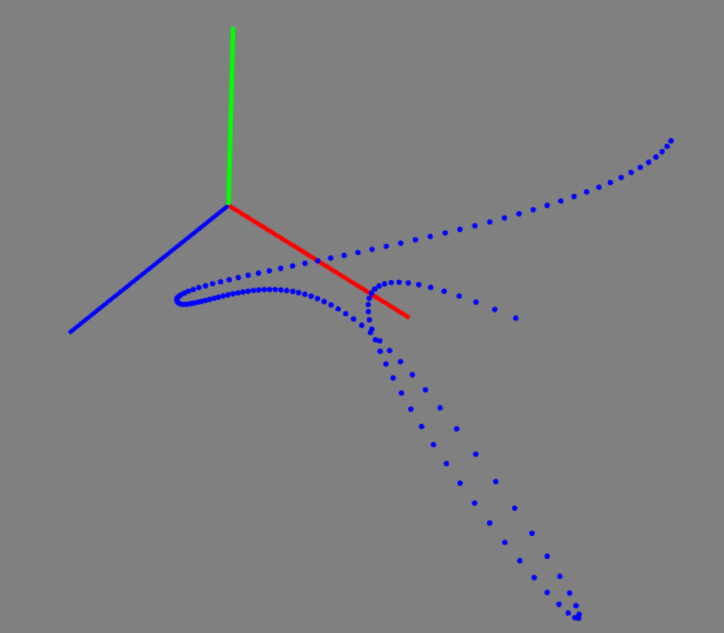
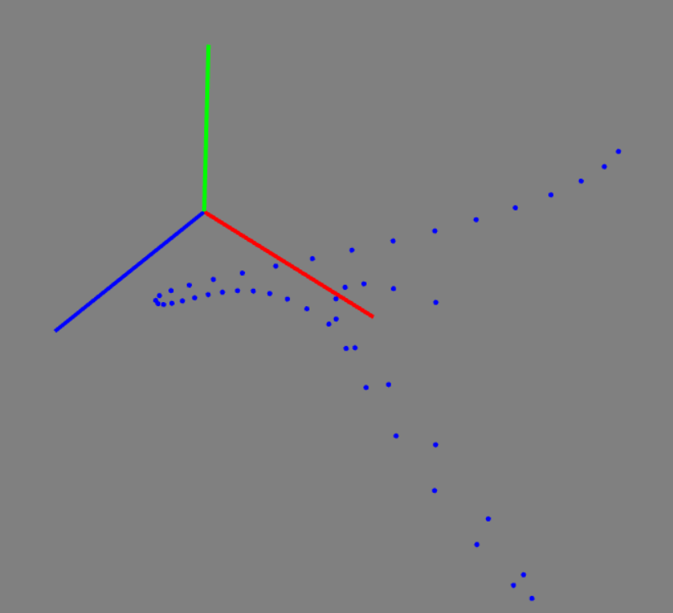
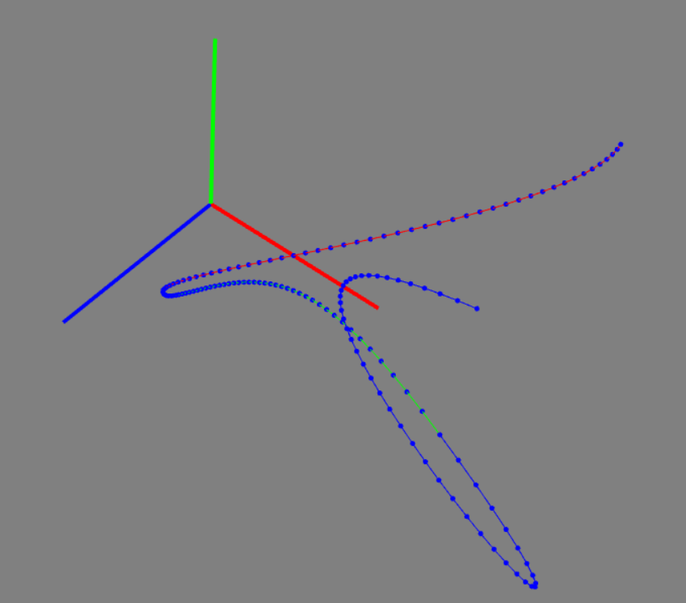
1. Point sequence generation
Press ‘+’ or ’-’ to increase or decrease point density
Pseudo code:
Kbd→case ‘+’ (-)
→case ‘-’
Increase or
decrease no. (+)
of steps

Slide 15
2. Visualize the sequence as piecewise linear curve

Slide 16
3. Press ‘space’ to approximate points passing through a curve
Pseudo code:
seg: no. of curve segments
r[i]: array of m random points
cp[j]: array of n control points for a curve passing through every point of r[]
seg= m-1
n = seg*4-seg+1
App[]: array of seg*steps points on the curve

Slide 17
3. Press ‘space’ to approximate points passing through a curve
Pseudo code:
1. Create array r : random points
r0, r1, r2, r3 …… rn
2. Create array cp : control points for polynomial/Bezier curve
seg1: cp0(r0), cp1 (random), cp2 (random), cp3(r1)
seg2: cp3(r1), cp4(cp3+(cp2-cp3)), cp5(random), cp6(r2)
seg3: cp6(r2), cp7(cp6+(cp5-cp6)), cp8(random), cp9(r3)
….
segn-1: cpn-3, cpn-2, cpn-1, cpn
3. Create app: points for approximate curve of each segment
seg1: app0=cp0, app1, app2, app2, …….app20 =cp3
seg2: app21=cp3, app22, app23,….app40=cp6
…

Slide 18
3. Press ‘space’ to approximate points passing through a curve
r₀ | r₁ | r₂ | … | r_{n-1} | r_{n}
seg1
cp₀ r₀ | cp₁ rand | cp₂ rand | cp₃ r₁
seg2
cp₃ r₁ | cp₄ | cp₅ rand | cp₆ r₂
… | … | … | …
cp₃+(cp₃-cp₂)
seg(n-1)
cp_{m-3} r_{n-1} | cp_{m-2} | cp_{m-1} rand | cp_{m} r_{n}
cp_{m-3}+(cp_{m-3}-cp_{m-4})

Slide 19
3. Press ‘space’ to approximate points passing through a curve
r₀ | r₁ | r₂ | … | r_{n-1} | r_{n}
seg1
cp₀ r₀ | cp₁ rand | cp₂ rand | cp₃ r₁
poly
app₀ cp₀ | app₁ |  | …. |  | app₁₉ | app₂₀ cp3
seg2
cp₃ r₁ | cp₄ | cp₅ rand | cp₆ r₂
… | … | … | …
cp₃+(cp₃-cp₂)
seg(n-1)
cp_{m-3} r_{n-1} | cp_{m-2} | cp_{m-1} rand | cp_{m} r_{n}
cp_{m-3}+(cp_{m-3}-cp_{m-4})

Slide 20
3. Press ‘space’ to approximate points passing through a curve
r2
r0
r1

Slide 21
3. Press ‘space’ to approximate points passing through a curve
cp5
r2
cp6
cp1
r0
cp0
cp3
cp4
r1
cp2

Slide 22
3. Press ‘space’ to approximate points passing through a curve
cp5
r2
cp6
cp1
r0
cp0
cp3
cp4
app1 to app20
r1
cp2

Slide 23
3. Press ‘space’ to approximate points passing through a curve
cp5
r2
cp6
cp1
r0
app21 to app40
cp0
cp3
cp4
app1 to app20
r1
cp2

Slide 24
3. Press ‘space’ to approximate points passing through a curve
cp5
r2
cp6
cp1
r0
cp0
cp3
cp4
r1
cp2

Slide 25
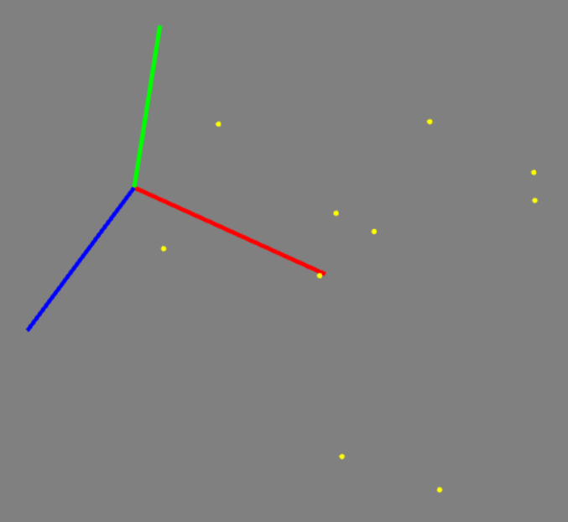
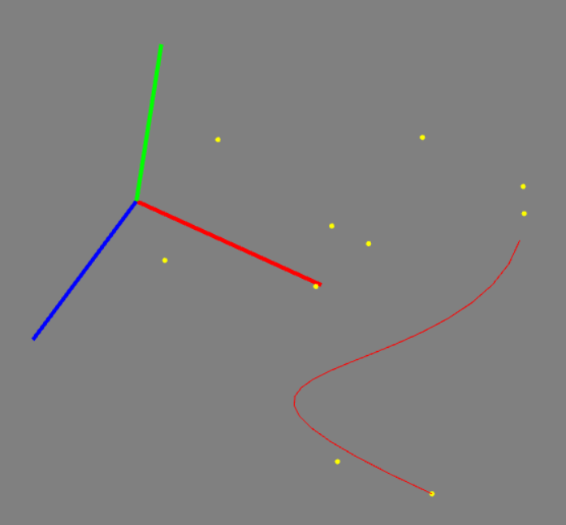
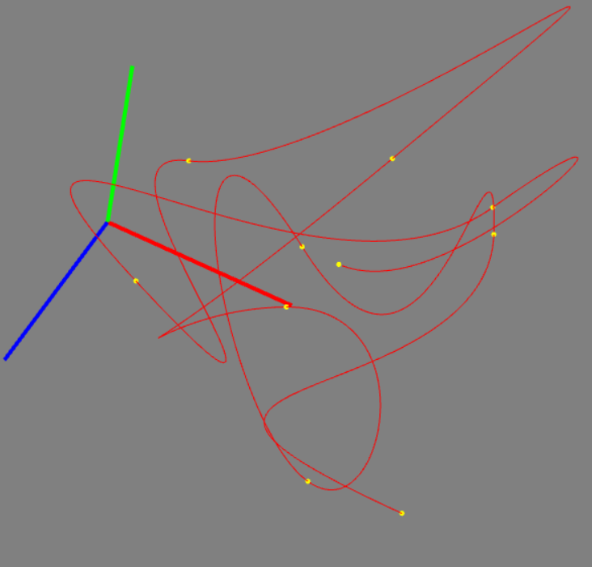
3. Press ‘space’ to approximate points passing through a curve

Slide 26
4. Press ‘<’ or ’>’ to change no. of segments of approximate curve
spaceCount=1
Kbd→case ‘>’
spaceCount++
case ‘<‘
spaceCount--

Slide 27
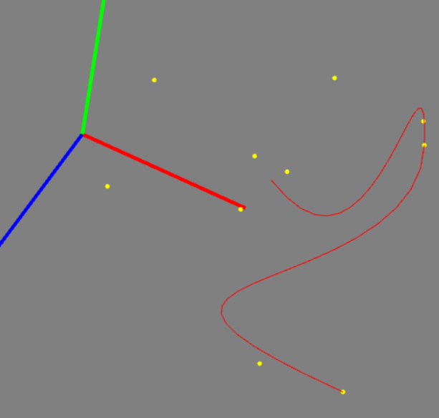
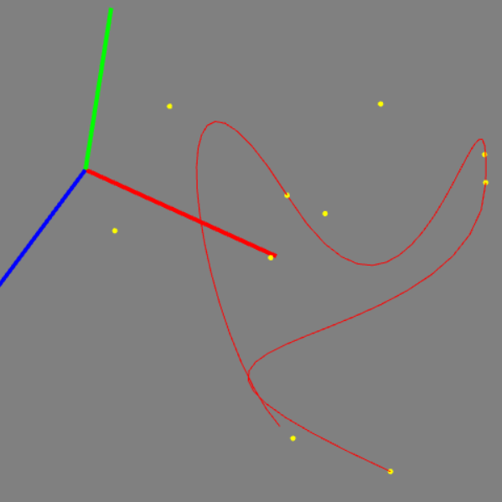
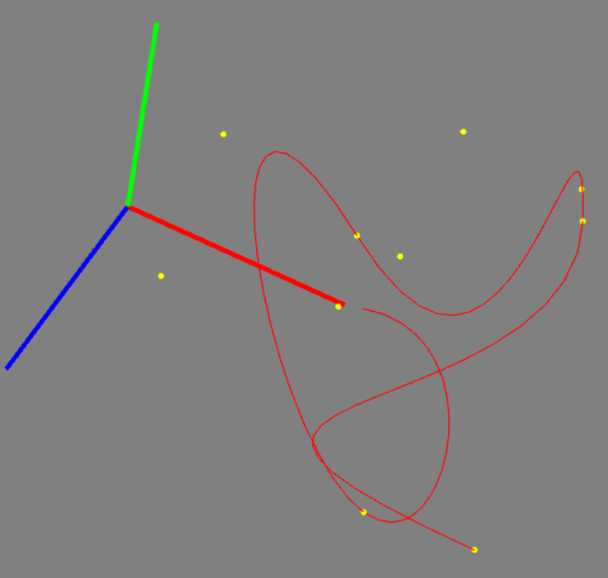
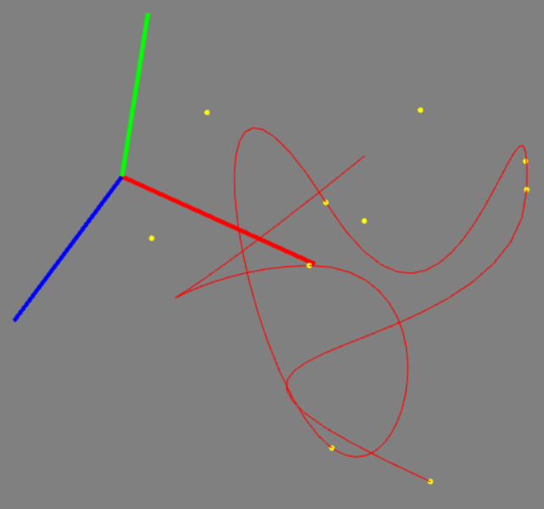
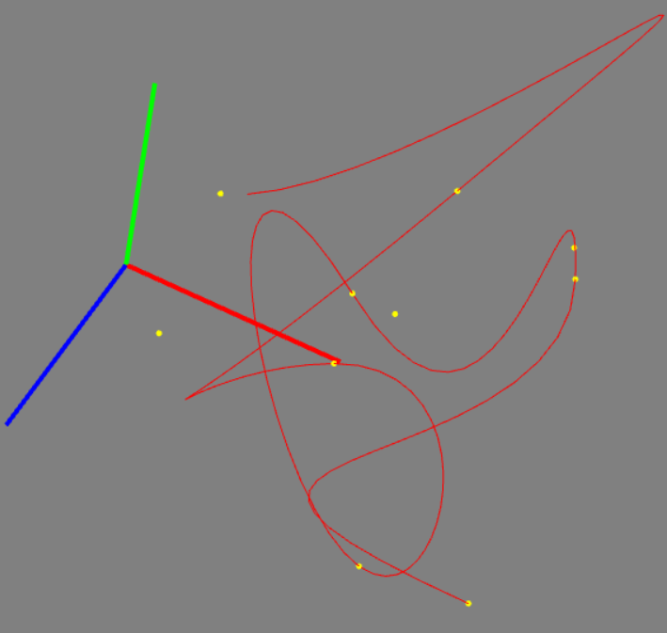
4. Press ‘<’ or ’>’ to change no. of segments of approximate curve
>
>
>
>

Slide 28
Thank You

