Slide 1
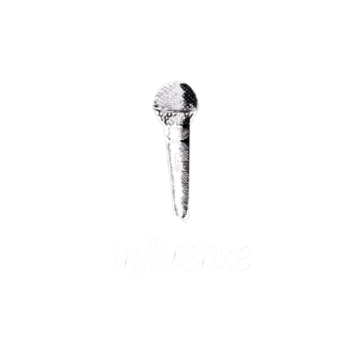


C
reative
B
lueprint
Visual Direction Board
2026

Slide 2
01 / COLOUR PALETTE
PRIMARY COLOR
SECONDARY COLOR
ACCENT COLOR
Visual Direction Board
2026

Slide 3
02 / TYPOGRAPHY
Hook &
Style
Cormorant Garamond
Playfair Display
Hook &
Style
Hook &
Style
Lora
CAPTIONS
Captions
Inter
2027
Visual Direction Board

Slide 4

03 / EDITING STYLE
Pacing
Slow
Fast
Edit Vibe
Beat-sync
transitions
Bold text
overlays
Transitions
Visual Direction Board
2026

Slide 5
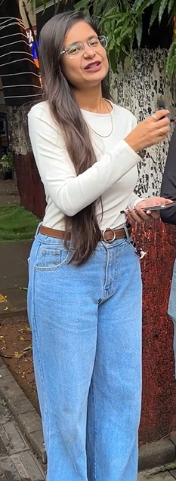
04 / WARDROBE Colour Combinations
STYLE TONE
Visual Direction Board
2026

Slide 6
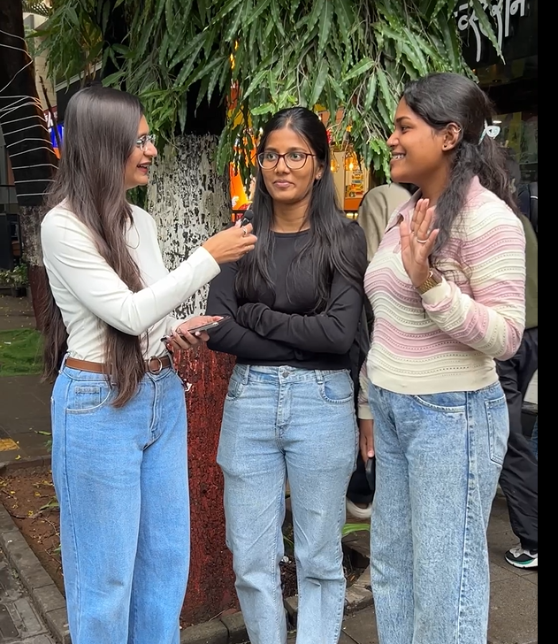
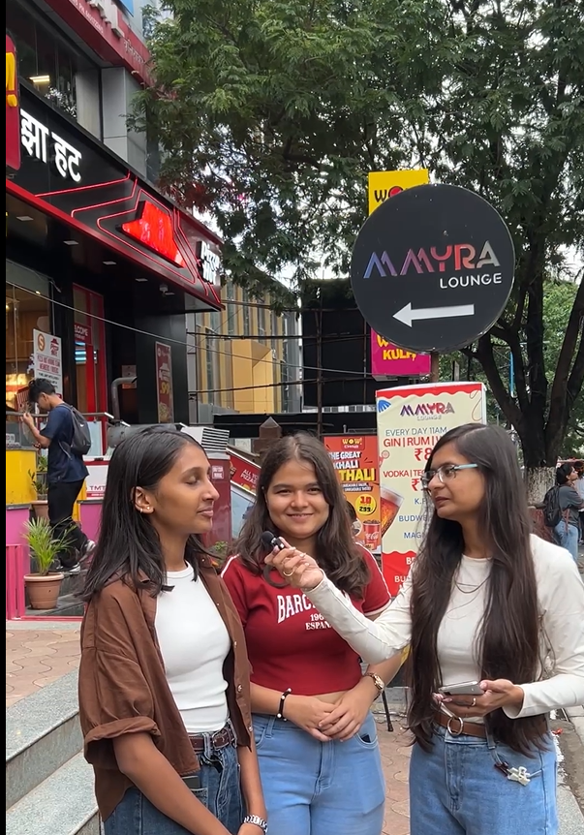
05 / BACKGROUNDS Key Locations
BACKGROUND TONE
Visual Direction Board
2026

