Slide 1





DATA analytics
-AcceleratorX,Bengaluru
Name-Devanshu Ranjan Upadhyay
Uni.Roll No: 2302840100080
Under Supervision: Mr. Aakash Maurya (Trainer at AcceleratorX & Sr.ML Engineer at Nagarro)

Slide 2
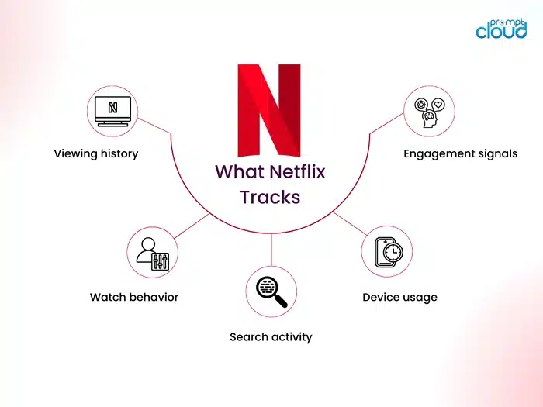
Table of content
Introduction
Problem Statement
Project Scope
Data Flow Diagram
Methodology
Implementation
Conclusion
Future Work
References
Q&A

Slide 3




Introduction
This project analyzes data from Netflix TV shows and movies using Python.
We use a publicly available dataset from Kaggle to explore different features like type, genre, release year, and duration.
The goal is to understand patterns and trends in Netflix content using data analysis techniques.
We will visualize the data, check for missing values, engineer new features, detect outliers, and even build a simple prediction model.
This analysis helps to learn how data can provide valuable insights for decision-making in entertainment platforms like Netflix

Slide 4
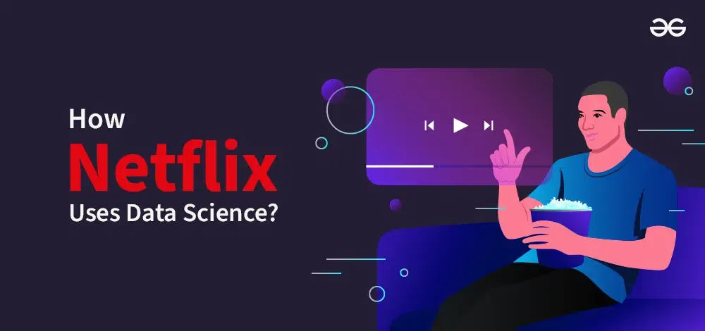

Problem statement
Netflix has a huge collection of shows and movies—but what stories does the data tell?
What types of content are popular? How do features like genre and release year change over time?
Can we use data to guess the release year based on other details?
Let’s explore the data, find patterns, and answer these questions together!

Slide 5

ProJECT SCOPE
Analyze Netflix TV shows and movies dataset from Kaggle to uncover patterns and insights.
Work includes data cleaning, exploration, and visualization of features like type, genre, release year, and duration
Perform feature engineering to transform raw data into usable formats (e.g., converting durations into minutes).
Detect outliers and analyze group-wise statistics to understand differences in content types.
Build a simple predictive model (linear regression) to explore relationships between features.
Provide actionable insights and a better understanding of Netflix content trends through data analytics.

Slide 6
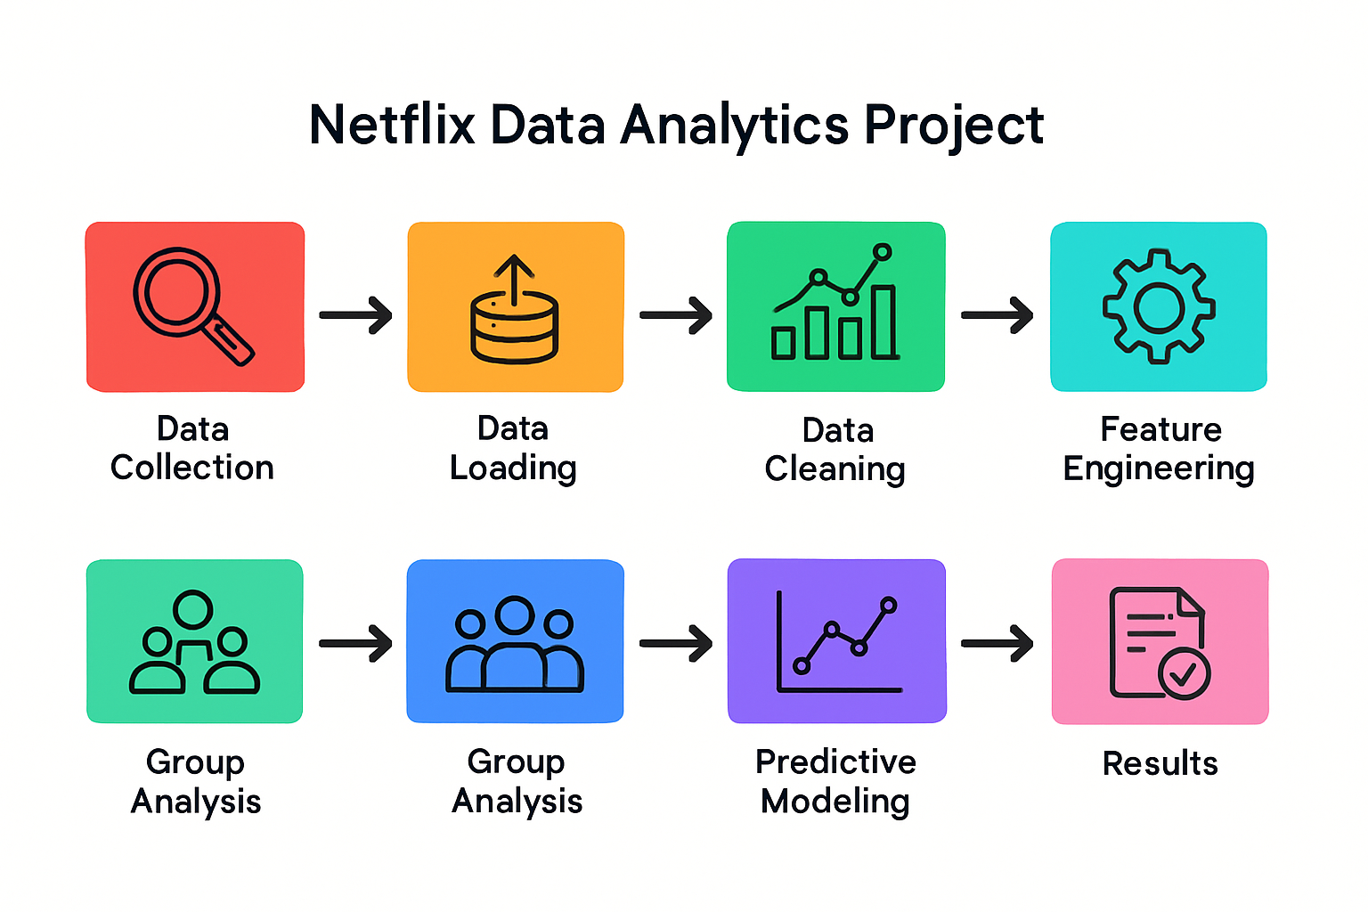
Data flow diagram

Slide 7
Methodology
Data Collection: Download Netflix TV shows and movies dataset from Kaggle using KaggleHub.
Data Loading: Load the dataset into Python using pandas for easy manipulation.
Data Exploration: Inspect the data structure, check for missing values, and understand feature distributions using summary statistics.
Data Visualization: Create charts to visualize categorical features (type, genre), release years, and durations to identify patterns.
Feature Engineering: Convert duration data into numerical minutes for better analysis.
Outlier Detection: Identify unusual data points using statistical techniques to clean the dataset.
Group-wise Analysis: Compare release years and other features across content types (movies vs TV shows).
Predictive Modeling: Use linear regression to predict release year based on duration and content type.

Slide 8

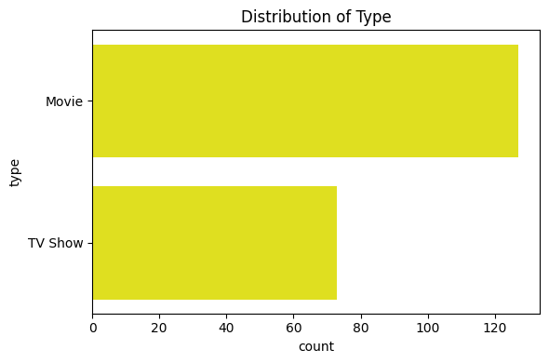
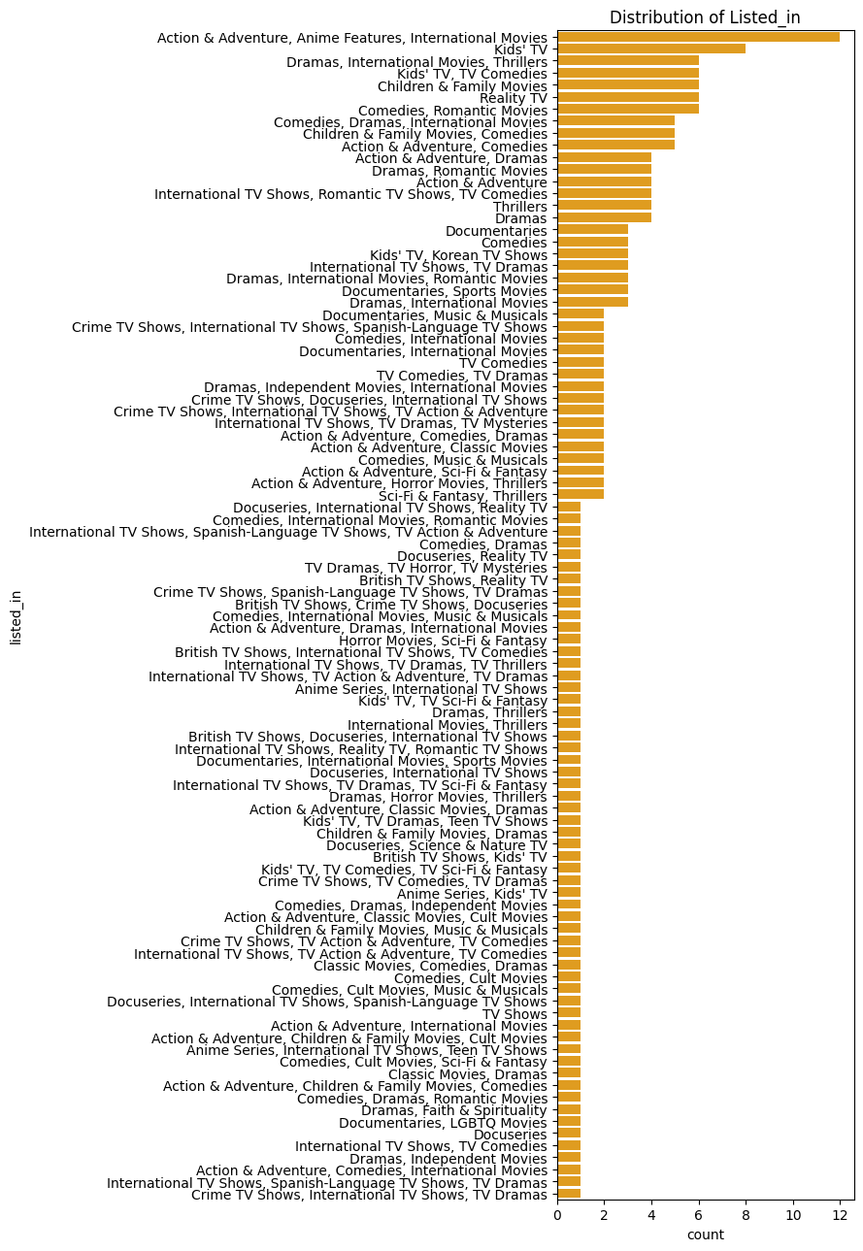
Implementation

Slide 9
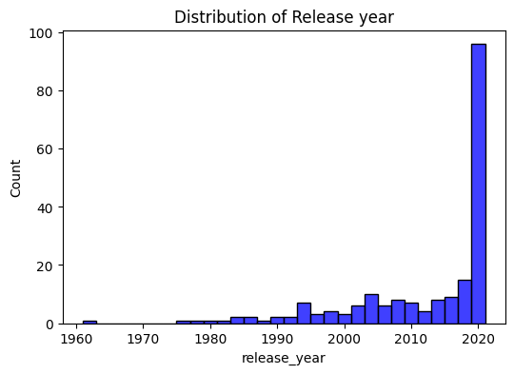
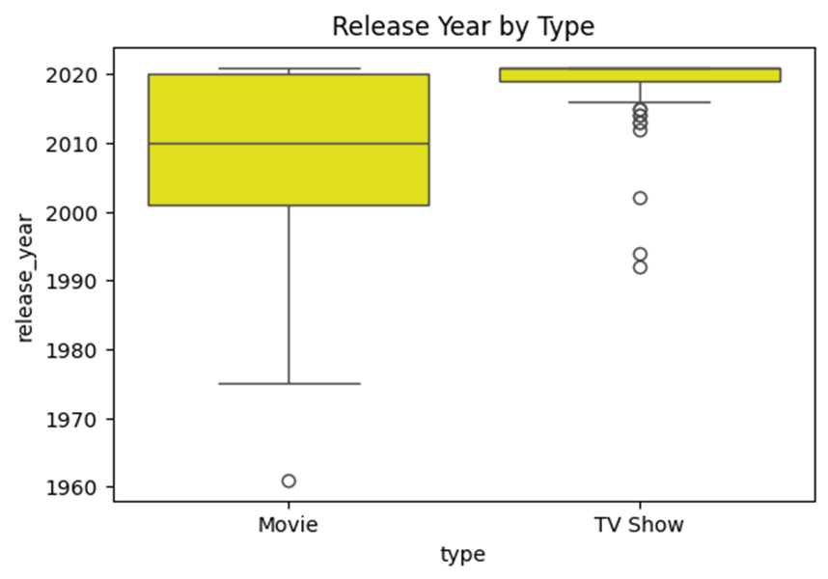
Implementation

Slide 10
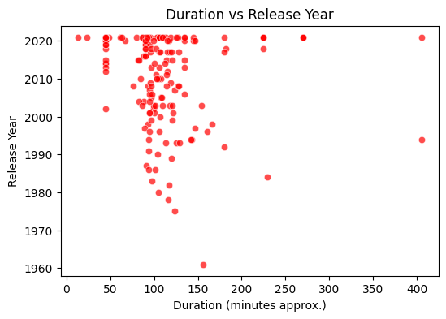
Implementation

Slide 11
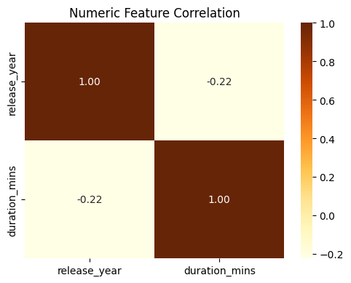
Implementation

Slide 12
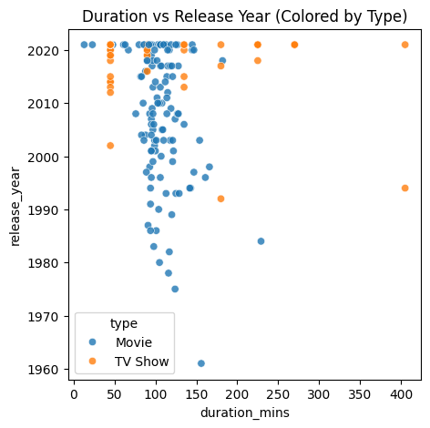
Implementation

Slide 13
INTERPRETATION
Movies vs. TV Shows: Netflix data has more movies (64%) than TV shows (36%).
Genre Diversity: Lots of genres—Action, Adventure, Anime, International, Kids’ TV—catering to many tastes.
Release Year Trends: Content spans from 1961 to 2021, with most growth after 2015.
Type by Year: years. Movies cover more years; TV shows are newer (mostly after 2010).
Duration Patterns: Most content runs between 13 and 403 minutes; longer shows appear in recent
Feature Correlations: Weak links between duration and year—newer titles tend to be a bit shorter.
Prediction Model: Duration and type explain only 13% of release year variation; other factors matter too.

Slide 14



Conclusion
We explored Netflix shows and movies data to find interesting trends.
Visuals and data cleaning helped reveal clear patterns.
Created a simple model to predict release year using key features.
This project shows how data analysis uncovers stories hidden in big datasets.

Slide 15
Question Time

Slide 16

Thank Tou

