Slide 1





Slide 01
IBM
ARTIFICIAL INTELLIGENCE
Exploring innovative AI solutions for the future
Sentiment Analysis of Product Reviews using Naive Bayes
Name - Devanshu Ranjan Upadhyay
Under Supervision – Mr Abhishek Singh
Date : 26 September 2025

Slide 2


Slide 02
IBM
Project Overview
Purpose: Analyze and classify product reviews as Positive, Negative, or Neutral
Key Features:
User-friendly Tkinter GUI
Real-time sentiment analysis
Visual feedback with emoji and color-coded sentiment

Slide 3
IBM
Slide 03
Technology Stack
Python Libraries:
Tkinter and ttk for GUI
Pandas for data handling
Sklearn for machine learning (CountVectorizer, LabelEncoder,MultinomialNB
2. Data : CSV file containing selected_text and sentiment columns

Slide 4
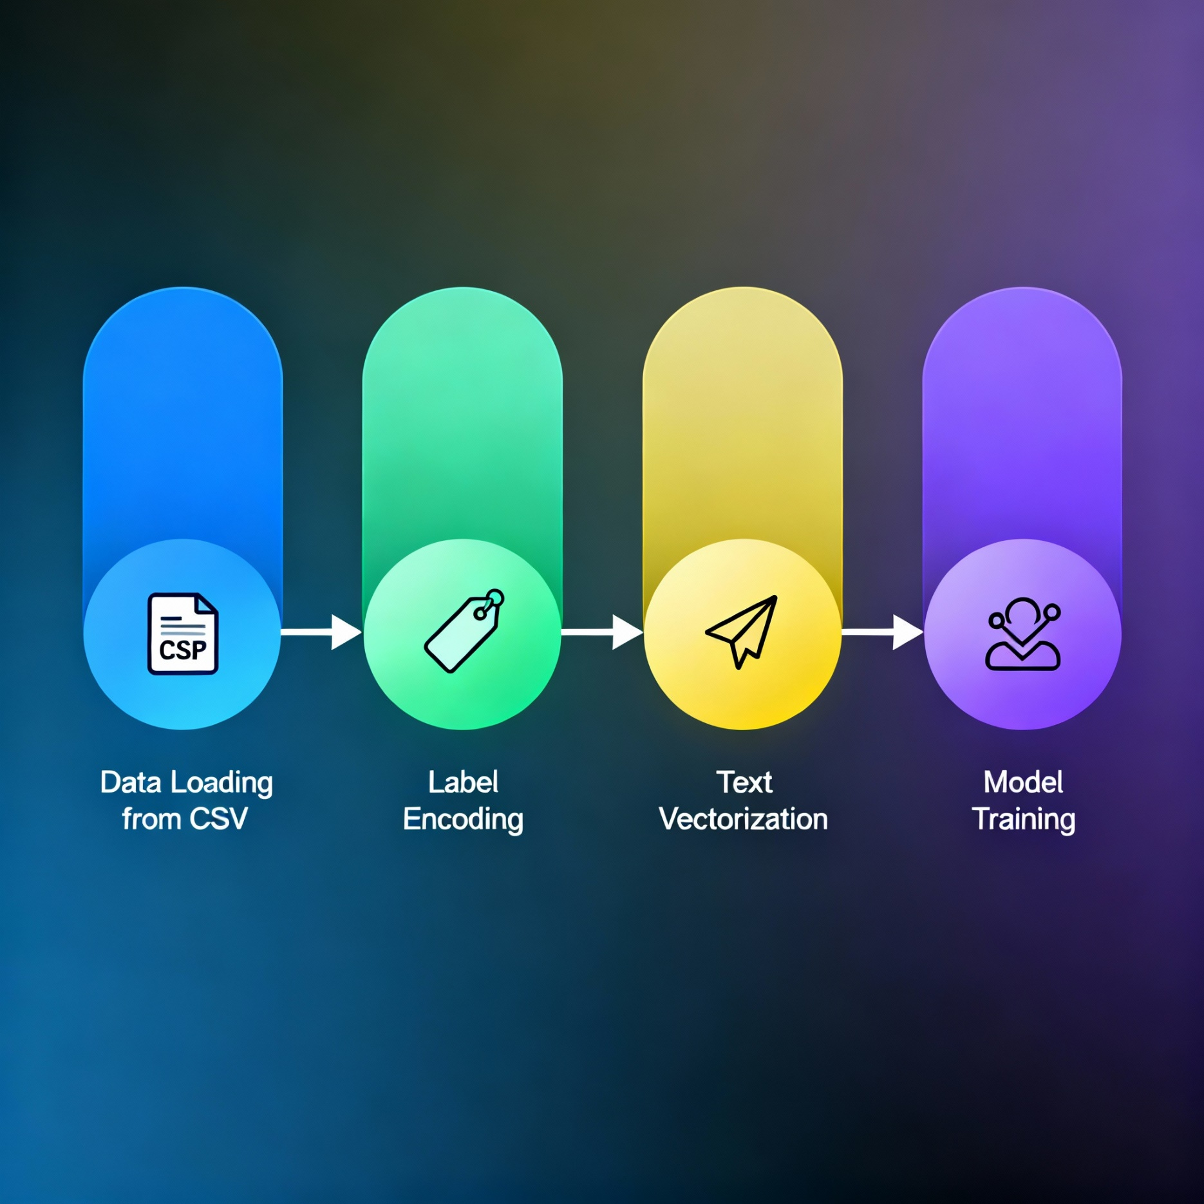
Slide 04
IBM
Machine Learning Workflow
www.reallygreatsite.com

Slide 5

Slide 05
IBM
Tkinter GUI Design
Main components:
Input Text Box for product reviews
Analyze and Reset buttons
Result display with emoji & color
Progress bar for processing feedback
User Experience:
Visual indicators, tooltips, and intuitive layout

Slide 6
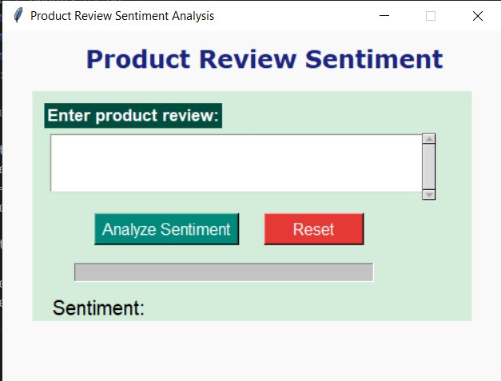
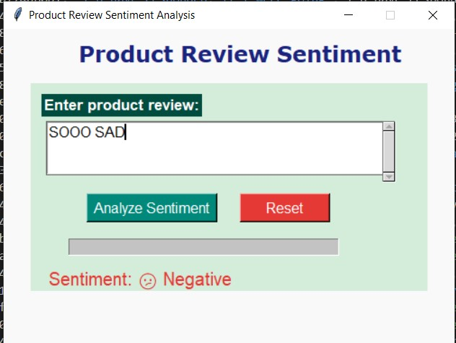
Slide 06
IBM
Demo & Takeaways

Slide 7
Future scope & Impact
Future Scope
Support for multiple languages
Integration with e-commerce platforms
Real-time dashboards and analytics
Automated continuous model updates
Impact
Faster, smarter business decisions
Enhanced buyer trust and experience
Saves time with automated review analysis
Improves product quality through feedback
Scalable for various industries and domaiAns

Slide 8



Slide 13
IBM
THANK YOU!
Thank you for joining us on this journey through AI innovation and possibilities.
www.reallygreatsite.com

