Slide 1
CREATE-BEST
Module 1 – Creating a Cloud database for your Android Application
By: Miguel Garzón
http://www.site.uottawa.ca/~mgarz042/

Slide 2
Agenda
Motivation
Development of a Back-end
Cloud Server
Custom Server
Mobile Backend as a Service
Overview of Firebase
Basics of JSON objects
Creating a Firebase database
Reading and Saving data
Basic Firebase Example

Slide 3
Motivation
If you are planning to develop a mobile app, chances are that you will require a backend for storing information, or managing content.
Depending on your needs, your knowledge and the project requirements, you have several options for developing a backend:
Custom server: You can set up your own server and host the backend on it. You will have complete control over the server and you can customize it to your specific requirements.
Cloud servers: Cloud servers mean virtual servers which run on cloud computing environment. Amazon AWS, Google App Engine and Azure are the most popular cloud server options.
Mobile Backend as a Service (MBaaS): BaaS enables you to manage a centralised database that lets your users share content via the cloud.

Slide 4
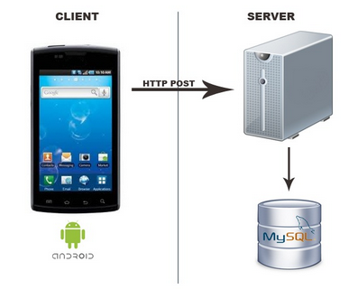

Custom Server
What is required?
Select the technology to be used for the
the server-side environment.
2. Setting up the environment
3. Develop an API (REST?)
4. Add Authentication
5. Handle security, routes, etc.
6. And more..

Slide 5
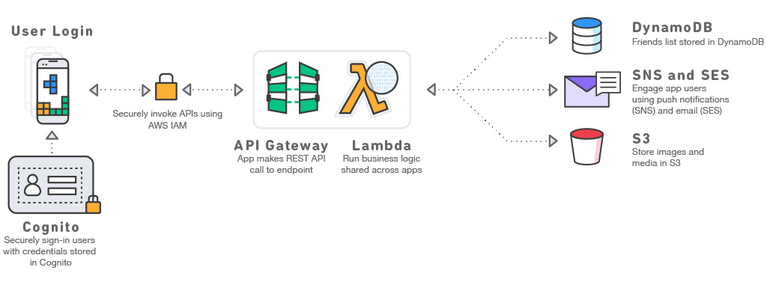
Cloud Server - AWS

Slide 6
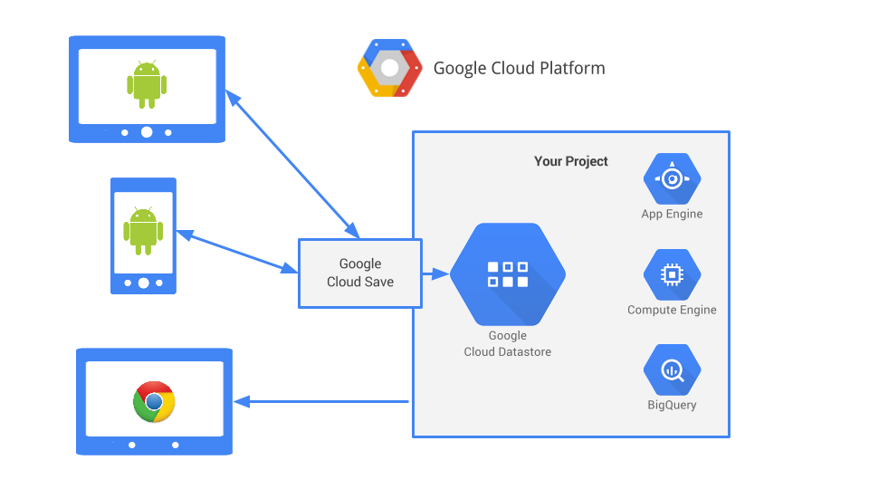
Cloud Server – Google Cloud Platform

Slide 7
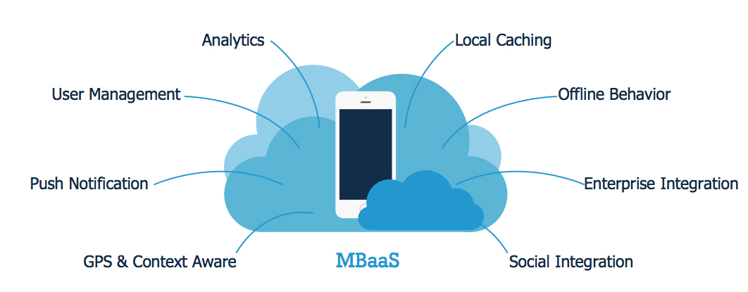
Mobile Backend as a Service (MBaaS)
The basic idea is similar to having your back-end development, maintenance and management outsourced to another party.
In other words,
The back-end is made available to developers as a web service.

Slide 8
Ever Heard of Firebase?
Firebase, a popular backend platform acquired by Google in October 2014.
Firebase allows you to store and sync data to a NoSQL cloud database.
The data is stored as JSON, synced to all connected clients in realtime, and available when your app goes offline.
It offers APIs that enable you to authenticate users with email and password, Facebook, Twitter, GitHub, Google, anonymous auth, or to integrate with existing authentication system.
Other than the Realtime Database and Authentication, it offers a myriad of other services including Cloud Messaging, Storage, Hosting, Remote Config, Test Lab, Crash Reporting, Notification, App Indexing, Dynamic Links, Invites, AdWords, AdMob.

Slide 9
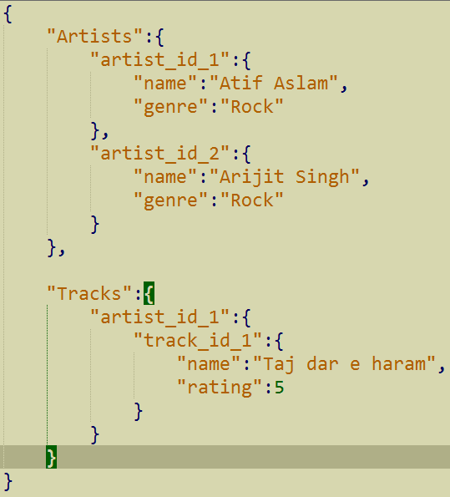
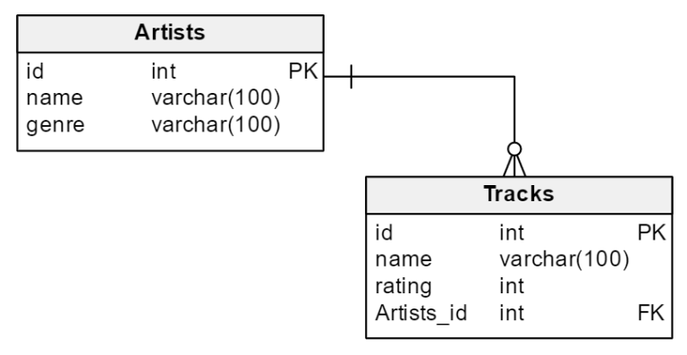
Firebase Data Basics – JSON objects
NON
SQL
SQL

Slide 10
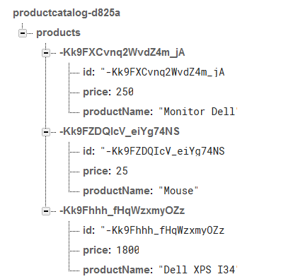
Firebase Terminology
All Firebase Realtime Database data is stored as JSON objects.

Slide 11
BASIC FIREBASE EXAMPLE

Slide 12
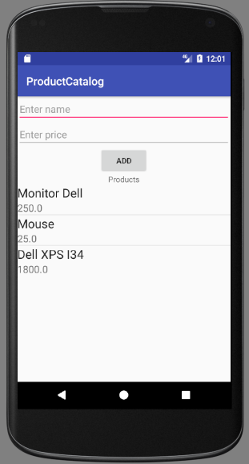
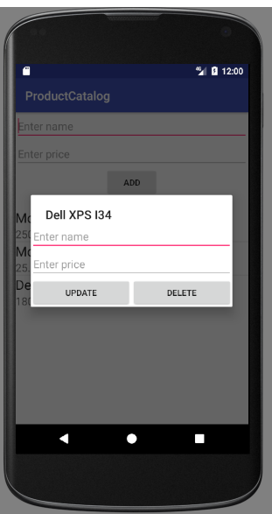
User Interface
Update Dialog:
LinearLayout
-> EditText
-> EditText
-> LinearLayout
-> Button
-> Button
Main Interface:
RelativeLayout
-> EditText
-> EditText
-> Button
-> TextView
-> ListView

Slide 13
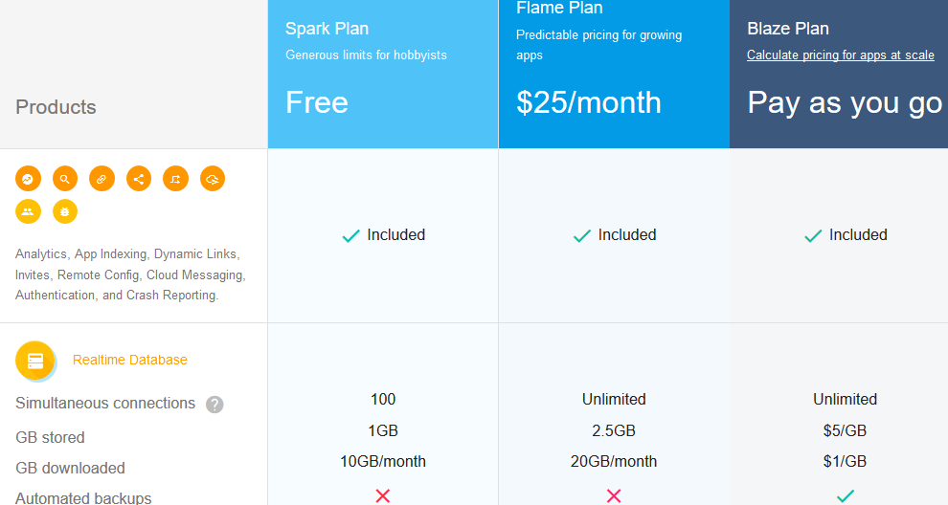
STEP 1 – Make an Account
The free account gives you the ability to have 100 devices connect to Firebase at a single point in time.
It’s worth noting that 99% of apps never outgrow the free tier, so it’s a great tier to start in.

Slide 14

STEP 1 – Make an Account (cont’d)
The free account gives you the ability to have 100 devices connect to Firebase at a single point in time. It’s worth noting that 99% of apps never outgrow the free tier, so it’s a great tier to start in.
Go to firebase.google.com and create an account.
After logging in to your account, head over to the Firebase console
And create a project that will hold your app’s data.

Slide 15
STEP 2: Connect Firebase to Your Application
To add Firebase to your android application:
2a. You can follow a manual process (three main steps are required).
Or
2b. You can explore and integrate Firebase services in your app directly from Android Studio using the Assistant window.
If you're using the latest version of Android Studio (version 2.2 or later), we recommend using the Firebase Assistant to connect your app to Firebase.
Prerequisites
A device running Android 4.0 (Ice Cream Sandwich) or newer, and Google Play services 10.2.4 or higher
The Google Play services SDK from the Google Repository, available in the Android SDK Manager
The latest version of Android Studio, version 1.5 or higher. Most recent version is 2.3.1.

Slide 16

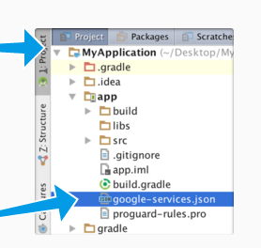
STEP 2a: Manually Connect Firebase to Your Application
Enter app details:
Create a project: Enter a name and country/region for the project.
Enter your Android project’s package name in the window that pops up. If your app is going to use certain Google Play services such as Google Sign-In, App Invites and Dynamic Links then you will have to provide the SHA-1 of your signing certificate. The application we will build won’t be using any of these services, so leave this field empty. More info about certificates. https://developers.google.com/android/guides/client-auth
Copy Config file: The wizard will allow you to generate a
configuration file. Download the file (google-services.json)
and move it into your Android app module root directory.
The JSON file contains configuration settings that the Android
app needs to communicate with the Firebase servers. It contains
details such as the URL to the Firebase project, the API key.

Slide 17
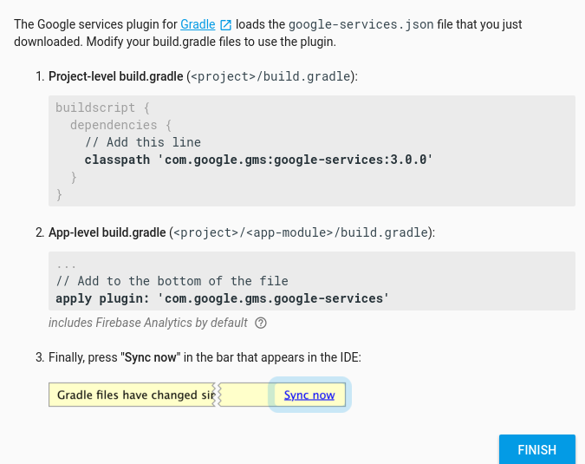
STEP 2a: Manually Connect Firebase to Your Application (cont’d)
3. Add to build.gradle

Slide 18
STEP 2b: Connect Firebase to Your Application using Android Studio
First make sure you have installed Google Repository version 26 or higher, using the following steps:
Click Tools > Android > SDK Manager.
Click the SDK Tools tab.
Check the Google Repository checkbox, and click OK.
Click OK to install.
Click Background to complete the installation in the background, or wait for the installation to complete and click Finish.

Slide 19
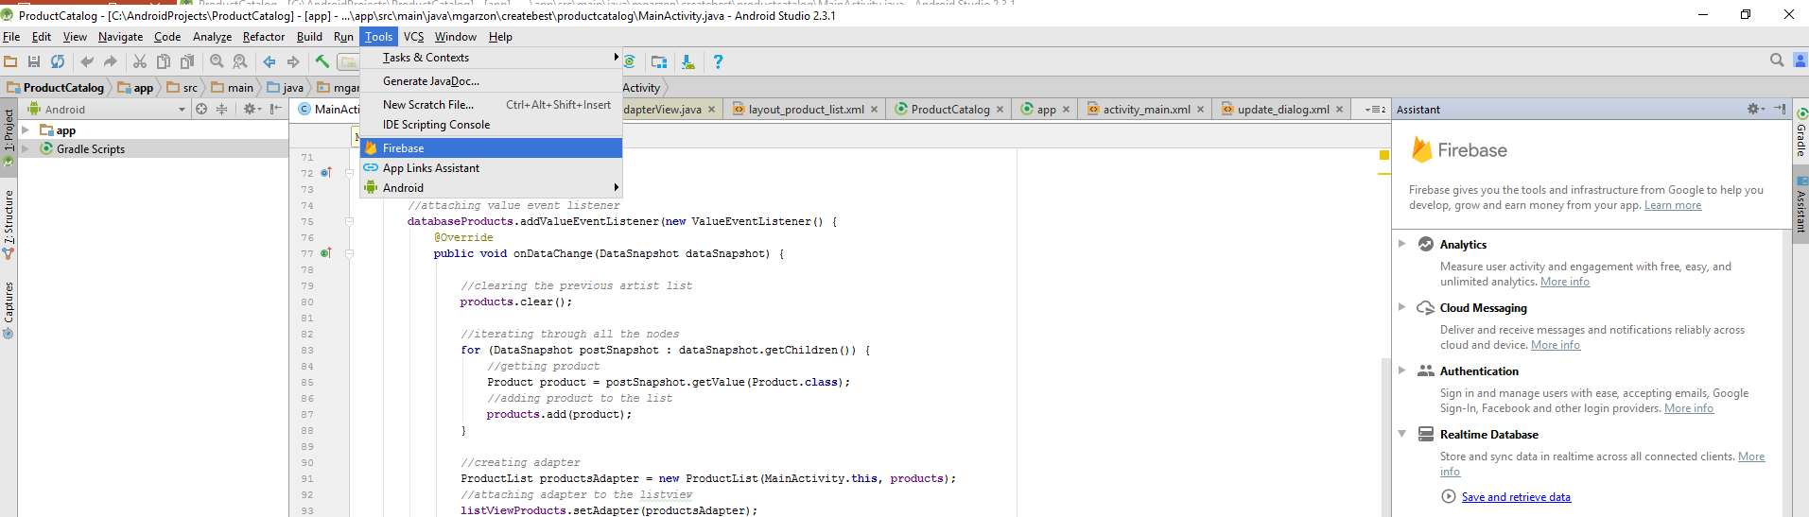
STEP 2b: Connect Firebase to Your Application using Android Studio (cont’d)
1. Click Tools > Firebase to open the Assistant window.
2. Click to expand one of the listed features then click the Save and Retrieve data (under Realtime Database) to connect to Firebase and automatically add the necessary code to your app.

Slide 20
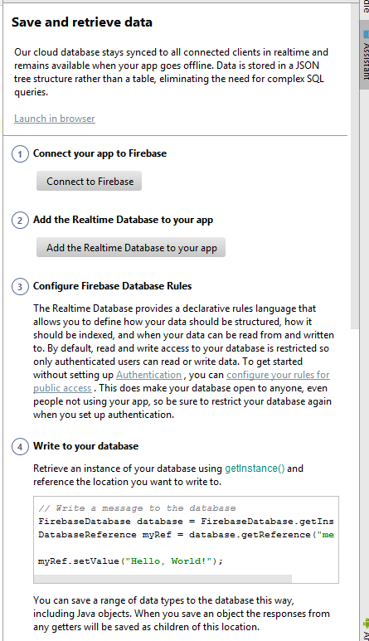

STEP 2b: Connect Firebase to Your Application using Android Studio (cont’d)
3. Click Connect to Firebase to open the window.
Enter the name for your Firebase project.
4. Click Add the Realtime Database to your app.
You are now ready to write and read form your
Database!

Slide 21
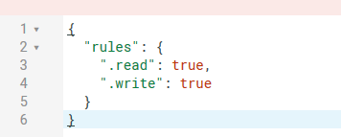
STEP 3 : Configure Firebase Database rules
The Realtime Database provides a declarative rules language that allows you to define how your data should be structured, how it should be indexed, and when your data can be read from and written to. By default, read and write access to your database is restricted so only authenticated users can read or write data.
To get started without setting up Authentication , you can configure your rules for public access.
Go to the firebase console and specify your rules as follows:

Slide 22
Step 4: Write and Read Data
To download and set up the sample application in Android Studio:
Download the ProductCatalog sample app from my personal Github.
You can either use the "Download ZIP" button on the Github Page or clone on the command line: https://github.com/mgarzon/ProductCatalog_v1
git clone https://github.com/mgarzon/ProductCatalog_v1.git
3. Import the project in Android Studio: Click File > New > Import Project.
4. Implement the code to add, delete and update a product which will be stored at the Firebase database.

Slide 23
THANK YOU!

