Slide 1
Price Prediction System for Online Retailing
Devayani Pawar, Sravishtta Kommineni

Slide 2
Problem
One of this product costs $49 and other costs $112.Looking at such type of products can you guess which product costs which one?
Item A | Item B
Puma women's Long sleeve turtle neck tee, size L, Great condition | Vince long-sleeve turtle neck tee, size L, Great condition

Slide 3

Motivation
Online shopping is increasing at a rapid rate with companies like Amazon Inc., eBay, Newegg, etc.
Companies have to deal with several kinds of items from various retailers at various scales as there are many features that could affect the price. Hence we try to suggest the price to the retailers by using the history of the past products sold.
We are using a dataset from a online website which has about 1.5 million items.

Slide 4
Data set
Train_id/test_id | integer
name | text
Item_condition_id | Categorica/-ordinal
Category_name | categorical
Brand_name | categorical
price | integer
shipping | Binary/boolean
Item_description | String/text

Slide 5
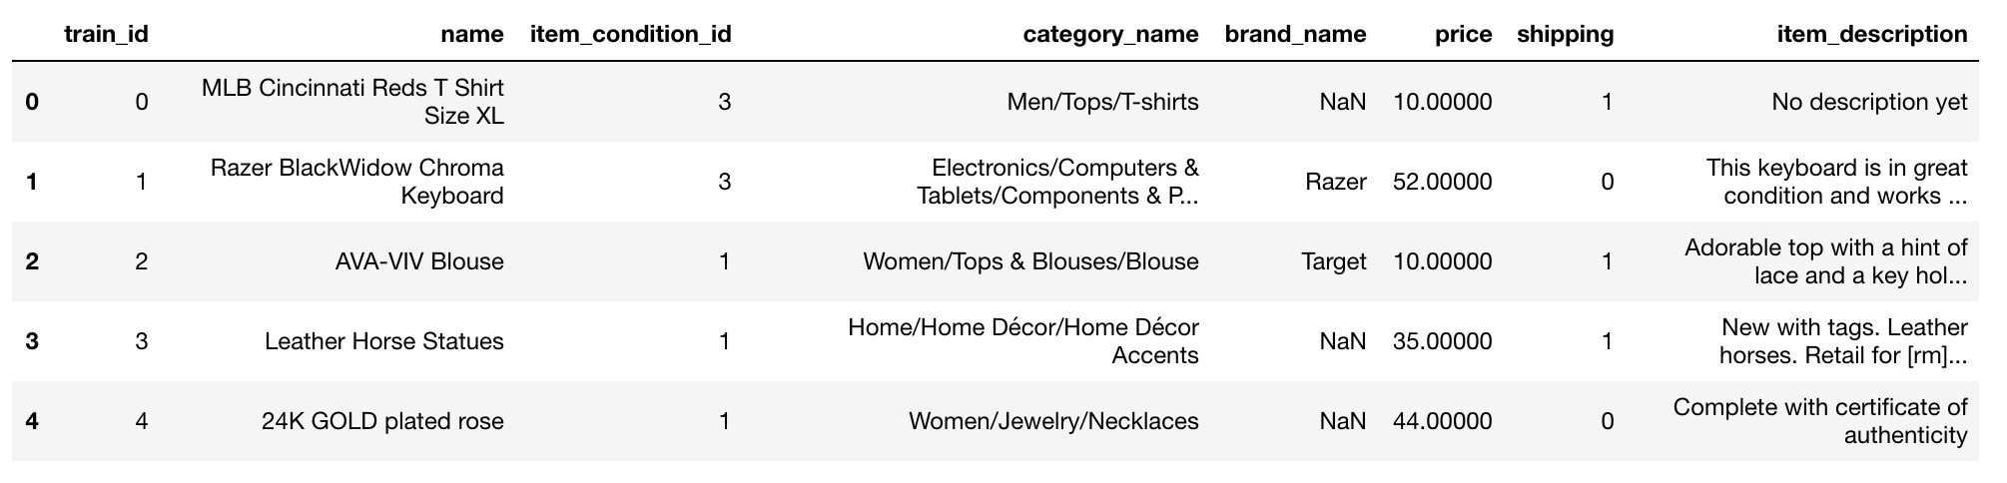
Data

Slide 6
Goal
To use algorithms that can automatically suggest the right product price using previous items from the retailers.

Slide 7


Slide 8
Initial Approaches

Slide 9
Classification - Item-Item prediction
Use K-Nearest Neighbor
First vectorize each item based on brand name, item description, and categories.
For each new test item, get the K-nearest items and get the weighted average in order to predict the price.
Problems
The vector space would be too large as there are so many unique words for the features.
TOO SLOW!!

Slide 10
Clustering
This dataset naturally makes clusters based on the type of category or even with the type of brand.
Problems
Categories are listed as follows
Men/Sports/Cycling
Woman/Cosmetics/Makeup
There are different tiers of categories, so items can be part of multiple clusters.

Slide 11
Approach:
Data Exploration and Analysis
Data preprocessing and Cleansing
Data modeling

Slide 12
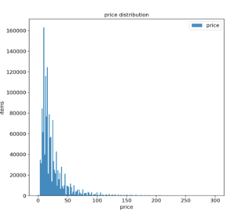
Exploratory data analysis
count 1482535.00000
mean 26.73752
std 38.58607
min 0.00000
25% 10.00000
50% 17.00000
75% 29.00000
max 2009.00000

Slide 13
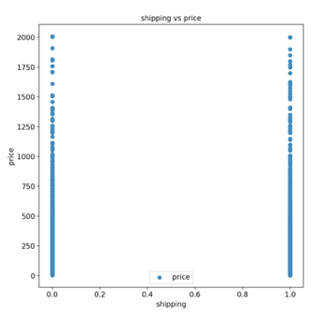
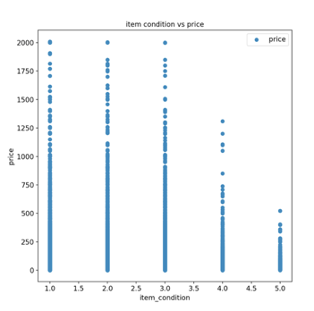
Shipping Vs price doesn’t show significant correlation but item condition vs price show that products with item condition 1-3 have higher prices.As most of the columns are categorical , a lot of useful information is contained in it.

Slide 14
Data cleansing
Removing the rows with price = 0 to remove noise.
There were a lot of missing data field under brand name, and item descriptions which became a challenge, so we had to fill them in ourselves

Slide 15
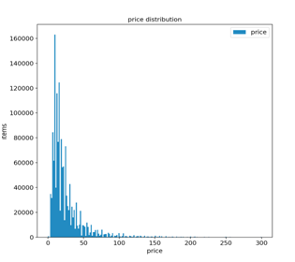
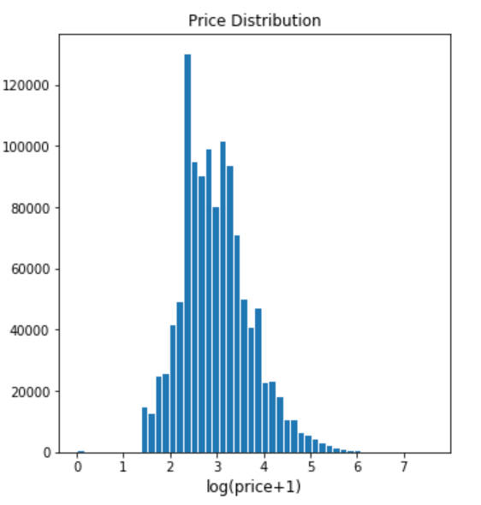
Feature Engineering
Logarithmic transformation to smooth long tailed or skewed data to more of a normal distribution to be used in regression setting.

Slide 16
Feature Engineering/Preprocessing
tokenization and stemming
Count Vectorizer (integer count for each word)to encode item name and item categories
TF-IDF Vectorizer(reducing to vector with weighted count for each word) to encode item description using ngrams(to increase features) and removing stop words- bag of words approach
mindf= 2 and max features = 100000
Ngrams: 1-3 (as the frequency of 1 and 3 gram words is more)

Slide 17
Feature Engineering/Preprocessing
One hot encoding for brand name, item condition and shipping
LabelBinarizer - performes binarization of brand names to include it as a feature to train the model(works with string)
getdummies() - creates new binary columns for item condition(ordinal) and shipping(binary)

Slide 18
Feature Engineering/Preprocessing
Trying to concatenate name, brand name and item description to get better feature extraction
Truncated SVD:
SVD is used for dimensionality reduction of item description while extracting important keywords.
For this n_iter =3 and n_components = 90 is used

Slide 19
Models Used
Switched to a regression setting

Slide 20
CatBoost Regression
CatBoost is short for Categorical Boost.
Helpful when the important features are categorical so we do not have to preprocess the data much in order to convert apply the regression
In our research we found out that the gradient boosting would be helpful as it will constantly build complex models every iteration and learn from the error of the previous model.
Problems when modelling with catboost.
Still had to convert the the various columns into a limited number of categories.

Slide 21
Regularization:
As the data has items with price $ 3- 2000, it shows lot of variation with price.
We have lot of information which is essentially just noise hence to overcome the problem of overfitting we choose regularization.
It allows shrinking of parameters which helps with collinearity and also reduces model complexity
It shrinks the coefficient by using tuning parameters alpha and lambda

Slide 22
Why Ridge Regression?
There are two types of regularization - lasso and ridge(linear regression win L1 and L2 penalty)
Lasso regression(L1 regularization) forces parameters to be zero if their effect size is too small hence we got RMSLE of 0.74 with it which was not so impressive.
Hence we tried Ridge (L2 regularization),in the case of multicollinearity, Ridge regression is the most effective solution than any other regression models and it proved right as we got better results with it

Slide 23
Ridge Regression
Ridge Regression (L2 regularization)
It deals with datasets with huge variance efficiently leading to better RMSE( or in our case RMSLE)
Tried with alpha = 0.4 and 0.8 got best results with alpha=0.8
Solver used = ‘lsqr’ which uses an iterative process and hence is fastest
RMSLE = 0.47

Slide 24
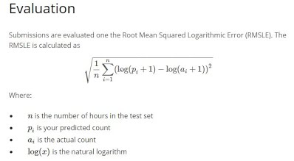
Evaluation metric
As we are predicting price using regression we decided to use RMSE as our evaluation metrics
In our case we used log transformation on our data to smoothen the values hence we are using RMSLE to calculate the error

Slide 25
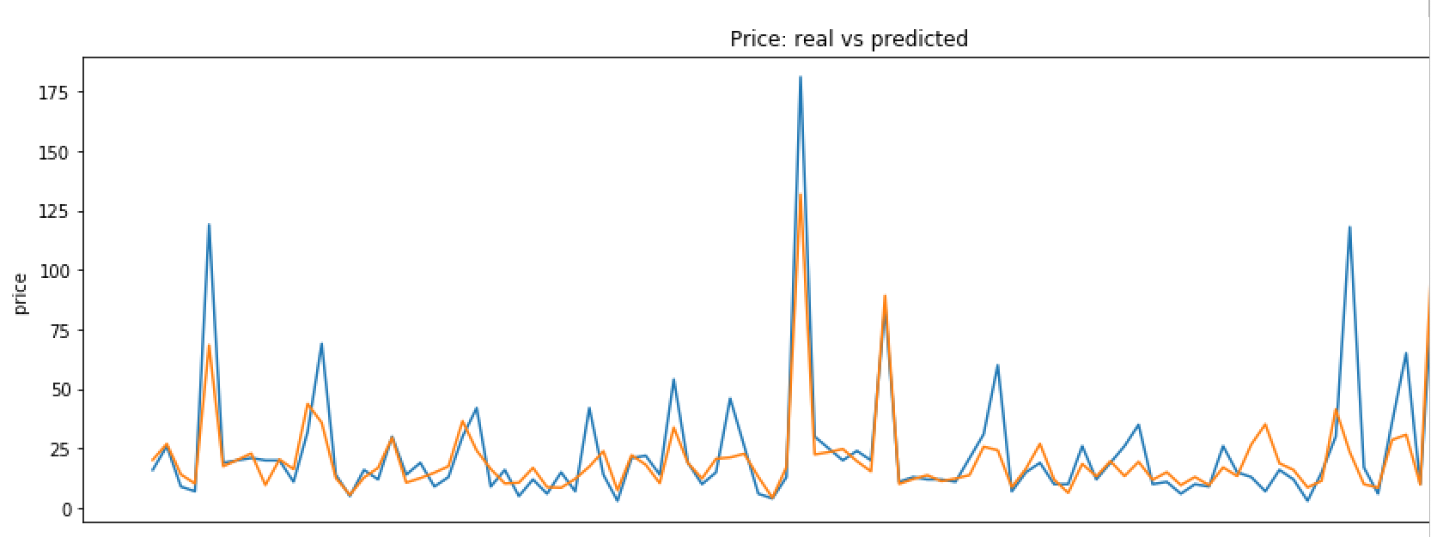
Ridge Predictions
Blue- Actual
Orange- Predicted

Slide 26
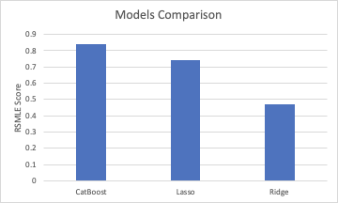
Results:

