Slide 1
CSC 505 - User Interface Design
MedRemind
By Devayan Mandal

Slide 2
Introduction
MedRemind is a mobile application which will remind the user to take their prescription medication and supplements in a timely manner.
Features:
Help organize a schedule for taking medications
Reminder provided even when device is turned off or on silent
Reminder provided for prescription refill
Add schedule for other family members and/or friends
Email synchronization provided with healthcare providers
Search for real time generic medication prices

Slide 3
Existing applications and projects similar to MedRemind
Professional medical mobile apps:
National Institute for Health and Care Excellence (NICE) mobile app (Patel, 2010): physician access only for up to date medical literature
CellScope Oto (Drell, 2014): secure server transmission of inner ear pictures to otolarynologist using iPhone
iBGStar Blood Glucose Monitoring System (Drell, 2014): measure blood sugar through portable meter connected to iPhone (for independent use by client)

Slide 4
Digital Reminder Mobile Apps (Apple Inc. App Store, 2014)
•Pill Monitor Free
•Meds Agenda
•Pill Prompter
•Med Tracker
•Dose organizer Lite

Slide 5
Weaknesses
No form of security to safeguard client sensitive health information
Doesn't allow for changing the appearance of the medication & provides the same screen for every new entry.
Mobile application bombards the user with excessive visual stimuli, as observed in the above screenshots
Provides no option to synchronize prescription refills with the user(s) participating pharmacy

Slide 6
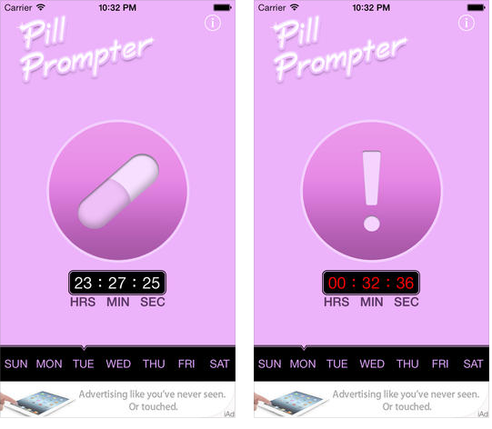

Slide 7
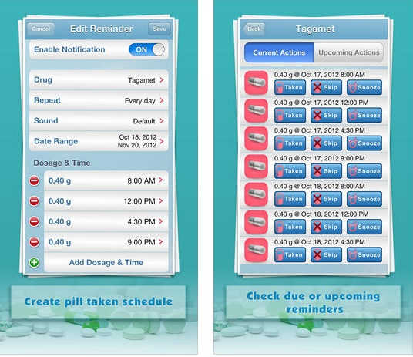

Slide 8
Technical Challenges and requirements:
Password lock required as the app stores client sensitive information
Spanish translations will be considered to address the large Spanish speaking population
Means of synchronizing participating pharmacy to reflect real time generic medication prices
Screen magnification options such as tapping or pinching to zoom in or out for the geriatic population

Slide 9
User Classes
MedRemind will support two classes of users within its design interface: 1. Administrator and 2. User
Administrator:
Assumed that the owner of the smartphone will be the primary user of the mobile application
Client sensitive information pertaining to medical records will be stored in the administrator profile

Slide 10
Personas
Steve (Administrator)
Martha (User)
Steve is a 35-year old man who is married to Martha and they have two children, Josh, who is 9 and Alicia, who is 7.
He works as a microbiologist in a private research facility
Both parents greatly rely on their cell phones, tablets and personal computers to communicate, stay organized and maintain a healthy social life

Slide 11
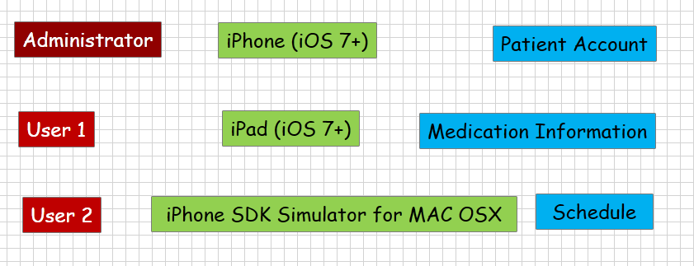
Domain Analysis
Identifying Entities pictorial depiction

Slide 12
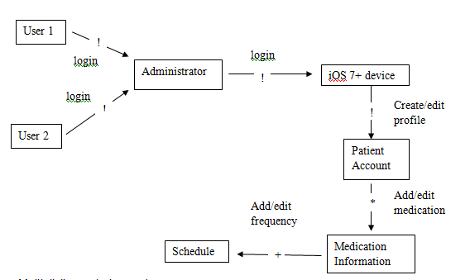
Domain Analysis Identifying Relationships

Slide 13
Scenarios
Steve presents a series of situations which involve both him and his wife, Martha, as they use the app to achieve certain medical reminder goals.
Steve adds a new prescription (described)
Steve adds Martha as a new user
Steve emails his pharmacy after noticing that the price checker reflects a lower cost for his prescription medication.
Steve deletes the prescription
Steve deletes Martha's patient profile as she downloaded the app on her iPad too.

Slide 14
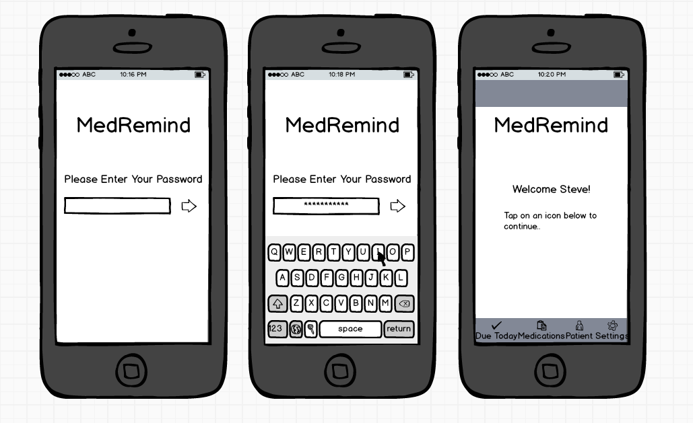
STORYBOARD Figure 1: Password requirement for entry into the MedRemind mobile app

Slide 15
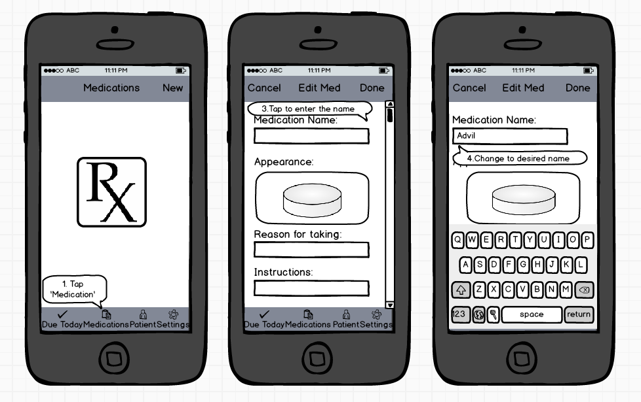
Figure 2: Add a new medication

Slide 16
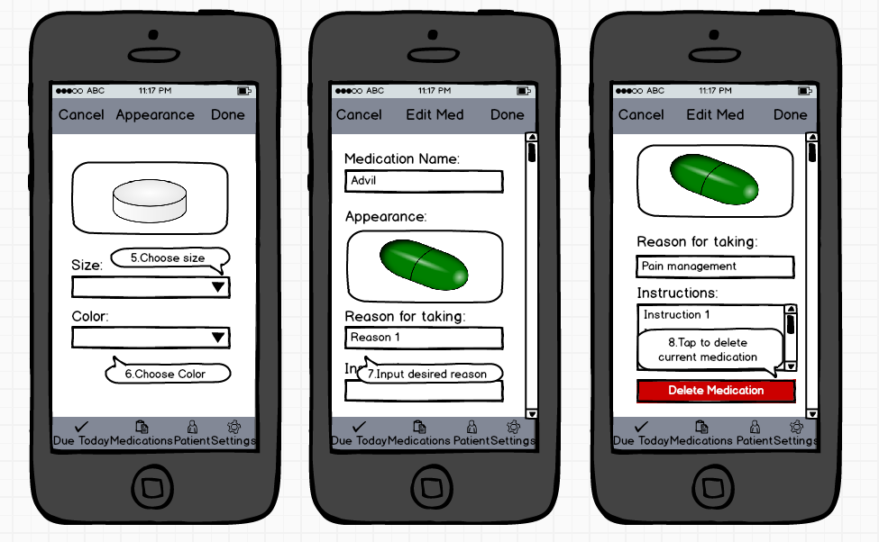
Figure 3: Edit the appearance of the medication and option to delete.

Slide 17
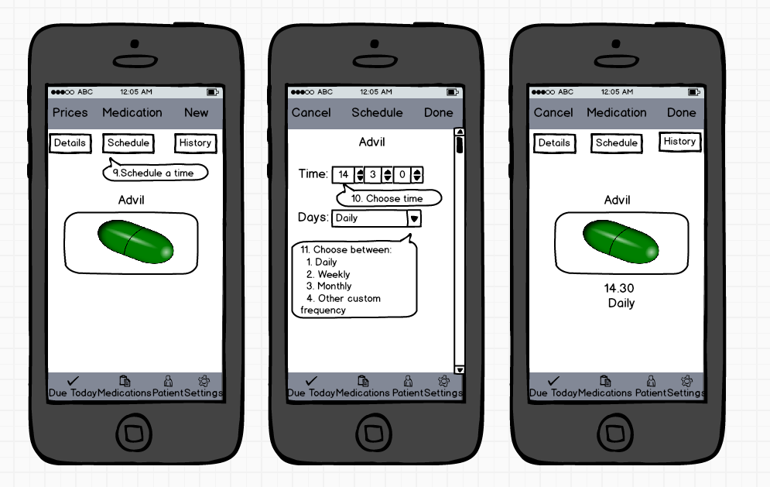
Figure 4: Set the time and day schedule for the reminder

Slide 18
References:
App Store Medical. 2014, Apple Inc. Retrieved December 6, 2014, from https://itunes.apple.com/us/genre/ios-medical/id6020?mt=8
Drell, L. (2014). AN APP A DAY KEEPS THE DOCTOR AWAY. Marketing Health Services, 34(2), 20-23.
Gilder, M. (2014). CSC 505-E2 Course Notes.
Heggestuen J (2013). "One in every five people in the world own a smartphone. one in every 17 own a tablet". Business Insider.
Patel A (2010). "The number one downloaded medical app on the iPhone -- Medscape [app review]". iMedicalApps
PR, N. (2014, March 26). Global Mobile Medical Apps Trends Industry. PR Newswire US.

Slide 19
Thank You!
Questions please…

