Slide 1
Data Visualization

Slide 2
Why is data visualization important?
Because of the way the human brain processes information, using charts or graphs to visualize large amounts of complex data is easier than poring over spreadsheets or reports. Data visualization is a quick, easy way to convey concepts in a universal manner
Data visualization can also:
Identify areas that need attention or improvement.
Clarify which factors influence customer behavior.
Help you understand which products to place where.
Predict sales volumes.

Slide 3
DIFFERENT TYPES OF DATA VISUALIZATION

Slide 4
Basic types of plot
line plot
bar plot
Pie chart
Scatter plot
Histogram

Slide 5
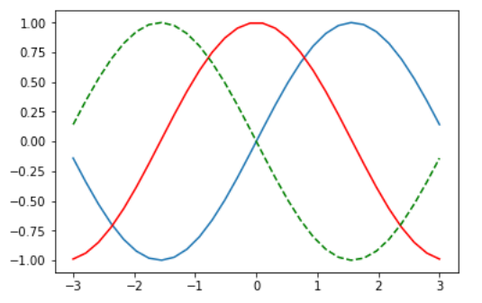
line plot
line chart or line graph is a type of chart which displays information as a series of data points called 'markers' connected by straight line segments.

Slide 6
Bar Chart
Bar Chart Shows comparisons between different categories, different parts of a whole.
Shows relationship between a numerical variable and a discrete variable.
Variations of Bar Chart :
Vertical Bar Chart or Column Chart : Best used to visualize relationship or comparisons with chronological data.
Horizontal Bar Chart : Useful when category labels are long.
Stacked Bar Chart : Used to compare different parts of a whole using discrete or continuous variables.
Grouped Bar Chart : Used to compare multiple data series in a given category.

Slide 7
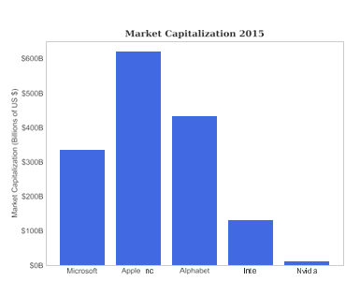
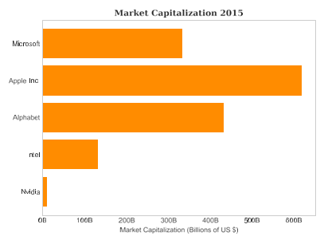
Vertical Bar Chart
Horizontal Bar Chart

Slide 8
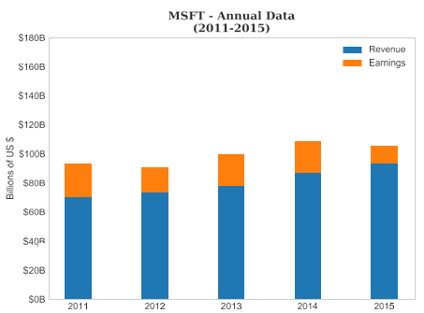

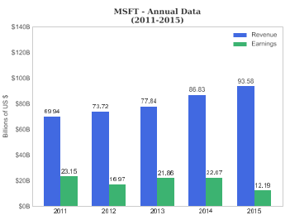
Stacked Bar Chart
Grouped Bar Chart

Slide 9
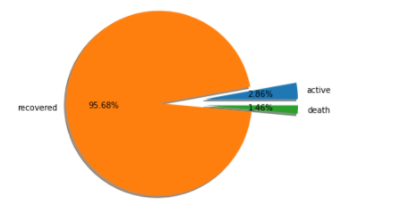
Pie Chart
Pie Chart is a circular statistical graphic, which is divided into slices to show part-to-whole relationships with continuous or discrete data.
It is best used with a small data.
Functions for plotting Pie Chart :

Slide 10

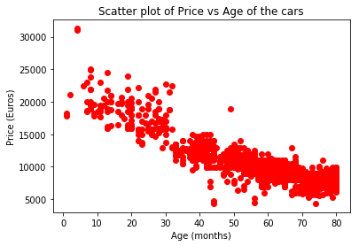
Scatter Plot
A scatter plot is a set of points that represents the values obtained for two different variables plotted on a horizontal and vertical axes
When to use scatter plots?
Scatter plots are used to convey the relationship between two numerical variables
Scatter plots are sometimes called correlation plots because they show how two variables are correlated
Pairing regardless of time

Slide 11
Histogram
What is a histogram?
It is a graphical representation of data using bars of different heights
Histogram groups numbers into ranges and the height of each bar depicts the frequency of each range or bin
When to use histograms?
To represent the frequency distribution of numerical variables

Slide 12

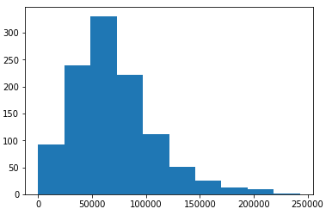



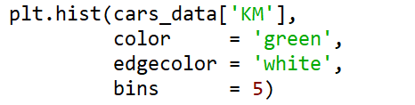

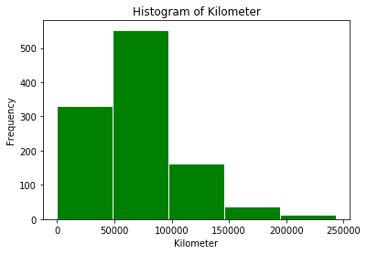




Histogram
Histogram with default arguments

Slide 13

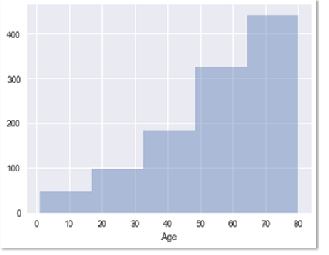
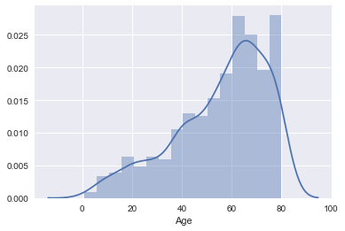
Histogram
Histogram with and without default kernel density estimate

Slide 14
Categorical Data Plots
Different types of plot for this:
barplot
countplot
boxplot
violinplot
stripplot
Swarmplot
factorplot

Slide 15
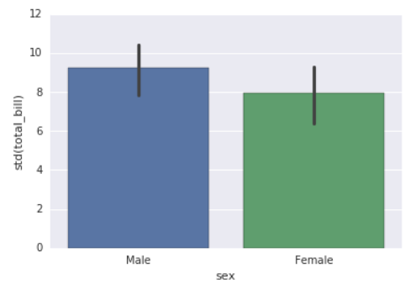
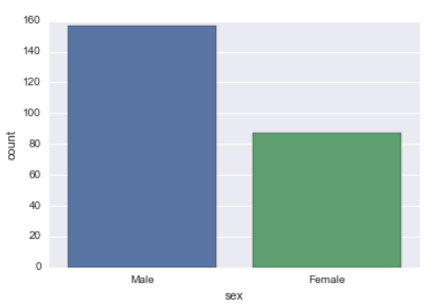
Categorical Data Plots
barplot and countplot
barplot is a general plot that allows you to aggregate the categorical data based off some function, by default the mean.
countplot is essentially the same as barplot except the estimator is explicitly counting the number of occurrences.
barplot
countplot

Slide 16
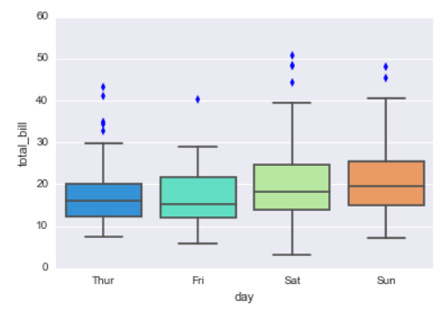
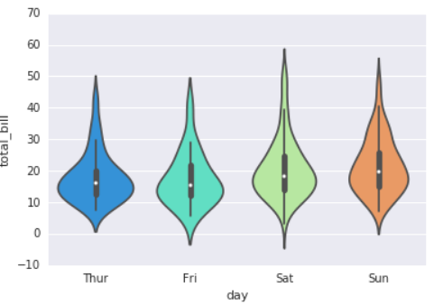
boxplot and violinplot
The box shows the quartiles of the dataset while the whiskers extend to show the rest of the distribution, except for points that are determined to be “outliers” .
A violin plot plays a similar role as a box and whisker plot. Unlike a box plot, in which all of the plot components correspond to actual datapoints, the violin plot features a kernel density estimation of the underlying distribution.
boxplot
violinplot

Slide 17
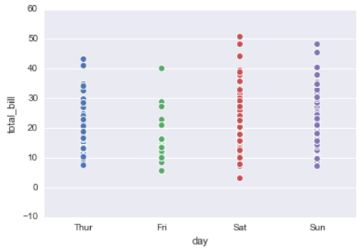
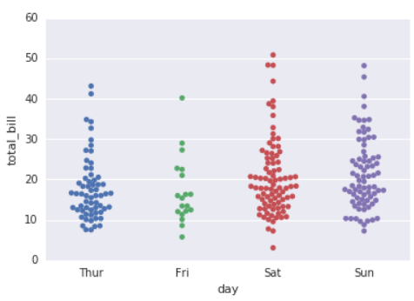
stripplot and swarmplot
A strip plot can be drawn on its own, but it is also a good complement to a box or violin plot in cases where you want to show all observations along with some representation of the underlying distribution.
The swarmplot is similar to stripplot(), but the points are adjusted (only along the categorical axis) so that they don’t overlap. This gives a better representation of the distribution of values.
strip plot
swarmplot

Slide 18
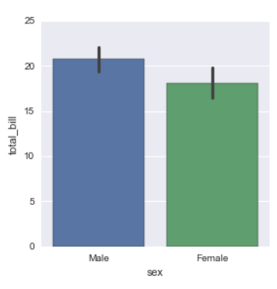
Factorplot
factorplot is the most general form of a categorical plot. It can take in a kind parameter to adjust the plot type

Slide 19
Distribution Plots
These plots allow us to visualize the distribution of a data set.
distplot
jointplot
rugplot
kdeplot
pairplot

Slide 20
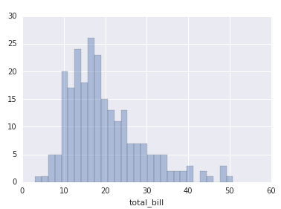
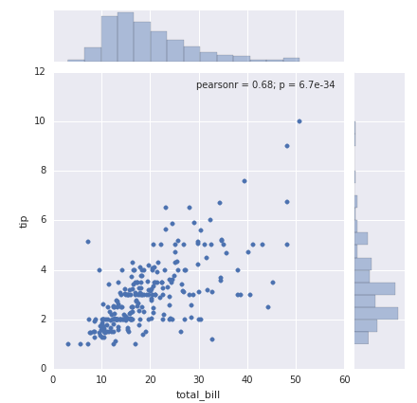
Distplot:The distplot shows the distribution of a univariate set of observations.
jointplot
jointplot() allows you to basically match up two distplots for bivariate data.
“scatter”
“reg”
“resid”
“kde”
“hex”

Slide 21
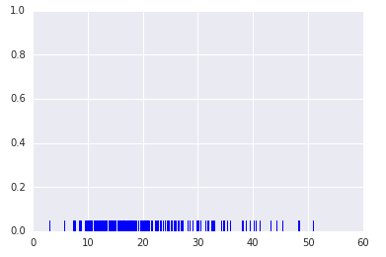
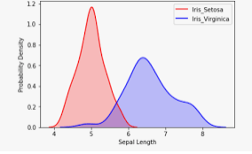
rugplot: rugplots are actually a very simple concept, they just draw a dash mark for every point on a univariate distribution.
kdeplot
kdeplots are Kernel Density Estimation plots. These KDE plots replace every single observation with a Gaussian (Normal) distribution centered around that value.

Slide 22
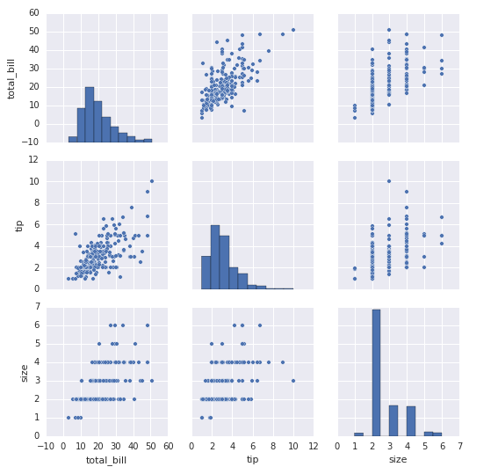
pairplot
pairplot will plot pairwise relationships across an entire dataframe (for the numerical columns) and supports a color hue argument (for categorical columns).

Slide 23
Matrix, Grid and Regression plots
Matrix plots allow you to plot data as color-encoded matrices and can also be used to indicate clusters within the data eg HEATmap
Grid plots are general types of plots that allow you to map plot types to rows and columns of a grid, this helps you create similar plots separated by features.eg Pairplot and Facetgrid
Regression plots allows you to display linear models, but it also conveniently allows you to split up those plots based off of features, as well as coloring the hue based off of features.eg IMplot

Slide 24
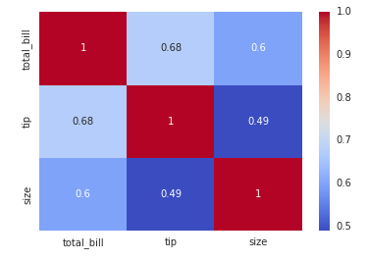
Heatmap
A Heatmap is a graphical representation of data where the individual values contained in a matrix are represented as colors. Heatmaps are perfect for exploring the correlation of features in a dataset.

Slide 25
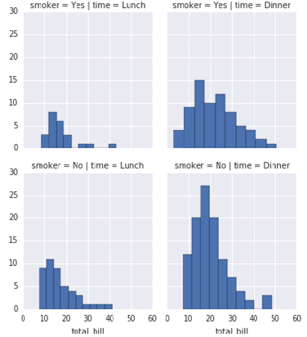
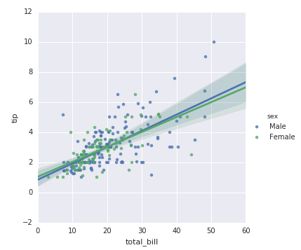
Facet Grid: Faceting is the act of breaking data variables up across multiple subplots and combining those subplots into a single figure.
lmplot plot is used to draw a scatter plot onto a FacetGrid.
Facet Grid
lmplot plot

Slide 26
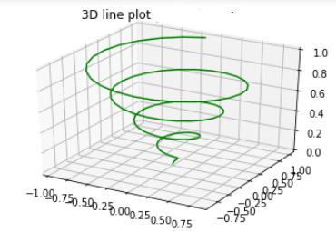
Other Plots
3-D plots: 3D utilities were developed upon the 2d and are enabled by importing the mplot3d toolkit.
Graph with lines and point are the simplest 3 dimensional graph. ax.plot3d and ax.scatter are the function to plot line and point graph respectively.

Slide 27
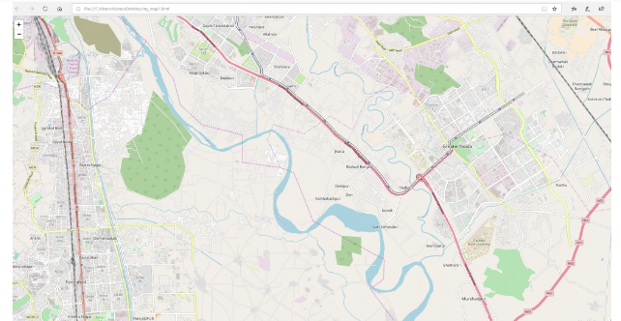
Geospatial plot
Folium makes it easy to visualize data that’s been manipulated in Python, on an interactive Leaflet map. This library has a number of built-in tilesets from OpenStreetMap, Mapbox etc.

