Slide 1
SKIN DISEASE DETECTION (DermaScan)

Slide 2
ABSTRACT
This project introduces DermaScan, an AI-powered, web-based application designed to address these challenges by offering real-time skin type classification and detection of six common skin diseases: Eczema, Rosacea, Herpes, Bullous, Psoriasis, and Warts.
Leveraging cutting-edge technologies including EfficientNet-B0, Convolutional Neural Networks (CNN), PyTorch, TensorFlow + Keras, and a Flask-based backend, DermaScan enables users to upload a skin image and receive immediate diagnostic insights along with visual heatmap explanations.
The system employs a lightweight, microservices-based architecture, uses Seaborn visualizations for model interpretability, and supports continuous learning via user feedback.
By integrating early-stage detection and user-friendly accessibility, DermaScan demonstrates the potential of deep learning applications in promoting proactive skin health management at a global scale.

Slide 3
PROBLEM STATEMENT
Global Burden of Skin Disorders: Skin conditions such as eczema, rosacea, and psoriasis affect millions globally, yet early detection remains limited.
Access Barriers: Many users lack access to qualified dermatologists, especially in rural or economically challenged regions.
Lack of Awareness: Patients are often unaware of their skin type (dry, oily, normal), which is a key factor in preventing skin-related issues.
Delayed Diagnosis: Without early identification, minor skin symptoms can escalate into severe, chronic conditions.
Need for AI Intervention: There is a strong demand for a fast, accessible, and cost-effective solution that provides early skin health insights using technology.
DermaScan addresses these challenges by offering AI-based detection of skin types and diseases via a simple image upload.

Slide 4
INTRODUCTION
The Problem:
Many people do not know their skin type, leading to incorrect skincare practices that worsen conditions.
Dry skin can cause irritation, flakiness, and infections if not managed properly.
Oily skin leads to acne, clogged pores, bacterial growth, and permanent scarring.
Dermatologists rely on subjective assessment, which may not always be accurate.
AI-based classification removes subjectivity and provides data-driven insights for improved skin health.
Our Approach:
Develop a Multi Model deep learning-based model to classify skin type and skin disease accurately using EfficientNet-B0.
Implement signal processing techniques to analyze skin texture, color variations, and moisture content.
Create a real-time web application that allows users to upload an image and receive instant analysis and recommendations.
Optimize the model to work on low-power devices, making it accessible on smartphones and tablets.

Slide 5
LITERATURE SURVEY
S. No | Title (Name of the journal, author and publication details) | Methodology (Provide a Summary of key studies and their findings) | Identification of gaps and limitations. (Identify the limitations of the Research Paper)
1 | Kawahara, J., BenTaieb, A., Hamarneh, G. (2016). Deep learning for skin lesion classification. IEEE Transactions on Medical Imaging, 35(5), 1182-1195. | Used CNN-based approach for lesion classification. Evaluated on ISIC dataset. Achieved state-of-the-art accuracy in melanoma detection. | May lack complete meaning and understanding Less adept at handling nuanced semantic information Can struggle with ambiguity and context
2 | Esteva, A., Kuprel, B., Novoa, R. A., Ko, J., Swetter, S. M., Blau, H. M., & Thrun, S. (2017). Dermatologist-level classification of skin cancer with deep neural networks. Nature, 542(7639), 115-118. | Used deep CNNs trained on over 130,000 images. Outperformed dermatologists in melanoma detection. Demonstrated potential for AI in dermatology. | Focused on cancer detection, not skin type classification. High computational requirements. Lacked generalizability to non-melanoma skin conditions.
3 | Codella, N. C., Nguyen, Q. B., Pankanti, S., Gutman, D., Helba, B., Halpern, A., & Smith, J. R. (2017). Deep learning ensembles for melanoma recognition in dermoscopy images. IBM Journal of Research and Development, 61(4/5), 5:1-5:15. | Developed an ensemble of deep learning models. Enhanced performance by combining multiple networks. Used dermoscopic images for precise melanoma classification. | Ensemble methods increased processing time. Required high-quality dermoscopic images. Not applicable for general skin-type classification.

Slide 6
RESEARCH GAPS
No dedicated AI models exist for real-time skin-type classification based on moisture balance and oil levels.
Lack of integration of signal processing techniques with deep learning models for enhanced accuracy.
No efficient, real-time AI-based web applications that offer instant analysis and personalized skincare recommendations.
The majority of AI skin studies focus on disease detection rather than proactive skin health assessment.
Limited publicly available datasets specifically curated for skin moisture and oil classification, restricting model training capabilities.
Absence of multi-modal data fusion techniques, combining visual, thermal, and spectroscopy data for better skin analysis.
Lack of user-adaptive models that consider age, gender, and ethnicity-based variations in skin types.
Minimal research on real-world deployment of AI skin analysis tools, making practical implementation a challenge.

Slide 7
RESEARCH OBJECTIVES
Develop a robust AI model using EfficientNet-B0 to classify skin types accurately, ensuring scalability and high accuracy.
Implement advanced signal processing techniques to analyze skin texture, color variation, moisture levels, and oil distribution.
Build a real-time web application with an intuitive user interface, allowing users to upload images and receive immediate, AI-powered analysis.
Enhance accuracy, efficiency, and computational feasibility, ensuring that the model is optimized for deployment on smartphones, tablets, and low-power devices.
Conduct comparative performance evaluations against existing models like ResNet, VGG16, and MobileNet, ensuring superior precision and recall.
Investigate the impact of external factors such as lighting conditions, skin tone variations, and environmental influences on the model’s accuracy.
Develop an adaptive learning mechanism where the AI system improves over time based on user feedback and dermatological evaluations.

Slide 8
IDENTIFY THE TECHNIQUE TO IMPLEMENT THE OBJECTIVES
Machine Learning Model :
EfficientNet-B0: High-performance neural network architecture for medical imaging.
TensorFlow & PyTorch: Deep learning frameworks for training and deploying models.
Torchvision: Image transformation and model integration for deep learning.
Seaborn: Data visualization for analyzing skin-type classification accuracy.
Signal Processing Techniques :
Feature Extraction: Identifies edges, textures, and moisture levels using advanced filtering methods.
- Texture Analysis: Edge detection, histogram equalization, color mapping, pixel clustering.
- Moisture Level Detection: Pixel intensity, light reflection analysis to determine hydration levels.
- Noise Reduction: Gaussian blur, median filtering to enhance image clarity before processing.

Slide 9
TECHNOLOGY STACK
Domain | Technologies Used
Frontend | HTML, CSS, JavaScript
Backend | Python, Flask (API Framework)
ML Frameworks | PyTorch, TensorFlow + Keras
Model Architecture | EfficientNet-B0 (for disease detection), CNN (for skin type)
Database | SQLite
Visualization | Seaborn, Matplotlib (for heatmaps and accuracy graphs)
Platform | Web browser (desktop + mobile responsive)

Slide 10
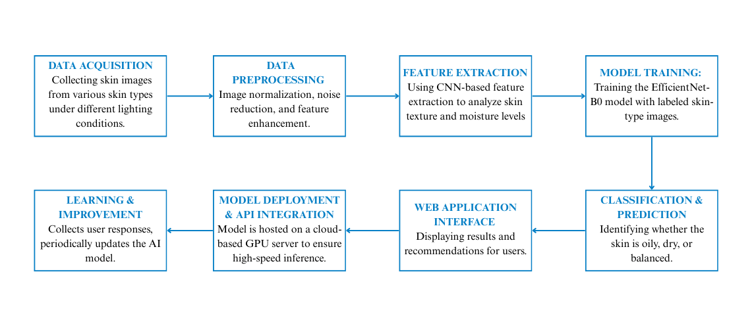
PROPOSED METHODOLOGY OF OUR APPROACH

Slide 11
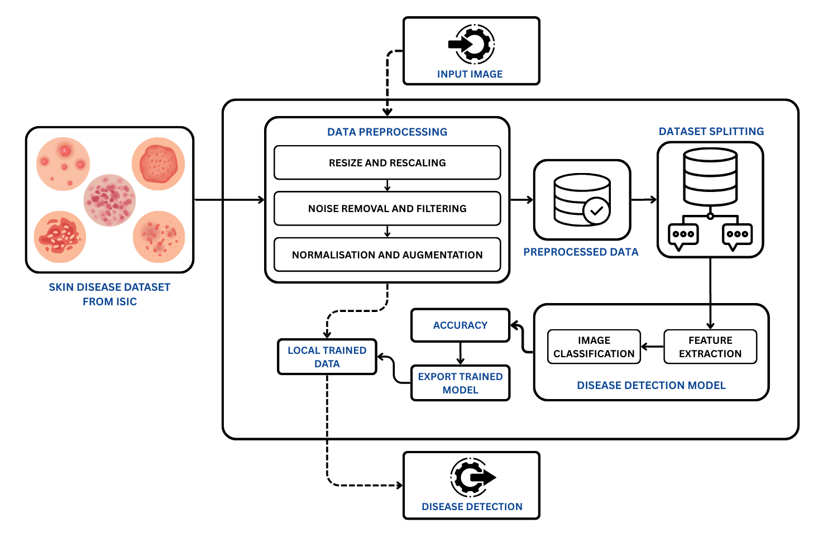
SYSTEM ARCHITECTURE BASED ON SKIN DISEASE DETECTION

Slide 12
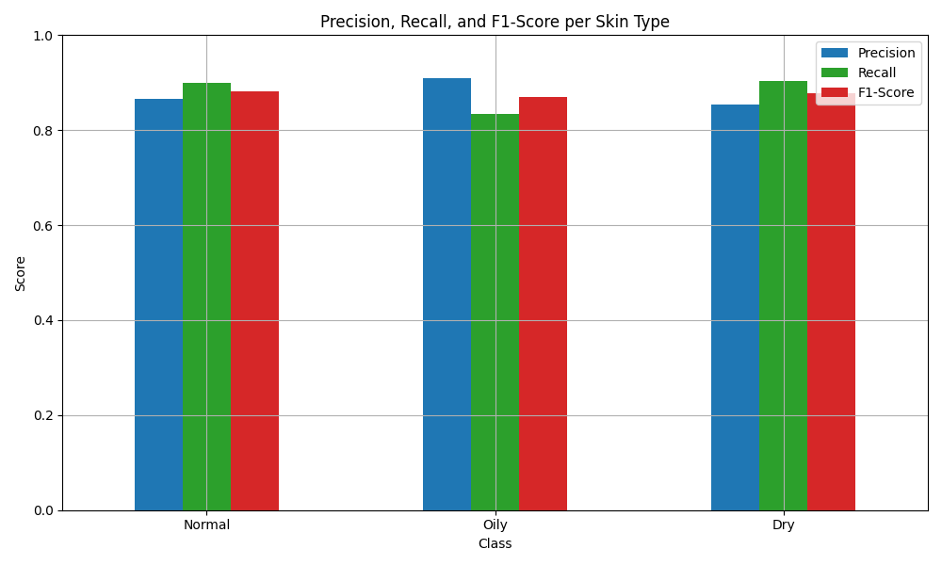
RESULTS AND DISCUSSION

Slide 13
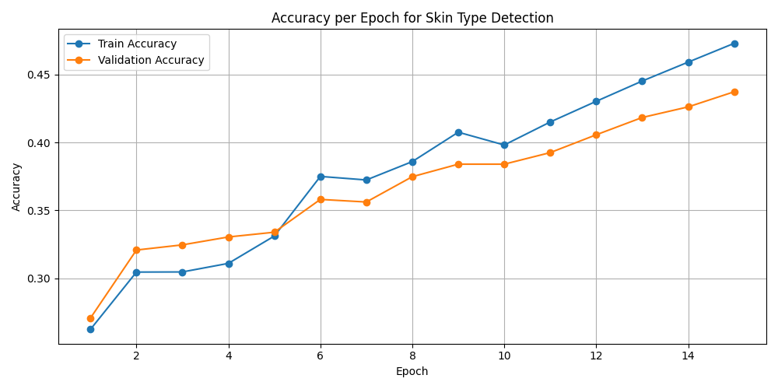
RESULTS AND DISCUSSION

Slide 14
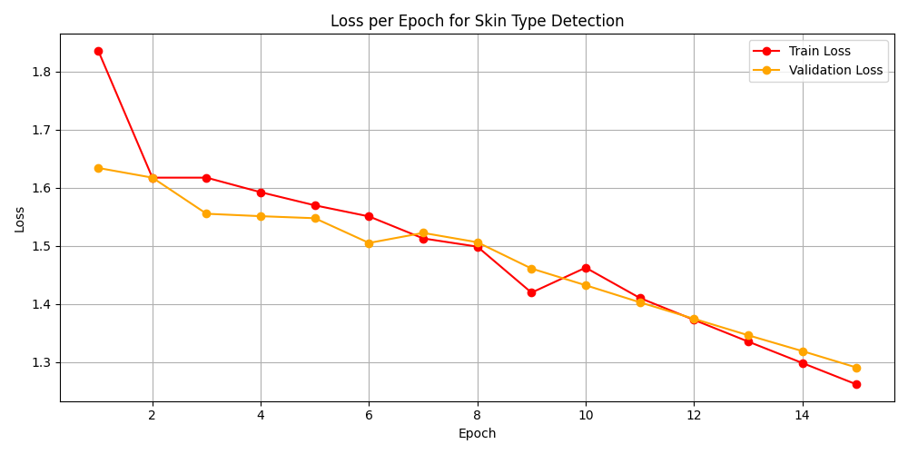
RESULTS AND DISCUSSION

Slide 15
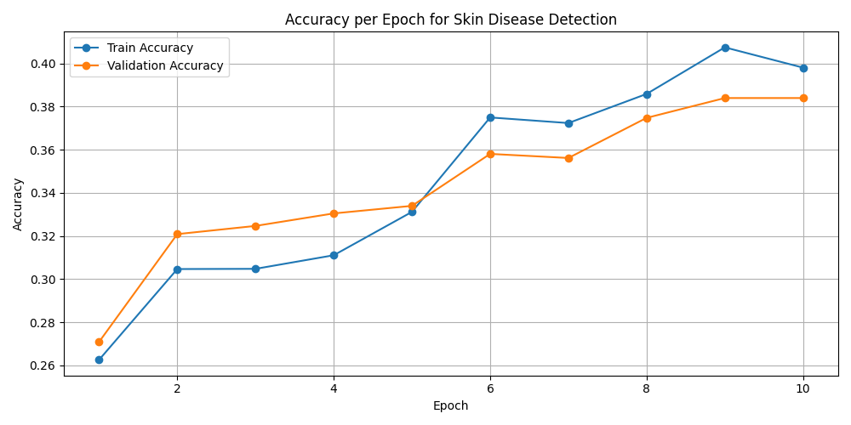
RESULTS AND DISCUSSION

Slide 16
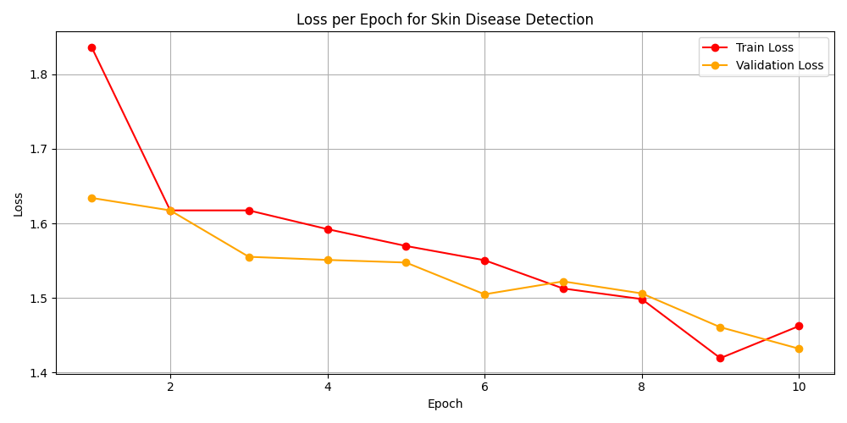
RESULTS AND DISCUSSION

Slide 17
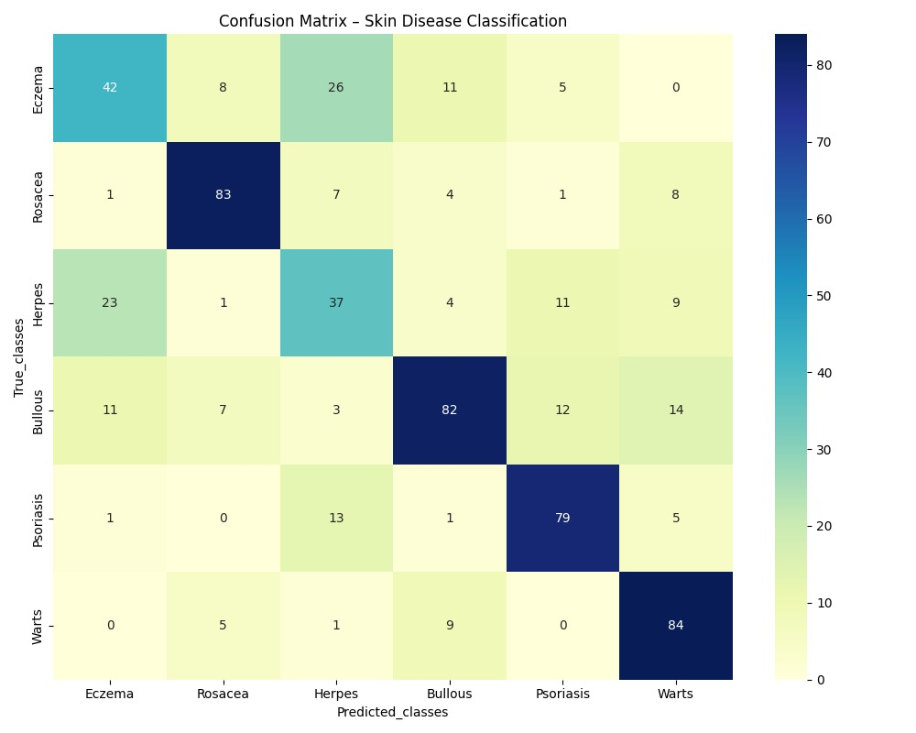
RESULTS AND DISCUSSION

Slide 18
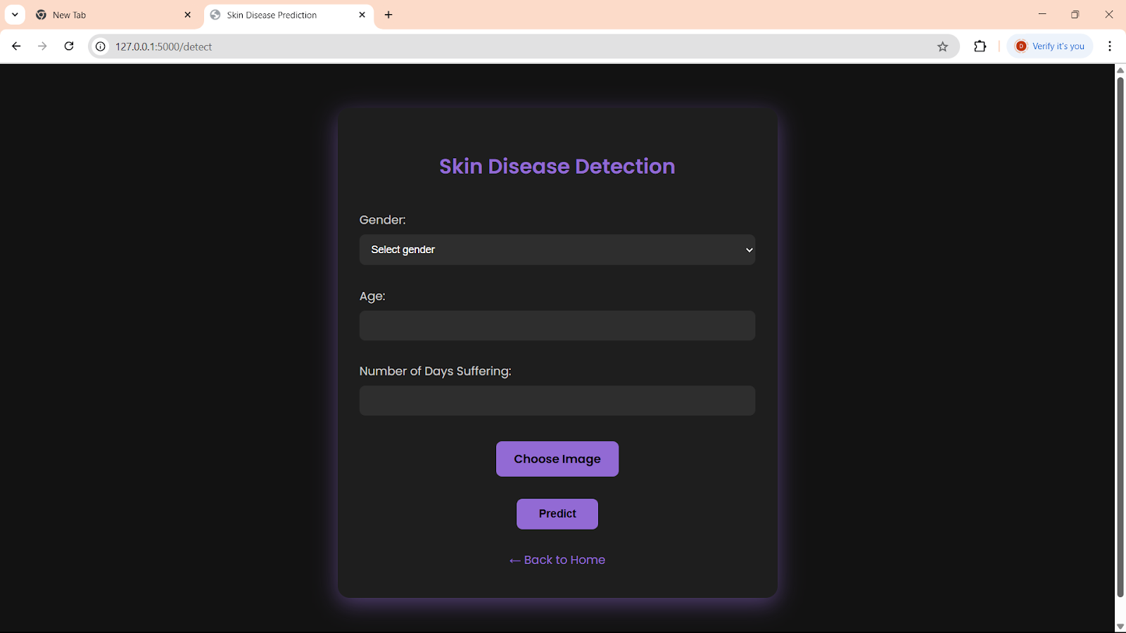
OUR WEBSITE

Slide 19
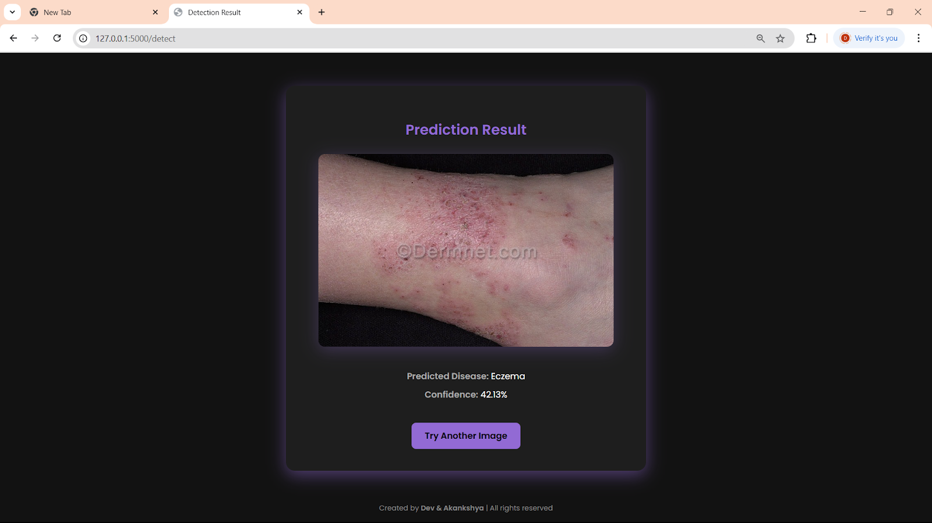
OUR WEBSITE

Slide 20
FUTURE WORK
While DermaScan provides a strong foundation for AI-driven dermatology, several improvements are planned:
Dataset Expansion: Increase diversity in terms of ethnicity, lighting, and skin tones to improve generalizability.
Rare Disease Detection: Incorporate few-shot learning and GAN-based data synthesis to cover rarer skin conditions.
Mobile Optimization: Implement model compression (e.g., pruning, quantization) for real-time inference on mobile and edge devices.
EHR Integration: Enable interoperability with Electronic Health Records using FHIR standards for clinical usage.
Longitudinal Monitoring: Add support for time-based lesion tracking to monitor disease progression and treatment response.
These enhancements will make DermaScan more robust, scalable, and suitable for real-world clinical deployment.

Slide 21
CONCLUSION
DermaScan represents a pivotal advancement in the intersection of AI and dermatology, offering a unified platform for skin type classification and skin disease detection through deep learning. By utilizing EfficientNet-B0 and advanced image preprocessing, the system demonstrates high accuracy and clinical relevance, while maintaining computational efficiency.
The seamless integration of a Flask-based web interface with a lightweight SQLite database ensures an interactive, real-time diagnostic experience that is accessible on both clinical and non-clinical fronts. DermaScan’s capacity to analyze fine-grained skin features—such as texture, tone, and lesion patterns—makes it capable of operating effectively even in visually similar conditions such as Rosacea, Psoriasis, and Bullous diseases.
By empowering users with real-time results, heatmap-based explanations, and AI-driven insights, DermaScan stands as an important tool in the field of teledermatology and preventive skin care. It has the potential to reduce diagnostic delays, enhance patient awareness, and support clinicians in early-stage decision-making.

Slide 22


JUSTIFICATION OF PROJECT SDG
This project aligns with the United Nations Sustainable Development Goals (SDGs), addressing key challenges in healthcare.
SDG 3: Good Health and Well-being
Enhances early diagnosis and treatment of skin conditions, reducing long-term dermatological complications.
Provides personalized recommendations to promote better skincare habits and disease prevention.
Reduces dependence on self-diagnosis, minimizing incorrect treatments that may worsen skin conditions.
Enables equitable access to AI-powered skin analysis, bridging gaps in dermatological healthcare.
SDG 9: Industry, Innovation & Infrastructure
AI-driven healthcare innovations enhance accessibility and efficiency.
Encourages technological advancements in dermatology, opening doors for further AI-based medical research.

Slide 23


PROJECT TIMELINE
PHASE | TASKS | WEEK 1-2 | WEEK 3-4 | WEEK 5-6 | WEEK 7-8 | WEEK 9-10 | WEEK 11-12
Research & Planning | Literature review, defining objectives
Data Collection | Gathering skin image dataset, preprocessing
Model Development | Training EfficientNet-B0 for classification.
Web Development | Designing frontend & backend, API setup
Testing & Validation | Model accuracy testing, UI/UX refinements
Deployment | Cloud deployment, final integration
Final Review | Report writing, final testing

Slide 24
REFERENCES
Kawahara, J., BenTaieb, A., Hamarneh, G. (2016). Deep learning for skin lesion classification. IEEE Transactions on Medical Imaging, 35(5), 1182-1195.
Esteva, A., Kuprel, B., Novoa, R. A., Ko, J., Swetter, S. M., Blau, H. M., & Thrun, S. (2017). Dermatologist-level classification of skin cancer with deep neural networks. Nature, 542(7639), 115-118.
Codella, N. C., Nguyen, Q. B., Pankanti, S., Gutman, D., Helba, B., Halpern, A., & Smith, J. R. (2017). Deep learning ensembles for melanoma recognition in dermoscopy images. IBM Journal of Research and Development, 61(4/5), 5:1-5:15.
Brinker, T. J., Hekler, A., Enk, A. H., Klode, J., Hauschild, A., Berking, C., ... & Haenssle, H. A. (2019). Deep learning outperformed 136 dermatologists in a head-to-head artificial intelligence comparison.
European Journal of Cancer, 113, 47-54.Litjens, G., Kooi, T., Bejnordi, B. E., Setio, A. A. A., Ciompi, F., Ghafoorian, M., ... & van der Laak, J. A. (2017). A survey on deep learning in medical image analysis. Medical Image Analysis, 42, 60-88.

Slide 25

THANK YOU

