Slide 1
dblite distributed ledger
(c) chainbelow
Revised Oct 1, 2019

Slide 2
Distributed Ledger
Lightweight unlike Blockchain systems
Embedded. Can be run from a chip – Olimex, Raspberry Pi.
Distributed replication
Immutable, encrypted append only ledgers
Node.JS and Python support
Multiple channels. Change channels on the fly.
Private channels.
Runs on Docker. Microservice distributable through Kubernetes

Slide 3
Core Architecture
Party
Asset
Contract

Slide 4
Data Model
JournalType
Party
Append
Only
Ledger
PartyType
Asset
AssetType
Agreement
ContractType
Transaction

Slide 5
Network Model
Trigger
47.90.242.27
Port 80
Virginia
47.90.204.172
47.254.67.33
Virginia Master
Broadcast
Encrypted
San Francisco
47.254.84.62
Port 80
San Francisco Master
47.89.177.100
Nodes are decoupled, independent units.
Units subscribe.
White-list can be introduced in public networks.
Virginia

Slide 6
Beta Testing
Tests are running on three nodes – one master, two worker nodes.
All IP addresses will be retired by Nov, 2019
All systems have node-red and dblite running on node-red.
If you do not wish to break the existing flow and try consensus based replication or round-robin replication, please open a new tab and not corrupt the current workspace.
Access to node-red on all server instances are protected by userid/password. In future with TLS certificates (work in progress).
This is an append-only database and not encrypted yet. The encryption node will be deployed to node-red shortly.
Once beta-tested, all code will be moved to gitlab or github.

Slide 7
Flow Models and Implementation

Slide 8
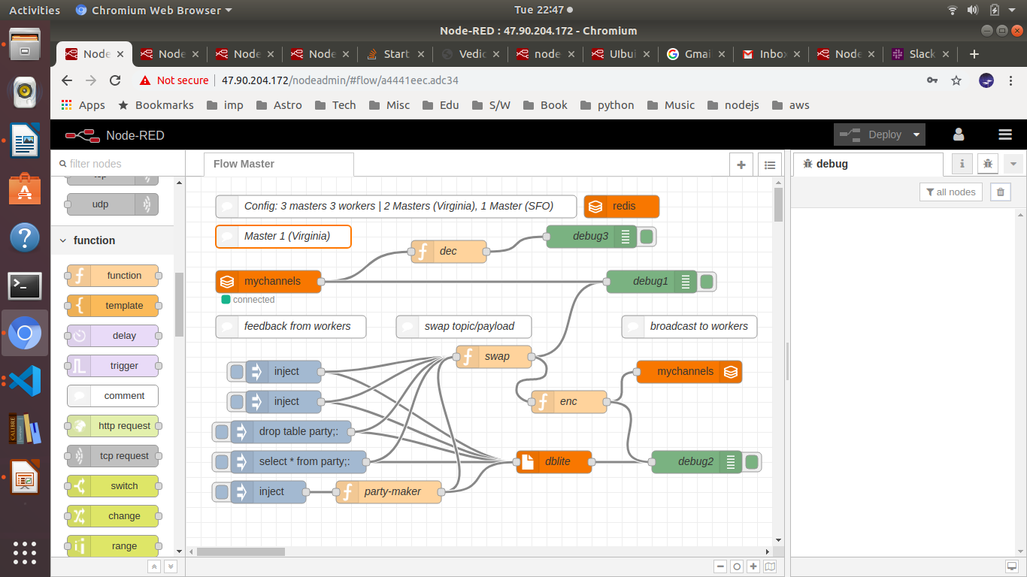
Screenshot – Master Node
Broadcast area. Will add a tx for rollbacks and commits
That’s the chainbelow dblite
Along with hashing algols
Events
Flows tested on different browsers –
FireFox, Chromium, Safari or Edge

Slide 9
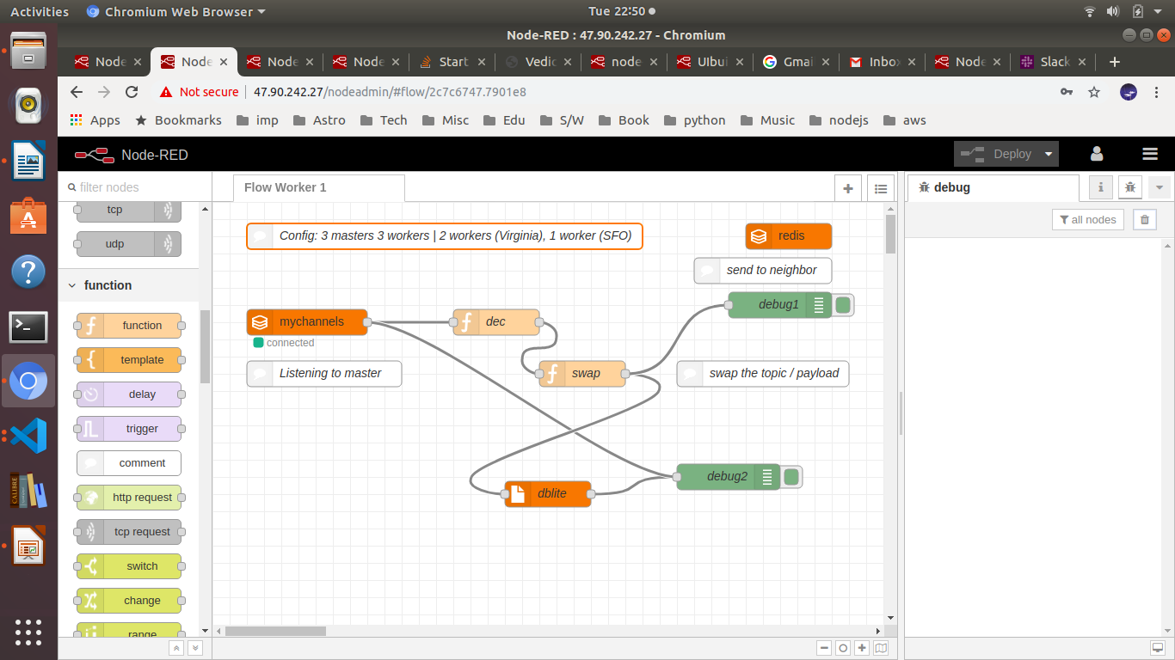
Worker 1
Listener (to the master)
Feedback to master
Replicated append only database

Slide 10
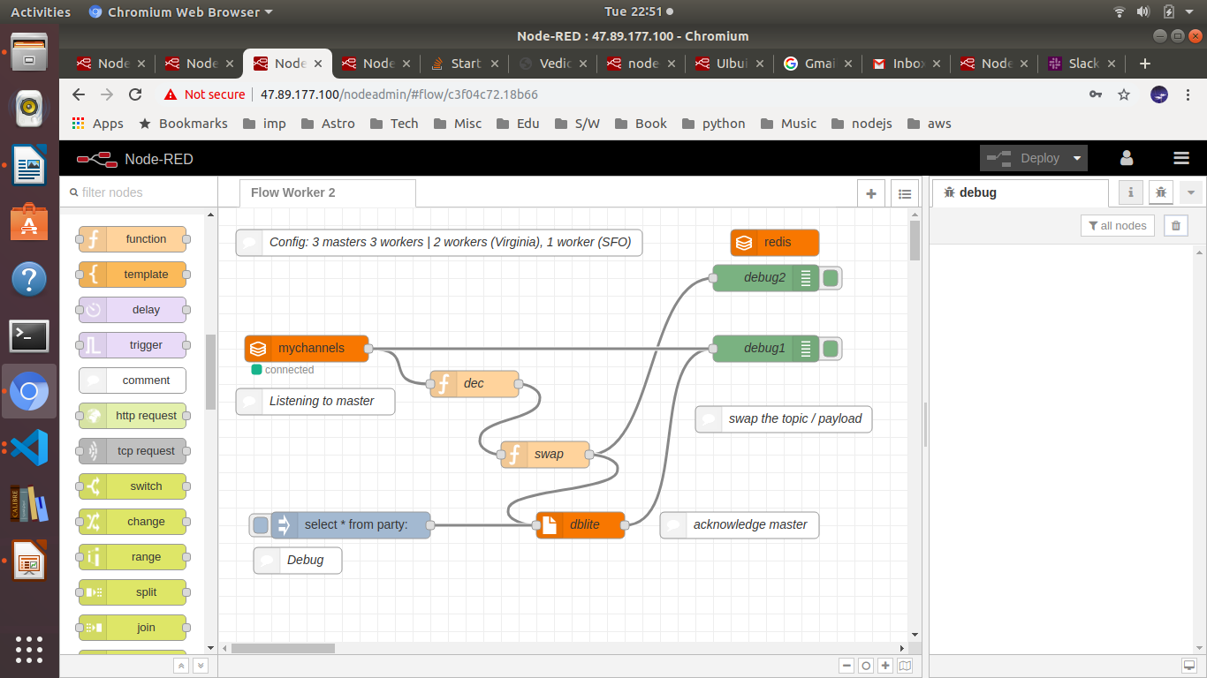
Worker Node 2
Similar to worker node 2. Running on a different IP address

Slide 11
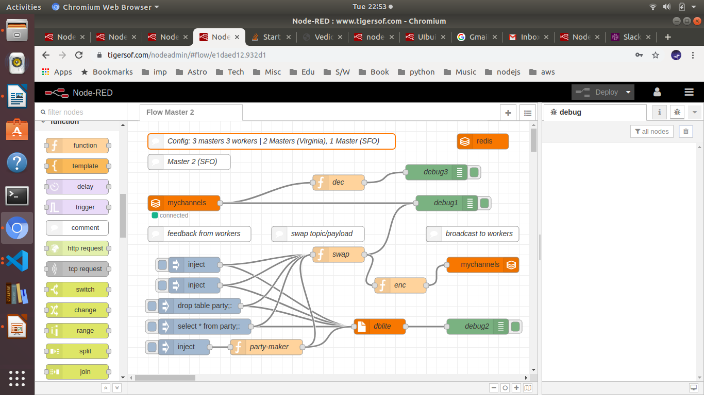
Second Master

Slide 12
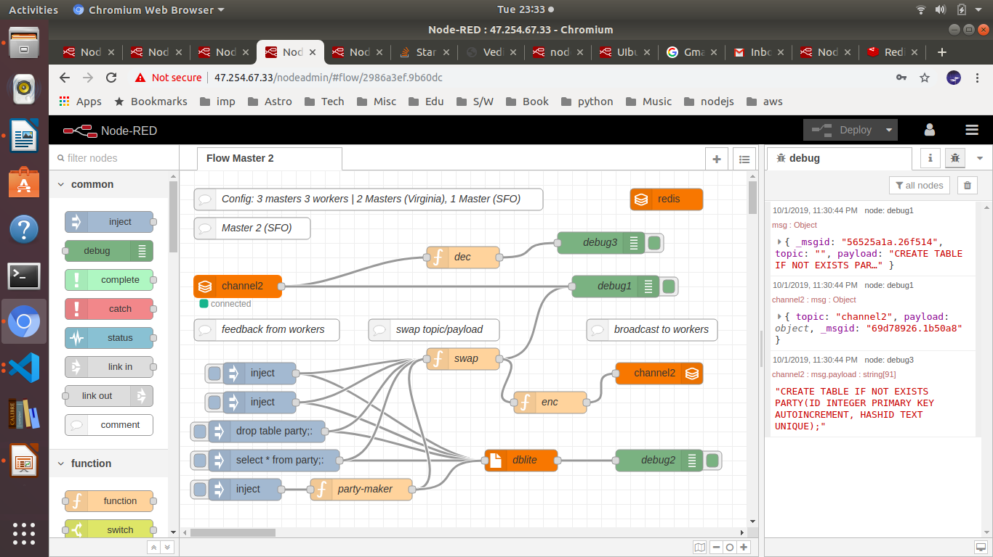
Another Master with different channel
Different channel

Slide 13
Working with the instances
All instances have same userid / password for the time being: admindb / dbl1ght@
Instances are running in Virginia and San Francisco regions. Plans to test with Singapore and Shanghai.
Multiple encrypted channels
Examples:
http://47.90.204.172:1880/ --- master
http://47.90.242.27:1880/ --- worker 1
http://47.89.177.100:1880/ --- worker 2

Slide 14
Beta Tests

Slide 15
Test Feedback
Please offer a comprehensive feedback. What were you testing? What bottlenecks you ran into?
Your ideas on improvements are solicited. Please be concise.
You can ignore typos/grammar issues. Will fix them later.

Slide 16
Features
One ledger serves all. Can be re-used
Ledger immutable. Self replicating.
Ledger can store up to 10 petabytes
Multiple channels. Private channels. On a single network or multiple networks
Nodes run on super micro-instances (512 KB RAM, 10 GB, Single Core). No limits to scaling.
Data encrypted SHA 512 at Rest, during transaction and in motion.

Slide 17
Legacy to DL Migration Effort
Minimal effort, compared to blockchain and others
ANSI SQL compatible. Little effort required to migrate legacy data.
Node.JS / Python resource friendly.

