Slide 1

Department of Mechanical Engineering
Pneumatic Scraper Blade for CNC Laser-Bed Cleaning
Presenting by:
Devanshu Borase,
Rushikesh Dhumal,
Pratik Kadam,
Yusuf Patwa
Guided by:
Prof. U. S. Gawai

Slide 2
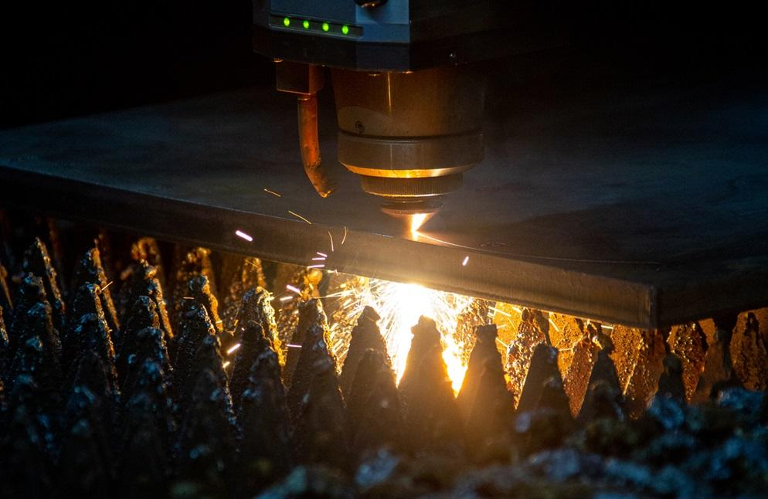
CONTENTS
Introduction
Problem Statement
Objective
Literature Review
Material selection
Methodology
Design Calculations of Pneumatic Cylinder
Design (3D Model & Simulation)
Fabricated Components and Assembly
Component Fitting and Working
Pneumatic System Setup and Working Configuration
Advantages and Limitations
Analysis
Cost of Project
Timeline of Work

Slide 3
ABSTRACT
The project “Pneumatic Scraper Blade for CNC Laser-Bed Cleaning” is designed to clean slag and dust automatically from CNC laser cutting beds.
In industries, cleaning is mostly done manually, which is time-consuming and unsafe for workers.
This system uses a pneumatic cylinder to move a scraper blade across the CNC bed for fast and uniform cleaning.
The setup is compact, portable, and low-cost, suitable for small and medium size workshops.
Testing shows that the system achieves efficient cleaning with smooth and reliable performance.
Overall, the project reduces manual effort, saves time in CNC laser cutting operations.

Slide 4
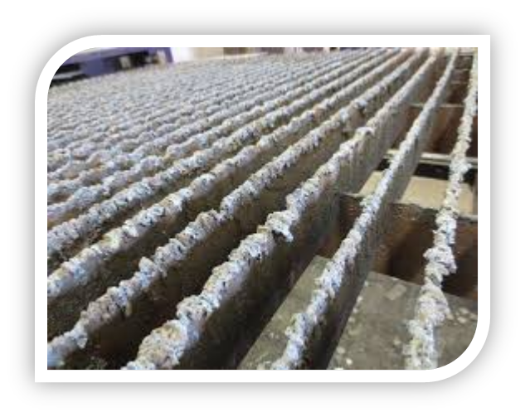
Introduction
CNC laser cutting machines are widely used for accurate and high-quality cutting in modern industries.
During cutting, slag, dust, and metal particles accumulate on the laser bed.
These residues reduce cutting accuracy, surface finish, efficiency, and productivity.
Manual cleaning is slow, labor-intensive, and sometimes unsafe for operators.
To solve this, a pneumatic scraper blade system is developed for automatic bed cleaning.
The system uses compressed air to operate a scraper blade.

Slide 5
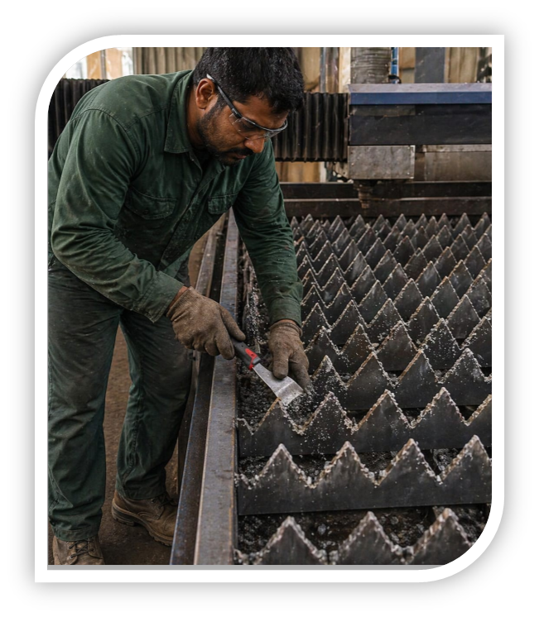
Problem Statement
During laser cutting operation at high temperature (1000º-3000ºc) metal gets welded on edges of the bed
Manual cleaning is time-consuming
Unsafe
Reduces machine efficiency
Affects cutting accuracy and surface finish.
In CNC laser cutting, slag and dust accumulate on the machine bed

Slide 6
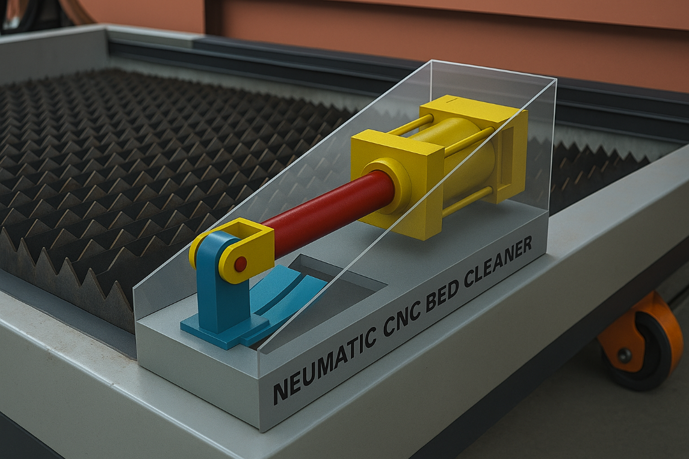
Objective
To remove dross formation a pneumatic scraper blade system for CNC bed cleaning is designed
To enhance the cleaning process, reducing manual effort and downtime.
To create a safe, reliable, and easy-to-operate cleaning mechanism for CNC machines.
To improve cutting accuracy and surface finish by removing slag and dust effectively.
To design and develop a pneumatic scraper blade system for CNC laser-bed cleaning.

Slide 7
Literature Review
Sr. no | Title | Author | Year | Observation
1. | Study of dross formation mechanisms in laser cutting processes and material removal techniques | Wandera | 2010 | Dross forms when molten metal is not properly expelled due to incorrect cutting speed, laser power and motion.
2. | Combined pneumatic cleaning and aspiration system using vortex dust collectors | Zhou et al. | 2023 | He worked on cleaning technologies and explained that uniform and controlled motion improves cleaning quality
3. | Research on the Influence of Laser Cleaning Parameters on the Removal Effectiveness of Al Metal Layers from Ceramic Substrate Surfaces | Li et al | 2025 | He studies how preassure levels affects cleaning efffeciency in industrial applications

Slide 8
4 | Combined Pneumatic Cleaning and Aspiration System Using Vortex Dust Collectors | Azarov. | 2019 | He studied the control and energy efficiency of pneumatic systems used in industrial applications.
5 | Energy Efficiency of Pneumatic Actuating Systems with Pressure-Based Air Supply Cut-Off | Boyko & Weber | 2024 | The study proved that even a small bore cylinder can deliver high thrust with low air consumption
6 | Design of Automated Chain Drive Slag Handling & Removal Machine for CNC Gas Cutting Process | Easwaramoorthi et al. | 2017 | Proposed a chain-driven automated system to remove slag from CNC beds, reducing manual cleaning effort.

Slide 9
Application of Literature Review
1. Azarov (2019)
His research proved pneumatics are reliable for automation, so we selected a pneumatic cylinder instead of a mechanical drive.
2. Boyko et al. (2024)
They showed small pneumatic cylinders give high force with low air use, so we chose a compact 32 mm bore cylinder.
3. Li et al. (2025)
Their study recommended optimal pressure control (1.0 MPa), so we used the same pressure range for safe cleaning.
4. Zhou et al. (2023)
They explained that uniform straight motion gives better cleaning, so we used a linear stroke pneumatic scraper.
5. Easwaramoorthi & Ramesh (2017)
Their mechanical slag removal system faced wear and vibration, so we improved this by using a smoother pneumatic system.

Slide 10
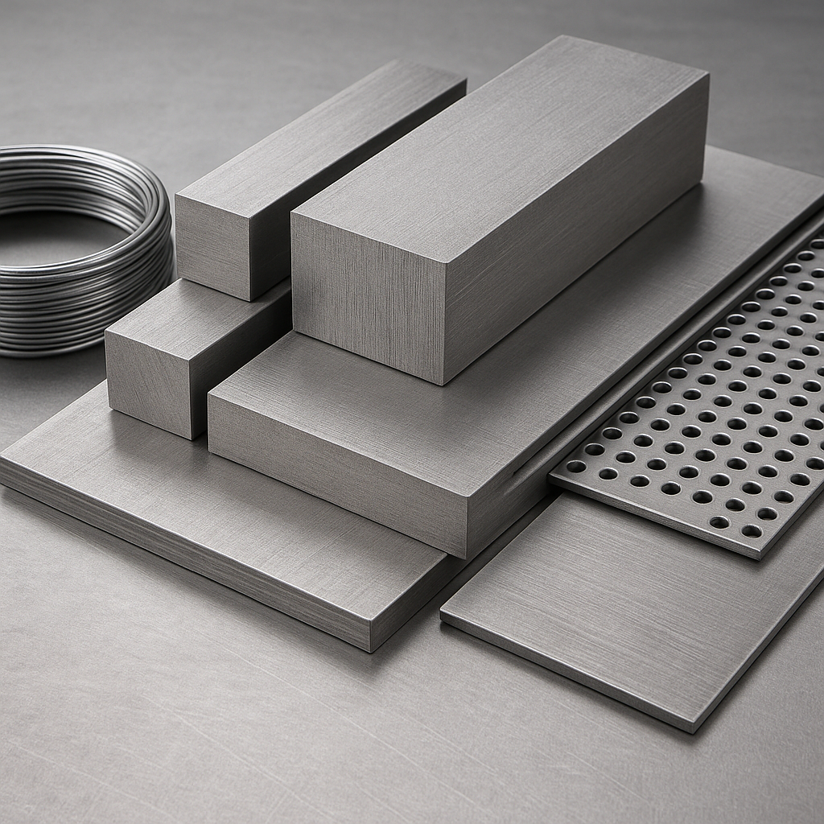
Material selection
Usually when it comes to cutting tools, material HSS ( High Speed Steel) is recommended by industry standards and reference books use HSS as cutting tools in most cases.
Upon conducting research and on-ground report with industry workers and operators, we chose the material En-31 black grade for our project.

Slide 11
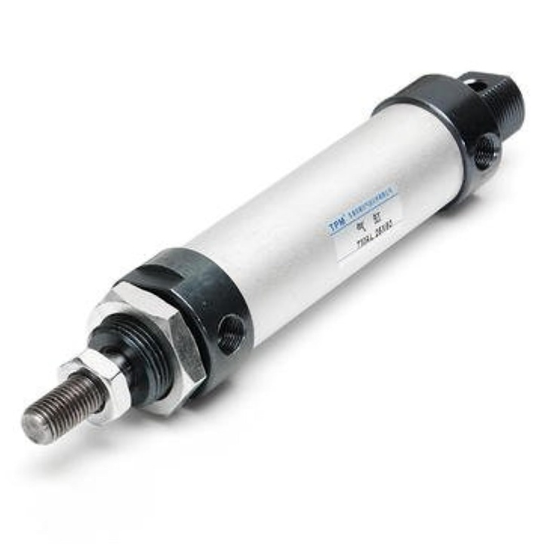
Design Calculations of Pneumatic Cylinder (Ø32 × 50 mm)
1. Piston Area
A=πd²/4
A=3.1416×(0.032)²/4
A=0.0008043 m²
2. Theoretical Force
F=P×A
3. Stroke Volume
V= A×S = 0.0008043×0.05 = 0.00004022 m³ =0.04022L
4.Probably borderline — 804 N is sufficient while we concentrate that force on a narrow, hardened scraper and use oscillation.
Pressure | Calculation | Result
0.7MPa | 7×10⁵ × 0.0008043 | 563N
1.0MPa | 10×10⁵ × 0.0008043 | 804N
Parameter | Result
Air Volume per Stroke | 0.04022L
Practical Air Use per Stroke | 0.04 – 0.05 L

Slide 12
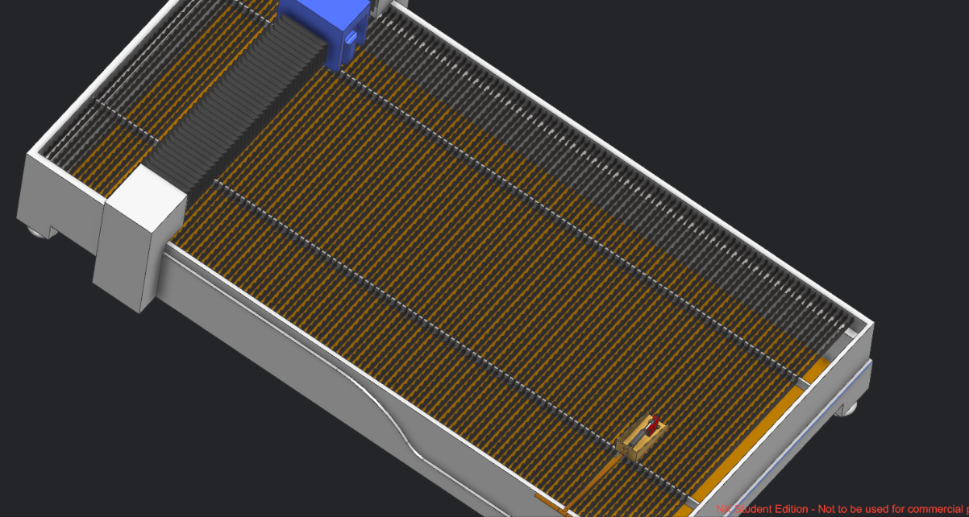
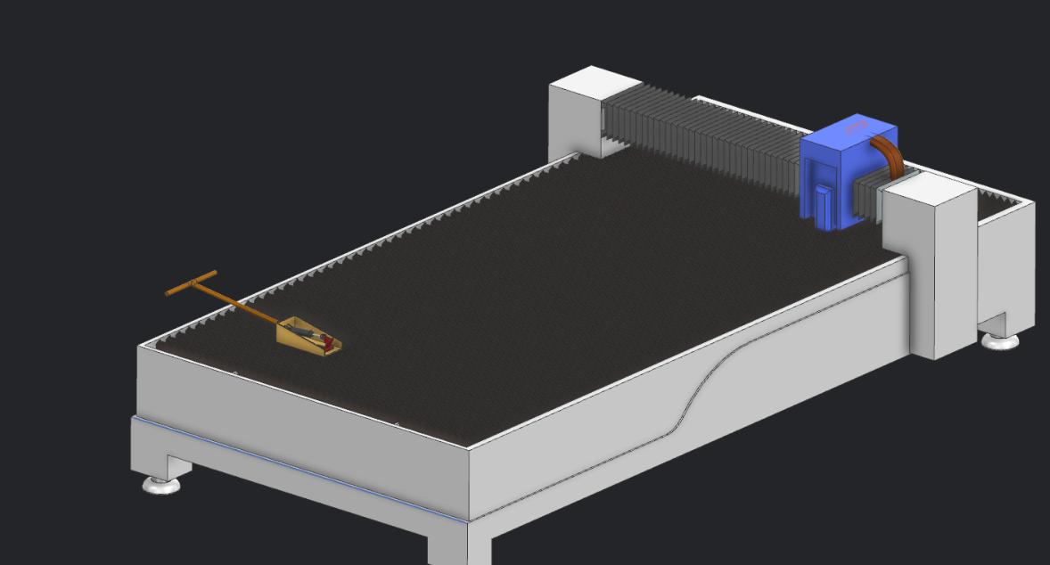
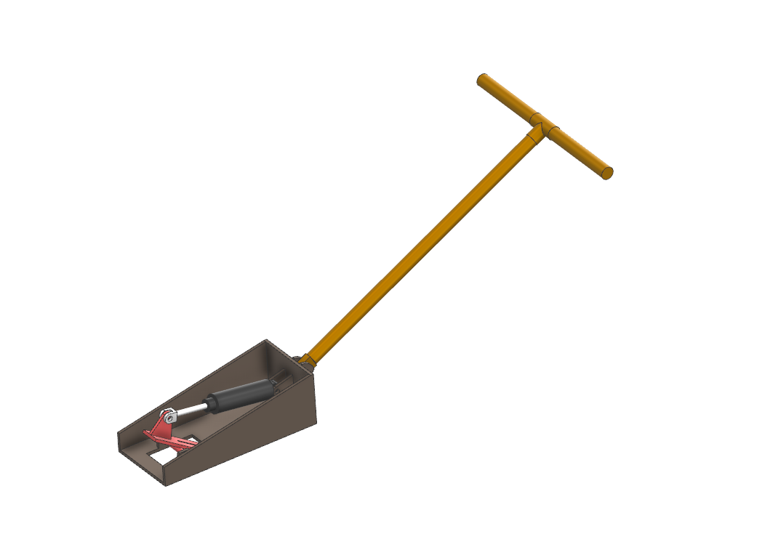
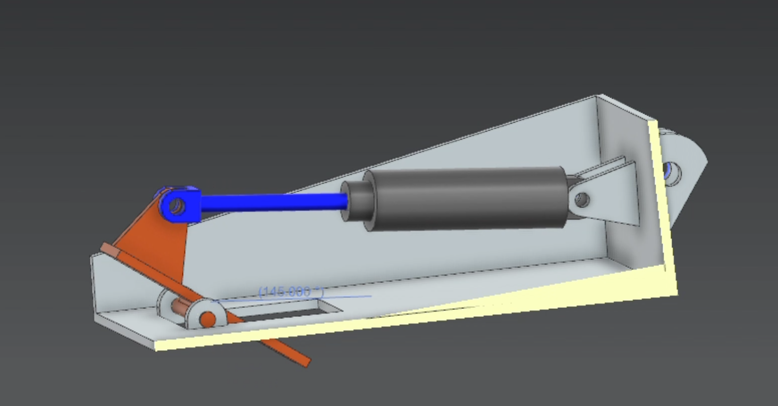

Slide 13
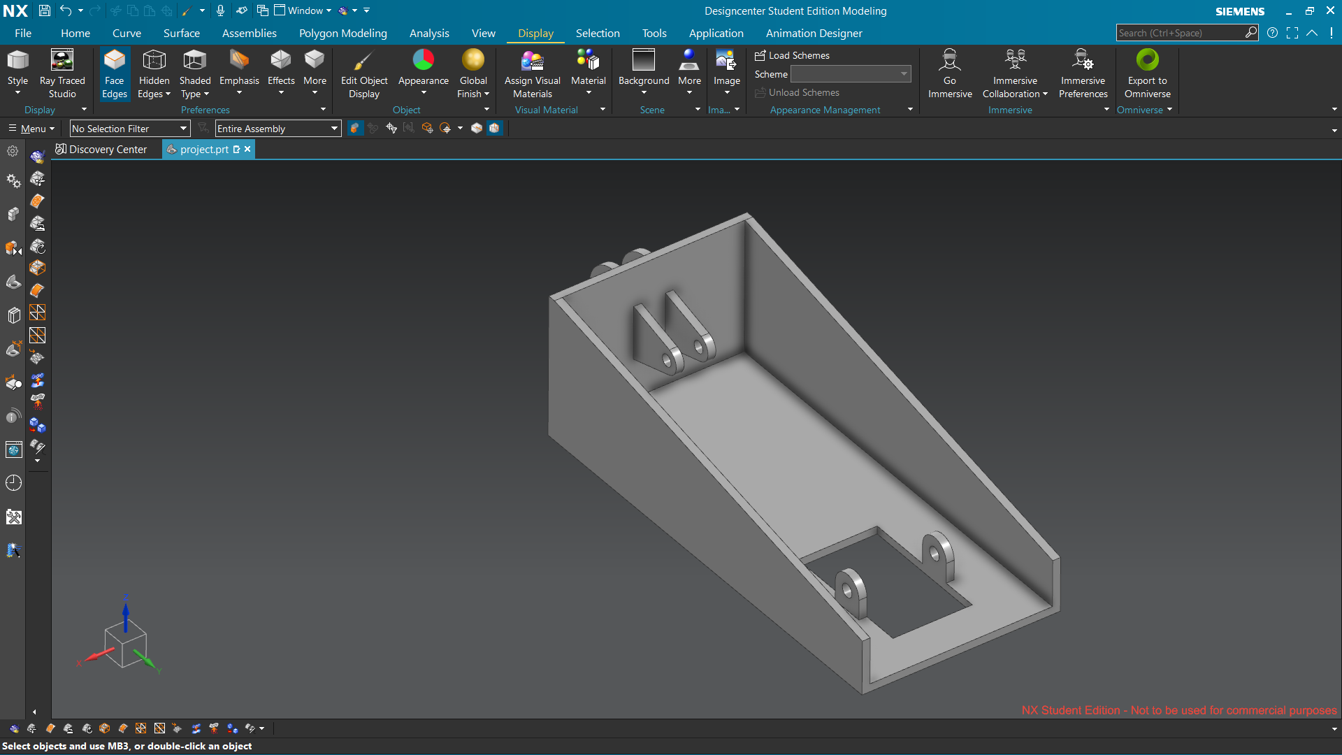
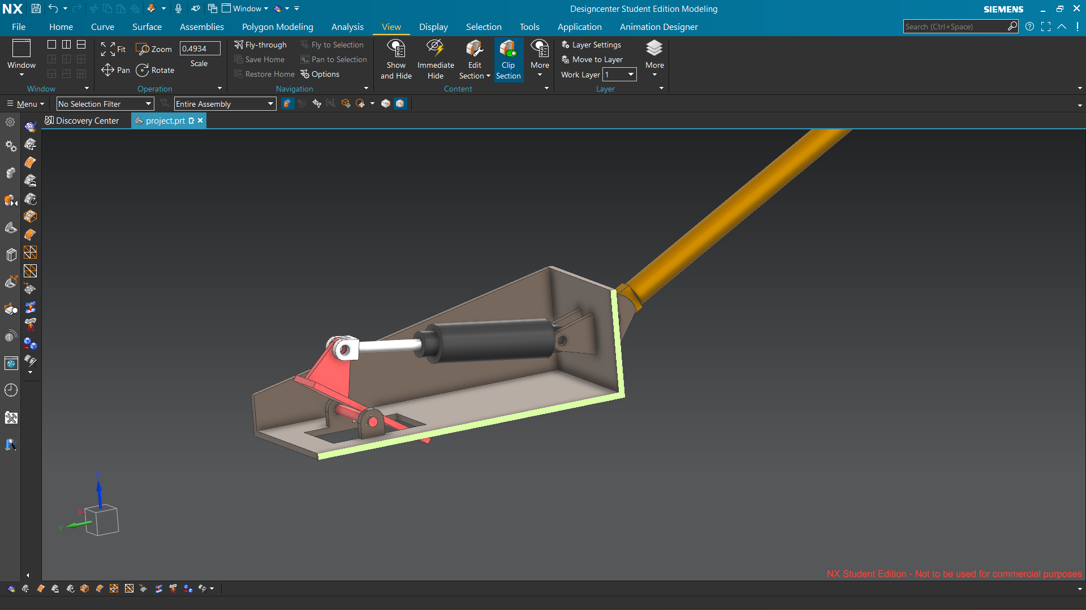
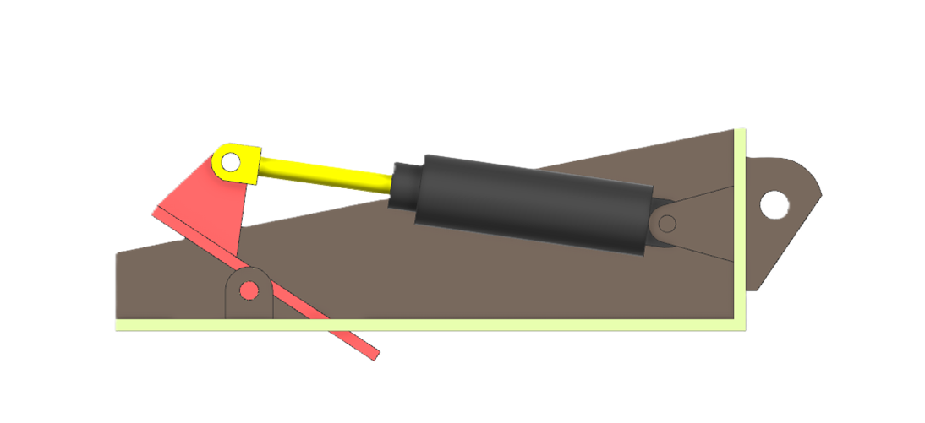

Slide 14
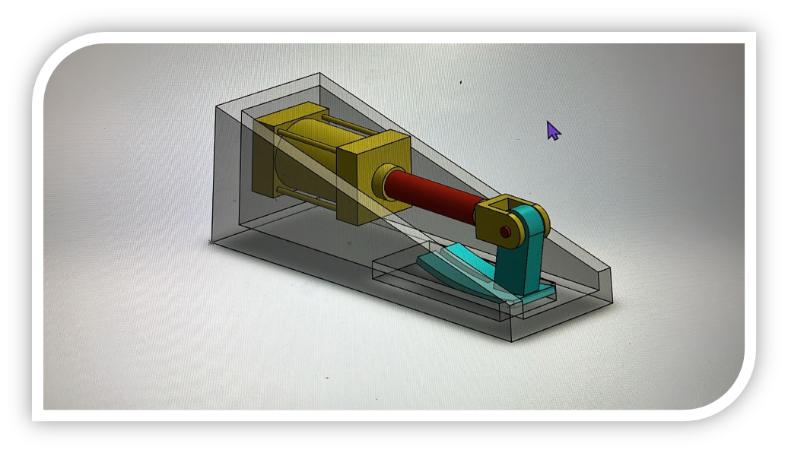
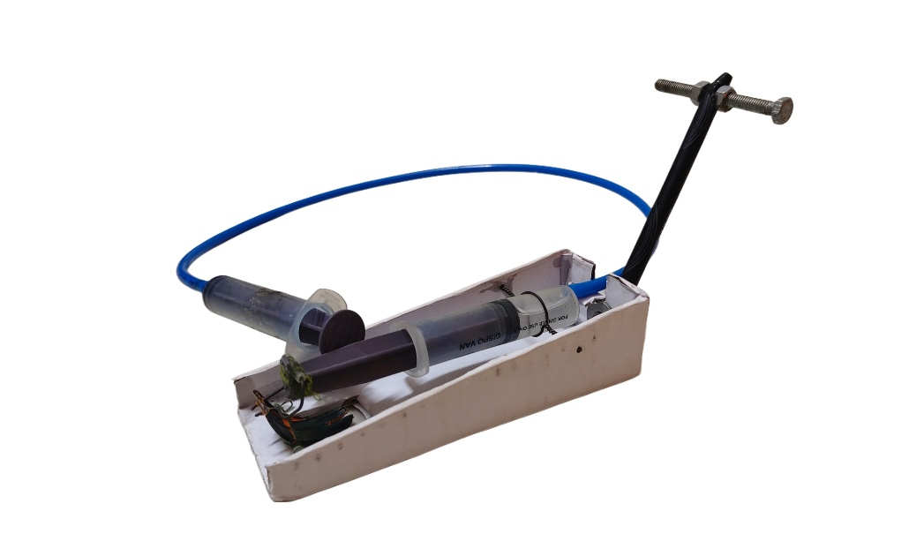
3D Model of Prototype
3D Model
Cardboard and Injection Prototype

Slide 15
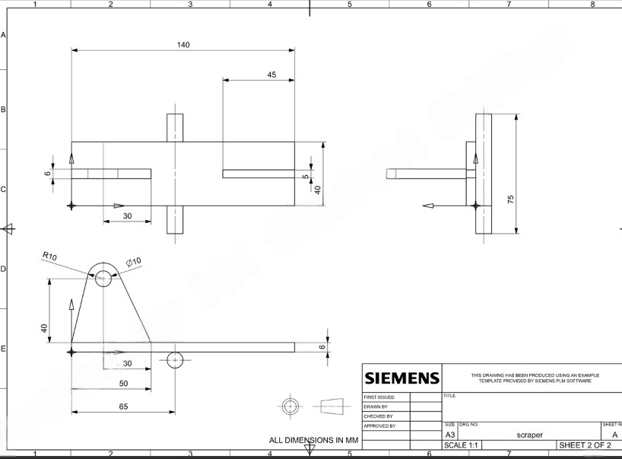
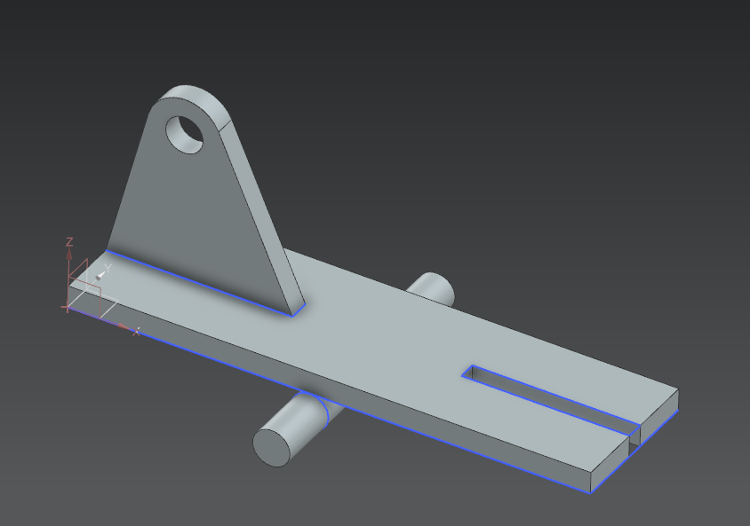
Drawing 2D :- Scraper Blade

Slide 16
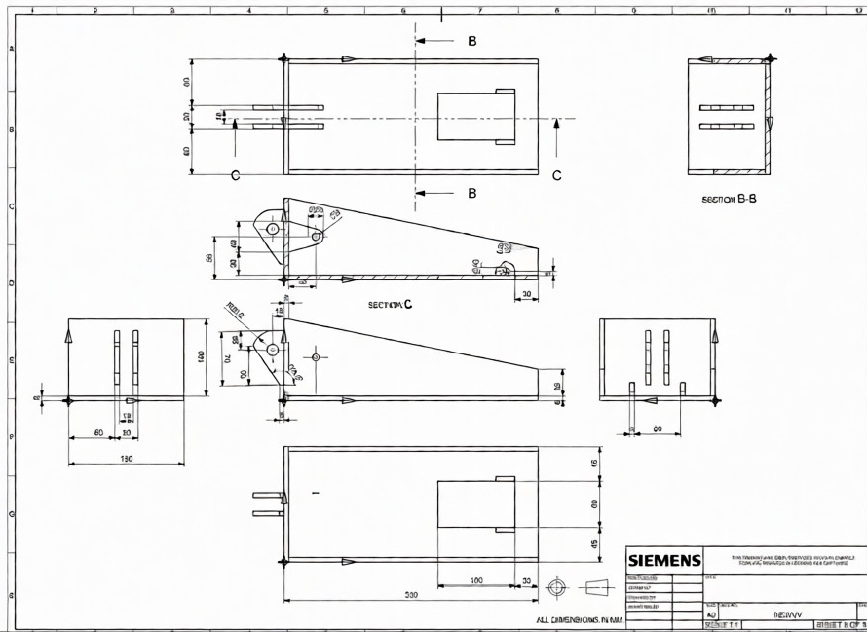
Drawing 2D :- Base

Slide 17
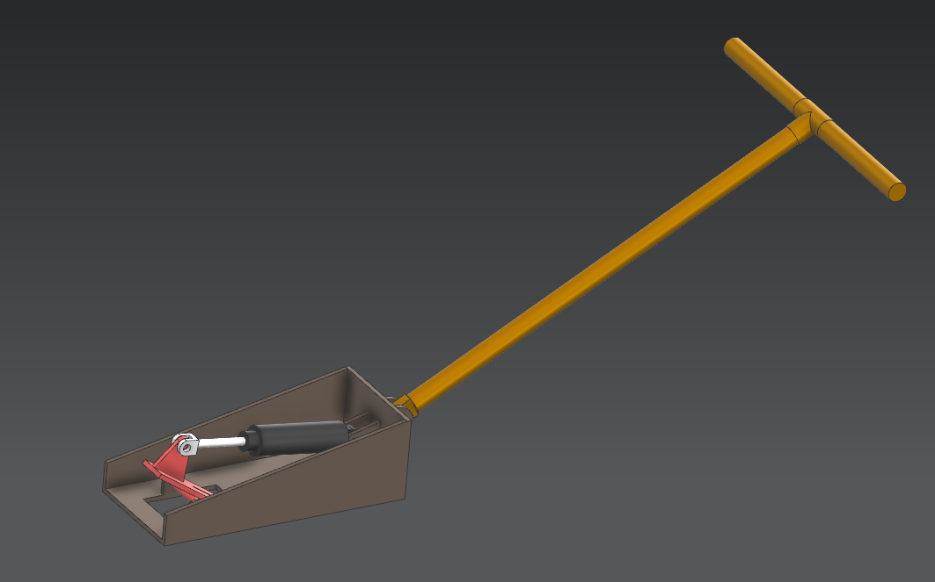
CAD Model of Assembly:-
Sectional Assembly View
Isometric Assembly View

Slide 18
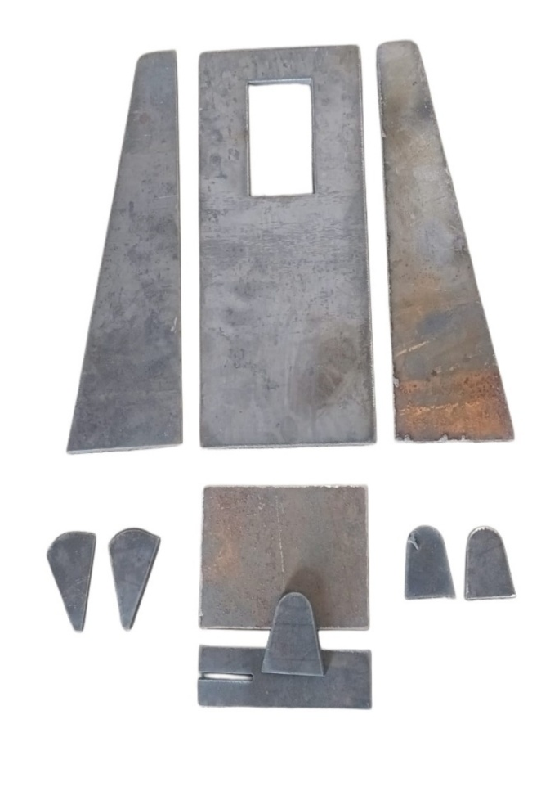
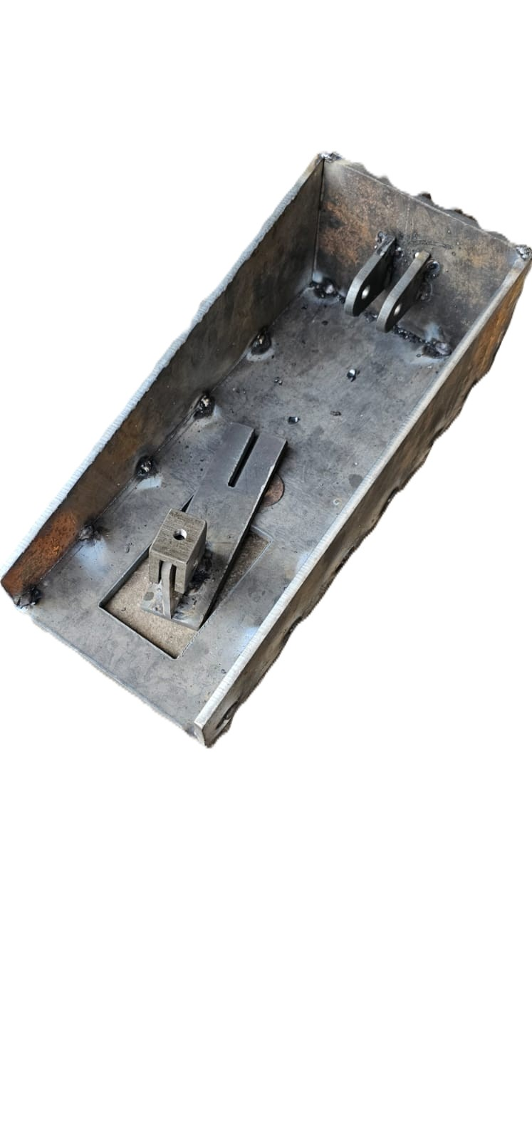
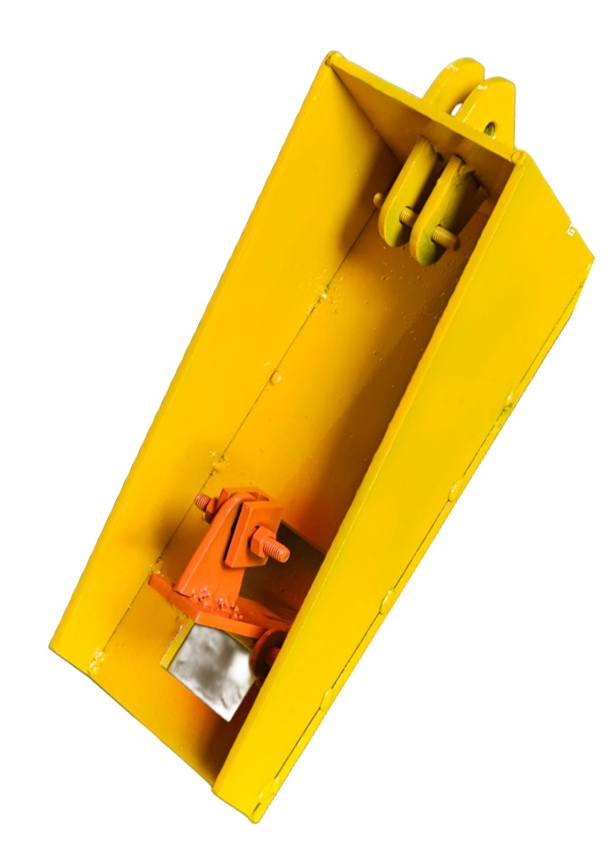
Fabricated Components and Assembly :-
Cut Components
Welded Assembly
Painted Assembly

Slide 19
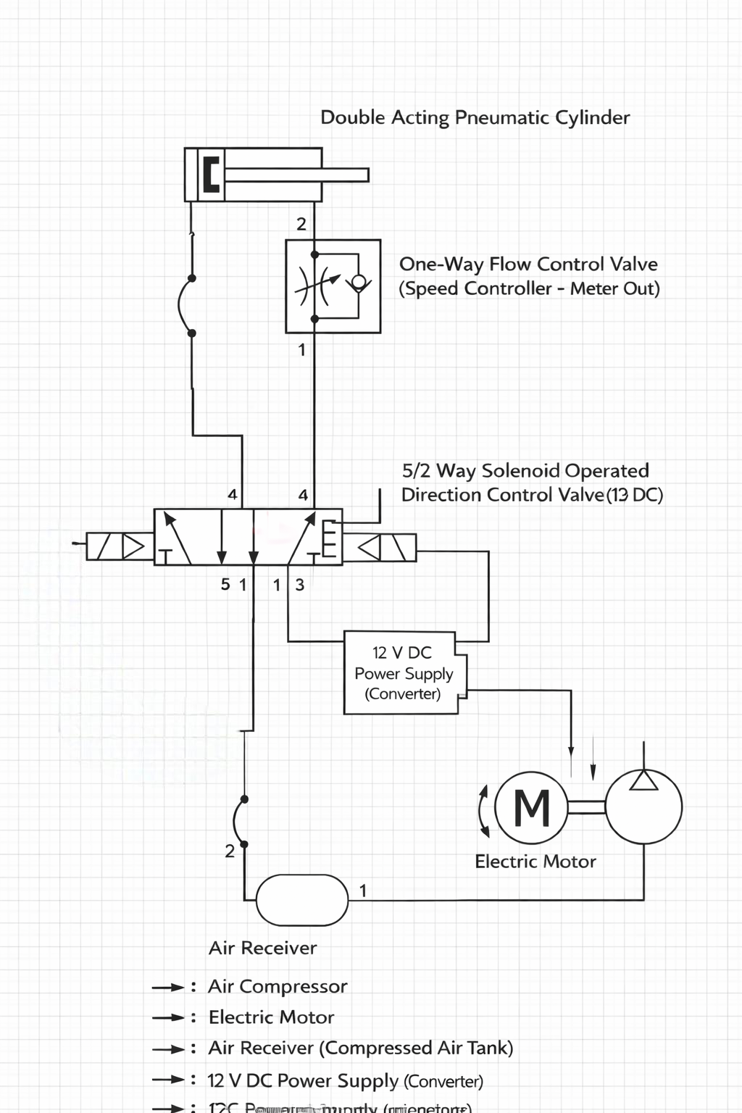
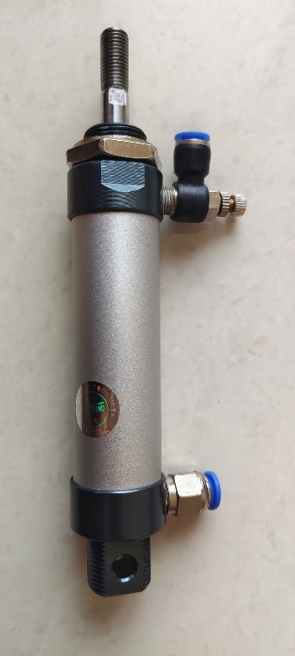

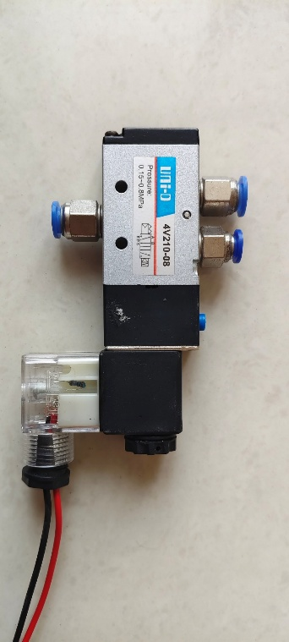
Component Fitting and Working
Double Acting Pneumatic Cylinder
12V DC Power Supply
5/2 Way Solenoid Operted valve

Slide 20
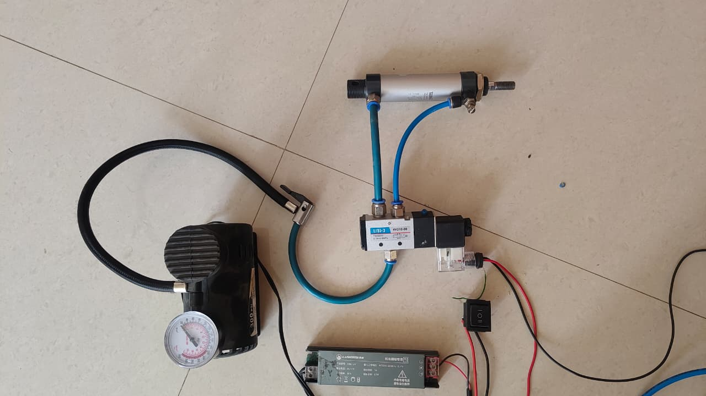
Pneumatic System Setup and Working Configuration
Pneumatic cylinder with solenoid valve control
Air supplied through compressor and pipes
Linear motion achieved using compressed air
Manual switch used for operation

Slide 21
Advantages
Easy to install on existing CNC machines
Compact and portable system
Potential to improve machining accuracy
Provides consistent cleaning mechanism (expected)
Simple and low-cost design
Limitations
System is semi-automatic and requires manual control
Blade may wear over time due to continuous scraping
Proper alignment is required for effective cleaning
Design is specific to current setup and needs modification for larger beds

Slide 22
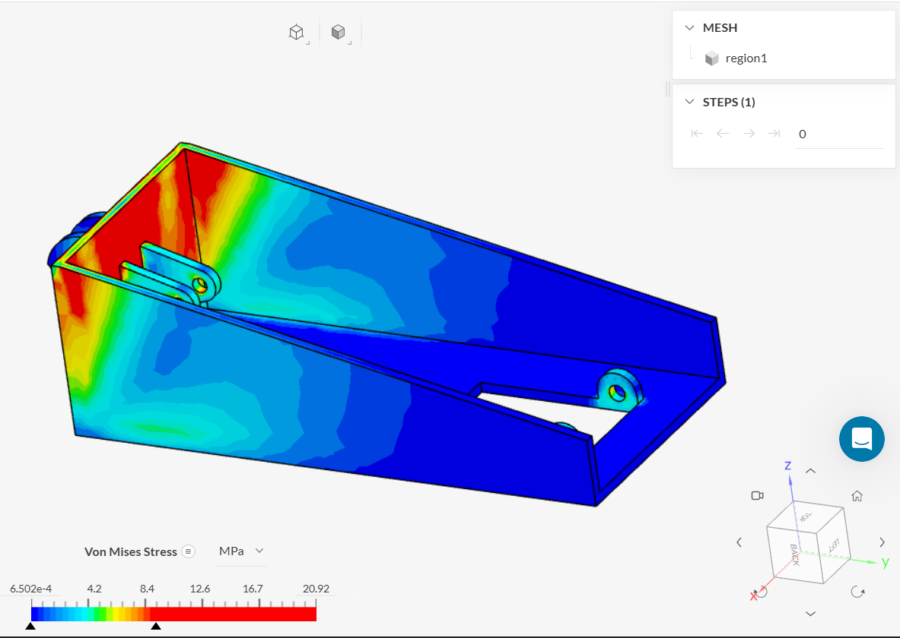
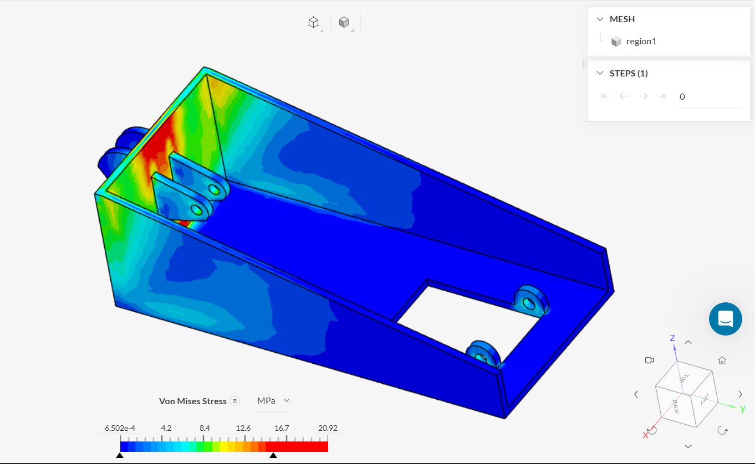
Finite Element Analysis (FEA) Results
Stress is 9.4 MPa
Stress is 10.5 MPa

Slide 23
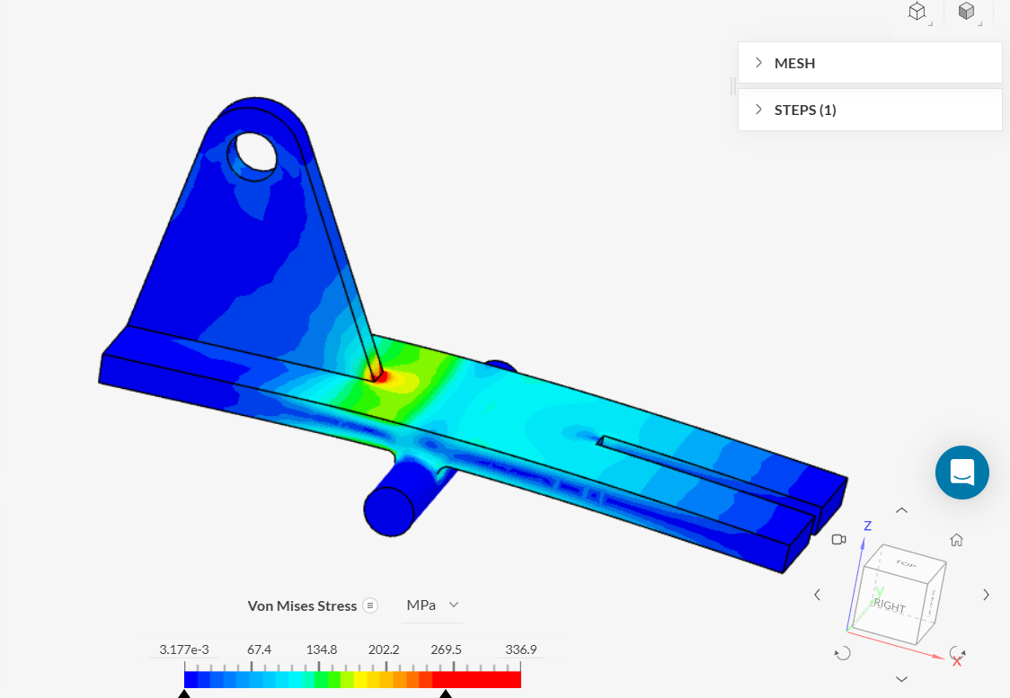
Finite Element Analysis (FEA) Results of Scraper Blade
Factor of Safety (FOS) Analysis
Design is safe with acceptable Factor of Safety
under working conditions.

Slide 24
Cost of Project
Total Estimated Cost = 7000

Slide 25
Timeline of work
Meeting No.1
Problem Identification & Objective Definition
Meeting No.2
Literature Review & Technique Selection (CNC laser cleaning methods, maintenance issues)
Meeting No.3
Concept Design & Initial Sketching
Meeting No.4
3D CAD Modelling (NX/CATIA)
Meeting No.5
Material Selection & Component Collection (scraper, pneumatic cylinder, hinge, etc.)
Meeting No.6
Assembly, Fitting & Working Mechanism Study
Meeting No.7
Finite Element Analysis (FEA) & Load Calculation
Meeting No.8
Results, Optimization & Report Preparation

Slide 26
Thank you!

