Slide 1
PROJECT- Bootstrapping an Amazon EC2 Instance Using User-data to Run a Python Web App
Team Members
Aparna
Venu
Bhanu Prakash
Rajesh
Notes:
PROJECT- Bootstrapping an Amazon EC2 Instance Using User-data to Run a Python Web App
Team Members
Aparna
Venu
Rajesh
Bhanu Prakash

Slide 2
Project- Agenda
Create an AWS CF stack with an Amazon EC2 instance, a security group with inbound access, and an IAM instance profile.
Install software packages on the EC2 instance's first launch by creating a user data asset.
Configure the software packages after installation using a script downloaded by the user data.
Deploy the application using user data.

Slide 3
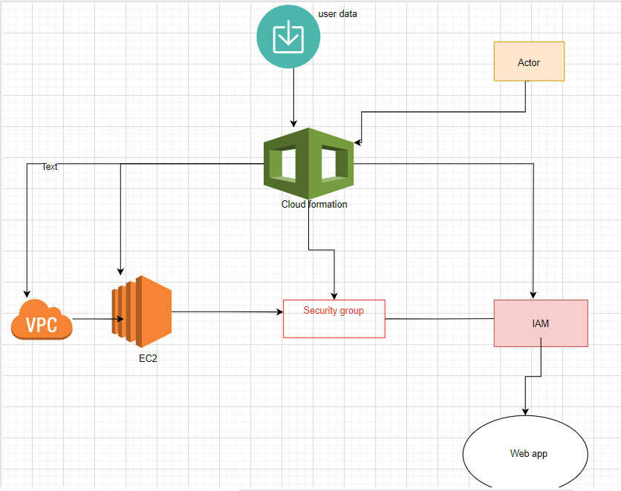
Project Architecture Diagram

Slide 4
.Create a vpc, subnets, IGW, Security groups,IAM, Key Pairs for EC2 instances with form of cloudformation script
.Then Upload YAML File In CloudFormation To Create Stack
Notes:
Create a vpc, subnets, IGW, Security groups,IAM, for EC2 instances with form of cloudformation script
Then Upload YAML File In CloudFormation To Create Stack

Slide 5
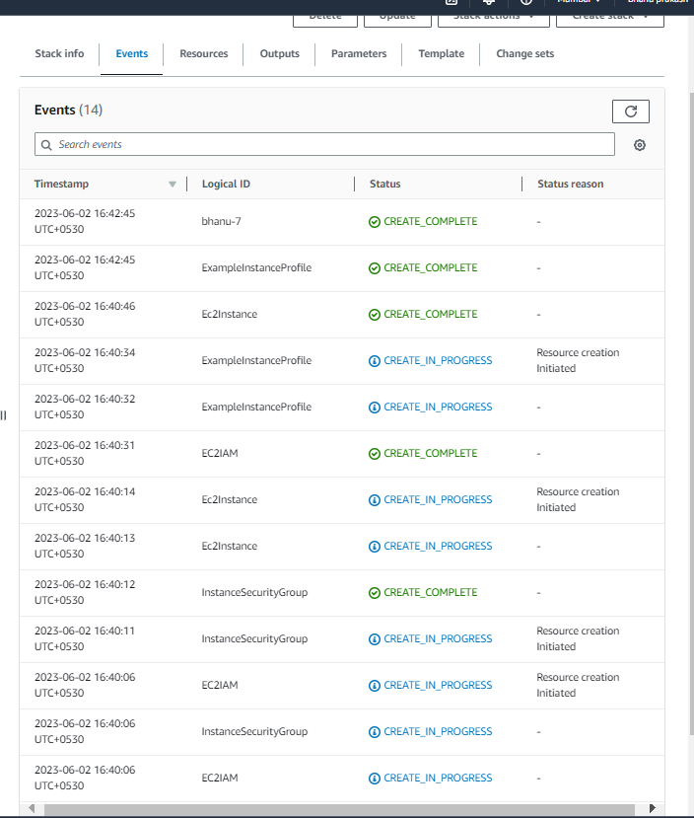
Events in CloudFormation
Notes:
Events in CloudFormation

Slide 6
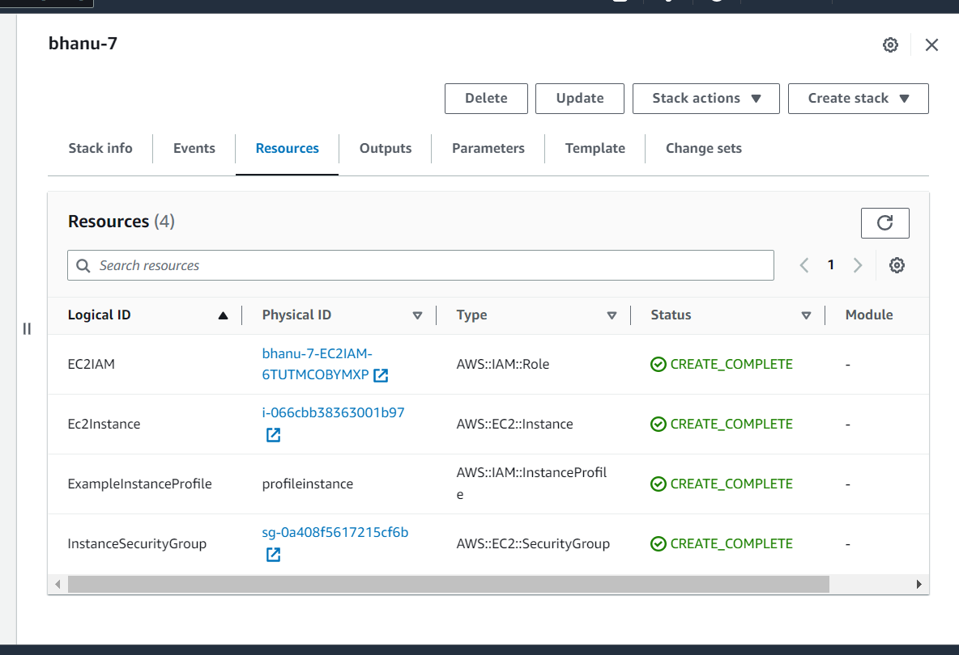
Resources created
EC2 instances
Security Groups With Inbound Access
IAM instance Profile
IAM Roles For Instance Profile
Notes:
Resources created
EC2 instances
Security Groups With Inbound Access
IAM instance Profile
IAM Roles For Instance Profile

Slide 7
EC2 Properties Defined
Instance Type : t2.micro
Keypair : Created Keypair
Image ID : Latest Amazon Linux 2
Security Group Properties Defined
Inbound Access 2. Outbound Access
SSH Access Via Port 22 1. All Traficc Access
http Access via Port 80
https Access via Port 443
Flask Access via Port 5000
IAM Instance Profile With Role As root Policy
1. AmazonEC2RoleforAWSCodeDeploy
2. AmazonSSMManagedInstanceCore

Slide 8
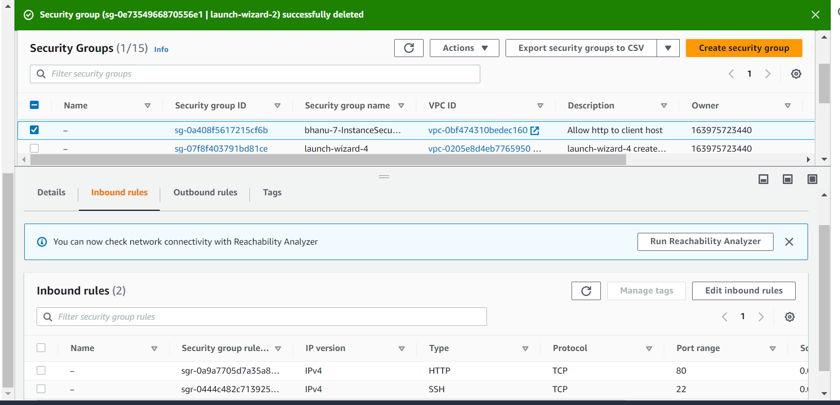
Security Group Inbound Rules Created By CF

Slide 9
User Data Bootstrapped
yum update -y
yum install -y httpd.x86_64
systemctl start httpd.service
systemctl enable httpd.service
yum install python3-pip -y
yum install git -y
pip3 install virtualenv
echo Hello Everyone Updated Software Pakages Installed httpd Started httpd Installed python3-pip
And VirtualEnv Installed Flask Installed Git For Cloning > /var/www/html/index.html

Slide 10
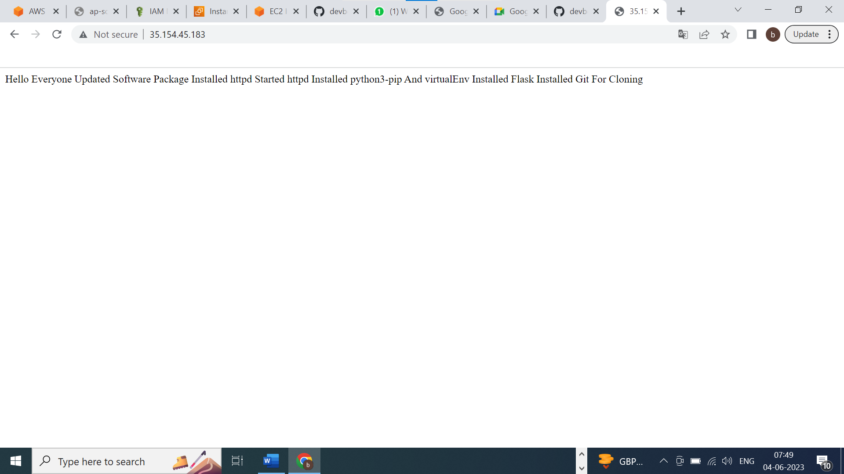

Slide 11
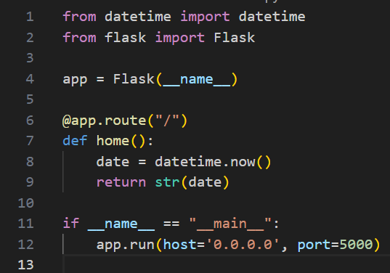
Python Flask Webapp Code To Display Date & Time

Slide 12
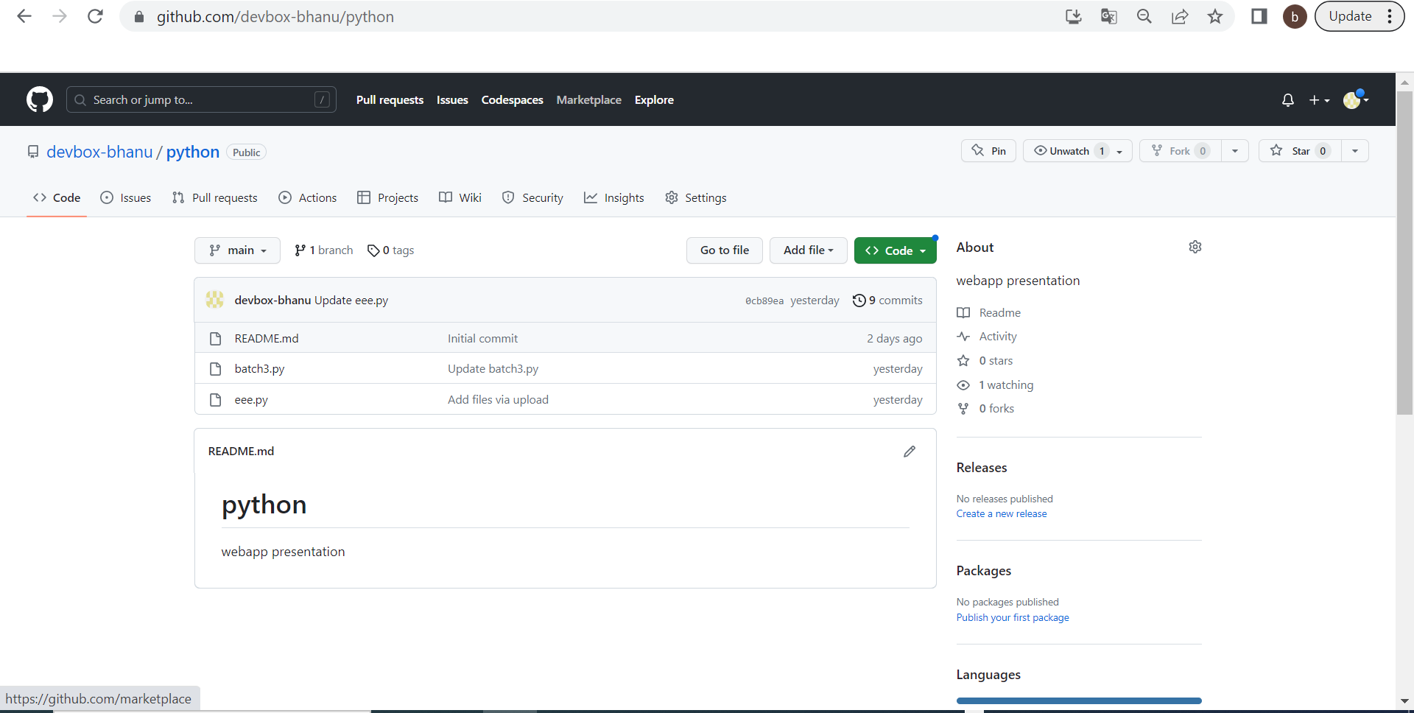
Created git Repository For eee.py

Slide 13
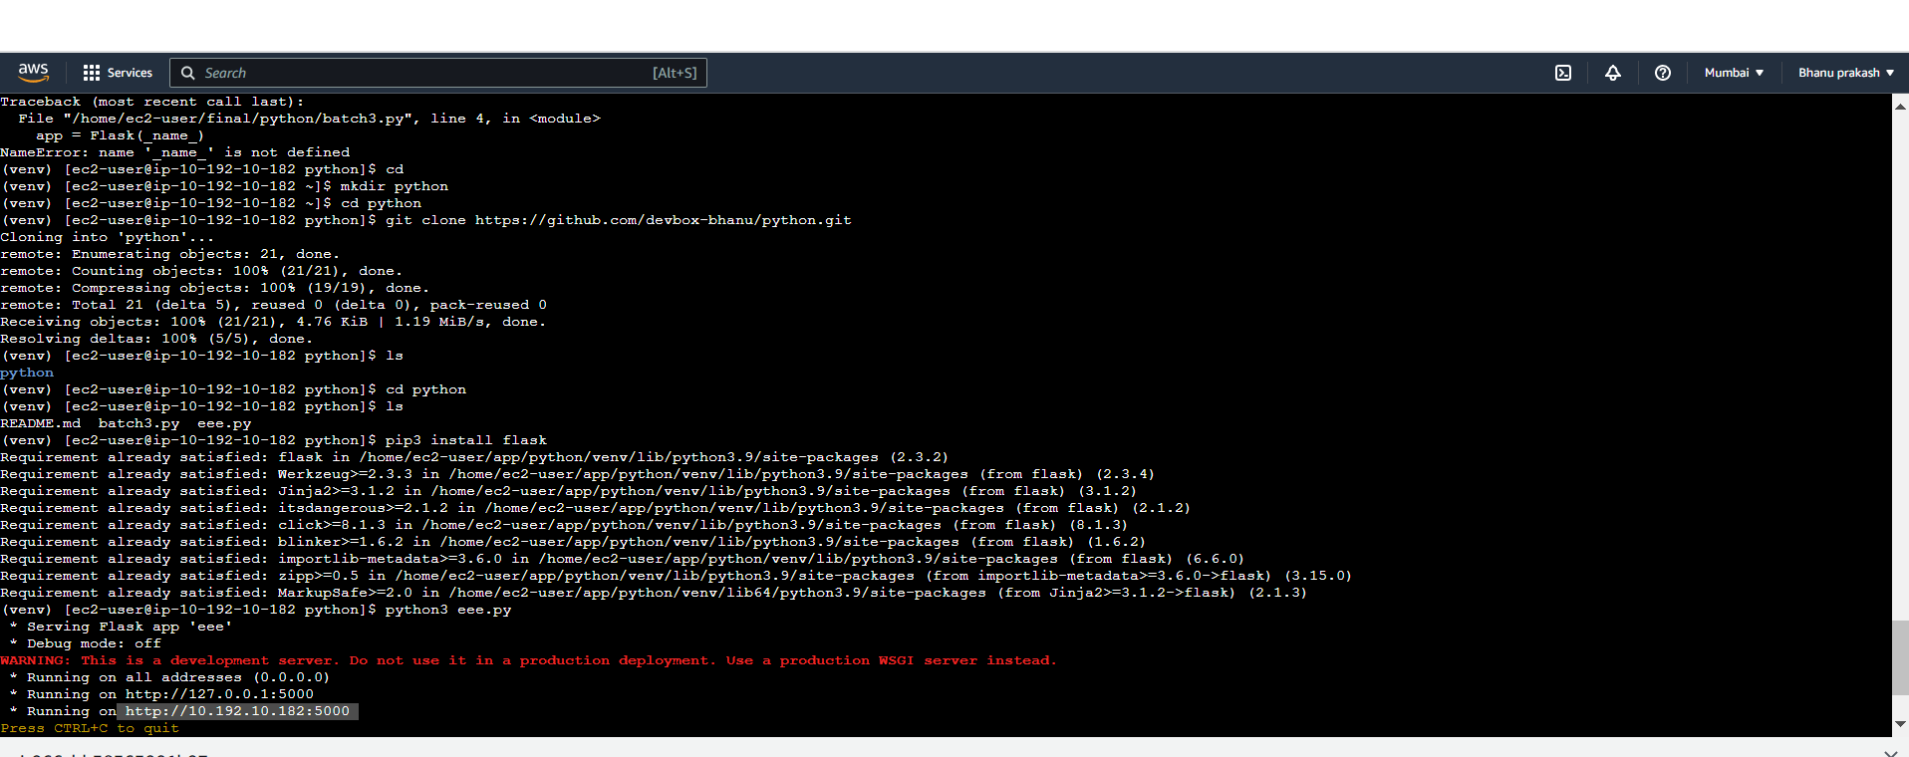
Connect EC2 Instance Thru EC2 Connect
mkdir python ~ To Create New App Directory
Cd python ~ To Change To Created Directory
git clone < https://github.com/devbox-bhanu/python.git
cd python ~ To Change To App Downloded Directory
ls ~ List Out eee.py batch3.py & README.md Files

Slide 14
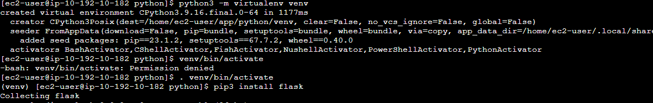
python3 -m virtualenv venv ~ To Create Virtual Environment
2. . venv/bin/activate ~ To Activate Virtual Environment
3. pip3 install Flask ~ To Install Flask

Slide 15
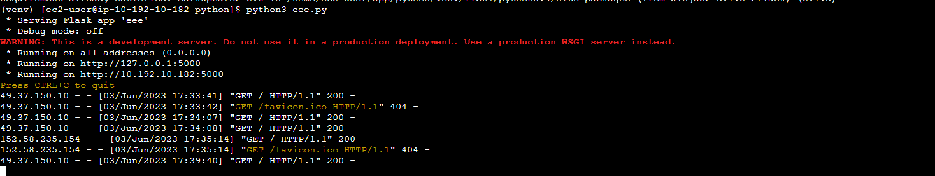
Python3 eee.py ~ To Deploy Flask Web App On Default Port No. 5000
http://publicIP:5000
http://http://35.154.45.183:5000/:5000/

Slide 16
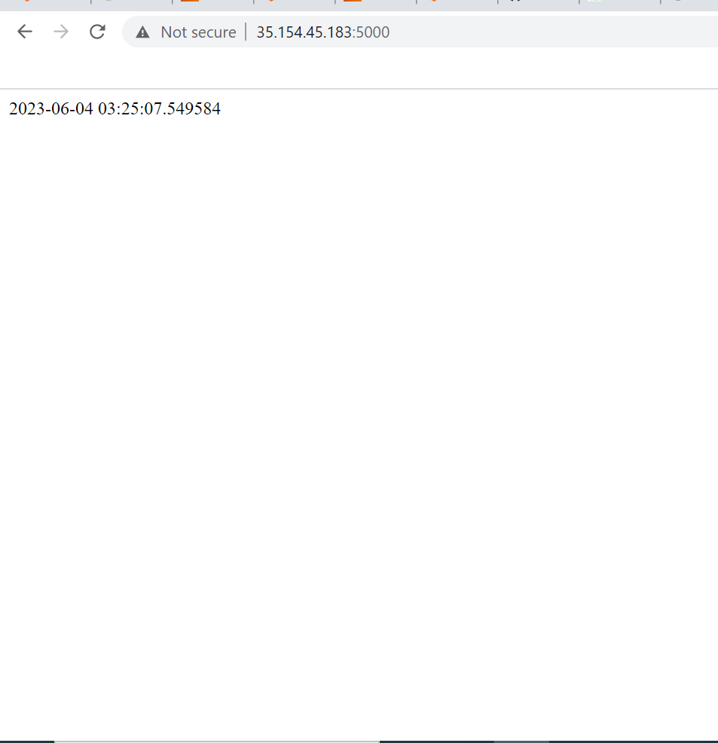
Deployed Flask Web App

Slide 17
Sl No. | Resources Used | Cost Involved
1 | EC2 Instance – t2.micro | $0.0116 Per Hour
2 | Security Group | No Charge
3 | IAM Role | No Charge
4 | Instance Profile | No Charge

Slide 18
Conclusion
1. I have finished the Build a Web Application on Amazon EC2 tutorial using CF to provision all
infrastructure, and configured your EC2 instance to install and configure OS packages to run the sample Python web app
Notes:
CONCLUSION

Slide 19
THANK YOU
Notes:
THANK YOU

