Slide 1
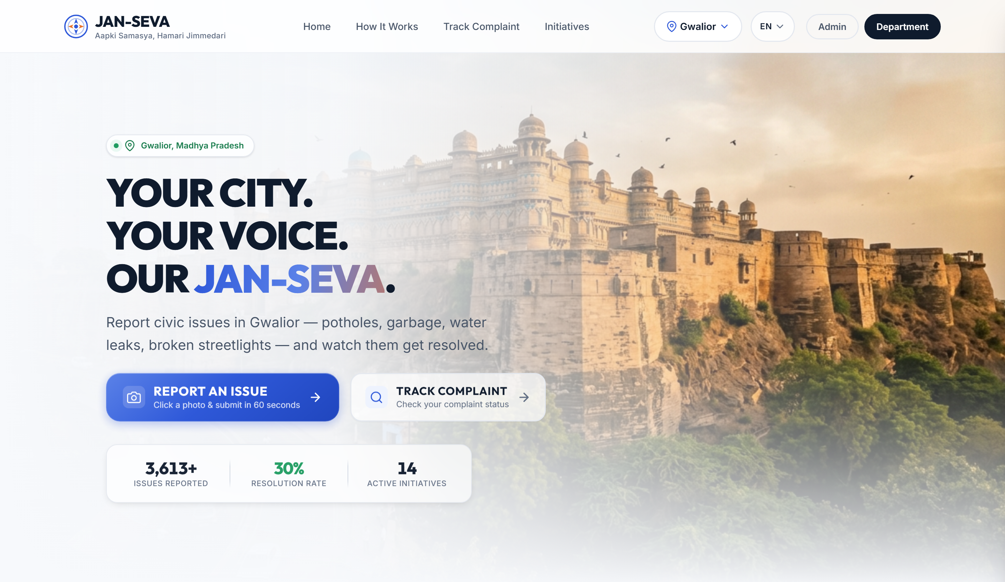

SMART INDIA HACKATHON 2026
TITLE PAGE
JAN-SEVA
जन-सेवा · Aapki Samasya, Hamari Jimmedari
Every citizen report becomes an evidence-bound job against a named piece of city infrastructure.
Problem Statement ID SIH018
Problem Statement Title Smart Civic Issue Reporting Platform
Theme Smart Automation
PS Category Software
Team Name Future Minds
Team ID <Enter Team ID>
Working prototype — not a mockup.
Citizen portal, five department portals and an Admin Command Centre — built and running.
Proof of Repair
Civic Asset Memory
One-Trip Work Card

Slide 2
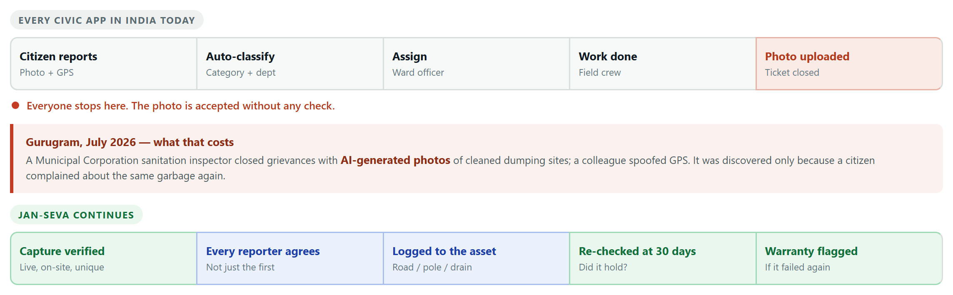
IDEA TITLE
Team Future Minds
Proposed Solution — India already solved civic reporting. Nobody verifies the repair. JAN-SEVA does.
1 Proof of Repair
Captured live in-app, at the location, on an un-spoofed device — and never reused.
2 Civic Asset Memory
Attached to a road segment, pole or drain. A repeat failure in the liability period is a warranty claim, not a new bill.
3 One-Trip Work Card
Same-skill jobs nearby are batched into one routed, offline visit. The crew drives once, not five times.

Slide 3
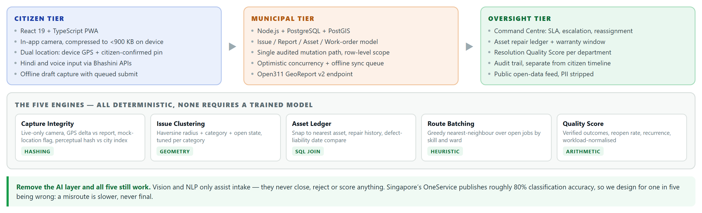
TECHNICAL APPROACH
Team Future Minds
Built and running today
• Citizen, department and admin portals — wizard, live tracking, SLA, escalation, audit trail
• Offline sync queue — ordered retry with backoff; no field note lost on weak signal
• Privacy by type — public view has no reporter field, so identity can’t leak
What we still have to build
• Server-side capture proof — nonce, RFC 3161 timestamp, Play Integrity, mock-location check
• Asset layer — real geometry from ULB GIS, or OSM segments where none exists
• Bhashini integration — Hindi speech to a structured complaint

Slide 4
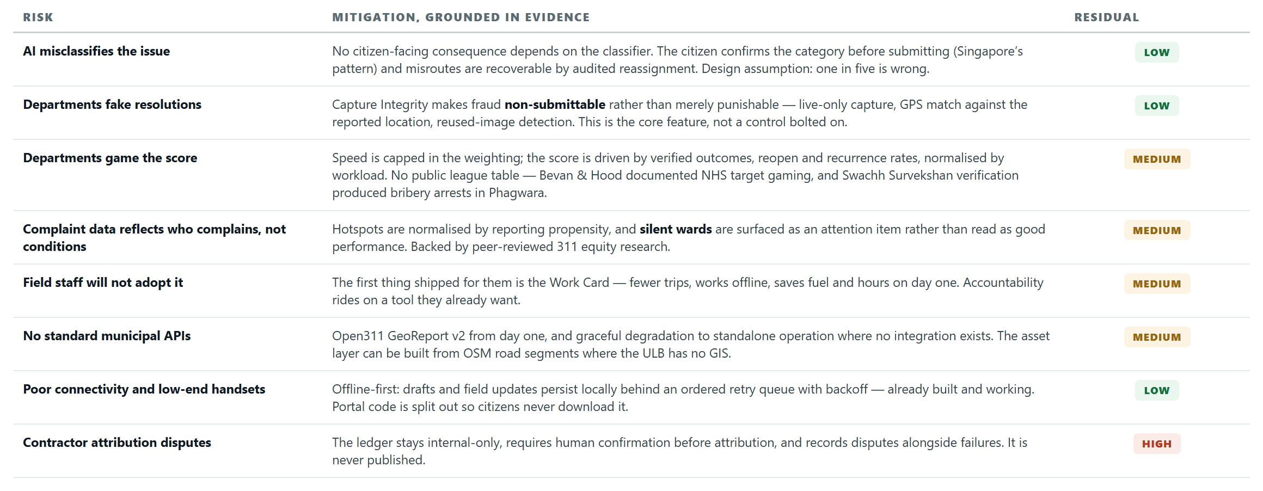
FEASIBILITY AND VIABILITY
Team Future Minds
Feasibility is already demonstrated — a working three-portal prototype exists, and every core engine is deterministic — hashing, geometry, a SQL join, a greedy heuristic.

Slide 5
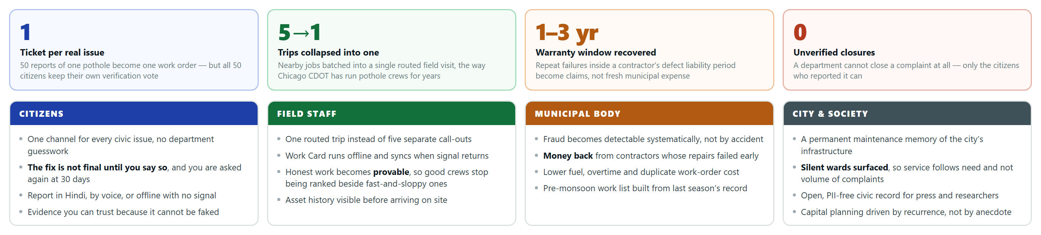
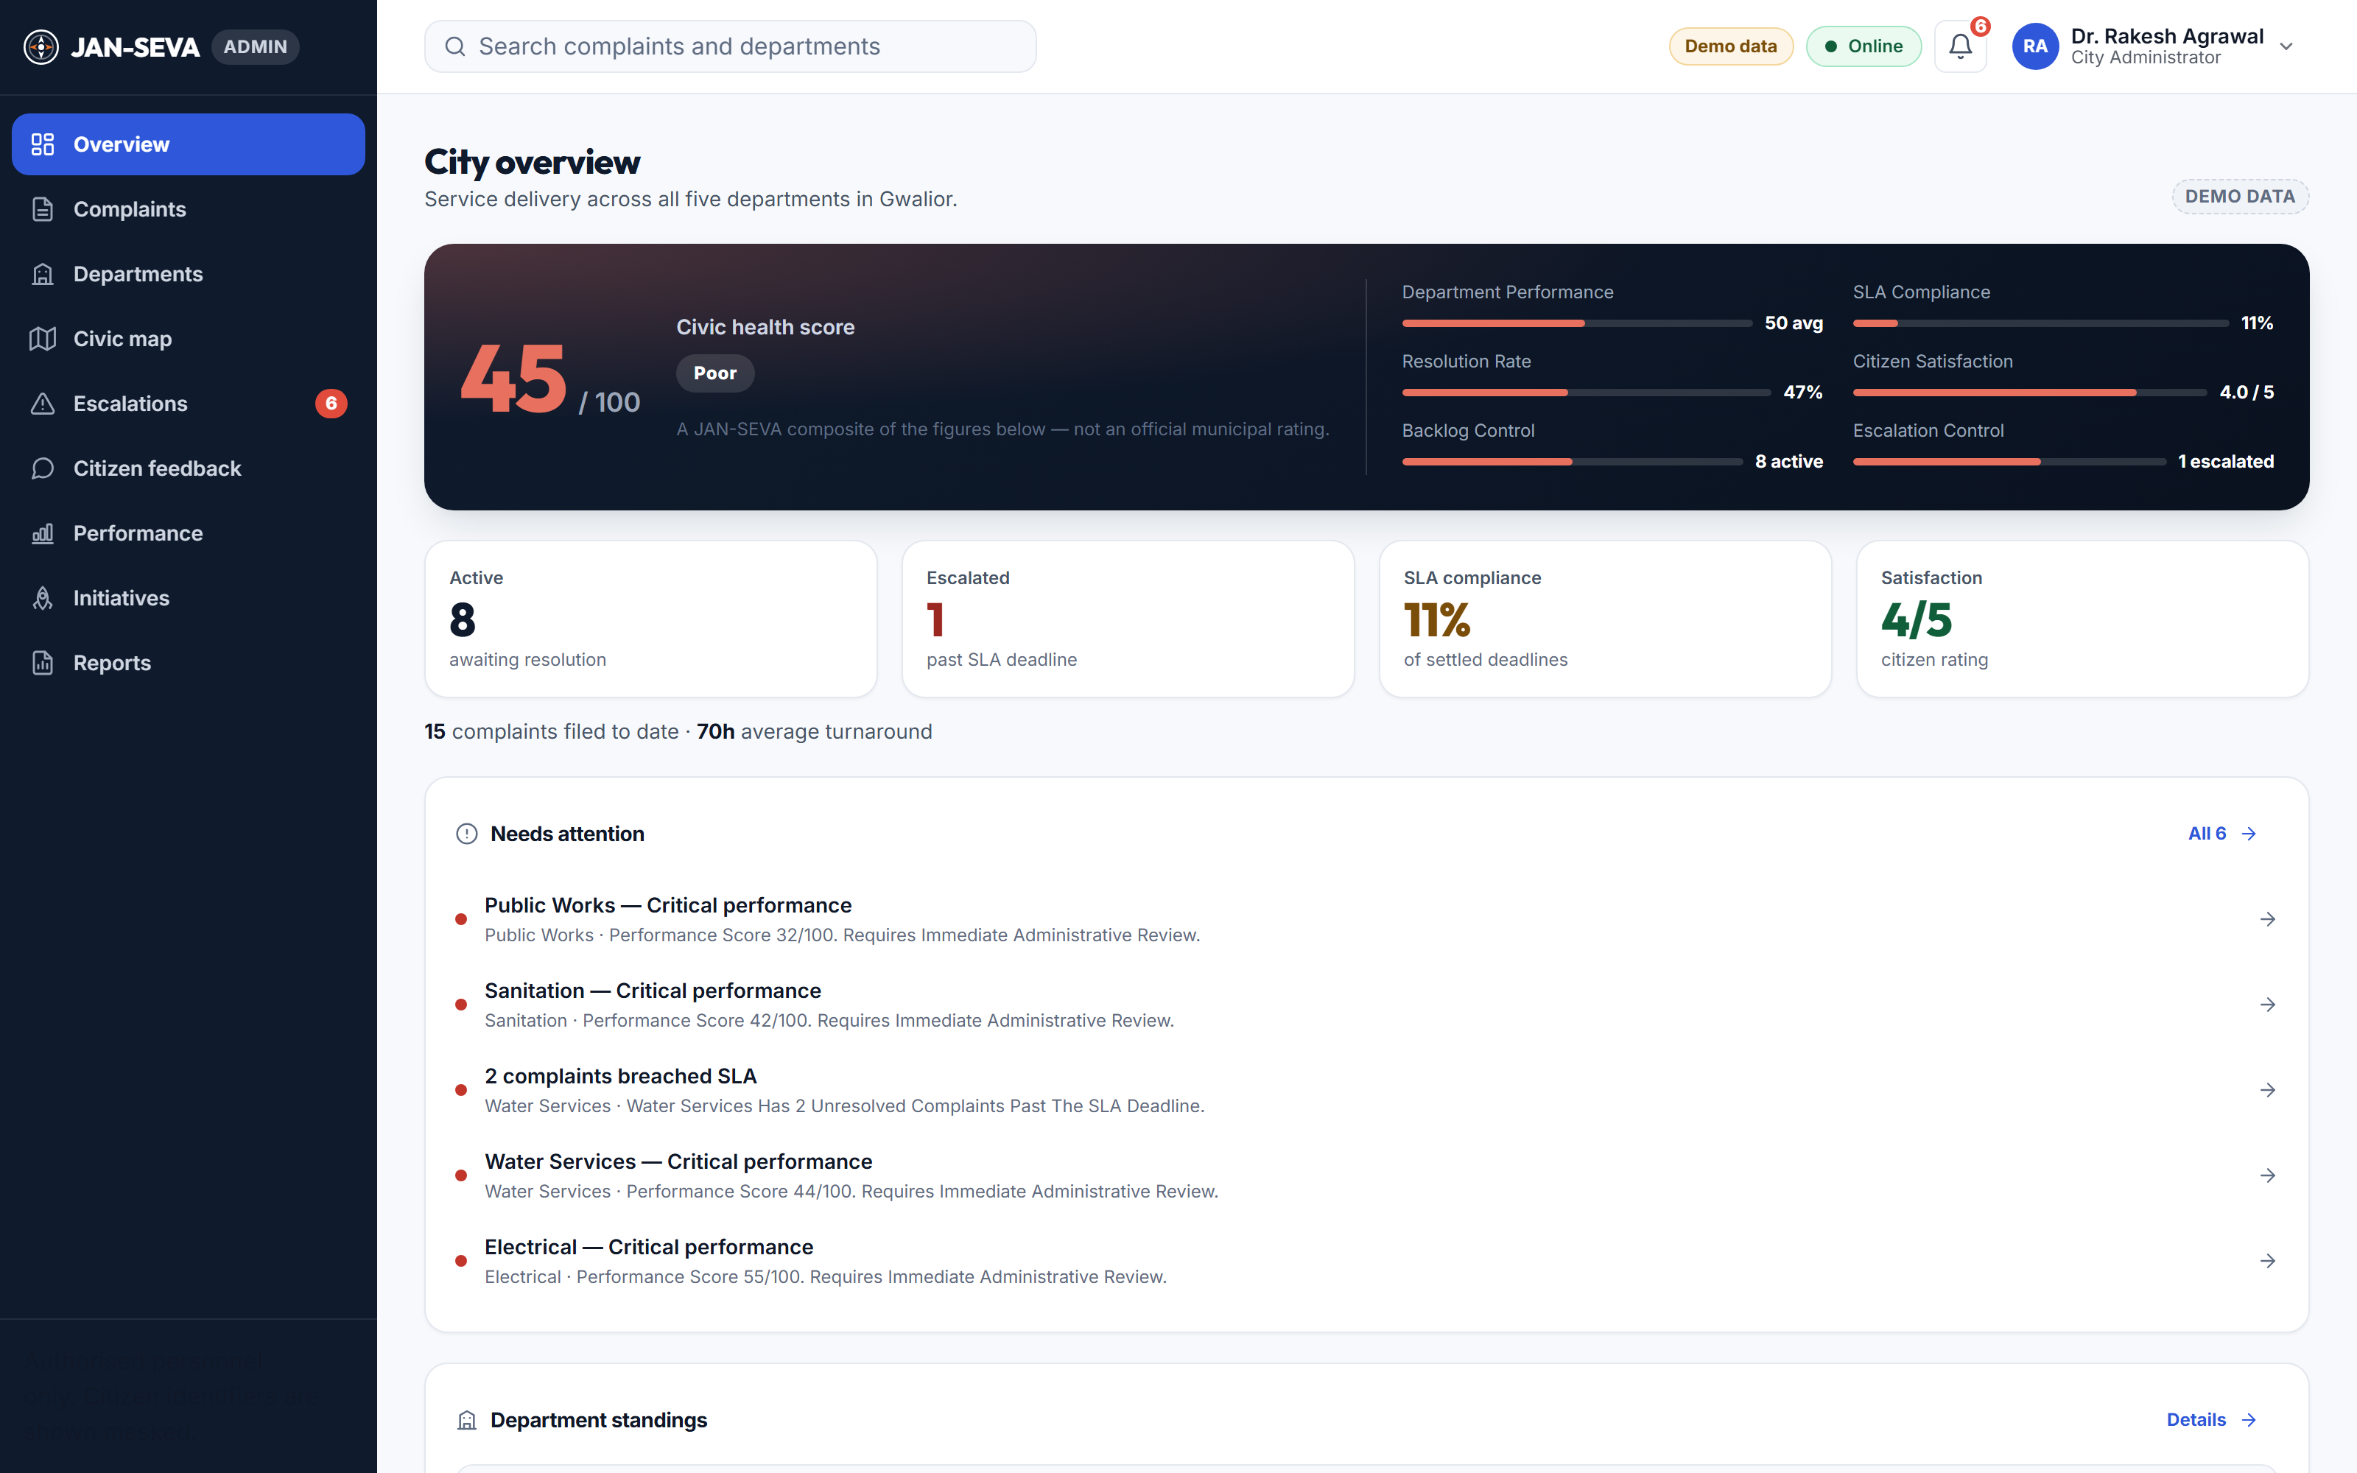
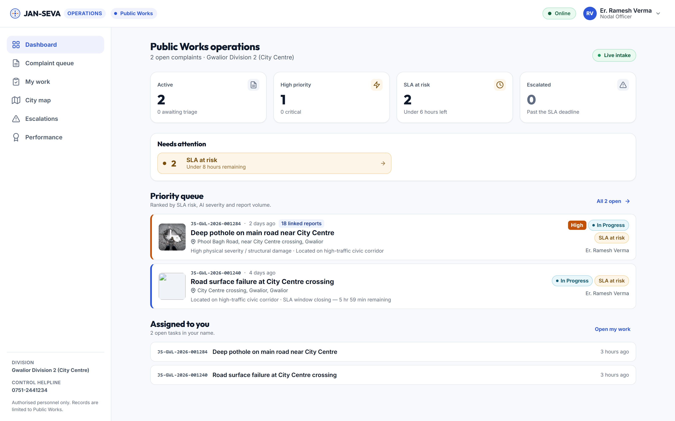
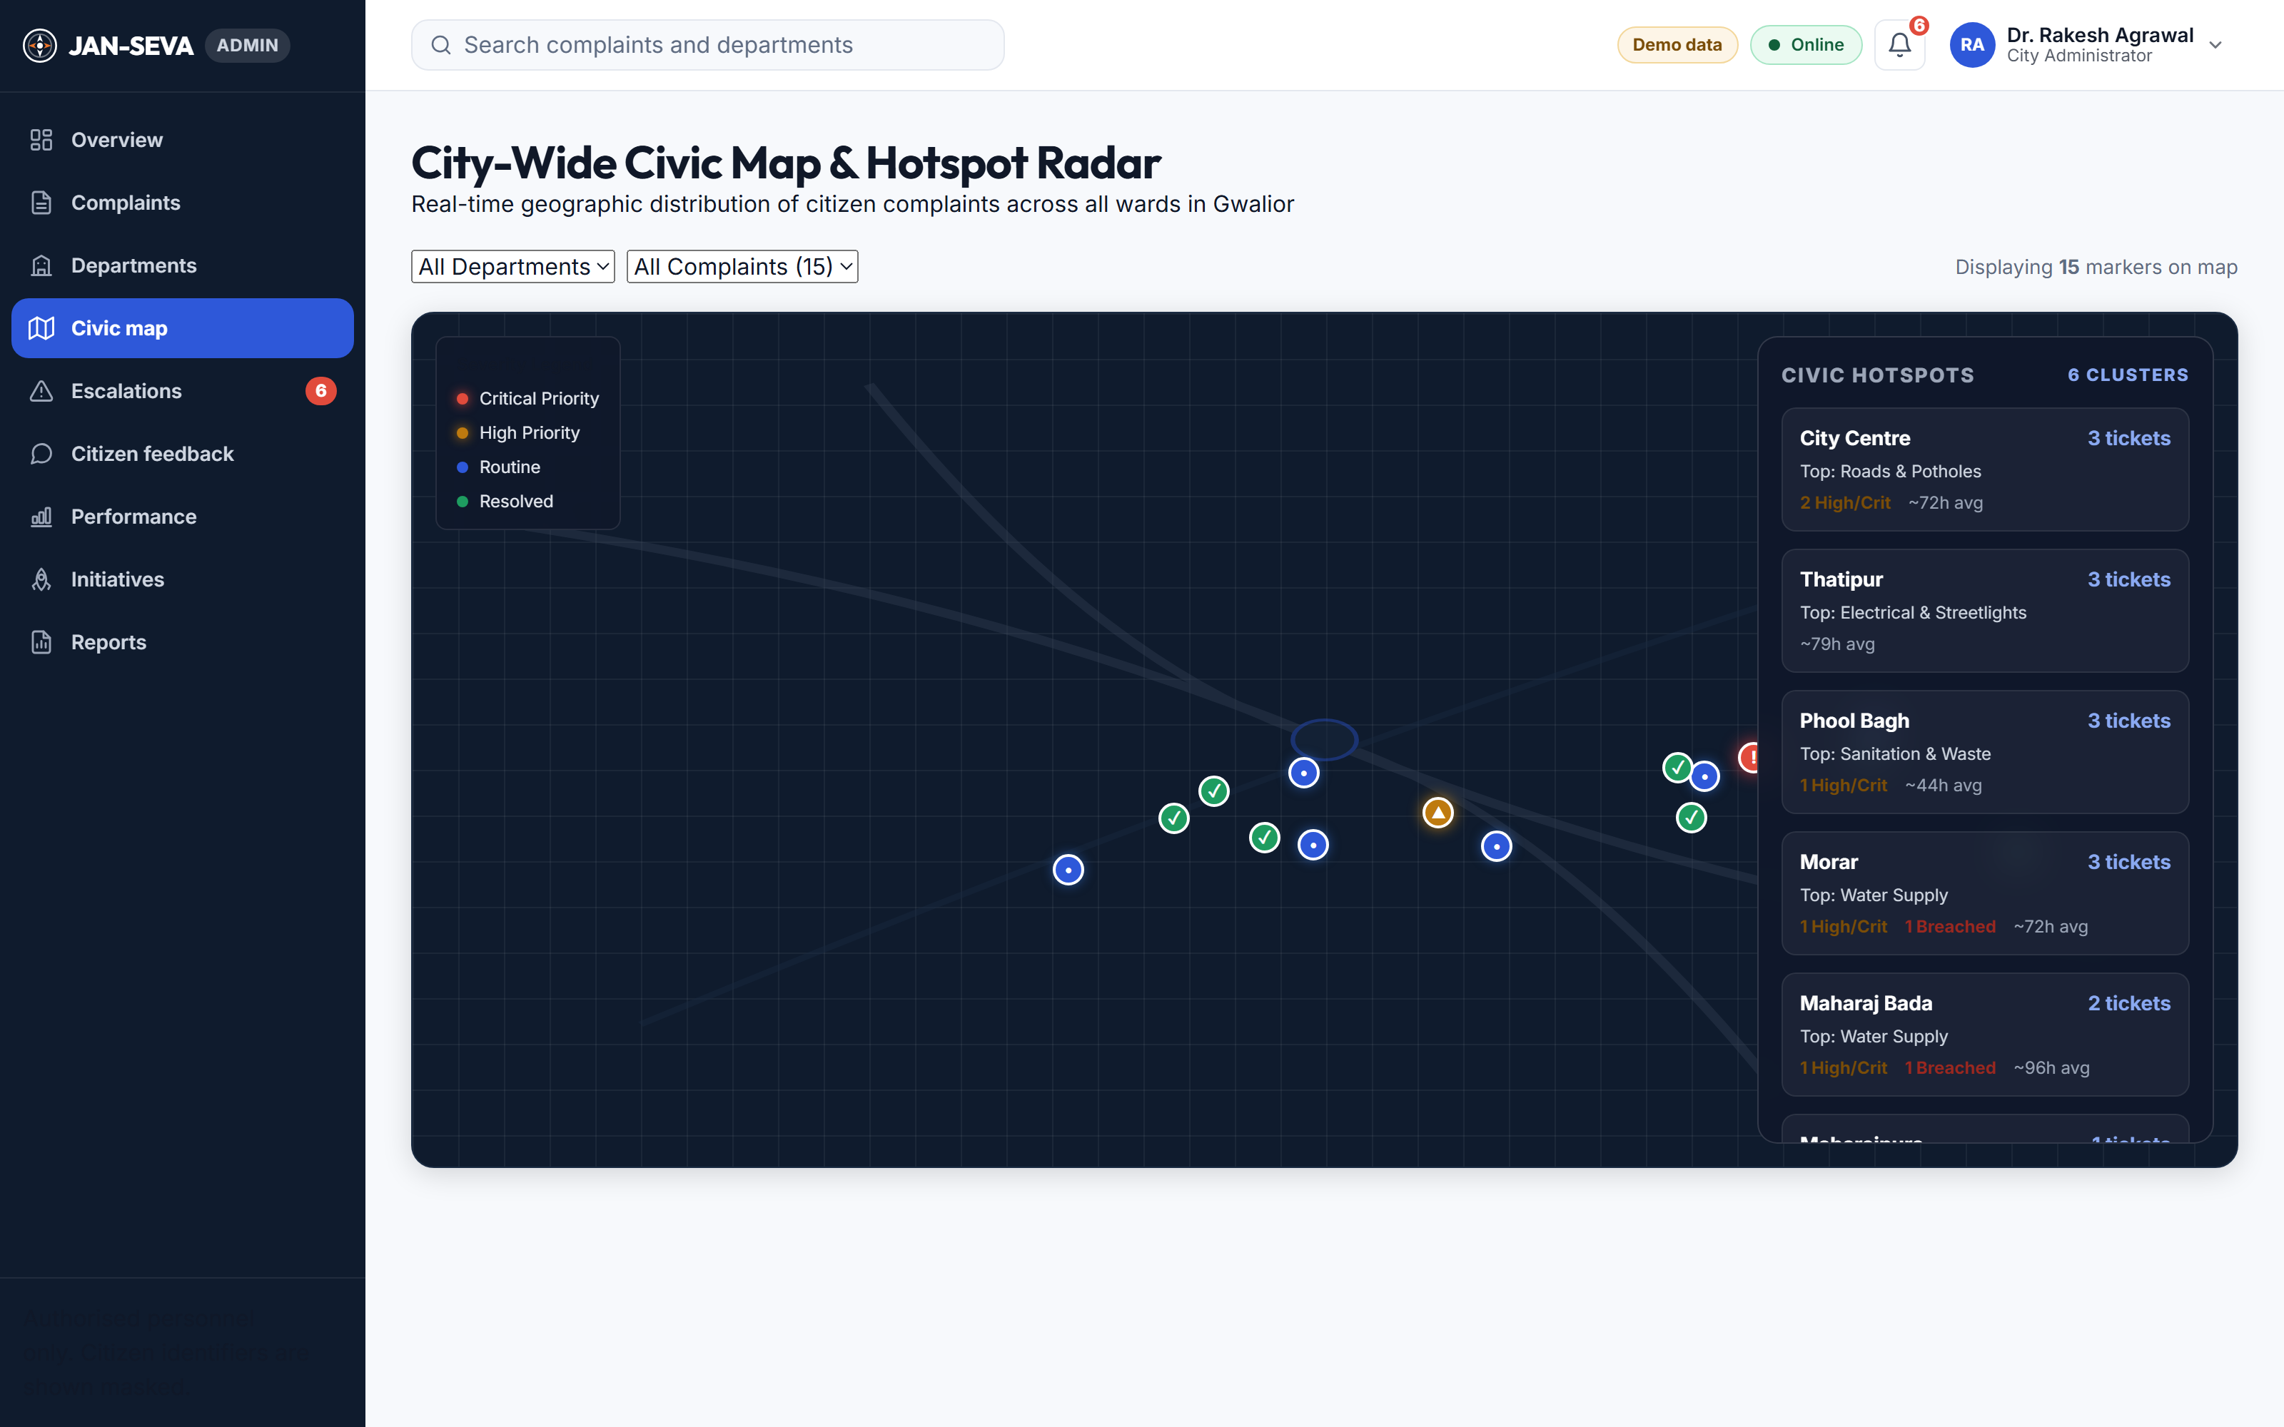
IMPACT AND BENEFITS
Team Future Minds
THE PROTOTYPE, RUNNING
Admin — civic health, SLA, escalations
Department — priority queue, field work
City map — ward hotspot clustering

Slide 6
RESEARCH AND REFERENCES
Team Future Minds
Every claim in this deck is sourced. Government and product docs first; peer-reviewed research for anything contested.
TIER 1 — GOVERNMENT & PRODUCT
TIER 2 — PEER-REVIEWED RESEARCH
TIER 3–4 — INDUSTRY & PRESS
• GovTech Singapore, OneService — ~80% case-type, ~85% routing accuracy. An honest ceiling for AI routing.
• DARPG CPGRAMS / IGMS — national spam, bulk and repeat-grievance detection, topic clustering.
• Swachhata-MoHUA (Janaagraha, 2025) — geotag capture, vote-up, resolution images, reopen. The India baseline.
• “A Cautionary Tail” (arXiv 1807.03860) — a rat model that passed on 311 data, then failed field inspection. Why we don’t ship complaint-based prediction.
• Kontokosta et al., 311 equity — propensity to complain varies with income and language; raw hotspots misallocate service.
• “Reporting bias in 311 data”, Annals of Applied Statistics — the correction method behind our Ward Reality Index.
• ThePrint, 2 July 2026 — Gurugram sacked an inspector for AI-generated closure photos; a colleague spoofed GPS. Our problem statement.
• Truepic Vision — controlled capture: rooted-device, GPS-spoof, screen-recapture and reused-image detection.
• SocietyWorks, FixMyStreet Pro — council asset layers: tap the actual lamp column, its reference auto-fills.
Where the evidence was not good enough, we say so. Swachhata’s per-category SLA hours are widely repeated but we could not confirm them against an official MoHUA source. Vendor figures are treated as capability evidence, never measured outcomes.

