Slide 1

SMART INDIA HACKATHON 2026
TITLE PAGE
Problem Statement ID – <SIH018>
Problem Statement Title- Smart Civic Issue Reporting Platform
Theme- Smart Automation
PS Category- Software
Team ID- Future Minds

Slide 2
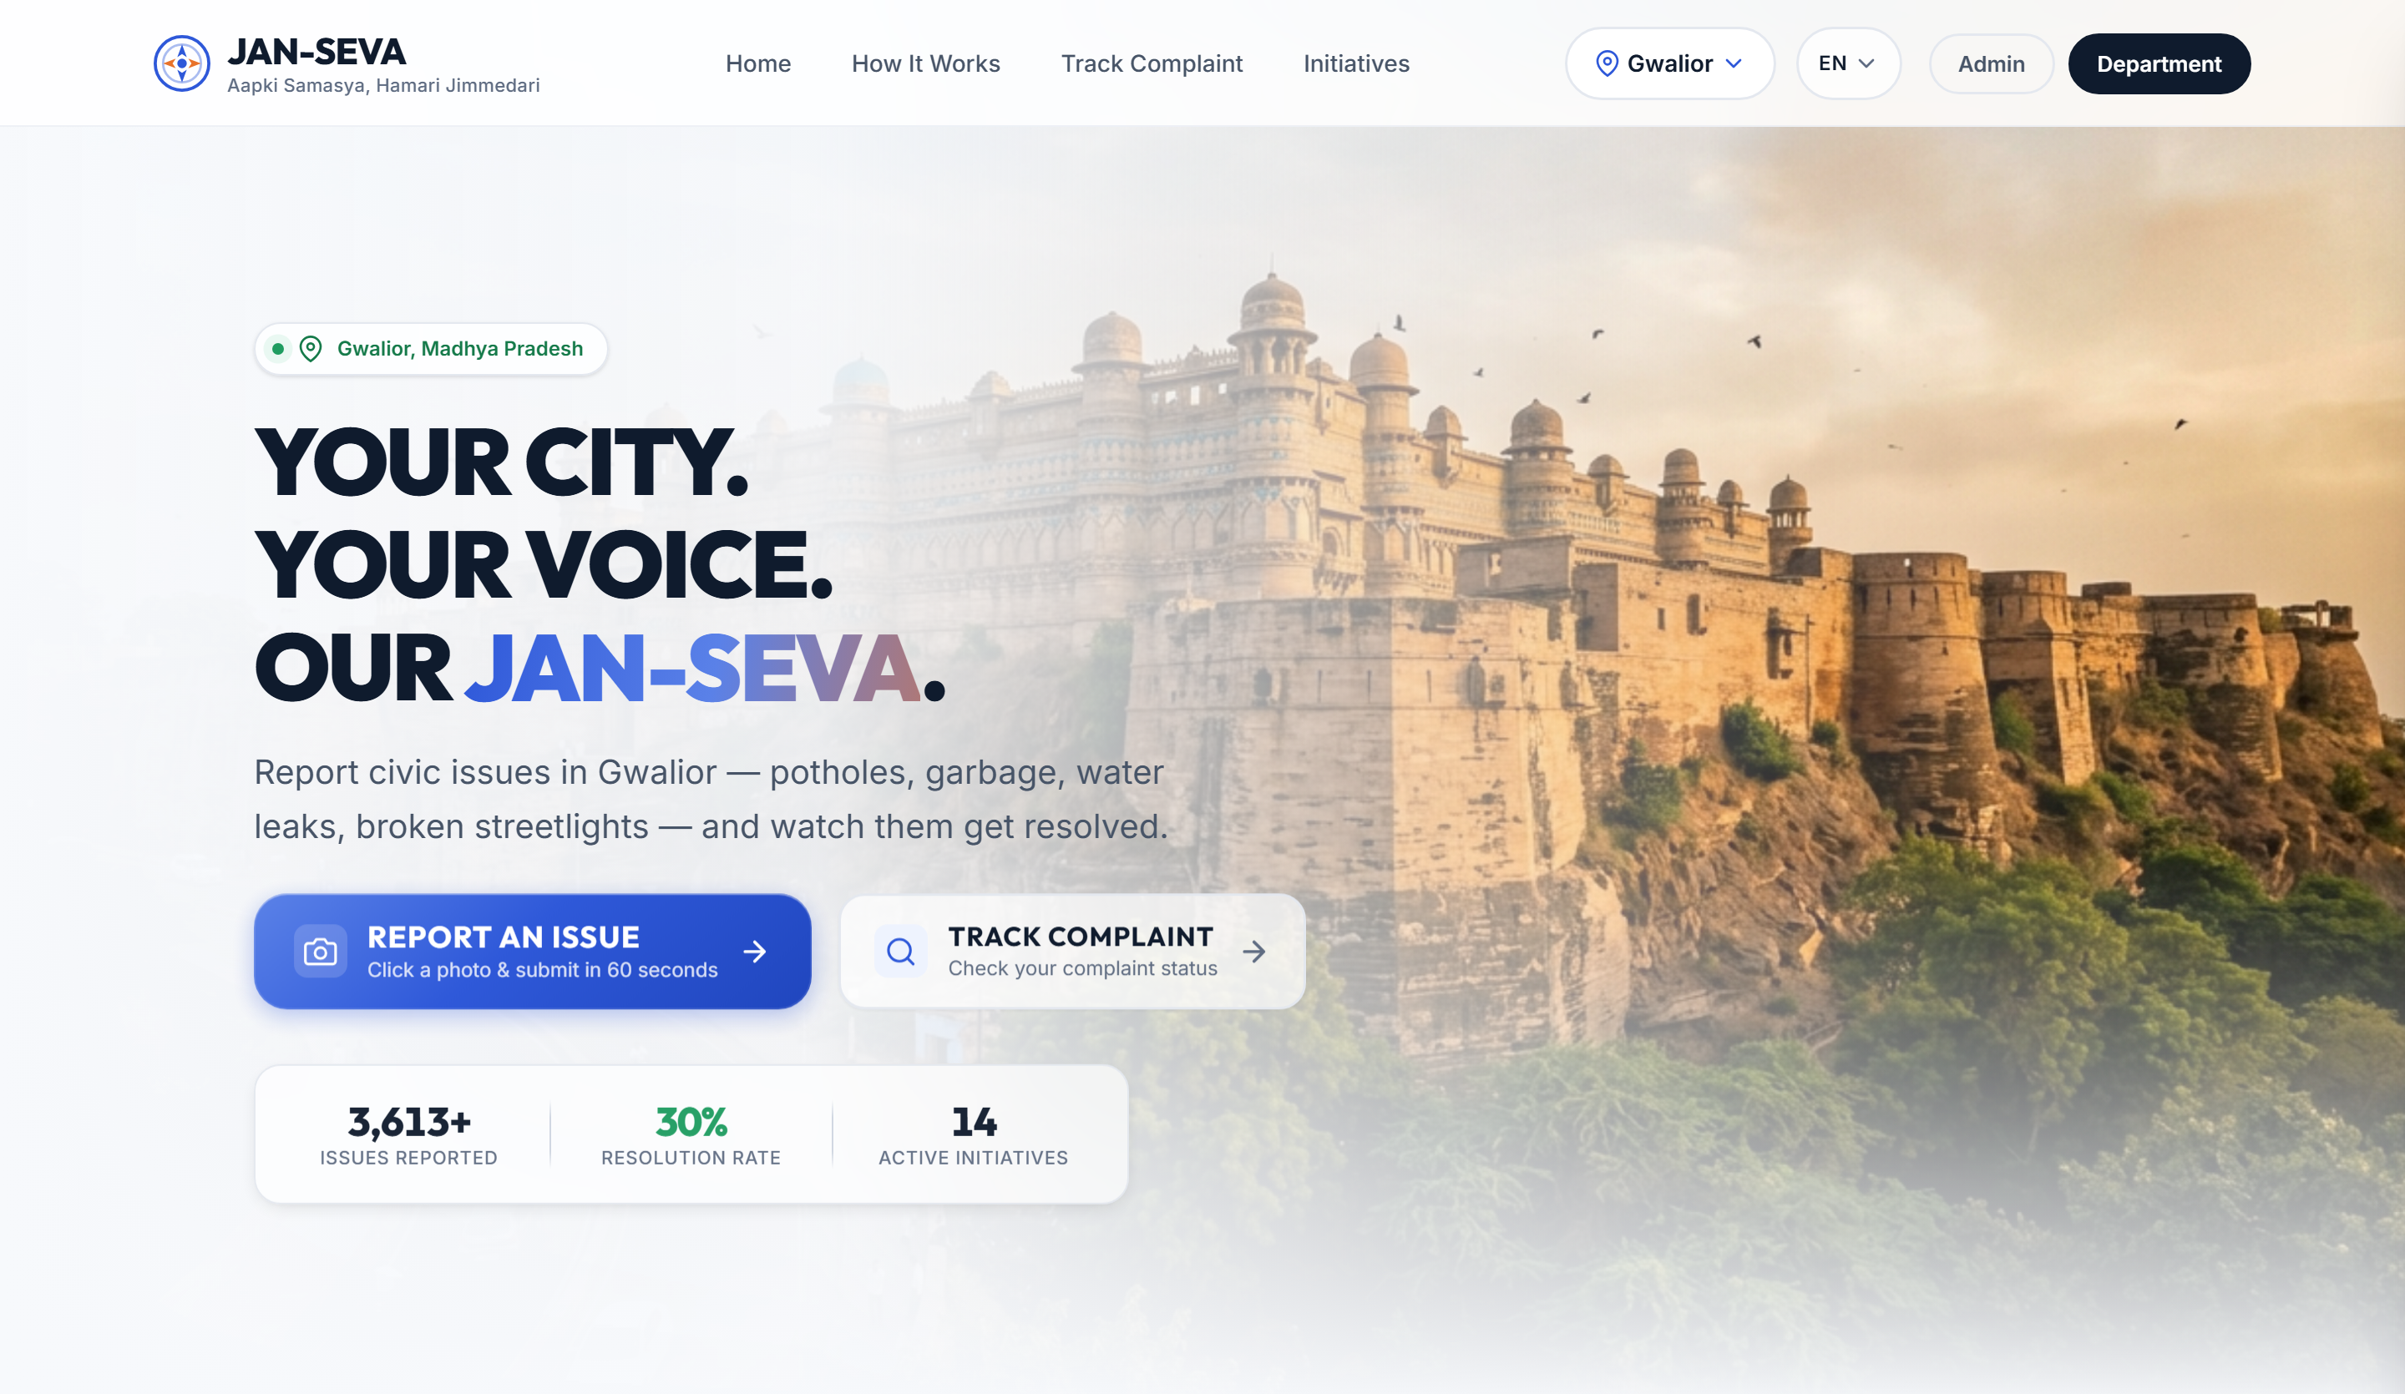
SMART INDIA HACKATHON 2026
TITLE PAGE
JAN-SEVA
जन-सेवा · Aapki Samasya, Hamari Jimmedari
A proof-of-work record for municipal maintenance — every citizen report becomes an evidence-bound job against a named piece of city infrastructure.
Problem Statement ID SIH018
Problem Statement Title Smart Civic Issue Reporting Platform
Theme Smart Automation
PS Category Software
Team Name Future Minds
Team ID IH09
Working prototype — not a mockup.
Citizen portal, five department portals and an Admin Command Centre are built and running: 207 source files, ~26,000 lines of TypeScript.
Proof of Repair
Civic Asset Memory
One-Trip Work Card

Slide 3
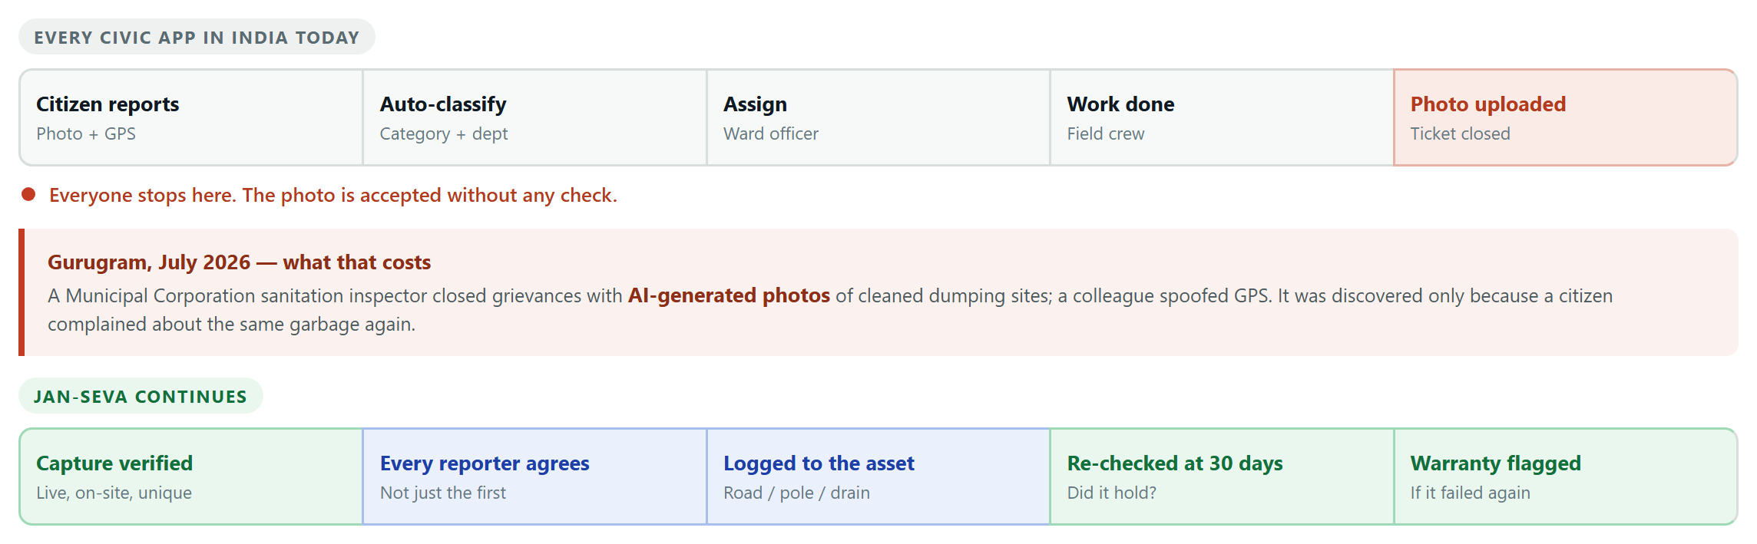
IDEA TITLE
Team Future Minds
Proposed Solution — India already solved civic reporting. Nobody verifies the repair. JAN-SEVA does.
1 Proof of Repair
Evidence must be captured live in-app, at the reported location, on an un-spoofed device, and must never have been submitted before anywhere in the city.
2 Civic Asset Memory
Reports attach to a road segment, pole or drain — not a coordinate. A repeat failure inside the contractor's defect liability period becomes a warranty claim, not a new municipal bill.
3 One-Trip Work Card
Nearby jobs of the same skill are batched into one routed field visit that works offline — so the crew drives once, not five times.

Slide 4
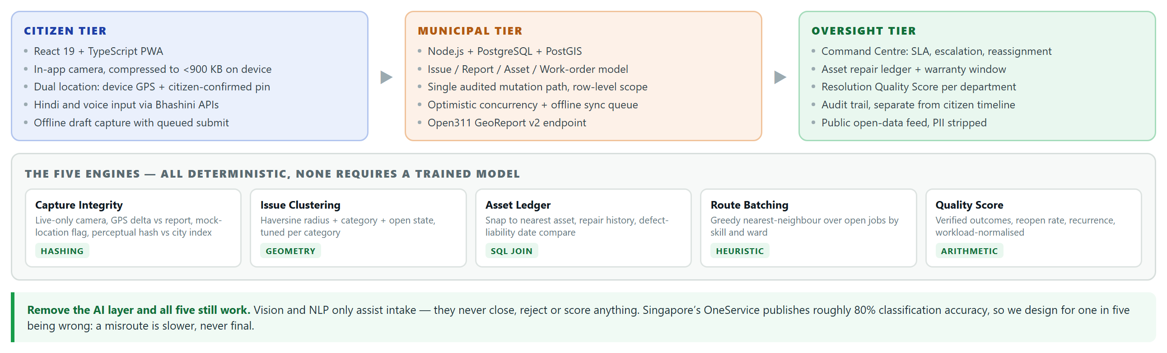
TECHNICAL APPROACH
Team Future Minds
Built and running today
• Citizen, department and admin portals — report wizard, live tracking, SLA engine, escalation, audit trail
• Offline sync queue — ordered retry with backoff, so a field note is never lost on one bar of signal
• Privacy by type — the public view has no reporter field, so identity cannot leak even by mistake
What we still have to build
• Server-side capture proof — issued nonce, RFC 3161 timestamp, Play Integrity and mock-location attestation
• Asset layer — real geometry from ULB GIS, or OSM road segments where no GIS exists
• Bhashini integration — Hindi speech to a structured complaint, using national language DPI

Slide 5
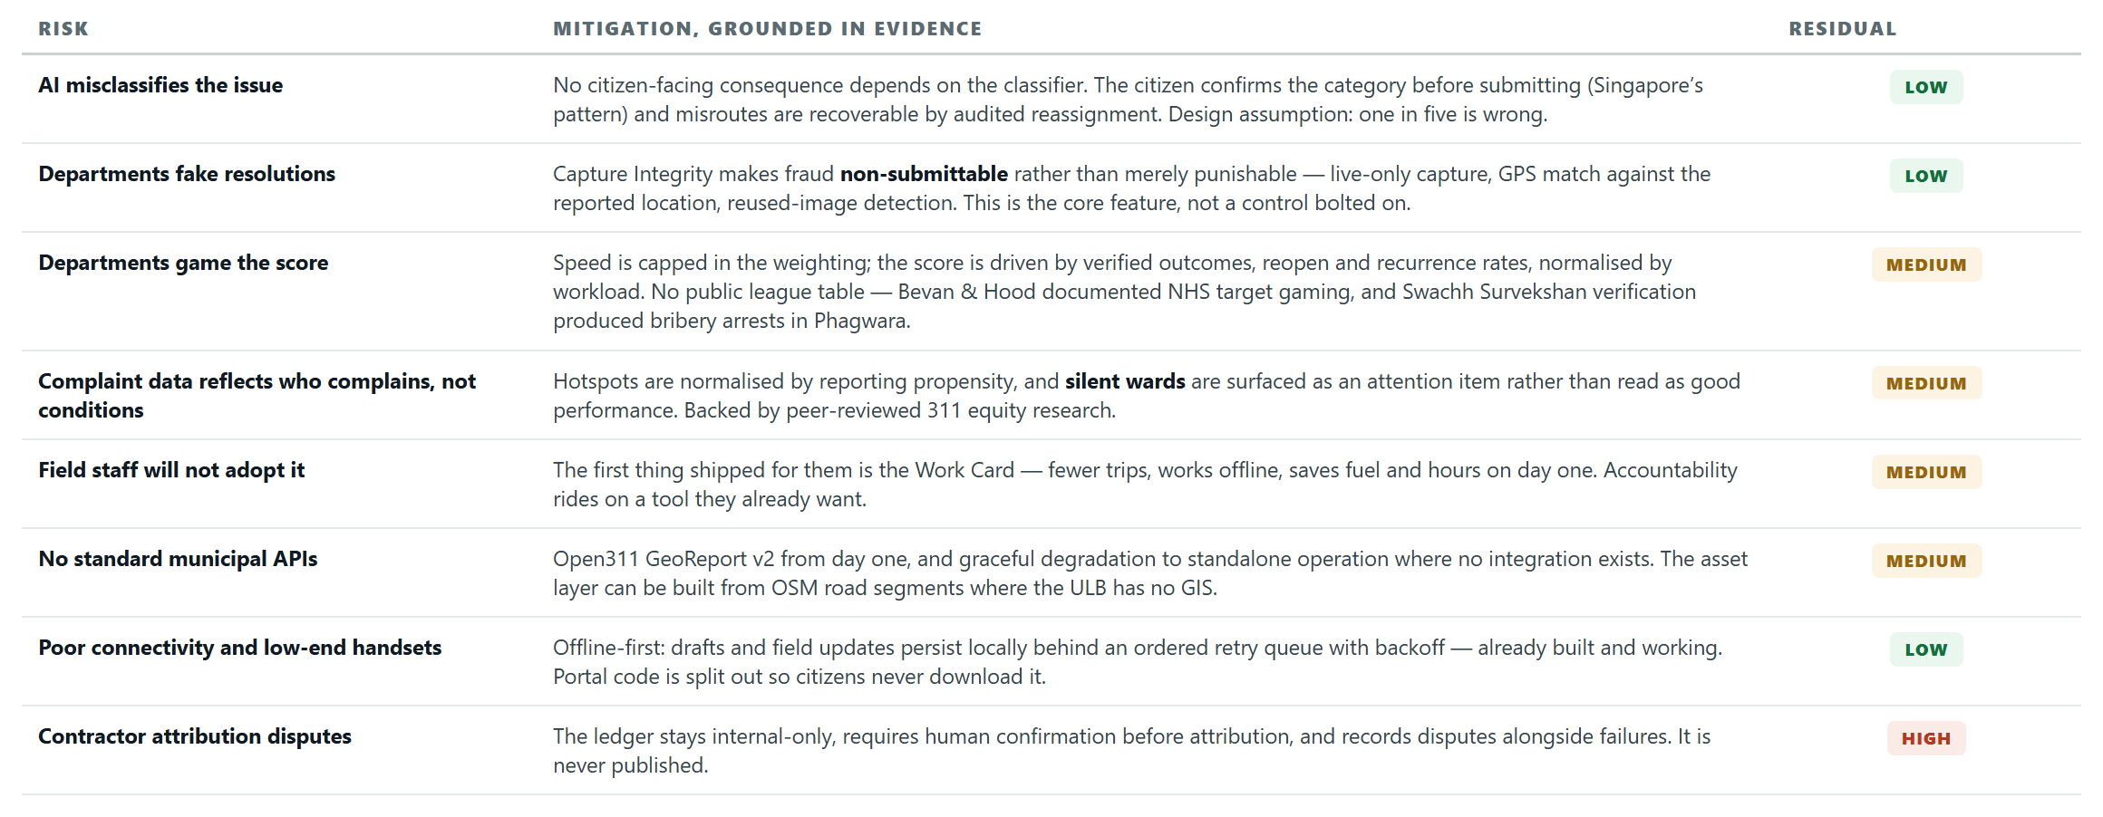
FEASIBILITY AND VIABILITY
Team Future Minds
Feasibility is already demonstrated — a working three-portal prototype exists, and every core engine is deterministic: hashing, geometry, a SQL join, a greedy heuristic and arithmetic.

Slide 6
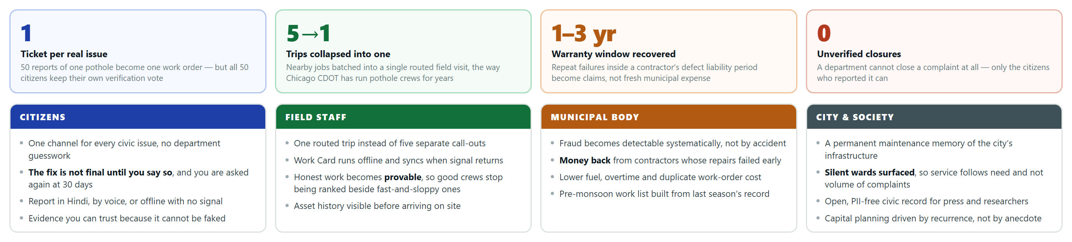
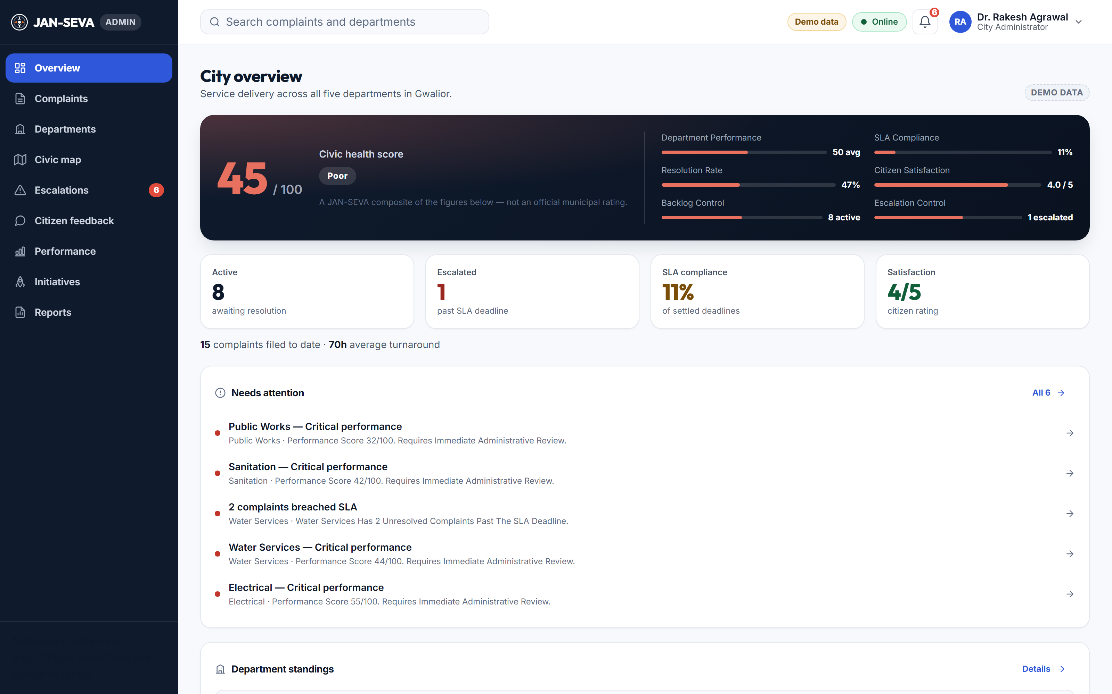
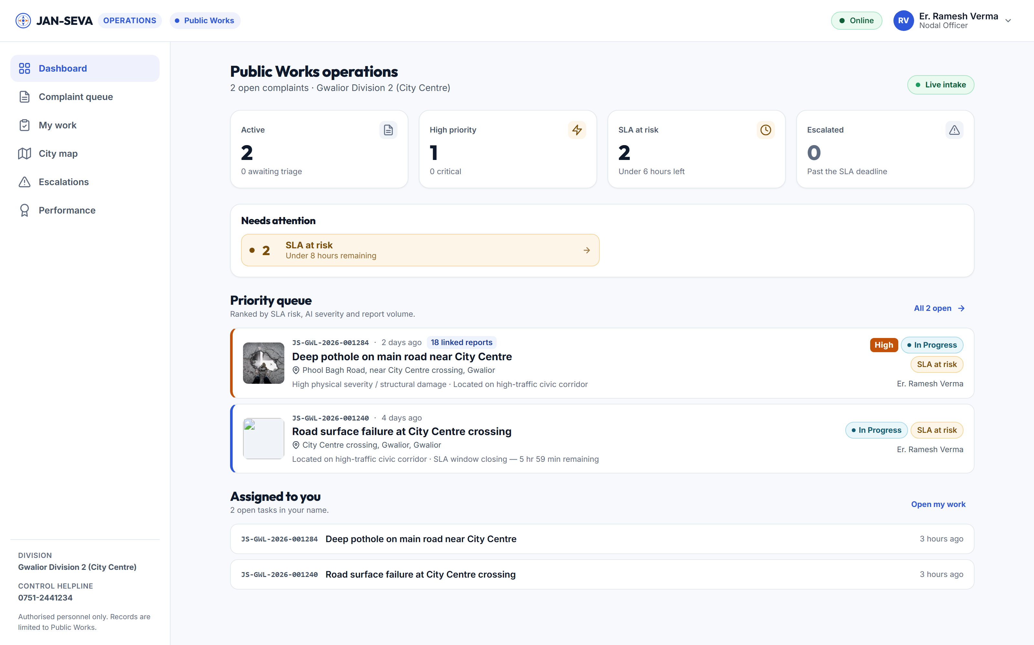
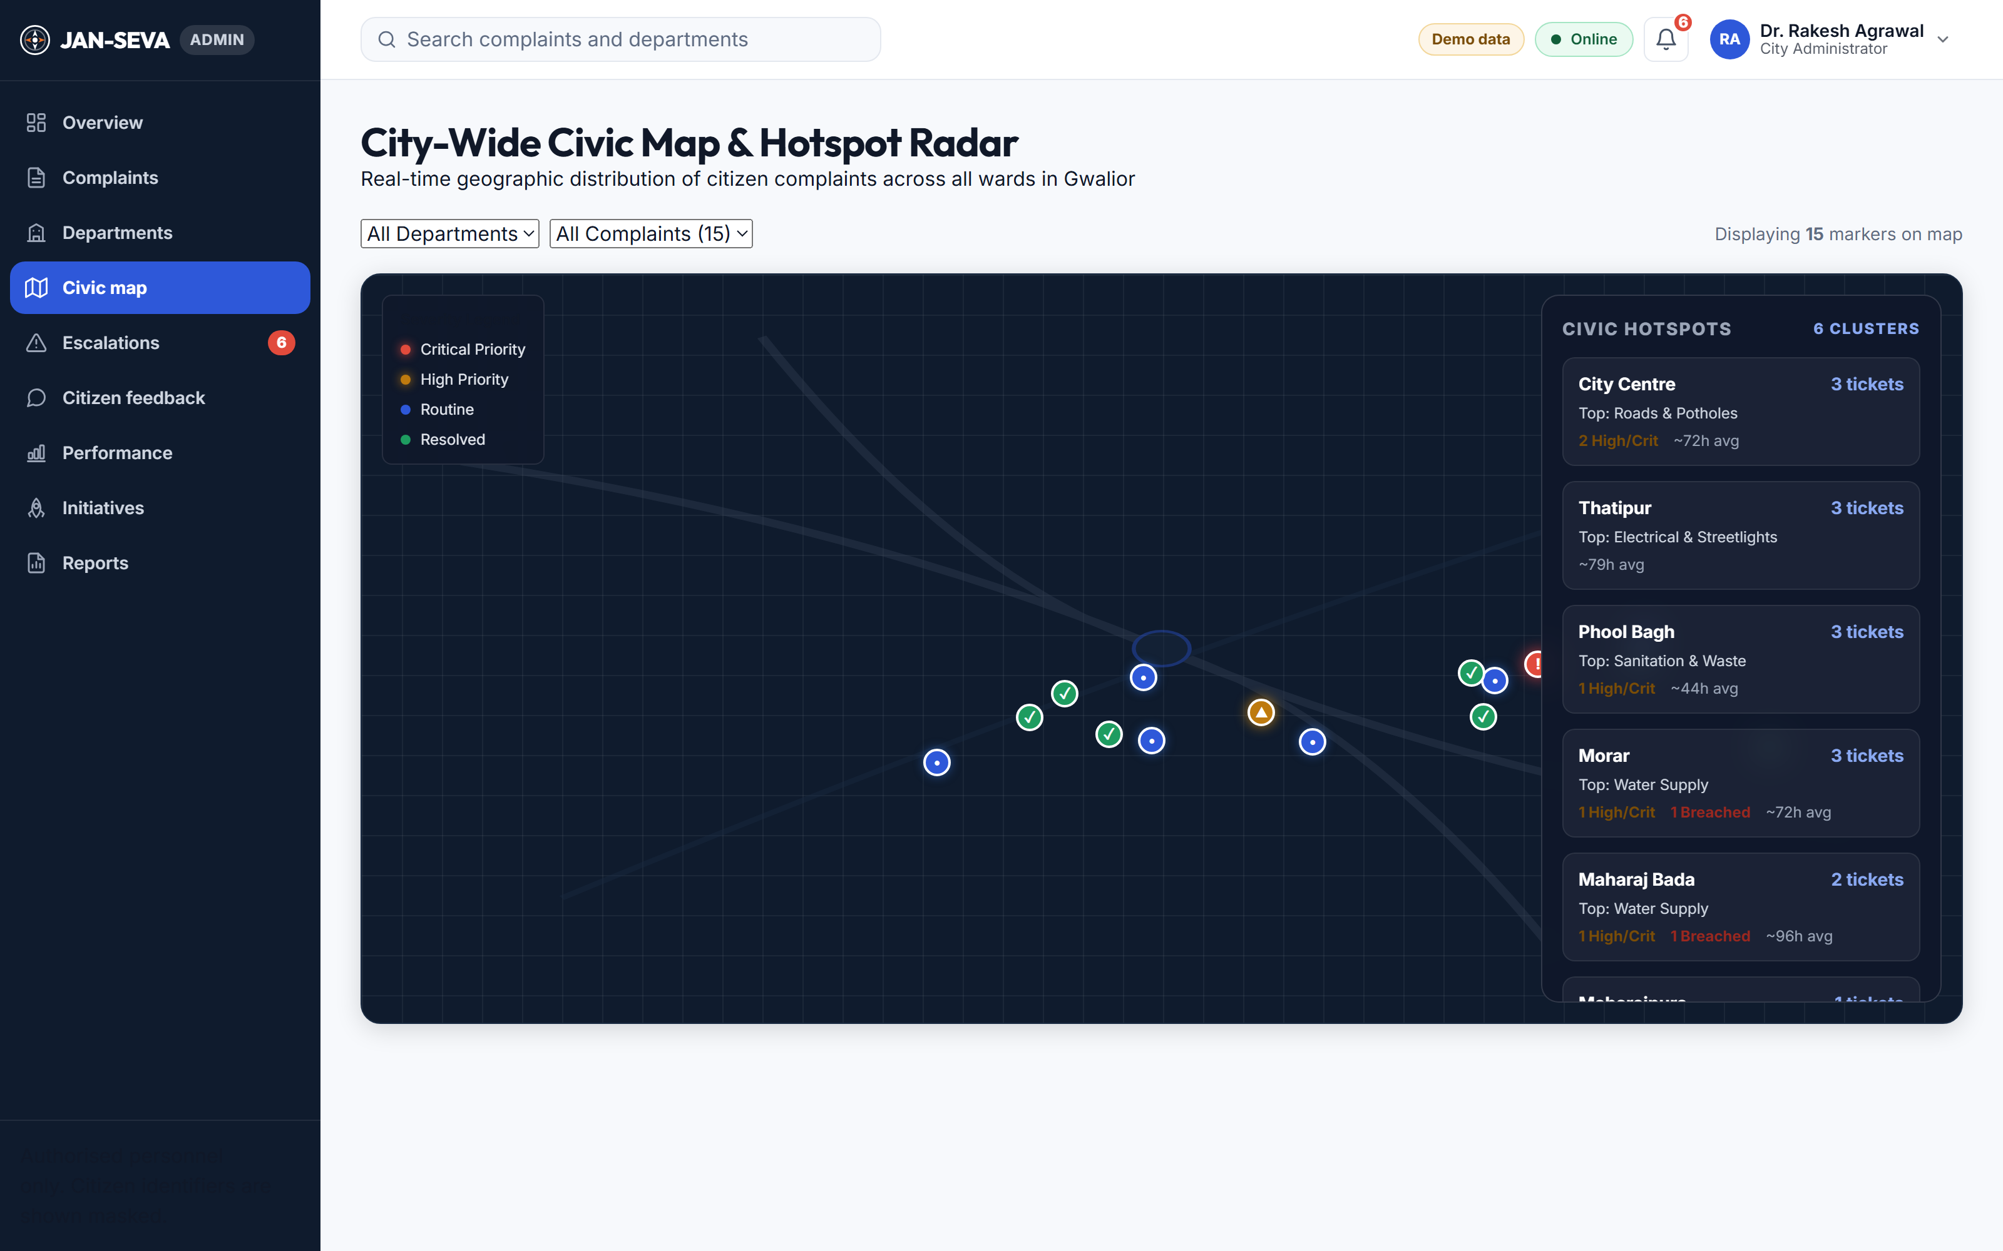
IMPACT AND BENEFITS
Team Future Minds
THE PROTOTYPE, RUNNING
Admin Command Centre — civic health, SLA and escalations
Department operations — priority queue and field work
City-wide civic map — hotspot clustering by ward

Slide 7
RESEARCH AND REFERENCES
TEAM
FUTURE
MINDS
Every claim in this deck is sourced. Government and product documentation first; peer-reviewed research for anything contested.
TIER 1 — GOVERNMENT & PRODUCT
TIER 2 — PEER-REVIEWED RESEARCH
TIER 3–4 — INDUSTRY & PRESS
• GovTech Singapore, OneService chatbot — publishes ~80% case-type and ~85% routing accuracy; sets an honest ceiling for AI routing claims.
• DARPG, CPGRAMS / pgportal.gov.in — IGMS already does spam, bulk and repetitive-grievance detection and topic clustering nationally.
• Swachhata-MoHUA listing (Janaagraha, v3.6.47, Apr 2025) — geotagged capture, vote-up, resolution images, reopen. The India baseline.
• City of Chicago CDOT, Pothole Repairs — daily 311 map drives crew routes; crews fill every pothole on the block.
• NYC Council Int 0744-2024 — would bar closing 311 requests solely as duplicates.
• Open311 GeoReport v2 — the interoperability standard we target.
• “A Cautionary Tail” (arXiv 1807.03860) — a DC rat model validated on 311 data and then failed field inspection. Why we do not ship complaint-based prediction.
• Kontokosta et al., equity in 311 reporting — propensity to complain varies with income, language and civic engagement, so raw hotspots misallocate service.
• “Estimating reporting bias in 311 complaint data”, Annals of Applied Statistics — the correction method behind our Ward Reality Index.
• Bevan & Hood, Public Administration (2006) — ranked public-sector targets get gamed; why we publish reasons, not a league table.
• “Decide Madrid: A Critical Analysis”, Sustainability — participation collapses without a closed feedback loop.
• ThePrint, 2 July 2026 — Gurugram MCG sacked a sanitation inspector for closing grievances with AI-generated photos; a colleague spoofed GPS. Our problem statement.
• SocietyWorks, FixMyStreet Pro — council asset layers: the citizen taps the actual lamp column and its reference auto-fills.
• Truepic Vision — controlled capture in insurance: rooted-device, GPS-spoof, screen-recapture and reused-image detection.
• The Tribune — Chandigarh MC raised road defect liability from one year to three; and QCI Swachh Survekshan verifiers arrested over an alleged bribe.
• Deccan Herald — BBMP's Sahaaya pulled from app stores, stranding citizens.
Where the evidence was not good enough, we say so. Swachhata's per-category SLA hours are widely repeated but we could not confirm them against an official MoHUA source; a CAG finding on Swachh Survekshan self-reported data appeared only in an unreliable aggregator, so it is excluded. Vendor performance figures are treated as capability evidence, never as measured outcomes.

