Slide 1


WSL While You Work: Writing cross-platform PowerShell on the same platform
Chris Blackden
@DevByAccident

Slide 2
How many of you work with Linux?
Notes:
Either as your primary system or developing for it?

Slide 3
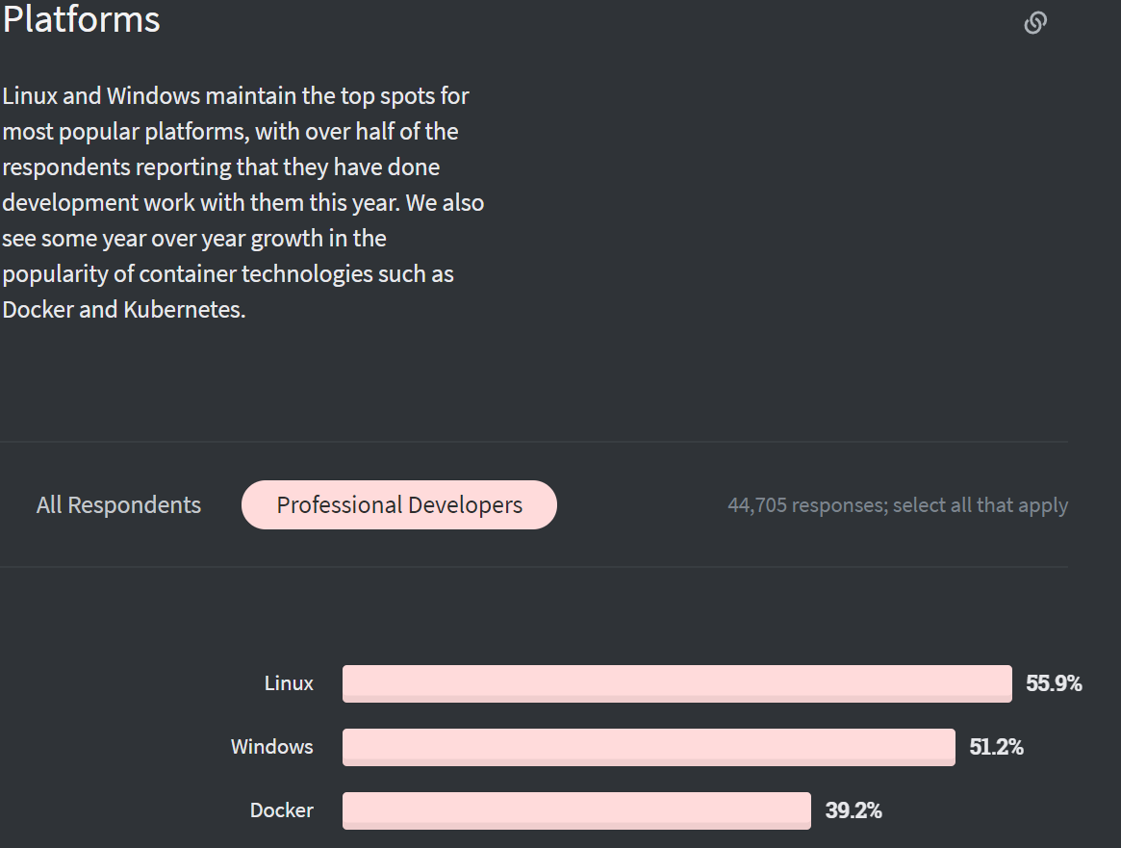
Source: https://insights.stackoverflow.com/survey/2020#technology-platforms-professional-developers5
Notes:
I found numbers as high as 96% of servers that professional developers worked on were Linux servers, but couldn’t verify that

Slide 4
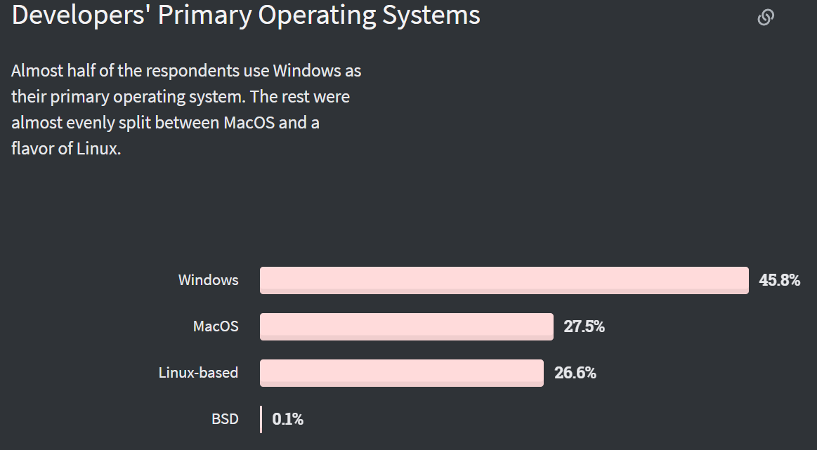
Source: https://insights.stackoverflow.com/survey/2020#technology-developers-primary-operating-systems
Notes:
So more than half of the market is using a Unix-based system for development. No doubt that helped influence Microsoft when they made PowerShell open-source, and…

Slide 5
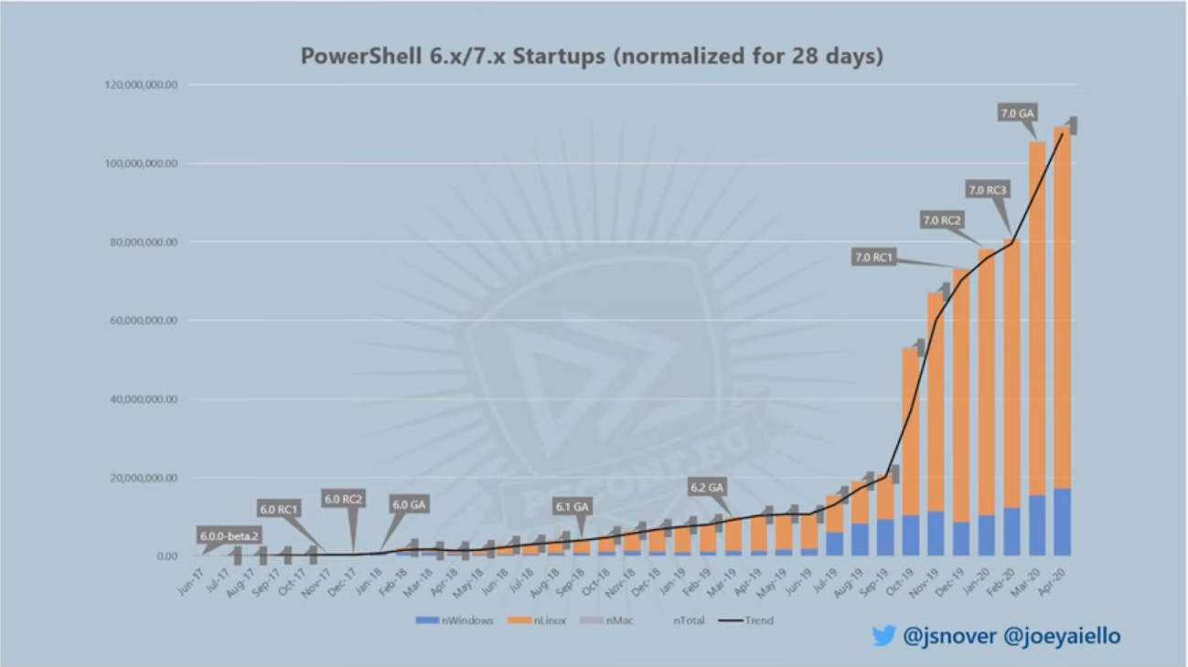
Source: State of the Shell - PSCONFEU 2020 - Keynote
Notes:
And it seems like it worked out. This slide shows the startups for PowerShell from different operating systems as shown in the PSCONFEU Keynote. Clearly making PowerShell cross-platform was a good move, but then the question becomes how to make the developer experience better on Windows?

Slide 6
WSL 101
Advanced WSL
Writing Cross-Platform PowerShell on WSL
Putting WSL to the test

Slide 7
Installing WSL
Advanced WSL
Writing Cross-Platform PowerShell on WSL
Putting WSL to the test

Slide 8
WSL 101

Slide 9
Installing WSL

Slide 10
Wsl – –install
(Coming soon)
Notes:
This was announced at MS Build 2020, but it’s not GA yet…
https://devblogs.microsoft.com/commandline/the-windows-subsystem-for-linux-build-2020-summary/#wsl-install

Slide 11
Enable Features
Microsoft-Windows-Subsystem-Linux
VirtualMachinePlatform
Set WSL2 as default
wsl --set-default-version 2

Slide 12
A Tale of two WSL versions…
WSL 1
WSL 1
WSL 2
Runs commands through a “pico-driver”
Uses same components as host operating system
No Linux kernel, just a translation layer
Runs commands through a “pico-driver”
Uses same components as host operating system
No Linux kernel, just a translation layer
Runs commands natively
Runs smaller, virtualized components
Linux kernel gets updated with Windows Updates
4x-5x faster than WSL1
Notes:
https://github.com/microsoft/WSL2-Linux-Kernel

Slide 13
Ubuntu Linux
Windows 10
Alpine Linux
Linux Kernel
Windows Kernel
Linux Kernel
Hypervisor
Source: https://www.thomasmaurer.ch/2019/06/install-wsl-2-on-windows-10/

Slide 14
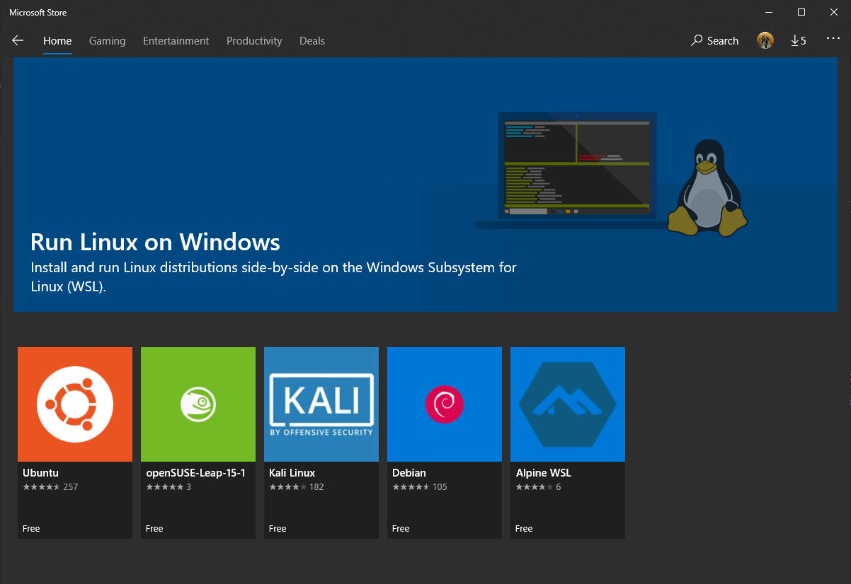
Notes:
You can install using the store, but I like the command line better

Slide 15
Demo
Notes:
This was announced at MS Build 2020, but it’s not GA yet…
https://devblogs.microsoft.com/commandline/the-windows-subsystem-for-linux-build-2020-summary/#wsl-install

Slide 16
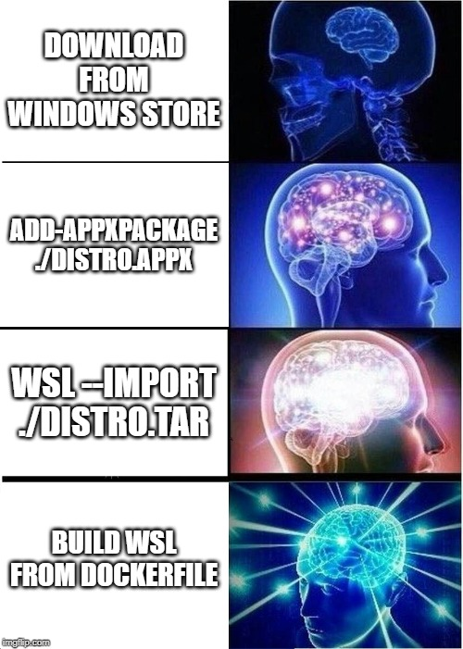

Slide 17
Advanced WSL

Slide 18
Demo

Slide 19
Writing Cross-Platform PowerShell on WSL

Slide 20
Demo
Notes:
This was announced at MS Build 2020, but it’s not GA yet…
https://devblogs.microsoft.com/commandline/the-windows-subsystem-for-linux-build-2020-summary/#wsl-install

Slide 21
Putting it to the test
Notes:
There’s only one way to know if WSL will last the test of time. It’s a well-known trial that has been the go-to for testing new technologies for over 25 years…

Slide 22

Can it run
?

Slide 23
Why use
Several different Open-Source variants
(I’m using Chocolate Doom engine with the Freedoom game assets)
Only compiles on Linux
It’s a great punchline
Source: https://github.com/id-Software/DOOM
Notes:
The Doom source code was open-sourced in 1997. The Windows version could never be released due to a copyright issue with one of the sound libraries.

Slide 24
Demo
Notes:
This was announced at MS Build 2020, but it’s not GA yet…
https://devblogs.microsoft.com/commandline/the-windows-subsystem-for-linux-build-2020-summary/#wsl-install

Slide 25
Thank You!!
Slides and Code samples available at
https://github.com/devbyaccident/summit-2020

