Slide 1



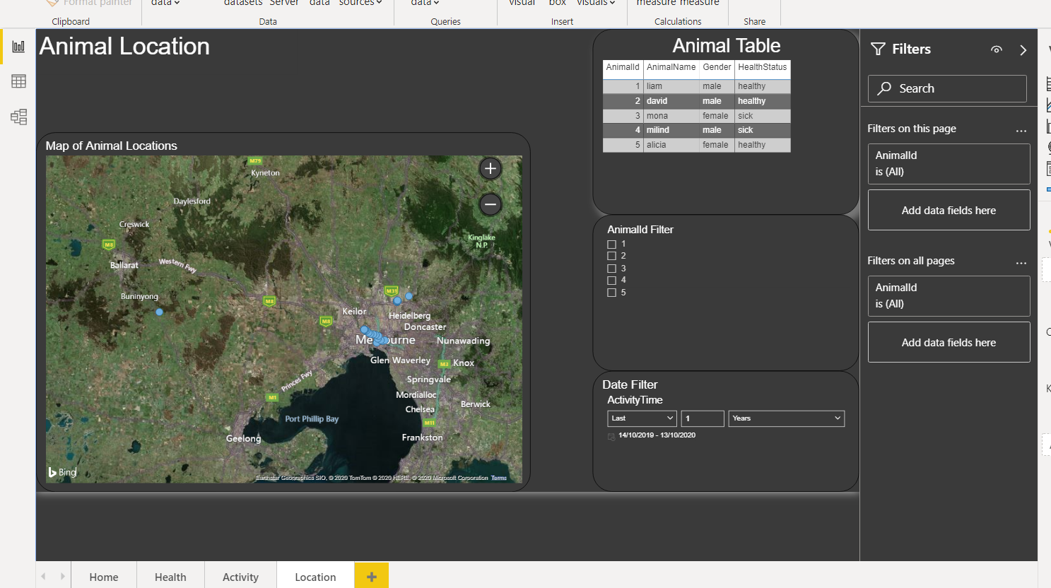
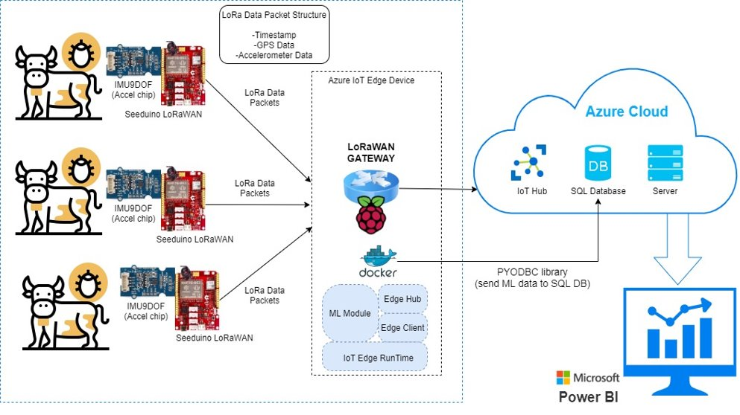
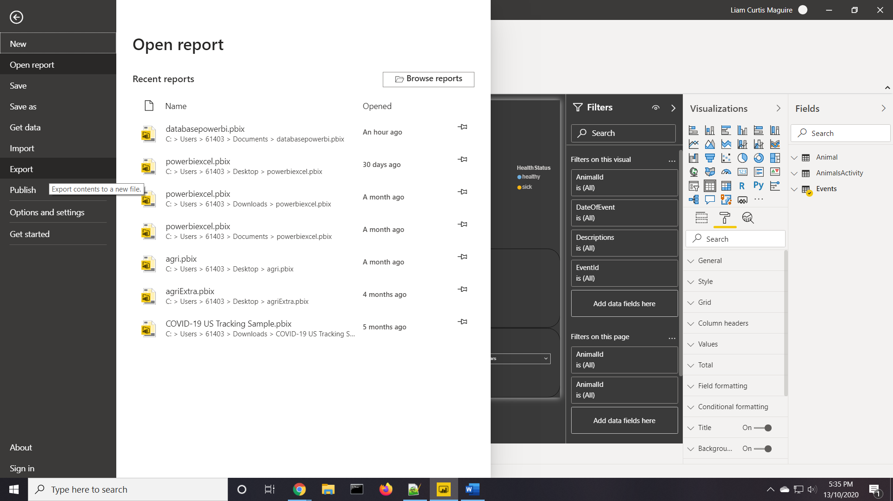
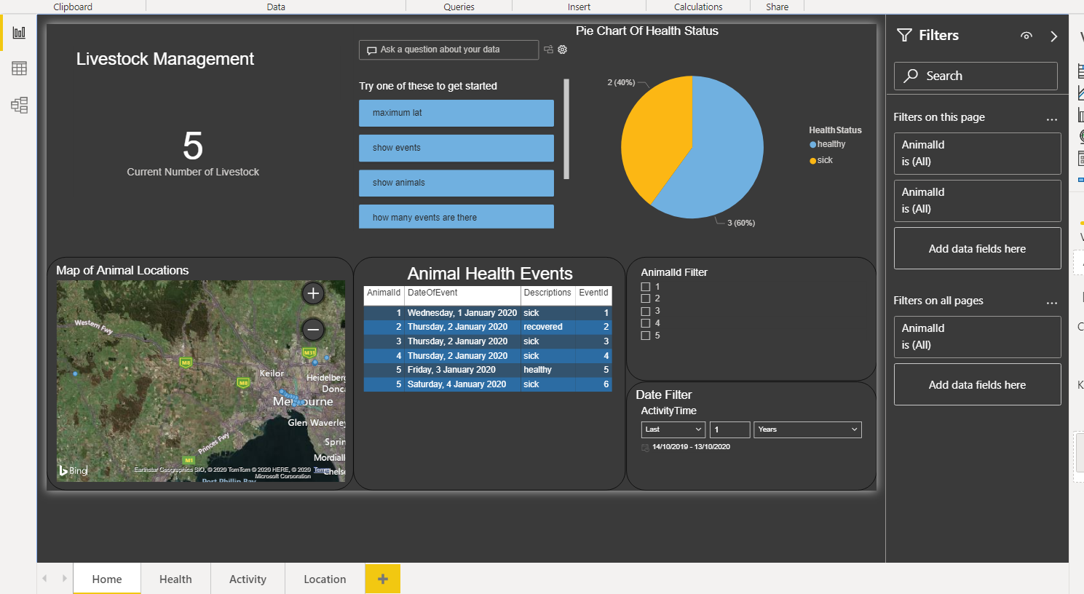
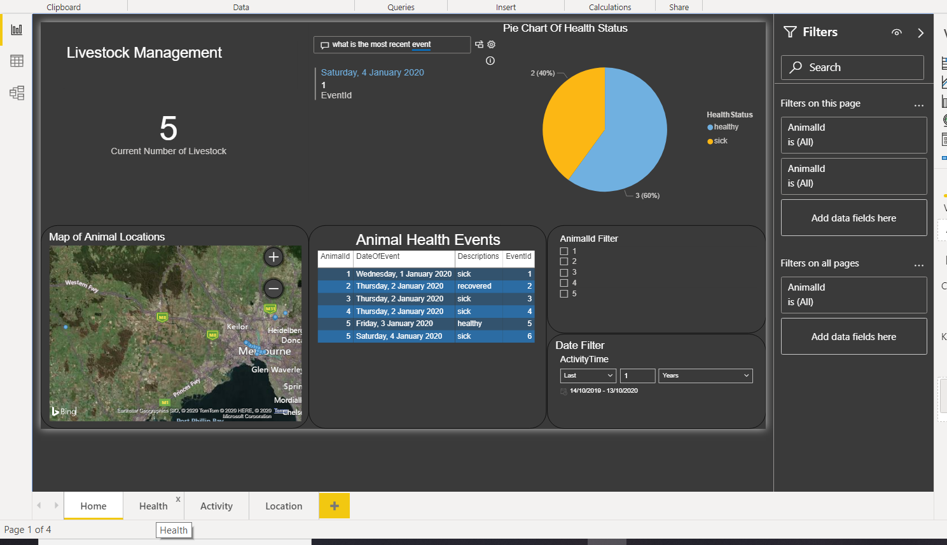









AgriTech IoT Project
In collaboration with Centre for Technology Infusion
Department of Computer Science and Information Technology
Industry Project 2020
Overview
AgriTech IoT is all about using cutting edge technologies in Agriculture and farm animal industry to improve the cost-benefit, productivity and animal welfare. Our team has built a prototype product and based on extensive research with animals’ behaviour and CTI our partner has provided us with an extensive data log.
System Architecture
Features
Recognizing animal activity based on raw data
Mapping location of the animal
Summary page of overall animal wellbeing and list of critical events
Real-time sensor data visualisation for individual animals
Generate PDF report of top-level statistics and individual animals
Send SMS/Email
Team I
Team Members:
Margareta Alicia Hadisaputra
Mona Abedi
David Wisniewski
Liam Maguire
Milind Rajpoot
Supervisor: Aidin Bervan
Lecturer: Torab Torabi
Development Tools

