Slide 1


Project
presentation
Presented By Srija .V

Slide 2
INTRODUCTION
The Indian Premier League (IPL) is one of the world’s most watched cricket tournaments.
With 17 seasons and thousands of matches, it generates massive amounts of data.
This project uses Power BI to analyze IPL player and team performances from 2008 to 2024.
The goal is to uncover key insights using interactive dashboards and visual analytics.
.

Slide 3
Project Overview
Project Title: IPL Performance Analysis using Power BI (2008–2024)
Objective: To analyze player and team performance trends using visual analytics
Tools Used: Power BI Desktop, DAX functions, slicers and charts
Scope: 51,000+ records covering batsmen, bowlers, fielders, teams, and match stats
Deliverables:
Interactive dashboards with top players and teams
Visual breakdown of extras, fielding stats, and performance by team
Key cricket insights from historical data
.

Slide 4
PROBLEMS
IPL generates vast volumes of data every season — thousands of matches, players, and events.
Raw data is complex and not easily interpretable without visual tools.
Teams, analysts, and fans lack consolidated insights on player and team performance over time.
Identifying top performers and patterns across 17 years requires powerful data analysis.
Manual analysis is time-consuming and error-prone without a dashboard solution.

Slide 5
OBJECTIVES
To analyze IPL match and player data from 2008 to 2024 using Power BI
To identify top performing batsmen, bowlers, and fielders across all seasons
To visualize team-wise performance, extras, and player contributions
To build interactive dashboards for easy filtering and comparative analysis
and to derive insights that can support team strategies

Slide 6
METHODOLOGY
Data Collection: IPL dataset covering seasons 2008–2024 with 51,000+ records
Data Cleaning: Removed duplicates, handled missing values, standardized team/player names
Data Modeling: Created relationships between batters, bowlers, teams, and match details
Visual Analysis: Developed interactive dashboards using Power BI with slicers and filters
Custom Metrics: Used DAX to calculate total runs, wickets, extras, and fielding stats

Slide 7
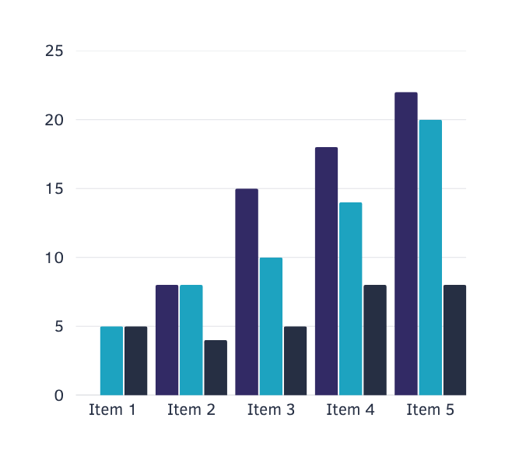
RESULT
The analysis showed that top batsmen like Dhawan, Gayle, and Kohli scored the most runs, while Chahal and Zaheer Khan led in wickets. KD Karthik and KL Rahul stood out in fielding. Wides and no-balls were the most common extras. Teams like CSK, MI, and RCB performed consistently well across seasons.

Slide 8
CONCLUSION
Power BI effectively visualized complex IPL datasets
Dashboards provide clear, quick insights into player and team performance
Fielding and extras significantly influence match outcomes
The project demonstrates the value of data-driven analysis in sports
Future scope: add predictive models for player and team forecasting

Slide 9
THANK
YOU

