Slide 2
Secure your applications with Identity Server 4
Thanh Tran

Slide 3
Agenda
Authentication vs Authorization
OAuth 2.0
OpenId Connect
IdentityServer4
Demo

Slide 4
Authentication vs Authorization

Slide 5
Authentication
who you are
(password, biometric)

Slide 6
Authorization
what you are allowed to do
(permission, claims)

Slide 7


The early stage of era
credential
Website
select * from users where
name=‘thanh’ and pass=‘123456’

Slide 8
The delegated authorization problem

Slide 9
The Facebook login page

Slide 10
The delegated authorization with OAuth2.0
Website
Login with Google
Login with Google
credential
redirect
username
password
account.google.com

Slide 11
OAuth 2.0

Slide 12
Terminology
Client: HTTP client capable of making OAuth-authenticated requests
Server: An HTTP server capable of accepting OAuth-authenticated requests
Protected resource: An access-restricted resource that can be obtained from the server using an OAuth-authenticated request
Resource owner: User
Credentials: Credentials are a pair of a unique identifier and a matching shared secret.
Token: A unique identifier issued by the server and used by the client to associate authenticated requests

Slide 13

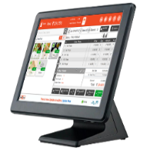







Factors
Client
Protected Resources
Server
Resource Owner
access_token

Slide 14
Grant Type
Grant type | Usage
Authorization code | MVC application that required user interaction.
Implicit | Single Page Application (SPA) like Angular, ReactJs.
Resource owner password | Use resource owner’s username and password. Make the legacy system compatible with new system.
Client credential | Server to server communication.

Slide 15
Channel
Type | Description
Front Channel | Single Page Application (SPA) like Angular, ReactJs.
Back Channel | Hosted by server like IIS, Tomcat. ASP.NET core MVC

Slide 16
Authorization code flow
/authorize?redirecturi=/callback
responseType=code
scope=profile
client_id=xxx-yyy-zzz
Login with Google
Username
Password
accounts.google.com/authorize
contacts.google.com
accquire access_token base on
authorization code
access_token
/callback?
code=authorization_code
Allow MyWebsite to access your public profile and contacts?
Welcome
Thanh
mywebsite.com/callback
accounts.google.com/consent

Slide 17
Implicit flow
/authorize?redirecturi=/callback
responseType=code
scope=profile
client_id=xxx-yyy-zzz
Login with Google
Username
Password
accounts.google.com/authorize
contacts.google.com
access_token
/callback?
access_token=xxx
Allow MyWebsite to access your public profile and contacts?
Welcome
Thanh
mywebsite.com/callback
accounts.google.com/consent

Slide 18
Problems
No standard way to get the user's information
Every implementation is a little different
No common set of scopes

Slide 19
OpenId Connect

Slide 20
OpenId Connect
ID token
UserInfo endpoint for getting more user information
Standard set of scopes
Standardized implementation
OpenId Connect
OAuth2.0
HTTPS

Slide 21
Authorization code flow
/authorize?redirecturi=/callback
responseType=code
scope=profile openid
client_id=xxx-yyy-zzz
Login with Google
Username
Password
accounts.google.com/authorize
accounts.google/info
accquire access_token base on
authorization code
access_token
/callback?
code=authorization_code
Allow MyWebsite to access your public profile and contacts?
Welcome
Thanh
mywebsite.com/callback
accounts.google.com/consent

Slide 22
OAuth <3 OpenID Connect
OAuth2.0 | OpenId Connect
Granting access to your API | Logging the user in
Getting access to user data in other systems (Authorization) | Making your accounts available in other systems (Authentication)

Slide 23
Show me!

Slide 24
IdentityServer4

Slide 25
Features
Authentication as a Service
Single Sign-on / Sign-out
Access Control for APIs
Federation Gateway
Focus on Customization

Slide 26
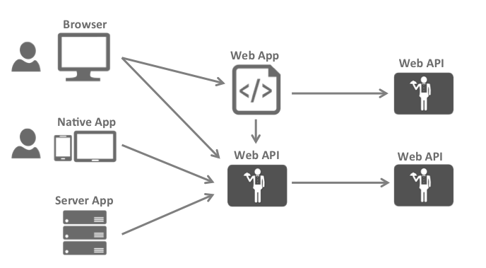
Big Picture

Slide 27
Endpoints (.well-known/openid-configuration)
Address | Description
/jwks | signature and public key
/authorize | to request tokens or authorization codes via the browser
/token | used to programmatically request tokens
/userinfo | retrieve identity information about a user
/endsession | trigger single sign-out
/checksession | check token lifetime
/revocation | revoking access tokens and refresh token
/deviceauthorization | request device and user codes

Slide 28
ApiResource & Client
ApiResource: a resource in your system that you want to protect
Client: use to access our new API

Slide 29
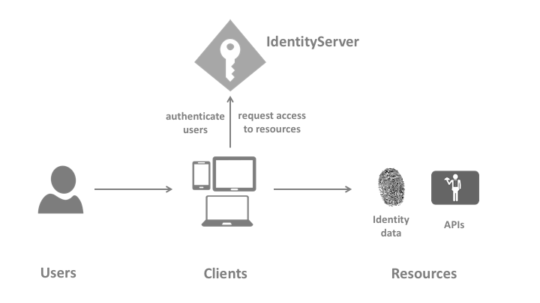
Demo
https://localhost:5000/
https://localhost:2500/
https://localhost:10000/

Slide 30
Q & A

Slide 31
References
https://tools.ietf.org/html/rfc2617
https://tools.ietf.org/html/rfc7616
https://tools.ietf.org/html/rfc7617
https://tools.ietf.org/html/rfc6749
https://tools.ietf.org/html/rfc5849
https://tools.ietf.org/html/rfc6750
https://simple.wikipedia.org/wiki/Chosen-plaintext_attack
https://developer.mozilla.org/en-US/docs/Web/HTTP/Authentication
https://tools.ietf.org/html/rfc7519
https://docs.oracle.com/cd/E39820_01/doc.11121/gateway_docs/content/part_oauth.html
http://openid.net/specs/openid-connect-core-1_0.html

